Slide 1
ISSUP Plenary 1

Slide 2
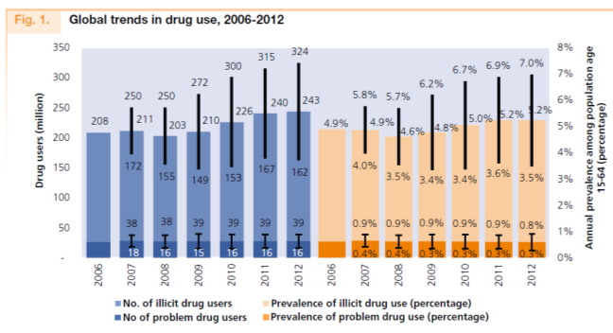
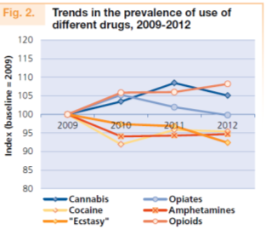
Drug Use Around the World Today
On a global level, drug use is stable.
243 million people (5.2% of world population) used an illicit drug at least once in the previous year.
27 million people (0.5% of world population) are problem drug users
Source: UNODC World Drug Report (2014).

Slide 3
Global Drug Use
Yes
No

