Slide 1
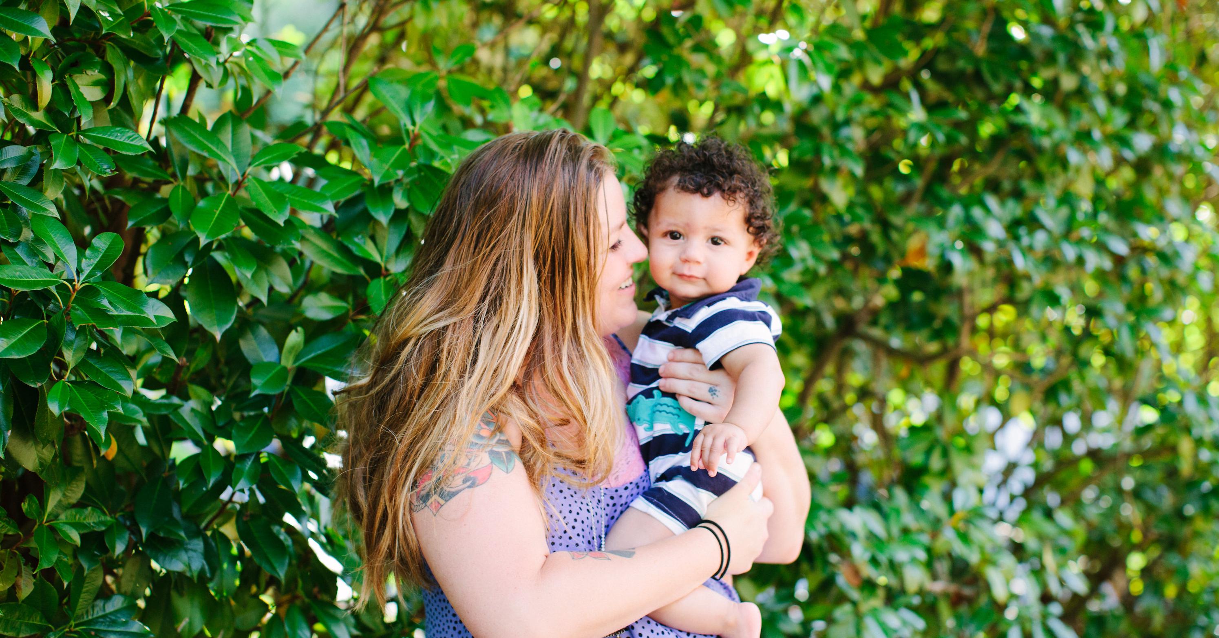
Treatment Together
Ways ATTACHMENT BASED PARENTING CAN IMPROVE MOTHER AND CHILD OUTCOMES IN TREATMENT FOR SUBSTANCE USE DISORDERS

Slide 2

ATTACHMENT THEORY
Originated from John Bowlby who worked with maladjusted and/or delinquent children
Mary Ainsworth, observed and made connections between maternal behaviors and child behaviors and responses
Strange Situation Procedure, a technique that continues to be widely used to classify behavior patterns in young children
The behavior patterns were broadly classified into one of two attachment styles: Secure or Insecure
A secure attachment allows the child to feel comfortable exploring the environment, which is critical for cognitive, social, and emotional development
Young children tend to have one primary attachment figure, and that the degree of attachment security with that figure is often reflected in later relationships
One of the most important predictors of healthy development in children is a secure attachment relationship between the child and primary caregiver
https://pixabay.com/en/mother-and-baby-family-baby-mother-1646449/
e.g., Holmes, J (1993). John Bowlby & Attachment Theory. Makers of modern psychotherapy. London: Routledge. p. 69; Ainsworth, M.D.S., Blehar, M. C., Waters, E., & Wall, S. (1978). Patterns of attachment: A psychological study of the strange situation. Hillsdale, NJ: Earlbaum
Notes:
Say
John Bowlby was a psychoanalyst who worked with maladjusted and/ or delinquent children, many of whom had experienced traumatic separations from their primary caregivers.
Bowlby’s initial work postulated that emotional and behavioral disorders in older children are linked to early attachment issues, either separations from and/or harsh treatment by their primary caregivers (particularly mothers).
John Bowlby was born into a British high-class family who had little contact with his mother or father as they both feared that such love and affection would “spoil” the child. He was fortunate to have the same nanny until he was four years old, his beloved nursemaid Minnie. However, she left the family and he described this as tragic as the loss of a mother. When nursemaid Minnie left the family, Bowlby and his siblings were under the primary care of nanny friend who was less than nurturing.
This early loss of Bowlby’s beloved nursemaid Minnie “mother-figure” fueled his interest later in life around what is now known as attachment theory.

Slide 3

UNDERSTANDING ATTACHMENT
The connection between secure attachment as an infant and later outcomes, is one of the primary reasons that attachment theory is of great relevance to those who work with and treat those who have substance use disorders
Substance use is often a consequence of insecure attachment, in an effort to avoid and/or ease the psychological pain and discomfort
Internal Working Models (IWMs) are the mental filters through which the child views and interacts with the world
According to attachment theory, the connections between early attachment style with a primary caregiver and longer term outcomes are explained by IWMs that children form based on repeated experiences with primary caregivers over time
Securely-attached infants would develop a “secure base script” that explains how attachment-related events happen – for example: “When I am hurt, I go to my mother and receive comfort”
Children with an insecure attachment and an IWM that says that the caregiver will be unavailable and/or rejecting when the child needs him/her may develop a chronic activation of the physiological stress-response system
e.g., Johnson-Laird PN (1983). Mental models. Cambridge, MA: Harvard University Press. pp. 179–87
Notes:
Say
There is a connection between secure attachment as an infant and later child and developmental outcomes.
This connection is one of the primary reasons that attachment theory is of great relevance to those who work with and treat older children and adolescents.
It is now recognized that substance use during childhood or adolescence is often a response to insecure attachment.
Such use may be thought of as an effort to avoid and/or ease the psychological pain and discomfort of feeling alone, isolated and not worthy of love and nurturing attention.

Slide 4
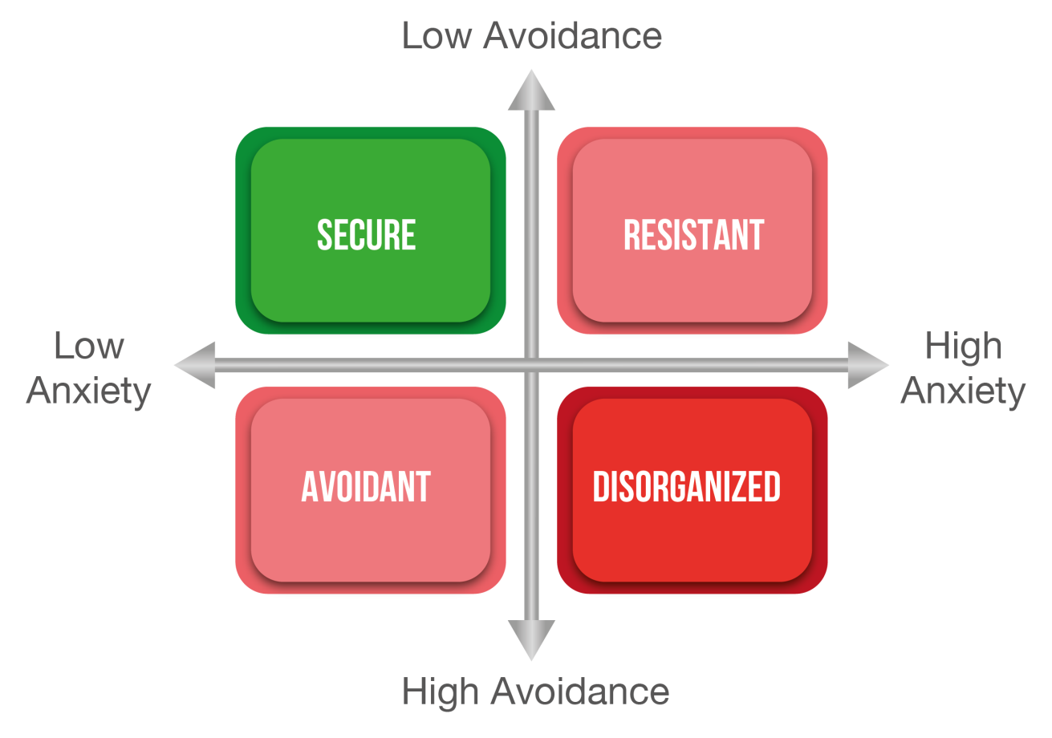
ATTACHMENT STYLES
e.g., Lyons-Ruth, K., & Jacobvitz, D. (1999). Attachment disorganization: Unresolved loss, relational violence and lapses in behavioral and attentional strategies. In J. Cassidy & P. Shaver (Eds.), Handbook of attachment (pp. 520–554). NY: Guilford Press.
Notes:
Clinicians often use the term “attachment strategies” to talk about the ways that children cope with and survive unstable and/or unsafe caregivers or environments.
For example, dissociation from a situation with a brutally abusive caregiver may be necessary for survival.
Similarly, for children using drugs and living on the streets, avoidance and anxiety may be vital, life-saving attachment strategies with their drug-dealing caregivers.
Thus, the counselor’s job, when working with older children and adolescents who needed to successfully implement “insecure” attachment strategies due to their circumstances, includes a set of strategies.
This chart shows the 4 styles of attachment.
There are 2 main dimensions that help describe attachment.
These 2 dimensions are Avoidance and Anxiety from low to high.
The type of attachment is based on the levels of anxiety and avoidance.
The healthiest style of attachment for children has been shown to be when caregivers have both low anxiety and low avoidance.
An example of secure attachment
Child actions: A child with secure attachment relationship explores freely in the presence of the caregiver, checks regularly to make sure the caregiver is still present, and restricts exploration during the caregiver’s absence. A child who is securely attached with a caregiver will show varying levels of distress in the absence of the caregiver but responds positively to the caregiver’s return. The child will seek contact with the caregiver when distressed and will settle down once contact is made and comfort is provided.
Caregiver actions: A caregiver who promotes secure attachment is sensitive to his or her infant's signals, receptive and accepting of their infant's distress, and consistent in applying this positive parenting style.
An example of resistant attachment
Child actions: Resistant attachment relationships are characterized by exaggerated expressions of attachment needs.
Children are reluctant to explore their environment and preoccupied with getting the attention of their caregiver. When a caregiver departs, the child becomes extremely distressed. When the caregiver returns, they both seek and resist contact. When they do seek contact they have difficulty settling down and do not respond well to their caregiver’s attempts at soothing.
Caregiver actions: Resistant attachment has been associated with a pattern of care in which the caregiver inconsistently responds to his or her infant's signals of distress.
An example of avoidant attachment
Child actions: Children in avoidant attachment relationships seem not to care whether a caregiver is present or absent. In the presence of the caregiver, avoidant children will explore their environment without interest in the caregiver's whereabouts. Upon departure children with avoidant attachment are minimally distressed. At reunion, they do not move toward the caregiver or try to initiate contact. In fact, they often ignore or avoid the caregiver.
Caregiver actions: Avoidant attachment has been associated with a pattern of care in which the caregiver does not provide adequate comfort when the infant is emotionally upset, ill, or hurt.
Disorganized Attachment
Child actions: In disorganized attachment relationships children either lack an organized pattern to their behavior or have strategies that repeatedly break down. When stressed, in the presence of their caregiver, these children appear disorganized or disoriented, displaying unusual behaviors such as approaching the caregiver with their head averted, trance-like freezing, or strange postures. These behaviors have been interpreted as evidence of fear or confusion with respect to the caregiver. Disorganized attachment is considered an extreme form of insecure attachment.
Many children who fall into the disorganized category have experienced some form of maltreatment or have a caregiver who has been traumatized by severe loss or abuse.
Caregiver actions: Associated with a pattern of care in which the caregiver provides maltreatment, neglect and is not predictable in treatment of or response to the child.

Slide 5
RELATIONSHIP BETWEEN NON-SECURE ATTACHMENT AND SUBSTANCE USE
Having been abused as a child is an important risk factor for abuse of one’s own children
There is a high incidence of abuse during childhood among women in treatment for substance use disorders
maternal substance abuse in particular is one of the most common factors associated with CM
Mothers who have substance use disorders have higher incidences of hostile attributions and inappropriate expectations of child behavior as well as repeated disruptions in their parenting behaviors
These disruptions can create a negative effect on the parent–child relationship, as evidenced in the increased rates of insecure attachment in children who have parents with substance use disorders
Mayes, L., Truman, S. Substance abuse and parenting. in: M. Bornstein (Ed.) Handbook of parenting: Vol. 4. Social conditions and applied parenting. 2nd ed. Lawrence Erlbaum Associates, Mahwah, NJ; 2002:329–359.; Suchman, Pajulo, DeCoste, & Mayes, Volume 55, Issue 2 April 2006 Pages 211–226 2006; Pajulo, Suchman, Kalland, & Mayes, 2006. Volume 27, Issue 5 September/October 2006 Pages 448–465 ).

Slide 6
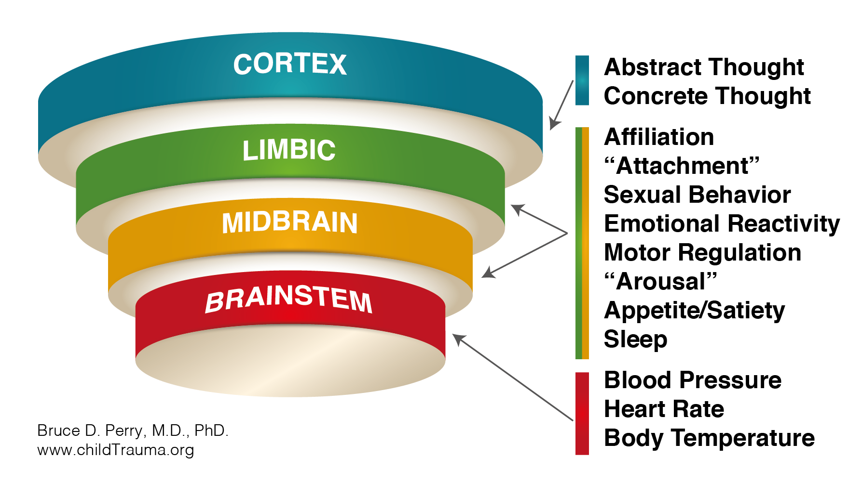
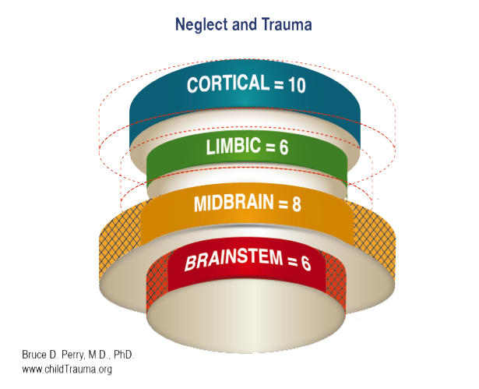
TRAUMA AND THE BRAIN
The brain has a “bottom-up” organization
Neurons and connections change in an activity-dependent fashion
This "use-dependent" development
The brain is most plastic (receptive to environmental input) in early childhood
With trauma and neglect, the midbrain is overactive and grows in size while the limbic and cortical structures are stunted in growth
e.g., Perry, B.D. (2001). Trauma and Terror in Childhood: The Neuropsychiatric Impact of Childhood Trauma In Ed., I. Schulz, S. Carella & D.O. Brady (Eds.). Handbook of Psychological Injuries: Evaluation, Treatment and Compensable Damages. American Bar Association Publishing.
Notes:
The brain has a “bottom-up” organization.
This Figure illustrates,
the bottom regions (i.e., brainstem and midbrain) control the simplest functions, such as respiration, heart rate and blood pressure regulation,
while the top areas (i.e., limbic and cortex) control more complex functions such as thinking and regulating emotions.

Slide 7
PARENTING INTERVENTIONS
Parenting Interventions: Common Characteristics of Effective Parenting Programs
Formal parenting interventions that are supported by research tend to have common characteristics, including:
  Behavioral parent training
  Skills training
  Family therapy
  In-home family support
Notes:
Strengthening Families Program SFP(http://www.strengtheningfamiliesprogram.org/) SFP is a family skills training program found to significantly reduce problem behaviors, delinquency, alcohol and drug abuse in children, and child maltreatment.
It is in 26 countries with language translations into Spanish, Portuguese, French, Dutch, Slovenian, Russian, Tai, Burmese, Chinese, and others.
The Incredible Years (http://incredibleyears.com/): Has been used in more than 20 countries and has been found to be effective in strengthening parenting skills, improving children’s emotion regulation, and reducing behavior problems.
Through this program parents and teachers use various strategies to help children regulate their emotions, improve their social skills, and have better school performance. Parents or teachers meet as a team with trained facilitators.
Children can also receive training in small groups by trained professionals and learn how to follow rules and cooperate, express emotions, problem-solve, manage anger, and make good friends.
PMTO- Parent Management Training –The Oregon Model (http:// www.isii.net/):
This program has been found to reduce child behavior problems and promote healthy child development.
It has been used in several countries.
It is a skills based program that offers praise and incentives to change behavior.
It focuses on:
limit setting- systematic, mild nonphysical consequences for negative behavior,
consistent monitoring & supervision of parents
helping to overcome family problems with a solution focused approach to prevent problems and address family issues, and finally
encouraging positive parental involvement in children’s activities.

Slide 8
OUTCOMES FROM UNC HORIZONS
Child Protective Service Involvement:
Outpatient women and children who complete the program: 75% of families had positive changes (e.g., closed cases, children reunited)
Residential women and children who complete the program: 95% of families with cases had positive changes (regained custody, cases closed)
Notes:
Developed by Arnold et al. (1993), the PS is a commonly used measure of parental discipline practices. The PS contains 30 items rated on a Likert scale of 1 (I let me child...) to 7 (I decide when my child...) that assess the behaviors parents use to discipline their children.

Slide 9
IMPROVING ATTACHMENT TO BREAK THE CYCLE
Parenting Interventions
Triple P (Positive Parenting Program)
  Shown to work across cultures, socio-economic groups, and in all kinds of family structures
Triple P: Positive Parenting Program 5 Steps to Positive Parenting
Create a safe, interesting environment (keep children busy so that they do not misbehave; give them access to interesting, safe activities) Have a positive learning environment (praise children when they do things you like; be affectionate; speak nicely; share your experiences with them) Use assertive discipline (set clear rules, be consistent, and use age-appropriate consequences; praise good behavior). Have realistic expectations (don’t expect more or less than your kids are capable of doing, and remember that everyone makes mistakes- no one is perfect). Take care of yourself as a parent (talk to other parents, exercise, take breaks, etc.)
Notes:
Triple P (Positive Parenting Program) Parenting (http://www.triplep. net/glo-en/home/): currently used in at least 25 countries and has been shown to work across cultures, socio-economic groups and in all kinds of family structures. It is has been translated into 17 languages.

Slide 10


FINAL THOUGHTS
Without treatment, children who are maltreated are at an increased risk to become adult with numerous mental health issues, and at increased risk to perpetuate abuse on their own children.
To address this paramount, intergenerational, public health issue, researchers and practitioners must continue to test parenting programs that address the parenting factors associated with abuse.
Although the attachment ﬁeld has made substantial progress over the past 20 years in developing and evaluating evidence-based attachment pro-grams the availability of effective, group-based attachment programs has lagged.
Given the well-documented importance of attachment security for healthy, long-term develop-mental outcomes for children, having attachment-based parenting programs that are manualized with easy-to-use formats is critical for broad dissemination.
e.g., Horton, E. & Murray, C. May 1 2015 In : Infant Mental Health Journal 36, 3, p. 320-336 p 17; https://pixabay.com/en/super-mami-mama-bebe-arms-happy-951187/;

Slide 11

Contact:
UNC Horizons
Hendrée E Jones, PhD
Executive Director, UNC Horizons
Professor,
Department of Obstetrics and Gynecology
School of Medicine
University of North Carolina at Chapel Hill
Hendree_Jones@med.unc.edu
Direct Line: 1-919-445-0501
Main Office: 1-919-966-9803
Fax: 1-919-966-9169

