Slide 1

Screening & Assessment
Notes:
The trainer will introduce the topic of “Screening & Assessment”. The trainer will explain that we will discuss practical methods for screening and assessing youth with substance abuse problems.

Slide 2
SCREENING & ASSESSMENT
Methodology:
Active discussion
Case Study
Role Play
Required Materials:
Easel Pad
Participant Manual
Notepad for each participant
Pens & Pencils
Duration: 6 hours
Notes:
The trainer will point out the methodology for this training. Active discussion refers to the trainer’s lecture but also participation from the audience in the form of questions, comments, suggestions that will enhance mutual learning.
The required materials for this module provide preparation for exercises.
The expected duration of this module is six hours.

Slide 3
SCREEENING & ASSESSMENT
Learning Objectives
  To learn the difference between screenings and assessments.
  To understand ethical guidelines when working with youth.
  To incorporate trauma-informed skills when working with youth.
Notes:
The trainer will introduce the learning objectives. But first, the trainer can ask the audience what their expectations are about this module.
Learning Objectives
To learn the difference between screenings and assessments.
To understand ethical guidelines when working with youth.
To incorporate trauma-informed skills when working with youth.

Slide 4
SCREENING & ASSESSMENT
  Learning Objectives continued…
  To understand the goals of screenings.
  To effectively manage crises
  To conduct effective screenings youth.
Notes:
The trainer will continue pointing out the learning objectives of this module.
Learning Objectives continued…
To understand the goals of screenings.
To effectively manage crises.
To conduct effective screenings youth.

Slide 5
SCREENING & ASSESSMENT
  Learning Objectives continued…
  To understand de goals of assessments.
  To learn about assessment methods and tools
  To conduct effective assessments of youth who are actively using.
  To learn the importance of case management.
Notes:
The trainer will continue pointing out the learning objectives of this module.
To understand de goals of assessments.
To learn about assessment methods and tools
To conduct effective assessments of youth who are actively using.
To learn the importance of case management

Slide 6
SCREENING VS. ASSESSMENT
Screening is a process for evaluating the possible presence of a particular problem. The outcome is normally a simple yes or no.
Assessment is a process for defining the nature of that problem, determining a diagnosis, and developing specific treatment recommendations for addressing the problem or diagnosis.
(SAMHSA/CSAT, 2009)
Notes:
The trainer will explain the difference between the process of screening and assessing youth. The trainer will ask the audience what is their understanding of the difference between screening and assessment. Then the trainer will define both terms as described above.
Screening is a process for evaluating the possible presence of a particular problem. The outcome is normally a simple yes or no.
Assessment is a process for defining the nature of that problem, determining a diagnosis, and developing specific treatment recommendations for addressing the problem or diagnosis.
The trainer will point out that before we begin learning more about screening and assessments of youth, we will cover ethical and legal considerations in the next few slides.

Slide 7
BEST ETHICAL PRACTICES WHEN WORKING WITH YOUTH
Beneficence
Fidelity & Responsibility
Integrity
Justice
Respect for People’s Rights and Dignity
Autonomy
(ACA, 2014; APA, 2017)
Notes:
The trainer will introduce the best ethical practices to working with youth and families affected by substance use/abuse as per the American Psychological Association’s code of ethics and the American Counseling Association’s code of ethics. These principles should guide the work with youth and families.
Beneficence & nonmaleficence: providers strive to provide services that benefits the individual and society to promote mental health and well-being. At the same time, service providers avoid actions that could cause harm to those you are serving.
Fidelity & Responsibility: Providers establish trusting relationships with those they serve; providers honor their commitments and keep promises.
Integrity: Providers promote honesty and truthfulness in their practice of counseling, therapy and any other treatment they provide.
Justice: Providers treat individuals equitably and fostering fairness and equality.
Respect for People’s Rights and Dignity: Providers respect the dignity and value of all people, their rights to privacy, confidentiality and self-determination.
Autonomy: Providers create environments that support the right of each person to control the direction of their own lives.

Slide 8
LEGAL AND ETHICAL CONCERNS
Some important concerns to take account are:
Confidentiality restrictions
When may confidential information be shared with others.
Rules about obtaining adolescent consent to disclose treatment information
The signature of the adolescent (and the issue of parental consent)
(Treatment Improvement Protocol, 1999)
Notes:
The trainer should point out those legal and ethical concerns, but it will depend on the context.
Confidentiality restrictions: The Federal confidentiality laws and regulations protect any information about an adolescent who has applied for or received any substance use/abuse-related assessment, treatment, or referral services from a program that is covered under the law.
When may confidential information be shared with others: The regulations also permit disclosure without the adolescent's consent in several situations, including medical emergencies, reporting child abuse, and communications among program staff.
Rules about obtaining adolescent consent to disclose treatment information: Most disclosures are permissible if an adolescent has signed a valid consent form that has not expired or been revoked. Generally 18 years old
The signature of the adolescent (and the issue of parental consent): The adolescent must always sign the consent form in order for a program to release information even to her parent or guardian. The program must get the signature of a parent, guardian, or other person legally responsible for the adolescent in addition to the adolescent's signature only if the program is required by State law to obtain parental permission before providing treatment to the adolescent.
Check the specific script about the legal and ethical concerns.

Slide 9
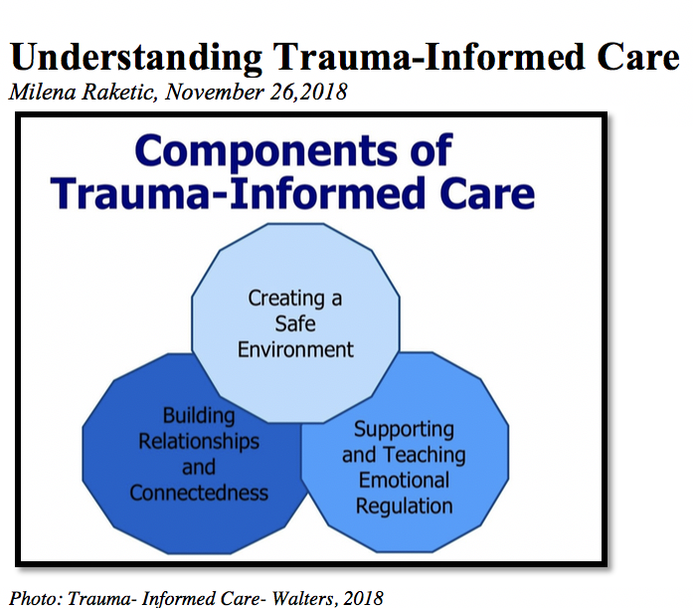
TRAUMA INFORMED INTERVIEWING
Create a Safe Environment:
  Use universal precautions of care.
  Trauma informed care starts at first contact with youth.
  Comfort Statements.
Buildings relationships and connectedness:
  Informed consent and full disclosure.
Supporting and teaching emotional regulation:
  Constant assessment of potential discomfort.
  Manage crises
Notes:
The trainer will remind the group about the topic of trauma informed care discussed on module 3. The trainer will discuss how to apply the principles of trauma informed care when screening and assessing youth.
CREATE A SAFE ENVIRONMENT:
Use universal precautions of care: If you recall on module 3, we discussed this concept. Universal precautions refers to the assumption a provider makes about potential clients. We do not know a person’s history of trauma and their specific coping mechanisms until we get to know them. Therefore, even if it is a screening or assessment, providers must assume that there could be trauma and utilize trauma-informed skills to make the space safe for the client.
Trauma informed care starts at first contact with youth: From the first contact with youth, the provider must utilize trauma-informed care as they conduct screenings and assessments. This helps to minimize re-traumatization of client in case there is trauma in their history.
Make comfort statements: providers should thank the client for showing up to the screen/assessment. Ask the client if they are comfortable or if the provider can do something to help them feel more comfortable.
BUILDING RELATIONSHIPS AND CONNECTEDNESS:
Informed consent and full disclosure: provide information about the process of the screen/assessment, inform them with detail and let them know they have a right to refuse to answer or to stop the interview at any time. This helps the client feel more in control of the emotional space and promotes trust towards provider.
SUPPORTING AND TEACHING EMOTIONAL REGULATION:
Constant assessment of potential discomfort: providers are tuned to the client’s body language, expressions that might indicate discomfort. Providers also prepare the client before asking uncomfortable questions. For example: “During this screening/assessment I will ask you questions that might be uncomfortable, if you feel that way, let me know so we can figure out how to make this process more comfortable for you”.
Manage crises: providers effectively manage potential crises that might arise during the screening/assessment. The trainer will point out that we will learn more about this in the next slide.

Slide 10
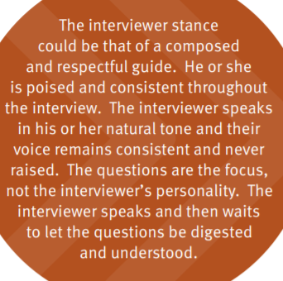
THE ROLE OF THE INTERVIEWER / PROVIDER
(SAMHSA, 2015)
Notes:
The Trainer discusses that the most important aspect of an effective contact with a youth is the provider’s demeanor and attitude towards the client.
The interviewer’s stance and tone during the administration of the data collection instrument are essential to maintaining the safe, controlled physical and interpersonal space established before the interview began. Interviewers must be able to manage their own emotions during the feel interview process. Signs of high anxiety, frustration, fear, or anger can make the interviewee unsafe during the process. It is the interviewer’s responsibility to manage his or her emotions during the interview, staying calm while displaying compassion when hearing difficult aspects of a person’s story and responding rather than reacting to the person’s behaviors during the interview.

Slide 11

MANAGING CRISES DURING SCREENINGS & ASSESSMENTS
Trauma disclosures.
Suicidal thoughts or feelings.
Violence.
Notes:
The trainer will discuss situations that might arise during a screening or assessment. Some of the most common include; trauma disclosures, suicidal thoughts or feelings and violent behavior.
The trainer asks the audience to raise their hand if they have encountered any of these situations.

Slide 12

TRAUMA DISCLOSURES
Redirect and stop.
Attend to the client’s feelings.
Stabilize
Check legalities
(SAMHSA, 2015)
Notes:
The trainer will discuss best practices to managing a client’s disclosure of past traumatic experiences such as; childhood sexual abuse, witness to domestic abuse, accidents, violence experienced in the community or others.
REDIRECT AND STOP: When a client discloses a traumatic experience, it is recommended that the interviewer gently redirects the client and stops them from continuing disclosure at length. It is not recommended that the interviewer probes more or asks for details of the trauma as this might re-traumatize the client. For example saying: “Susan, it sounds like that experience brings up strong feelings, you don’t need to give me details now, perhaps we can process that once you’re fully in treatment later on”.
ATTEND TO THE CLIENT’S FEELINGS: the providers’ goal is to address client’s feelings of distress. Providing statements to validate their feelings and reassuring client can help them regain stability. For example saying: “that sounds like it was a very hurtful experience, I’m here to support you, you’re in a safe place, what can I do to help you feel more comfortable right now?”
STABILIZE: Provide the client with enough time and space to recover from the emotional distress, offer water and offer to take a break from the interview. Once the client regains stability, ask the client if they feel well enough to continue the interview and honor their decision.
The trainer will discuss with the audience the duty to report in case of sexual abuse or exposure to domestic violence as it relates to the context where this training is being taught. The trainer can ask “what is the legal duty of providers when they hear cases of sexual abuse?”

Slide 13
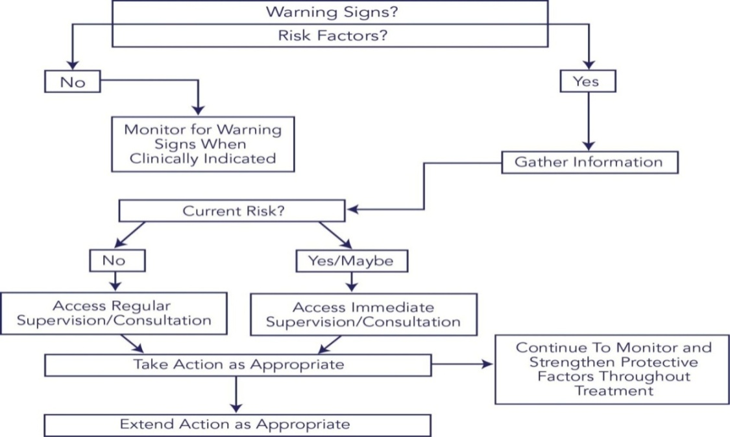
SUICIDAL THOUGHTS OR FEELINGS
Understanding suicide
GATE is an intervention for suicidal thoughts or feelings
  Gather information
  Access supervision
  Take responsible action
  Extend the action
(CSAT/TIP, 2009)
Notes:
The trainer will discuss the topic of encountering suicidal thoughts or feelings when screening or assessing a client.
UNDERSTANDING SUICIDE:
The trainer should explain that adolescents with substance use disorders are at especially high risk of suicidal behavior. As such, suicide risk is a problem that every frontline counselor must be able to address.
Adolescents in crisis may experience suicide ideation—thoughts about hurting or killing themselves. These thoughts are common and predictable responses to the distress felt during a crisis. Some counselors may experience discomfort when talking about suicide ideation and may avoid the topic. However, because of the relatively high risk among youth who use substances, it is vitally important that counselors become comfortable and confident
in addressing issues relating to suicide with their clients.
 Adolescents often enter treatment at a point when their substance use is out of control, increasing a variety of risk factors for suicide.
 They enter treatment when a number of substance-related life crises may be cooccurring (e.g., school, legal, family).
 They enter treatment at peaks in depressive symptoms.
 Mental health problems (e.g., depression, post-traumatic stress disorder [PTSD], anxiety disorders, some personality disorders) associated with suicide risk often cooccur among people who use substances.
 Crises that are known to increase suicide risk sometimes emerge during drug treatment (e.g., relapse, family readjustment stress, transitions between levels of treatment).
The trainer should explain that there is a 4-step process to intervene when there is a suicide risk suspected. The four steps form the acronym GATE. The steps are:
Gather information;
Access supervision;
Take responsible action; and
Extend the action.
Gather information:
There are two steps to gathering information:
Screening for and identifying warning signs; and
Asking follow up questions.
Screening
Screening consists of asking very brief, uniform questions at intake (and throughout treatment as necessary) to determine whether further questions about suicide risk are necessary. There is a myth that asking a person about suicidal thoughts may put the idea in his or her head and increase the risk. This is not true. Being asked about suicide may actually be a relief for many people.
Sample Screening Questions
Introducing the topic (use either statement):
1. Now I am going to ask you a few questions about suicide.
2. I have a few questions to ask you about suicidal thoughts and behaviors.
Screening for suicidal thoughts (ask either question):
1. Have you thought about killing yourself?
2. Have you thought about carrying out suicide?
Screening for suicide attempts (ask either question):
1. Have you ever tried to take your own life?
2. Have you ever attempted suicide?
Asking Follow-up Questions
Ask follow-up questions when clients respond “yes” to one or more screening questions or any time you notice a warning sign. The purpose of asking follow up questions is to have as much information as possible so that you, your supervisor, and the treatment team can develop a good plan of action. You also will want to provide as much information as possible to another provider should you make a referral.
Access supervision:
You should not make a judgment about the seriousness of suicide risk or try to manage suicide risk on your own unless you have an advanced mental health degree and specialized training in suicide risk management and it is understood by your program that you are qualified to manage such risk independently.
Receiving input from a peer is not enough. Although such input may be helpful, consultation is a more formal process whereby information and advice are obtained from:
A professional with clear supervisory responsibilities;
A multidisciplinary team that includes such a person; or
An outside consultant experienced in managing suicidal clients who has been approved by your program for this purpose.
When obtaining supervision or consultation, assemble all the information you have gathered on your client’s suicidal thoughts and/or suicide attempts through the screening and follow up questions, as well as data from other sources of information (e.g., other providers, family members, treatment records).
In some circumstances, you will need to obtain immediate consultation. In other circumstances, obtaining consultation at regularly scheduled supervision or team meetings may be sufficient.
Circumstances Requiring Immediate Supervision or Consultation
At Intake:
Direct warning signs are evident (suicidal communication, seeking access to method, making preparations);
Answers to follow-up questions to suicide screening questions suggest that there is current risk;
Answers to follow-up questions to indirect warning signs suggest that there is current risk; and
Additional information (e.g., from the referral source, family member, medical record) suggests that there is current risk.
During Treatment:
Emergence (or reemergence) of direct warning signs suggests current risk;
Emergence (or reemergence) of indirect warning signs that, on follow up questioning, suggests current risk;
Answers to suicide screening questions asked during the course of treatment suggest current risk; and
Additional information (e.g., from another provider or family member) suggests current risk.
Circumstances That Can Wait for Regularly Scheduled Supervision or Consultation
At Intake:
One or more indirect warning signs are present, but answers to follow-up questions indicate that there is no reason to suspect current risk for suicidal behavior (e.g., a client is socially isolated and abusing substances, but otherwise shows no indications of suicidal thoughts or plans);
One or more risk factors are present, but there are no accompanying warning signs or other indications to suspect current risk for suicidal behavior;
During screening, client discloses a history of suicidal thoughts or suicide attempts, but there are no accompanying warning signs or other indications to suspect current risk for suicidal behavior; and
Additional information (e.g., from the referral source or a family member) suggests your client has a history of suicidal thoughts or attempts, but there are no accompanying warning signs or other indications to suspect current risk for suicidal behavior.
During Treatment:
Client reports (or alludes to) a history of suicidal thoughts that you had not previously been aware of, but there are no accompanying warning signs or other indications to suspect current risk for suicidal behavior;
Client reports (or alludes to) prior suicide attempts that you had not previously been aware of, but there are no accompanying warning signs or other indications to suspect current risk for suicidal behavior;
Additional information (e.g., from another provider or family member) suggests a history of suicidal thoughts or attempts that you had not previously been aware of, but there are no accompanying warning signs or other indications to suspect current risk for suicidal behavior; and
Client with a history of suicidal thoughts or behaviors experiences an acute stressful life event or a setback in treatment (e.g., substance abuse relapse), but there are no accompanying warning signs or other indications to suspect current risk for suicidal behavior.
Take responsible action
The actions taken should be sensible in light of the information that has been gathered about suicidal thoughts and/or previous suicide attempts. Although the potential actions are many, they can generally be described along a continuum of intensiveness. In instances of greater seriousness, you will generally take more intensive actions. For less serious circumstances, you will likely take fewer intensive actions. Note that “less intensive” does not mean no action; it merely indicates that the counselor may have more time to formulate a response, the actions may be of lower intensity, and/or fewer individuals and resources may be involved.
Counselors are also advised to be aware of local emergency services providers who are trained and experienced at providing medical intervention for suicide attempts. Such providers must be prepared to use pharmacological intervention (e.g., naloxone) for suicide attempts by overdose.
Possible Responsible Actions
Arrange a referral:
To a clinician for further assessment of suicide risk;
To a provider for mental health counseling;
To a provider for medication management;
To an emergency services provider (e.g., hospital emergency department) for acute risk assessment;
To a mental health mobile crisis team that can provide outreach to a physically inaccessible client at his or her home (or shelter) and make a timely assessment; or
To a more intensive substance abuse treatment setting.
Restrict access to methods of suicide (you will need the help of family members or friends).
Temporarily increase the frequency of care, including more frequent telephone check-ins.
Temporarily increase the level of care (e.g., refer client to residential or hospital-based treatment).
Involve a case manager if possible (e.g., to coordinate care, to check on the client occasionally).
Involve the primary mental disorder care provider if there is one.
Encourage the client to attend (or increase attendance at) 12-Step meetings such as Alcoholics Anonymous, Narcotics Anonymous, or Cocaine Anonymous.
Enlist family members or significant others (selectively, depending on their health, closeness to the client, and motivation) in observing indications of a return of suicide risk.
Observe the client for signs of a return of risk.
Create a safety card (see below) with the client in the event of a return of acute suicidal thoughts.
Create a detailed safety plan with the client in the event of relapse to alcohol or drugs.
Give the client an emergency hotline number.
Invite the client to contact you (or an emergency hotline) in the event of acute suicidal thoughts.
Extend the action:
A common misconception is that suicide risk is an acute problem that, once dealt with, ends. Unfortunately, individuals who are suicidal commonly experience a return of suicide risk following any number of setbacks, including relapse to substance use, a distressing life event (e.g., breakup with a partner), increased depression, or any number of other situations. Sometimes suicidal behavior even occurs in the context of substantial improvement in mood and energy. Therefore, monitoring for signs of a return of suicidal thoughts or behavior is essential.
There is also a tendency to refer a client experiencing suicidal thoughts and behaviors to another provider and then assume that the issue has been taken care of. This is a mistake. It is essential to follow up with the provider to determine that the client kept the appointment. It is also critical to coordinate care on an ongoing basis, for example, to alert a provider that a client has relapsed and may be vulnerable to suicidal thoughts.
Extending the action emphasizes the importance of watching for a return of suicidal thoughts and behaviors, following up with referrals, and coordinating on an ongoing basis with providers who are addressing the client’s suicidal thoughts and behaviors.
Examples of Extending the Action
Confirm that a client has kept the referral appointment with a mental health provider (or other professional).
Follow up with the hospital emergency department when a client has been referred for acute assessment.
Coordinate with a mental health provider (or other professional) on an on-going basis.
Coordinate with a case manager on an on-going basis.
Check with the client about any recurrence of or change in suicidal thoughts or attempts.
Confirm that the client still has his or her safety card (ask the client to show it to you) and remains willing to use it if the need arises
Check with family members (with the client’s knowledge and consent) about any recurrence of or change in suicidal thoughts or attempts.
Reach out to family members to keep them engaged in the treatment process after a suicide crisis passes.
Observe the client for signs of a return of risk.
Confirm that the client and, where appropriate, the family still have an emergency phone number to call in the event of a return of suicidal thoughts.
Confirm that the client still does not have access to a method of suicide (e.g., gun, stash of pills).
Follow up with the client about suicidal thoughts or behaviors if a relapse (or other stressful life event) occurs.
Monitor and update the treatment plan as it concerns suicide.
Document all relevant information about the client’s condition and your responses, including referrals made and the outcomes of the referrals.
Complete a formal treatment termination summary when and under whatever circumstances this stage of care is reached.

Slide 14

VIOLENT BEHAVIOR
Understanding the type of aggressive behavior.
Physical safety
Verbal Strategies
(CPI, 2020; CWTI, 2006)
Notes:
The trainer should explain that adolescents with substance abuse problems might be under the influence or might be withdrawing from the substance, therefore their behaviors can be erratic if they are actively using.
Understanding the type of aggressive behavior: providers must assess whether the client is verbalizing discomfort and is resistant to the screen or assessment. If warning signs such as pacing, angry facial expression, violent statement are made, the adolescent might be ale to benefit from verbal strategies. Anger usually escalates slowly, therefore a close assessment of the client’s body language is crucial. If the aggression is impulsive without warning, the youth might be under the influence or might have a medical condition that triggers the behavior.
Physical safety: it is important to consider the space where you’re interviewing the client. Always sit close to doorways to exit in case your client becomes physically aggressive. Also, interview rooms should be free from items that can become lethal.
Verbal strategies:
Remain calm. When the provider is in control of their own emotions, verbal strategies are more successful.
Check the scene to get other people out of the room so you can manage the client’s crisis.
Point out what you are noticing in the youth; their behaviors, their words and their demeanor. Sometimes youth can become agitated and not realize they are becoming aggressive. For example tell the youth “Larry, I noticed you are cracking your knuckles and breathing heavier, should we take a break and make sure you're feeling ok?”. This can help the youth to become aware of their reactions and come back to a balanced state, also preventing the aggression to escalate.
Validate feelings. The client might be feeling anger or fear, verbally reassure them, say “I can see you are upset; you have every right to feel that ay right now”. Validating feelings helps the client connect with the worker.
Embrace silence. Some clients don’t want to speak about anything, embrace that and stay in the room with the youth. You can say “It’s ok if you don’t feel like talking, I’m going to stay here with you to make sure you’re feeling ok”.

Slide 15
SCREENING

Slide 16

SCREENING
Should last no more than 30 minutes
Simple instrument
Relationship to substance
  Frequency
  Severity
Should take place in private area.
(SAMHSA/CSAT, 2009)
Notes:
The trainer will introduce some basic principles to keep in mind while screening youth.
Should last no more than 30 minutes: a screening is a basic set of questions meant to explore whether there is a problem that needs attention, it should not take longer than the stated time.
Simple instrument: Short-versions of tools that we will cover on next slide.
Relationship to substance
Frequency
Severity
Should take place in private area: whether this is in juvenile detention centers, NGOs, hospitals, private companies, schools, religious communities or other settings, make sure the screening happens in a private area.

Slide 17
SCREENING METHODS
Brief structured interview questions
  Youth participation
  Caregiver/Parent
Screening Tools
  NIDA -12 questions
  CRAFFT – 6 questions
Notes:
The trainer will discuss that there are different ways to screen. The most accepted types are through brief questions or utilizing brief tools.
Brief structured interview questions: simply asking a youth about their drug use can provide us with information. It is important that the youth is engaged and involved, and if it is possible, a caregiver can also be included in a brief interview about the youth’s use of substances.
Screening Tools:
NIDA: The National Institute on Drug Abuse (NIDA) quick screen is designed to inquire about use of most addictive substances.
CRAFFT:

Slide 18
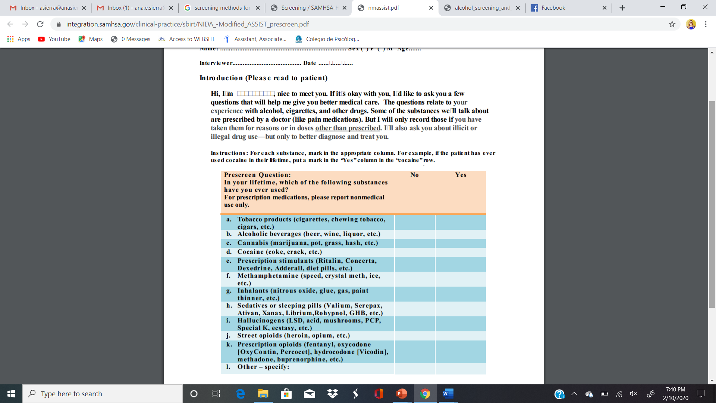
National Institute on Drug Abuse (NIDA) Screen
NIDA Screen is a set of brief questions on the use of substances.
Has a suggested script to help youth understand the nature of the questions.
Notes:
The trainer will introduce the NIDA screening tool. The trainer will read the introduction and the instructions of the instrument displayed on the slide. The tool can be found after the appendixes under the Tools Section.

Slide 19

Let’s Practice!
Notes:
The trainer will direct the group to their appendix documents where they will find the NIDA screening tool. The trainer will ask participants to partner with another person to practice asking the questions on the screening tool. The trainer will instruct the group that the partners formed will read the script as it is displayed on the tool and ask each question, then switch so each partner has time to practice. Remind the audience to incorporate trauma-informed skills when practicing.
Ask participants to be creative and think of some of their current clients to impersonate when practicing the exercise.
After the exercise the trainer will engage the group to discuss how it felt to conduct this role play exercise. Ask the audience if anything came up for them during the time they were interviewing or playing the interviewee. The trainer can also ask the audience if they noticed any trauma-informed skills utilized during this practice.

Slide 20
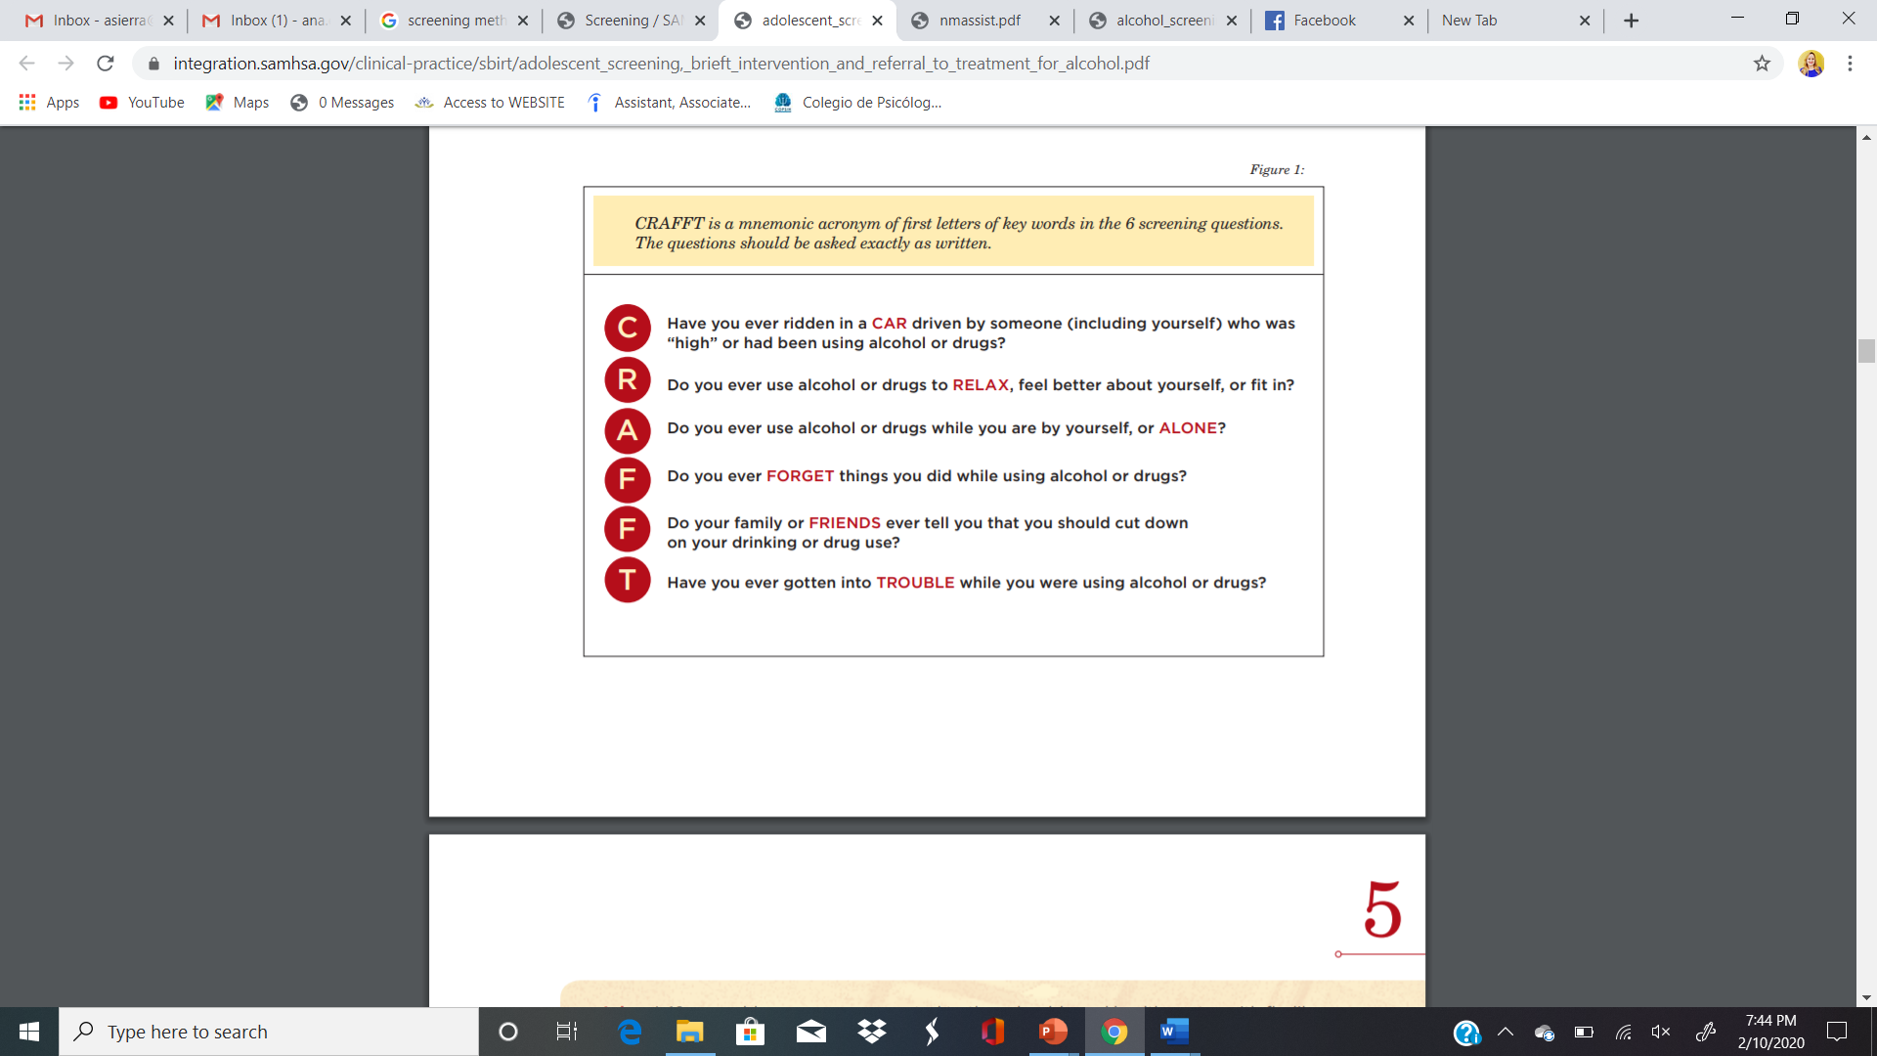
CRAFFT Screening Tool
6 questions.
Each questions equal to one point.
20 languages.
(CRAFFT.ORG, 2020)
Notes:
The trainer will introduce the CRAFFT tool. The trainer will refer the group to the Tools Section of the documents where they will find the tool along with the translations of the tool.
The CRAFFT has been utilized internationally and is translated into 20 languages.
Burmese
Dutch
English
French
German
Haitian Creole
Hebrew
Japanese
Khmer
Laotian
Mandarin Chinese
Nepali
Portuguese (Portugal)
Portuguese (Brazil)
Russian
Spanish (LatAm)
Spanish (Spain)
Turkish
Ukrainian
Vietnamese

Slide 21
Let’s Practice!
Notes:
The trainer will direct the group to their appendix documents where they will find the CRAFFT screening tool.
The trainer will ask participants to partner again to practice asking the questions in the tool. Remind the audience to incorporate trauma-informed skills when practicing. Ask participants to be creative and think of some of their current clients to impersonate when practicing the exercise.
After the exercise the trainer will engage the group to discuss how it felt to conduct this role play exercise. Ask the audience if anything came up for them during the time they were interviewing or playing the interviewee. The trainer can also ask the audience if they noticed any trauma-informed skills utilized during this practice.

Slide 22
ASSESSMENTS

Slide 23
ASSESSMENTS
What is an assessment?
An assessment is a process that consists of collecting data, interpreting it and developing a plan based on the strengths and weaknesses that are revealed through the data.
The patient assessment includes capacities, strengths, problems, needs and resources, as well as weaknesses and risk areas.
To sum up, the assessment includes all the positive and negative aspects of the patient.
Notes:
The trainer will discuss the components of an assessment.
What is an assessment?
An assessment is a process that consists of collecting data, interpreting it and developing a plan based on the strengths and weaknesses that are revealed through the data.
The patient assessment includes capacities, strengths, problems, needs and resources, as well as weaknesses and risk areas.
To sum up, the assessment includes all the positive and negative aspects of the patient.

Slide 24
ASSESSMENTS
What is the Relationship between the Assessment and Treatment Planning for Drug and Alcohol Use?
It’s the first step in formulating a treatment plan.
It’s a continual process, which starts with an early assessment and continues throughout the whole treatment process

Slide 25
ASSESSMENTS
Comprehensive Assessment
  Physical Health
  Psychological Health
  Social Assessment
  Vocational/Educational Assessment
Notes:
The trainer will introduce assessment approaches. The assessment is most comprehensive when a semi-structured interview is completed on major life domains and also a validated tool is utilized as well.
Physical Health
A. Complete medical and drug history
B. In-patient programs (complete physical and, when indicated, a neurological assessment)
C. Routine inquiry might include:
1. When last treated or seen by physician
2. When last complete physical examination was done
3. Awareness of the presence of any medical problem
4. What, if any, medication/drug, prescribed or otherwise, is being taken.
5. Physical Health Assessment includes an appropriate laboratory work-up in in-patient programs.
Psychological Health
A. History of psychological problem areas
B. Family history
C. Previous psychiatric treatment
D. Direct observation of the client and assessment of specific behavior
Social Assessment
A. Environment (home, neighborhood, etc.)
B. Religious background and affiliation
C. Childhood history
D. Military Service
E. Financial status
F. Alcohol and consumption of other drugs (current and past, among other members of the family and in the home).
G. Evaluation of characteristics of social peer group and environmental settings the patient comes.
H. Consideration of the patient's family circumstances, current living situation, and social, ethnic, cultural, financial, emotional, and health factors.
I. A consideration of the expectations of the family or friends regarding the patient's treatment, the degree to which they expect to be involved, and their expectations regarding the length of time and type of treatment required.
Vocational/Educational Assessment
A. Vocational history
B. Educational history (including academic and vocational training- diplomas, degrees, certifications, licenses)
C. A consideration of the individual’s past experiences with and attitudes toward work, present motivations or areas of interest, and possibilities for future education, training, and/or employment
D. Availability of resources
Drug intervention
Support Services
E. Discrimination/Pre-conceived notions
F. Stigmatization of mental health issues
G. When/how the assessment takes place
H. Lack of validation of instruments with populations served on a local level

Slide 26

ASSESSMENTS
Global Appraisal of Individual Needs (GAIN)
Teen Addiction Severity Index (T-ASI)

Slide 27
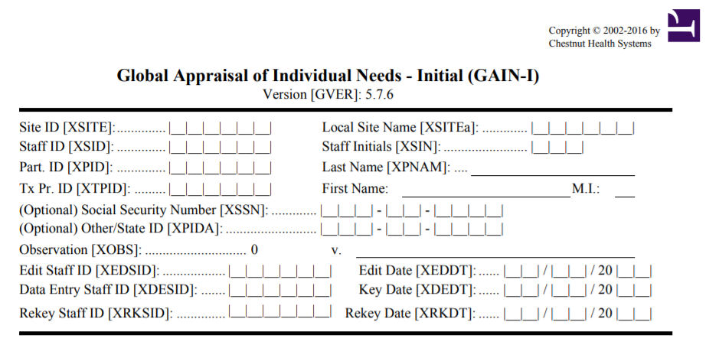
Global Appraisal of Individual Needs (GAIN)
Semi-structured interview
75 – 100 minutes to administer, 15 to score
(GAINCC.ORG, 2015)
Notes:
The trainer will introduce the GAIN tool. Direct the audience to the appendix documents where the full version of the GAIN will be discussed.
This is a standardized bio-psycho-social assessment designed to help clinicians gather information for diagnosis, placement, and treatment planning. As with any self-report, the GAIN is limited by the veracity of the individual respondent's answers; it should be collected by someone certified in GAIN administration, combined with other information and interpreted by clinical or other qualified personnel prior to taking any specific actions.

Slide 28
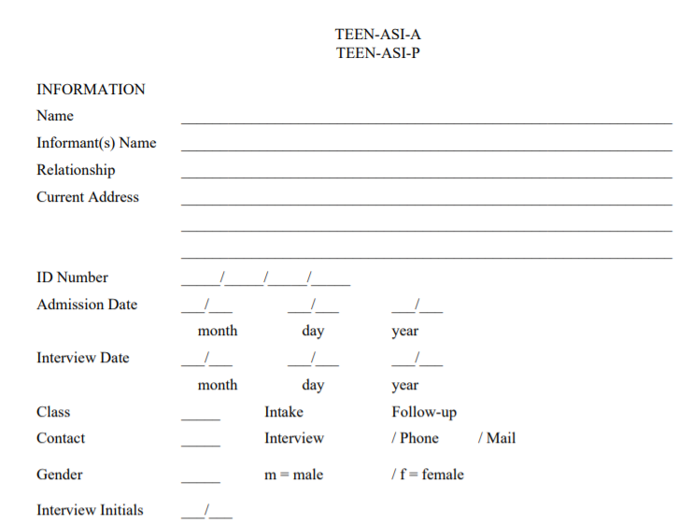
Teen Addiction Severity Index (T-ASI)
Semi-structured interview
30 – 45 minutes to administer,
10 to score
(Kaminer et, al 2009)
Notes:
The trainer will introduce the T-ASI. Direct the audience to the appendix documents where the full version of the T-ASI will be discussed.
The objective of this face-to-face structured interview combined with opportunity for assessor to offer comments, confidence ratings (indicating whether the information may be distorted), and severity ratings (indicating how severe the assessor believes is the need for treatment or counselling). It is specifically created to address substance abuse in youth.

Slide 29
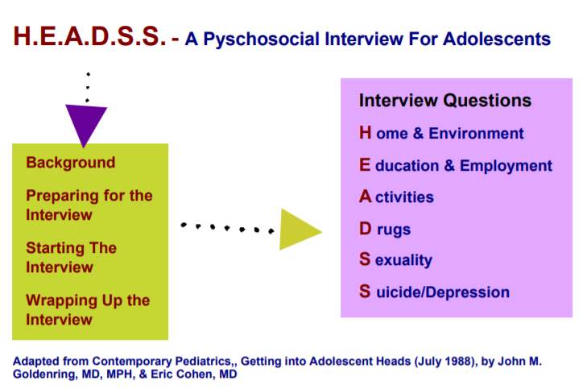
HEADSS
Interview
3 – 90 minutes
(Cohen et al, 1991)
Notes:
The trainer will introduce the HEADSS. Direct the audience to the Tools Section where the full version of the HEADSS will be discussed.
The purpose of this assessment is to facilitate communication and to create a sympathetic, confidential, respectful environment where youth may be able to attain adequate health care. The approach is known as the acronym HEADSS (Home, Education/employment, peer group Activities, Drugs, Sexuallity, and Suicide/depression).

Slide 30
Let’s Practice!
Notes:
The trainer will direct the group to a practice exercise. The trainer will provide about 5 minutes so all participants can browse through both tools, the GAINS, T-ASI and HEADSS. Then each person will choose which one to practice with for this exercise.
The trainer will ask participants to partner again to practice asking the questions in the tool. Remind the audience to incorporate trauma-informed skills when practicing. The time limit for this exercise is 5 minutes per person then switch for another 5 minutes. The goal is to get a little practice on how to conduct the assessments. Ask participants to be creative and think of some of their current clients to impersonate when practicing the exercise.

Slide 31
OTHER SCREENIGNS & ASSESSMENTS
Adolescent Health Review (AHR)
Adolescent Substance Abuse Subtle Screening Inventory (SASSIA2)
Brief Psychiatric Rating Scale – Children (BPRS-C)
Notes:
The trainer will introduce some options for self-administered tools. These can be utilized if attempts to interview the youth are unsuccessful.
The Adolescent Health Review: is designed to assist health care professionals in screening adolescents for risks to their physical and emotional health. The AHR is designed for use only as an adjunct to standard clinical practice. This instrument is not recommended for children under age 12, adolescents with limited English proficiency, or other adolescents who have reading difficulties.
Adolescent Substance Abuse Subtle Screening Inventory (SASSIA2): Identifies high or low probability of substance dependence and substance abuse disorders for clients 12 to 18 years of age. The SASSI-A2 also provides clinical insight into family and social risk factors, level of defensive responding, and consequences of substance misuse.
Brief Psychiatric Rating Scale – Children (BPRS-C): A 21-item, clinician-based rating scale that is designed for use in evaluating psychiatric problems of children and adolescents
The trainer will point out that these tools are available for free and are listed on the appendix. We will be discussing the importance of case management in the next few slides.

Slide 32

CASE MANAGEMENT
Case Management
Case Coordination
Casework
(CMSA.ORG, 2017)
Notes:
The trainer will introduce the concept and practice of case management.
Case management is a collaborative process of assessment, planning and follow up which is geared to meet a client’s and family’s needs with the goal of achieving wellness. Case management also serves to connect the client with resources or other services needed to meet the goals of treatment. Case managers are individuals who are trained to work with people who are vulnerable and are knowledgeable of resources that can help the population they’re serving.
Case Coordination is a feature of case management and reflects the role often adopted by the case manager in the lead agency. Their role is to collaboratively manage and coordinate the multiple services that a client may require
Casework is the regular direct, contact with people that supports them to implement their case plan

Slide 33
CASE MANAGEMENT MODELS
Notes:
The trainer will discuss two main case management models that are effective when working with youth with complex needs.

Slide 34
GENERAL CASE MANAGEMENT
Trust and relationships
Provision of Resources
Provision of Services
Follow up
Constant adaptation to meet client’s needs
Notes:
The trainer will discuss the core concepts of general case management. Youth with substance abuse challenges present with multiple challenges and barriers. Case management is additional to the single therapy goals.
Trust and relationships: The most effective way to engage youth and families is to gain their trust. If you recall the trauma-informed care approach allows case managers to also engage clients in a way that empowers them, and trust is achieved, resulting in effective treatment.
Provision of Services: Case managers screen with tools (we will discuss later) what are the needs of the client and provide services such as: mental health referrals, substance abuse program referrals, legal, medical, educational, economic and connection to potential sources of support such as church or mentors.
Follow up: Case managers provide resources but also actively follow up with youth and families to ensure that engagement to those referrals have happened. Youth and families often experience difficulty accessing services and follow up allows the case manager to advocate if a service has not been accessed.
Constant adaptation to meet client’s needs: Case managers constantly assess and re-assess the youth’s progress and adapt their focus on the support needed depending on the client’s needs, as these needs will shift throughout treatment.

Slide 35
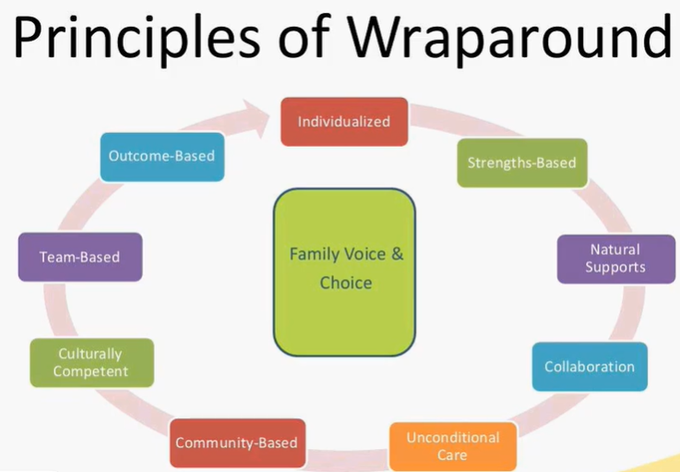
WRAP AROUND MODEL
Evidence-based case management method.
Principles:
  Voice & Choice at the core
  Individualized care
  Strengths-based
  Natural Supports
  Team-based collaborative planning
  Unconditional Care
  Community-based care
  Culturally Competent
  Outcome-based
(Burns, 2008; NWI, 2008)
Notes:
The trainer will introduce the Wrap-Around Model to case management. This model is meant to serve youth and families with multiple needs and difficult to engage. The core of this model involved systems working together to provide best treatment outcomes for families.
Principles of Wrap-Around Model:
Voice & Choice at the core: Youth that come from families with multiple challenges face several barriers and might have experienced negative treatment outcomes in the past. Therefore, assuring that the youth’s voice and choice is at the core of the plan of care empowers families to take ownership of their treatment, resulting in better treatment outcomes.
Individualized care: All families are not the same. This concept refers to investigating the youth’s relationship with the systems around them; school, family, community. The plan of care should be inclusive of the youth’s environments.
Strengths-based: This lens focuses on the strengths of the youth. Although you might see several challenges, all youth also have strengths. This lens assumes that the youth is the expert in their own life and the role of the case manager is to empower them and build their capacity to reach their potential. The trainer will direct the audience to find the “Tentative List of Life Strengths Gleaned from Positive Psychology Literature” and read a few that can apply to youth.
Natural Supports: The role of the case manager is to find within the youth’s context those positive supports or opportunities for positive supports.
Team-based collaborative planning: The systems collaborating such as; school, community entities, parents, and youth work together towards the goals of the family. Other systems might be from need for resources; food vouchers, housing, employment, educational goals, and others that might be specific case by case.
Unconditional Care: The case manager is expected to provide unconditional care, that is, no matter how little progress a youth might be experiencing, care will continue and the same supports will continue to be available.
Community-based care: An important aspect of this model is that case managers are flexible and meet the client where they’re at. Community-cased care refers to services that can happen on the street, at the home, or at school to follow with treatment.
Culturally Competent: The case manager is highly aware of the youth’s specific barriers related to culture and aspects of diversity. If you recall the ADDRESSING model we reviewed in the Trauma Module, we can incorporate it in this model.
Outcome-based: The case manager utilizes concrete outcomes to the goals provided.
The trainer will provide the audience with the link to the National Wrap-around initiative: https://nwi.pdx.edu/

Slide 36
CASE MANAGEMENT TOOLS

Slide 37
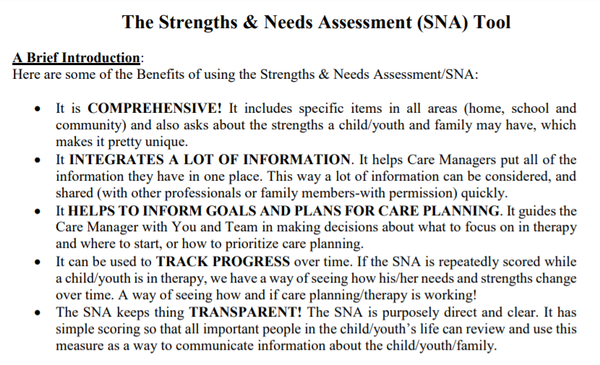
The Strengths & Needs Assessment (SNA) Tool
(Lyons, 2016)
Notes:
The trainer will introduce the SNA Tool. The trainer will direct the audience to the Tools Section to review the tool together.
Six Key Principles of the tool:
Items were selected because they are each relevant to care planning.
Each item uses a 4-level rating system.
Rating should describe the individual, not the individual in services.
Culture and development should be considered prior to establishing the action levels. Cultural sensitivity involves considering whether cultural factors are influencing the expression of needs and strengths
The ratings are generally “agnostic as to etiology”. In other words this is a descriptive tool. It is about the “what” not the “why”. Only one item, Adjustment to Trauma, has any cause-effect judgments.
A 30-day window is used for ratings in order to make sure assessments stay “fresh” and relevant to the child or youth’s present circumstances. However, the action levels can be used to over-ride the 30-day rating period.

Slide 38
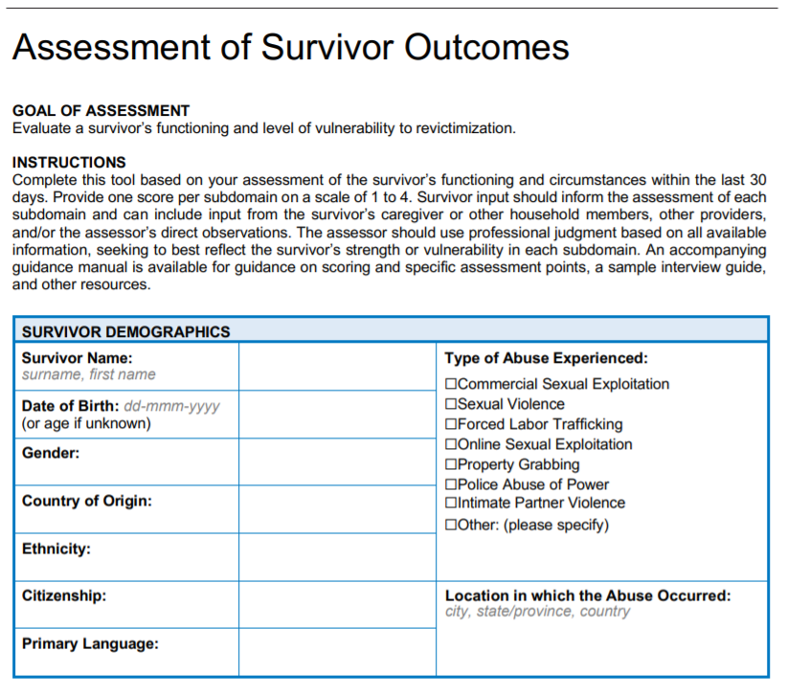
Assessment of Survivor Outcomes (ASO)
(IJM.ORG, 2018)
Notes:
The trainer will introduce the Assessment of Survivor Outcomes (ASO). This is specific to special populations: youth that have experienced traumatic events in the form of crimes, for example; sexual abuse, commercial sexual exploitation, online sexual exploitation, and forced labor.
The domains being assessed include:
Safety
Legal Protection
Mental Wellbeing
Economic Empowerment & Education
Social Support
Physical Wellbeing

Slide 39
Let’s Practice!
Notes:
The trainer will direct the group to a practice exercise. The trainer will instruct the audience to read the case study that will be displayed on the next slide. They will choose one of the tools to assess the youth’s case management needs.
The trainer will ask participants to spend the next 10 minutes,

Slide 40
CLINICAL CASE STUDY
Lidia is 15-years-old, Hispanic, heterosexual adolescent. Lidia is an immigrant, she arrived at the main country when she was 8 years old but is currently undocumented in the current country. Lidia was hospitalized due to suicidal ideations. You’re the case manager who is meeting with her prior to her discharge. During your assessment you find out Lidia’s history of sexual trauma by her uncle, from the age of 9 through 12. Lidia verbalizes previous suicidal attempts and recent cutting. Although Lidia speaks the main language, she struggles academically, and in the past, she has skipped school various times. You also find out that Lidia will be living with her mother, who does not believe the abuse happened. Lidia believes her family does not like her because she told about the abuse by her uncle who is in jail, she mentions that her aunt told her “you broke the family apart”.
Lidia admits to trying several drugs throughout the last few years. She admits to heavy use of alcohol, some marihuana and trying mushrooms one time. Her drug of choice is alcohol and she is not willing to stop the use. Lidia also admits to having unprotected sex with several peers when drunk in the past.
Notes:
The trainer will introduce the case study and allow 10 minutes for the audience to formulate a case management plan. Remind the audience to incorporate trauma-informed skills when practicing and discuss how they would utilize it with the client featured. Also, remind the staff of other models we learned about to incorporate to this specific case.
Ask the audience “what is the first goal of treating this client?” The answers can vary but anything from focusing on the relationship with the client to trauma-informed responses indicates the audience is on track. The audience could also mention the diversity model ADDRESSING to discuss the specific circumstances of this case.
Ask the audience “what are the main services this client needs?” The answers can be; educational resources, family support/counseling, mental health treatment, substance abuse treatment, mentoring support or connection to an entity that can provide support, legal aid due to undocumented status, healthcare/STD check, and safety plan for suicidal ideations.

