Slide 1
Motivational Interviewing –
Engaging, Motivating and Empowering Clients to Make Sustainable Positive Changes
Igor Koutsenok, MD
Professor of Psychiatry, University of California San Diego
Director, UCSD Center for Criminality and Addiction Training and Research
Director, International Addiction Technology Transfer Center – Ukraine
Co-Director, International Addiction Technology Transfer Center, SE Asia

Slide 2
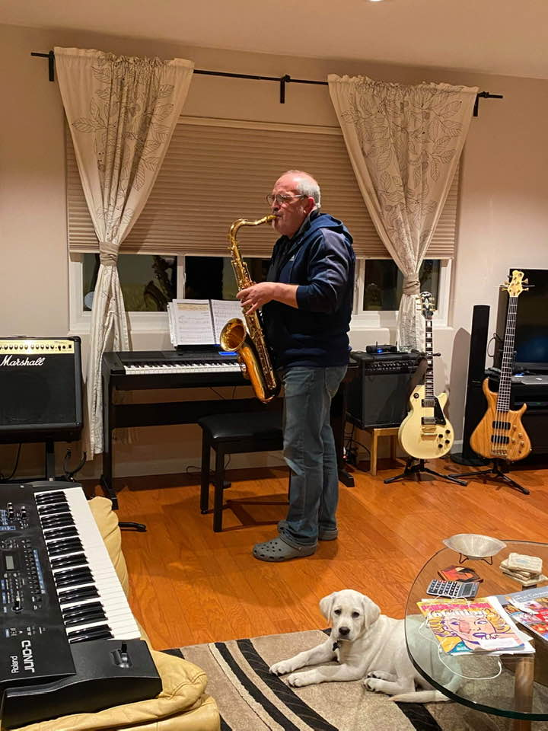

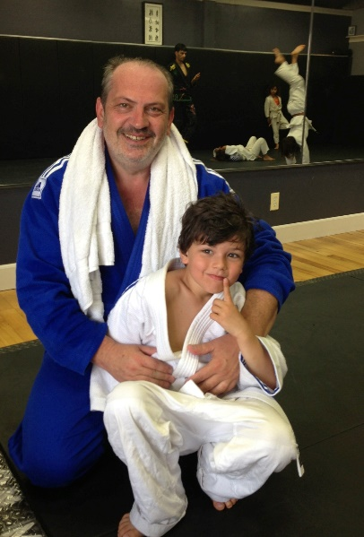
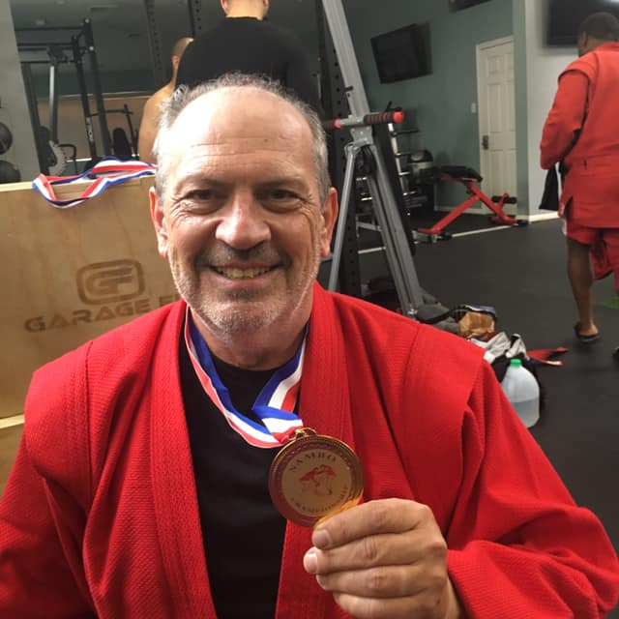
Your trainer- Igor Koutsenok, MD
Father of three
Addiction Psychiatrist
Professor of Psychiatry at the University of California San Diego
Chief of Prevention, Treatment and Rehabilitation at UNODC-Vienna (2013-2016)
MINT member since 2008
Facilitated more than 50 MI trainings and workshops in more than 15 countries
I love judo, playing jazz saxophone
Notes:
Paul

Slide 3
My personal goals in this training
To actually train you in Motivational Interviewing, not just to review the curriculum
To demonstrate a variety of training tools, techniques and strategies
To model MI consistent behavior for you
To mobilize your own experience in dealing with real challenging problems in your life to enhance learning of MI
To support your journey toward excellence in MI

Slide 4
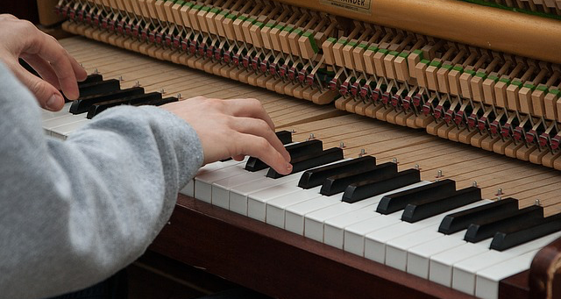
Why these goals?
Because learning MI is
very similar to learning
how to play a piano or
tennis.
Instructions are necessary and you will learn more ABOUT playing but will not help you play.
Practicing is critical and learning will be quicker if done with a coach

Slide 5
Goals of Your Work
What do you already use that works to motivate your clients?
What do you see others using that doesn't work?
Notes:
See Activity 1 (page 1).

Slide 6
Traditional Concepts about Motivation
People are either motivated or not
If they are not motivated, there is not much we can do
A client is motivated when he/she agrees with the staff/counselor
Confrontation is the best way to bring about change
Notes:
Let’s begin by talking about motivation…you are all motivated to be here, some for external reasons, some for internal reasons. Let’s talk about some assumptions people have had in the past regarding motivation.
Elicit from trainees any thoughts they have on motivation or how they have experienced seeing others try to motivate clients, only to have it backfire.

Slide 7
Myth :
“The patient must be ready for treatment, the patient has to be motivated for treatment. If he/she is not motivated, there is nothing we can do”

Slide 8
What the science tells us:
Working with patients’ motivation is one of the key clinical skills of the therapists, i.e. motivation is OUR problem, not the patient’s
The earlier we involve the client in any type of treatment the better chances we give the client to succeed

Slide 9
UNMOTIVATED IV DRUG USERS
Booth et al. University of Denver, 2002
  4,000 IV Drug Users in 15 cities
  Seeking HIV testing - Not Treatment
Randomly assigned to:
  HIV Testing Only
  HIV Testing PLUS MET Counseling
Six Month Follow-Up Results

Slide 10
Some Outcomes at Six Months (%)
Booth et al., 2012

Slide 11
Another study: Unmotivated Pregnant Drug Users
Svikis, J., et al. Johns Hopkins, 2004
246 Cocaine Abusing, Pregnant Women
Seeking Pre-Natal Care - Not Treatment
100 Received 2-Week Prenatal Care + Motivational Enhancement Treatment (Abstinence Focused)
146 Received - Standard Pre-Natal Care
Costs and Complications of Delivery

Slide 12
Cocaine Positive Urine at Delivery
146 Control Women
73%
100 Treated Women
*27%

Slide 13
Weight and Gestational Age
146 Control Women
2534 gms
34 wks
100 Treated Women
*2939 gms
*39 wks

Slide 14
NICU Stay and Costs
146 Control Women
39 days
$46,700
100 Treated Women
*7 days
*$14,500

Slide 15
I guess you would you agree with me that
Effective interventions in clients with a variety of dysfunctions is impossible without changes in the clint’s behavior?

Slide 16
If you agree, here is the $10 M question:
Why people don’t
just change?

Slide 17
You would think . . .
That having had a heart attack would be enough for someone to quit smoking and exercise more.
That hangovers, damaged relationships, would be enough to convince people to do something about their drinking or drug use
That being diagnosed with diabetes will be enough to someone to start a diet and medication
That time spent in the jail or prison would dissuade someone from re-offending
and sometimes it does . . . .

Slide 18
Yet so often it is not enough.
Why?
Notes:
18

Slide 19
Common believes why people do not change
The problem with them is ...
They don’t SEE the problem (denial, lack of insight)
They don’t KNOW HOW to change
They simply don’t CARE

Slide 20
So, if these explanations are true, there are simple solutions, and you don’t need this training
Give them INSIGHT and KNOWLEDGE, and they will change
Give them SKILLS how to change, and they will do it
Give them FEAR - make people feel afraid enough, give them orders, tell them to stop doing what is wrong.

Slide 21
Individual Exercise: Think About Your Own Change Process
Think about a problem behavior you have changed at some point in your life.
Notes:
Teaching Instruction: This initial exercise is introduced to prepare participants to engage in today’s presentations and practical application exercises. The exercise is to be completed individually as it asks for information and reflection of a personal nature. The exercise and brief follow-up should take approximately 30 minutes.
SAY: In order to promote competency in the skills discussed in Module 3, you will be asked to show your understanding through demonstrating key techniques and strategies of elements found in the four processes. Module 3 encourages active learning by inviting you to respond in challenging formats including role-play and question/answer exercises.
In preparation for future role plays during this training, we invite you to participate in an initial exercise titled Think About Your Own Change Process. It is found on Resource Page 3.1 in your Participant Manual. Your responses to the questions are confidential unless you wish to discuss them during a group review of the exercise. The questions are designed help you decide on a problem behavior to discuss when you role-play a client. This does not mean it has to be a personal behavior you yourself wish to change, but it should be a behavior that you do have a personal commitment to see a client/friend or family member change. For example, if you have lost an important person in your life to lung cancer, then you may well have a very powerful commitment to not smoking. It also is used to help you “put yourself in the shoes” of clients who often struggle with change. The written part of the exercise will take 20 minutes. We will then take 10 minutes for any voluntary responses you may have to the exercise. Let’s begin.
Teaching Instruction: Provide 5, and 2 minutes warnings. When the written portion of the task is done, invite participants to respond to the exercise in any way they wish.
ASK: Would anyone like to tell us what this experience was like for you? (Encourage responses as relevant. Thank all participants when the exercises is complete.)

Slide 22
Motivation is:
The probability for an individual to initiate and maintain a desirable behavioral change

Slide 23
Motivation is:
Fundamental to change
Very dynamic
Motivation can be external and/or internal (continuum)

Slide 24
What is ambivalence?
Ambivalence is having two contradictory thoughts about the same thing (“should I, or I should not…?)
Ambivalence is normal
Particularly sensitive to interpersonal interaction with helping practitioners and strongly influenced by their interpersonal style
Ambivalence is exactly the material that Motivational Interviewing works with
Most people know the solution even if they are reluctant to use it
Notes:
We often hear “I learned ‘active listening’ 40 years ago—this is nothing new.” Indeed, Miller was a student of Carl Rogers and empathic listening is the ground-work of M.I., but M.I. is quite distinct from active listening. One of the main differences is the focus on , what Miller and Rollnick call, Change Talk.
It looks easy watching someone else do it but many are surprised to find how difficult it is to actually do M.I.
It takes time and effort to learn but can be used very quickly with clients. Some people report that MI saves time and effort by evoking cooperation and collaboration rather than defensiveness and resistance.
MI is a tool for helping people change (e.g., high risk offenders). It has little effect on those who don’t need to change (low risk). They are already changing.

Slide 25

So, what does it take to make a transition from
Contemplation
To Action

Slide 26
What is Resistance/Discord?
Resistance to change is the Ambivalence Under Pressure
Resistance is a result of the interaction, not a symptom of any pathology

Slide 27
Difference between Ambivalence and Resistance/Discord
Ambivalence is a reflection of the interaction between the client and the PROBLEM
Resistance is a reflection of the interaction between the client and YOU

Slide 28
Question:
How do you handle clients’ resistance?
Notes:
These are some ways to roll with resistance. If we feel the “wrestle” come up, in MI this is a signal to interact in a different manner with the client.
Ask for some concrete examples of rolling with resistance that the trainees may have witnessed this week, whether in the training or on the job. Hint: Think about how you, as the trainer, may have rolled with resistance!

Slide 29
Let’s experience it
Please think about something real in your life that you:
  want to change
  need to change
  should change
  have been thinking about changing
But you haven’t changed yet
  i.e. – something you’re ambivalent about!

Slide 30
Counselors, please do ONLY the following
Listen what is the issue that the person has
Tell the client why he/she should make a change
Tell to the client at least 3 specific benefits of making this change
Tell the client how to change
Emphasize how important it is for them to make the change
Persuade the person to do it!
If no result – start over !
Notes:
See Activity 2A (page 1).

Slide 31
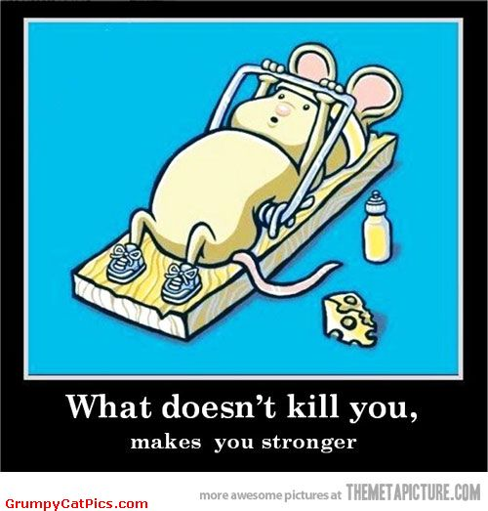
Traps that increase resistance
The Expert Trap
The Premature Focus Trap
Notes:
SAY: Disengagement has been described as the “communication of nonmutuality” (Miller and Rollnick, 2013). Here, the implied message to the client is that the clinician is the one in charge; the one with the answers to the client’s problems. This message creates the conditions for the client to become passive, dependent, and often to flee treatment. There are 6 common traps that promote disengagement with a potential client.
The Assessment Trap
The Expert Trap
The Premature Focus Trap
The Labeling Trap
The Blaming Trap
The Chat Trap (Miller and Rollnick. 2013)
Let’s take a look at each.
________________________________________________________________________________
W.R. Miller and S. Rollnick, Motivational Interviewing, Helping People Change, Third Edition. Chapter 6. Phase 1-Building Motivation for Change. The Guilford Press, NY, London 2013. www.guilford.com)

Slide 32
The Expert Trap
An “information-in-answer-out” expert role does not work well when the goal is one of personal change. One of the foundational tenets of MI is that you don’t have the solution for clients without their own expertise.
Notes:
SAY: Asking a series of closed-ended questions signals to the client that you are the one in charge. It also implies that there is an answer to your problem/s once all the questions are asked.
An “information-in-answer-out” expert role does not work well when the goal is one of personal change. One of the foundational tenets of MI is that you don’t have the solution for clients without their own expertise.

Slide 33
The Premature Focus Trap
The client becomes disengaged due to the clinician’s lack of listening to his or her real story.
A power struggle emerges about the proper topic for early discussion.
The client becomes a passive partner and typically does not return.
Notes:
SAY: This situation involves the clinician “honing in” on what the so-called real problem is without fully engaging the client to learn what his or her pressing concerns are.
This trap often involves the following consequences:
The client becomes disengaged due to the clinician’s lack of listening to his or her broader concerns.
A power struggle emerges about the proper topic for early discussion.
The client becomes a passive partner or does not return.

Slide 34
Part 2
Client
  “Something I’ve been thinking about changing is…”
Counselor
  Ask, and listen with interest. Give no advice:
  What do you think you will like about making this change?
  How might you go about it, in order to succeed?
  What are the three best reasons to do it?
  What will happen if you don’t make this change?
Summarize what you heard.
Ask: “What will you do next?”
Notes:
Participants will break into groups of 3 or 4 to experience a style of interaction that is more facilitative of behavior change than direct persuasion in most cases. The roleplay will last 5 minutes with 5 minutes to debrief. Most participants will report feelings of validation, clarification of their own thoughts about change, and empowerment to change. Some may report that they want information or advice in order to decide what to do.

Slide 35
What is Motivational Interviewing?
Motivational Interviewing is a collaborative, person-centered, and directive communication style to address the common problem of ambivalence and elicit and strengthen internal motivation for change.

Slide 36

MI: Spirit and general principles
What is the target behavior?
Empathy
Evocation
Emphasize personal choice
Roll with Resistance
Notes:
We have provided the following slides to demonstrate each concept. You could choose to ask audience members to come up with own examples.

Slide 37
Four Fundamental Processes
Planning-building commitment to change and plan of action
Evoking-eliciting the client’s own motivation for change (the hearth of MI)
Focusing – development of a specific direction in the conversation about change (target)
Engaging – the process of establishing a helpful connection and working relationship

Slide 38
Four Processes:
Engaging is about “How shall we travel together?”
Focusing asks “Where to?”
Evoking is about “Whether” and “Why” and
Planning is about “How” and “When”
Notes:
SAY: It may be helpful to clarify one point about client readiness. Some clients are ready to change their behaviors as soon as they enter treatment. They already have the motivation needed to pursue a goal of change. In this case the clinician does not need to apply MI, but simply use the knowledge and skills necessary to ensure the client has the knowledge, skills and supports necessary to achieve the stated goal.
Other clients will benefit from all of some of the processes offered by MI to achieve ‘client readiness’. Let’s take a quick look at the singular purpose of each of the four processes:
Engaging is about “How shall we travel together?”
Focusing asks “Where to?”
Evoking is about “Whether” and “Why” and
Planning is about “How” and “When”. (Miller and Rollnick, 2013)
The degree of ‘client readiness’ is determined by which set of questions the client is most responsive to – or ready to address. MI techniques and principles apply in all four processes. What differs is the purpose of their application.
___________________________________________________________________________
W.R. Miller and S. Rollnick, Motivational Interviewing, Helping People Change, Third Edition. Chapter 20. Developing a Change Plan. The Guilford Press, NY, London 2013. www.guilford.com)

Slide 39
Giving advise and information
Sometimes necessary
If unsolicited – always leads to defensiveness
Offer advise or information with permission
A helpful strategy – EPE (elicit-provide-elicit)

Slide 40
Effectiveness of MI
Shown to work in:
  Addictions
  Gambling
  Medication adherence
  Diet and exercise
  Co-occurring disorders
  Eating disorders
  Adults and youth in criminal justice system
Notes:
Selected Bibliography:
Bender, K., Springer, D. W., & Kim, J. S. (2006). Treatment effectiveness with dually diagnosed adolescents: A systematic review. Brief Treatment and Crisis Intervention, 6, 177-189.
Feldstein, S. W., & Ginsburg, J. I. D. (2006). Motivational interviewing with dually diagnosed adolescents in juvenile justice settings. Brief Treatment and Crisis Intervention, 6, 218-231.
Hettema, J., Steele, J., & Miller, W. R. (2005). Motivational interviewing. Annual Review of Clinical Psychology, 1, 91-111.
Sinha, R. Easton, C., Renee-Aubin, L, & Carroll, K. M. (2003). Engaging young probation-referred marijuana-abusing individuals in treatment: A pilot trial. The American Journal of Addictions, 12, 314-323.
Stein, L. A. R., et al. (2006). Enhancing substance abuse treatment engagement in incarcerated adolescents. Psychological Services, 3, 25-34.

Slide 41
Myths about MI
I (we) already do it
It is easy
It can be learned in a workshop
It takes more time
It won’t work on high risk or difficult clients
Notes:
We often hear “I learned ‘active listening’ 40 years ago—this is nothing new.” Indeed, Miller was a student of Carl Rogers and empathic listening is the ground-work of M.I., but M.I. is quite distinct from active listening. One of the main differences is the focus on , what Miller and Rollnick call, Change Talk.
It looks easy watching someone else do it but many are surprised to find how difficult it is to actually do M.I.
It takes time and effort to learn but can be used very quickly with clients. Some people report that MI saves time and effort by evoking cooperation and collaboration rather than defensiveness and resistance.
MI is a tool for helping people change (e.g., high risk offenders). It has little effect on those who don’t need to change (low risk). They are already changing.

Slide 42
How do we Roll with Resistance?
Avoid arguing for change (you will really have a hard time arguing with me if I do not argue with you)
Resistance is a signal to respond differently - Shift the direction
Listen and reflect
Notes:
These are some ways to roll with resistance. If we feel the “wrestle” come up, in MI this is a signal to interact in a different manner with the client.
Ask for some concrete examples of rolling with resistance that the trainees may have witnessed this week, whether in the training or on the job. Hint: Think about how you, as the trainer, may have rolled with resistance!

Slide 43
Expressing Empathy:
Reflective Listening:
1) Getting into the client’s shoes
2) They know that you know
Notes:
We will spend the whole morning working on reflective listening skills, which are essential to MI.
Discuss that demonstrating empathy is usually done through reflective listening. Empathy involves two aspects: 1) that the listener gets into the other’s shoes, i.e. understands what the client is thinking/feeling and 2) that the client knows that the listener knows.

Slide 44
Empathy
Empathy is not:
  Having had the same experience or problem
  Identification with your client
  “Let me tell you my story”
Empathy is:
  The ability to accurately understand your client’s meaning
  The ability to reflect that accurate understanding back to your client

Slide 45
Empathy
Empathy is similar to gas in your car – it does not define where will you go, which route will you take, when will you take off or stop.
But you certainly are not going anywhere without it.

Slide 46

Fundamental MI Skills
OARS
Open-ended questions
Affirmation
Reflective listening
Summarize
Notes:
Open-ended questions
Affirmations
Reflections
Summaries
These are all considered “opening strategies” to understand the client’s perspective.

Slide 47
Closed Questions
Open Questions
Invite a short answer (not only Yes/No)
  Did you drink this week?
Ask for specific information
  What is your address?
Might be multiple choice
  What do you plan to do: Quit, cut down, or keep on smoking?
They limit the client’s answer options
Open the door, encourage client to talk
Encourage elaboration and discussion
Leave broad latitude for how to respond
Both are needed and important, they just serve different purposes

Slide 48
Open ended Close ended
Begin with “What,”“How,”“Tell me about,”“Describe,” etc.
What do you think will be some of the things that might be problematic?
How are you managing your cravings now?
Tell me about your experiences in…
Describe your living situation.
Begin with “Have/Had/Has,” “Which,”“How many,”“Did/Do/ Does,”“Is/Are,”“When.”
Is not following the prescribed regiment going to be hard for you?
Have you had any problems? How many times did you do ^{that?}
When was the last time you had this problem?
Do you like where you are living now?

Slide 49
The “Dead” Questions
“Why don’t you ______?”
Why can’t you _______?”
“Why haven’t you change?”
“What keeps you doing this?”
“Why do you have to smoke?”
“What were you thinking when you messed up?”
“Why aren’t you trying harder?”
“What are the three best reasons for you to drop out of this program?”
“What’s the matter with you?”

Slide 50
Large-group Exercise: Open-ended Questions
A 36-year-old man tells you:
“My neighbor really makes me mad. He’s always over here bothering us and wants to have a drink. I am in recovery and I feel like I am about to relapse. Sometimes he calls us late at night after we’ve gone to bed, and I really feel like telling him to get lost.”
Please turn away from the screen
Notes:
Teaching Instruction: This activity allows participants a chance to practice formulating open-ended questions from closed ones. It also is an energizer and fun. This activity has participants forming two large circles and competing to successfully reword a list of closed questions into open-ended questions. The trainer/co-trainer will act as time-keeper and determine if an answer qualifies as successful. The first circle to successfully complete the list of questions is announced “Winner of the Open-Ended Questions” After the exercise the facilitator will refer participants to Resource Page 3.2. titled How to Ask Open-ended Questions in their Participant Manuals. Allow not more than 30 minutes for this activity.
SAY: Let’s take some time to practice formulating open-ended questions. I will read a list of closed questions and you will respond with an open-ended question. Sounds easy yes? Except there is a twist. We will form two teams. Each team will form a circle. As the team leaders shout out a closed question, they will throw a ball to someone who in turn has 5 seconds to answer. If correct, a new closed question – and the ball - will be shouted out to another person in the circle. If incorrect, the ball is thrown to a new participant until a correct open-ended response is offered. The first circle to reword all closed questions successfully becomes “Winner of the Open-Ended Questions” . Let the game begin.
Please form two circles.
Choose a team leader. (Once this is done each team leader is given a list of closed questions)
The Trainer will keep time (5 seconds per question per person) and determine if responses are successful or not.
Let the game begin.
Teaching Instruction: Congratulate the winning team and thank all for participating. Refer participants to Resource Page 3.2. titled How to Ask Open-ended Questions in their Participant Manuals. See below for the list of closed questions used in this exercise:
So you are here because you are concerned about your use of alcohol, correct?
How many children do you have?
Do you agree that it would be a good idea for you to go through detoxification?
First, I’d like you to tell me some about your marijuana use. On a typical day, how much do you smoke?
Do you like to smoke?
How has your drug use been this week, compared to last: more, less, or about the same?
Do you think you use amphetamines too often?
How long ago did you have your last drink?
Are you sure that your probation officer told you that it’s only cocaine he is concerned about in your urine screens?
When do you plan to quit drinking?

Slide 51
Snap-closed ended, clap-open ended
Why don’t you just tell him to leave you alone?
Are you going to confront him?
How often does he do that?
Is he drunk when he calls?
Why do you think he does these things?
Do you feel like hurting him?
Have you ever talked to him about your recovery?
Can you think of a time when he did behave better?
Does it happen often?
What else might you do besides telling him off?
What do you think you might do that will help?
On a scale of one to ten, how mad does he make you?
Why are you telling me this?
Don’t you think it’s time you tried something different?
Does he remind you of anyone else?

Slide 52
Open Questions Practice
Convert the closed questions below to open ones. Remember there are many possible responses. Be creative. Come up with at least three open questions for each example. You want your questions to elicit what the patient knows, wants, believes, thinks, and feels. It is usually wise to avoid asking why questions, as they tend to have an accusatory or demanding tone, and thus put people on the defensive.
How many times have you used meth in the past six months?
Is there some reason you can’t come to the next appointment?
You know your smoking puts your kids at risk for getting asthma? Right?

Slide 53
Supporting Self-Efficacy: Affirmations
Acknowledgement of…
  Struggles or difficulties
  Successes
  Skills and/or strengths
  Goals and values
  Notice and appreciate a positive action − “Catch them doing something right”
Notes:
Affirmations are when we notice and comment on strengths or characteristics of clients.

Slide 54
Affirmations Include…
Commenting positively on an attribute
  You’re a strong person, a real survivor.
A statement of appreciation
  I appreciate your openness and honesty.
Catch the person doing something right
  Thanks for doing that today!
A compliment
  I like the way you said that.
An expression of hope, caring, or support
  I hope this weekend goes well for you!
Notes:
Allow time to read. Comments or questions.
What do trainees think of the difference between the statements that started with “you” and the ones that started with “I”? Most people comment that affirmations that start with “you” seem stronger.

Slide 55
Forming Affirmations Practice
Think of a friend, relative, client, or patient that you know. Write down the various strengths, virtues, and positive qualities you see in this person.
Provide several affirmations that you might offer to this person related to particular strengths or qualities that you identified. For example:
- That took a lot of courage to...
- You’re a very resourceful person.
- You showed a lot of patience when...
- You put in many hours of hard work to achieve...

Slide 56
“I'm sick of this, everything just keeps getting messed up. I do good for a week and then the other guys start getting on my nerves, talking about my family. I go to that program, I'm learning stuff. I think it's helping and then the same day I get into a huge fight and end up in lockdown. Staff doesn't like me, I can't do anything right. They're always on my case. I don't know what you all want from me. I'm just trying to get by in here. It's not as easy as you make it sound.”

Slide 57
Expressing Empathy:
Reflective Listening
Notes:
We will spend the whole morning working on reflective listening skills, which are essential to MI.
Discuss that demonstrating empathy is usually done through reflective listening. Empathy involves two aspects: 1) that the listener gets into the other’s shoes, i.e. understands what the client is thinking/feeling and 2) that the client knows that the listener knows.

Slide 58
Reflective Listening
Good listening is fundamental to MI.
Reflective listening is a basic skill used in all four processes of MI.
Behind the discipline of good listening is a trust that helps clients explore their own experiences and perceptions – even those that may be uncomfortable.
Notes:
SAY: Good listening is fundamental to MI. Reflective listening is a basic skill used in all four processes of MI. Behind the discipline of good listening is a trust that helps clients explore their own experiences and perceptions – even those that may be uncomfortable.
Remember, the more you listen, the greater an opportunity for the client to speak. The more the client speaks, the greater the chances for talking oneself into change.

Slide 59

The Accuracy Function
of Reflection
Bridge the gap by reflection
What the
speaker means
What the listener
thinks the speaker means
1
4
What the
listener hears
2
3
What the
speaker says
SPEAKER
LISTENER
R
Notes:
Reflective listening is a way to make sure we, as listeners, understood what the speaker meant…and the speaker knows this.

Slide 60
Why the Emphasis on Reflection?
Research
  Get more and more valid info with reflections than with questions
Questions
  People do NOT feel listened to with questions
  Agenda is “listener’s” not speaker’s
Reflections
  Speaker feels listened to and heard and cared about
  Therefore, willing to disclose more and better info
  Speaks about what’s on his or her mind rather than answering what is on listener’s mind
  Less lying
Notes:
Ask participants to read.
Emphasize: “Speaker feels listened to, HEARD, and CARED about.”
Ask, “Why less lying?” Add the following if not forthcoming: 1) People lie in generalities, less in detail—it is easier to lie in response to closed questions. 2) people less likely to lie to someone who is listening, hearing and caring.

Slide 61
Reflective Listening
Always a statement, not a question.
Drop voice at end of sentence.
Can choose to reflect content or feelings
Examples of stems:
  “It sounds like you….”
  “You are feeling….”
  “You’re wondering if…”
Notes:
Provide some examples of the same sentence said with the voice raised at the end , and lowered. Both are the same sentence but are experienced completely different by the listener:
“You think that this is something that might be useful?”
“You think that this is something that might be useful.”
Reflective listening is about listening to the client and responding to what they said, meant, thought, etc. in a statement.

Slide 62
Different messages with questions vs. statements
“You’re feeling uncomfortable?” vs.
“You’re feeling uncomfortable”
“Don’t you think this is a problem? vs.
“You don’t think this is a problem”
“Are you considering a divorce?” vs.
“You are considering a divorce”

Slide 63

Levels of Reflection
Simple Reflections
  Repetition
  Rephrase
Complex Reflections
  Paraphrase
  Double-sided
  Amplified
  Reflection of feeling
  Metaphor

Slide 64
It is time for some laughter

Slide 65

How do we Roll with Resistance?
Avoid arguing for change
Avoid meeting resistance with resistance
Shift direction of the momentum
Resistance is a signal to respond differently
Notes:
These are some ways to roll with resistance. If we feel the “wrestle” come up, in MI this is a signal to interact in a different manner with the client.
Ask for some concrete examples of rolling with resistance that the trainees may have witnessed this week, whether in the training or on the job. Hint: Think about how you, as the trainer, may have rolled with resistance!

Slide 66
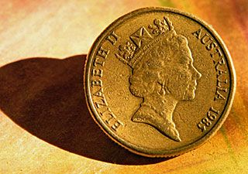
Reflective Responses for Resistance
(SAD)
Simple reflection
Amplified reflection
Double-sided reflection
Notes:
Ways to respond to resistance: SAD (Y=clients, S=Staff)
Simple reflection : Tells the client that you understand the meaning of his or her words.
Y: I don’t really have an alcohol problem. I just drink cause everyone else does.
S: You drink to be part of your friends.
Y: I smoke because I smoke. There is no particular mood or event that led to smoking for me.
S: There’s no pattern to your smoking; you smoke because you choose to smoke.
Amplified refection : Taking what the client has said and adding a bit; exaggerating what they have said in an effort to raise awareness of the need for change or build discrepancy.
Y: I don’t have a problem unless my friends come by to party. They don’t have to work so they can stay out all night.
S: So you can make your own choices except when these friends make you party.
Y: I doubt that there is a problem at school. I don’t have difficulties doing my school work.
S: As long as your work is getting done, everything is OK then.
Double-sided reflection : Taking what the client has said and stating both sides of the argument for and against change.
Y: I hate taking that medication! It makes my mouth dry and all I want to do is eat.
S: You are against the medication because of the side effects and you know that you need it to keep from getting the depression symptoms back which are even worse.
Y: I really don’t see how I could begin a counseling program now with my new baby and all.
S: So on the one hand you are really busy and you’d really like to be a good mom for your baby by working on some of your anger issues with a counselor.

Slide 67
I don’t want to be in this stupid substance abuse program! I don’t have a drug problem. The juduge told me I had to do this program to go home. I really want to go home and be good. I can stop drinking and smoking weed when I want to; it’s not a problem for me. I have not done any drugs since I have been locked up.

Slide 68
Work is boring and I don’t want to go anymore. It’s a waste of my time and I’m not learning anything. My boss is stupid. He gives me the dirtiest jobs just because I’m the new guy. I am really smart and they are boring me. When I get out of treatment I want to get a job and I am smart enough to fill out an application without help. I will do fine finding a job where I can learn something. I realize that I have to help my family with support when I get out. That’s what is really important to me.

Slide 69
Every time I come to a case conference, all you ever do is ask me if I still hang out with my using friends. My friends gave me support when my family was not around. My friends are good people. We only use drugs sometimes; it’s not as bad as you think. Plus it’s too hard to leave your longtime friends. I like this journal stuff on values; it reminds me of when I had family and support around. I would like to live like that again. I know that my family still cares about me, but I have my friends now and we look out for each other. I’m really torn between my family and my friends

Slide 70
Practicing Reflections
Read the sentence stem and come up with at least three different responses to each item. Each should emphasize a different aspect of the statement. Example:
It’s been fun, but something has got to give. I just can’t go on like this anymore.
- You’ve enjoyed yourself.
- You’re worried about what might happen.
- It’s time for a change.

Slide 71
I know I could do some things differently, but if she would just back off, then the situation would be a whole lot less tense; then these things wouldn’t happen.
I’ve been depressed lately. I keep trying things other than drinking to help myself feel better, but nothing seems to work, except having a couple of drinks.
So, I’m not too worried, but it’s been over a year since I’ve had an HIV test.
I know I’m not perfect, but why do they have to always tell me what to do. I’m not 3!
I might have a problem, but who are you to be giving me advice. What do you know about drugs? I bet you’ve never even done any!
I don’t think I have a drinking problem. It’s just that my partner is overly sensitive because her dad was an alcoholic.

Slide 72
Practice
1. Personal change(reflections only w/chips)

Slide 73
Exercise: The value of reflections
Groups of 3 (interviewer – speaker - observer)
Interviewer: using OARS, assist the patient in resolving his/her ambivalence
Each question will cost you a chip
For each reflection you will earn a chip
The interview is over when you accomplish the goal or run out of money
Discuss what was difficult or challenging

Slide 74
Listen for What?
Recognizing,
Reinforcing, and Eliciting
Change Talk
Notes:
Change talk is one of the key concepts of MI. We will be practicing how to recognize it when we hear it and then how to reinforce it. If we don’t hear it, we can still elicit it from the client.

Slide 75
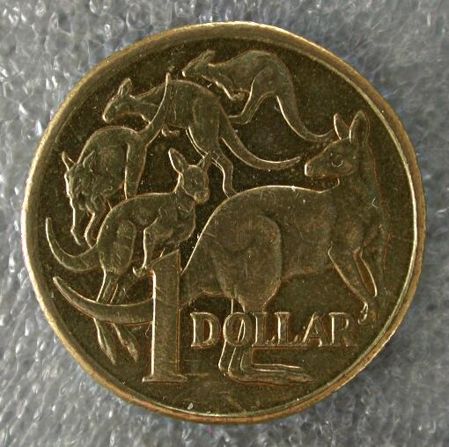
Change Talk and Sustain Talk
Opposite Sides of a Coin

Slide 76
Change Talk
Change talk is any client speech that favors movement in the direction of change
Previously called “self-motivational statements” (Miller & Rollnick, 1991)
Change talk is by definition linked to a particular behavior change goal

Slide 77
3 Magic Skills in Dancing With Change Talk
Recognize it Respond Evoke + Invite
Notes:
Paul

Slide 78

Change Talk
DESIRE to change (want, like, wish . . )
ABILITY to change (can, could . . )
REASONS to change (if . . then)
NEED to change (need, have to, got to . .)
Commitment
Activation
Taking steps
DARN CATs

Slide 79
Let’s learn how to recognize change talk

Slide 80
Recognize Change Talk Practice
Example: I really don’t want to stop smoking, but I know that I should. I’ve tried before and it’s really hard.
Options:
A. You really don’t want to quit.
B. It’s pretty clear to you that you ought to quit.
C. You’re not sure if you can quit.
(Option B is the reflection that reinforces the change talk.)

Slide 81
1. I don’t drink any more than most people I know. Sure, I sometimes feel a little foggy the next day, but it wears off quick. It’s no big deal.
2. Sure, I want my kids back, and I want to be a good mother, but the court’s making it impossible. There’s no way I can do all those things they’re making me do.
3. Last time I tried to quit smoking, I was really bad to be around for 5 days. I was just going off on everybody. But, then, after that I was pretty cool and then after 2 weeks, I was able to be cool all the time. But, I can’t be losing my cool with people for 5 days you know. In my situation, if I go off on the wrong people, it could be bad man, real bad.
4. Hey, I can’t go inpatient. If I’ve got to go someplace, why can’t I go to AA or something? If I go inpatient for 28 days, I’m going to lose my job, plus a lot of other bad stuff. You understand what I’m saying.
5. When you take that first hit man, there’s no feeling like it. At that moment, you just don’t care about all the bad stuff drugs do to your life; it’s just this amazing rush and nothing else matters.
6. Yeah, I was going to night classes. I went every day, did my homework and I admit, I was feeling good about that. But, it’s gotten just too hard, you know, it’s causing me to be tired at work, and even though my wife says she’s for me finishing, I can tell she is getting tired of having the extra burden with the kids and all. Man, I would like to have that certificate, though.
7. I have no time to go to counseling. I really hate that I’m so much more impatient with my kids than I used to be because I’m so miserable. But, I can’t leave them alone. I don’t trust anyone else to take care of them the way I do.

Slide 82
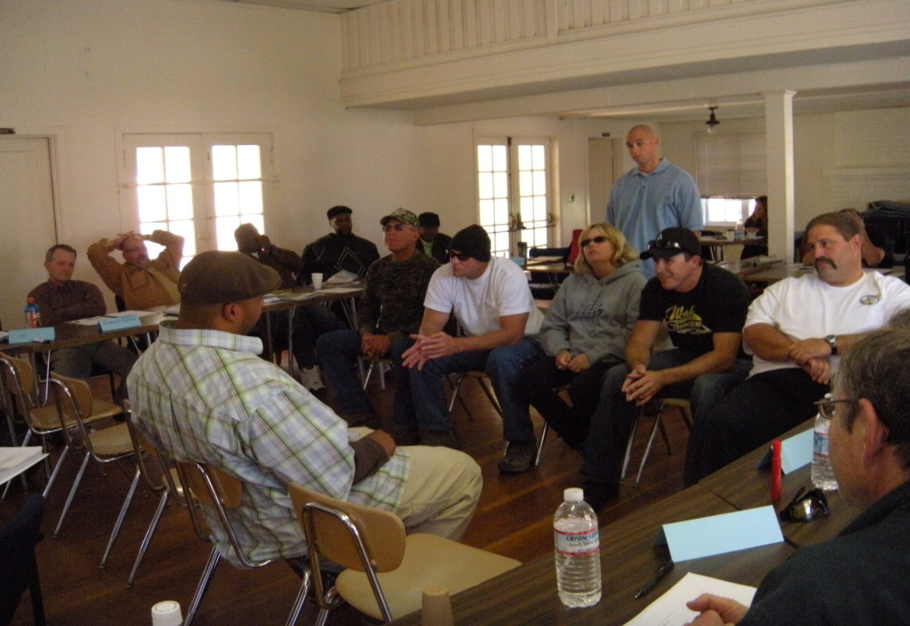
Strategies for Eliciting Change Talk
Elaboration Questions
Affirmations
Reflections
Summaries
Importance/Readiness Ruler
Querying Extremes
Looking back/Looking forward
Evocative Questions
Decisional Balance
Values and Goals
Notes:
These are some ways to elicit change talk. The next four slides provide examples of elaboration questions for DARN.
The Importance/ Readiness Ruler and Decisional Balance will be demonstrated.
Querying extremes examples are:
“What would be the worst thing that would happen if you stayed in your gang?”
“If you were to go back to school, what would be the best thing that would come out of it?”
Looking back/Looking forward:
“When you look back on your life, think of a time when you were happy. What was that like for you?
“When you look down the road, if you keep using drugs, what do you think your life will be like?”
Evocative questions:
“If you were to make this change, how would you go about it?”
“What would be the first step you would take to denounce your gang?”
Values and goals: Helping the client think about what is important to him or her and connecting it to desired behavior.
“What would it mean for you to be a good mom? What would you have to do?” “How would drug use fit in to that?”

Slide 83
Responding to Change Talk
Elaborating questions – asking for:
  more detail
  in what ways
  specific examples
Affirming – commenting positively on the person’s statement or ability to accomplish the change
Reflecting – attending to change elements
Summarizing – collecting bouquets of change talk
Notes:
We respond to each type of language a little differently. Change talk we want to encourage so we use the following techniques when we hear it.

Slide 84
Evoking Change Talk
Desire: If you made these changes what would your life be like?
Why not stay just as you are now?
Ability: How confident are you that if you decided to, you could stop drinking?
Which choice is the most likely one for you right now?
Reasons: What are your arguments to get sober? What are your arguments to keep going as your are?
Needs: What do you have to do?
Is there anything you must do no matter what?
Notes:
SAY: In MI we find that people in general tend to become more committed to what they hear themselves saying. Listening for and supporting change talk helps clients recognize and resolve ambivalence enough to progress towards change.
ASK: But how exactly does a clinician evoke change talk, making it more likely to occur?
SAY: There are several strategies.
The simplest one is to ask for it using open-ended questions. By using the preparatory change talk subtypes – desire, ability, reasons, and need – you can begin to help your client generate some ideas. Let’ look at some examples of each:
Desire: If you made these changes what would your life be like?
Why not stay just as you are now?
Ability: How confident are you that if you decided to, you could stop drinking?
Which choice is the most likely one for you right now?
Reasons: What are your arguments to get sober?
What are your arguments to keep going as your are?
Needs: What do you have to do?
Is there anything you must do no matter what?

Slide 85
Evoking Change Talk: Querying Extremes
Useful with clients who seem to have little interest in change at present.
Involves asking clients to describe the worst or best consequences of change vs. no change. For example:
  “What if you just go on as you have been, what do you think the worst thing can happen?”
Conversely,
  “Imaging for a second that you succeeded in changing you ____________. What good things could come out of that?”
Notes:
SAY: Querying extremes can be helpful with clients who seem to have little interest in change at present. This involves asking clients to describe the worst or best consequences of change vs. no change. For example:
“What if you just go on as you have been, what do you think the worst thing can happen?” Conversely,
“Imaging for a second that you succeeded in changing your ___________________________________. What good things could come out of that?”
Querying extremes allows clients to come up with their own scenarios to describe the consequences for change versus maintaining the status quo.

Slide 86
Evoking Change Talk: Looking Back / Looking Forward
Looking back engages the client in remembering times before the problem emerged. For example:
  Can you describe what it was like when you weren’t using? How was it different from now?
Looking forward serves to elicit change talk in asking the client to imagine life after a change or with no change. For example:
  I hear that things are getting out of hand for you. How would you like things to be?
Notes:
SAY: Looking back engages the client in remembering times before the problem emerged. It serves to highlight both the discrepancy of things in the present and the possibility that the future can be better. Such questions may look like this:
Can you describe what it was like when you weren’t using? How was it different from now?
How have you changed from 10 years ago?
Looking forward serves to elicit change talk in asking the client to imagine life after a change. This could elicit a client’s hopes. Conversely it can be structured to ask the client to think about the future if no change occurs. It serves to highlight both the discrepancy of things in the present and the possibility that the future can be better. Such questions may look like this:
I hear that things are getting out of hand for you. How would you like things to be?
How do you think things will be for you a year from now if you keep doing what you’re doing now?
Note: In western culture time is linear in many other cultures it is cyclical, so in that case use the concept of the “next season “ or something similar for “future”.

Slide 87
Evoking Change Talk: Exploring Goals and Values
The process of “engaging” introduced us to the importance of goals and values.
Exploring what matters most to someone is helpful in developing rapport increasing the possibility of change talk to occur.
In the process of evoking, change talk and motivation arise from the inconsistency between the client’s current status or behavior and his or her chosen values and goals.
Notes:
SAY: When we introduced you to the process of “engaging”, we discussed the importance of understanding a client’s goals and values. In the process of evoking, exploring what matters most to someone is helpful in developing rapport increasing the possibility of change talk to occur.
In the process of evoking, change talk and motivation arise from the inconsistency between the client’s current status or behavior and his or her chosen values and goals. Because values often speak to one’s ideals, they may serve to point out discrepancy’s in one’s values and their behaviors. This is fodder for change talk.

Slide 88
IMPORTANCE RULER
0 |  |  |  | 10
Not important at all |  |  |  | Most important
“On a scale of 1 (not at all important) to 10 (extremely important) how important would you say it is for you to _____________________________________?
“Why are you at ____ and not 0 (or a lower number)?”
“What would it take for you to move from _____ to a higher number?”
“How confident are you that you could make the change if you decided to?”
Notes:
SAY: Another strategy is using the Importance Ruler. In Module 2 you became familiar with the concept of using a scale or ruler to rate the level of importance or degree of readiness a client has with any particular idea or action. The Readiness Ruler is another version of the Importance Ruler. It asks the degree of readiness or willingness a client is to do a task.
The Importance Ruler has been used in MI since 1999. (Butler, Rollnick, Cohen, Russell, Bachmann, and Stott, 1999). It typically uses an imaginary scale running from 0 to 10 with 0 being “not at all important” and 10 being “most important”. Asking a client how important something is to him or her can be quite evocative. For instance, to directly ask someone how confident, how ready, or how important something is may be perceived as pressuring them. Using rulers or scales, like giving advice, can be helpful in getting a conversation going, but should be used sparingly. The first question the clinician will ask is:
“On a scale of 1 (not at all important) to 10 (extremely important) how important would you say it is for you to ___________________________? “
This gives some information though limited. The value for change talk comes with the follow-up question about the number the person chose:
“Why are you at _____ and not 0 (or a lower number)?” Note that this could seem judgmental if the clinician asked the opposite question, i.e. “ Why are you at 6 and not 10?” The former question is most likely to evoke change talk – the reasons why change is important. A third question is:
“What would it take for you to move from ______ to a higher number?” You might also ask, “How confident are you that you could make the change if you decided to?” ((Miller and Rollnick, 2013)
Remember, the follow-up questions are the richest source for eliciting change talk.
______________________________________________________________________________
Butler, C.C., Rollnick, S., Cohen,D., Russell,I., Bachmann, M. and Stott, N. Motivational consulting versus brief advice for smokers in general practice: A randomized trial. British journal of General Practice, 49. 1999.
W.R. Miller and S. Rollnick, Motivational Interviewing, Helping People Change, Third Edition; Chapter 13: Evoking the Person’s Own Motivation. The Guilford Press, NY, London 2013. www.guilford.com)

Slide 89
Decisional Balance
What will I gain if I don’t make this change? | What will I lose if I don’t make this change?
What will I lose if I make this change? | What will I gain from making this change?
1
3
2
4
Notes:
Demonstrate this activity by asking for one volunteer. Ask him or her to state a behavior that he or she is thinking of changing (that is not too personal). Draw this box on a large sheet of paper. Going in the order listed, ask the person the question in each box, filling in a few short responses. When you are done, provide a summary, again in the order listed. Emphasize that it is important to follow the order, as you are being strategic in what you want your client to hear last.
See Activity 18B “Decisional Balance”

Slide 90
Summaries:
Collect material already offered
  So far you’ve expressed concern about your family, getting a job, and staying clean…
  What else?
Link something just said with something discussed earlier
  That sounds a bit like what you told me about that lonely feeling you get when no one comes to see you.
Transition: Draw together what has happened and transition to a new task
  Let me summarize what you’ve told me so far. You came in because you were …, and it scared you when . . . Then you mentioned… and now…
  …Where does that leave you?
Notes:
Summaries can be used in a variety of ways. One of the metaphors is that a summary can be like a bouquet of flowers in that it collects various statements the client has said, to present him or her with something more powerful than a single flower. Hearing oneself speak and then to have the words reflected back in a specific manner can in and of itself begin to create change.

Slide 91
Large-group Exercise: Summarizing
“Yes, I know that I should have stayed with the children instead of going over to my friends house to party. But it wasn’t for such a long time. I don’t remember drinking that much. And anyway, that was nothing compared to getting locked out of my own house. When my wife got home she was so angry the kids were alone and was at my friends. I don’t know what she’s going to do next. At least my friend was there for me and let me stay with him. He was a life-saver.”
Develop a summarizing statement and share it with the group.
Notes:
Teaching Instruction: The facilitator will ask for volunteers to offer a summary statement for the following client statement:
“Yes, I know that I should have stayed with the children instead of going over to my friend’s house to party. But it wasn’t for such a long time. I don’t remember drinking that much. And anyway, that was nothing compared to getting locked out of my own house. When my wife got home she was so angry the kids were alone and was with my friends. I don’t know what she’s going to do next. At least my friend was there for me and let me stay with him. He was a life-saver.”
Allow about 15 minutes for entire activity.
SAY: Please read the client statement on the slide above and develop a summarizing statement to share with the group. Please raise your hand when you are ready to volunteer your summary.
Teaching Instruction: The facilitator will list responses on the poster wall for all to see. When reviewing responses, the facilitator will use the following example to inform participants of a recommended formatting of a summary if appropriate:
“It sounds like you are concerned about your drinking because it is causing you to not be there for your kids sometimes and is really angering your wife and you don’t know how she’ll react if this happens again. You also seemed to think quitting will probably mean not associating with your friends any more. That doesn’t sound like an easy choice.”

Slide 92
Signs of Readiness
Decreased resistance
Decreased discussion about the problem
More conversations about ways to approach change
More change talk
Questions about change
Envisioning
Experimenting
Notes:
When we see these signs in clients, it means they are getting ready to think about making a commitment to a change. Envisioning means they are making statements about the changed behavior, like, “When I get a job” or “When I renounce my gang…”
Experimenting means that they begin to try out some of the new behaviors.

Slide 93
Change Plans
What are your goals?
What steps do you need to take to reach these goals?
What will it look like when you have reached your goals?
Who can help you with your plan?
Notes:
These are some questions you could ask a client who is thinking of making a change.

Slide 94
Committing to a Plan
Goal setting
  “Sounds like your goal is ____”
Steps and resources
  “You mentioned some steps before—which might be the first?”
  “You probably have a start-date in mind.”
  “I’m guessing you have some resources in mind.”
Solidifying commitment
  “Sounds like you are committed to making this happen.”
  “You probably have thought of ways to keep this as a priority—to follow-through and not put it off.”
Writing it down
Notes:
These are some ways to reinforce behavior changes.

Slide 95
Putting it all together:
Integration of Skills Activities
Notes:
See Activities 19 A (Vignettes Role Play) and 19B (5 Chair Activity).

Slide 96
Developing a
Change Plan and
Consolidating Commitment

Slide 97
Four Fundamental Processes
Planning-building commitment to change and plan of action
Evoking-eliciting the client’s own motivation for change (the hearth of MI)
Focusing – development of a specific direction in the conversation about change (target)
Engaging – the process of establishing a helpful connection and working relationship

Slide 98
End of the Training
Feedback regarding today:
One thing I found interesting was…
One thing I found surprising was…

Slide 99
If you have more questions…
ikoutzenok@ucsd.edu

Slide 100

Thank you for your hard work!

