Slide 1

School Prevention Program for the use of Substances
How is school prevention adapted in times of COVID-19?
Azucena Avalos J, Psychologist, MSc

Slide 2
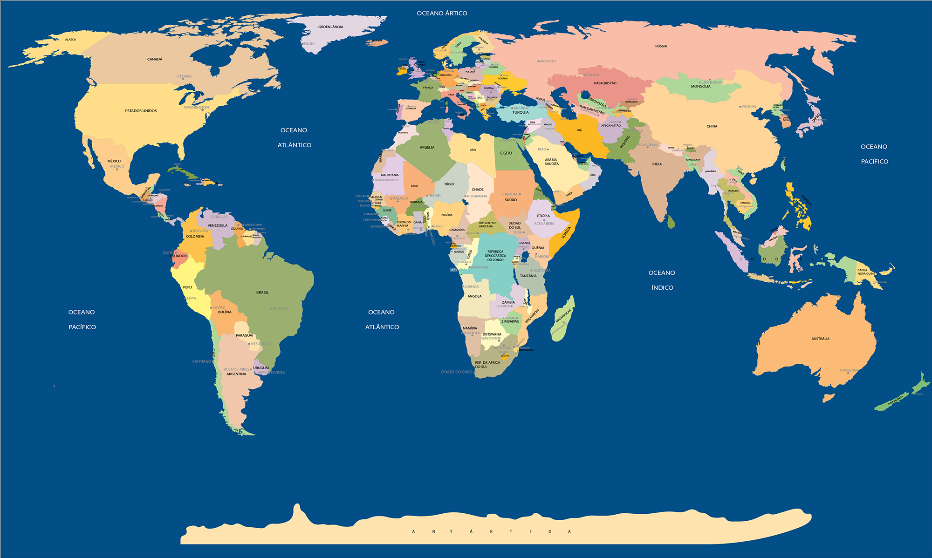

Slide 3


This presentation is based on the experiences and lessons learned in the Project: “A Demonstration Project to Apply the Principles and Practices of the Universal Prevention Curriculum (UPC) to Schools in Peru” that is possible thanks to the Federal Assistance Award from the State Department of the United States of America (SPE50018CA0001) and the Drug Advisory Program of the Colombo Plan which is supported by the Bureau of International Narcotics and Law Enforcement Affairs (INL)

Slide 4
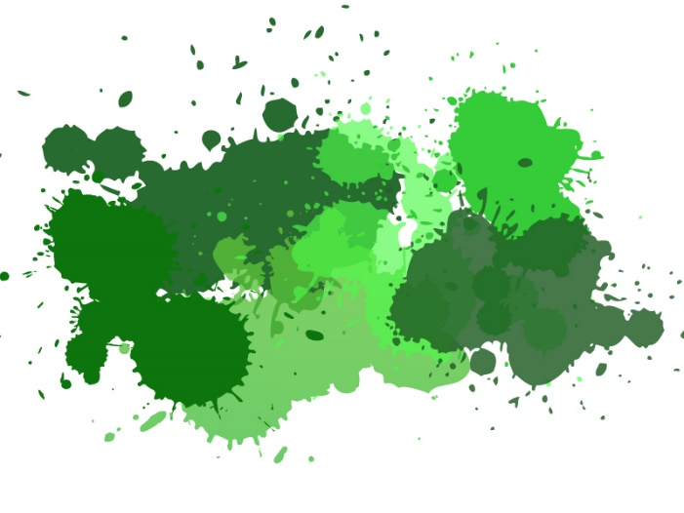
Definition of prevention
Prevention is the application of prevention science to address the health and safety of individuals through improving socialization processes to enhance self-realization and participation in society.
                IS SCHOOL PREVENTION NEEDED?

Slide 5
Etiology Model - The basis for the intervention
- Beliefs
- Attitudes
Macro-Level
Environments
Biological/
Personal
Characterístics
Behavior:
Substance
Use
Intentions
- cognitive, social and affective competences
Micro-Level
Environments
Socialization
©Sloboda, 2015
Notes:
SAY:
Here we are beginning to make the transition from understanding the processes of socialization to those processes that lead up to engagement in a behavior--whether a positive or negative behavior, such as substance use. This framework illustrates the factors involved in the human motivation and change processes we work with in prevention. You remember that we discussed this as one of the SPR Principles of Prevention. It extends the Etiology Model that we were looking at to show what factors are responsible for behaviors.
It shows how the various environmental levels, personal characteristics and the socialization process interact in the decision-making that takes place before the use of any substance and performance of other problem behaviors.
Remember, socialization is the process involved in learning the culture, attitudes, beliefs, language, and behavior of the society within which we live. A key concept is that evidence-based prevention teaches the acceptable attitudes and behaviors of society in order to avoid substance use and become successful, healthy adults.
As we saw in Module 2, genetic and other biological factors play a significant role in the achievement of developmental benchmarks, that is, the goal of each stage of development, from infancy to early adulthood, that includes: intellectual ability, language development, cognitive, emotional, and psychological functioning, and attainment of social competency skills.
As we noted before, the extent to which developmental benchmarks are met determines our level of vulnerability to influences from our environment. Such vulnerability can vary within an individual and across developmental periods. Children who don’t reach early developmental benchmarks are most likely the most vulnerable as failure to achieve these early benchmarks signifies their difficult in reaching later ones.
Environmental factors can both lessen or enhance this vulnerability. As environmental experiences are associated with heightened stress or adversity, the risk for substance use is increased. The environmental influences are viewed at two major levels, those in close proximity to the individual—micro level environments—and those that are more distant—macro level environments.
It is the combination of these environmental influences and personal characteristics of individuals that shapes beliefs, attitudes, and behavior. So it is possible for vulnerable children who receive positive parenting to overcome their challenges while similarly vulnerable children who are neglected by their parents may not be so successful.
What is also important to note in this slide is that the two levels of influence--the macro- and micro-level--do not operate independently to influence our behavior, but they also impact one another. For instance, family stability and even parenting behaviors can be challenged when one or both caregivers are unemployed for long periods of time. If we live in impoverished or disorganized neighborhoods, children may be at risk or not feel safe. Think about the basic challenge of just walking to school through such a community.

Slide 6
Where to intervene?
School prevention policy
School prevention climate and culture
Prevention curricula
Macro-Level
Environments
- Beliefs
- Attitudes
Biological/
Personal
Characterístics
Behavior:
Substance
Use
Intentions
- Cognitive, social and affective competences
Micro-Level
Environments
Socialization
Interactive teaching skills
©Sloboda, 2015
Notes:
SAY:
Here we are beginning to make the transition from understanding the processes of socialization to those processes that lead up to engagement in a behavior--whether a positive or negative behavior, such as substance use. This framework illustrates the factors involved in the human motivation and change processes we work with in prevention. You remember that we discussed this as one of the SPR Principles of Prevention. It extends the Etiology Model that we were looking at to show what factors are responsible for behaviors.
It shows how the various environmental levels, personal characteristics and the socialization process interact in the decision-making that takes place before the use of any substance and performance of other problem behaviors.
Remember, socialization is the process involved in learning the culture, attitudes, beliefs, language, and behavior of the society within which we live. A key concept is that evidence-based prevention teaches the acceptable attitudes and behaviors of society in order to avoid substance use and become successful, healthy adults.
As we saw in Module 2, genetic and other biological factors play a significant role in the achievement of developmental benchmarks, that is, the goal of each stage of development, from infancy to early adulthood, that includes: intellectual ability, language development, cognitive, emotional, and psychological functioning, and attainment of social competency skills.
As we noted before, the extent to which developmental benchmarks are met determines our level of vulnerability to influences from our environment. Such vulnerability can vary within an individual and across developmental periods. Children who don’t reach early developmental benchmarks are most likely the most vulnerable as failure to achieve these early benchmarks signifies their difficult in reaching later ones.
Environmental factors can both lessen or enhance this vulnerability. As environmental experiences are associated with heightened stress or adversity, the risk for substance use is increased. The environmental influences are viewed at two major levels, those in close proximity to the individual—micro level environments—and those that are more distant—macro level environments.
It is the combination of these environmental influences and personal characteristics of individuals that shapes beliefs, attitudes, and behavior. So it is possible for vulnerable children who receive positive parenting to overcome their challenges while similarly vulnerable children who are neglected by their parents may not be so successful.
What is also important to note in this slide is that the two levels of influence--the macro- and micro-level--do not operate independently to influence our behavior, but they also impact one another. For instance, family stability and even parenting behaviors can be challenged when one or both caregivers are unemployed for long periods of time. If we live in impoverished or disorganized neighborhoods, children may be at risk or not feel safe. Think about the basic challenge of just walking to school through such a community.

Slide 7
How was the school's substance use prevention program implemented?

Slide 8
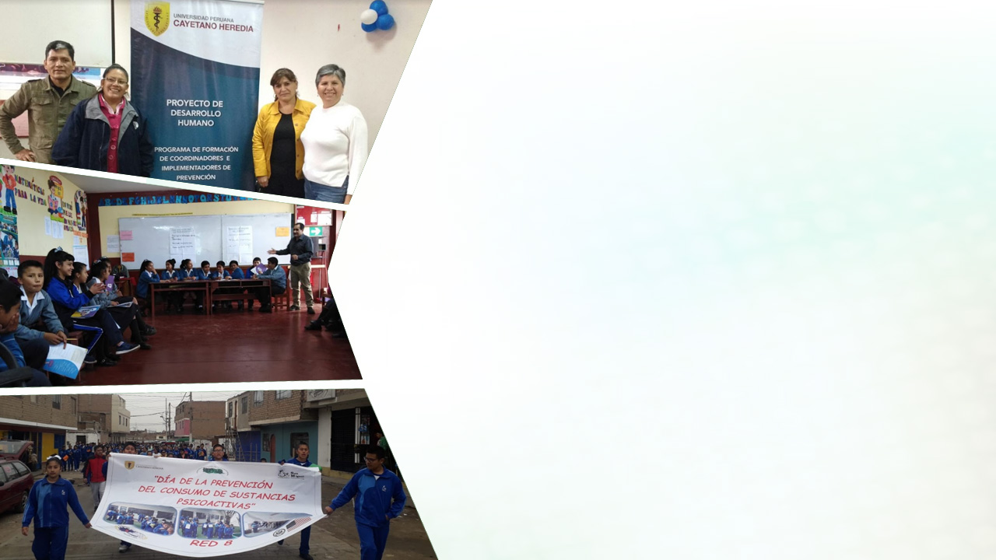

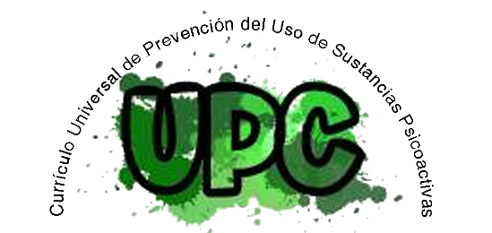


SCHOOL´S SUBSTANCE USE PREVENTION PROGRAM
A demonstration Project to Apply the Principles and Practices of the Universal Prevention Curriculum (UPC) to Schools in Peru
Fernando Salazar Silva, MPH, Ph.D.
Azucena Avalos Jara, MSc
July 2020

Slide 9

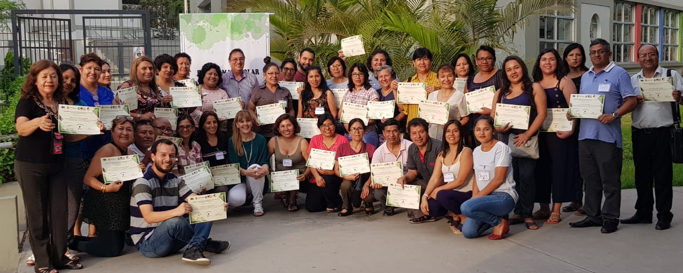
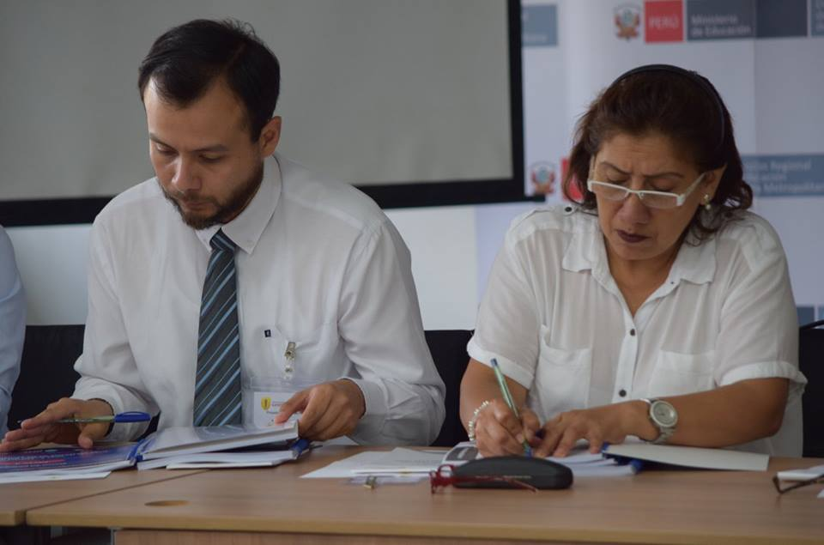
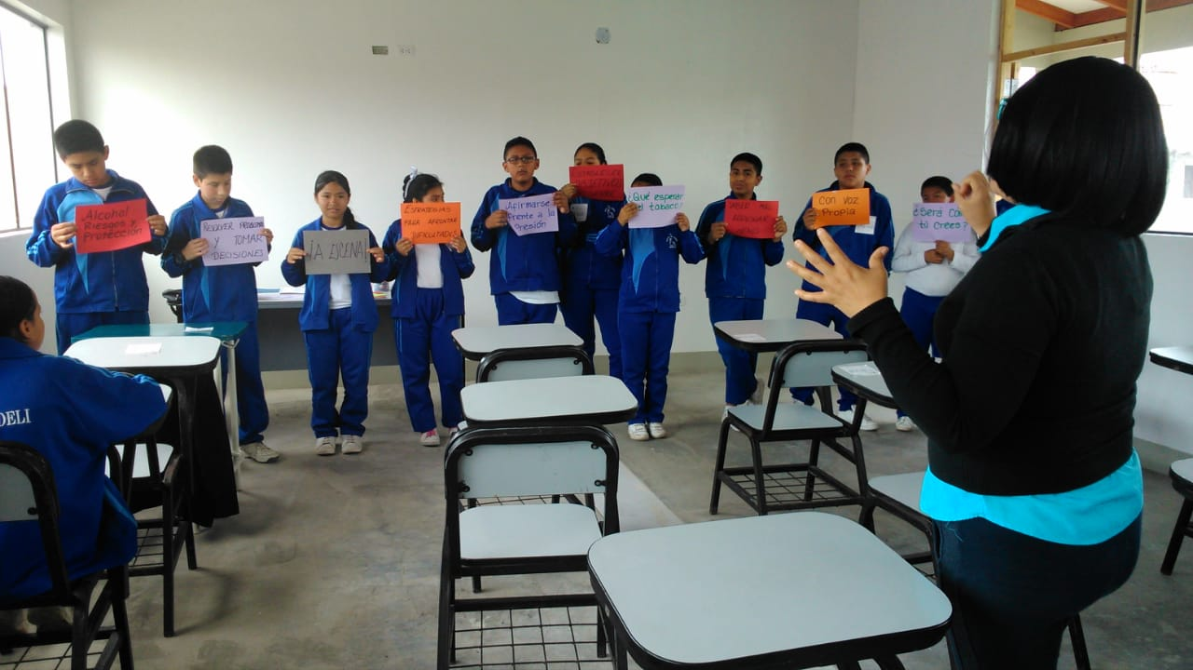
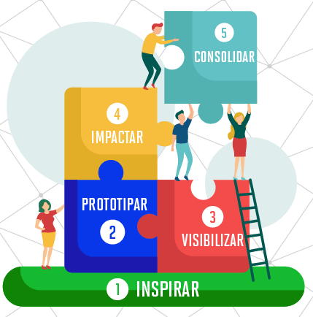

Capacitación en el
Currículo Universal de Prevención
Intervención basada en evidencia científica
Estándares de calidad internacionales
Training in the
Universal Prevention Curriculum
Scientific evidence-based intervention
International quality standards
Prevention Leadership Action Team - PLAT
Establish the conditions for prevention and link with the CNE
Intervention planning (PLAT)
Project: Learning through service
DPCC
PCI
Prevention curricula
12 session
Tutoría
PCI
Prevention positive climate
Convivencia escolar
Prevention Policy
PEI/RI
INTERACTIVE TEACHING SKILLS
Implementation, Monitoring and Technical Assistance and feedback
Fidelity and Adaptation
Development of the implementation model
Technical assistance and feedback
Piloting the intervention
Technical assistance and feedback

Slide 10
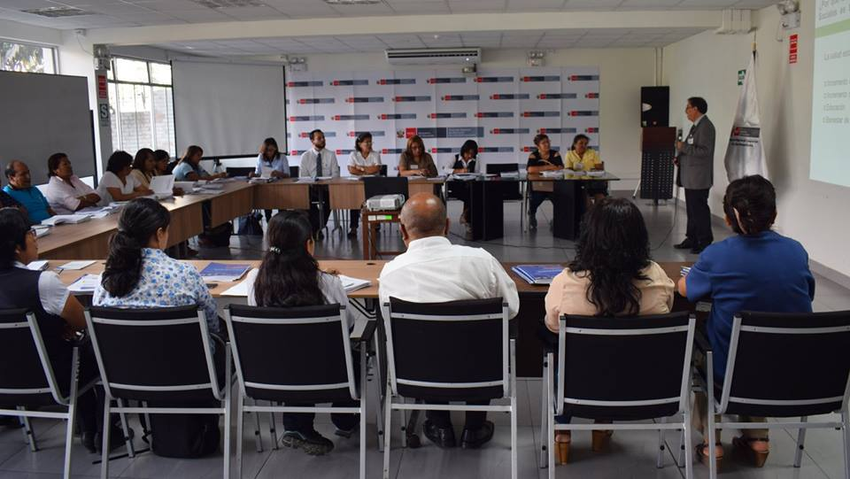
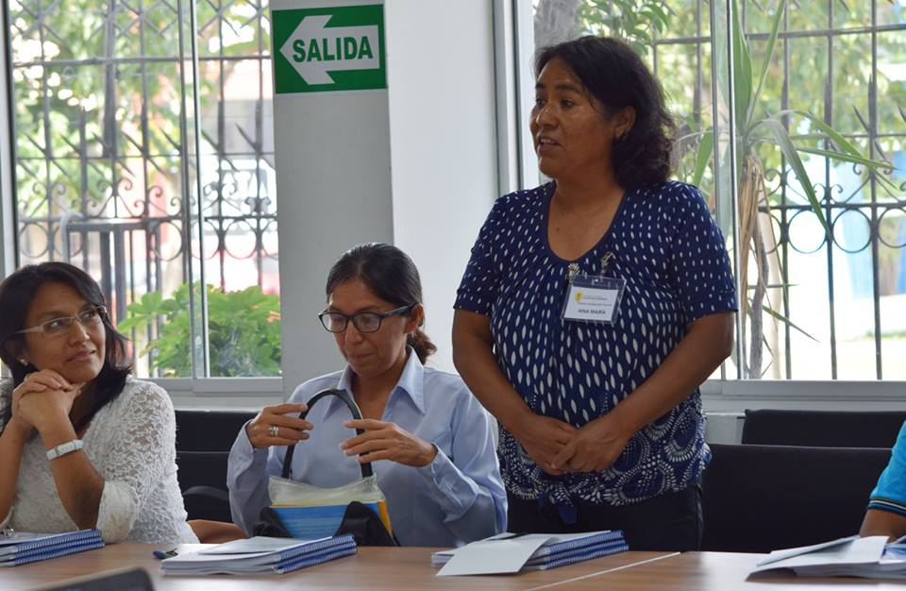
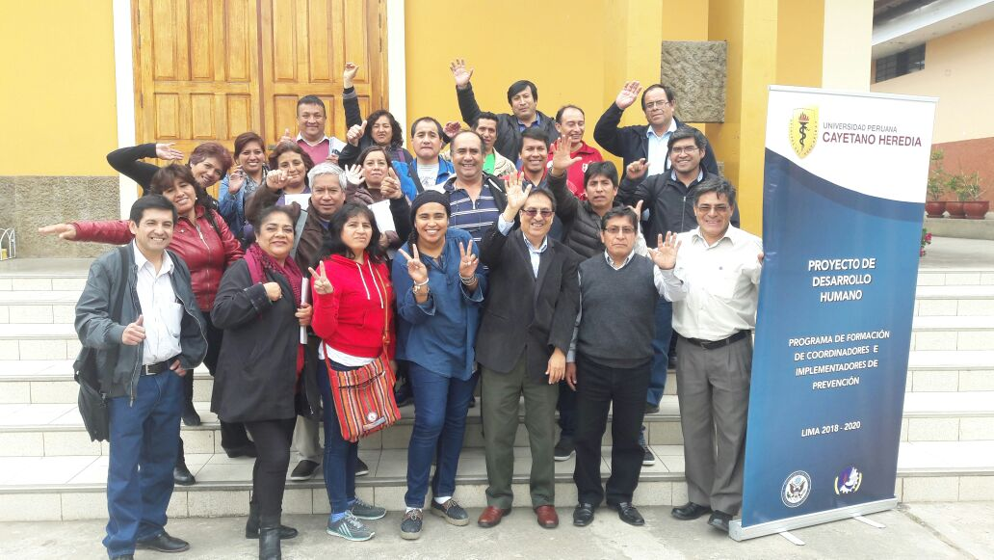
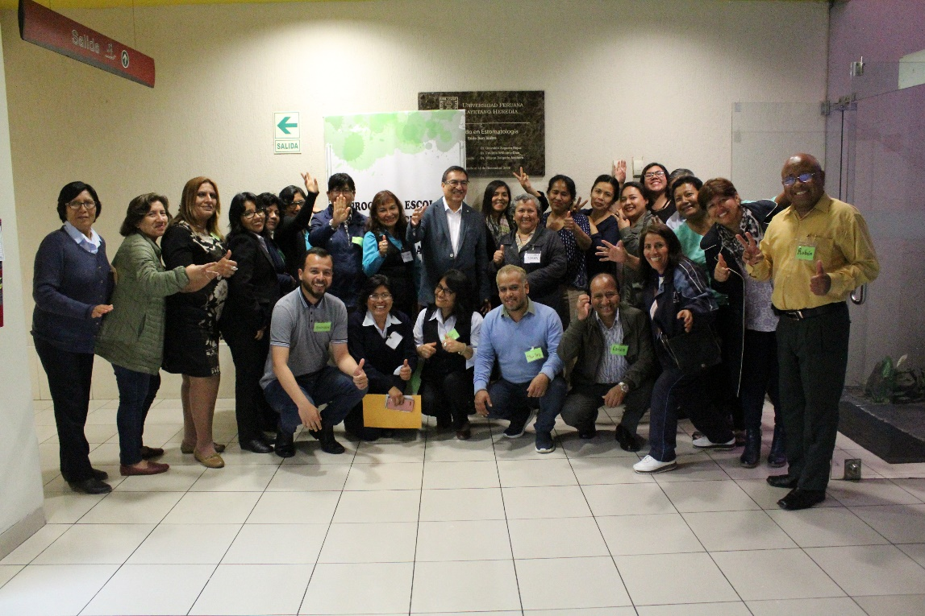
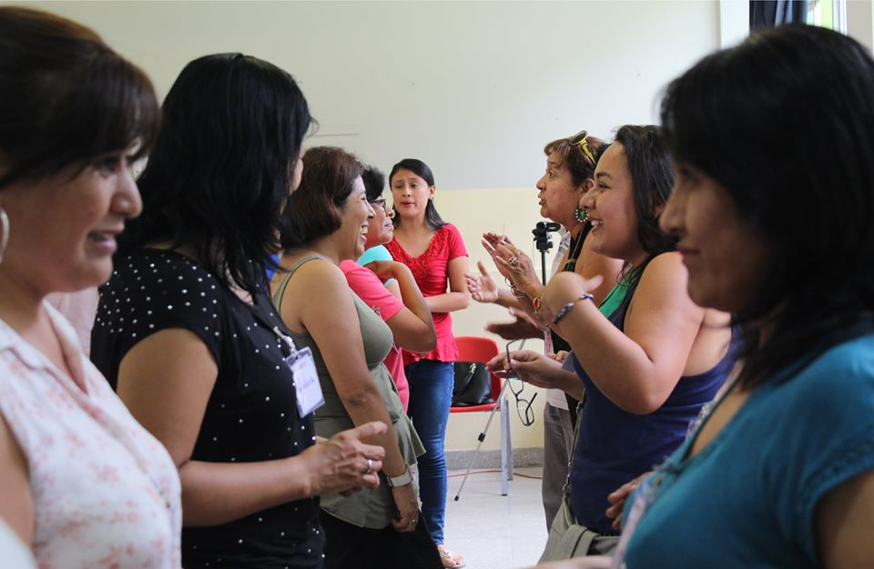
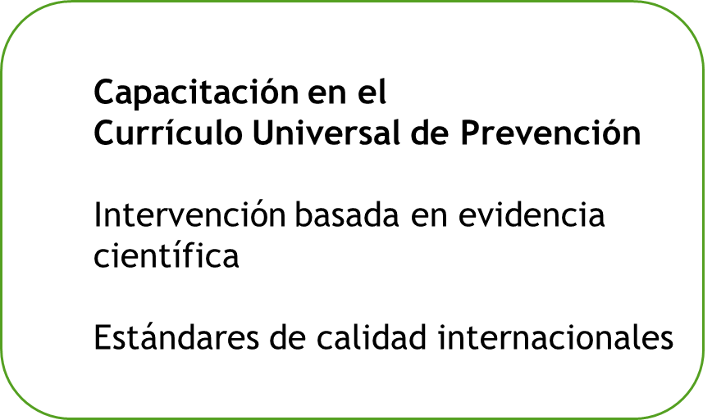
CAJAMARCA
LIMA
METROPOLITANA
CALLAO
TRAINING

Slide 11
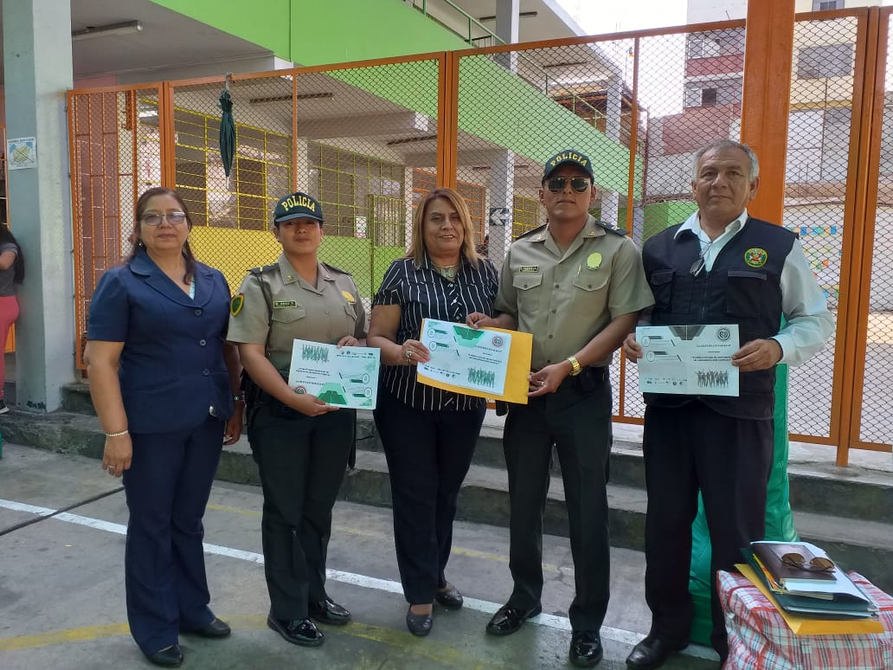
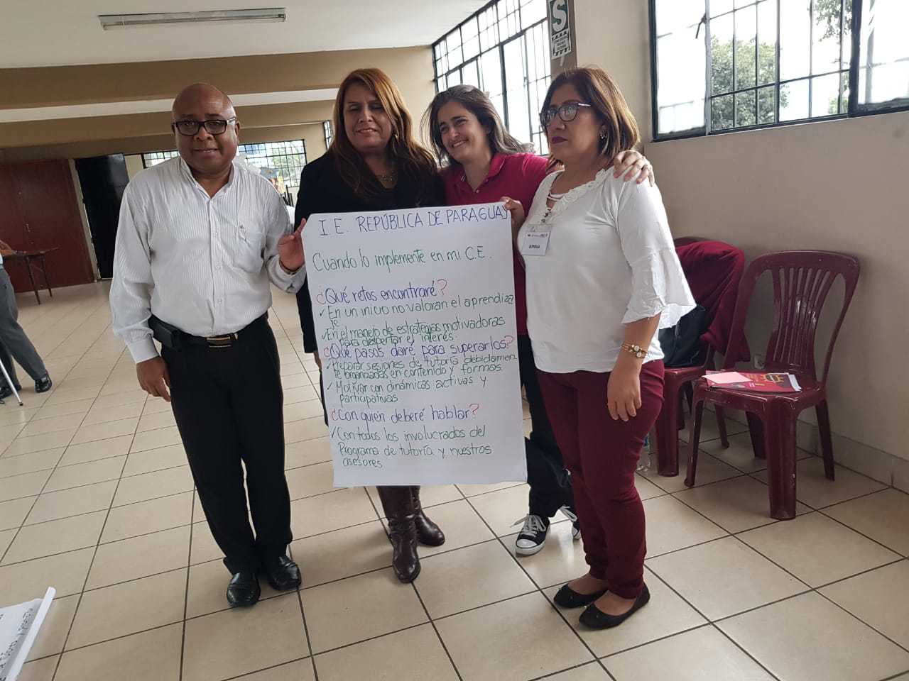
Prevention Leadership Action Team - PLAT
Establishing the conditions for prevention
CREATING CONDITIONS FOR PREVENTION

Slide 12
Intervention planning (PLAT)
PLANNING

Slide 13
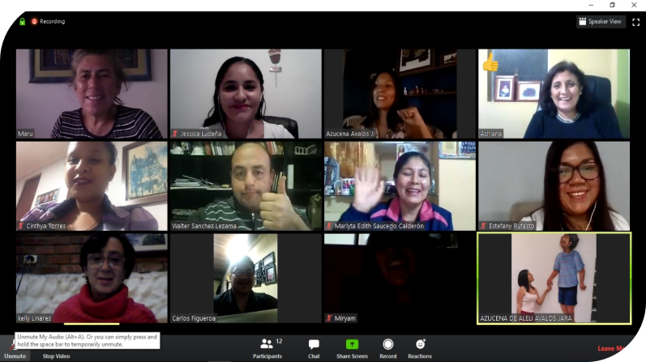
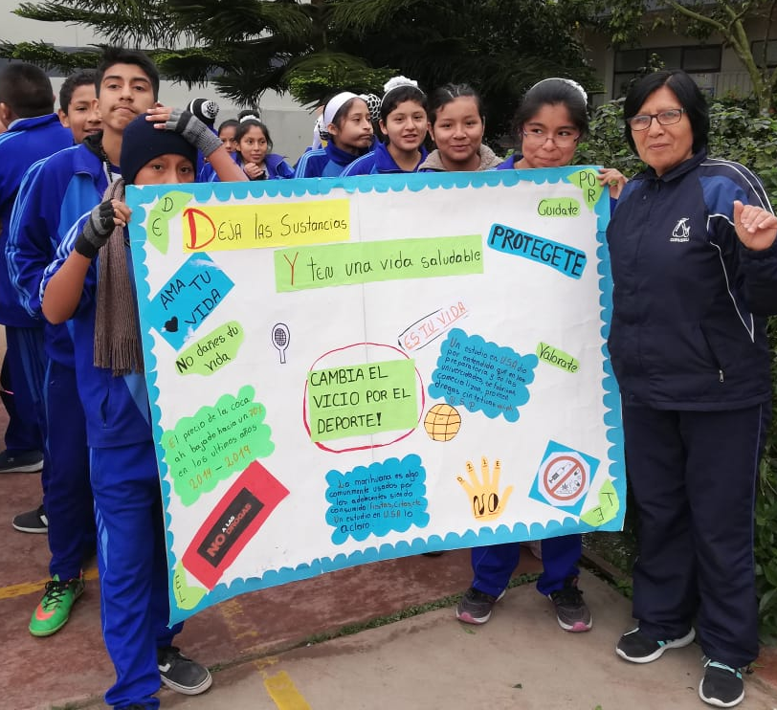
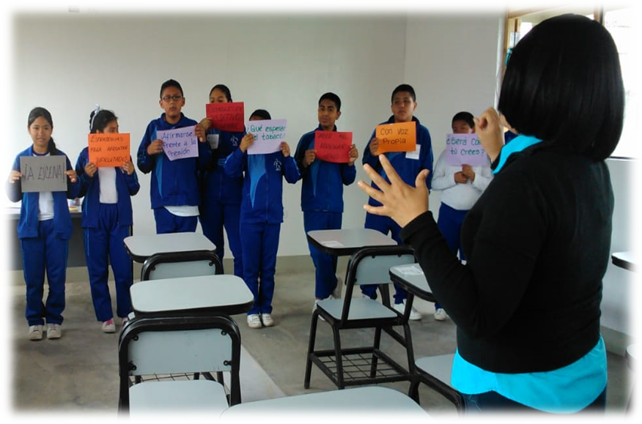
Implementation, Monitoring and Technical Assistance and feedback
FIDELITY AND ADAPTATION
Development of the implementation model
Technical assistance and feedback
STANDARDIZATION
Piloting the intervention
Technical assistance and feedback
QUALITY ADJUSTMENT
PILOTING
ADJUSTMENT
EFECTIVE IMPLEMENTATION

Slide 14

Link with the National Education Curriculum
SUSTAINABILITY
Learning through service
Development of the Citizenship and Civic Person
Institutional Curriculum Plan
Prevention
Curricula
Tutoring
Institutional Curriculum Plan
Positive school climate
School Convivence
Prevention
Policy
Institutional Educational Plan
Rules of Procedure
SUSTAINABILITY
INTERACTIVE TEACHING SKILLS

Slide 15
What results are being observed?
Mid-term results:
Schoolchildren substance use; intention to use;
attitudes; normative beliefs

Slide 16
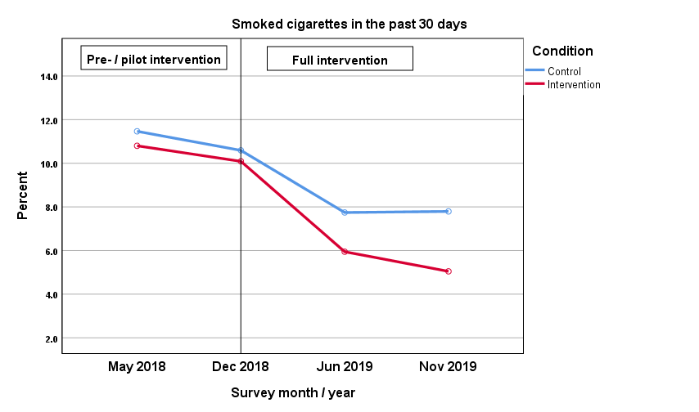
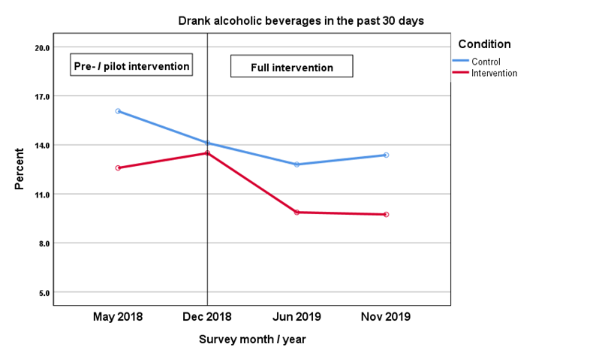
Encuesta / Mes / Año

Slide 17
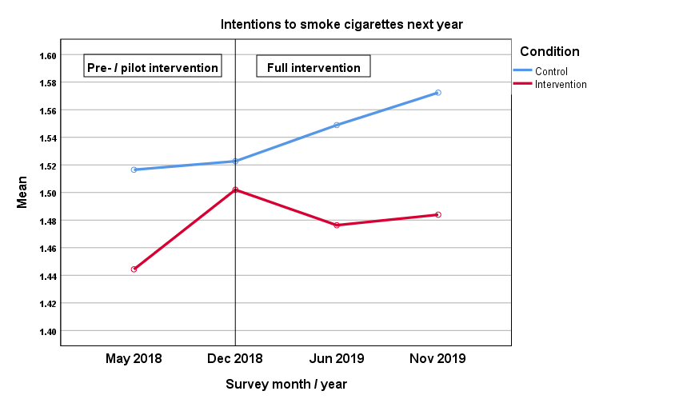
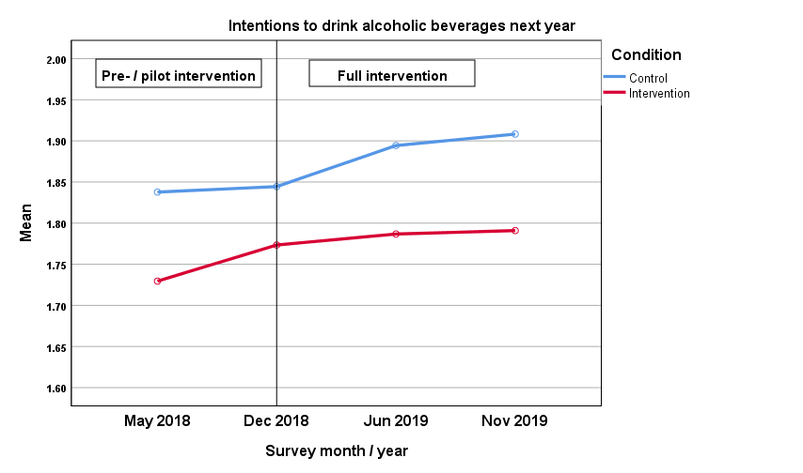
Encuesta / Mes / Año

Slide 18
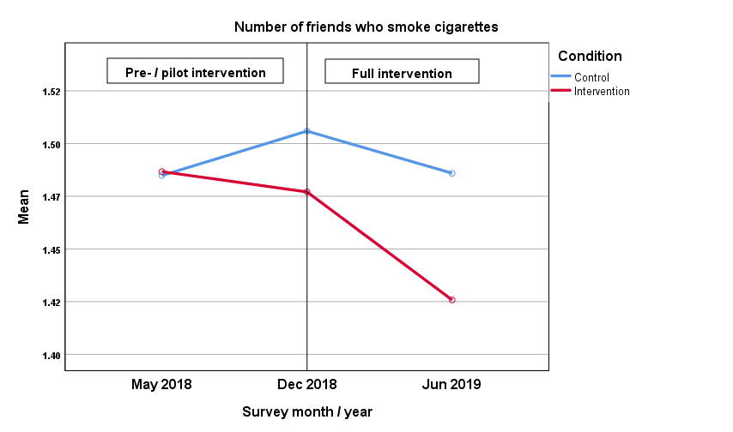
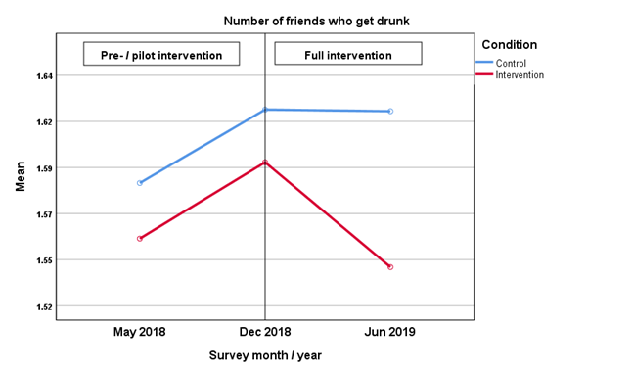
Encuesta / Mes / Año

Slide 19
…times of COVID-19
How do teachers work on the components of the program: prevention policies, classroom management, the positive climate at school and service to others (solidarity actions to the community)?

Slide 20
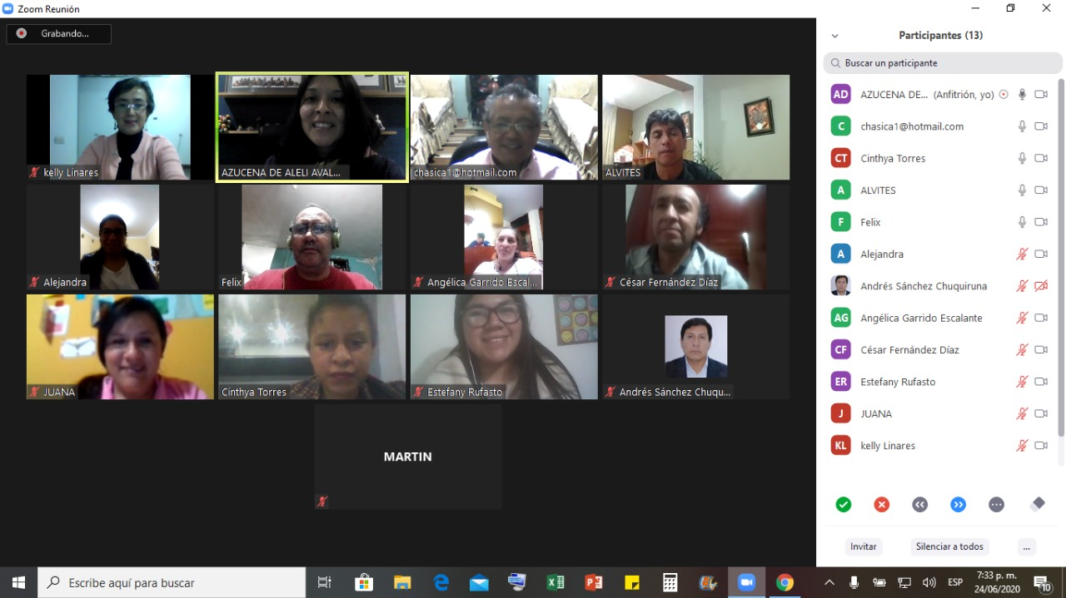
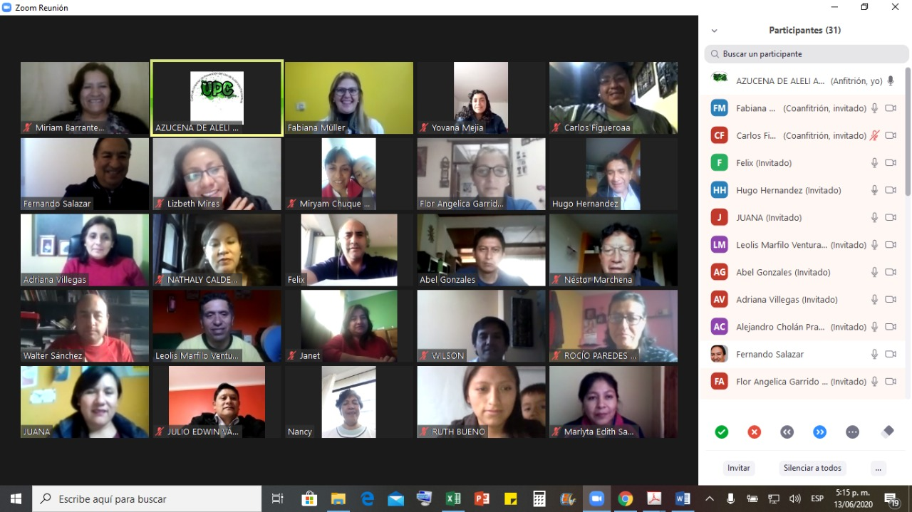



Project: Learning through service
DPCC
PCI
Prevention curriculum
12 session
Tutoría
PCI
Prevention positive climate
Convivencia escolar
Prevention Policies
PEI/RI
Implementation 2020
Implementation 2018 - 2019
FAMILY CONNECTION
Social, emotional and academic skills for the effective implementation of evidence-based practices aimed at improving the climate at home.
Survey
Functioning
Family
Need: Covid-19 Pandemic
LINEA BASAL
MONITORING IMPLEMENTATION
Fidelity and adaptation of content and methodology
Feedback and technical assistance
IMPLEMENTATION FAMILY CONNECTION
Intervention planning (PLAT)
Virtual workshops
TRAINING
IN FAMILY CONNECTION
Home practices
PILOTING
Survey
Functioning
Family
EVALUATION AND SUSTAINABILITY AGREEMENTS
Teachers, principals, authorities
SEGUIMIENTO

Slide 21
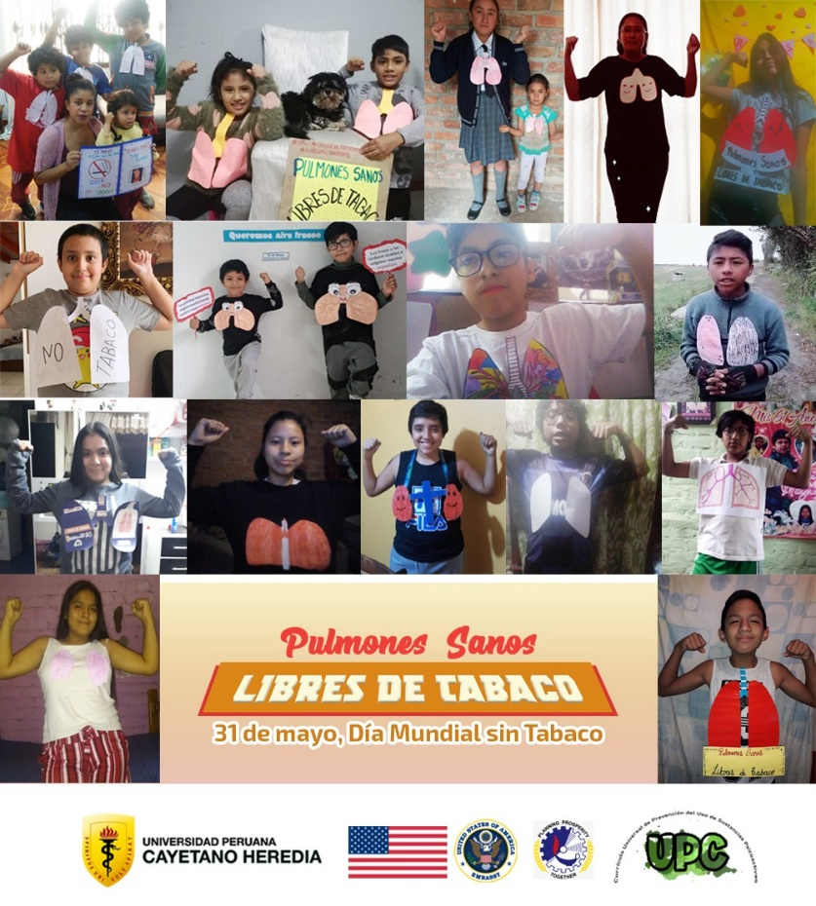
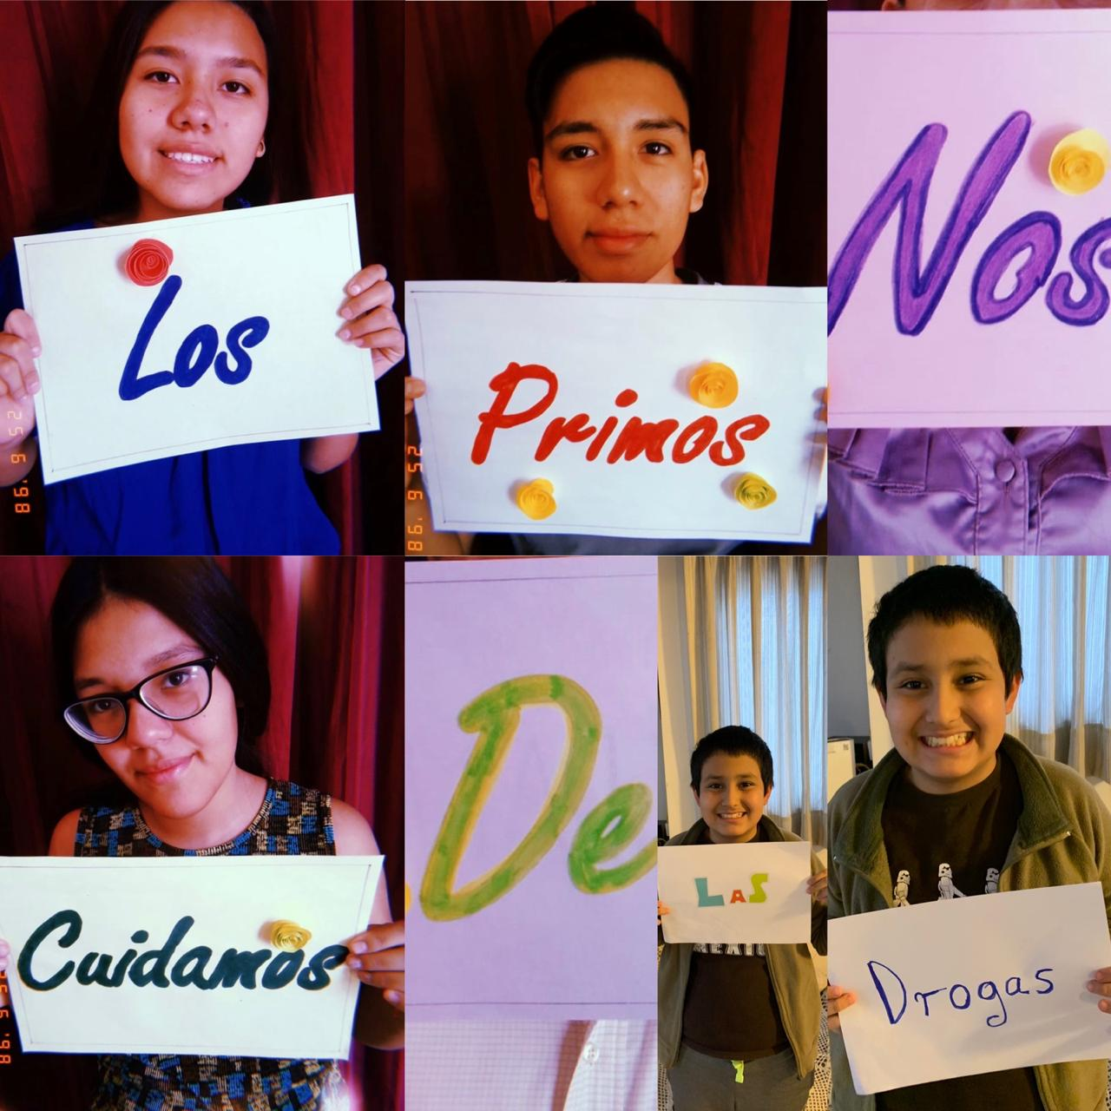
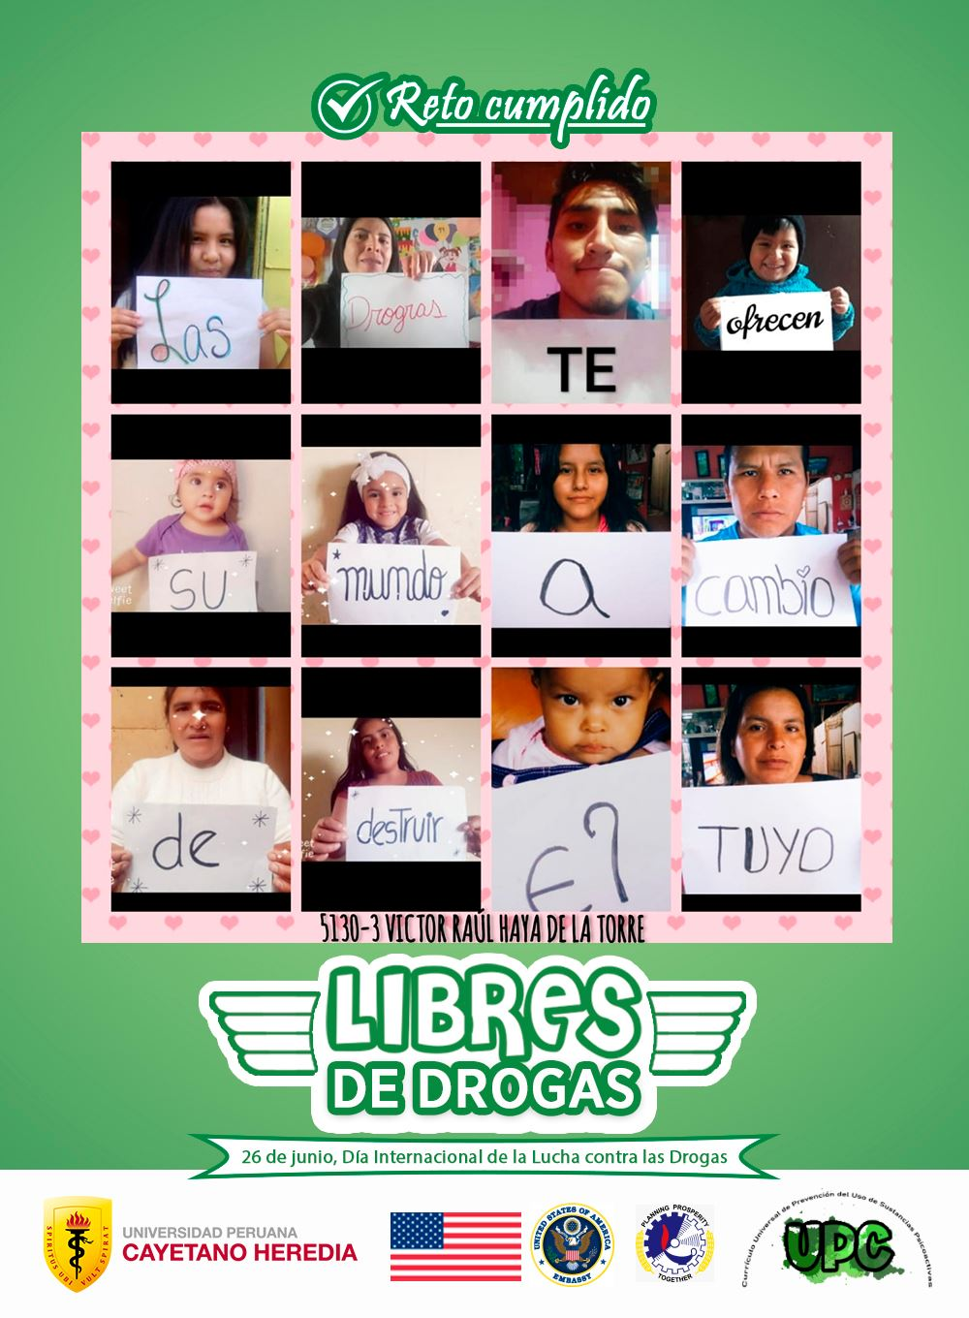
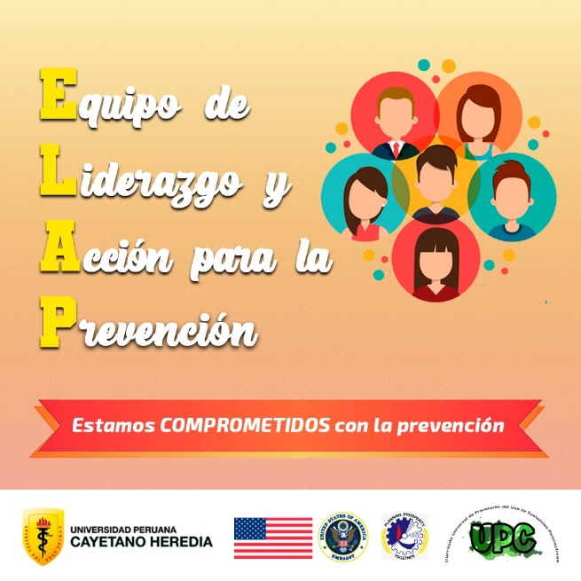
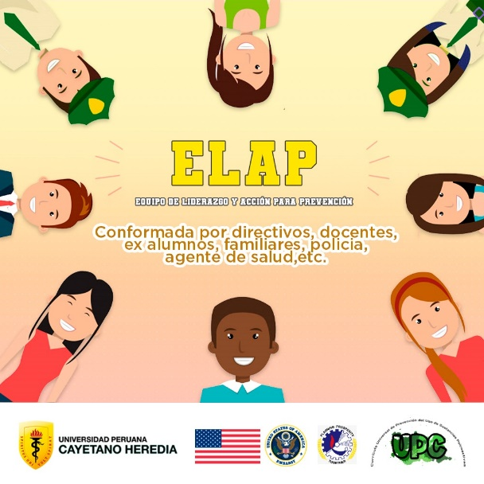
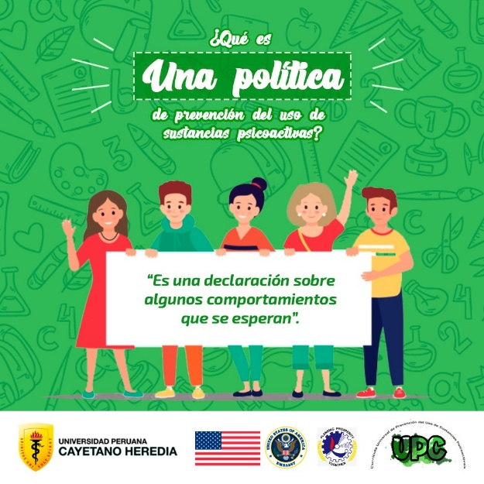
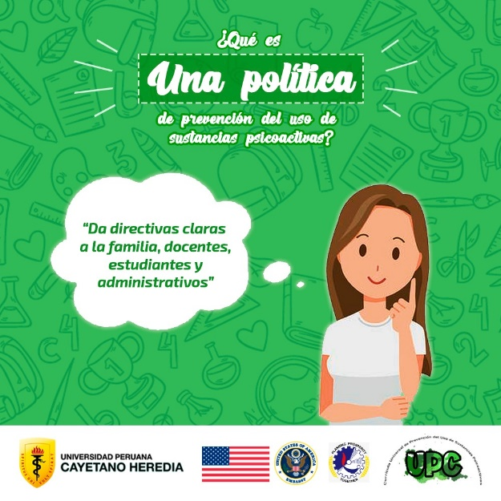
PREVENTION POLICY

Slide 22
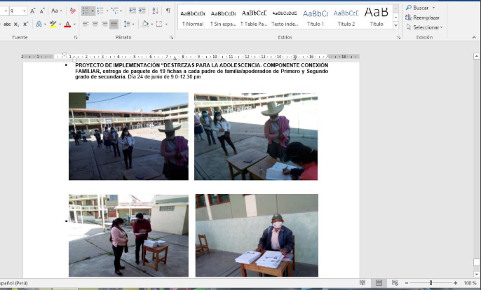
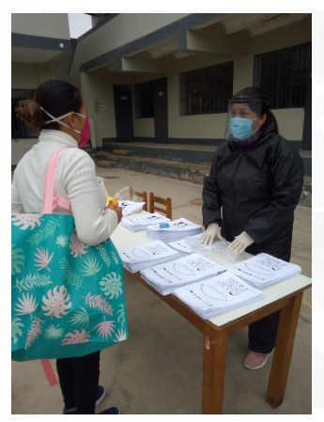
In rural areas where connectivity does not reach, families organize with PLAT to deliver work material
They use security protocols to minimize contagion
POSITIVE CLIMATE AT HOME
Preparation of the Prevention Policies of COVID-19
Based on international prevention principles and standards

Slide 23
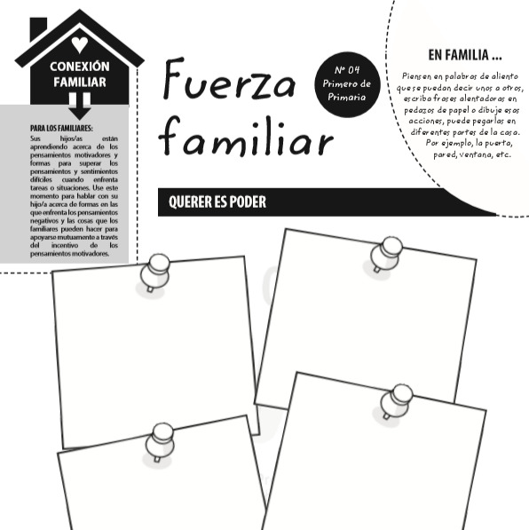
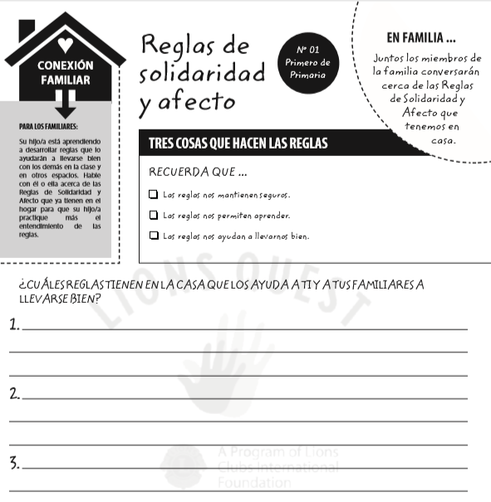
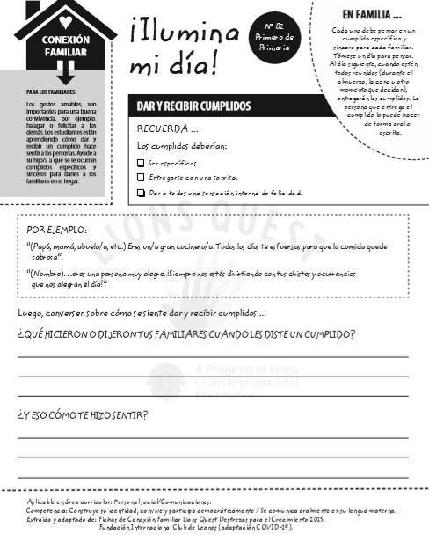
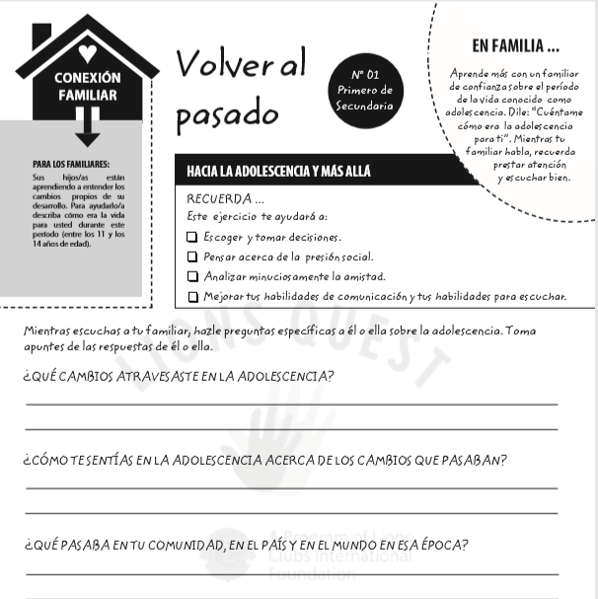
Rules of solidarity and affection
Family strength
Light up my day
Back to the past
PREVENTION CURRICULUM AT HOME

Slide 24
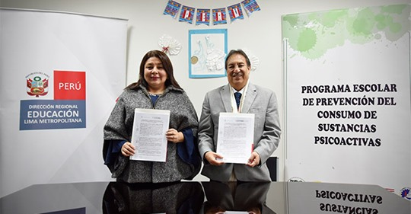
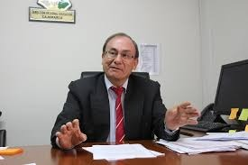
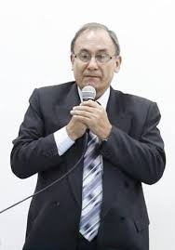
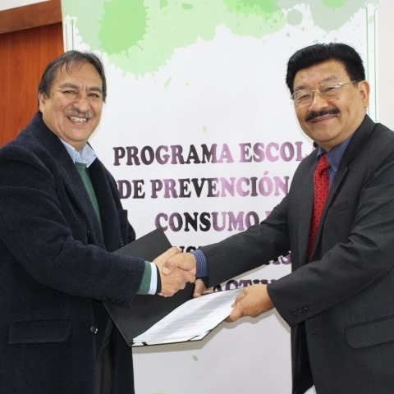
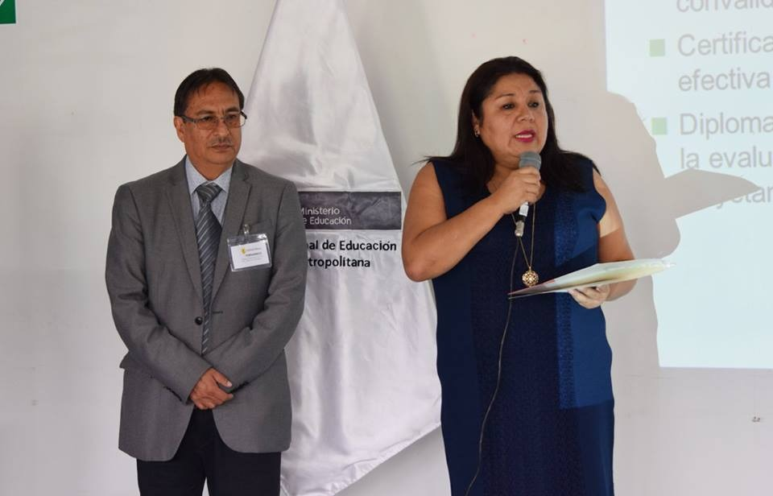
Looking for program sustainability
SUSTAINABILITY

Slide 25
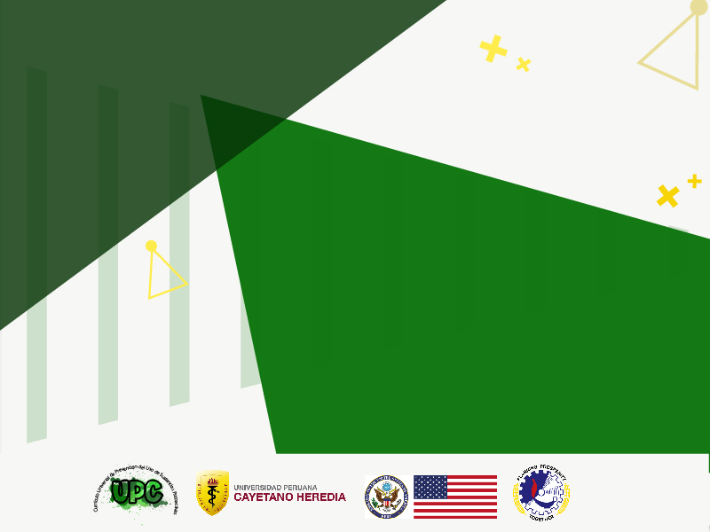
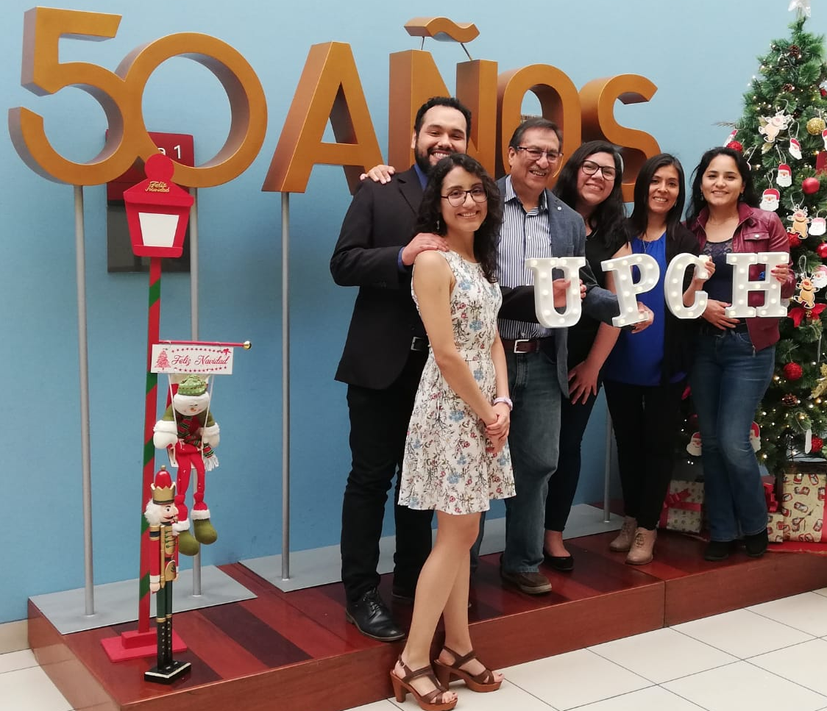
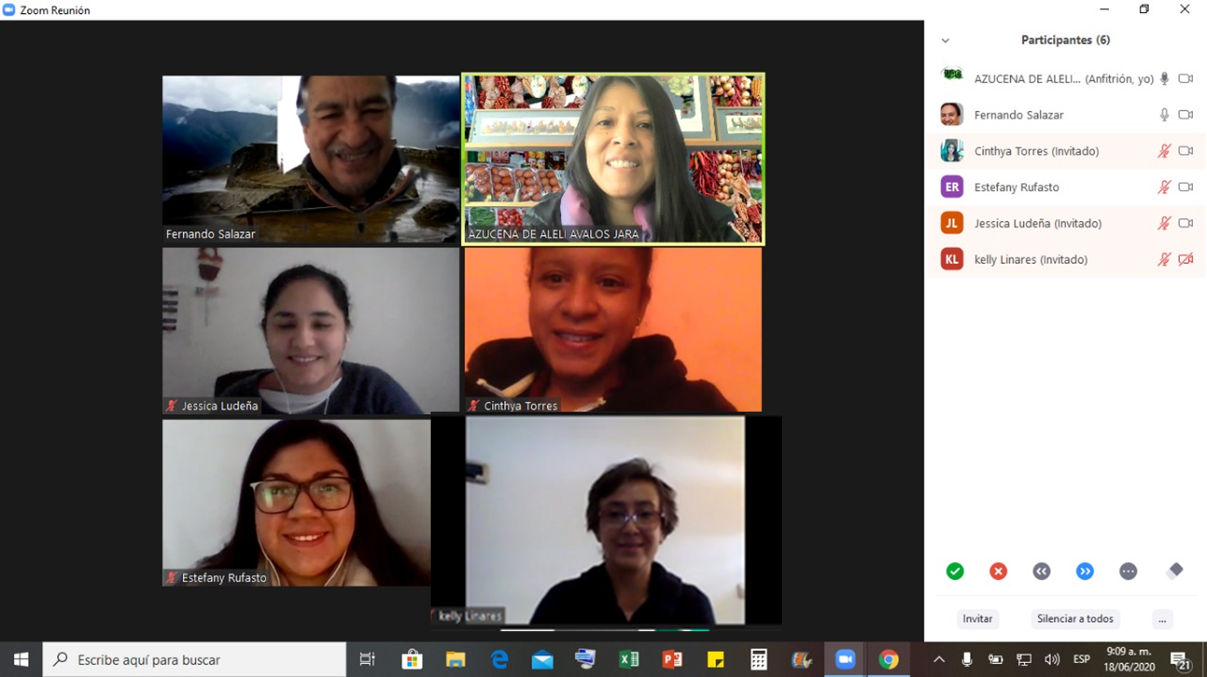
THE A TEAM:
Fernando Salazar Silva, Ph.D.
Principal Investigator and Project Director
fernando.salazar.s@upch.pe
Azucena Avalos Jara, MSc
Associated Investigator and Implementation Coordinator
Inés Bustamante Rivero, Ph.D. – Master Trainer UPC
Joel Salinas Piélago, MD Psychiatrist – Master Trainer UPC
Jessica Ludeña Herrera – Monitoring and evaluation
Estefany Rufasto Hernández – Monitoring and evaluation
Kelly Linares - Monitoring and evaluation
Carlos Figueroa – Social Communicator
Máximo Grados - Manager
https://www.facebook.com/universalpreventioncurriculum/

