Slide 1
Trainer Introduction
Notes:
The trainer will discuss the introduction which has the purpose of the curriculum, instructions and guidance as to how to best teach the material on adolescent substance abuse and use.

Slide 2
CICAD Inter-American Drug Abuse Control Commission
MISSION
Enhance the human and institutional capacities of its Member States to reduce the production, trafficking and use of illegal drugs, and to address the health, social and criminal consequences of the drug trade in the Americas.
Notes:
The trainer will emphasize the mission of the CICAD and how this related to the current curriculum. Substance abuse among adolescents debilitates societies and increases criminal activity in the future. Therefore the CICAD developed this curriculum to address the global need to intervene with youth, that way contributing to the wellness of countries across the globe.
INTRODUCTION
The Inter-American Drug Abuse Control (CICAD)’s mission is to Enhance the human and institutional capacities of its Member States to reduce the production, trafficking and use of illegal drugs, and to address the health, social and criminal consequences of the drug trade in the Americas

Slide 3
HEMISPHERIC DRUG STRATEGY
Implementation of a variety of evidence-based preventions programs aimed at distinct target populations.
Evidence-based & research-informed interventions for programing.
Factors such as biological, psychological, social and others must be addressed and treated as a public health matter.
Notes:
Hemispheric Drug Strategy: Demand reduction requires, in accordance with the situation and magnitude of the drug problem in each country, the implementation of a variety of evidence-based prevention programs, aimed at distinct target populations, which together constitute a comprehensive system. From a methodological and design standpoint, these programs should be systematic, with specific measurable objectives. Drug dependence is a chronic, relapsing disease that is caused by many factors, including biological, psychological or social, which must be addressed and treated as a public health matter, consistent with the treatment of other chronic diseases

Slide 4
PURPOSE OF THIS CURRICULUM
The purpose of this training is twofold;
  First to provide an overall conceptualization of substance use and abuse in the adolescent population, current trends, latest research and raise the problem of adolescent substance abuse as a public health problem.
  Second, to teach and practice competencies in the assessment and treatment of substance abuse in the adolescent population, families and societies globally.
Notes:
The trainer will emphasize the importance of developing and training in the subject matter. The trainer can also discuss how intervening with adolescents who use substances can benefit societies. The trainer will emphasize that the current curriculum utilizes the most recent research in best treatments for adolescents who use substances.
The purpose of this training is twofold; first to provide an overall conceptualization of substance use and abuse in the adolescent population, current trends, latest research and raise the problem of adolescent substance abuse as a public health problem. Second, to teach and practice competencies in the assessment and treatment of substance abuse in the adolescent population, families and societies globally.
Adolescent substance use and abuse is a public health problem at the global level. Adolescent substance abuse contributes to the deterioration of societies that can last their entire lifetime. As such, there is a need to equip lay counselors, grassroot programs/organizations and government-funded programs across the globe to effectively understand and treat substance use and abuse in the adolescent population. The current training provides current research on the trends of adolescent substance abuse, effective evidenced-based assessment and treatment modalities for working with youth.

Slide 5
UTILIZATION OF THIS CURRICULUM
Utilization of this manual can vary as each context might have to adapt information to context and culturally relevant language that applies to diverse contexts.
The goal of this curriculum is to provide a wide range of information so that each context can then adapt it to their specific population if necessary.
Notes:
The trainer must emphasize that this curriculum can be adapted to each context as it is necessary without compromising the core concepts taught in the course.
Utilization of this manual can vary as each context might have to adapt information to context and culturally relevant language that applies to diverse contexts. The goal of this curriculum is to provide a wide range of information so that each context can then adapt it to their specific population if necessary.

Slide 6
Learning Objectives
TRAINING INTRODUCTION GOALS
Create a positive learning community and environment.
Provide guidance on how to teach the curriculum.
Discuss training methodology.
Provide an overview of the training modules.
Provide materials to evaluate the content and effectiveness of the training.
Notes:
Training Introduction Goals and Objectives:
Goals:
Create a positive learning community and environment.
Give participants background information on the project
Discuss training methodology
Explore impact of personal beliefs and values on adolescent programming
Understand trends in adolescent substance use in the Caribbean
Objectives:
Participants who complete the training introduction will be able to:
Describe the background of the training project
Discuss differences and similarities among adolescents now and in the past
Identify personal values related to adolescent substance use and their impact on efforts with adolescent AOD work
Describe the trends in adolescent substance use in the Caribbean, as well as related risk factors.

Slide 7
THE TRAINER MANUAL
This Trainer Manual has five parts:
  Part I—Trainer Introduction (this section);
  Part II—Master Agendas;
  Part III—Evaluation Forms & Pre/Post Tests;
  Part IV—Training Modules;
  Part V—Appendices.
Notes:
THE TRAINER MANUAL
This Trainer Manual has five parts:
Part I—Trainer Introduction (this section);
Part II—Master Agendas;
Part III—Evaluation Forms & Pre/Post Tests;
Part IV—Training Modules;
Part V—Appendices.
Part II - Master Agenda
The Master Agenda is included for planning. This training is designed to be delivered over 15 consecutive days, as reflected on the Master Agenda. However, the modular structure allows for flexibility. If necessary, the training could be offered over several weeks (with some modifications), although all modules should be delivered in the order in which they are presented in the manual. If your context does not utilize the optional module, you can make necessary adjustments to the agenda.
The times indicated for module activities are guidelines. Actual times will depend on each training group’s size and participation level based on participants’ learning needs, time can be allotted by the trainer than is indicated on a particular topic. The Master Agenda also assumes that the training day will be delivered within working hours. The trainer should prepare a daily schedule for participants, using actual start and end times.
Part III - Evaluation Forms
Evaluation Forms includes two types of forms: general evaluation forms and pre/post tests for each module. The general evaluation forms include a Daily Evaluation form for participants to complete at the end of each day of training and an Overall Training Evaluation form to be used at the end of the training. The Daily Evaluation helps the trainer identify whether adjustments need to be made during the training. The Overall Training Evaluation provides an overall look at participants’ experiences. Participants need to know completing the forms is important and their feedback will improve training content and delivery over time.
The pre/posttests address the knowledge, skills and attitudes covered in each of the individual modules. These brief questionnaires assess both the quality of the material and its presentation, as well as the participants’ integration of the material in each module.
Part IV - Training Modules
The Training Modules provides instructions for presenting the eight modules in the curriculum. Each Module in the manual includes:
A Preparation Checklist;
A timeline;
List of materials and teaching methodology;
An overview of goals;
Presentation and exercise instructions;
Exercise materials;
Copies of the PowerPoint slides.
Trainer presentations are written with instructions and script text following each corresponding slide. Trainers should feel free to use their own words and add examples. Adding real-life examples enriches the training experience but needs to be balanced with time considerations. At the same time, please note that the style of interactive lecture used throughout this curriculum guides the trainer to solicit examples from participants first, then to offer examples of one’s own.
Part IV - Appendices
Appendices includes:
Appendix A—Suggested Handouts for Distribution; and
Appendix B—References
Appendix B—Research references are particularly important. This appendix provides resources for background reading on major curriculum topics to help trainers become as familiar as possible with the curriculum topics.

Slide 8
THE PARTICIPANT MANUAL
The overall training goals
Learning Objectives for each of the modules
Handouts of the PowerPoint slides with space for taking notes
Case studies/Role plays
Notes:
THE PARTICIPANT MANUAL
Trainers must tell participants to bring their manuals with them each day. The Participant Manual contains the following:
The overall training goals
Learning Objectives for each of the modules
Handouts of the PowerPoint slides with space for taking notes
Case studies/Role plays
The trainer also provides each participant with a notebook. It can be a spiral-bound notebook, a lined notepad, or simply pieces of paper stapled together. Participants use the notebook as a journal, for specific writing exercises, and to note:
Shared resources they would like to review later;
Topics they would like to read more about;
A principle they would like to think more about;
A technique they would like to try;
Ways to use their new skills and knowledge in their practice; and
Possible barriers to using new techniques.

Slide 9
OVERVIEW OF TRAINING MODULES
The training series is comprised of six separate modules:
  Module 1: Introduction to Adolescent Substance Use
  Module 2: Adolescent Development
  Module 3: Trauma and Trauma-Informed Care
  Module 4: Screening and Assessment Adolescents
  Module 5: Adolescent Treatment Interventions
  Module 6: High Risk Youth
Notes:
The trainer will provide a brief overview of the topics within each module:
Module 1: Provides an introduction and conceptualization of the topic of adolescent substance abuse.
Module 2: Provides an overview of the development of the adolescent at the physical, emotional, mental, cognitive, and neurological levels.
Module 3: Provides in-depth conceptualization of Trauma-informed Care (TIC) and skills to work with youth.
Module 4: Provides techniques, tools and practice of methodologies to screen and assess youth.
Module 5: Provides a range of treatment interventions that are effective in treating adolescent substance abuse. It also conceptualizes the importance of treatment at the individual, relational, community and societal levels.
Module 6: This optional module provides information on the nature of gangs and can be utilized in contexts where this is a common problem.

Slide 10
THE TRAINER
Experience working with adolescents and with AOD use;
Experience using research-based techniques;
Ability to facilitate adult group learning.
Understanding and sensitivity to culturally relevant issues.
Ability to work with participants in a positive, empathetic manner
Notes:
This curriculum can be implemented by individuals with previous training/teaching experience and experience working with youth. However, trainers should have had this or similar training and be familiar with the youth population. Trainers for this course should have the following knowledge and skills:
Experience working with adolescents and with AOD use;
Experience using research-based techniques;
Ability to facilitate adult group learning, including use of diverse exercises, case studies, and group exercises that address multiple learning styles;
Understanding and sensitivity to culturally relevant issues specific to both the participants and the client treatment populations; and
Ability to work with participants in a positive, empathetic manner
Two trainers, or co-trainers, are essential for multiday courses. In addition, a support person to help with logistics is ideal, particularly with training groups of more than 20 participants.

Slide 11

TRAINER DEMEANOR
Professional presentation attire.
Careful personal grooming.
Perfumes and colognes can be distracting and should be avoided in excess.
Practice basic table manners for professional presentations.
Notes:
The trainer must become familiar with the content of each bullet point to be able to discuss. Avoid reading off the slide.
Trainer demeanor
A professional appearance is an important aspect of this training. You will be perceived as an expert on the subject matter; therefore a clean and professional demeanor is key to be a successful trainer.
There is only one opportunity to make a good first impression. In the first minute of meeting someone new, people make multiple assumptions about the new person. For example; the new person’s levels of expertise, success, education, and knowledge. Most people start making these assumptions before a single word is uttered. They process visual information and quickly form opinions. Attire, grooming, posture, and facial expressions affect these opinions. The following guidelines may be useful:
Clothing says a lot about a person. Dressing professionally during the training shows respect for participants. On the one hand, dressing too casually or sloppily signals that the trainer does not take the relationship seriously. On the other hand, dressing too formally places distance between the trainer and the participants.
“Flashy” is distracting at best. Flashy or large earrings, necklaces, and watches focus participants’ attention on the objects, not on the content of the training.
Careful personal grooming (brushed teeth, combed hair, a fresh shave or trimmed beard, clean fingernails) says that the trainer cares about what others think of him or her.
Perfumes and colognes can be distracting and should be avoided. Many people have allergies or simply dislike certain scents. Ensure that fragrances don’t force participants out of the training room!
Practice basic table manners for professional presentations; neither the trainer nor the participants should chew gum during the training sessions.

Slide 12

THE LEARNING APPROACH
Learning styles in adults –The adult learner
The approach: The learning approach for the training series includes:
  Trainer-led presentations and discussions;
  Interactive lectures;
  Brainstorming sessions
  Small-group exercises and presentations;
  Case Studies and presentation;
  Skills role-plays
Notes:
THE LEARNING APPROACH
The adult learner
Although some didactic presentation by the trainer is necessary, the training series relies heavily on interactive lecture, collaborative exercises and other learner-directed activities. Adults have a great deal to offer the learning process, having already accumulated knowledge through their education, work, and other experiences. The curriculum provides opportunities for the trainer to encourage participants to share their relevant experience and knowledge with others and to connect them with the curriculum content. This process also facilitates increased partnerships and collaborations when participants return to their home communities.
The training series follows the premise that training of adult learners should be based on the following principles:
Focus on real-world problems;
Emphasize how the information can be applied;
Relate the information to learners’ goals;
Relate the materials to learners’ experiences;
Allow debate of and challenge to ideas;
Listen to and respect the opinions of learners;
Encourage learners to be resources for the trainer and for one another; and
Treat learners with RESPECT.
The approach: The learning approach for the training series includes:
Trainer-led presentations and discussions;
Interactive lectures;
Brainstorming sessions
Small-group exercises and presentations;
Case Studies and presentation;
Skills role-plays
Role-plays and other exercises are important parts of the training approach. The trainer can help participants feel safe during and learn from these experiences by:
Ensuring that participants understand what they are to do or observe;
Affirming role-players’ willingness to participate;
Offering assistance as needed; and
Using nonjudgmental language and tone during debriefings (e.g., What was it like for you being the client? What was the hardest part for you as the worker?).
It can also be helpful to have participants stand up and literally shake off the roles they were playing before continuing the training.

Slide 13
PREPARATION
General preparation of includes; logistics, selecting and preparing participants and becoming familiar with the curriculum.
The training space is an attractive and well-organized training space can enhance a participant’s learning experience.
Equipment and supplies such as laptops, projectors and other technical aids can be utilized to best teach the current curriculum.
Notes:
Major training preparation tasks include:
Logistical planning, including scheduling, selecting the site, and obtaining or arranging for equipment and supplies at the site;
Selecting and preparing participants; and
Becoming thoroughly familiar with the curriculum.
Scheduling and site selection are connected. If a hotel site is used, planning needs to begin several months ahead of time.
The training space
An attractive, well-organized training space can enhance a participant’s learning experience. The room must be large enough to accommodate all participants and small groups. Seating small groups at round tables is ideal because it saves significant time moving into and out of small groups for the many exercises. The trainer must be able to rearrange the room and seating for presentations and exercises. Additional small tables around the edges of the room can hold supplies, learning materials, and trainer materials.
The ideal space is not always possible, however, If the space is not large enough to accommodate tables, small groups can always push back chairs and work on the floor if participants are comfortable doing so. Using more than one room at a site can help with space for small-group activities. However, no more than two rooms should be used because it is helpful to have a trainer present in each room to continuously monitor the group process. The training space must provide privacy for role-plays and other activities.
The trainer can create colorful posters or mobiles to add life to the training room. Posters can present key concepts, such as the stages of change. Playing music softly as participants enter the training room (and, when appropriate, during some activities) creates an inviting atmosphere and relaxes participants. Providing tea, coffee, water, and snacks for refreshment breaks encourages participants to mingle and talk with one another during these times. Participants will need information on where to get lunch, if it is not provided.
Equipment and supplies
The PowerPoint presentations require a laptop computer, a projector, and screen. A remote control for the projector allows the trainer to move freely around the room. If a remote is not available, the co-trainer who is not currently presenting or a training assistant can advance slides.
If a PowerPoint projector is not available (or breaks down during the training!), the training can continue without it. The Participant Manual has copies of all slides, and the Trainer Manual has all the information to explain each slide.
At least one whiteboard (with markers), several pads or rolls of easel pad paper, tape, and blank paper are essential to the training. The Preparation Checklist in each Module indicates the specific supplies needed for the module.

Slide 14
PARTICIPANTS (AUDIENCE)
This training is intended for individuals who actively work with adolescents with substance use and abuse challenges. This can include; case managers, lay counselors, therapists, social workers, and other officials within each context who work with adolescents. It is ideal that participants have more than two years of experience working with youth.
Preparing participants: The trainer can prepare participants for learning and increase their positive expectations before the training begins by sending participants a pre-training package that contains items such as:
  Friendly, enthusiastic welcome letter;
  The training Master Agenda and;
  Training goals and learning objectives
Notes:
Participants (audience)
Selecting and preparing participants
Ideally, the training group should be large enough to be divided into at least four small groups of at least four participants each, but the training materials can be adjusted for smaller training groups. The training group should not be larger than 25 participants and should comprise the same members throughout the training modules.
The trainer can prepare participants for learning and increase their positive expectations before the training begins by sending participants a pre-training package that contains items such as:
Friendly, enthusiastic welcome letter;
The training Master Agenda and;
Training goals and learning objectives
The trainer also could ask participants to bring a picture or object that makes them feel relaxed and that can be used to decorate the training space. An energizer on the first day could involve discussing participants’ pictures or objects with the group and placing them in the room. This activity indicates that the trainer cares about participants’ comfort and that the training may be different from what participants are accustomed to. When possible, a personal call from a trainer can engage participants and give the trainer useful information about them and their level of interest and motivation.

Slide 15
BECOMING FAMILIAR WITH THE CURRICULUM & CUSTOMIZING
Trainers & co-trainers should read the curriculum, study it, and make sure they understand the training goals and learning objectives of each module and are fully prepared to facilitate the exercises.
Customizing the curriculum: the trainer also must have a good understanding of the needs of the training group and be prepared to adapt the training accordingly. For example, the trainer may need to:
  Simplify the language.
  Culturally appropriate teaching.
  Provide many examples throughout the training.
  Be creative.
Notes:
Becoming familiar with the curriculum
Trainers should read the curriculum, study it, and make sure they understand the training goals and learning objectives of each module and are fully prepared to facilitate the exercises. The better a trainer knows the material, the more s/he can focus on the participants. Solid preparation helps a trainer relax and be more engaging. Co-trainers should strategize their roles and responsibilities ahead of time.
The content and timeline box in each module have a column labeled “Person Responsible.” This page should be photocopied so that trainers can use it for multiple training groups. Co-trainers can specify in this space the training sections for which each will take primary responsibility. Depending on the match of presentation styles and personalities, some trainers choose to deliver entire modules before switching roles; others prefer to switch roles more frequently.
Other decisions to make include:
When each co-trainer will capture comments from participants on newsprint or act as timekeeper;
What the expectations are for individual and small-group process observation; and
Whether content contributions are accepted and/or expected from the non-presenting co-trainer.
Customizing the curriculum
The trainer should be prepared to share his or her examples. Whenever possible, the trainer should describe experiences with particular techniques used with clients. The trainer should discuss any adaptations that were necessary for applying techniques to members of ethnic, cultural, or gender groups. The trainer should also ask participants to share experiences from their work to ensure that the training addresses specific concerns.
The trainer also must have a good understanding of the needs of the training group and be prepared to adapt the training accordingly. For example, the trainer may need to:
Simplify the language (particularly clinical terms and jargon) to make concepts easier to understand;
Allow more time for participants to understand concepts that may be foreign to their cultural worldview or personal experiences;
Be more participative with providing examples if participants have limited experience with adolescents; and
Be creative (e.g., use metaphor or traditional storytelling to make a point).

Slide 16
Important! Although the curriculum can and should be adapted to suit participants’ needs and trainers’ personalities and training styles, trainers must maintain the integrity of the content. For example: The logistics of an exercise may be changed, but the learning objectives should remain the same and be met. Group discussion is a valuable part of learner-directed training, but Trainers need to manage the time well and not let undirected discussion replace information dissemination or practice exercises. Trainers should not assume that participants already know certain information; sections should not be skipped. This training is for individuals new to the area of adolescent substance misuse; participants need all the information in the curriculum. Training timelines allow for interactivity and creativity. However, trainers must remember that adding extra exercises and allowing extended discussion will increase the time needed to complete the module.

Slide 17
EVALUATION FORMS & PRE/POST TESTS
Evaluation forms are provided to participants at the end of each day.
Pre/Post tests are administered as follows:
  Pre-test will be administered prior to the start of each module.
  Post-test will be administered after the end of each module.
Notes:
The trainer should point out to the handouts with the samples of the evaluation forms and pre/post tests to discuss this section.

Slide 18

Introduction to Adolescent Substance Use
Module 1: Adolescent Development & Substance Use
Notes:
The trainer should welcome all the participants and thank them for being part of this training. S/he should introduce him/herself, adding information to the introduction which provides foundation for his/her expertise in working with adolescents. The trainer should then ask participants to introduce themselves, each saying their name, country of origin/country of work, institution and position there, populations with which they have worked and years experience with adolescents.
The trainer should lead the group to a discussion of basic rules during the time of the training. An easel pad should be used to write these rules. The trainer can start by suggesting an example such as; 1) Respectful listening and communication during discussions. The trainer should allow some participants to suggest other rules to engage them in the process. The trainer can also write one expectation of the current training. S/he should note expectation responses on the easel pad, then review them, pointing out the expectations that will be covered by the training, and those that will not. S/he should thank the participants and point out the different areas of expertise in the room.
The trainer should introduce the training by asking the participants why they think it is important to look at adolescent substance use differently from how we look at adult substance use. What are the most important differences? The trainer should note the responses on newsprint, then validate the reasons that are most noteworthy.
Module 1: Provides an introduction and conceptualization of the topic of adolescent substance abuse.

Slide 19
ADOLESCENT DEVELOPMENT & SUBSTANCE USE
Methodology:
Active discussion
Required Materials:
Easel Pad
Participant Manual
Notepad for each participant
Pens & Pencils
Duration: 8 hours
Notes:
The trainer will point out the methodology for this training. Active discussion refers to the trainer’s lecture but also participation from the audience in the form of questions, comments, suggestions that will enhance mutual learning.
The required materials for this module provide preparation for exercises.
The expected duration of this module is eight hours.

Slide 20
ADOLESCENT DEVELOPMENT & SUSBTANCE USE
Learning Objectives:
  To prioritize adolescent substance abuse as a global public health problem.
  To understand the issue of adolescent substance use and its impact to societies.
  To learn about the prevalence of different types of substances adolescents are exposed to across the globe.
Notes:
The trainer should discuss the learning objectives and engage the group in their comments and whether these objectives have met some of their expectations. The trained should emphasize the need for this type of training. The trainer should ask the group to thoroughly consider participation as they have had experiences working with youth and their experiences are valuable for mutual learning.
Learning Objectives:
To prioritize adolescent substance abuse as a global public health problem.
To understand the issue of adolescent substance use and its impact to societies.
To learn about the prevalence of different types of substances adolescents are exposed to across the globe.
To understand the differences between use, misuse and abuse of substances among adolescents.
To learn about the factors that impact future adolescent substance use.

Slide 21
ADOLESCENT DEVELOPMENT & SUSBTANCE USE
  To understand the differences between use, misuse and abuse of substances among adolescents.
  To learn about the factors that impact future adolescent substance use.
Notes:
The trainer will continue to discuss the learning objectives.
Learning Objectives:
To understand the differences between use, misuse and abuse of substances among adolescents.
To learn about the factors that impact future adolescent substance use.

Slide 22
ADOLESCENT DEVELOPMENT & SUSBTANCE USE
Learning Objectives
  To conceptualize the adolescence experience.
  To learn about stages of adolescent development at the physical, emotional, cognitive, mental, and psychological levels.
  To learn about the adolescent brain and most recent research on development.
Notes:
The trainer will introduce the learning objectives. But first, the trainer can ask the audience what their expectations are about this module.
Learning Objectives
To conceptualize the adolescence experience.
To learn about stages of adolescent development at the physical, emotional, cognitive, mental, and psychological levels.
To learn about the adolescent brain and most recent research on development.

Slide 23
ADOLESCENT DEVELOPMENT & SUSBTANCE USE
  Learning Objectives continued…
  To review the bio-psychosocial model
  To understand the impact of substance use/abuse's on neurological development.
  To learn about developmental factors that promote wellness in youth.
Notes:
The trainer will continue pointing out the learning objectives of this module.
Learning Objectives continued…
To review the bio-psychosocial model
To understand the impact of substance use/abuse's on neurological development.
To learn about developmental factors that promote wellness in youth.

Slide 24
ADOLESCENT SUSBTANCE USE AS A PUBLIC HEALTH CRISIS
Adolescent substance use is a global public health problem. The harmful use of alcohol causes disease, social and economic burdens in societies.
Drug use and health consequences is highest among young people.
Early use of substances increases a person’s chances of developing an addiction. Drugs change brains—and this can lead to serious neurological damage, drug misuse and other serious problems.
(PLNDP, 2001, UNODC, 2018; WHO, 2001, WHO, 2014)
Notes:
The trainer should be familiar with the description of the problem below and be able to use the bullet points to guide the conversation. The trainer will now conceptualize substance abuse among adolescents as a public health problem.
The problem
Early use of substances increases a person’s chances of developing an addiction. Drugs change brains—and this can lead to serious brain damage, drug misuse and other serious problems. Risk of drug misuse increases greatly during times of transition. Adults and children are affected differently. For an adult, a divorce or loss of a job may lead to drug misuse; for an adolescent, risky times include moving, changing schools and other major transitions. In early adolescence, when children advance from elementary through middle school, they face new and challenging social and academic situations. Often during this period, children are exposed to illicit substances such as cigarettes and alcohol for the first time. When they enter high school, adolescents may encounter greater availability of drugs, drug use by older teens, and social activities where drugs are used.
Adolescent behaviors that are a normal aspect of development, such as the desire to try new things or take greater risks, may increase adolescent tendencies to experiment with drugs. Some teens may give in to the urging of drug-using friends to share the experience with them. Others may think that taking drugs (such as steroids) will improve their appearance or their athletic performance or that taking substances such as alcohol or marijuana will help their anxiety in social situations. Adolescents are still developing judgment and decision-making skills may limit their ability to accurately assess the risks of all of these forms of drug use.
Using illicit substances in adolescence can disrupt brain function in areas critical to motivation, memory, learning, judgment, and behavior control. Therefore, it is not surprising that adolescents who regularly use alcohol and other drugs often have family and social problems, poor academic performance, health-related problems (including mental health), and involvement with the juvenile justice system.
Due to the complex nature of the relationships among all of these areas impacting adolescents, experts came together to address the need for drug misuse services developed specifically for adolescents. These areas of impact are different than those of adults, as is the related brain chemistry. As such, a clear need to develop resources to meet the growing demand for services geared particularly to this target population was identified. This manual is the result of those efforts.
The overall goal of this training series is to reduce the significant health, social, and economic problems associated with adolescent alcohol and other drug use. The goal is to build international treatment capacity through training, professionalizing, and expanding the regional treatment workforce. The training prepares counselors by providing the latest information about adolescents, substance misuse. Facilitators learn information on treatment and how to facilitate hands-on activities to develop skills and confidence in a relatively new treatment workforce. The curricula also provide an updated review for those who are beginning to supervise workers who are new to work with this population.

Slide 25
ADOLESCENT SUSBTANCE USE AS A PUBLIC HEALTH CRISIS
Often during adolescence there, is exposure to substances such as cigarettes and alcohol for the first time.
The goal is to build international treatment capacity through; psychoeducation, counseling, training, professionalizing, and expanding the regional treatment workforce
(PLNDP, 2001, UNODC, 2018; WHO, 2001, WHO, 2014)
Notes:
The trainer emphasizes that adolescent substance use is a public health crisis that must be addressed as this debilitates societies. More specifically, interventions with adolescents are crucial because:
Often during adolescence there, is exposure to substances such as cigarettes and alcohol for the first time.
The goal is to build international treatment capacity through training, professionalizing, and expanding the regional treatment workforce.

Slide 26

INTERNATIONAL STANDARDS
The United Nations’ International Standards on Drug Use Prevention state that adolescents should avoid and abstain from substances to encourage health development and benefit societies.
(UNODC, 2015)
Notes:
The trainer will briefly discuss the international standards on adolescent substance use.
The United Nations’ International Standards on Drug Use Prevention state that adolescents should avoid and abstain from substances to encourage health development and benefit societies. This document provides recent research and interventions of how to address substance abuse in adolescents.

Slide 27

ABOUT ADOLESCENT DEVELOPMENT
Adolescence is a period of transition between childhood to adulthood.
“Window of opportunity” concept.
Cultural expression of adolescent development.
  Examples: Quinceañeras in the Americas.
(Britanica.com, 2019; GlobalCitizen.com, 2020)
Notes:
The trainer will introduce the topic of adolescent development by discussing facts about adolescence.
Adolescence is a period of transition between childhood to adulthood: children at this stage go through tremendous changes. During this time, the changes can be confusing and overwhelming, thus cause emotional and behavioral patterns that signal stress. Children at these stages need consistent guidance and support. Young adolescents are particularly vulnerable when they are still developing.
“Window of opportunity” concept: There are two windows of opportunity in human beings for maximum and rapid development; from birth to three and during adolescence. This is when the most intense brain development happens in a human being.
Cultural expression of adolescent development.
Examples: Quinceañeras in the Americas refers to a festivity where a young teenage girl is presented in society as a woman. Some of the rituals include; a religious mass, a reception, a choreographed dance and some symbolic rituals include the young girl passing down a doll to a younger sibling, the same way she is leaving behind her childhood. This festivity comes from a combination of indigenous rituals and the introduction of Catholicism in the Americas.
Let’s discuss what are some rites of passages for adolescents in your context.

Slide 28
Let’s discuss some examples of rite of passages in your context and other cultures
(Britanica.com, 2019; GlobalCitizen.com, 2020)
Notes:
The trainer will engage the group in conversation about examples they know in their context or rituals they have heard about from other cultures. The goal of this small exercise is to increase cultural awareness of how adolescents might experience their expectations in society.
The trainer can also provide these examples:
Jewish Tradition: Bar and Bat Mitzvah
In the Jewish coming of age tradition, young boys and girls celebrate their Bar and Bat Mitzvahs at age 13 and 12 in order to demonstrate their commitment to their faith. It is a major symbol for teenagers to prove to society that they are faithful to the Jewish Law.
Khatam Al Koran Tradition: Malaysia
In Malaysia, at age 11 Muslim girls celebrate Khatam Al Koran. Young girls spend years preparing for this event which demonstrates to society their growing maturity at their local mosque. In a large ceremony, girls recite the last chapter of the Koran to family, friends and society.
Japanese Tradition: Seijin-no-Hi
In Japan, the second Monday of January marks a special day- the day in which 20 year olds get to dress up in their finest traditional attire, attend a ceremony in local city offices, receive gifts, and party to their hearts’ content amongst friends and family. It’s their Coming of Age Festival, otherwise known as Seijin-no-Hi.

Slide 29
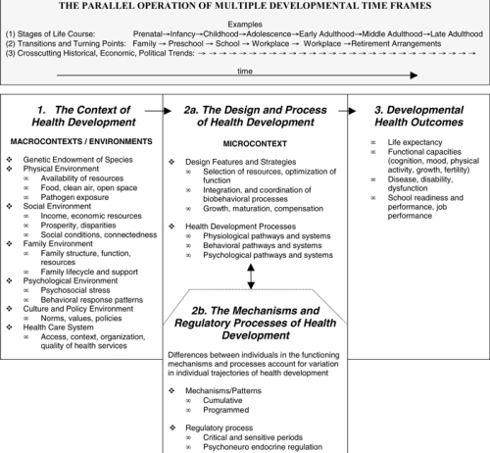
DEVELOPMENT DEPENDS ON SEVERAL FACTORS AND CAN VARY ACROSS COUNTRIES.
(Halfon & Hochstein, 2002)
Notes:
The trainer will introduce The Life Course Health Development (LCHD) Framework. This framework explains the various factors that influence human development depending on the context and resources. The audience can find the image above in Appendix A.
The LCHD framework presented here is based on four related principles that explain how biological factors and environments transform individual biobehavioral functioning across the lifespan or life course.
The multiple contexts of health development.
The design and process of health development.
Mechanisms that account for variation in the trajectories of health development.
The integration of multiple time frames of health development.

Slide 30

DOMAINS OF DEVELOPMENT
Notes:
The trainer will introduce the types of development and will point out that each will be discussed in the following slides. The trainer should say that we will heavily discuss the physical development at the biological and neurological level. Then we will go through the typical stages of adolescence.

Slide 31
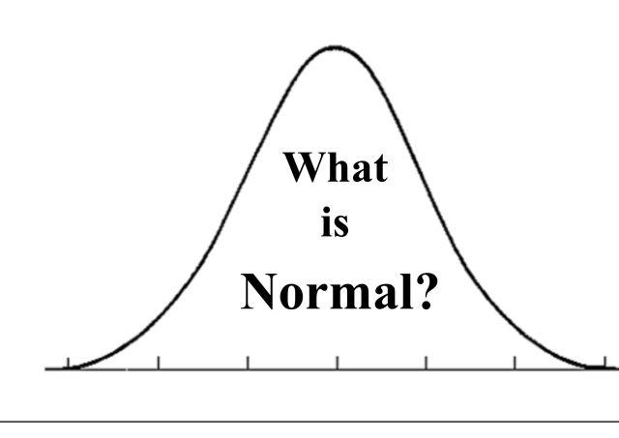
ADOLESCENT DEVELOPMENT EXERCISE
Is it normal that adolescents to...
  Argue just because they want to?
  Jump to conclusions?
  Be self-centered?
  Constantly find adults wrong?
  Be dramatic?
(APA, 2002)
Notes:
The trainer will conduct a small exercise where each participant will raise their hand if they find the statement to be true. The trainer will call on those who raise their hand to explain why they believe their position. Then the trainer will explain the research behind the statements. All statements are true. This exercise should take about 20 minutes.
Is it normal that adolescents to...
Argue just because they want to? Adolescents are practicing cognitive skills that help them see both sides of a problem, therefore they might go on tangents and also might contradict themselves, this can be frustrating for adults but it is necessary that they practice these skills.
Jump to conclusions? Adolescents are more likely to jump to conclusion as they’re continuing to learn how to have complex conversations. The shame of being wrong can be highly stressful for the adolescent.
Be self-centered? Adolescents are just becoming aware of themselves, their identities and their place in the world. Therefore they think about themselves a lot and it happens at home, school and with peers. Thinking about others is a skill they’re learning as well and should be encouraged.
Constantly find adults wrong? Adolescents are becoming aware of the flaws in adults and the world. Therefore, they will challenge adult’s positions more often as they have a need to understand the complexity of situations.
Be dramatic? Everything in their development is just beginning as we will learn in the next slides. This can be a confusing time and can lead to strong expressions of their feelings. Adults carry larger responsibilities that adolescents don’t and might not place importance on the adolescents’ problems, making the adolescent frustrated.

Slide 32
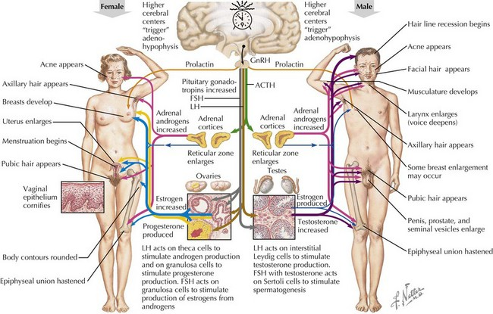
(Hopkinsmedicine.org, 2020; Standfordchildrens.org, 2020)
Notes:
The trainer will discuss the aspects within physical development that are important during adolescence. The trainer will direct the audience to Appendix A where they will find the image above to reference.
There is rapid physical growth during this period of time: the cascade of hormones during puberty begin different types of processes throughout the body. The hypothalamus is the part of the brain that controls the pituitary gland and the pituitary gland is the master gland of the body.
Body changes: adolescents grow at a very rapid rate; larger bodies, larger internal organs and stronger body scent. They also experience skin breakouts and change in voice tone.
Gender Hormones: Boys produce testosterone which begins production of semen, first erection and usually boys begin exploring themselves through masturbation. Girls produce estrogen hormones which begins the readiness of sexual maturity and usually girls begin their first menstrual cycle and breast growth during this time. Both sexes experience growth of pubic hair
Gender Differences: males and females slightly differ in onset of puberty
Boys beginning stage of puberty is from 9.5 to 14 years old.
Girls beginning stage of puberty is from 8 to 13 years old.

Slide 33
SEXUAL DEVELOPMENT
Adolescence prepares the body for reproduction.
Sexual Development Vs. Gender Identity.
Sexuality is a complex and fluid concept.
(Hopkinsmedicine.org, 2020; Standfordchildrens.org, 2020)
Notes:
The trainer should introduce the concept of sexual development and ensure the difference between development and Identity if clear.
Adolescence prepares the body for reproduction: during this period of time, the human body begins preparing to mature sexually and becomes ready for reproduction.
Sexual Development Vs. Gender Identity: Biological Sexual Development during adolescence is not the same as gender identity development. Bodily changes happen for males and females but that does not indicate their sexual preference.
The trainer should explain that sexuality is an important part of understanding puberty, as our sexuality is a key piece of our identity. Many people believe that the word sexuality is synonymous with sex. In reality sex or sexual behavior is only a small part of sexuality. Humans are sexual beings from womb to tomb.
Sexuality is s fluid concept:
The trainer should continue to the realm of sexual identity.
Biological Sex – an individual’s biological status as male or female.
Gender role - refers to the cultural expectations of male and female behavior, acting masculine or feminine. Expressive actions and/or behaviors that society connects with being male or female.
Gender Identity – identifying yourself as either male or female based on internal feelings (may be different from the biological sex).
Sexual Orientation – romantic attraction and feelings towards individuals of the same, opposite, or both sexes.

Slide 34
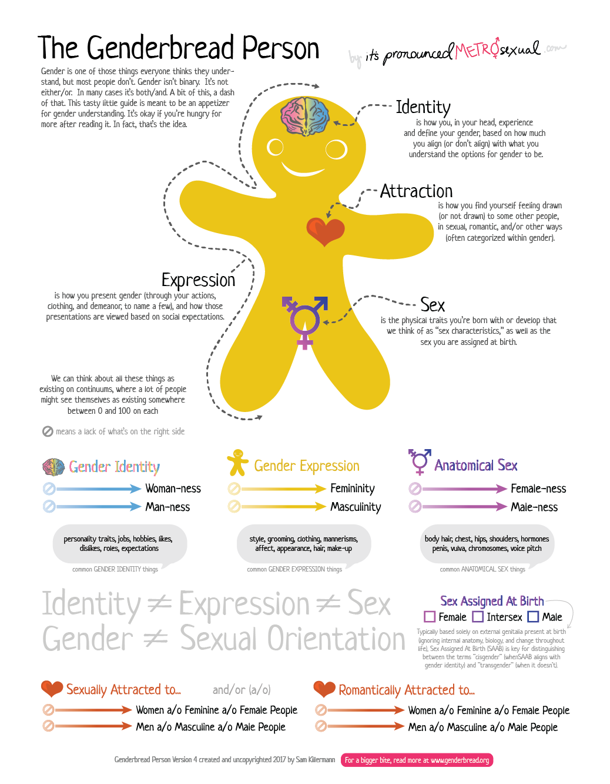
SEXUAL DEVELOPMENT EXERCISE
Find the Genderbread Person in Appendix A.
Take a few minutes to read throughout the page.
Identify your own sexual identity, expression, gender, sex and sexual orientation.
Notes:
The trainer will conduct a brief exercise for the audience to understand sexual development, identity and the fluidity of sexuality. The trainer will direct the audience to Appendix A. This exercise to take about 15 minutes.
The trainer will direct the audience to:
Find the Genderbread Person in Appendix A.
Take 15 minutes to read throughout the page.
Identify your own sexual identity, expression, gender, sex and sexual orientation.
Now the trainer will

Slide 35
EMOTIONAL/COGNITIVE DEVELOPMENT
Areas of major development:
  Abstract thinking
  Sense of identity
  Independence
  Responsibility
  Moral reasoning
(APA, 2002; Raising Children Network, 2018)
Notes:
The trainer will introduce the aspects of emotional and cognitive development.
Areas of major development:
Abstract thinking: Children’s neurological changes help them conceptualize situations, going from “black and white” thinking to a complex understanding. This skills is necessary to plan for goals, think about the future and evaluate alternatives.
Sense of identity: Adolescence is a time that is crucial where an individual becomes aware of himself/herself. They think about themselves a lot, their experience, their values, their environment and how the world interacts with them to learn about how to behave, think and feel.
Independence: A sense of independence develops and it is a health trait as it is related to their self-confidence; they’re trying to practice surviving, managing life and choices on their own.
Responsibility: Adolescents are learning about responsibility for their actions. In early stages, they still have a hard time thinking about future consequences of risky behaviors.
Moral Reasoning: refers to ethical behavior. This atmosphere should reinforce the concept that racism, sexism, homophobia, ageism, and biases against persons with disabilities are inherently destructive to both the individual and society.
Influences

Slide 36
STAGES OF ADOLESCENCE
Notes:
The trainer should introduce the topic that will be discussed, Stages of Adolescence. The trainer should also tell the group that we will discuss early, middle and late adolescence in general. The trainer should emphasize that all children develop in different ways, some slower than others, and that’s normal.

Slide 37
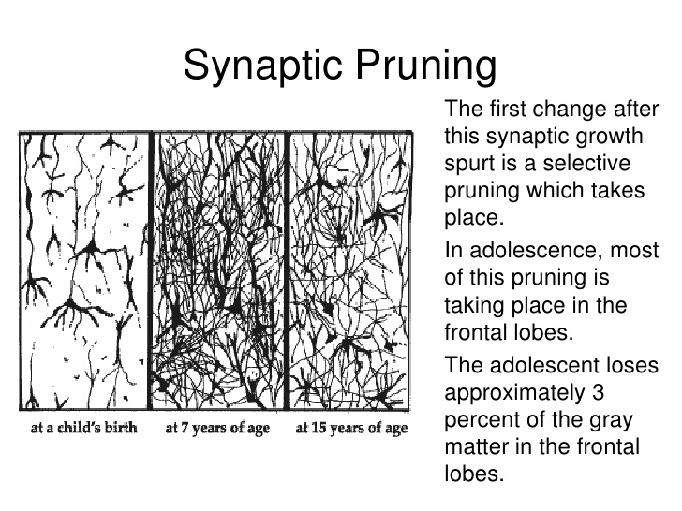
EARLY ADOLESCENCE
Early Adolescence occurs between
the ages of 10 – 14
  Fast physical growth.
  Brain begins intense shaping.
  Black and white thinking.
  Sense of identity
  Strongly identifies with peers.
  Higher need for privacy.
(Allen & Waterman, 2019; NPJS.org, 2015; Sukel, 2018)
Notes:
The trainer will introduce the brief overview of Early Adolescence (Ages 10 to 14).
Fast physical growth: During this stage, children experience rapid growth in their bodies. We discussed the physical changes before.
Brain begins intense shaping: The brain’s cells can almost double in over a year’s time period at this stage. The brain also begins a process called Synaptic Pruning; this eliminates synapses in the brain that are not necessary, and this is critical for health brain development. Neuroscientists have observed onset of serious mental illnesses at this stage such as schizophrenia.
Black-and-white thinking. Children experience “right/great” or “wrong/bad” thinking as they have not developed abstract thought.
Sense of identity: It is normal at this stage for young people to center their thinking on themselves (called "egocentrism"). They spend a lot of time thinking about themselves, their place in the world and expectations of them as they learn to figure out their sense of identity.
Strongly identifies with peers identifies strongly with a peer group in an attempt to recreate a substitute family.
Higher need for privacy. At this stage, children might become more independent and spend more time alone.
Adolescents are limited primarily by their brain development, so while they are struggling with the tasks they must accomplish, they don’t have the skills to do so in a healthy manner. Adolescents at this stage are very concrete, so that they are seeking new tasks but are grounded only in their own experiences to date, not what they may project. For example, in trying to separate from the family, that may look like just spending time away from the family, more with peers, more alone. As they are still limited, they seek what is familiar, so that if there is dysfunction in the family, it is likely that the peer group with which they identify mimics the same dysfunction. For example, if there is a dynamic of family violence, there is likely to be violence among their peers.

Slide 38

MIDDLE ADOLESCENCE
Middle Adolescence occurs between
the ages of 15 - 17
Physical changes continue.
Brain continues to change
Interest in romantic and sexual relationships.
Child-parent conflict
Higher concern for others & empathy
(Allen & Waterman, 2019; NPJS.org, 2015;NSP, 2009; Sukel, 2018)
Notes:
In this section the trainer will continue describing general changes in middle adolescence. This is a period of great conflict, as the young person continues to struggle to accomplish the tasks of adolescence, but now is becoming aware of his/her limitations. This result in frustrations, which can get projected onto the family or other authority figures. As such, adolescents will identify even more with their peers, while the family adjusts to the new stage in their own development. They are still grounded in what is concrete, so that they will demonstrate their separateness through dress, language, music, etc.
Physical changes continue: The body continues to grow and adapt to adulthood. At this stage girls usually have regular periods.
The brain continues to change: Much of this is because the frontal lobes are the last areas of the brain to mature―development is not complete until a person is well into their 20s! The frontal lobes play a big role in coordinating complex decision making, impulse control, and being able to consider multiple options and consequences. Middle adolescents are more able to think abstractly and consider "the big picture," but they still may lack the ability to apply it in the moment. For example, in certain situations, kids in middle adolescence may find themselves thinking things like:
"I'm doing well enough in math and I really want to see this movie… one night of skipping studying won't matter."
Do I really have to wear a condom during sex if my girlfriend takes the pill?"
"Marijuana is legal now, so it can't be that bad.“
Interest in romantic and sexual relationships: During this stage, teenagers begin to question their romantic preferences as well as their bodies through masturbation. Teens begin to develop feelings of attraction and live towards peers.
Child-parent conflict: They may spend less time with family and more time with friends, also tend to test limits from parents more.
Higher concern for others & empathy: At this stage, more complex thinking is achieved and teenagers are able to “put themselves in someone else’s shoes”, thus creating feelings of empathy.

Slide 39

LATE ADOLESCENCE
Late Adolescence occurs between
the ages of 18 – 24
Firmer sense of identity
Developed bodies
Invincible complex
Brain changes
(Allen & Waterman, 2019; NPJS.org, 2015;NSP, 2009; Sukel, 2018)
Notes:
At this stage, brain development has progressed and the need to ground oneself in the concrete begins to fade. The focus is on determining one’s new identity, in relationship to the family, the community and society as a whole. The trainer should ask for some examples of how young people begin to determine how to handle their separation from the family in terms of their identity, bringing the group back to the point that this stage doesn’t end at 18, but continues as the brain completes its development.
Ability to control impulses: Increased control over emotions and instant gratification is evident as they’re able to think more about the future, consequences and their life’s goals. Additionally, they’re able to conceptualize social and cultural norms and expectations and higher sense of identity.
Developed bodies: At this stage puberty has ended and bodies are fully developed and mature enough for reproduction.
Invincible complex: “It won’t happen to me” it is a frequent rational and behavioral response in adolescents. There is a desire to thrill-seeking and new adventures and thus more likely to try risky behaviors.
Brains changes: The last area to develop in adolescents in the pre-frontal lobes. This area must be stimulated by adults as reasoning ability is a learned skill. Having frequent “learning moments” to teach adolescents to conceptualize complex satiations and exercise imagination and possibilities can be extremely positive.

Slide 40

What are my values on Adolescent AOD Use?
Identifying personal values regarding adolescent alcohol and other drug (AOD) use is important for effective communication about these issues with your clients.
Notes:
The trainer will explain that, key to the work that is performed with adolescents, is the understanding of the values and belief system we bring into our work. S/he should ask the group why they believe that their own beliefs would impact work with adolescents. The trainer should lookout for responses such as: bias in development of treatment plans, preconceived notions about clients which can be barriers to a thorough assessment, the adolescent can perceive these beliefs, etc.
The trainer will then explain that the next exercise is to focus on clarifying our own values. S/he should explain that, as far as values are concerned, there are no “right” or “wrong” answers, and that everyone should challenge themselves to be honest regarding their beliefs and responses. The trainer will explain that the next exercise is called “forced choices” and will require that everyone “take a stand” regarding their own reactions to the statements read.

Slide 41
WHEN IS ADOLESCENT SUBSTANCE USE A PROBLEM?
Adolescents experiment with new experiences as part of their developmental stage.
Experimentation of alcohol is the most common, but this doesn’t necessarily indicate that it will be a substance abuse issue.
When the use begins to affect the following domains, then it can indicate a serious problem:
  Educational performance
  Peer and family relationships
  Delinquent behavior
(APA, 2013; Drgufree.org, 2020)
Notes:
The trainer can pose the question to the audience to hear some an
Adolescents experiment with new experiences as part of their developmental stage: it can be a normal expression of a developmental stage of the adolescent and combined with possible peer pressure. It is always important to understand the motivation of the behavior.
Experimentation of alcohol is the most common, but this doesn’t necessarily indicate that it will be a substance abuse issue: in the same way that some adolescents begin to experiment, they also stop on their own, so it is important to bring attention to the behavior if it becomes a problem.
When the use begins to affect the following domains, then it can indicate a serious problem:
Educational performance
Peer and family relationships
Delinquent behavior
swers.

Slide 42
CLINICAL DEFINITION OF SUBSTANCE ABUSE
The ICD defines Dependence Syndromes as a cluster of physiological, behavioral and cognitive phenomena in which the use of the substance takes higher priority in an individual.
  Drug Use: Pattern of psychoactive substance use that is causing damage to health.
  Drug Abuse: a strong desire to have the drug.
  Dependence: Physiological need to have the drug.
(APA, 2013; WHO, 2019)
Notes:
The trainer will provide a definition of substance abuse as indicated by the ICD-11. The trainer should spend more time discussing the ICD-10 and the guidelines below.
ICD Definition: The Tenth Revision of the International Classification of Diseases and Health Problems (ICD-10) defines the dependence syndrome as being a cluster of physiological, behavioural, and cognitive phenomena in which the use of a substance or a class of substances takes on a much higher priority for a given individual than other behaviours that once had greater value.
ICD-10 Diagnostic guidelines
A definite diagnosis of dependence should usually be made only if three or more of the following have been present together at some time during the previous year:
A strong desire or sense of compulsion to take the substance;
Difficulties in controlling substance-taking behaviour in terms of its onset, termination, or levels of use;
A physiological withdrawal state when substance use has ceased or have been reduced, as evidenced by: the characteristic withdrawal syndrome for the substance; or use of the same (or closely related) substance with the intention of relieving or avoiding withdrawal symptoms;
Evidence of tolerance, such that increased doses of the psychoactive substance are required in order to achieve effects originally produced by lower doses (clear examples of this are found in alcohol- and opiate-dependent individuals who may take daily doses sufficient to incapacitate or kill nontolerant users);
Progressive neglect of alternative pleasures or interests because of psychoactive substance use, increased amount of time necessary to obtain or take the substance or to recover from its effects;
Persisting with substance use despite clear evidence of overtly harmful consequences, such as harm to the liver through excessive drinking, depressive mood states consequent to periods of heavy substance use, or drug-related impairment of cognitive functioning; efforts should be made to determine that the user was actually, or could be expected to be, aware of the nature and extent of the harm.

Slide 43
Complete the sentences…
Adolescents today are...
Adolescents today should ..
When I was an adolescent, I felt...
When I was an adolescent, I wanted...
Notes:
The trainer should ask the participants to complete the following sentences through a brainstorm exercise. The trainer will note responses on the Easel pad. After everyone has responded, s/he should read the following quotes, asking the group to identify when in time they believe the quote was originally said.
“I see no hope for the future of our people if they are dependent on frivolous youth of today, for certainly all youth are reckless beyond words…When I was young, we were taught to be discreet and respectful of elders, but the present youth are exceedingly disrespectful and impatient of restraint.”
Hesiod, 8th Century BC
“Our youth now love luxury. They have bad manners, contempt for authority; they show disrespect for their elders and love chatter in place of exercise; they no longer rise when elders enter the room; they contradict their parents, chatter before company; gobble up their food and tyrannize their teachers.”
-Socrates, 5th Century BC
The trainer should point out that adolescence today is not all that different from adolescence throughout time, and that adults have always tended to see adolescents in the same light.

Slide 44

Forced Choices Exercise
Notes:
The trainer will read a variety of statements in connection to adolescents and adolescent AOD use.
Forced Choices Exercise Instructions:
Participants will choose to either agree or disagree with the statements below. This will help participants identify some of their values regarding their personal views. The trainer can ask the group to either move to one extreme of the room if they agree with the statement read, or to the other side of the room if they disagree with the statement read. Alternately, the trainer can ask participants to stand up if they agree with the statement read or remain seated if they disagree with the statement read.
The trainer should read each statement and allow participants to indicate if they agree with the statement or disagree with the statement. Once they have indicated their choice, the trainer should ask those who agreed with the statement why they believe that someone might disagree with the statement. Then, s/he should ask those who disagreed with the statement why they believe that someone might agree with the statement. The trainer should allow some time for discussion.
The trainer should then read each of the following statements, allowing participants to respond and to defend why someone might respond opposite to their own beliefs.
STATEMENTS:
I think that alcohol and other drug use is a normal developmental process.
I am comfortable if an adolescent tells me s/he likes AOD use.
It is acceptable for a seventeen-year-old to drink alcohol.
It is the family’s job to address any adolescent alcohol or drug use.
It’s to be expected that a young person experiments with marijuana.
By providing medically accurate information about both the risks and perceived benefits of alcohol and other drug use, it encourages adolescents to experiment.
Most adolescent boys will try alcohol before legal age.
Most adolescent girls will try alcohol before legal age.
Alcohol and other drug use are more harmful to younger adolescents than to older adolescents.
Early alcohol and other drug use are an indicator that an adolescent has some form of pathology.
Young people court mandated into treatment are likely to be more successful in treatment than young people who come into treatment due to their family's urging.
A fifteen-year-old is capable of making positive choices on his/her own.
The family is the key factor in providing drug treatment to adolescents.
It is more understandable that a young male experiments with alcohol and other drugs than when a young female does it.
Addressing alcohol and other substance misuse in adolescence will prevent later use as an adult.

Slide 45
THE ADOLESCENT BRAIN ON DRUGS

Slide 46
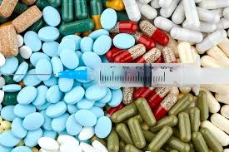
TYPES OF SUSBTANCES
Alcohol
Marihuana (Cannabis)
Tobacco & Nicotine Products
Inhalants
Cocaine Substances
Amphetamine Stimulants (Ecstasy)
Opioids (Heroin)
Controlled Prescription Drugs
Psychoactive Drugs
Energy drinks
Bath Salts
(NIH, 2019)
Notes:
The trainer will describe the different types of substances that adolescents might use. The trainer can ask the group what are some examples of types of substances they’ve heard adolescents consume. The trainer can ask the group if there are any other substances that adolescents use that is not mentioned on this PowerPoint slide.
The trainer will become familiar with the descriptions below and briefly discuss with the group. The NIH Drug Facts sheets are on the reference list for participants to read further on each of the drugs (NIH, 2019)
Alcohol: found in beer, wine, hard liquor comes from fermentation of sugars and yeast.
Marihuana (Cannabis): Marijuana refers to the dried leaves, flowers, stems, and seeds from the hemp plant, Cannabis sativa.
Tobacco: Contains nicotine, an ingredient that can lead to addiction, which is why so many people who use tobacco find it difficult to quit.
Inhalants: solvents (liquids that become gas at room temperature), aerosol sprays, gases, nitrites.
Cocaine Substances: a strong addictive stimulant drug made from the leaves of the coca plant.
Amphetamine Stimulants (Ecstasy): Also called Molly, is a 3,4-methylenedioxy-methamphetamine (MDMA) is a synthetic drug that alters mood and perception.
Opioids (Heroin): Heroin is an opioid drug made from morphine, which is a natural substance taken from the seed pod of the various opium poppy plants.
Controlled Prescription Drugs: Controlled substances are prescribed by a medical professional; they range from stimulants, depressants to painkillers.
Psychoactive Drugs: Also called Hallucinogens are spilt into two categories classic hallucinogens (such as LSD) and dissociative drugs (such as PCP). Both types of hallucinogens can cause hallucinations, or sensations and images that seem real.
Energy drinks: newer trends among adolescents and readily available over the counter, they contain a high dose of caffeine.
Bath Salts: Synthetic cathinones are human-made stimulants chemically related to cathinone, a substance found in the khat plant.
Although there is a wide range of substances, the trainer should point out that the focus will be on Alcohol and Marihuana as they are the most used substances.

Slide 47
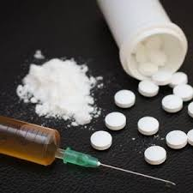
ROUTES OF DRUG ADMINISTRATION
Oral – swallowed
Sublingually –Placed under tongue
Buccally – Placed between cheek/gums
IV – Given by injection into vein
Rectal –Placed into rectum
Ocular route- Placed in the eye
Nasally -Sprayed into the nose
Inhalation –Inhaling vapors by mouth and/or nose into lungs
Applied to the skin
Notes:
The trainer will discuss the general routes of drug administration. These are routes used by different types of substances, the trainer should ask the group if they’re aware of other ways of administering drugs into the body that are not mentioned in this list.
The trainer should discuss the following more in detail:
Oral:
The trainer should begin with the oral route. The drug gets into the blood by passing through the stomach to the small intestine where it is absorbed into the blood (like food or beverages). The drug must be absorbed into the blood, go to the heart, to the lungs, to the heart again, then to the brain. The drug is also diluted in with the food and beverages. This is a long and not very efficient way to take drugs. Drugs which are taken this way include alcohol, pills, marijuana or hashish.
IV:
The trainer should continue with injection. The drug goes directly into the bloodstream, through a subcutaneous injection (under the skin), an intramuscular injection (skin popping) or an intravenous injection (mainlining). The person gets the drug directly, with no gradual onset, so the user experiences what is called a "rush," which is the high all at once. Risks are related to unsanitary injection equipment, poor injection techniques, and toxins in the drugs. Poor injection techniques can produce damage to the nerves or abscesses. Bacteria injected can cause endocarditis, an infection around the lining of the heart. Heroin can be injected in any manner, cocaine can only be injected intravenously, due to its toxicity.
SMOKED:
The trainer should conclude with smoking or inhaling. The drug goes through the lung where air comes close to blood vessels for the exchange of oxygen and carbon dioxide. If stretched out, the surface area for this exchange inside the lungs would cover half a football field. The route is much shorter. as the blood only has to go from the lungs to the heart to the brain. This is the most efficient way to get your drug into your system. It also has a quick onset, with a "rush." Risks include damage to the lungs and frequent respiratory problems. Drugs taken this way include tobacco, crack/cocaine, marijuana and hashish.
Nasally:
The trainer should continue with sniffing. The drugs is passed through the mucous membranes, which are very thin and filled with blood vessels. These membranes are in the nose, gums and genitals. The drug passes through the membrane easily, gets into the blood, to the heart, lungs, then brain. This is a more efficient way to take drugs, although the risk is high for damage to these membranes. Drugs taken this way include tobacco, cocaine and heroin.

Slide 48
CIGARETTES & TOBACCO
Notes:
The trainer will introduce the prevalence of Cigarettes by region as per the Center for Disease Control’s Global Youth Tobacco Survey. These surveys are conducted in all regions; African, Middle Eastern, The Americas, Europe and South East Asia.
The trainer will also emphasize the range of age in these surveys are teenagers from 13-15 years old.

Slide 49
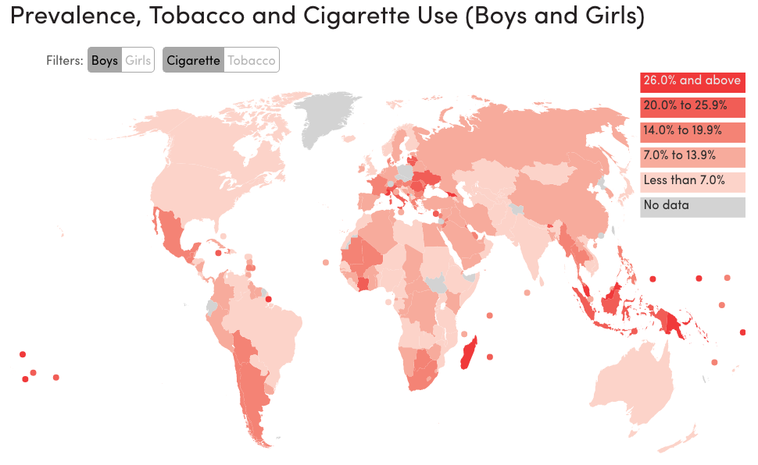
(Tobaccoatlas.org, 2019)
Notes:
The map displays data of cigarette use by adolescent boys across the globe. The trainer should explain that the darker red indicated highest prevalence.

Slide 50
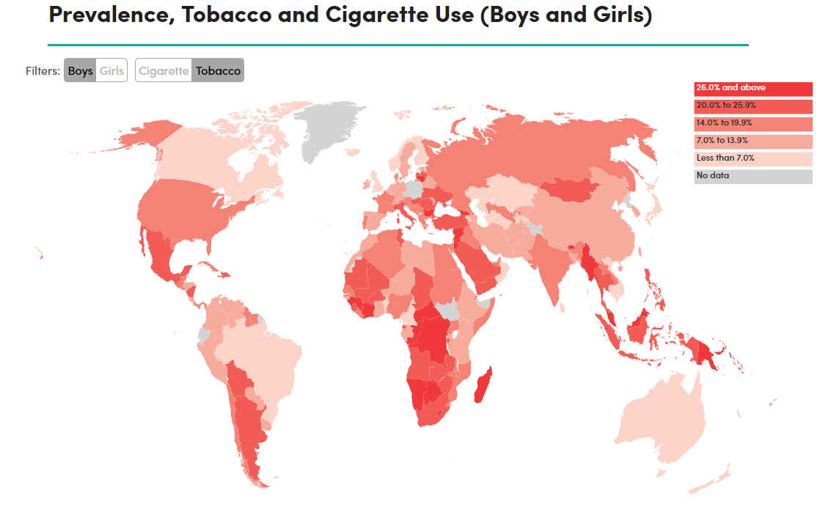
(Tobaccoatlas.org, 2019)
Notes:
The map displays data of Tobacco use by adolescent boys across the globe. The trainer should explain that the darker red indicated highest prevalence.

Slide 51
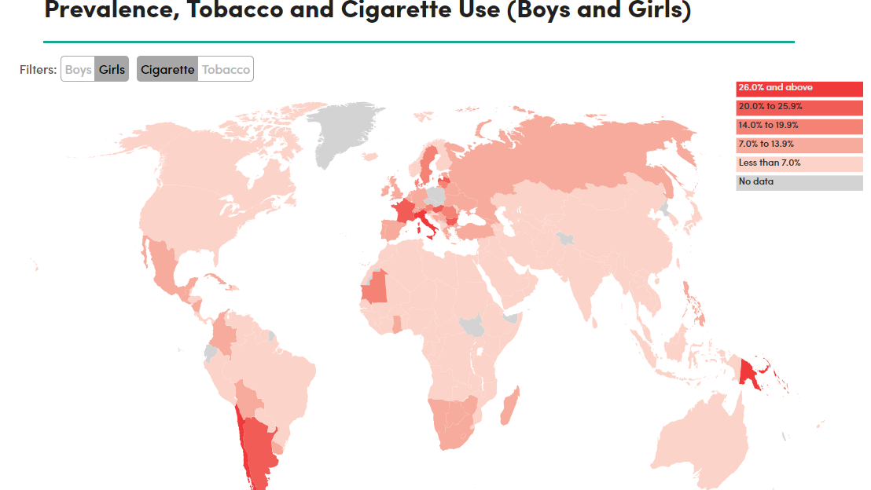
(Tobaccoatlas.org, 2019)
Notes:
The map displays data of cigarette use by adolescent girls across the globe. The trainer should explain that the darker red indicated highest prevalence.

Slide 52
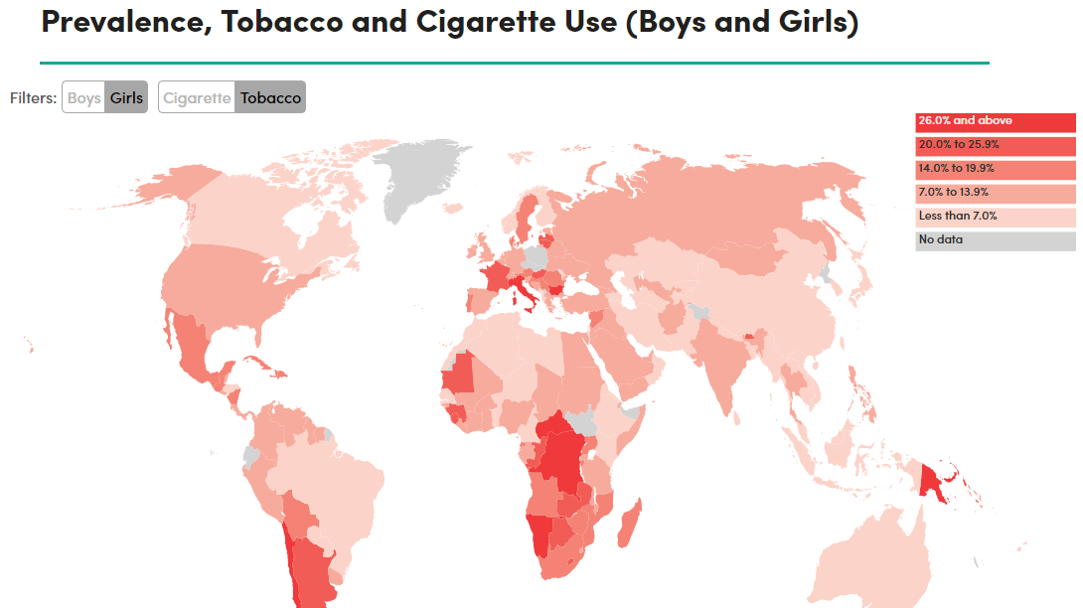
(Tobaccoatlas.org, 2019)
Notes:
The map displays data of Tobacco use by adolescent girls across the globe. The trainer should explain that the darker red indicated highest prevalence.

Slide 53
ALCOHOL
Notes:
The trainer will introduce the prevalence of Alcohol by region as per the World Health Organization (WHO) and the Department of Health and Human Services (hhs.gov). These surveys are conducted in all regions; African, Middle Eastern, The Americas, Europe and South East Asia. In this section, we will also cover the effects of alcohol in the adolescent brain.

Slide 54
ALCOHOL IN ADOLESCENTS
Alcohol is the most used drug among adolescents, even more than Marihuana and Tobacco.
Adolescent males drink at a slightly higher rate than adolescent females.
Adolescents who drink alcohol are more likely to skip school, fail grades and become more aggressive in the future.
Adolescents who use alcohol are more likely to try other drugs.
Historically since 2002 to 2015 rates of underage drinking have remained stable.
(Alcohol.org, 2019; HHS, 2019;YRBSS, 2016)
Notes:
The trainer will discuss facts about alcohol in adolescents.
Alcohol is the most used drug among adolescents, even more than Marihuana and tobacco.
Adolescent males drink at a slightly higher rate than adolescent females.
Adolescents who drink alcohol are more likely to skip school, fail grades and become more aggressive in the future.
Adolescents who use alcohol are more likely to try other drugs.
Historically since 2002 to 2015 rates of underage drinking have remained stable.

Slide 55
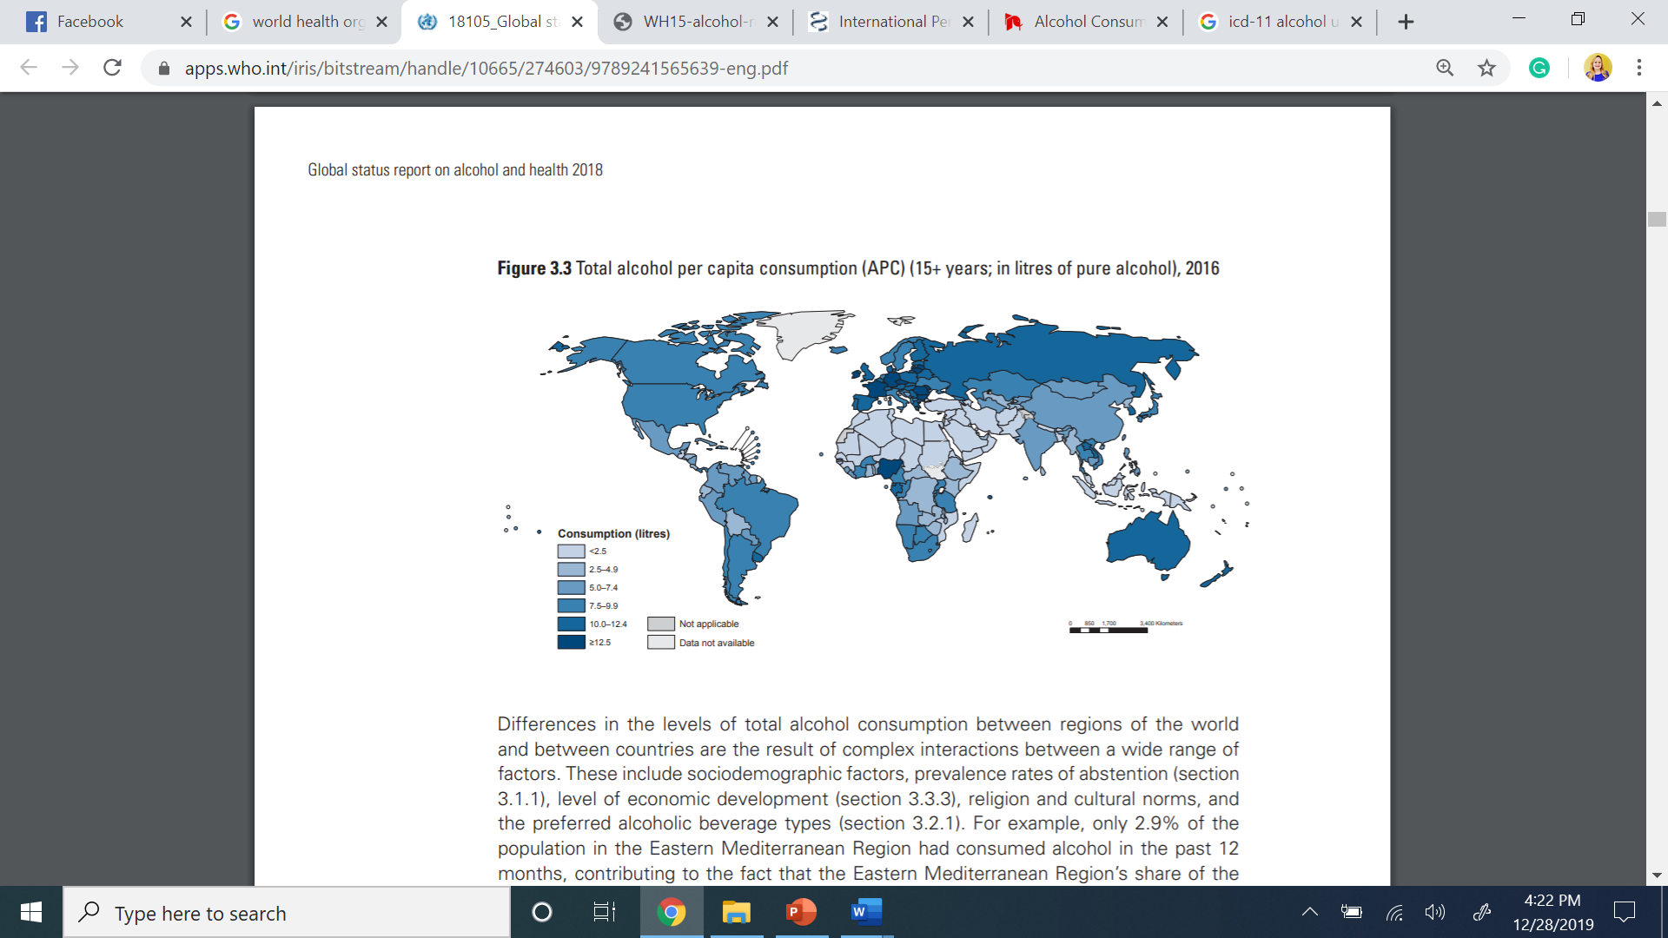
WHO, 2018
Notes:
The trainer will present the world map by the World Health Organization’s Alcohol status report in 2018. The trainer should clarify that the current data displays the current prevalence of alcohol consumption of people 15 and over.
The trainer should emphasize the numbers of the following data:
The European Region has the highest rate of all (43.8%)
The Region of the Americas has the second’s highest at (38.2%)
The Western Pacific Region (37.9%).
The Eastern Mediterranean Region has the lowest rates (1.2%)
Global trends:
Average alcohol consumption was highest in Europe, the Americas, and established market economies such as Australia, Japan, and New Zealand.
Average alcohol consumption generally was lower in Africa and Asia.
Alcohol consumption was particularly low in the Muslim countries in the eastern Mediterranean region and on the Indian subcontinent.

Slide 56
ALCOHOL IN ADOLESCENTS GLOBALLY
Worldwide, more than a quarter (26.5%) of all 15–19-year-olds are current drinkers, amounting to 155 million adolescents:
Region | Adolescents (15-19) in millions
African Region | 22.5
The Americas | 29.9
Mediterranean Region | .7
South-East Asia Region | 37.9
Western Pacific Region | 41.9
(WHO, 2018)
Notes:
The trainer will discuss the current number of adolescent users across the globe. The trainer should point out this data is measured by numbers in millions per region.

Slide 57
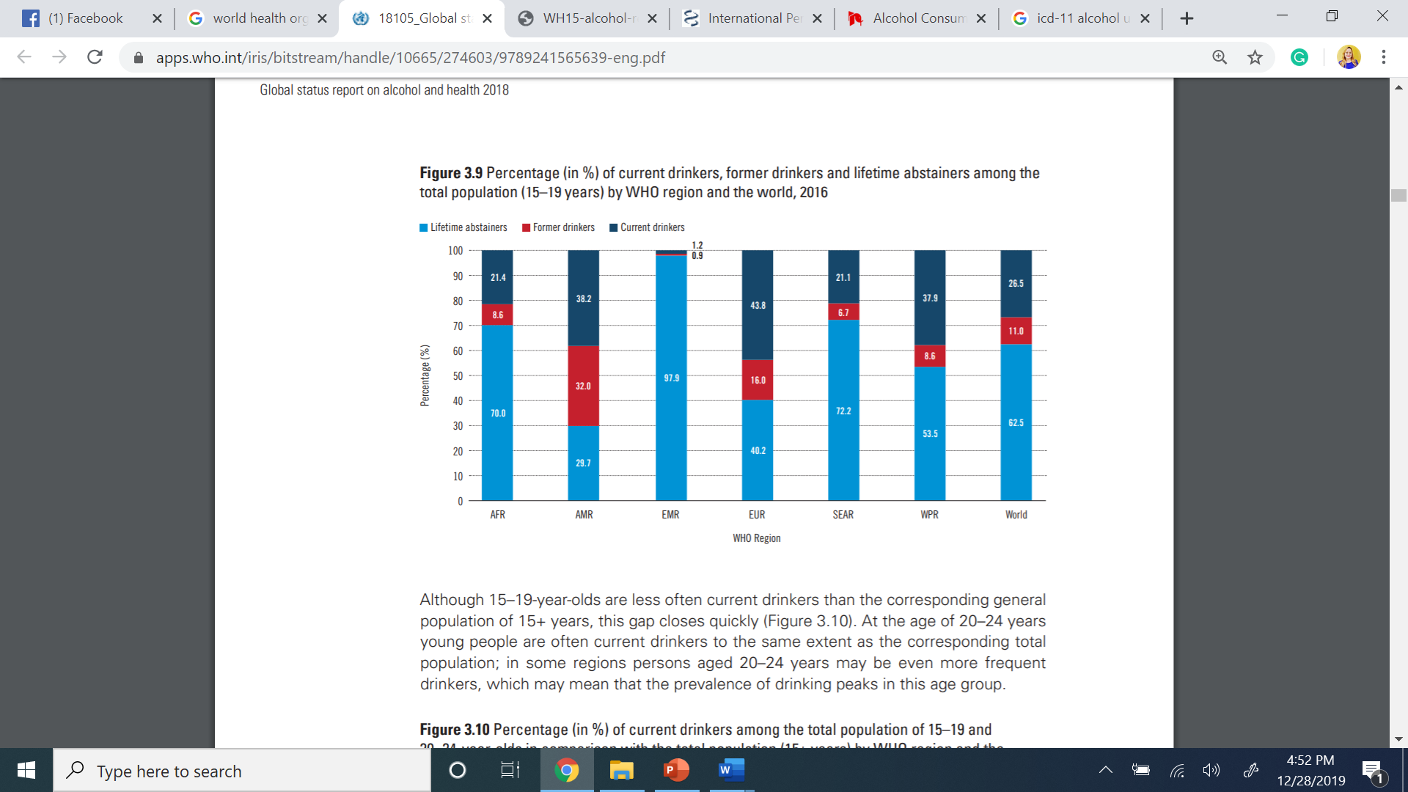
Notes:
The trainer will discuss the data and assist the audience interpret the numbers. More importantly, the trainer should point out that most adolescents do not use alcohol and/or experiment with alcohol but are not current drinkers.
Acronyms for regions:
AFR = African Region, 21.4% are current drinkers.
AMR = The Americas Region, 38.2% are current drinkers.
EMR = Middle Eastern Region, 1.2% are current drinkers.
EUR = European Region, 43.8% are current drinkers.
SEAR = South-East Asian Region, 21.1% are current drinkers.
WPR = Western Pacific Region, 37.9 % are current drinkers.
World = 26.5% are current drinkers.

Slide 58
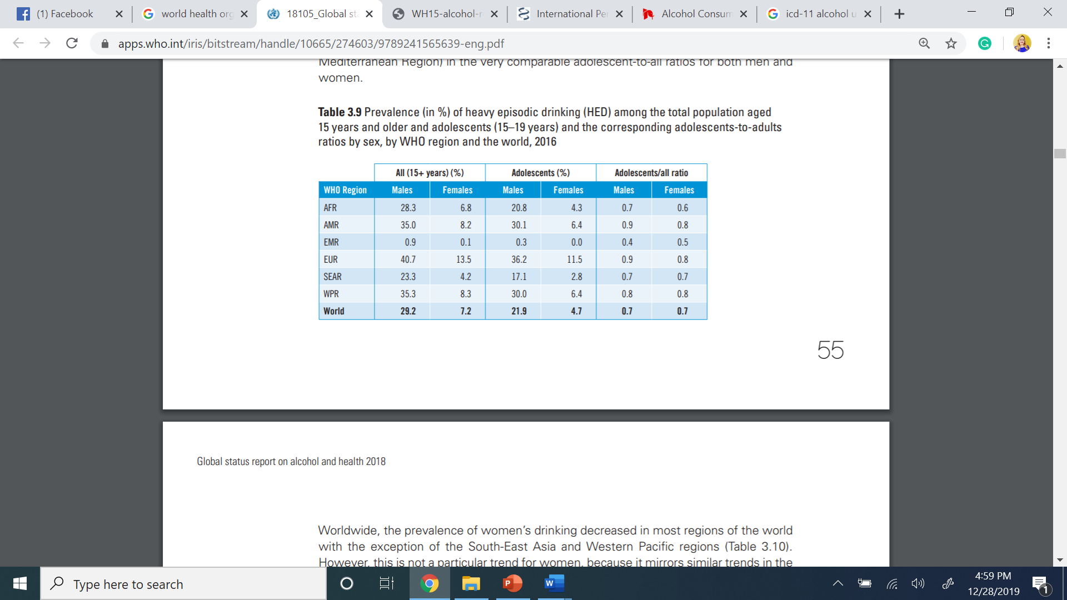
Notes:
The trainer should point out the difference between adult drinkers and adolescent drinkers across regions. It is important to point out that the rate of percentage of adolescents comes from the overall number of drinkers. For example; in the Americas Region 35.0 percent of all males 15+ includes all adults as well, but from that number there are 30.1% of adolescents, therefore there are more adult drinkers in general than adolescents. The data must not be interpreted in a way that can mistake the perception of the rate of alcohol use among adolescents.

Slide 59
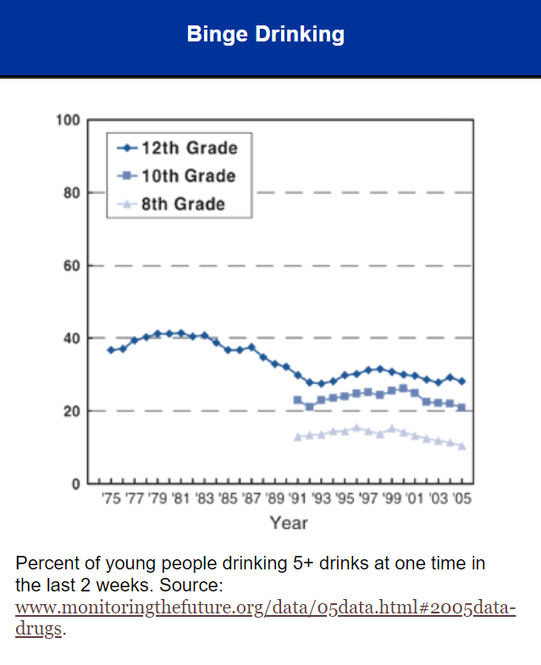
ADOLECENT BINGE DRINKING
Binge drinking is the most harmful way adolescents use alcohol.
From those who drink, 18% binge drank alcohol.
Young males are more likely to engage in binge drinking.
Violence behavior such as; motor vehicle accidents, homicide and suicide can result from binge drinking.
(NIAAA, 2004)
Notes:
The trainer will discus the topic of binge drinking as it is one of the most harmful and most common ways young adolescents use alcohol.
Binge drinking is the most common way that adolescents use alcohol: Binge drinking is defined, for males, as drinking five or more drinks on one occasion, and, for females, four or more drinks on one occasion.
Binge drinking is the most harmful way adolescents use alcohol.
From those who drink, 18% binge drank alcohol.
Young males are more likely to engage in binge drinking.
Violence behavior such as; motor vehicle accidents, homicide and suicide can result from binge drinking.

Slide 60
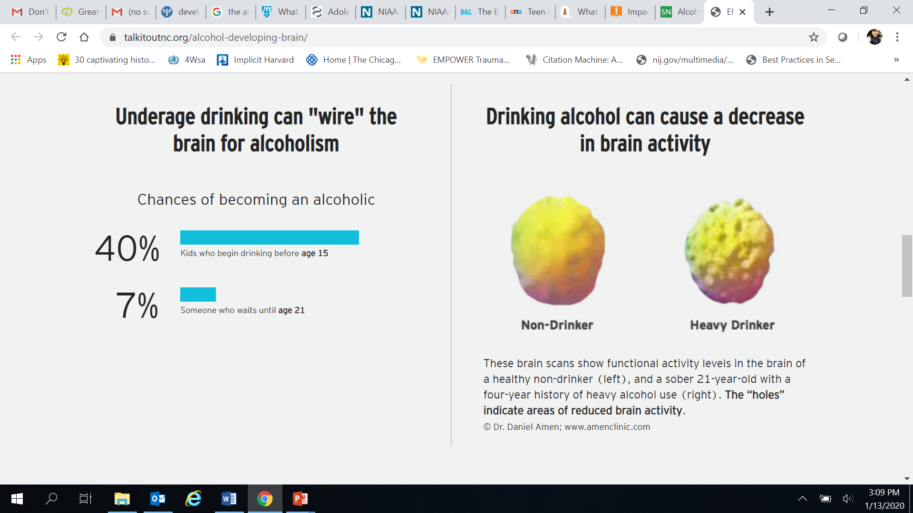
THE ADOLESCENT BRAIN ON DRUGS: ALCOHOL
It is paramount to discourage substance use until neurobiological development is complete.
Underage drinking can wire the brain for alcoholism.
Prolonged alcohol use during adolescent can cause irreversible damage.
(Amen Clinics, 2020; Silvery, 2012; Risher et al, 2015; Talkitoutnc.org, 2020)
Notes:
The trainer will introduce how certain drugs affect the brain. The trainer should explain that substance use hijacks the brain’s “wiring.” This wiring is responsible for everything from low level function, such as major movements, to high level function, such as decision-making and judgment.
It is paramount to discourage substance use until neurobiological development is complete: research strongly suggest the brain is impacted by early use of substances. Even substances like Alcohol which are legal at age 18 can impact adolescent’s cognitive abilities and decision-making capacity. Neurological damage has been observed in brain connections (synapses).
Underage drinking can wire the brain for alcoholism: Research suggest that when adolescents use alcohol, 90% of the time is it by binge drinking. This type of drinking causes major impairment and increases the likelihood of becoming an alcoholic by 40%. Prolonged drinking causes brain inflammation.
Prolonged alcohol use during adolescent can cause irreversible damage: research suggests that nerve cells in the brain are immature throughout adolescence and past the min-20s. Using Alcohol for a prolonged period of time during a crucial developmental time causes irreversible damage; those who drink more lose more white matter which helps send messages quicker and for longer distances within the brain.

Slide 61
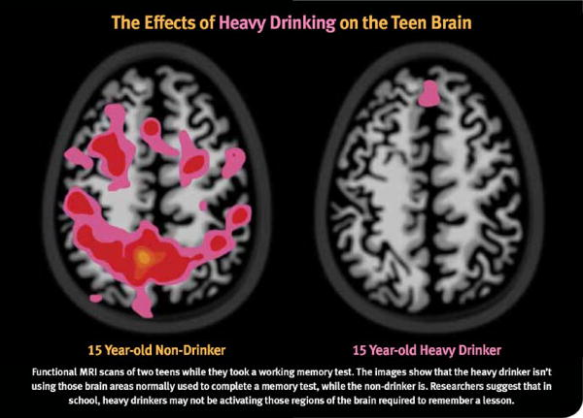
(Paturel, 2012)
Notes:
The trainer should explain that the image represents two teenagers; one a heavy drinker on the right and a nondrinker on the left. They are both working on a memory test. It is evident that areas in the heavy drinker brain are not active, thus performance is lower and the task can be viewed as too difficult.
Researchers suggest that in school, heavy drinkers may not be activating those regions of the brain required to remember a lesson.

Slide 62
MARIHUANA
Notes:
The trainer will introduce the prevalence of Marihuana and facts about adolescent use of Marihuana.

Slide 63
MARIHUANA (CANNABIS)
Cannabis use can have a negative impact in the adolescent brain, resulting in irreversible neurological damage.
Cannabis use among adolescents has increased overtime as it can be viewed as a socially accepted behavior in many countries globally.
Cannabis is the preferred drug of choice among young people. It is often consumed along with other substances.
Social norms in some countries have created a cultural acceptance of Marihuana use.
Early onset is a predictor of chronic substance use among adolescents.
(OAS/CICAD, 2019; UNODC, 2018)
Notes:
The trainer can define what is Marihuana? Or can ask the group to provide their definition and understanding of the drug. Marijuana refers to the dried leaves, flowers, stems, and seeds from the hemp plant, Cannabis sativa. The plant contains the mind-altering chemical delta-9-tetrahydrocannabinol (THC) and other related compounds. Extracts can also be made from the cannabis plant.
Cannabis use can have a negative impact in the adolescent brain, resulting is irreversible neurological damage.
Cannabis use among adolescents has increased overtime as it can be viewed as a socially accepted behavior in many countries globally.
Cannabis is the preferred drug of choice among young people. It is often consumed along with other substances.
Social norms in some countries have created a cultural acceptance of Marihuana use.
Early onset is a predictor of chronic substance use among adolescents.

Slide 64
MARIHUANA CONTINUED
Smoking Marihuana can lead to breathing problems in the future.
Eating Marihuana can lead to poisoning.
Using marihuana in adolescence can damage the developing brain.
Research suggest that using marihuana before the age of 16 are at high risk of developing drug use disorders and mental health problems such as anxiety, depression, and personality disorders.
Adolescents experience lack of motivation, poor school performance and general dissatisfaction with life.
(NIDA, 2017; OAS/CICAD, 2019; UNODC, 2018)
Notes:
Smoking Marihuana can lead to breathing problems in the future.
Eating Marihuana can lead to poisoning.
Using marihuana in adolescence can damage the developing brain.
Research suggest that using marihuana before the age of 16 are at high risk of developing drug use disorders and mental health problems such as anxiety, depression, and personality disorders.
Adolescents experience lack of motivation, poor school performance and general dissatisfaction with life.
Brain development will be covered in more detail in the next module.

Slide 65
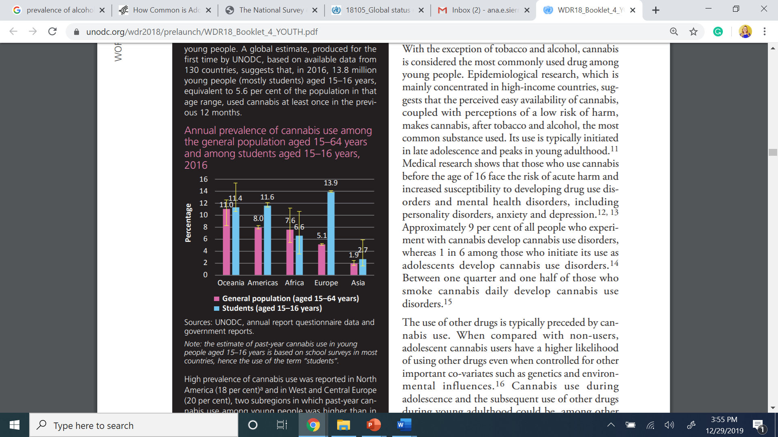
(UNODC, 2018)
Notes:
The trainer will introduce the global prevalence of Marihuana or Cannabis use among young people by the UNODC.
Cannabis use among young people In most countries, cannabis is the most widely used drug, both among the general population and among young people. A global estimate, produced for the first time by UNODC, based on available data from 130 countries, suggests that, in 2016, 13.8 million young people (mostly students) aged 15–16 years, equivalent to 5.6 per cent of the population in that age range, used cannabis at least once in the previous 12 months.

Slide 66
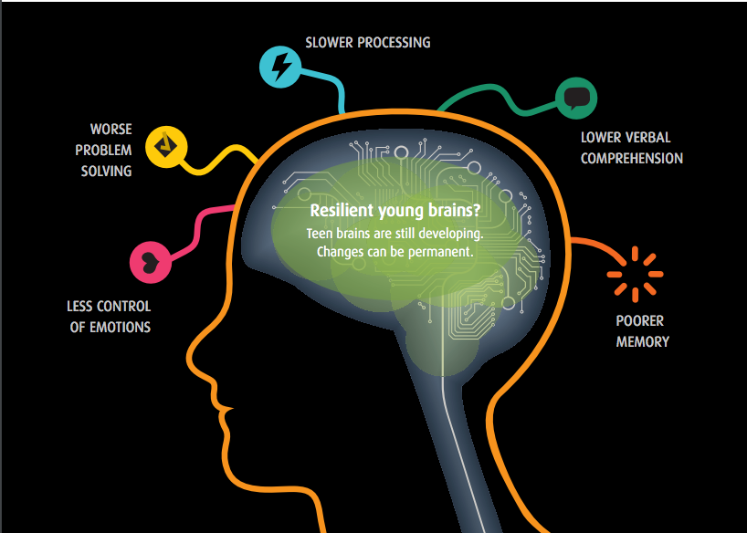
THE ADOLESCENT BRAIN ON DRUGS: MARIHUANA
Most utilized illicit drug.
Impairs brain systems.
Poor mental health
Gateway drug.
(APA, 2015; Drugabuse.gov, 2019; Orr et al, 2019; HHS.gov, 2018)
Notes:
The trainer will discuss the impact of marihuana use on the developing brain.
Most utilized illicit drug: Marihuana is quickly becoming more accepted in societies through the legality of it in many contexts. Although this drug has provided evidence of positive effects treating terminal illnesses, pains and seizures, the risks for this drug on the developing brain for regular use are concerning.
Impairs brain systems: In the short term, marijuana use has been shown to impair functions such as attention, memory, learning and decision-making. Use of marihuana is linked to impairment of critical systems that help the brain shape and grow, these systems are linked to emotions and response to stress. A study of 46 brains of 14 year old children found enlarged gray matter which contradicts adolescent development by disrupting the synaptic pruning process.
Poor mental health: Additionally, marihuana use is linked to learning problems, lower IQ and increased suicidal attempts. Recent genetic studies have found long-term users’ specific genes are affected that place them at higher risk of mental health issues.
Gateway drug: there is a 130% likelihood that an adolescent using marihuana regularly will also use opioids.

Slide 67
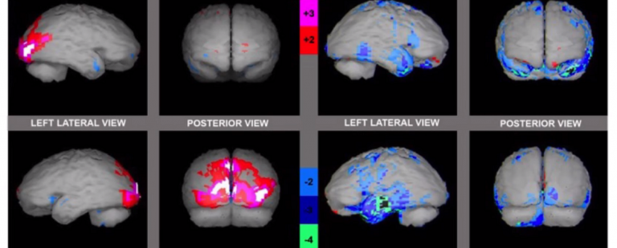
Healthy Brain Marihuana
(Mena et al, 2013)
Notes:
A Study by Mena et al, 2013 found that students that were consumers exclusively of marihuana demonstrate coincident abnormal findings of neuroimages and neuropsychological tests in areas of the brain related with learning and also significant differences between consumers with non-consumers in the neuropsychological tests.

Slide 68
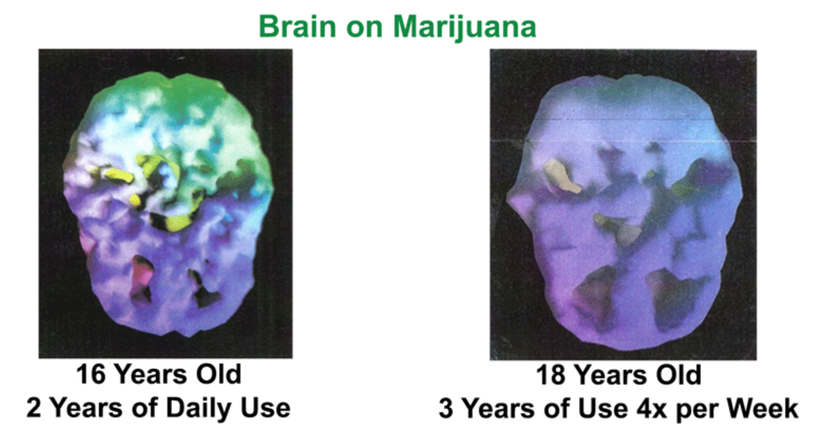
(Lodiaction.org, 2020)

Slide 69
PREFRONTAL CORTEX AFFECTED AREAS
Controlling impulses
Inhibiting inappropriate behavior
Initiating appropriate behavior
Stopping an activity on completion
Shifting/Adjusting behavior when situation changes
Providing a temporary workspace for working memory
Organizing things
Planning behavior
Setting priorities among tasks and goals
Making decisions
Empathy
Sensitivity to feedback (reward and punishment)
Insight
Notes:
The trainer should review all of the functions of the prefrontal cortex, soliciting examples as to how this function might impact on initiation or continuation of substance use. For example, the ability to control impulses can impact on both initiation, with the impulse of curiosity or reaction to peer pressure, as well as continuation, with the “reward” reaction that comes from a pleasurable experience under the influence of a substance.
Functions of Prefrontal Cortex
Controlling impulses
Inhibiting inappropriate behavior
Initiating appropriate behavior
Stopping an activity on completion
Shifting/Adjusting behavior when situation changes
Providing a temporary workspace for working memory
Organizing things
Planning behavior
Setting priorities among tasks and goals
Making decisions
Empathy
Sensitivity to feedback (reward and punishment)
Insight

Slide 70
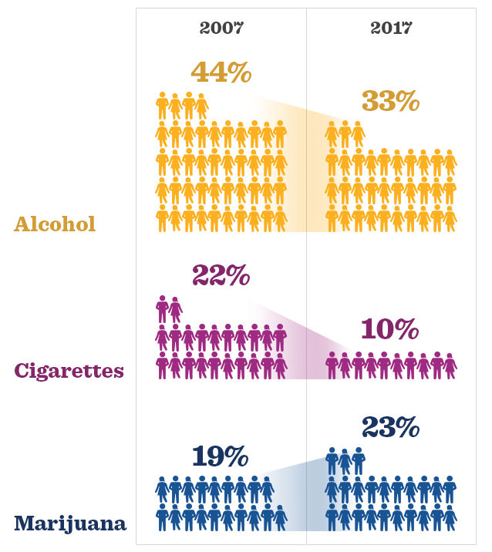
Trends in Alcohol, Cigarette and Marijuana Use: 30-day prevalence in 12th graders
(Johnston et al, 2018)
Notes:
The trainer should explain the data from the MONITORING FUTURE National Survey Results on Drug Use. The data show the prevalence of use in the last 30 days of alcohol, cigarettes and marijuana. The trainer should point out that Marijuana use among adolescents is increasing, whereas alcohol and cigarettes are decreasing in general.

Slide 71
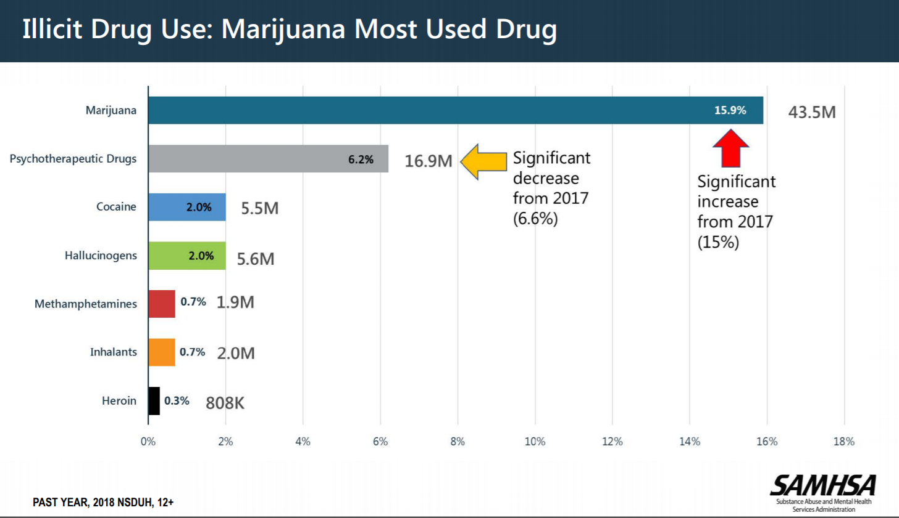
(SAMHSA, 2018)
Notes:
The trainer should discuss the graph and emphasize that Marihuana is the most used illicit drug among adolescents. The graph above represents data from a national survey in the United States.

Slide 72
OTHER SUSBTANCES
Notes:
The trainer will discuss other substances that even though they’re less frequent in adolescents, some of them are adolescent trends and on the rise of consumption.

Slide 73
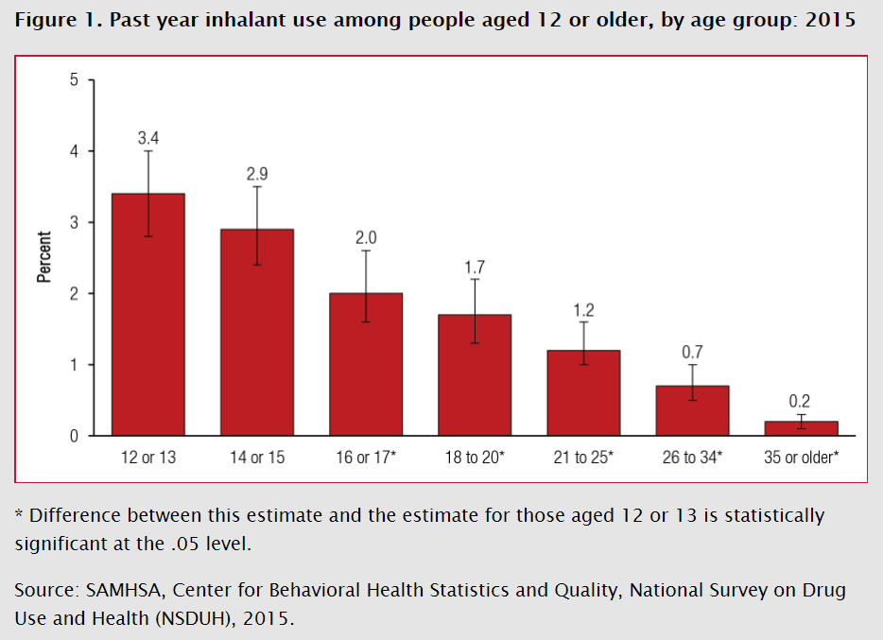
INHALANTS
Definition of Inhalants
    Volatile Solvents
    Aerosol
    Gasses
(CDC, 2019; SAMHSA, 2017)
Notes:
The trainer should provide an overview of the prevalence of inhalants use, as per the CICAD report on Drug Use in the Americas. The definition of inhalant is a challenge for drug researchers: the term covers a broad range of chemical substances used for different purposes and in most cases sold legally and have differing degrees of psychoactive and pharmacological effects. Prevalence of past year use of inhalants ranges from 1.4% to 12%. Inhalant use has been found at a young age, with lifetime prevalence rates of over 10% among eighth grade students in some countries.
Volatile Solvents: Liquids that vaporize in room temperature, available in homes; glues, correction fluids, markers, degreasers, dry-clean fluids, gasoline, etc.
Aerosol: Sprays; paint, deodorant, cooking spray, fabric protectors, etc.
Gasses: can be used in medical procedures (laughing gas) and available in homes such as; propane tanks, refrigerants.
Among young people living on the street, the most commonly used drugs are likely to be inhalants, which can include paint thinner, petrol, paint, correction fluid and glue.

Slide 74
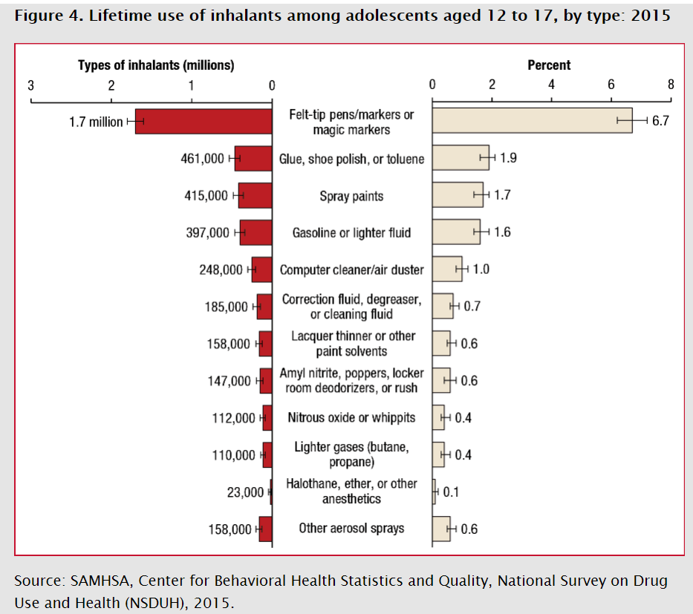
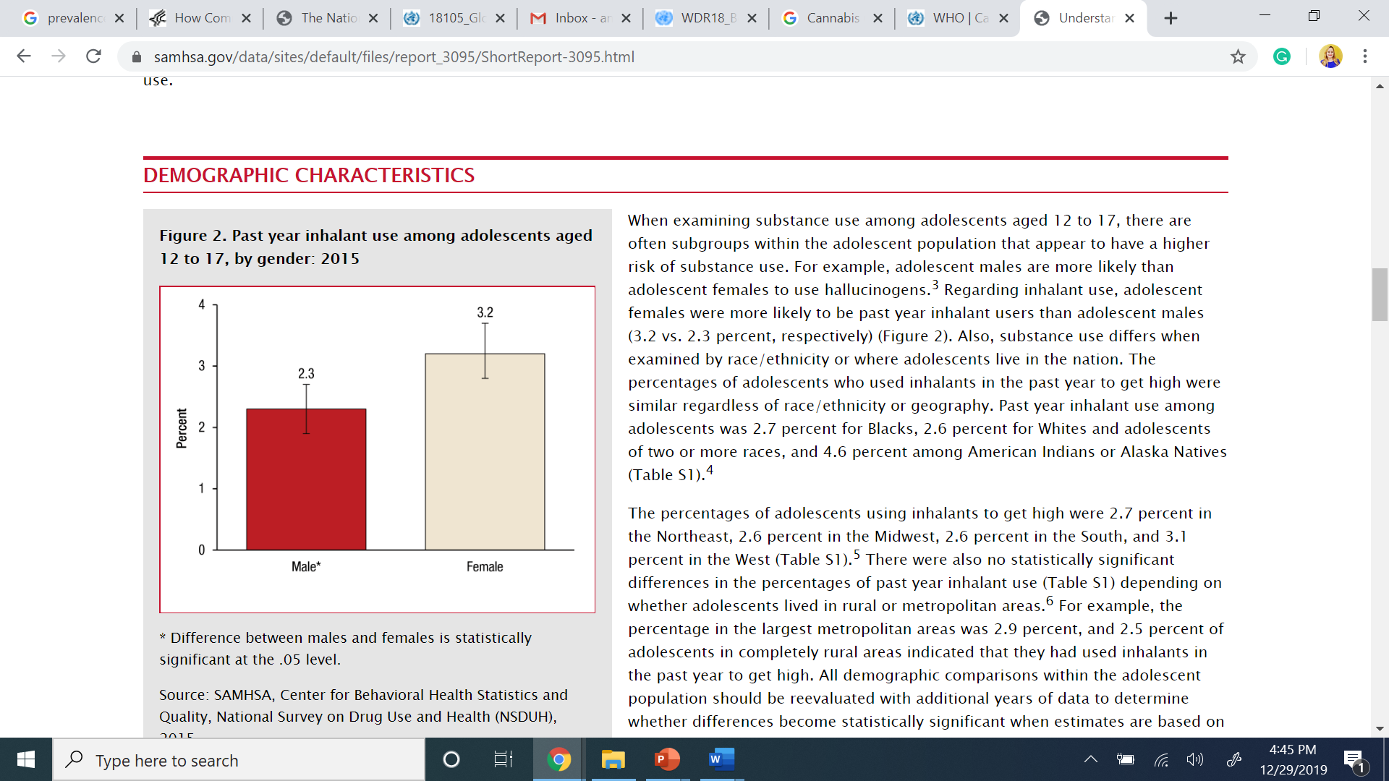
ABOUT INHALANT USE
(CDC, 2019; SAMHSA, 2017)
Notes:
The trainer should discuss briefly the charts on the slide.
On this first chart, it should be noted that Felt-tip pens/markers or magic markers was the most commonly identified type of inhalant used by adolescents to get high.
The second chart displays the fact that females are higher users of inhalants than males.
Inhalants are highly accessible, cheap, and easy to hide; they are also addictive and deadly. Inhalants are particularly appealing to adolescents for many reasons; they are legal, low cost, and easy to acquire.

Slide 75
COCAINE
Cocaine
  Indicators of cocaine use vary by population, past year prevalence ranges from 0.03% to almost 2%.
  There are clear differences in cocaine use among boys and girls in secondary school, with higher rates of use among boys.
(OAS/CICAD, 2019; UNODC, 2018)
Notes:
Cocaine
Indicators of cocaine use vary by population, past year prevalence ranges from 0.03% to almost 2%.
There are clear differences in cocaine use among boys and girls in secondary school, with higher rates of use among boys.

Slide 76
ECSTASY
Ecstasy
  “Ecstasy” use in the general population ranges from 0.01% to a maximum of 0.9%.
  “Ecstasy” use tends to be higher among boys than girls—except for Guatemala, Panama, and Uruguay, where they are roughly equal.
Club drugs such as “ecstasy”, methamphetamine, cocaine, ketamine, LSD and GHB are used in high-income countries
Notes:
Ecstasy
“Ecstasy” use in the general population ranges from 0.01% to a maximum of 0.9%.
“Ecstasy” use tends to be higher among boys than girls—except for Guatemala, Panama, and Uruguay, where they are roughly equal.
Club drugs such as “ecstasy”, methamphetamine, cocaine, ketamine, LSD and GHB are used in high-income countries

Slide 77
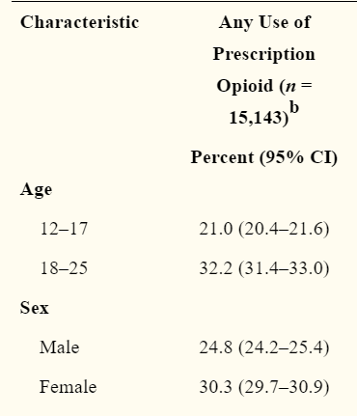
OPIOIDS & PRESCRIPTION DRUGS
Opioid use has increased over time.
Heroin is an opioid and the only illegal drug across the world.
Prescribed opioids include; oxycodone (OxyContin®), hydrocodone (Vicodin®), codeine, and morphine, among others.
In 2016, 3.6 percent of adolescents ages 12-17 reported misusing opioids over the past year.
Females are more likely to misuse prescription opioids.
Youth Opioid use is directly linked to sexual risk behavior.
(HHS, 2019; Hudgings et al, 2019)
Notes:
Cocaine
Indicators of cocaine use vary by population, past year prevalence ranges from 0.03% to almost 2%.
There are clear differences in cocaine use among boys and girls in secondary school, with higher rates of use among boys.
Ecstasy
“Ecstasy” use in the general population ranges from 0.01% to a maximum of 0.9%.
“Ecstasy” use tends to be higher among boys than girls—except for Guatemala, Panama, and Uruguay, where they are roughly equal.
Club drugs such as “ecstasy”, methamphetamine, cocaine, ketamine, LSD and GHB are used in high-income countries
Youth Opioid use is directly linked to sexual risk behavior.

Slide 78

OTHER TRENDS
Bath Salts
  “Bath salts” are usually swallowed, snorted through the nose, inhaled, or injected with a needle. Snorting or injecting is the most harmful.
  Bath salts can produce feelings of joy and increased social interaction, including an increased sex drive. But they can also cause paranoia, nervousness, and hallucinations (seeing or hearing things that are not real).
  Researchers do know that bath salts are chemically like amphetamines, cocaine, and MDMA.
  1% of adolescents has used bath salts.
(CDC, 2018; NIDA, 2019; Ruiz & Scherr, 2018)
Notes:
Bath Salts
“Bath salts” are usually swallowed, snorted through the nose, inhaled, or injected with a needle. Snorting or injecting is the most harmful.
Bath salts can temporarily produce feelings of joy and increased social interaction, including an increased sex drive. But they can also cause paranoia, nervousness, and hallucinations (seeing or hearing things that are not real).
Researchers do know that bath salts are chemically like amphetamines, cocaine, and MDMA. Therefore, some of the effects of “bath salts"—such as feeling energetic and agitated—are similar.
Energy Drinks
High caffeine content per serving.
adolescent energy drink consumption has significantly increased in the past 10 years.
The CDC reports that drinkers aged 15 to 23 who mix alcohol with energy drinks are four times more likely to binge drink at high intensity (i.e., consume six or more drinks per binge episode) than drinkers who do not mix alcohol with energy drinks.

Slide 79

OTHER TRENDS
Energy Drinks
  High caffeine content per serving.
  adolescent energy drink consumption has significantly increased in the past 10 years.
  The CDC reports that drinkers aged 15 to 23 who mix alcohol with energy drinks are four times more likely to binge drink at high intensity (i.e., consume six or more drinks per binge episode) than drinkers who do not mix alcohol with energy drinks.

Slide 80
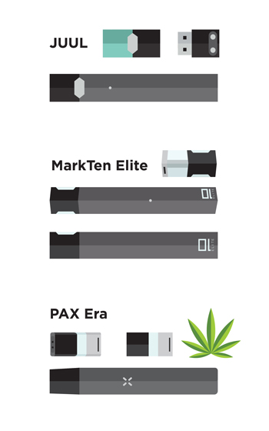
OTHER TRENDS
E-cigarettes
  Contain nicotine a highly addictive substance
  Trend that began with the introduction of e-cigarettes to help smokers quit cigarettes.
  Adolescent use had increased throughout the past few years in developed countries.
  A study found that user characteristics are mostly white male and female adolescents.
  An average of 25% of students used e-cigarettes, which is correlated to use of other substances.
  Data from the 2019 Monitoring the Future Survey of 8th, 10th and 12th graders show alarmingly high rates of e-cigarette use compared to just a year ago, with rates doubling in the past two years.
(CDC, 2020; Hrywna et al, 2020; NIDA, 2019)
Notes:
E-cigarettes
Contain nicotine a highly addictive substance
Trend that began with the introduction of e-cigarettes to help smokers quit cigarettes.
Adolescent use had increased throughout the past few years in developed countries.
A study found that user characteristics are mostly white male and female adolescents.
An average of 25% of students used e-cigarettes, which is correlated to use of other substances.
Data from the 2019 Monitoring the Future Survey of 8th, 10th and 12th graders show alarmingly high rates of e-cigarette use compared to just a year ago, with rates doubling in the past two years.

Slide 81
PREDISPOSITION TO SUBSTANCE USE/ABUSE
Notes:
The trainer will now discuss factors that place adolescents at risk of using substances

Slide 82
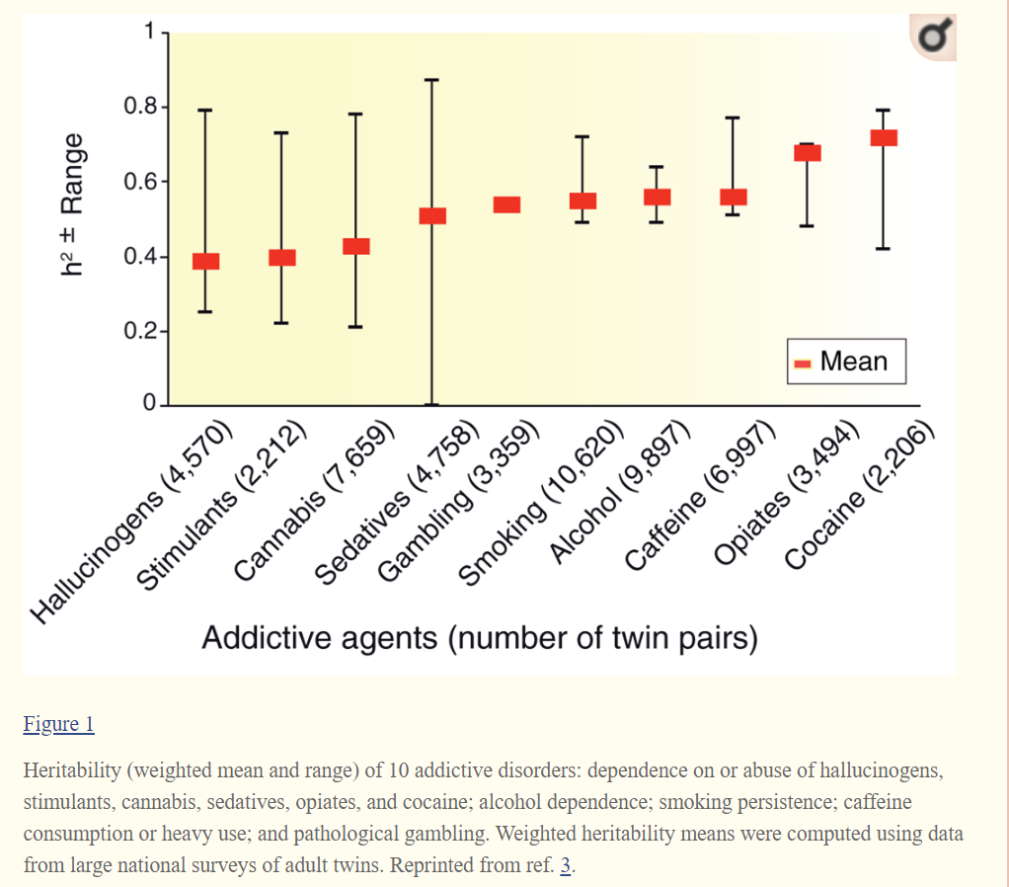
GENETICS
(Bevilacqua & Goldman, 2009)
Notes:
The trainer will discuss the role of genetic predisposition to addiction.
In this chart, it is depicted that Heritability (weighted mean and range) of 10 addictive disorders: dependence on or abuse of hallucinogens, stimulants, cannabis, sedatives, opiates, and cocaine; alcohol dependence; smoking persistence; caffeine consumption or heavy use; and pathological gambling. Weighted heritability means were computed using data from large national surveys of adult twins.
The literature suggest that genes influence a person’s predisposition to be addicted to specific drugs. However, the environment also plays an important role in a person’s exposure to the substance and also the person’s decision to try the substance.

Slide 83

Predisposition due to Mental Health Conditions
Learning Disorders (ADD/ADHD)
Mental Illness
Childhood Trauma
(APA, 2001; NIDA, 2018; NCTSN, 2008)
Notes:
The trainer will discuss the predisposition to substance abuse due to mental health vulnerabilities.
Learning disorders: Children with learning disorders often experience difficulties in social environments which can lead to reduced self-esteem, academic difficulty, loneliness, depression and the desire for social acceptance. Thus, learning disabilities may indirectly lead to substance abuse by generating the types of behavior that typically lead to substance abuse.
Mental Illness: Research suggest high rates of comorbid substance use disorders and anxiety disorders—which include generalized anxiety disorder, panic disorder, and post-traumatic stress disorders. Adolescence is a crucial time where mental illness/symptoms can begin to appear, thus making this time-frame a vulnerable time for substance use.
Childhood Trauma: It is well-documented in research that one in four children and adolescents have experienced at least one traumatic event before the age of 16. From that number, about 13% will develop post-traumatic stress disorder (PTSD), which highly influences an adolescents’ vulnerability to substance use. This will be covered more in detail in the Trauma module.

Slide 84
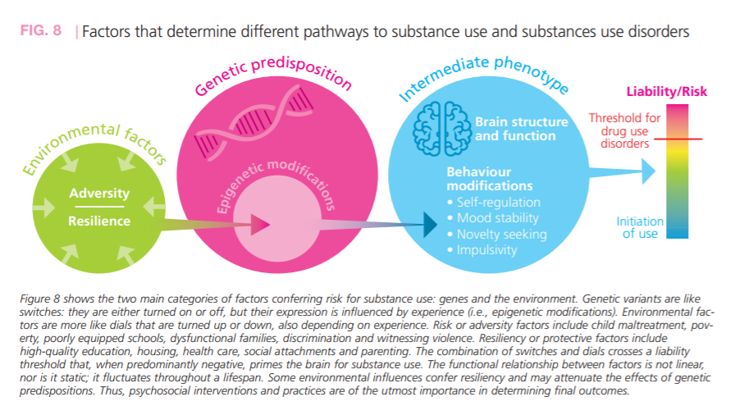
(UNODC, 2018)
Notes:
The trainer should explain the model in this slide and allow the audience to read the footnote to better understand the figure. These are the factors associated with risk of substance use.
Environmental factors were discussed in the previous slide. Developing resilience is one of the factors that best predicts overall wellness among adolescents. That is, when adolescents respond positively to adversity it is more likely that they will not engage in use of substances. Resilience is a major protective factor.
Genetic predisposition was discussed previously.
The combination of these factors can impact an adolescents’ likelihood of substance abuse in the future.

Slide 85
BIO-PSYCHO-SOCIAL MODEL

Slide 86
Social
Supports
Family Background
Cultural Traditions
Social/economic Status
Education
Psychological
Learning/Memory
Attitude/Beliefs
Personality
Behaviors
Emotions
Coping Skills
Past Trauma
Biological
Gender
Physical Illness
Disability
Genetic vulnerability
Neurochemistry
Stress Reactivity
Medication Effects
BIO-PSYCHO-SOCIAL MODEL
(Researchgate.net, 2018)
Notes:
The trainer should introduce the bio-psychosocial model of understanding substance use, explaining that it is not just an understanding of adolescent development needed to explain the relationship between youth and substance use. It is important to understand why and how substances work. An essential piece of understanding substance use is understanding its complexity. Substance use is not a simple behavior. It is related to several domains. S/he should explain the following:
Biological: The physicial factors which impact on the initiation, continuation or process of recovery from substance use
Psychological: The emotional factors which impact on the initiation, continuation or process of recovery from substance use
Social: The societal, cultural and community factors which impact on the initiation, continuation or process of recovery from substance use
The trainer should solicit an example of factors from each area. Then, s/he should break the participants into groups to brainstorm reasons why young people will use drugs – bio, psycho, and social. Each group should focus on one area, and work for approximately 10 – 15 minutes to identify all of the factors that address their particular aspect of the model, including those factors which impact on initiation, continuation and recovery.
After each group has completed working, they should choose a member of their group to present and explain what they brainstormed, and which have to do with initiation, continuation or recovery. After they have presented, the trainer should validate each group’s findings and pass on to the following slides.

Slide 87
CAUSES OF SUBSTANCE USE THROUGH THE LENS OF THE BIO-PSYCHOSOCIAL MODEL
Social
Supports
Family Background
Cultural Traditions
Social/economic Status
Education
Psychological
Learning/Memory
Attitude/Beliefs
Personality
Behaviors
Emotions
Coping Skills
Past Trauma
Biological
Gender
Physical Illness
Disability
Genetic vulnerability
Neurochemistry
Stress Reactivity
Medication Effects
Biological
Psychological
Social
Notes:
The trainer should review the following set of slides regarding the bio-psychosocial reasons that people initiate and or/continue to use substances, soliciting examples of each reason. These may include alcoholism in the family, self-medication for physical and/or psychological pain, practical outcomes (increased energy or positive feelings), or learning negative coping mechanisms from family experiences.
Biological
1. Physically dependent
. Genetic predisposition
. Helps: get to sleep, with anxiety, with physical/emotional pain
. Decreases psychiatric symptoms
. Provides energy (i.e. caffeine, cocaine)
Psychological
1. Likes the buzz
. Treats feelings of depression
. Helps with feelings of inferiority
. Treats anxiety
. Increases confidence/self esteem
. Helps to forget problems
. Learned behavior
Social
1. Everyone does it
2. Family influence
3. Helps to fit in with peers
4. Way to socialize and meet people
5. Increases self-confidence so can meet others

Slide 88
CONSEQUENCES OF SUSBTANCE ABUSE
Social
Supports
Family Background
Cultural Traditions
Social/economic Status
Education
Psychological
Learning/Memory
Attitude/Beliefs
Personality
Behaviors
Emotions
Coping Skills
Past Trauma
Biological
Gender
Physical Illness
Disability
Genetic vulnerability
Neurochemistry
Stress Reactivity
Medication Effects
Notes:
The trainer should continue to review the bio-psychosocial model, now focusing on the problems that result when people use substances, focusing on the biological and psychological problems, and soliciting examples as before.
Biological
1. Death from overdose
2. Cancer, heart disease, strokes. Lung disease/Emphysema, accidents pneumonia, Diabetes, HIV/AIDS, suicide, chronic liver disease
3. High Blood Pressure
4. Toxic psychosis
5. Increased Tolerance
6. Withdrawal
7. Onset of other disabilities
Psychological
Depression
Decrease in self esteem/confidence
Not learn other ways to deal with stress and rewards
Self-hatred
Projected self-hatred onto family, friends and counselor
Social
Lose friends
Isolation
Friends who are users will support continued use
Increased possibility for psychopathology
Impact on family members and friends
Difficulties in school
Incarceration

Slide 89
CASE STUDY
In your small groups, analyze your case study of an adolescent in early stages of substance use, and identify all of the bio-psychosocial risk factors that are associated with this young person, including cultural issues.
Notes:
The trainer should explain that they will be examining a number of different cases of young people who are either starting to use substances or beginning to see the problems associated with substance use. S/he should break the group into smaller groups of 5 – 6 people and distribute one case study to each group. Case studies can be found in Appendix C: Case Studies.
The groups should work for 15 – 20 minutes to identify the bio-psychosocial factors that are associated with this young person’s substance use. Someone in each group should take notes and someone should be identified to present back to the larger group.
After the groups have had time to develop their lists of factors, each group should read their case study aloud to the larger group and present the bio-psychosocial factors they have identified with that particular young person. The trainer should process the exercise by asking the larger group if they are in agreement, if they identify any factors they feel were missed and thank the presenter from each group.
The trainer should then take a little time to summarize the exercise and relate it back to the slides that were reviewed prior to the case study.

Slide 90
GENERAL RISK/PROTECTIVE FACTORS
Child’s attachment style
Household Environment
Early onset
Self-esteem
Academic performance
Peers & social norms
Community
Poverty
(CDC, 2019; DHHS, 2011; Maharaj et al, 2009; NIDA, 2003)
Notes:
The trainer should explain that, as part of this training, some of the risk and protective factors which impact on these levels of use will be examined. The trainer will discuss risk and protective factors side by side as displayed in the definitions below.
Child’s attachment style (NIDA, 2003): this aspect refers to a child’s bonding with caregivers. A child who experiences warmth, support, feelings of care, being understood and love highly influences general wellbeing and decreases the risk of an adolescent making the choice to use. On the other hand, when a child experiences parental negative criticism, high expectations, rigid and strict parenting and emotional unavailability increases an adolescent’s risk for substance use.
Household environment (CDC, 2019): family history of substance use and current parental use of substances can highly impact an adolescents’ access and normality of substance use. An adolescent exposed to substances within the family unit has a higher risk of starting drug use. At the general population level, international research has identified extreme economic deprivation, conflict in the family, a family history of mental health/behavioral problems and a lack of a protective environment as common risk factors for most adolescent substance abuse, delinquency, pregnancy and dropping out of school.
Early Onset/use: research shows that young people who initiate drug use before the age of 15 are at twice the risk of having drug problems as those who wait until after the age of 19.
Self-esteem: Adolescents with a positive self-concept, high self-esteem and emotional wellbeing are less likely to use substances.
Academic Performance: The trainer should explain that, among the domains of factors which impact on adolescent substance use is included the school environment. Research has shown that low school quality, difficult access, labor demands and social norms are directly tied to the risk of substance use. Additionally, an adolescent’s positive connection/relationship with school can be a protective factor.
Peers & Social Norms: Adolescents find meaning in peer relationships as they’re figuring themselves out. Adolescents who associate with peers who are disruptive, use substances and are involved in criminal activity are more likely to use substances.
The trainer should explain that, on the broadest level, social norms, gender and region impact on adolescent substance use. The trainer should ask for specific examples, such as social norms which support alcohol use, double standards with respect to male vs female substance use, and regional accessibility to different substances.
Community: availability of drugs and other substances in the community can increase an adolescent’s access, therefore increasing substance use. High rates of delinquency in the community and general violence can also increase the risk.
Poverty: The trainer should explain that the family is a very important domain, as most adolescents are still living within a family environment. Household poverty and lack of connectedness increase risk of substance use. The trainer should ask participants why.
The trainer will close by summarizing these factors that influence substance use in adolescents and also let the group know that we will discuss more protective factors in detail in the treatment module where we will cover the concept of resilience. Ultimately, the goal of any program is to reduce risk factors and increase protective factors. Further, the international literature suggests that strategies incorporating positive youth development and resilience have a greater likelihood of improving the health outcomes of adolescent than risk-reduction alone

Slide 91
DEVELOPMENTAL WELLNESS IN YOUTH
Notes:
The trainer will introduce the next section’s topic. The goal of this section is to learn about developmental factors that are necessary for youth wellbeing and providing the audience with tools to conceptualize an adolescents’ protective factors.

Slide 92
DEVELOPMENTAL ASSETS
The Developmental Assets® are 40 research-based, positive qualities that influence young people’s development, helping them become caring, responsible, and productive adults.
Based in youth development, resiliency, and prevention research, the Developmental Assets framework has proven to be effective and has become the most widely used approach to positive youth development in the United States and, increasingly, around the world.
The framework has been adapted to be developmentally relevant from early childhood through adolescence.
(Search-Institute.org, 2017)
Notes:
The trainer should explain that research has been conducted regarding the life skills areas that adolescents must have in order to succeed in difficult environments. As with resiliency theory, this model looks at why some young people are doing well, despite their circumstances that would put them at risk. The Search Institute, a research organization on youth development, has identified 40 characteristics, or assets, which support positive youth development, and strengthen adolescent’s ability to grow into healthy adults with the necessary skills to succeed.
The Developmental Assets® are 40 research-based, positive qualities that influence young people’s development, helping them become caring, responsible, and productive adults. Based in youth development, resiliency, and prevention research, the Developmental Assets framework has proven to be effective and has become the most widely used approach to positive youth development in the United States and, increasingly, around the world. The framework has been adapted to be developmentally relevant from early childhood through adolescence.

Slide 93
DEVELOPMENTAL ASSETS
SUPPORT:
Family Support
Positive Family Communication
Other Adult Relationships
Caring Neighborhood
Caring School Climate
Parent Involvement in Schooling
EMPOWERMENT:
Community Values Adolescents
Youth as Resources
Service to Others
Safety
(Search-Institute.org, 2017)
Notes:
The trainer should review the different areas or factors that impact on positive youth development – those assets identified by the Search Institute as supporting healthy bio-psychosocial growth. The first area of assets to be reviewed are those that are external assets, in other words, assets which are not dependent on the adolescent him/herself.
External Assets: Support
Family Support | Family life provides high levels of love and support.
Positive Family Communication | Young person and her or his parent(s) communicate positively, and young person is willing to seek advice and counsel from parents.
Other Adult Relationships | Young person receives support from three or more nonparent adults.
Caring Neighborhood | Young person experiences caring neighbors.
Caring School Climate | School provides a caring, encouraging environment.
Parent Involvement in Schooling | Parent(s) are actively involved in helping the child succeed in school.
The trainer should continue to review the external assets, this time in the area of empowerment.
External Assets: Empowerment
Community Values Adolescents | Young person perceives that adults in the community value adolescents.
Adolescents as Resources | Young people are given useful roles in the community.
Service to Others | Young person serves in the community one hour or more per week.
Safety | Young person feels safe at home, school, and in the neighborhood

Slide 94
DEVELOPMENTAL ASSETS
BOUNDARIES AND EXPECTATIONS:
Family Boundaries
School Boundaries
Neighborhood Boundaries
Adult Role Models
Positive Peer Influence
High Expectations
CONSTRUCTIVE USE OF TIME:
Creative Activities
Youth Programs
Religious Community
Time at Home
(Search-Institute.org, 2017)
Notes:
The trainer should continue to review the external assets, this time in the area of boundaries and expectations.
External Assets: Boundaries and Expectations
Family Boundaries | Family has clear rules and consequences and monitors the young person’s whereabouts.
School Boundaries | School provides clear rules and consequences.
Neighborhood Boundaries | Neighbors take responsibility for monitoring young people’s behavior.
Adult Role Models | Parent(s) and other adults model positive, responsible behavior.
Positive Peer Influence | Young person's best friends model responsible behavior.
High Expectations | Both parent(s) and teachers encourage the young person to do well.
The trainer should continue to review the external assets, this time in the area of constructive use of time.
External Assets: Constructive Use of Time
Creative Activities | Young person spends three or more hours per week in lessons or practice in music, theater, or other arts.
Youth Programs | Young person spends three or more hours per week in sports, clubs, or organizations at school and/or in community organizations.
Religious Community | Young person spends one hour or more per week in activities in a religious institution.
Time at Home | Young person is out with friends "with nothing special to do" two or fewer nights per week.

Slide 95
DEVELOPMENTAL ASSETS
COMMITMENT TO LEARNING:
Achievement Motivation
School Engagement
Homework
Bonding to School
Reading for Pleasure
POSTIVE VALUES:
Caring
Equality and Social Justice
Integrity
Honesty
Responsibility
Restraint
(Search-Institute.org, 2017)
Notes:
The trainer should then go on to explain the internal assets, in other words, skills and capacities that a young person exhibits or develops in various sectors. The first area for review is commitment to learning.
Internal Assets: Commitment to Learning
Achievement Motivation | Young person is motivated to do well in school.
School Engagement | Young person is actively engaged in learning.
Homework | Young person reports doing at least one hour of homework every school day.
Bonding to School | Young person cares about her or his school.
Reading for Pleasure | Young person reads for pleasure three or more hours per week.
The trainer should continue to review the internal assets, this time in the area of positive values.
Internal Assets: Positive Values
Caring | Young Person places high value on helping other people.
Equality and Social Justice | Young person places high value on promoting equality and reducing hunger and poverty.
Integrity | Young person acts on convictions and stands up for her or his beliefs.
Honesty | Young person "tells the truth even when it is not easy.“
Responsibility | Young person accepts and takes personal responsibility.
Restraint | Young person believes it is important not to be sexually active or to use alcohol or other drugs.

Slide 96
DEVELOPMENTAL ASSETS
SOCIAL COMPETENCIES:
Planning and Decision Making
Interpersonal Competence
Cultural Competence
Resistance Skills
Peaceful Conflict Resolution
POSITIVE IDENTITY:
Personal Power
Self-Esteem
Sense of Purpose
Positive View of Personal Future
(Search-Institute.org, 2017)
Notes:
The trainer should continue to review the internal assets, this time in the area of social competencies.
Internal Assets: Social Competencies
Planning and Decision Making | Young person knows how to plan ahead and make choices.
Interpersonal Competence | Young person has empathy, sensitivity, and friendship skills.
Cultural Competence | Young person has knowledge of and comfort with people of different cultural/racial/ethnic backgrounds.
Resistance Skills | Young person can resist negative peer pressure and dangerous situations.
Peaceful Conflict Resolution | Young person seeks to resolve conflict nonviolently.
The trainer should continue to review the internal assets, this time in the area of positive identity.
Internal Assets: Positive Identity
Personal Power | Young person feels he or she has control over "things that happen to me."
Self-Esteem | Young person reports having a high self-esteem.
Sense of Purpose | Young person reports that "my life has a purpose."
Positive View of Personal Future | Young person is optimistic about her or his personal future.

Slide 97

Research-based factors that promote youth wellbeing & development
Recent research has identified five core spheres that significantly improve youth’s wellbeing and development.
(CSSP, 2020)
Notes:
The trainer will discuss each of the core concepts that promote youth wellbeing. The trainer should discuss the list under each domain and pick a few examples to ask the audience about how a particular statement can influence an adolescent’s choice to use substances.
Cognitive and Social Emotional Competence
developing executive function skills (e.g., considering potential consequences; seeing alternate solutions to problems)
engaging in self-regulating behaviors (e.g., control of thinking and feelings; staying on task in the face of distractions)
developing character strengths (e.g., persistence, gratitude, integrity)
experiencing positive emotions (e.g., joy, optimism, faith, compassion for others)
taking responsibility for one’s self and one’s decisions
developing self-awareness, self-esteem, self-efficacy, and self-compassion
committing to and preparing to achieve productive goals
having both positive images of the person one wants to become and negative images of the person one wants to avoid becoming, as well as plans to achieve the possible selves

Slide 98
YOUTH RESILIENCE
Stress Management and responding to crises well (stressors, challenges, or adversity) while at the same time building on individual characteristics, strengths, and interests aids the adolescent in gaining resiliency.
(CSSP, 2020)
Notes:
The trainer will discuss the concept of resiliency as it related to how it impacts youth’s wellbeing. The trainer will discuss various statements below and provide examples. The trainer will emphasize that all these can be taught to adolescents and that in fact they must be taught during adolescent development.
Youth Resilience:
managing the stressors of daily life and functioning well when faced with challenges, adversity, and trauma
calling forth one’s inner strength to proactively meet personal challenges, manage adversities, and heal the effects of trauma
having a positive attitude about life and oneself
believing that one’s life is important and meaningful
becoming more self-confident and self-efficacious
having faith; feeling hopeful and optimistic
envisioning positive future possibilities
believing that one can make and achieve goals
working with purpose to achieve goals
facing challenges and making productive decisions about addressing challenges
seeking help when needed
thinking about and being accountable for one’s actions and the consequences of one’s actions
managing anger, anxiety, sadness, feelings of loneliness, and other negative feelings
learning from failure

Slide 99
SOCIAL CONNECTIONS
Networks of support and having healthy, sustained relationships with people, institutions, the community, and a higher power that promote a sense of trust, belonging, and a belief that one matters
(CSSP, 2020)
Notes:
The trainer will discuss the importance of how youth relate to their environment is fundamental to build positive networks of support.
Social Connections
Building a trusting relationship with at least one caring and competent adult who:
listens in a non-judgmental manner
is dependable/can be counted on
provides well-informed guidance, advice, and help in solving problems
promotes high expectations
sets developmentally appropriate limits, rules, and monitoring
provides emotional support (e.g., affirming good problem-solving skills)
provides instrumental support/concrete assistance (e.g., transportation)
provides informational support (e.g., post-secondary educational opportunities)
provides spiritual support (e.g., hope and encouragement)
provides an opportunity to engage with others in a positive manner
helps buffer youth from stressors
helps reduce feelings of isolation
promotes meaningful interactions in a context of mutual trust, respect, and appreciation
Being constructively engaged in social institutions (e.g., school, religious communities, recreational facilities) that are safe, stable, and equitable
Building a trusting relationship with positive, optimistic, mutually respectful peers who have similar values
Having a sense of connectedness that enables youth to feel loved, secure, confident, valued, and empowered to “give back” to others

Slide 100
KNOWLEDGE OF ADOLESCENT DEVELOPMENT
Learn about the physical changes during adolescence, especially about physical and neurological development, the impact of trauma, and identity development.
(CSSP, 2020)
Notes:
The trainer will discuss that when an adolescent becomes aware of the physical and neurological changes in their bodies that explain their moods, behaviors, thought-processes they feel more in control and are able to understand themselves and their place in the world.
Knowledge of Adolescent Development
Encouraging parents, adults who work with youth, and youth themselves to increase their knowledge and understanding about adolescent development
Seeking, acquiring, and using accurate information about:
adolescent brain development
physical and emotional changes that occur during puberty
one’s culture
societal rules, demands, expectations, and threats
one’s personal developmental history and needs, including one’s trauma history
sexual behavior, responsibility, choices, and consequences
essential life skills (e.g., managing money)
developing abstract thinking and improved problem-solving skills
developing a belief system and sense of morality
engaging in positive risk-taking and avoiding negative risk-taking
forging a personally satisfying identity
identifying productive interests, realistic goals, and steps to achieve goals
developing mature values and behavioral controls used to assess acceptable and unacceptable behaviors
building and sustaining healthy relationships with peers and adults
gaining independence from parents and other adults while maintaining strong connections with them

Slide 101
CONCRETE SUPPORT IN TIMES OF NEED
Understanding the importance of asking for help and advocating for oneself; receiving quality services (e.g., health care, housing, education) designed to preserve youths’ dignity, provide opportunities for skill development, and promote healthy development
(CSSP, 2020)
Notes:
The trainer will discuss the concept of developing adolescent’s self-advocacy skills and resourcefulness.
Concrete Support in Times of Need
being able to identify, find, and receive the basic necessities everyone deserves, as well as specialized services (e.g., medical, mental health, social, educational, or legal)
being resourceful
understanding one’s rights in accessing eligible services
navigating through service systems
seeking help when needed
being treated respectfully and with dignity when seeking and receiving services

Slide 102
COGNITIVE AND SOCIAL EMOTIONAL COMPETENCE
Acquiring skills and attitudes that are essential for forming an independent identity and having a productive, responsible, and satisfying adulthood
(CSSP, 2020)
Notes:
The trainer will discuss this concept which is one of the most important aspects that aid healthy adolescent development. As adolescents are learning these skills during a critical time, it should be emphasized that they need assistance with these concepts from adults in their lives.
Cognitive and Social Emotional Competence
developing executive function skills (e.g., considering potential consequences; seeing alternate solutions to problems)
engaging in self-regulating behaviors (e.g., control of thinking and feelings; staying on task in the face of distractions)
developing character strengths (e.g., persistence, gratitude, integrity)
experiencing positive emotions (e.g., joy, optimism, faith, compassion for others)
taking responsibility for one’s self and one’s decisions
developing self-awareness, self-esteem, self-efficacy, and self-compassion
committing to and preparing to achieve productive goals
having both positive images of the person one wants to become and negative images of the person one wants to avoid becoming, as well as plans to achieve the possible selves

Slide 103
SUMMARY
Adolescent substance abuse is a global public health problem where societies are tremendously affected.
International standards state that adolescents should not use substances as it can permanently damage the developing brain.
Alcohol and Marihuana are the most common drugs used among adolescents
A combination of genetics, environmental and social factors can impact adolescent substance use.
Notes:
Alcohol and marijuana are the main drugs of use by students in most of the countries included in this comparative report. Prevalence is relatively high for this population but there is plenty of variability from country to country. Tobacco is also used throughout the region, but to a lesser extent than alcohol and even marijuana. There is a lot of experimentation with cigarettes, but current use rates are very low. Marijuana prevalence overtook past year cigarette prevalence

Slide 104
SUMMARY
Adolescence is a confusing and stressful time for children.
Adolescent development is a process that begins roughly at 10 and ends in the mid-20s.
Substance abuse during adolescence has a negative impact on brain development.
Adolescents are still highly dependent in environmental factors to support them and teach them good choices.
In conclusion, adolescents should abstain from use of substances for healthy brain development.
Notes:
The trainer will summarize the most important information from module two.
Adolescence is a confusing and stressful time for children.
Adolescent development is a process that begins roughly at 10 and ends in the mid-20s.
Substance abuse during adolescence has a negative impact on brain development.
Adolescents are still highly dependent in environmental factors to support them and teach them good choices.
In conclusion, adolescents should abstain from use of substances for healthy brain development.

Slide 105
Module 2: Trauma and Trauma Informed Care
Notes:
The trainer will introduce the topic of “trauma and trauma informed care”. The trainer will explain that we will discuss the concept of trauma, understand the nature of trauma and provide insight on how to assist youth who are struggling with addictions.

Slide 106
TRAUMA AND TRAUMA INFORMED CARE
TRAUMA AND TRAUMA INFORMED CARE
Methodology:
Active discussion
Case Study
Role Play
Required Materials:
Easel Pad
Participant Manual
Notepad for each participant
Pens & Pencils
Duration: 6 hours
Notes:
The trainer will point out the methodology for this training. Active discussion refers to the trainer’s lecture but also participation from the audience in the form of questions, comments, suggestions that will enhance mutual learning.
The required materials for this module provide preparation for exercises.
The expected duration of this module is six hours.

Slide 107
TRAUMA AND TRAUMA INFORMED CARE
Learning Objectives
  To define and conceptualize the nature of trauma.
  To learn about the Adverse Childhood Experiences (ACE) Study.
  To understand the neurological response to trauma.
  To understand the link between trauma and addictions.
Notes:
The trainer will introduce the learning objectives. But first, the trainer can ask the audience what their expectations are about this module.
Learning Objectives
To define and conceptualize the nature of trauma.
To learn about the Adverse Childhood Experiences (ACE) Study.
To understand the neurological response to trauma.
To understand the link between trauma and addictions

Slide 108
TRAUMA AND TRAUMA INFORMED CARE
  Learning Objectives continued…
  To conceptualize trauma informed care approach.
  To learn and practice trauma informed care skills when working with youth.
  To integrate trauma informed care approaches within service institutions.
Notes:
The trainer will continue pointing out the learning objectives of this module.
Learning Objectives continued…
To conceptualize trauma informed care approach.
To learn and practice trauma informed care skills when working with youth.
To integrate trauma informed care approaches within service institutions.

Slide 109
OVERVIEW OF TRAUMA
Notes:
The trainer should introduce the concept of trauma, asking participants to brainstorm a list of events that they consider trauma. The trainer should make note of each on an easel pad. The list can include:
Domestic Violence
Sexual Assault
Racism
Sexism
Loss of a loved one
Homeless
Violent Crime—victim or witness
Natural Disaster
Language Barrier/moving to a different country
Abandonment
Physical Illness
Incarceration
The trainer should discuss that teenagers could be impacted from events that traditionally are not considered traumatic, for example:
Moving to a new place
Breaking up with a significant other as a teenager
Starting a new school

Slide 110
PROCESSING…
What did you notice about the group’s answers?
  Unique interpretation of event(s)
  Doesn’t have to happen to you
Notes:
The trainer should stress that trauma is subjective, and that there are major and minor traumas, in other words, trauma with a big T vs. little t. The experience is unique to the individual. Trauma can be simple, in other words a one time experience. It can also be complex, meaning a series of traumas over an extended period of time.

Slide 111
HIERARCHY OF TRAUMA
In small groups, examine the index cards given to you and decide how traumatic each event is using a scale of 1-20 (with 20 being the most severe and 1 being the least).
Tape the index card where you feel appropriate on the scale on the white board.
Notes:
Developing Hierarchy of Trauma
The trainer should draw on a white board or easel pad a scale from one to twenty, marking every five numbers on the board. S/he should divide participants into small groups, giving each group 3-5 cards, each with a different traumatic event on it. The trainer should ask the groups to come to a consensus on how “bad” each event is, 0 being harmless, 20 being very bad. Index cards include:
HIV Diagnosis
Surviving a hurricane
Child listening to parents fight
Verbal abuse by a stranger
Being held hostage
Being in a car accident
Witnessing a bad car accident where someone dies
Playing a violent video game
Going to war as a soldier
Repeated sexual assault as a child
Civilian in combat zone

Slide 112
DEFININING TRAUMA
Individual trauma results from an event, series of events, or set of circumstances experienced by an individual as physically or emotionally harmful or life-threatening with lasting adverse effects on the individual’s functioning and mental, physical, social, emotional, or spiritual well-being.
(SAMHSA, 2020)
Notes:
The trainer will introduce the definition of trauma which could affect adolescents and families.
Definition as per Substance Abuse Mental Health Services Administration (SAMHSA): Individual trauma results from an event, series of events, or set of circumstances experienced by an individual as physically or emotionally harmful or life-threatening with lasting adverse effects on the individual’s functioning and mental, physical, social, emotional, or spiritual well-being.

Slide 113
GENDER DIFFERENCES
Male
  More likely to experience a potential traumatic event
  More likely to report physical violence by strangers
  More likely to experience trauma in childhood
Female
  Two times more likely to be diagnosed with Post Traumatic Stress Disorder (PTSD)
  More likely to report interpersonal physical or sexual abuse
  More likely to experience more severe potential traumatic events
  Likely to experience trauma from at any time from childhood throughout adulthood
(Tolin & Foa, 2006)
Notes:
The trainer will explain that there are similarities and differences between genders with respect to trauma. While both experience high levels of trauma, among males, the trauma will more likely be related to physical violence by strangers than among females, who are more likely to report interpersonal physical or sexual abuse, specifically a higher risk of adult sexual assault and child sexual abuse. Compared with male participants, female participants are more likely to experience certain types of PTE that are disproportionately likely to lead to PTSD. However, when male and female participants experienced the same category of traumatic event, there is a small to moderate effect indicating greater frequency or severity of PTSD among female participants compared with male participants.

Slide 114
ADVERSE CHILDHOOD EXPERIENCES (ACE) STUDY
(CDC, 2019; SAMHSA, 2020)
Notes:
The trainer should explain that there have been ongoing studies on the impact of childhood trauma on later life experiences. Childhood abuse, neglect, and exposure to other traumatic stressors which we term Adverse Childhood Experiences (ACE) are common.

Slide 115
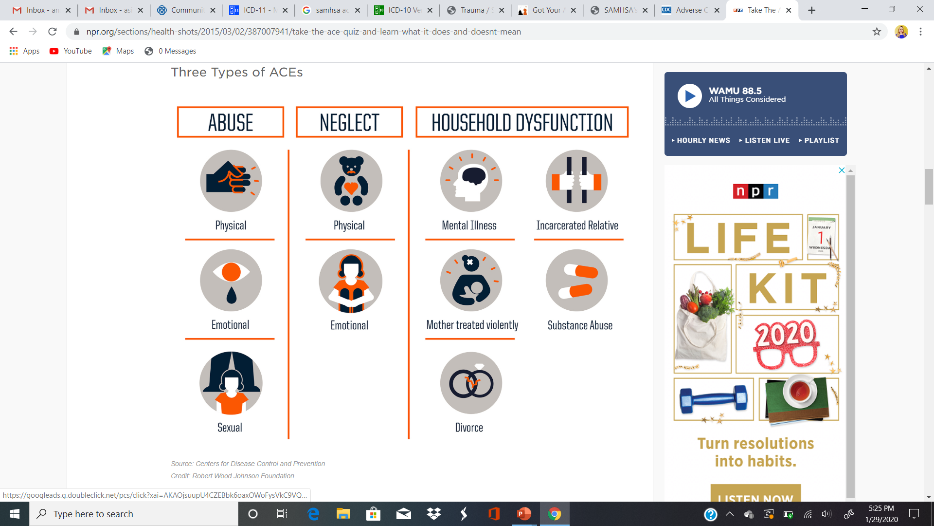
ACE STUDY
About the Survey:
  Measured three main areas related to childhood trauma.
  Abuse, Neglect and Household Dysfunction
Self-awareness exercise
  See appendix resource to find the ACE Survey
(CDC, 2019; SAMHSA, 2020)
Notes:
The trainer will discuss the ACE survey and the three main areas related to childhood trauma.
ABUSE: Physical, Emotional and Sexual.
NEGLECT: Physical, Emotional
HOUSEHOLD DYSFUNCTION: Mental Illness, Incarcerated Relative, Mother Treated Violently, Substance Abuse and Divorce.
SELF AWARENESS EXERCISE: Now the trainer will conduct a self-awareness exercise for the group. Direct the group to find the ACE survey on the appendix page and give the group about 5 minutes to complete the survey on themselves. The purpose of this activity is for providers to be aware of their scores, but they do not have to share to the group. The trainer should explain that it is important to be aware of our own vulnerabilities in conceptualizing and treating trauma in others.
ACE SURVEY
1. Did a parent or other adult in the household often or very often… Swear at you, insult you, put you down, or humiliate you? or Act in a way that made you afraid that you might be physically hurt?
No___If Yes, enter 1 __
2. Did a parent or other adult in the household often or very often… Push, grab, slap, or throw something at you? or Ever hit you so hard that you had marks or were injured?
No___If Yes, enter 1 __
3. Did an adult or person at least 5 years older than you ever… Touch or fondle you or have you touch their body in a sexual way? or Attempt or actually have oral, anal, or vaginal intercourse with you?
No___If Yes, enter 1 __
4. Did you often or very often feel that … No one in your family loved you or thought you were important or special? or Your family didn’t look out for each other, feel close to each other, or support each other?
No___If Yes, enter 1 __
5. Did you often or very often feel that … You didn’t have enough to eat, had to wear dirty clothes, and had no one to protect you? or Your parents were too drunk or high to take care of you or take you to the doctor if you needed it?
No___If Yes, enter 1 __
6. Were your parents ever separated or divorced?
No___If Yes, enter 1 __
7. Was your mother or stepmother:
Often or very often pushed, grabbed, slapped, or had something thrown at her? or Sometimes, often, or very often kicked, bitten, hit with a fist, or hit with something hard? or Ever repeatedly hit over at least a few minutes or threatened with a gun or knife?
No___If Yes, enter 1 __
8. Did you live with anyone who was a problem drinker or alcoholic, or who used street drugs?
No___If Yes, enter 1 __
9. Was a household member depressed or mentally ill, or did a household member attempt suicide?
No___If Yes, enter 1 __
10. Did a household member go to prison?
No___If Yes, enter 1 __
Once everyone completes the survey, the trainer will move onto the results of the ACE Study.

Slide 116
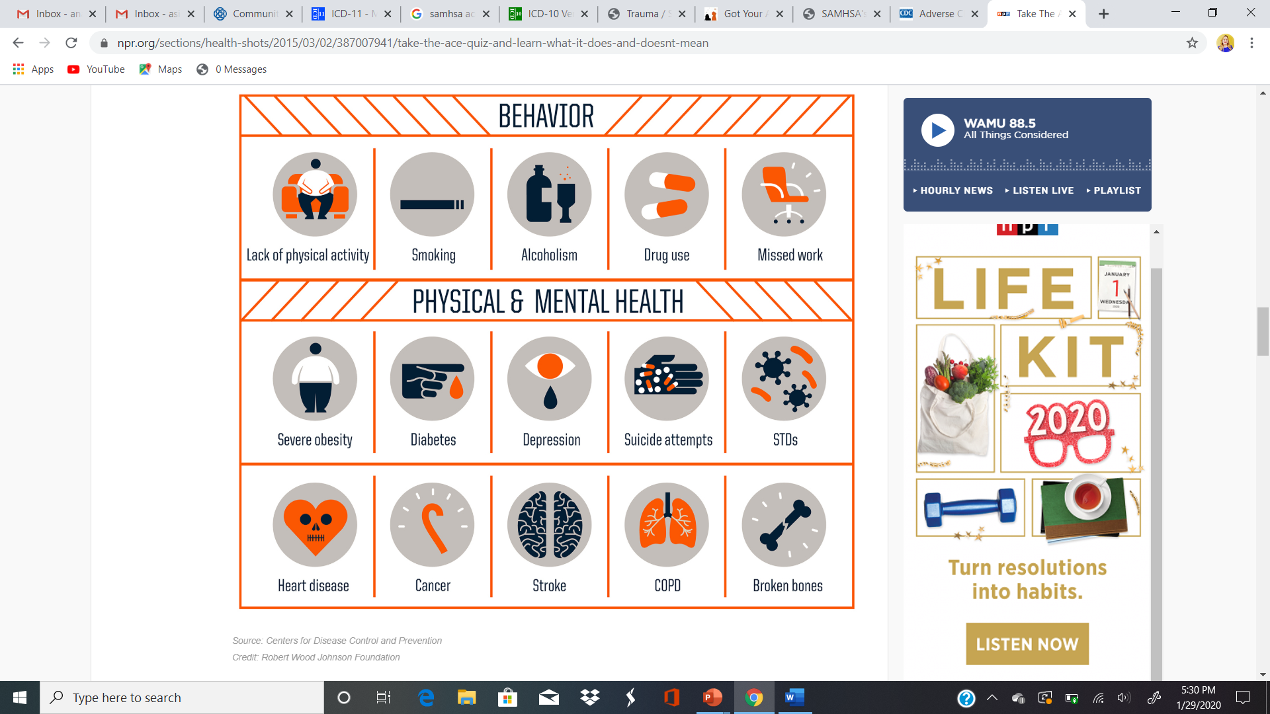
ACE STUDY RESULTS
The study found that:
childhood trauma was very common, even in employed white middle-class, college-educated people with great health insurance;
there was a direct link between childhood trauma and adult onset of chronic disease, as well as depression, suicide, being violent and a victim of violence;
more types of trauma increased the risk of health, social and emotional problems.
people usually experience more than one type of trauma – rarely is it only sex abuse or only verbal abuse.
(CDC, 2019; SAMHSA, 2020)
Notes:
The trainer will share the results of the ACE study by pointing out the findings.
The study found that:
childhood trauma was very common, even in employed white middle-class, college-educated people with great health insurance;
there was a direct link between childhood trauma and adult onset of chronic disease, as well as depression, suicide, being violent and a victim of violence;
more types of trauma increased the risk of health, social and emotional problems.
people usually experience more than one type of trauma – rarely is it only sex abuse or only verbal abuse.
The trainer will focus on the behavioral impact that is caused by childhood trauma related to substance abuse which will be covered on the next slide.

Slide 117
ACE RESULTS RELATED TO SUBSTANCE USE/ABUSE
Alcoholism and alcohol abuse
Chronic obstructive pulmonary disease
Depression
Fetal death
Health-related quality of life
Illicit drug use
Ischemic heart disease (IHD)
Liver disease
Risk for intimate partner violence
Multiple sexual partners
Sexually transmitted diseases (STDs)
Smoking
Suicide attempts
Unintended pregnancies
Early initiation of smoking
Early initiation of sexual activity
Adolescent pregnancy
Notes:
The trainer should go on to explain that ACE Study uses the ACE Score, which is a total count of the number of ACEs reported by respondents. The ACE Score is used to assess the total amount of stress during childhood and has demonstrated that as the number of ACE increase, the risk for the following health problems increases in a strong and graded fashion:
Alcoholism and alcohol abuse
Chronic obstructive pulmonary disease
Depression
Fetal death
Health-related quality of life
Illicit drug use
Ischemic heart disease (IHD)
Liver disease
Risk for intimate partner violence
Multiple sexual partners
Sexually transmitted diseases (STDs)
Smoking
Suicide attempts
Unintended pregnancies
Early initiation of smoking
Early initiation of sexual activity
Adolescent pregnancy

Slide 118
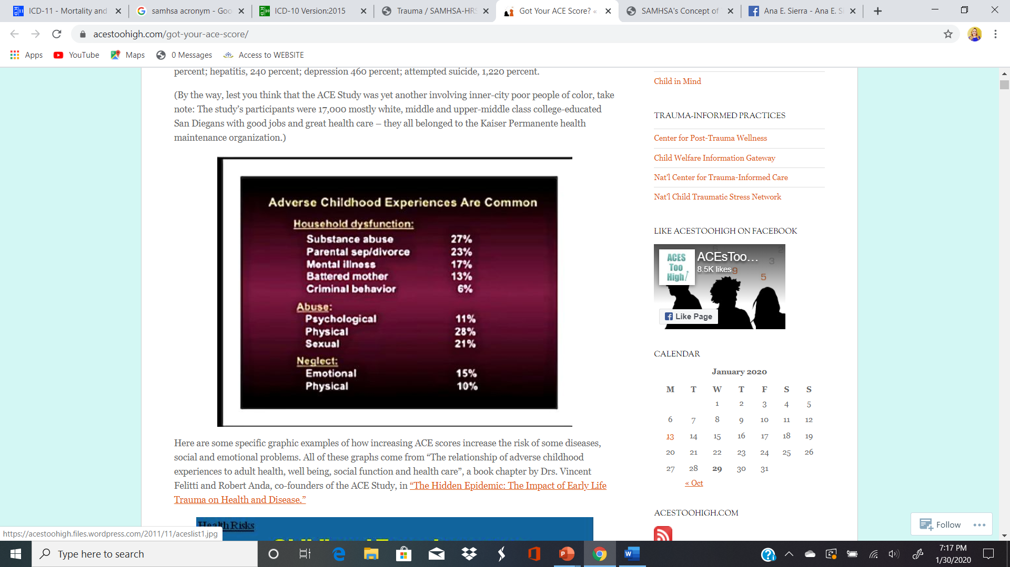
(CDC, 2019; SAMHSA, 2020)
Notes:
The trainer will reinforce the importance of the ACE as it relates to substance abuse. The trainer should stress that, although exact prevalence estimates vary, there is a consensus that most consumers of mental health services are trauma survivors and that their trauma experiences help shape their responses to outreach and services. As such, it is important to assume that every client seen in drug treatment is likely to have been exposed to trauma and therefore should be treated as such.

Slide 119
TRAUMATIC EXPEREINCES AROUND THE WORLD
Notes:
The trainer will discuss statistics about experiences of trauma around the world by the WHO World Mental Health Survey.

Slide 120

WORLD HEALTH ORGANIZATION WORLD MENTAL HEALTH SURVEY
The WHO World Mental Health Survey was conducted in the following regions of the world:
  The Americas
  South-East Asia
  Europe
  Africa
  Eastern Mediterranean
  The Western Pacific
(WHO, 2008)
Notes:
The trainer should introduce the WHO World Mental Health Survey.
The WHO World Mental Health Survey Initiative conducted The WHO World Mental Health Survey: Global Perspectives on the Epidemiology of Mental Disorders study. This is the largest global mental health study performed, with a sample of 200,000 individuals, which covered all regions of the world;
The Americas (Argentina, Brazil, Colombia, Colombia-Medellin, Mexico, Peru and the United States)
South-East Asia (Myanmar and Nepal)
Europe (Belgium, Bulgaria, France, Germany, Italy, Israel, Netherlands, Norther Ireland, Poland, Portugal, Romania, Spain, Spain-Murcia, Turkey and Ukraine)
Eastern Mediterranean (Iraq, Lebanon, Qatar, Saudi Arabia), and;
The Western Pacific (Australia, China 1 & 2, Japan and New Zealand)

Slide 121
WORLD HEALTH ORGANIZATION WORLD MENTAL HEALTH SURVEY FINDINGS
70.3% prevalence of lifetime traumatic experience exposure.
On average, participants reported at least 4.5 traumatic experiences.
Of the traumatic experiences reported:
  27.1% were community violence-related
  25% were accidents & illnesses
  20.4% were related to organized violence
  14.7% included rape and domestic violence
  8.4% included physical violence by a caregiver as a child or witnessing domestic abuse.
(WHO, 2008)
Notes:
The study assessed lifetime exposure to traumatic experiences in adults. The results are shocking:
There was a 70.3% prevalence of lifetime traumatic experience exposure.
Of those the mean number of traumatic experiences was 4.5.
27.1% of traumatic experiences included being mugged/threatened with a weapon, other manmade disaster, and unexpected death of a loved one.
25% of traumatic experiences included accidents/injuries; natural disasters, toxic chemical spill, motor vehicle collision, any other life-threatening accident, life-threatening illness and loved one with a life-threatening illness.
20.4% of all traumatic experiences included participation in organized violence; combat experience as soldier, purposely injured/killed, accidentally injured/killed, witnessed death/serious bodily injury, and witness atrocities.
14.7% of all traumatic experiences included sexual violence victimization; rape, sexual assault, stalked, beaten by a romantic partner, traumatic event to loved one, and private event.
8.4% of all traumatic experiences included physical violence victimization; beaten by caregiver, beaten by anyone in the home (excluding romantic partner) and witnessed physical violence at home.

Slide 122
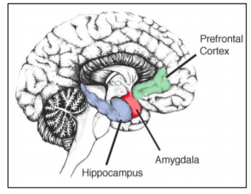
TRAUMA
&
THE BRAIN
Notes:
The trainer will introduce the neurological response to trauma.
The trainer should review how responses might differ in a traumatic event. Perception is personal. The trainer should ask what kind of factors might influence perception. S/he should also ask how those factors might impact on the trauma response. For example, an individual with a strong support system and caring adults would not be impacted in the same way as an individual who is homeless and alone on the streets. S/he should ask for more examples, which reflect the impact of stress management skills, coping skills, previous exposure to trauma, etc.
The trainer should ask how this understanding might affect the way one works with those affected by trauma? The context in which the trauma occurs in key, as well as those individual factors. As such, the immediate trauma response may vary, even when the people have experienced the same trauma.
What is important in the provision of services to individuals affected by trauma is an awareness of one’s own responses and feelings. In this manner, a hierarchy of trauma becomes unimportant, as the use of a hierarchy can cause some service providers to minimize what they perceive as minor incidents, without taking into account the subjective experience of the adolescent. Everyone is entitled to his/her own interpretation and will react differently. If the client is minimizing his/her reaction, it might be a coping mechanism and that’s acceptable.

Slide 123
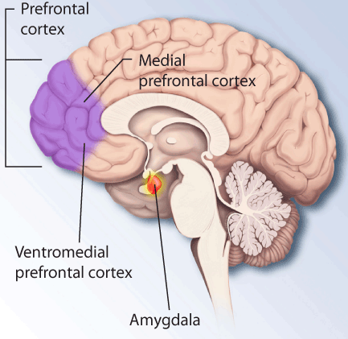
THE EMOTIONAL BRAIN
Important brain structures:
  The Amygdala
  Prefrontal Cortex
Notes:
The amygdala, which readies the body for action, may get "hi-jacked" by neurobiological changes caused by trauma, and the trauma victim responds before the "thinking" part of the brain (i.e., cerebral cortex) can weigh threats. The resultant hypervigilance seen in trauma victims can cause them to go immediately from stimulus to an arousal response, without being able to make the intervening assessment of the cause of their arousal. This causes them to overreact and intimidate others.
The amygdala is a small, almond-shaped portion of the brain. It’s the emotional part. It’s the primitive part of the brain. It interprets messages that there’s danger or it’s safe. It knows nothing about reasoning or cognitive functions. It deals with feelings and emotions. It’s the alarm portion of the brain.
It becomes highly active during and while remembering a traumatic incident. It controls our behavior. When you’ve experienced trauma it’s hypersensitive--overreacts to normal stimuli.
Trauma affects many other parts of the brain as well. De Bellis and colleagues noted that pediatric subjects with PTSD had smaller intracranial, cerebral, prefrontal cortex, prefrontal cortical white matter, right temporal lobe volumes, and areas of the corpus callosum and its subregions.
Because of the excess and adverse neurobiological results of trauma, people with PTSD may experience a deactivation of the prefrontal cortex (which is responsible for executive functioning.)
The prefrontal cortex, the part of the frontal lobes lying just behind the forehead, is often referred to as the “CEO of the brain.” This brain region is responsible for cognitive analysis and abstract thought, and the moderation of “correct” behavior in social situations. The prefrontal cortex takes in information from all of the senses and orchestrates thoughts and actions to achieve specific goals.
The prefrontal cortex is one of the last regions of the brain to reach maturation. This delay may help to explain why some adolescents act the way they do. The so-called “executive functions” of the human prefrontal cortex include:
Focusing attention
Organizing thoughts and problem solving
Foreseeing and weighing possible consequences of behavior
Considering the future and making predictions
Forming strategies and planning
Ability to balance short-term rewards with long term goals
Shifting/adjusting behavior when situations change
Impulse control and delaying gratification
Modulation of intense emotions
Inhibiting inappropriate behavior and initiating appropriate behavior
Simultaneously considering multiple streams of information when faced with complex and challenging information
**Traumatic experiences slow down the maturation of this area of the brain!!!!!!
If those areas of the brain are impacted by traumatic experiences, what is the influence on decision making ability, and how may drug use behaviors be related?

Slide 124
THE BRAIN’S REPOSNSE TO TRAUMA
Amygdala
Detects Situation of danger
Sympathetic Nervous System Activates
Stress hormones released
Bodily
reactions
Prolonged state of alarm
  (Campbell, 2019)
Notes:
The trainer will explain the pathway of the brain’s response to trauma.
The amygdala is like the “smoke detector”, responsible to respond to situations that are threatening. Sometimes the Amygdala might react with just a perceived threat. If someone suddenly entered the room, we are conducting this training without notice, most people would jump at the sound of a slammed door. That is the amygdala’s job. When someone experiences a traumatic event, the threat is real.
The Amygdala detects possible situations of danger, then the sympathetic envious system is activated and releases stress hormones. The outcome of this reaction is a prolonged state of alarm in the body and emotional brain.

Slide 125
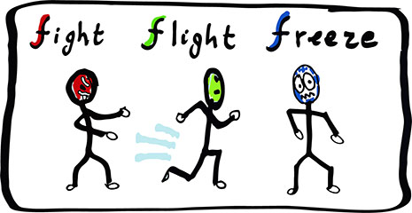
TRAUMA REACTIONS
(Campbell, 2019)
Notes:
The trainer should ask the group if they have heard of the “Fight, Flight or Freeze” reaction, noting that the body prepares for any of these reactions when confronted with a threat. The trainer should ask what kind of the changes happen physically when threatened. These should include such reactions as dilated pupils, increased adrenaline, blood diverted to limbs, increased heart rate, etc.
The memory of the traumatic event can also be affected. The emotional brain is in charged of survival and in this type of state, the brain’s ability to encode memories in an organized manner fails to do so. This is why sometimes survivors of trauma will forget details of an event, or does not recall events.
The trainer should ask the participants how do the fight, flight and freeze modes connect to drug using behaviors? The trainer should note that trauma may cause such reactions as aggression, running away from problems, feeling separate from one’s body and one’s experiences (depersonalization and dissociation). Participants may respond with some of the following:
Aggression/rage=looking for an outlet for release, such as drugs
Running away from problems =not recognizing the long term impact of actions
Depersonalization=feeling separate from your body, don’t feel like you own your actions, don’t care about risky behaviors
Dissociation=Leads to little recall—don’t learn from mistakes=more risk taking behaviors even if they know it is wrong
The trainer will explain that this overload of stress makes the patient more likely to experience other symptoms which we will now address…

Slide 126
TRAUMA & ADDICTIONS
Adolescents with as history of early trauma are more likely to be addicted to substances, and display the following:
  Engage in risk-taking behaviors
  Be more impulsive
  Have boundary issues
  Distrust others
  Low self-esteem
  Difficulty relating to others
  Display irritability/hostility
Notes:
The trainer will explain that trauma and addictions are interrelated.
Adolescents with a history of early trauma engage in more risk-taking behaviors, such as substance abuse (including binge drinking), multiple sex partners, and criminal involvement, and are at a greater risk for sexual assaults and relationship violence; and add data about childhood trauma is common; "38.5% of American adults endorse having experienced a traumatic event before age 13 years”.

Slide 127
STRESS DISORDERS
Stress disorders are a cluster of diagnoses that differentiate different types of reactions individuals can experience resulting from trauma.
International Classification of Diseases (ICD) Definitions
  Adjustment Disorder
  Post-Traumatic Stress Disorder
  Complex Post-Traumatic Stress Disorder
(ICD, 2020)
Notes:
The trainer will introduce usual stress disorder associated with experiencing trauma as per The International Classification of Diseases (ICD), which is an internationally accepted manual to code diseases. The trainer will discuss Adjustment Disorder, Post-Traumatic Stress Disorder, and Complex Post-Traumatic Stress Disorder in detail on the next slides.

Slide 128
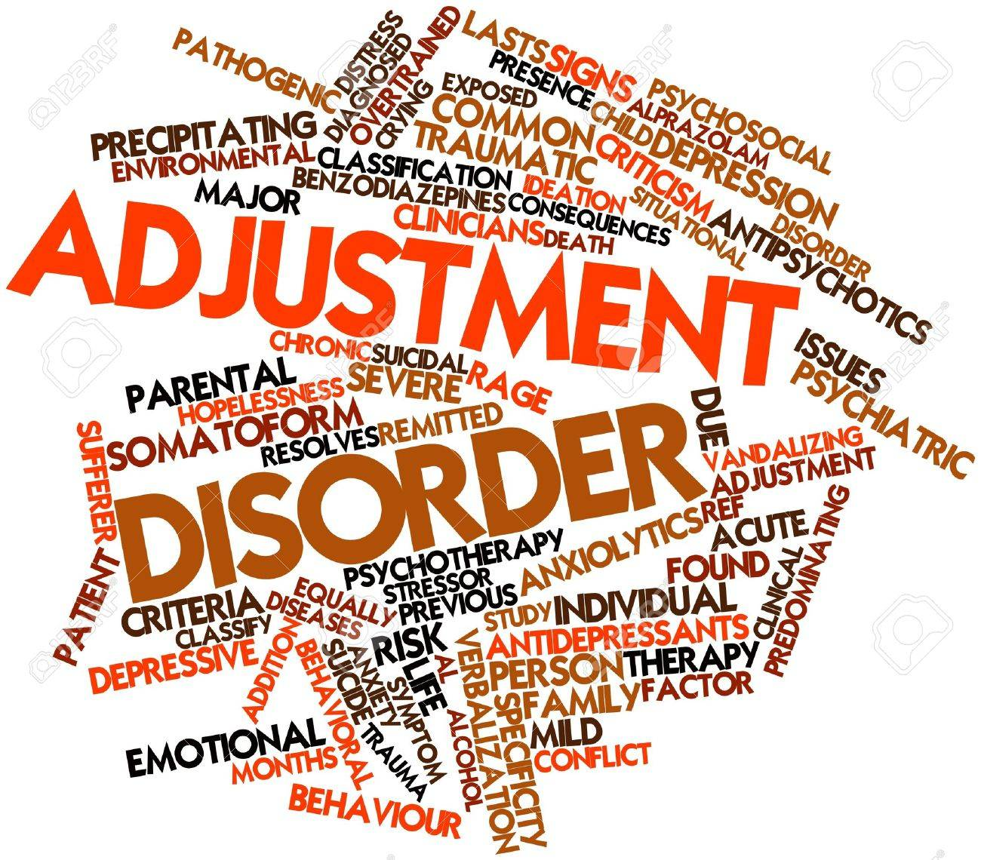
ADJUSTMENT DISORDER
(ICD, 2020)
Notes:
Adjustment Disorder Definition: Adjustment disorder is a maladaptive reaction to an identifiable psychosocial stressor or multiple stressors (e.g., divorce, illness or disability, socio-economic problems, conflicts at home or work) that usually emerges within a month of the stressor.
The disorder is characterized by preoccupation with the stressor or its consequences, including excessive worry, recurrent and distressing thoughts about the stressor, or constant rumination about its implications, as well as by failure to adapt to the stressor that causes significant impairment in personal, family, social, educational, occupational or other important areas of functioning. The symptoms are not of sufficient specificity or severity to justify the diagnosis of another Mental and Behavioural Disorder and typically resolve within 6 months, unless the stressor persists for a longer duration.

Slide 129
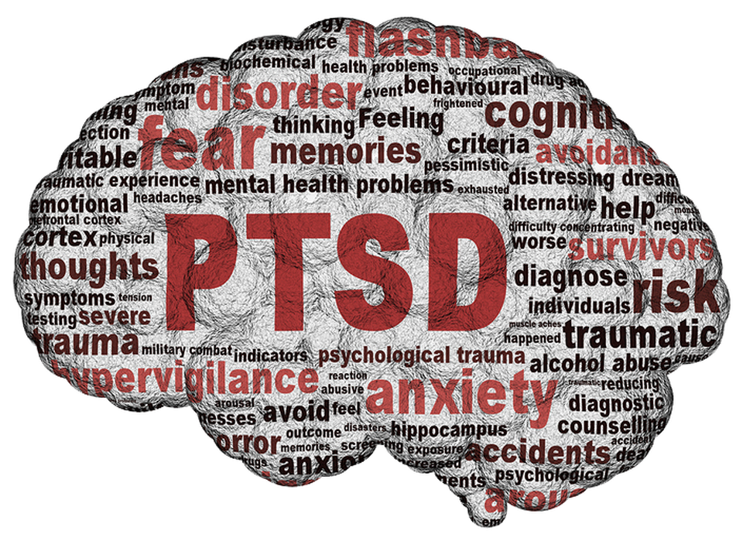
POST-TRAUMATIC STRESS DISORDER (PTSD)
Re-experiencing
Avoidance
Hypervigilance
Impairment in major life aspect
(ICD, 2020)
Notes:
Post-traumatic stress disorder (PTSD) Definition: Post-traumatic stress disorder (PTSD) is a disorder that may develop following exposure to an extremely threatening or horrific event or series of events. It is characterized by all of the following:
re-experiencing the traumatic event or events in the present in the form of vivid intrusive memories, flashbacks, or nightmares. These are typically accompanied by strong or overwhelming emotions, particularly fear or horror, and strong physical sensations;
avoidance of thoughts and memories of the event or events, or avoidance of activities, situations, or people reminiscent of the event or events; and
persistent perceptions of heightened current threat, for example as indicated by hypervigilance or an enhanced startle reaction to stimuli such as unexpected noises.
The symptoms persist for at least several weeks and cause significant impairment in personal, family, social, educational, occupational or other important areas of functioning.
The trainer will emphasize that Post-Traumatic Stress Disorder can be the result of an individual experiencing one or various experiences where the individual believes their life was at risk. This is different than Complex Post-Traumatic Stress Disorder which we will discuss on the next slide.

Slide 130
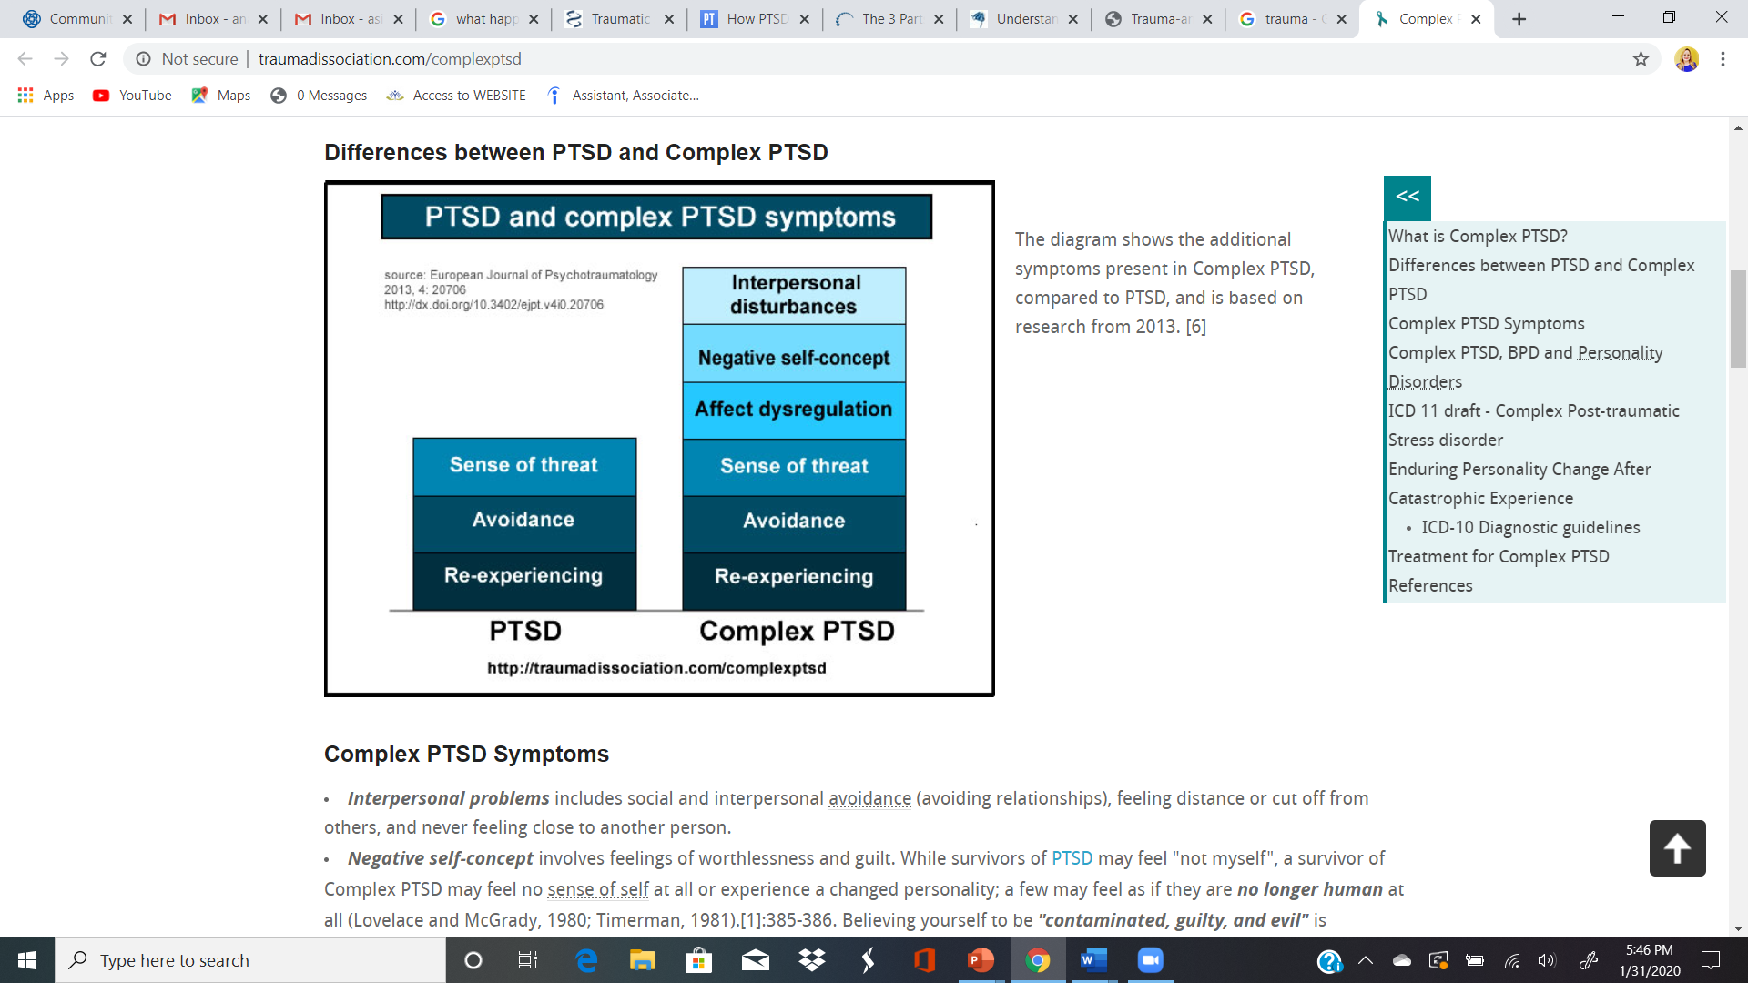
COMPLEX POST TRAUMATIC STRESS DISORDER (CPTSD)
All individuals with CPTSD meet criteria for PTSD as well.
Additional symptoms include:
  Affect Regulation
  Negative Self-concept
  Interpersonal disturbances
(ICD, 2020)
Notes:
The trainer will build from the definition of PTSD and discuss the additional symptoms that are present in CPTSD. Individuals with CPTSD met all the criteria for PTSD as well. However, there are more symptoms in CPTSD; affect regulation, negative self-concept, and interpersonal disturbances.
Complex Post-Traumatic Stress Disorder Definition: Complex post-traumatic stress disorder (Complex PTSD) is a disorder that may develop following exposure to an event or series of events of an extremely threatening or horrific nature, most commonly prolonged or repetitive events from which escape is difficult or impossible (e.g., torture, slavery, genocide campaigns, prolonged domestic violence, repeated childhood sexual or physical abuse).
All diagnostic requirements for PTSD are met. In addition, Complex PTSD is characterized by severe and persistent
problems in affect regulation;
beliefs about oneself as diminished, defeated or worthless, accompanied by feelings of shame, guilt or failure related to the traumatic event; and
difficulties in sustaining relationships and in feeling close to others. These symptoms cause significant impairment in personal, family, social, educational, occupational or other important areas of functioning.

Slide 131
SYMPTOMS = ADAPTATIONS
Individuals react differently to trauma and may experience a range of physical and/or emotional reactions.
There is no “right” or “wrong” way to react to trauma.
Human responses are normal reactions to abnormal events.
Notes:
The trainer should stress, once again, that individual reactions to trauma are mediated by a number of factors, like the risk and protective factors just reviewed. As such, individuals react differently to trauma, even if the trauma experienced is the same. There is no “right” or “wrong” way to react to trauma, although there are healthier and more damaging reactions.

Slide 132
TRAUMA INFORMED CARE (TIC)

Slide 133
TRAUMA INFORMED CARE
A program, organization, or system that is trauma-informed:
  Realizes the widespread impact of trauma and understands potential paths for recovery;
  Recognizes the signs and symptoms of trauma in clients, families, staff, and others involved with the system;
  Responds by fully integrating knowledge about trauma into policies, procedures, and practices; and
  Seeks to actively resist re-traumatization
(SAMHSA, 2014)
Notes:
The trainer should then review the definition of “trauma-informed care,” as per the US Substance Abuse and Mental Health Services Administration (SAMHSA). That definition is as follows:
“A program, organization, or system that is trauma-informed:
Realizes the widespread impact of trauma and understands potential paths for recovery;
Recognizes the signs and symptoms of trauma in clients, families, staff, and others involved with the system;
Responds by fully integrating knowledge about trauma into policies, procedures, and practices; and
Seeks to actively resist re-traumatization”

Slide 134
TRAUMA INFORMED CARE
A culture change
A multidimensional, systems approach to dealing with histories of trauma
  Taking steps to make sure every part of the organization, management, and service delivery system is assessed and potentially modified to include a basic understanding of how trauma affects the life of an individual seeking services
(SAMHSA, 2014)
Notes:
The trainer should stress that trauma has a long-term impact on individuals. For example, most people tend to think linearly normally and look for consistency – trauma survivors cannot focus, recall, think differently. The trainer should explain that, in drug treatment, we tend to label these kind of clients as “non-compliant,” as they are not responding to our screenings and assessments, as well as our interventions in the manner that is normally expected. However, due to the recognition of the high prevalence of trauma, it is necessary that, particularly in drug treatment, there is a culture change to respond to this recognition. It cannot be an individual within an organization, but the organization as a whole must respond in order to take steps to make sure every part of the organization, management, and service delivery system is assessed and potentially modified to include a basic understanding of how trauma affects the life of an individual seeking services.

Slide 135
TRAUMA INFORMED CARE
TIC is a universal precautions approach that is designed to be both preventative and rehabilitative in nature. It address the relationship between environmental or subjective triggers, the perception of danger, and the neurobiological activation that leads to a distressed physical state and resulting in problematic behavior.
(Harris & Fallot, 2001; NASMHPD, 2010 )
Notes:
The trainer should stress that trauma-informed organizations utilize universal precautions, asking participants what they think that means. S/he should explain that universal precautions assume that you’re dealing with a trauma survivor. As such, interventions across the organization are designed to empower and support, to avoid re-traumatization. The trainer should provide this example: When a doctor has to perform surgery on someone with physical trauma, he/she puts on gloves to operate. Think about trauma informed care as the gloves that you need to put on to be able to effectively work with the survivor.

Slide 136
Key Concept: Trauma-informed Care
Safety
Trustworthiness
Peer Support
Collaboration
Empowerment, Voice, Choice
Cultural, Historical and Gender Issues
(SAMHSA, 2014)
Notes:
The trainer will discuss the core concepts of trauma-informed care and provide examples from each concept:
Safety: the physical and emotional space of a treatment center, clinic, or NGO is safe; from appropriate room spaces decorated with developmentally-appropriate items to rooms that are private. Emotional safety refers to staff being able to get along well to work together for the youth. Youth can tell of two co-workers don’t like each other or if there’s gossip or other dysfunction in the workplace. For youth to feel safe, they have to feel it in the treatment center.
Trustworthiness: The organization is transparent with operations and decisions to be able to build trust with the youth. This means that staff are responsible to explain the processes and be honest about the possible outcomes. When organizations are open and trustworthy, youth engagement is higher.
Peer Support: Mutual connection, support and shared experiences to build trust with youth.
Collaboration: Partnering with the youth towards the same goals to increase engagement. Youth that are treated as partners in their healing are more likely to own their recovery. Therefore coming up with goals that both provider and youth agree with is critical.
Empowerment, Voice, Choice: It is critical that youth feel their voice matters. Organizations aim to ensure practices that encourage youth to decide, provide feedback, and chose how they want to work on their healing.
Cultural, Historical and Gender Issues: The organization does not discriminate based on race, ethnicity, sexual orientation, nationality, disability, etc..
The trainer will discuss cultural diversity in detail on the next slide.

Slide 137
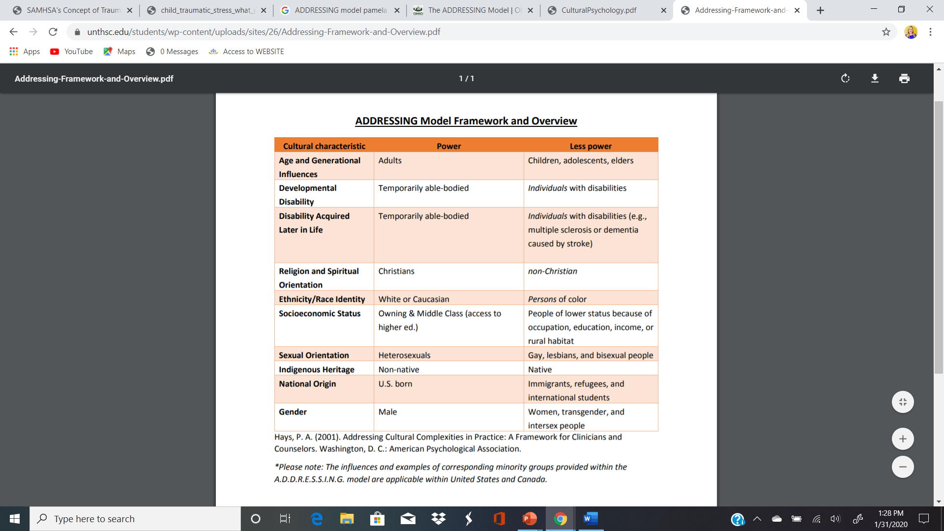
Diversity is complex and varies across countries
Let’s do an exercise!
Notes:
The trainer will introduce the ADDRESSING Model by Pamela Hayes. The trainer will point out the complexity of the concept of diversity. The model provides with examples of cultural characteristics: Age, Developmental disability, Disability acquired later in life, Religion and spiritual orientation, Ethnicity/Race identity, Sexual Orientation, Indigenous heritage, National Origin, and Gender. The trainer will discuss the groups with power and less power as they are displayed on the slide. The trainer should also explain that this specific chart is based on the U.S. and Canadian context, but other country’s information can be very different. For example; countries where most citizens are Muslim, that will be the religion under “power” and other religions are in the “less power” Colum.
The trainer will facilitate a cultural awareness exercise. First participants will become familiar with the ADDRESSING Model’s cultural characteristics. Participants are instructed to pair with a peer and for about 2 minutes for each person, they will share with the other person an aspect of their identity from the model and discuss the impact of that identity on their lives. For example; a participant might choose a religion and discuss how it shapes their worldview and way of coping with stress. After each person shares, the trainer will bring the group together and then ask the group: “Is there something new you learned from your partner’s experience?”, “

Slide 138
EXAMPLES OF TRAUMA INFORMED LANGUAGE
NOT TRAUMA INFORMED | TRAUMA INFORMED
“Youth is resistant to treatment” | “Youth is struggling to cope with abstinence”
“Youth is disrespectful to staff” | “Youth does not feel safe in the space”
“Youth lies about the use of substances” | “Youth is working through ambiguity of substance use”
“Youth is not engaged in treatment plan” | “Youth needs adaptation to treatment plan to meet them where they’re at”
“Youth plays the victim” | “Youth is letting me know their previous coping styles to being held accountable”
“The family is unwilling to heal” | “The family requires multiple interventions for their needs”
Notes:
The trainer will ask a member of the audience to reach one of the responses from both columns, for example “youth is resistant to treatment” and the trauma informed response “youth is struggling to cope with abstinence” and think about how those two messages convey a different message, not only to the client but to providers and how we communicate with each other.

Slide 139
Smart Tips for Building and Utilizing a Trauma-Informed Lens in Your Task Force
Review agency policies and procedures to identify and remove any that are potentially unsafe and harmful to trafficking victims with histories of trauma.
Provide education and training of staff, including those working directly with trafficking victims as well as other providers in relevant systems of care.
Screen for trauma in multiple settings.
(Clawson, Salomon & Goldbatt, 2008)
Notes:
The trainer will discuss the suggested step to ensure a trauma informed lens in organizations.
Review agency policies and procedures to identify and remove any that are potentially unsafe and harmful to trafficking victims with histories of trauma.
Provide education and training of staff, including those working directly with trafficking victims as well as other providers in relevant systems of care.
Screen for trauma in multiple settings.

Slide 140
Ensure safety and meet basic service needs.
Build long-term, sustaining relationships and provide opportunities for regaining valued social roles.
Provide access to trauma-specific treatment services.
Specific to adolescents, use group therapy to address skills development, affect regulation, interpersonal connections, and competence and resiliency building.
Understand the role that culture plays in resiliency and the importance of community resources as potentially mediating the trauma experience, particularly for foreign-born victims.
(Clawson, Salomon & Goldbatt, 2008)

Slide 141
Make peer models and supports available.
Engage survivors in programming.
Develop alternatives to traditional therapies.
(Clawson, Salomon & Goldbatt, 2008)

Slide 142
Module 3: Screening & Assessment
Notes:
The trainer will introduce the topic of “Screening & Assessment”. The trainer will explain that we will discuss practical methods for screening and assessing youth with substance abuse problems.

Slide 143
SCREENING & ASSESSMENT
SCREEENING & ASSESSMENT
Methodology:
Active discussion
Case Study
Role Play
Required Materials:
Easel Pad
Participant Manual
Notepad for each participant
Pens & Pencils
Duration: 6 hours
Notes:
The trainer will point out the methodology for this training. Active discussion refers to the trainer’s lecture but also participation from the audience in the form of questions, comments, suggestions that will enhance mutual learning.
The required materials for this module provide preparation for exercises.
The expected duration of this module is six hours.

Slide 144
SCREEENING & ASSESSMENT
Learning Objectives
  To learn the difference between screenings and assessments.
  To understand ethical guidelines when working with youth.
  To incorporate trauma-informed skills when working with youth.
Notes:
The trainer will introduce the learning objectives. But first, the trainer can ask the audience what their expectations are about this module.
Learning Objectives
To learn the difference between screenings and assessments.
To understand ethical guidelines when working with youth.
To incorporate trauma-informed skills when working with youth.

Slide 145
SCREENING & ASSESSMENT
  Learning Objectives continued…
  To understand the goals of screenings.
  To effectively manage crises
  To conduct effective screenings youth.
Notes:
The trainer will continue pointing out the learning objectives of this module.
Learning Objectives continued…
To understand the goals of screenings.
To effectively manage crises.
To conduct effective screenings youth.

Slide 146
SCREENING & ASSESSMENT
  Learning Objectives continued…
  To understand de goals of assessments.
  To learn about assessment methods and tools
  To conduct effective assessments of youth who are actively using.
  To learn the importance of case management.
Notes:
The trainer will continue pointing out the learning objectives of this module.
To understand de goals of assessments.
To learn about assessment methods and tools
To conduct effective assessments of youth who are actively using.
To learn the importance of case management

Slide 147
SCREENING VS. ASSESSMENT
Screening is a process for evaluating the possible presence of a particular problem. The outcome is normally a simple yes or no.
Assessment is a process for defining the nature of that problem, determining a diagnosis, and developing specific treatment recommendations for addressing the problem or diagnosis.
(SAMHSA/CSAT, 2009)
Notes:
The trainer will explain the difference between the process of screening and assessing youth. The trainer will ask the audience what is their understanding of the difference between screening and assessment. Then the trainer will define both terms as described above.
Screening is a process for evaluating the possible presence of a particular problem. The outcome is normally a simple yes or no.
Assessment is a process for defining the nature of that problem, determining a diagnosis, and developing specific treatment recommendations for addressing the problem or diagnosis.
The trainer will point out that before we begin learning more about screening and assessments of youth, we will cover ethical and legal considerations in the next few slides.

Slide 148
BEST ETHICAL PRACTICES WHEN WORKING WITH YOUTH
Beneficence
Fidelity & Responsibility
Integrity
Justice
Respect for People’s Rights and Dignity
Autonomy
(ACA, 2014; APA, 2017)
Notes:
The trainer will introduce the best ethical practices to working with youth and families affected by substance use/abuse as per the American Psychological Association’s code of ethics and the American Counseling Association’s code of ethics. These principles should guide the work with youth and families.
Beneficence & nonmaleficence: providers strive to provide services that benefits the individual and society to promote mental health and well-being. At the same time, service providers avoid actions that could cause harm to those you are serving.
Fidelity & Responsibility: Providers establish trusting relationships with those they serve; providers honor their commitments and keep promises.
Integrity: Providers promote honesty and truthfulness in their practice of counseling, therapy and any other treatment they provide.
Justice: Providers treat individuals equitably and fostering fairness and equality.
Respect for People’s Rights and Dignity: Providers respect the dignity and value of all people, their rights to privacy, confidentiality and self-determination.
Autonomy: Providers create environments that support the right of each person to control the direction of their own lives.

Slide 149
LEGAL AND ETHICAL CONCERNS
Some important concerns to take account are:
Confidentiality restrictions
When may confidential information be shared with others.
Rules about obtaining adolescent consent to disclose treatment information
The signature of the adolescent (and the issue of parental consent)
(Treatment Improvement Protocol, 1999)
Notes:
The trainer should point out those legal and ethical concerns, but it will depend on the context.
Confidentiality restrictions: The Federal confidentiality laws and regulations protect any information about an adolescent who has applied for or received any substance use/abuse-related assessment, treatment, or referral services from a program that is covered under the law.
When may confidential information be shared with others: The regulations also permit disclosure without the adolescent's consent in several situations, including medical emergencies, reporting child abuse, and communications among program staff.
Rules about obtaining adolescent consent to disclose treatment information: Most disclosures are permissible if an adolescent has signed a valid consent form that has not expired or been revoked. Generally 18 years old
The signature of the adolescent (and the issue of parental consent): The adolescent must always sign the consent form in order for a program to release information even to her parent or guardian. The program must get the signature of a parent, guardian, or other person legally responsible for the adolescent in addition to the adolescent's signature only if the program is required by State law to obtain parental permission before providing treatment to the adolescent.
Check the specific script about the legal and ethical concerns.

Slide 150
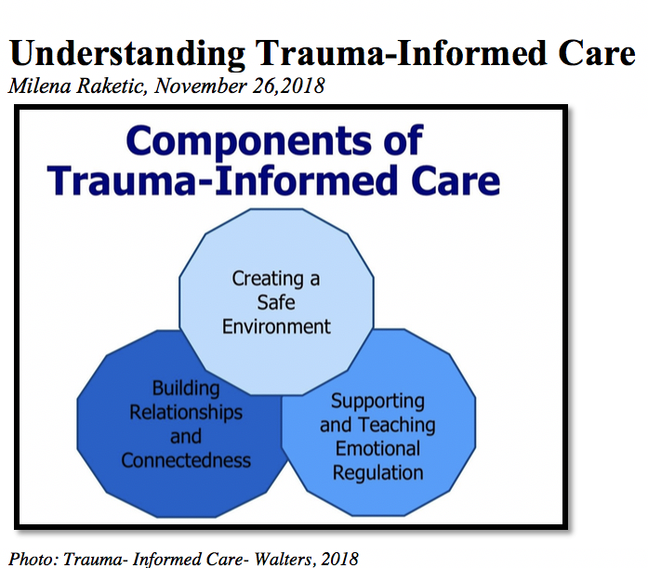
TRAUMA INFORMED INTERVIEWING
Create a Safe Environment:
  Use universal precautions of care.
  Trauma informed care starts at first contact with youth.
  Comfort Statements.
Buildings relationships and connectedness:
  Informed consent and full disclosure.
Supporting and teaching emotional regulation:
  Constant assessment of potential discomfort.
  Manage crises
Notes:
The trainer will remind the group about the topic of trauma informed care discussed on module 3. The trainer will discuss how to apply the principles of trauma informed care when screening and assessing youth.
CREATE A SAFE ENVIRONMENT:
Use universal precautions of care: If you recall on module 3, we discussed this concept. Universal precautions refers to the assumption a provider makes about potential clients. We do not know a person’s history of trauma and their specific coping mechanisms until we get to know them. Therefore, even if it is a screening or assessment, providers must assume that there could be trauma and utilize trauma-informed skills to make the space safe for the client.
Trauma informed care starts at first contact with youth: From the first contact with youth, the provider must utilize trauma-informed care as they conduct screenings and assessments. This helps to minimize re-traumatization of client in case there is trauma in their history.
Make comfort statements: providers should thank the client for showing up to the screen/assessment. Ask the client if they are comfortable or if the provider can do something to help them feel more comfortable.
BUILDING RELATIONSHIPS AND CONNECTEDNESS:
Informed consent and full disclosure: provide information about the process of the screen/assessment, inform them with detail and let them know they have a right to refuse to answer or to stop the interview at any time. This helps the client feel more in control of the emotional space and promotes trust towards provider.
SUPPORTING AND TEACHING EMOTIONAL REGULATION:
Constant assessment of potential discomfort: providers are tuned to the client’s body language, expressions that might indicate discomfort. Providers also prepare the client before asking uncomfortable questions. For example: “During this screening/assessment I will ask you questions that might be uncomfortable, if you feel that way, let me know so we can figure out how to make this process more comfortable for you”.
Manage crises: providers effectively manage potential crises that might arise during the screening/assessment. The trainer will point out that we will learn more about this in the next slide.

Slide 151
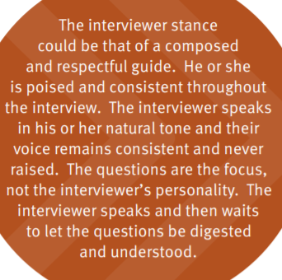
THE ROLE OF THE INTERVIEWER / PROVIDER
(SAMHSA, 2015)
Notes:
The Trainer discusses that the most important aspect of an effective contact with a youth is the provider’s demeanor and attitude towards the client.
The interviewer’s stance and tone during the administration of the data collection instrument are essential to maintaining the safe, controlled physical and interpersonal space established before the interview began. Interviewers must be able to manage their own emotions during the feel interview process. Signs of high anxiety, frustration, fear, or anger can make the interviewee unsafe during the process. It is the interviewer’s responsibility to manage his or her emotions during the interview, staying calm while displaying compassion when hearing difficult aspects of a person’s story and responding rather than reacting to the person’s behaviors during the interview.

Slide 152

MANAGING CRISES DURING SCREENINGS & ASSESSMENTS
Trauma disclosures.
Suicidal thoughts or feelings.
Violence.
Notes:
The trainer will discuss situations that might arise during a screening or assessment. Some of the most common include; trauma disclosures, suicidal thoughts or feelings and violent behavior.
The trainer asks the audience to raise their hand if they have encountered any of these situations.

Slide 153

TRAUMA DISCLOSURES
Redirect and stop.
Attend to the client’s feelings.
Stabilize
Check legalities
(SAMHSA, 2015)
Notes:
The trainer will discuss best practices to managing a client’s disclosure of past traumatic experiences such as; childhood sexual abuse, witness to domestic abuse, accidents, violence experienced in the community or others.
REDIRECT AND STOP: When a client discloses a traumatic experience, it is recommended that the interviewer gently redirects the client and stops them from continuing disclosure at length. It is not recommended that the interviewer probes more or asks for details of the trauma as this might re-traumatize the client. For example saying: “Susan, it sounds like that experience brings up strong feelings, you don’t need to give me details now, perhaps we can process that once you’re fully in treatment later on”.
ATTEND TO THE CLIENT’S FEELINGS: the providers’ goal is to address client’s feelings of distress. Providing statements to validate their feelings and reassuring client can help them regain stability. For example saying: “that sounds like it was a very hurtful experience, I’m here to support you, you’re in a safe place, what can I do to help you feel more comfortable right now?”
STABILIZE: Provide the client with enough time and space to recover from the emotional distress, offer water and offer to take a break from the interview. Once the client regains stability, ask the client if they feel well enough to continue the interview and honor their decision.
The trainer will discuss with the audience the duty to report in case of sexual abuse or exposure to domestic violence as it relates to the context where this training is being taught. The trainer can ask “what is the legal duty of providers when they hear cases of sexual abuse?”

Slide 154
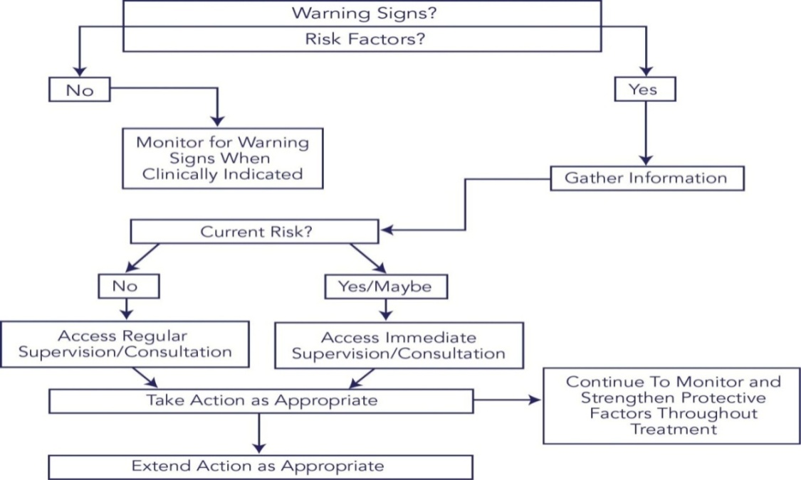
SUICIDAL THOUGHTS OR FEELINGS
Understanding suicide
GATE is an intervention for suicidal thoughts or feelings
  Gather information
  Access supervision
  Take responsible action
  Extend the action
(CSAT/TIP, 2009)
Notes:
The trainer will discuss the topic of encountering suicidal thoughts or feelings when screening or assessing a client.
UNDERSTANDING SUICIDE:
The trainer should explain that adolescents with substance use disorders are at especially high risk of suicidal behavior. As such, suicide risk is a problem that every frontline counselor must be able to address.
Adolescents in crisis may experience suicide ideation—thoughts about hurting or killing themselves. These thoughts are common and predictable responses to the distress felt during a crisis. Some counselors may experience discomfort when talking about suicide ideation and may avoid the topic. However, because of the relatively high risk among youth who use substances, it is vitally important that counselors become comfortable and confident
in addressing issues relating to suicide with their clients.
 Adolescents often enter treatment at a point when their substance use is out of control, increasing a variety of risk factors for suicide.
 They enter treatment when a number of substance-related life crises may be cooccurring (e.g., school, legal, family).
 They enter treatment at peaks in depressive symptoms.
 Mental health problems (e.g., depression, post-traumatic stress disorder [PTSD], anxiety disorders, some personality disorders) associated with suicide risk often cooccur among people who use substances.
 Crises that are known to increase suicide risk sometimes emerge during drug treatment (e.g., relapse, family readjustment stress, transitions between levels of treatment).
The trainer should explain that there is a 4-step process to intervene when there is a suicide risk suspected. The four steps form the acronym GATE. The steps are:
Gather information;
Access supervision;
Take responsible action; and
Extend the action.
Gather information:
There are two steps to gathering information:
Screening for and identifying warning signs; and
Asking follow up questions.
Screening
Screening consists of asking very brief, uniform questions at intake (and throughout treatment as necessary) to determine whether further questions about suicide risk are necessary. There is a myth that asking a person about suicidal thoughts may put the idea in his or her head and increase the risk. This is not true. Being asked about suicide may actually be a relief for many people.
Sample Screening Questions
Introducing the topic (use either statement):
1. Now I am going to ask you a few questions about suicide.
2. I have a few questions to ask you about suicidal thoughts and behaviors.
Screening for suicidal thoughts (ask either question):
1. Have you thought about killing yourself?
2. Have you thought about carrying out suicide?
Screening for suicide attempts (ask either question):
1. Have you ever tried to take your own life?
2. Have you ever attempted suicide?
Asking Follow-up Questions
Ask follow-up questions when clients respond “yes” to one or more screening questions or any time you notice a warning sign. The purpose of asking follow up questions is to have as much information as possible so that you, your supervisor, and the treatment team can develop a good plan of action. You also will want to provide as much information as possible to another provider should you make a referral.
Access supervision:
You should not make a judgment about the seriousness of suicide risk or try to manage suicide risk on your own unless you have an advanced mental health degree and specialized training in suicide risk management and it is understood by your program that you are qualified to manage such risk independently.
Receiving input from a peer is not enough. Although such input may be helpful, consultation is a more formal process whereby information and advice are obtained from:
A professional with clear supervisory responsibilities;
A multidisciplinary team that includes such a person; or
An outside consultant experienced in managing suicidal clients who has been approved by your program for this purpose.
When obtaining supervision or consultation, assemble all the information you have gathered on your client’s suicidal thoughts and/or suicide attempts through the screening and follow up questions, as well as data from other sources of information (e.g., other providers, family members, treatment records).
In some circumstances, you will need to obtain immediate consultation. In other circumstances, obtaining consultation at regularly scheduled supervision or team meetings may be sufficient.
Circumstances Requiring Immediate Supervision or Consultation
At Intake:
Direct warning signs are evident (suicidal communication, seeking access to method, making preparations);
Answers to follow-up questions to suicide screening questions suggest that there is current risk;
Answers to follow-up questions to indirect warning signs suggest that there is current risk; and
Additional information (e.g., from the referral source, family member, medical record) suggests that there is current risk.
During Treatment:
Emergence (or reemergence) of direct warning signs suggests current risk;
Emergence (or reemergence) of indirect warning signs that, on follow up questioning, suggests current risk;
Answers to suicide screening questions asked during the course of treatment suggest current risk; and
Additional information (e.g., from another provider or family member) suggests current risk.
Circumstances That Can Wait for Regularly Scheduled Supervision or Consultation
At Intake:
One or more indirect warning signs are present, but answers to follow-up questions indicate that there is no reason to suspect current risk for suicidal behavior (e.g., a client is socially isolated and abusing substances, but otherwise shows no indications of suicidal thoughts or plans);
One or more risk factors are present, but there are no accompanying warning signs or other indications to suspect current risk for suicidal behavior;
During screening, client discloses a history of suicidal thoughts or suicide attempts, but there are no accompanying warning signs or other indications to suspect current risk for suicidal behavior; and
Additional information (e.g., from the referral source or a family member) suggests your client has a history of suicidal thoughts or attempts, but there are no accompanying warning signs or other indications to suspect current risk for suicidal behavior.
During Treatment:
Client reports (or alludes to) a history of suicidal thoughts that you had not previously been aware of, but there are no accompanying warning signs or other indications to suspect current risk for suicidal behavior;
Client reports (or alludes to) prior suicide attempts that you had not previously been aware of, but there are no accompanying warning signs or other indications to suspect current risk for suicidal behavior;
Additional information (e.g., from another provider or family member) suggests a history of suicidal thoughts or attempts that you had not previously been aware of, but there are no accompanying warning signs or other indications to suspect current risk for suicidal behavior; and
Client with a history of suicidal thoughts or behaviors experiences an acute stressful life event or a setback in treatment (e.g., substance abuse relapse), but there are no accompanying warning signs or other indications to suspect current risk for suicidal behavior.
Take responsible action
The actions taken should be sensible in light of the information that has been gathered about suicidal thoughts and/or previous suicide attempts. Although the potential actions are many, they can generally be described along a continuum of intensiveness. In instances of greater seriousness, you will generally take more intensive actions. For less serious circumstances, you will likely take fewer intensive actions. Note that “less intensive” does not mean no action; it merely indicates that the counselor may have more time to formulate a response, the actions may be of lower intensity, and/or fewer individuals and resources may be involved.
Counselors are also advised to be aware of local emergency services providers who are trained and experienced at providing medical intervention for suicide attempts. Such providers must be prepared to use pharmacological intervention (e.g., naloxone) for suicide attempts by overdose.
Possible Responsible Actions
Arrange a referral:
To a clinician for further assessment of suicide risk;
To a provider for mental health counseling;
To a provider for medication management;
To an emergency services provider (e.g., hospital emergency department) for acute risk assessment;
To a mental health mobile crisis team that can provide outreach to a physically inaccessible client at his or her home (or shelter) and make a timely assessment; or
To a more intensive substance abuse treatment setting.
Restrict access to methods of suicide (you will need the help of family members or friends).
Temporarily increase the frequency of care, including more frequent telephone check-ins.
Temporarily increase the level of care (e.g., refer client to residential or hospital-based treatment).
Involve a case manager if possible (e.g., to coordinate care, to check on the client occasionally).
Involve the primary mental disorder care provider if there is one.
Encourage the client to attend (or increase attendance at) 12-Step meetings such as Alcoholics Anonymous, Narcotics Anonymous, or Cocaine Anonymous.
Enlist family members or significant others (selectively, depending on their health, closeness to the client, and motivation) in observing indications of a return of suicide risk.
Observe the client for signs of a return of risk.
Create a safety card (see below) with the client in the event of a return of acute suicidal thoughts.
Create a detailed safety plan with the client in the event of relapse to alcohol or drugs.
Give the client an emergency hotline number.
Invite the client to contact you (or an emergency hotline) in the event of acute suicidal thoughts.
Extend the action:
A common misconception is that suicide risk is an acute problem that, once dealt with, ends. Unfortunately, individuals who are suicidal commonly experience a return of suicide risk following any number of setbacks, including relapse to substance use, a distressing life event (e.g., breakup with a partner), increased depression, or any number of other situations. Sometimes suicidal behavior even occurs in the context of substantial improvement in mood and energy. Therefore, monitoring for signs of a return of suicidal thoughts or behavior is essential.
There is also a tendency to refer a client experiencing suicidal thoughts and behaviors to another provider and then assume that the issue has been taken care of. This is a mistake. It is essential to follow up with the provider to determine that the client kept the appointment. It is also critical to coordinate care on an ongoing basis, for example, to alert a provider that a client has relapsed and may be vulnerable to suicidal thoughts.
Extending the action emphasizes the importance of watching for a return of suicidal thoughts and behaviors, following up with referrals, and coordinating on an ongoing basis with providers who are addressing the client’s suicidal thoughts and behaviors.
Examples of Extending the Action
Confirm that a client has kept the referral appointment with a mental health provider (or other professional).
Follow up with the hospital emergency department when a client has been referred for acute assessment.
Coordinate with a mental health provider (or other professional) on an on-going basis.
Coordinate with a case manager on an on-going basis.
Check with the client about any recurrence of or change in suicidal thoughts or attempts.
Confirm that the client still has his or her safety card (ask the client to show it to you) and remains willing to use it if the need arises
Check with family members (with the client’s knowledge and consent) about any recurrence of or change in suicidal thoughts or attempts.
Reach out to family members to keep them engaged in the treatment process after a suicide crisis passes.
Observe the client for signs of a return of risk.
Confirm that the client and, where appropriate, the family still have an emergency phone number to call in the event of a return of suicidal thoughts.
Confirm that the client still does not have access to a method of suicide (e.g., gun, stash of pills).
Follow up with the client about suicidal thoughts or behaviors if a relapse (or other stressful life event) occurs.
Monitor and update the treatment plan as it concerns suicide.
Document all relevant information about the client’s condition and your responses, including referrals made and the outcomes of the referrals.
Complete a formal treatment termination summary when and under whatever circumstances this stage of care is reached.

Slide 155

VIOLENT BEHAVIOR
Understanding the type of aggressive behavior.
Physical safety
Verbal Strategies
(CPI, 2020; CWTI, 2006)
Notes:
The trainer should explain that adolescents with substance abuse problems might be under the influence or might be withdrawing from the substance, therefore their behaviors can be erratic if they are actively using.
Understanding the type of aggressive behavior: providers must assess whether the client is verbalizing discomfort and is resistant to the screen or assessment. If warning signs such as pacing, angry facial expression, violent statement are made, the adolescent might be ale to benefit from verbal strategies. Anger usually escalates slowly, therefore a close assessment of the client’s body language is crucial. If the aggression is impulsive without warning, the youth might be under the influence or might have a medical condition that triggers the behavior.
Physical safety: it is important to consider the space where you’re interviewing the client. Always sit close to doorways to exit in case your client becomes physically aggressive. Also, interview rooms should be free from items that can become lethal.
Verbal strategies:
Remain calm. When the provider is in control of their own emotions, verbal strategies are more successful.
Check the scene to get other people out of the room so you can manage the client’s crisis.
Point out what you are noticing in the youth; their behaviors, their words and their demeanor. Sometimes youth can become agitated and not realize they are becoming aggressive. For example tell the youth “Larry, I noticed you are cracking your knuckles and breathing heavier, should we take a break and make sure you're feeling ok?”. This can help the youth to become aware of their reactions and come back to a balanced state, also preventing the aggression to escalate.
Validate feelings. The client might be feeling anger or fear, verbally reassure them, say “I can see you are upset; you have every right to feel that ay right now”. Validating feelings helps the client connect with the worker.
Embrace silence. Some clients don’t want to speak about anything, embrace that and stay in the room with the youth. You can say “It’s ok if you don’t feel like talking, I’m going to stay here with you to make sure you’re feeling ok”.

Slide 156
SCREENING

Slide 157

SCREENING
Should last no more than 30 minutes
Simple instrument
Relationship to substance
  Frequency
  Severity
Should take place in private area.
(SAMHSA/CSAT, 2009)
Notes:
The trainer will introduce some basic principles to keep in mind while screening youth.
Should last no more than 30 minutes: a screening is a basic set of questions meant to explore whether there is a problem that needs attention, it should not take longer than the stated time.
Simple instrument: Short-versions of tools that we will cover on next slide.
Relationship to substance
Frequency
Severity
Should take place in private area: whether this is in juvenile detention centers, NGOs, hospitals, private companies, schools, religious communities or other settings, make sure the screening happens in a private area.

Slide 158
SCREENING METHODS
Brief structured interview questions
  Youth participation
  Caregiver/Parent
Screening Tools
  NIDA -12 questions
  CRAFFT – 6 questions
Notes:
The trainer will discuss that there are different ways to screen. The most accepted types are through brief questions or utilizing brief tools.
Brief structured interview questions: simply asking a youth about their drug use can provide us with information. It is important that the youth is engaged and involved, and if it is possible, a caregiver can also be included in a brief interview about the youth’s use of substances.
Screening Tools:
NIDA: The National Institute on Drug Abuse (NIDA) quick screen is designed to inquire about use of most addictive substances.
CRAFFT:

Slide 159
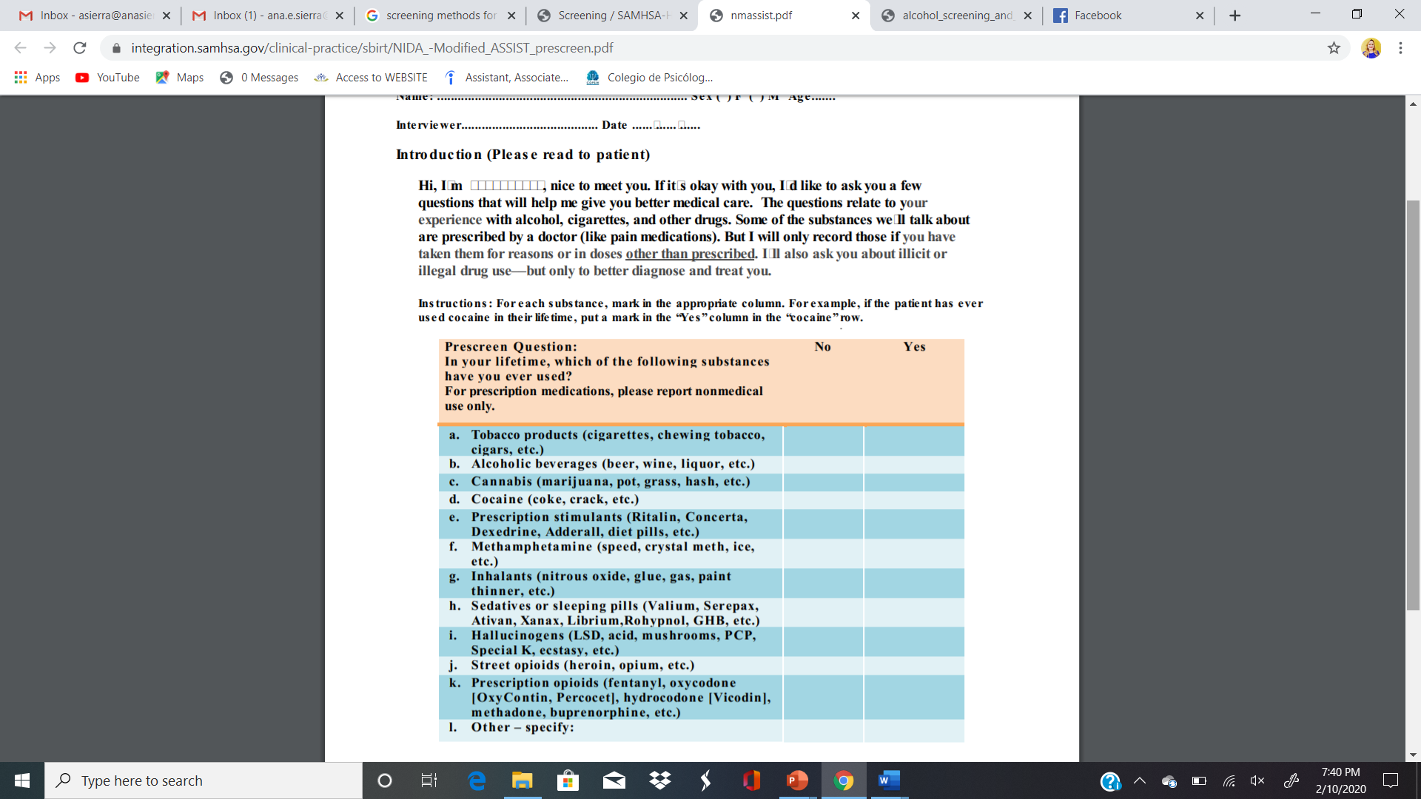
National Institute on Drug Abuse (NIDA) Screen
NIDA Screen is a set of brief questions on the use of substances.
Has a suggested script to help youth understand the nature of the questions.
Notes:
The trainer will introduce the NIDA screening tool. The trainer will read the introduction and the instructions of the instrument displayed on the slide. The tool can be found after the appendixes under the Tools Section.

Slide 160

Let’s Practice!
Notes:
The trainer will direct the group to their appendix documents where they will find the NIDA screening tool. The trainer will ask participants to partner with another person to practice asking the questions on the screening tool. The trainer will instruct the group that the partners formed will read the script as it is displayed on the tool and ask each question, then switch so each partner has time to practice. Remind the audience to incorporate trauma-informed skills when practicing.
Ask participants to be creative and think of some of their current clients to impersonate when practicing the exercise.
After the exercise the trainer will engage the group to discuss how it felt to conduct this role play exercise. Ask the audience if anything came up for them during the time they were interviewing or playing the interviewee. The trainer can also ask the audience if they noticed any trauma-informed skills utilized during this practice.

Slide 161
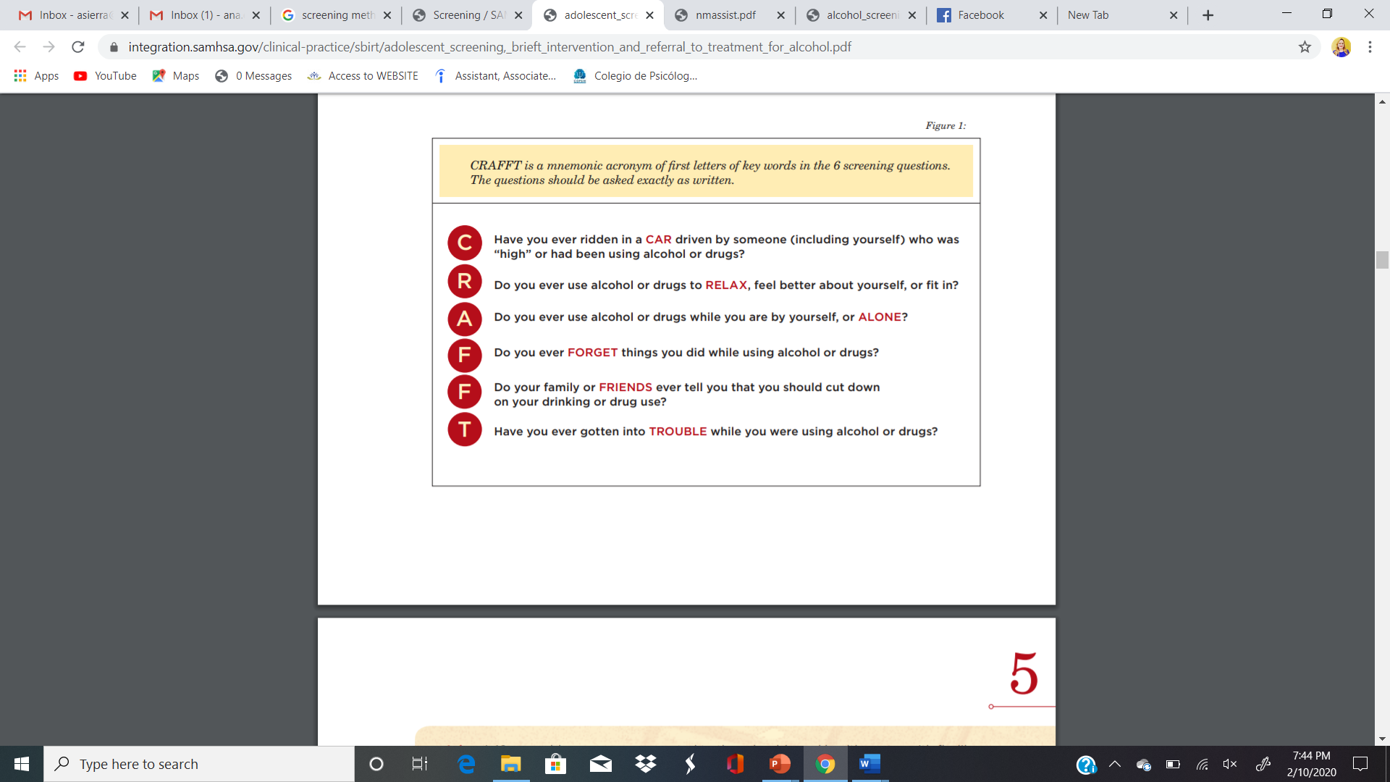
CRAFFT Screening Tool
6 questions.
Each questions equal to one point.
20 languages.
(CRAFFT.ORG, 2020)
Notes:
The trainer will introduce the CRAFFT tool. The trainer will refer the group to the Tools Section of the documents where they will find the tool along with the translations of the tool.
The CRAFFT has been utilized internationally and is translated into 20 languages.
Burmese
Dutch
English
French
German
Haitian Creole
Hebrew
Japanese
Khmer
Laotian
Mandarin Chinese
Nepali
Portuguese (Portugal)
Portuguese (Brazil)
Russian
Spanish (LatAm)
Spanish (Spain)
Turkish
Ukrainian
Vietnamese

Slide 162
Let’s Practice!
Notes:
The trainer will direct the group to their appendix documents where they will find the CRAFFT screening tool.
The trainer will ask participants to partner again to practice asking the questions in the tool. Remind the audience to incorporate trauma-informed skills when practicing. Ask participants to be creative and think of some of their current clients to impersonate when practicing the exercise.
After the exercise the trainer will engage the group to discuss how it felt to conduct this role play exercise. Ask the audience if anything came up for them during the time they were interviewing or playing the interviewee. The trainer can also ask the audience if they noticed any trauma-informed skills utilized during this practice.

Slide 163
ASSESSMENTS

Slide 164
ASSESSMENTS
What is an assessment?
An assessment is a process that consists of collecting data, interpreting it and developing a plan based on the strengths and weaknesses that are revealed through the data.
The patient assessment includes capacities, strengths, problems, needs and resources, as well as weaknesses and risk areas.
To sum up, the assessment includes all the positive and negative aspects of the patient.
Notes:
The trainer will discuss the components of an assessment.
What is an assessment?
An assessment is a process that consists of collecting data, interpreting it and developing a plan based on the strengths and weaknesses that are revealed through the data.
The patient assessment includes capacities, strengths, problems, needs and resources, as well as weaknesses and risk areas.
To sum up, the assessment includes all the positive and negative aspects of the patient.

Slide 165
ASSESSMENTS
What is the Relationship between the Assessment and Treatment Planning for Drug and Alcohol Use?
It’s the first step in formulating a treatment plan.
It’s a continual process, which starts with an early assessment and continues throughout the whole treatment process

Slide 166
ASSESSMENTS
Comprehensive Assessment
  Physical Health
  Psychological Health
  Social Assessment
  Vocational/Educational Assessment
Notes:
The trainer will introduce assessment approaches. The assessment is most comprehensive when a semi-structured interview is completed on major life domains and also a validated tool is utilized as well.
Physical Health
A. Complete medical and drug history
B. In-patient programs (complete physical and, when indicated, a neurological assessment)
C. Routine inquiry might include:
1. When last treated or seen by physician
2. When last complete physical examination was done
3. Awareness of the presence of any medical problem
4. What, if any, medication/drug, prescribed or otherwise, is being taken.
5. Physical Health Assessment includes an appropriate laboratory work-up in in-patient programs.
Psychological Health
A. History of psychological problem areas
B. Family history
C. Previous psychiatric treatment
D. Direct observation of the client and assessment of specific behavior
Social Assessment
A. Environment (home, neighborhood, etc.)
B. Religious background and affiliation
C. Childhood history
D. Military Service
E. Financial status
F. Alcohol and consumption of other drugs (current and past, among other members of the family and in the home).
G. Evaluation of characteristics of social peer group and environmental settings the patient comes.
H. Consideration of the patient's family circumstances, current living situation, and social, ethnic, cultural, financial, emotional, and health factors.
I. A consideration of the expectations of the family or friends regarding the patient's treatment, the degree to which they expect to be involved, and their expectations regarding the length of time and type of treatment required.
Vocational/Educational Assessment
A. Vocational history
B. Educational history (including academic and vocational training- diplomas, degrees, certifications, licenses)
C. A consideration of the individual’s past experiences with and attitudes toward work, present motivations or areas of interest, and possibilities for future education, training, and/or employment
D. Availability of resources
Drug intervention
Support Services
E. Discrimination/Pre-conceived notions
F. Stigmatization of mental health issues
G. When/how the assessment takes place
H. Lack of validation of instruments with populations served on a local level

Slide 167

ASSESSMENTS
Global Appraisal of Individual Needs (GAIN)
Teen Addiction Severity Index (T-ASI)

Slide 168
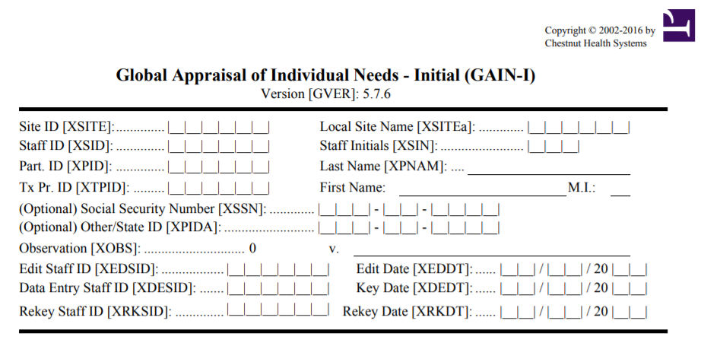
Global Appraisal of Individual Needs (GAIN)
Semi-structured interview
75 – 100 minutes to administer, 15 to score
(GAINCC.ORG, 2015)
Notes:
The trainer will introduce the GAIN tool. Direct the audience to the appendix documents where the full version of the GAIN will be discussed.
This is a standardized bio-psycho-social assessment designed to help clinicians gather information for diagnosis, placement, and treatment planning. As with any self-report, the GAIN is limited by the veracity of the individual respondent's answers; it should be collected by someone certified in GAIN administration, combined with other information and interpreted by clinical or other qualified personnel prior to taking any specific actions.

Slide 169
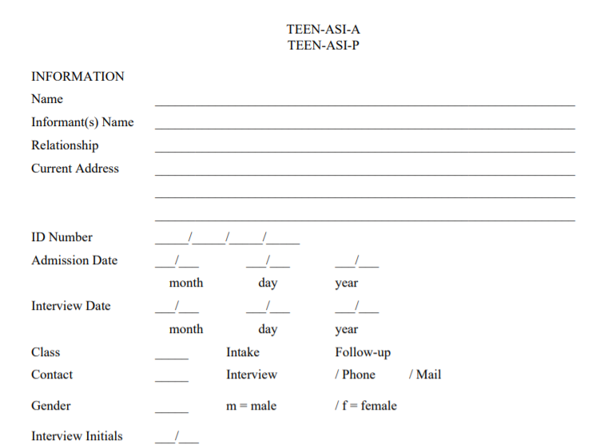
Teen Addiction Severity Index (T-ASI)
Semi-structured interview
30 – 45 minutes to administer,
10 to score
(Kaminer et, al 2009)
Notes:
The trainer will introduce the T-ASI. Direct the audience to the appendix documents where the full version of the T-ASI will be discussed.
The objective of this face-to-face structured interview combined with opportunity for assessor to offer comments, confidence ratings (indicating whether the information may be distorted), and severity ratings (indicating how severe the assessor believes is the need for treatment or counselling). It is specifically created to address substance abuse in youth.

Slide 170
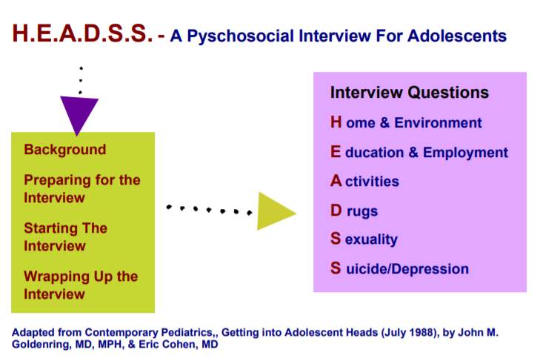
HEADSS
Interview
3 – 90 minutes
(Cohen et al, 1991)
Notes:
The trainer will introduce the HEADSS. Direct the audience to the Tools Section where the full version of the HEADSS will be discussed.
The purpose of this assessment is to facilitate communication and to create a sympathetic, confidential, respectful environment where youth may be able to attain adequate health care. The approach is known as the acronym HEADSS (Home, Education/employment, peer group Activities, Drugs, Sexuallity, and Suicide/depression).

Slide 171
Let’s Practice!
Notes:
The trainer will direct the group to a practice exercise. The trainer will provide about 5 minutes so all participants can browse through both tools, the GAINS, T-ASI and HEADSS. Then each person will choose which one to practice with for this exercise.
The trainer will ask participants to partner again to practice asking the questions in the tool. Remind the audience to incorporate trauma-informed skills when practicing. The time limit for this exercise is 5 minutes per person then switch for another 5 minutes. The goal is to get a little practice on how to conduct the assessments. Ask participants to be creative and think of some of their current clients to impersonate when practicing the exercise.

Slide 172
OTHER SCREENIGNS & ASSESSMENTS
Adolescent Health Review (AHR)
Adolescent Substance Abuse Subtle Screening Inventory (SASSIA2)
Brief Psychiatric Rating Scale – Children (BPRS-C)
Notes:
The trainer will introduce some options for self-administered tools. These can be utilized if attempts to interview the youth are unsuccessful.
The Adolescent Health Review: is designed to assist health care professionals in screening adolescents for risks to their physical and emotional health. The AHR is designed for use only as an adjunct to standard clinical practice. This instrument is not recommended for children under age 12, adolescents with limited English proficiency, or other adolescents who have reading difficulties.
Adolescent Substance Abuse Subtle Screening Inventory (SASSIA2): Identifies high or low probability of substance dependence and substance abuse disorders for clients 12 to 18 years of age. The SASSI-A2 also provides clinical insight into family and social risk factors, level of defensive responding, and consequences of substance misuse.
Brief Psychiatric Rating Scale – Children (BPRS-C): A 21-item, clinician-based rating scale that is designed for use in evaluating psychiatric problems of children and adolescents
The trainer will point out that these tools are available for free and are listed on the appendix. We will be discussing the importance of case management in the next few slides.

Slide 173

CASE MANAGEMENT
Case Management
Case Coordination
Casework
(CMSA.ORG, 2017)
Notes:
The trainer will introduce the concept and practice of case management.
Case management is a collaborative process of assessment, planning and follow up which is geared to meet a client’s and family’s needs with the goal of achieving wellness. Case management also serves to connect the client with resources or other services needed to meet the goals of treatment. Case managers are individuals who are trained to work with people who are vulnerable and are knowledgeable of resources that can help the population they’re serving.
Case Coordination is a feature of case management and reflects the role often adopted by the case manager in the lead agency. Their role is to collaboratively manage and coordinate the multiple services that a client may require
Casework is the regular direct, contact with people that supports them to implement their case plan

Slide 174
CASE MANAGEMENT MODELS
Notes:
The trainer will discuss two main case management models that are effective when working with youth with complex needs.

Slide 175
GENERAL CASE MANAGEMENT
Trust and relationships
Provision of Resources
Provision of Services
Follow up
Constant adaptation to meet client’s needs
Notes:
The trainer will discuss the core concepts of general case management. Youth with substance abuse challenges present with multiple challenges and barriers. Case management is additional to the single therapy goals.
Trust and relationships: The most effective way to engage youth and families is to gain their trust. If you recall the trauma-informed care approach allows case managers to also engage clients in a way that empowers them, and trust is achieved, resulting in effective treatment.
Provision of Services: Case managers screen with tools (we will discuss later) what are the needs of the client and provide services such as: mental health referrals, substance abuse program referrals, legal, medical, educational, economic and connection to potential sources of support such as church or mentors.
Follow up: Case managers provide resources but also actively follow up with youth and families to ensure that engagement to those referrals have happened. Youth and families often experience difficulty accessing services and follow up allows the case manager to advocate if a service has not been accessed.
Constant adaptation to meet client’s needs: Case managers constantly assess and re-assess the youth’s progress and adapt their focus on the support needed depending on the client’s needs, as these needs will shift throughout treatment.

Slide 176
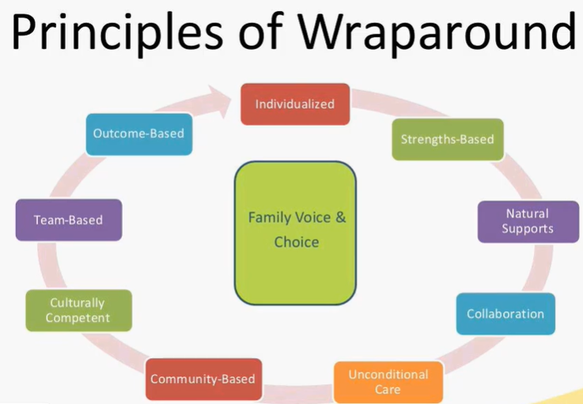
WRAP AROUND MODEL
Evidence-based case management method.
Principles:
  Voice & Choice at the core
  Individualized care
  Strengths-based
  Natural Supports
  Team-based collaborative planning
  Unconditional Care
  Community-based care
  Culturally Competent
  Outcome-based
(Burns, 2008; NWI, 2008)
Notes:
The trainer will introduce the Wrap-Around Model to case management. This model is meant to serve youth and families with multiple needs and difficult to engage. The core of this model involved systems working together to provide best treatment outcomes for families.
Principles of Wrap-Around Model:
Voice & Choice at the core: Youth that come from families with multiple challenges face several barriers and might have experienced negative treatment outcomes in the past. Therefore, assuring that the youth’s voice and choice is at the core of the plan of care empowers families to take ownership of their treatment, resulting in better treatment outcomes.
Individualized care: All families are not the same. This concept refers to investigating the youth’s relationship with the systems around them; school, family, community. The plan of care should be inclusive of the youth’s environments.
Strengths-based: This lens focuses on the strengths of the youth. Although you might see several challenges, all youth also have strengths. This lens assumes that the youth is the expert in their own life and the role of the case manager is to empower them and build their capacity to reach their potential. The trainer will direct the audience to find the “Tentative List of Life Strengths Gleaned from Positive Psychology Literature” and read a few that can apply to youth.
Natural Supports: The role of the case manager is to find within the youth’s context those positive supports or opportunities for positive supports.
Team-based collaborative planning: The systems collaborating such as; school, community entities, parents, and youth work together towards the goals of the family. Other systems might be from need for resources; food vouchers, housing, employment, educational goals, and others that might be specific case by case.
Unconditional Care: The case manager is expected to provide unconditional care, that is, no matter how little progress a youth might be experiencing, care will continue and the same supports will continue to be available.
Community-based care: An important aspect of this model is that case managers are flexible and meet the client where they’re at. Community-cased care refers to services that can happen on the street, at the home, or at school to follow with treatment.
Culturally Competent: The case manager is highly aware of the youth’s specific barriers related to culture and aspects of diversity. If you recall the ADDRESSING model we reviewed in the Trauma Module, we can incorporate it in this model.
Outcome-based: The case manager utilizes concrete outcomes to the goals provided.
The trainer will provide the audience with the link to the National Wrap-around initiative: https://nwi.pdx.edu/

Slide 177
CASE MANAGEMENT TOOLS

Slide 178
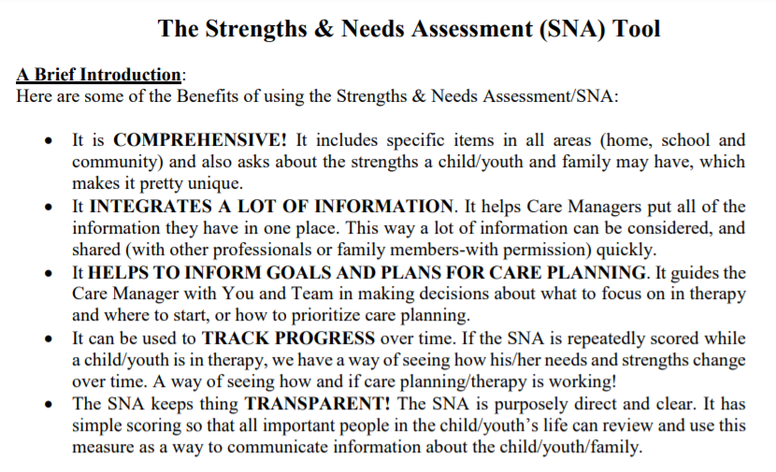
The Strengths & Needs Assessment (SNA) Tool
(Lyons, 2016)
Notes:
The trainer will introduce the SNA Tool. The trainer will direct the audience to the Tools Section to review the tool together.
Six Key Principles of the tool:
Items were selected because they are each relevant to care planning.
Each item uses a 4-level rating system.
Rating should describe the individual, not the individual in services.
Culture and development should be considered prior to establishing the action levels. Cultural sensitivity involves considering whether cultural factors are influencing the expression of needs and strengths
The ratings are generally “agnostic as to etiology”. In other words this is a descriptive tool. It is about the “what” not the “why”. Only one item, Adjustment to Trauma, has any cause-effect judgments.
A 30-day window is used for ratings in order to make sure assessments stay “fresh” and relevant to the child or youth’s present circumstances. However, the action levels can be used to over-ride the 30-day rating period.

Slide 179

Assessment of Survivor Outcomes (ASO)
(IJM.ORG, 2018)
Notes:
The trainer will introduce the Assessment of Survivor Outcomes (ASO). This is specific to special populations: youth that have experienced traumatic events in the form of crimes, for example; sexual abuse, commercial sexual exploitation, online sexual exploitation, and forced labor.
The domains being assessed include:
Safety
Legal Protection
Mental Wellbeing
Economic Empowerment & Education
Social Support
Physical Wellbeing

Slide 180
Let’s Practice!
Notes:
The trainer will direct the group to a practice exercise. The trainer will instruct the audience to read the case study that will be displayed on the next slide. They will choose one of the tools to assess the youth’s case management needs.
The trainer will ask participants to spend the next 10 minutes,

Slide 181
CLINICAL CASE STUDY
Lidia is 15-years-old, Hispanic, heterosexual adolescent. Lidia is an immigrant, she arrived at the main country when she was 8 years old but is currently undocumented in the current country. Lidia was hospitalized due to suicidal ideations. You’re the case manager who is meeting with her prior to her discharge. During your assessment you find out Lidia’s history of sexual trauma by her uncle, from the age of 9 through 12. Lidia verbalizes previous suicidal attempts and recent cutting. Although Lidia speaks the main language, she struggles academically, and in the past, she has skipped school various times. You also find out that Lidia will be living with her mother, who does not believe the abuse happened. Lidia believes her family does not like her because she told about the abuse by her uncle who is in jail, she mentions that her aunt told her “you broke the family apart”.
Lidia admits to trying several drugs throughout the last few years. She admits to heavy use of alcohol, some marihuana and trying mushrooms one time. Her drug of choice is alcohol and she is not willing to stop the use. Lidia also admits to having unprotected sex with several peers when drunk in the past.
Notes:
The trainer will introduce the case study and allow 10 minutes for the audience to formulate a case management plan. Remind the audience to incorporate trauma-informed skills when practicing and discuss how they would utilize it with the client featured. Also, remind the staff of other models we learned about to incorporate to this specific case.
Ask the audience “what is the first goal of treating this client?” The answers can vary but anything from focusing on the relationship with the client to trauma-informed responses indicates the audience is on track. The audience could also mention the diversity model ADDRESSING to discuss the specific circumstances of this case.
Ask the audience “what are the main services this client needs?” The answers can be; educational resources, family support/counseling, mental health treatment, substance abuse treatment, mentoring support or connection to an entity that can provide support, legal aid due to undocumented status, healthcare/STD check, and safety plan for suicidal ideations.

Slide 182
Module 4: Adolescent Drug Treatment
Notes:
The trainer will introduce the Module. We will focus on Adolescent Drug Treatment.

Slide 183
ADOLESCENT DRUG TREATMENT INTERVENTION
ADOLESCENT DRUG TREATMENT INTERVENTION
Methodology:
Active discussion
Case Study
Role Play
Required Materials:
Easel Pad
Participant Manual
Notepad for each participant
Pens & Pencils
Duration: 10 hours
Notes:
The trainer will point out the methodology for this training. Active discussion refers to the trainer’s lecture but also participation from the audience in the form of questions, comments, suggestions that will enhance mutual learning.
The required materials for this module provide preparation for exercises.
The expected duration of this module is ten hours.

Slide 184
ADOLESCENT DRUG TREATMENT INTERVENTION
Learning Objectives
  To identify factors specific to adolescents when considering drug treatment
  To identify the principles of adolescent AOD treatment
  To understand factors for considerations for treatment interventions
  To identify specifics factors to planning treatment for adolescents
Notes:
The trainer will introduce the learning objectives. But first, the trainer can ask the audience what their expectations are about this module.
Learning Objectives
To identify factors specific to adolescents when considering drug treatment
To identify the principles of adolescent AOD treatment
To understand factors for considerations for treatment interventions
To identify specifics factors to planning treatment for adolescent

Slide 185
ADOLESCENT DRUG TREATMENT INTERVENTION
  Learning Objectives continued…
  To understand particular legal and ethical concerns when providing treatment.
  To identify the training needs
  To describe different types of treatment and interventions for adolescents and families
Notes:
The trainer will continue pointing out the learning objectives of this module.
Learning Objectives continued…
To understand particular legal and ethical concerns when providing treatment.
To identify the training needs
To describe different types of treatment and interventions for adolescents and families

Slide 186
ADOLESCENT DRUG TREATMENT INTERVENTION
  Learning Objectives continued…
  To understand the role of family therapy in the treatment of adolescents.
  To describe general impact of drugs use on families.
  To describe family roles and rules
  To explain level of involvement of families in adolescentsˈ treatment
Notes:
The trainer will continue pointing out the learning objectives of this module.
Learning Objectives continued…
To understand the role of family therapy in the treatment of adolescents.
To describe general impact of drugs use on families.
To describe family roles and rules
To explain level of involvement of families in adolescentsˈ treatment

Slide 187
PRINCIPLES OF ADOLESCENTS AOD TREATMENT
Adolescent substance use must be identified and addressed as soon as possible.
Adolescents can benefit from an intervention even if they are not addicted to a drug.
(National Institute on Drug Abuse 2014)
Notes:
The trainer should review the following points from these next slides, addressing basic principles of adolescent AOD use.
Adolescent substance use needs to be identified and addressed as soon as possible. Drugs can have long-lasting effects on the developing brain and may interfere with family, positive peer relationships, and school performance. Most adults who develop a substance use disorder report having started drug use in adolescence or young adulthood, so it is important to identify and intervene in drug use early.
Adolescents can benefit from a drug misuse intervention even if they are not addicted to a drug. Substance use disorders range from problematic use to addiction and can be treated successfully at any stage, and at any age. For young people, any drug use (even if it seems like only “experimentation”), is cause for concern, as it exposes them to dangers from the drug and associated risky behaviors and may lead to more drug use in the future. Parents and other adults should monitor young people and not underestimate the significance of what may appear as isolated instances of drug taking.

Slide 188
PRINCIPLES OF ADOLESCENTS AOD TREATMENT
Routine medical/mental health visits are an opportunity to screen adolescents about substance use.
Testing adolescents for STDs/HIV is an important part of AOD treatment.
(National Institute on Drug Abuse 2014)
Notes:
The trainer should review the following points from these next slides, addressing basic principles of adolescent AOD use.
Routine annual medical visits are an opportunity to ask adolescents about drug use. Standardized screening tools are available to help pediatricians, dentists, emergency room doctors, psychiatrists, and other clinicians determine an adolescent’s level of involvement (if any) in tobacco, alcohol, and illicit and nonmedical prescription drug use. When an adolescent reports substance use, the health care provider can assess its severity and either provide an onsite brief intervention or refer the teen to a substance misuse treatment program.
Testing adolescents for sexually transmitted diseases is an important part of drug treatment. Adolescents who use drugs are at an increased risk for diseases that are transmitted sexually. All drugs of misuse alter judgment and decision making, increasing the likelihood that an adolescent will engage in unprotected sex and other high-risk behaviors such as unsafe tattooing and body piercing practices—potential routes of virus transmission. Substance use treatment can reduce this risk both by reducing adolescents’ drug use (and thus keeping them out of situations in which they are not thinking clearly) and by providing risk-reduction counseling to help them modify or change their high-risk behaviors.

Slide 189
PRINCIPLES OF ADOLESCENTS AOD TREATMENT
Legal interventions/sanctions or family pressure may play an important role in getting adolescents to enter, stay in and complete treatment.
Treatment should be tailored to the unique needs of the adolescent.
(National Institute on Drug Abuse 2014)
Notes:
Legal interventions and sanctions or family pressure may play an important role in getting adolescents to enter, stay in, and complete treatment. Adolescents with substance use disorders rarely feel they need treatment and almost never seek it on their own. Research shows that treatment can work even if it is mandated or entered into unwillingly.
Substance use disorder treatment should be tailored to the unique needs of the adolescent. Treatment planning begins with a comprehensive assessment to identify the person’s strengths and weaknesses to be addressed. Appropriate treatment considers an adolescent’s level of psychological development, gender, relations with family and peers, how well he or she is doing in school, the larger community, cultural and ethnic factors, and any special physical or behavioral issues.

Slide 190
PRINCIPLES OF ADOLESCENTS AOD TREATMENT
Treatment should address the needs of the whole person, not just his/her AOD use.
Behavioral therapies are effective in addressing adolescent AOD use.
(National Institute on Drug Abuse 2014)
Notes:
Treatment should address the needs of the whole person, rather than just focusing on his or her drug use. The best approach to treatment includes supporting the adolescent’s larger life needs, such as those related to medical, psychological, and social well-being, as well as housing, school, transportation, and legal services. Failing to address such needs simultaneously could sabotage the adolescent’s treatment success.
Behavioral therapies are effective in addressing adolescent drug use. Behavioral therapies, delivered by trained clinicians, help an adolescent stay off drugs by strengthening his or her motivation to change. This can be done by providing incentives for abstinence, building skills to resist and refuse substances and deal with triggers or craving, replacing drug use with constructive and rewarding activities, improving problem-solving skills, and facilitating better interpersonal relationships.

Slide 191
PRINCIPLES OF ADOLESCENTS AOD TREATMENT
Families and the community are important aspects of treatment.
Effectively treating AOD use in adolescents requires also identifying and treating other mental health conditions they might have.
(National Institute on Drug Abuse 2014)
Notes:
Families and the community are important aspects of treatment. The support of family members is important for an adolescent’s recovery. Several evidence-based interventions for adolescent drug misuse seek to strengthen family relationships by improving communication and improving family members’ ability to support abstinence from drugs. In addition, members of the community (such as school counselors, parents, peers, and mentors) can encourage young people who need help to get into treatment—and support them along the way.
Effectively treating substance use disorders in adolescents requires also identifying and treating any other mental health conditions they may have. Adolescents who misuse drugs frequently also suffer from other conditions including depression, anxiety disorders, attention-deficit hyperactivity disorder (ADHD), oppositional defiant disorder, and conduct problems. Adolescents who misuse drugs, particularly those involved in the juvenile justice system, should be screened for other psychiatric disorders. Treatment for these problems should be integrated with the treatment for a substance use disorder.

Slide 192
PRINCIPLES OF ADOLESCENTS AOD TREATMENT
Sensitive issues, such as violence and child abuse, or risk of suicide should be identified and addressed.
It is important to monitor substance use during treatment.
Staying in treatment for an adequate period of time and continuity of care afterward are important.
(National Institute on Drug Abuse 2014)
Notes:
Sensitive issues such as violence and child abuse or risk of suicide should be identified and addressed. Many adolescents who misuse drugs have a history of physical, emotional, and/or sexual abuse or other trauma. If abuse is suspected, referrals should be made to social and protective services, following local regulations and reporting requirements.
It is important to monitor drug use during treatment. Adolescents recovering from substance use disorders may experience relapse, or a return to drug use. Triggers associated with relapse vary and can include mental stress and social situations linked with prior drug use. It is important to identify a return to drug use early before an undetected relapse progresses to more serious consequences. A relapse signals the need for more treatment or a need to adjust the individual’s current treatment plan to better meet his or her needs.
Staying in treatment for an adequate period of time and continuity of care afterward are important. The minimal length of drug treatment depends on the type and extent of the adolescent’s problems, but studies show outcomes are better when a person stays in treatment for 3 months or more. Because relapses often occur, more than one episode of treatment may be necessary. Many adolescents also benefit from continuing care following treatment, including drug use monitoring, follow-up visits at home, and linking the family to other needed services.

Slide 193
FACTORS FOR CONSIDERATION
Engaging young people requires a special set of skills and patience.
Delays in normal cognitive and social-emotional development are associated with adolescent substance use.
Notes:
The trainer should address the following factors that should be considered in providing AOD treatment to adolescents.
Engaging young people requires a special set of skills and patience. - The trainer should ask what some of these skills might be, referring back to some of the guidelines for counseling adolescents.
Delays in normal cognitive and social-emotional development are associated with adolescent substance use. – The trainer should ask participants what the impact of these delays might be with respect to their success at AOD treatment.

Slide 194
FACTORS FOR CONSIDERATION
Role of the family is pivotal
Treatment should be age-appropriate, and separate from adults.
Notes:
The trainer should address the following factors that should be considered in providing AOD treatment to adolescents.
Role of the family is pivotal – The trainer should ask why it is more important to involve the family in adolescent AOD treatment.
Treatment should be age-appropriate and separate from adults. – Again, the trainer should ask why.

Slide 195
FACTORS FOR CONSIDERATION
Many adolescents have been pressured into treatment.
Confidentiality issues must be clarified.
Notes:
The trainer should review some of the specific cultural/regional concerns for consideration with respect to adolescents.
Many adolescents have been pressured into treatment. – What is the impact of entering treatment under external pressures?
Confidentiality issues must be clarified. – At what age can consent be provided, and if an adolescent cannot consent, what impact does that have on his/her confidentiality?

Slide 196
FACTORS FOR CONSIDERATION
High level of subcultural acceptance of AOD use
Societal acceptance of alcohol and tobacco
Enforcement of existing laws varies
Notes:
The trainer should review some of the specific cultural/regional concerns for consideration with respect to adolescents.
High level of subcultural acceptance of AOD use: Subculture impacts of accessibility, use and treatment. Ex. Conflict between school and home
Societal acceptance of alcohol and tobacco: Alcohol and tobacco use can contribute to risk for other AOD use.
Enforcement of existing laws varies: Decriminalization and mixed messages – is marijuana considered “harmless?”

Slide 197
FACTORS FOR CONSIDERATION
Stigmatization of AOD use
Language/discourse on AOD use is crucial
Societal controversies and double standards
Drug use is viewed through a criminal justice lens
Notes:
Stigmatization of AOD use: all use, particularly among adolescents, is stigmatized, and therefore hidden, and difficult to address as such.
Language/discourse on AOD use is crucial: Developmentally, adolescents do not have the capacity for abstract thought to differentiate between use and misuse. No future-focus among adolescent to see down the line.
Societal controversies and double standards: Acceptance of some level of use among males, not accepted among females.
Drug use is viewed through a criminal justice lens: More punitive than rehabilitative, need to revisit this point of view. Roots in religious heritage.

Slide 198
FACTORS FOR CONSIDERATION
No understanding that drug use exists on a continuum, and is not all or nothing
Drugs used in region do not lend themselves to substitution therapy
Lack of available options for treatment and other services
Notes:
No understanding that drug use exists on a continuum, and is not all or nothing: Concept of controlled use, harm reduction, and as such, no alternative to abstinence exists.
Drugs used in region do not lend themselves to substitution therapy – Most prevalent substances of use are alcohol and marijuana.
Lack of available options for treatment and other services – many countries have limited or no services.

Slide 199

ADOLESCENT AND TREATMENT
What are some of the age-specific factors to take into account when planning treatment for an adolescent?
Notes:
The trainer should pose the question to the participants, “What are some of the age-specific factors to take into account when planning treatment for an adolescent?”
S/he should be looking for responses, such as brain development, perceived harm, parental involvement, consent, key populations, etc. The trainer should allow some time for discussion, asking about adaptations that individual programs have made to serve adolescents, what programs exist that are equipped to serve adolescents, what is the impact of not adapting to adolescent service needs?

Slide 200
ADOLESCENT AND TREATMENT
Drug use at an early age is an important predictor of development of a substance use disorder later.
At the same time, consider that experimentation of substances is common in adolescence and might not require invasive treatment.
(National Institute on Drug Abuse 2014)
Notes:
The trainer should follow up the discussion by summarizing the following points regarding adolescent AOD treatment.
Drug use at an early age is an important predictor of development of a substance use disorder later.
Impaired memory/thinking ability and other problems caused by drug use can derail a young person’s social and educational development.

Slide 201
ADOLESCENT AND TREATMENT
Impaired memory/thinking ability and other problems caused by drug use can derail a young person’s social and educational development.
Adolescents in treatment report using different substances than adult patients do.
Adolescents may be less likely to feel they need help or to seek treatment on their own.
(National Institute on Drug Abuse 2014)
Notes:
The trainer should follow up the discussion by summarizing the following points regarding adolescent AOD treatment.
Adolescents in treatment report using different substances than adult patients do.
Adolescents may be less likely to feel they need help or to seek treatment on their own. Within some subcultures, there may be conflict between what the adolescent is seeking and what the family feels is necessary, for example with marijuana use.

Slide 202
ADOLESCENT AND TREATMENT
The largest proportion of adolescents who receive treatment are referred from juvenile justice system.
Effective treatment for adolescents requires some form of behavioral therapy.
(National Institute on Drug Abuse 2014)
Notes:
The largest proportion of adolescents who receive treatment are referred from juvenile justice system.
Effective treatment for adolescents requires some form of behavioral therapy.

Slide 203
ADOLESCENT AND TREATMENT
Treatment must be individualized so as to consider:
  Developmental Stage
  Cognitive Ability
  Influence of family, friends and others
  Mental/Physical health concerns
  Academic performance
(National Institute on Drug Abuse 2014)
Notes:
The trainer can explain the following considerations: - -
- Developmental Stage: There are three broad stages of development: early childhood, middle childhood, and adolescence.
- Cognitive Ability: mental capability involving reasoning, problem solving, planning, abstract thinking, complex idea comprehension, and learning from experience.
- Influence of family, friends and others: The support of family members is important for an adolescent’s recovery
- Mental/Physical health concerns: poor mental health can negatively impact on physical health, leading to an increased risk of some conditions like drug addiction.
- Academic performance: consumption may have negative effects on the brain’s development and alter its structure and function. As a result, learning problems may arise and a student’s academic performance will be less than optimal.

Slide 204

COMPONENTS OF COMPREHENSIVE DRUG ABUSE TREATMENT
(National Institute on Drug Abuse 2014)
Notes:
People who are addicted to drugs often suffer from other health (e.g., depression, HIV), occupational, legal, familial, and social problems that should be addressed concurrently, for that reason the best programs provide a combination of therapies and other services to meet an individual patient’s needs.

Slide 205
LEGAL AND ETHICAL CONCERNS
Some important concerns to take account are:
Confidentiality restrictions
When may confidential information be shared with others
Rules about obtaining adolescent consent to disclose treatment information
The signature of the adolescent (and the issue of parental consent)
(Treatment Improvement Protocol 1999)
Notes:
The trainer has to point those legal and ethical concerns, but it will depend on the context.
Confidentiality restrictions: The Federal confidentiality laws and regulations protect any information about an adolescent who has applied for or received any substance use/abuse-related assessment, treatment, or referral services from a program that is covered under the law.
When may confidential information be shared with others: The regulations also permit disclosure without the adolescent's consent in several situations, including medical emergencies, reporting child abuse, and communications among program staff.
Rules about obtaining adolescent consent to disclose treatment information: Most disclosures are permissible if an adolescent has signed a valid consent form that has not expired or been revoked. Generally 18 years old
The signature of the adolescent (and the issue of parental consent): The adolescent must always sign the consent form in order for a program to release information even to her parent or guardian. The program must get the signature of a parent, guardian, or other person legally responsible for the adolescent in addition to the adolescent's signature only if the program is required by State law to obtain parental permission before providing treatment to the adolescent.

Slide 206

AREAS OF TRAINING NEEDS TO DEVELOP TREATMENT PROFESSIONALS.
Changes/updates in ICD
New practices
Family dynamics
Adolescent development
Sexual/physical abuse
Gender issues
Mental health issues
Grief and loss
Notes:
The trainer should explain that professional training is key to effective treatment delivery. S/he should ask the participants for examples of some of the professional training they have received and how useful/not useful they’ve been. The trainer should ask the group why they think ongoing training is so I
important. S/he should then review the areas of training needs to develop treatment professionals.

Slide 207
AREAS OF TRAINING NEEDS TO DEVELOP TREATMENT PROFESSIONALS.
Cultural competency
Recreational/pro-social activities
Psychopharmacology
Group dynamics/therapy
Referral/resources
Tx planning/documentation
Related health issues
Notes:
The trainer should explain that professional training is key to effective treatment delivery.
Understanding the relationship between substance use and adolescent development is crucial for designing effective interventions and treatment strategies.

Slide 208
GENOGRAM IN THERAPY
A genogram is a popular tool among therapists delving in therapy. The graphic tool provides detailed information on the interpersonal relationship within a family unit. It takes into account the past and present aspects that impact the current situation
(www.genopro.com)
Notes:
The trainer discusses the genogram as a therapeutic instrument, a genogram can be utilized to better assess the circumstances and the reaction of the people involved in a problem. This tool can be used when working with the adolescent only and when working with the family unit.

Slide 209
HOW TO CREATE A GENOGRAM
Genograms use a combination of special rules and symbols to depict a lot of information about families as succinctly as possible. Some of these rules and practices have been standardized, and should be followed so future readers can understand your documentation.
Other rules and symbols used in genograms differ depending on who you ask, or what reference you use.
(www.therapistaid.com)
Notes:
it isn't a big deal what symbols you use, as long as you are consistent. This will allow you to look at a genogram from any client—even those you don't know as well—and still glean useful information about their family.

Slide 210

HOW TO CREATE A GENOGRAM
Gender
(www.therapistaid.com)
Notes:
Men are depicted by a square and women are depicted by a circle.

Slide 211

HOW TO CREATE A GENOGRAM
Family Relationships
(www.therapistaid.com)
Notes:
Family relationships are depicted by two gender symbols connected by a line beneath them. Men should always appear on the left, and women on the right

Slide 212

HOW TO CREATE A GENOGRAM
Family Relationships
(www.therapistaid.com)
Notes:
Descriptive symbols, which are placed on top of the family relationship line, give more detail about the relationship's status. Each of these symbols can be placed over any type of line (for example, the "separated" symbol could be placed over the "committed relationship" line or the "marriage" line).

Slide 213

HOW TO CREATE A GENOGRAM
Emotional Relationships
(www.therapistaid.com)
Notes:
Emotional relationships are depicted with a line directly connecting two gender symbols (different from family relationship connections, where the line is beneath them). These lines can be used to connect any two people on the genogram.

Slide 214

HOW TO CREATE A GENOGRAM
Children
(www.therapistaid.com)
Notes:
Children are placed beneath their parents, with a line stemming from the parents' family relationship line. Children should be listed from left to right, oldest to youngest.

Slide 215

HOW TO CREATE A GENOGRAM
Lifespan
(www.therapistaid.com)
Notes:
Deaths are indicated with an "X" inside the person's symbol. In some cases it may be important to add extra information such as a person's age, or dates related to birth and death.

Slide 216

(www.genopro.com)
Notes:
The trainer explain s/he can use genograms to depict just about anything that you think might be relevant to treatment.
Genograms fit in naturally during the assessment portion of treatment. Not only can genograms provide great information about your client, they can also inform you about family history of mental illness or addictions, which can give insight into possible diagnoses.
Feel free to create additional markers to fit your needs. For example, you might use an asterisk to indicate "difficulty with anger", or a squiggly line above a gender symbol to indicate "alcohol addiction".
Tip: Include a key whenever you use custom markers. Future you probably won't remember what the jumble of asterisks, squiggles, and diamonds mean.
During family therapy, a genogram can also be used as a way to measure progress. Completing genograms at various points throughout treatment may help you and your clients see when and where there have been improvements to relationships.

Slide 217
POINTS OUT STRENGTHS
A genogram helps clients gain a wider perspective in tackling their family problems.
A genogram isn’t all about pointing the weaknesses in the family relationship.
Can also be used to identify strengths that will act as the client’s support toward recovery from trauma or similar stressful circumstances.
(www.genopro.com)
Notes:
Regularly reviewing the genogram can aid patients in remembering past experiences that led them to current situations. This is especially helpful in resolving issues occurring in a recurring pattern. Doing this also empowers patients by reiterating that they’re the experts who understand their family’s dynamics; that they have the capacity to change things on their own.
Instead of viewing a member as someone problematic that needs to be cut off, clients will be able to see them as individuals facing their battles – that they need the same support everyone is getting even if they don’t seem to ask for it.

Slide 218
Exercise: FAMILY GENOGRAM
1.Draw your genogram for at least 3 generations. Label anything that seems important to you. See if you can locate pictures of family members to go with the circles and squares on your page.
2. Try to identify any addictions, family tension, conflicts, or incidents of children parenting their parents. What patterns emerge? What do you now know about yourself that you failed to see before? What stories are important enough to be handed down? Who/what is the family proud of? What secrets does the family hide from others?
3. Discuss your genogram with 2 other people in your class that you choose.
Notes:
The trainer give 20 min for the exercise, at the end if someone wants to present to the class remember, with this exercise in particular, the importance of confidentiality. Nothing revealed should ever leave the classroom. Be worthy of the trust placed in you as others take the risk of discussing private and sensitive material with you.

Slide 219

INTERVENTIONS

Slide 220
STAGES OF CHANGE
This model recognizes that different people are in different stages of readiness for change.
It is important not to assume that people are ready for or want to make an immediate or permanent behavior change.
(Australian Government of Health 2004)
Notes:
The trainer has to explain some generals aspects
In the early 1980s, James Prochaska and Carlo DiClemente (among others) developed a model to explain the process of change in the context of substance use and dependence. Based on their research of 'self-changers', the Stages-of-Change model forms part of a broader conceptual framework known as the Transtheoretical Model (Prochaska & DiClemente, 1982; 1986).
By identifying a person's position in the change process, a worker can more appropriately match the intervention to the young person's stage of readiness for change.

Slide 221


Notes:
The trainer has to explain each of the stages
1 Precontemplation - In this stage, people do not intend to take action in the foreseeable future (defined as within the next 6 months). People are often unaware that their behavior is problematic or produces negative consequences. People in this stage often underestimate the pros of changing behavior and place too much emphasis on the cons of changing behavior.
2 Contemplation - In this stage, people are intending to start the healthy behavior in the foreseeable future (defined as within the next 6 months). People recognize that their behavior may be problematic, and a more thoughtful and practical consideration of the pros and cons of changing the behavior takes place, with equal emphasis placed on both. Even with this recognition, people may still feel ambivalent toward changing their behavior.
3 Preparation (Determination) - In this stage, people are ready to take action within the next 30 days. People start to take small steps toward the behavior change, and they believe changing their behavior can lead to a healthier life.
4 Action - In this stage, people have recently changed their behavior (defined as within the last 6 months) and intend to keep moving forward with that behavior change. People may exhibit this by modifying their problem behavior or acquiring new healthy behaviors.
5 Maintenance - In this stage, people have sustained their behavior change for a while (defined as more than 6 months) and intend to maintain the behavior change going forward. People in this stage work to prevent relapse to earlier stages.
6 During this change process, most people will experience relapse. Relapses can be important for learning and helping the person to become stronger in their resolve to change. Alternatively relapses can be a trigger for giving up in the quest for change. The key to recovering from a relapse is to review the quit attempt up to that point, identify personal strength
Termination - In this stage, people have no desire to return to their unhealthy behaviors and are sure they will not relapse. Since this is rarely reached, and people tend to stay in the maintenance stage, this stage is often not considered in health promotion programs.
.

Slide 222
STAGES OF CHANGE
Stimulus Control
Reinforcement Management
Counter-Conditioning
Helping Relationships
Self-Liberation
Social Liberation
Environmental Reevaluation
Self-Reevaluation
Dramatic Relief
Consciousness Raising
Ten processes of change have been identified with some processes being more relevant to a specific stage of change than other processes.
(Wayne W. LaMorte, MD, PhD, MPH 2019)
Notes:
These processes result in strategies that help people make and maintain change.
Consciousness Raising - Increasing awareness about the healthy behavior.
Dramatic Relief - Emotional arousal about the health behavior, whether positive or negative arousal.
Self-Reevaluation - Self reappraisal to realize the healthy behavior is part of who they want to be.
Environmental Reevaluation - Social reappraisal to realize how their unhealthy behavior affects others.
Social Liberation - Environmental opportunities that exist to show society is supportive of the healthy behavior.
Self-Liberation - Commitment to change behavior based on the belief that achievement of the healthy behavior is possible.
Helping Relationships - Finding supportive relationships that encourage the desired change.
Counter-Conditioning - Substituting healthy behaviors and thoughts for unhealthy behaviors and thoughts.
Reinforcement Management - Rewarding the positive behavior and reducing the rewards that come from negative behavior.
Stimulus Control - Re-engineering the environment to have reminders and cues that support and encourage the healthy behavior and remove those that encourage the unhealthy behavior.

Slide 223

CASE STUDY
Case study - Which stage of readiness for change seems to fit each young person?
Sarah is a 16-year-old girl who has been using marihuana for about two years. On assessment, Sarah tells you that she has been trying to cut down on her use and has even had a period of two weeks where she didn't use it. She appears to be high when you meet with her.
(Australian Government of Health 2004)
Notes:
The trainer can discuss about the answer and why the answer
Correct answer
Sarah - Preparation

Slide 224

CASE STUDY
Case study Which stage of readiness for change seems to fit each young person?
James is a 14-year-old boy who smokes cannabis and tobacco. On assessment of his cannabis use, he states that he can 'take it or leave it'. He tends to smoke with friends on the weekend. James smokes cigarettes whenever he can afford them. He also drinks alcohol to the point where he 'blacks-out' about once a month.
(Australian Government of Health 2004)
Notes:
The trainer can discuss about the answer and why the answer
Correct answer
James - Precontemplation

Slide 225

CASE STUDY
Case study – Which stage of readiness for change seems to fit each young person?
Sammie is an 18-year-old male who has been heavily using for about three years. He drinks on a daily basis and also smokes marihuana when drunk sometimes. Sammie has been in numerous incidents while drunk. His family are very worried about his use and the trouble he is in. Sammie has no desire to stop. He states, 'It's a hassle sometimes, but at least I’m not doing hard drugs'.
(Australian Government of Health 2004)
Notes:
The trainer can discuss about the answer and why the answer
Correct answer
Sammie - Precontemplation

Slide 226

CASE STUDY
Case study – Which stage of readiness for change seems to fit each young person?
Gracie is a 17-year-old female who is involved in a Drug Court program. She has a history of poly-drug use and has worked as a sex worker. Gracie has been trying to stay off cocaine and speed. She continues to drink heavily a couple of times a week and also takes street benzos as she says this helps her to sleep. Gracie's latest urinalysis reveals cannabis, benzodiazepines and amphetamines. She is pretty worried that she will be taken off the Drug Court Program and she states she really wants to stay out of trouble.
(Australian Government of Health 2004)
Notes:
The trainer can discuss about the answer and why the answer
Correct answer
Gracie - Action

Slide 227
LIMITATIONS OF THE STAGES OF CHANGE
The theory ignores the social context in which change occurs.
The questionnaires that have been developed to assign a person to a stage of change are not always standardized or validated.
There is no clear sense for how much time is needed for each stage, or how long a person can remain in a stage.
The model assumes that individuals make coherent and logical plans in their decision-making process when this is not always true.
(Wayne W. LaMorte, MD, PhD, MPH 2019)
Notes:
The trainer can explain about the limitations which should be considered when using this theory in public health
Also s/he can ask about other limitations the audience can see.

Slide 228
MOTIVATIONAL INTERVIEWING

Slide 229
MOTIVATIONAL INTERVIEWING
Motivational interviewing is a psychotherapeutic approach that attempts to move an individual away from a state of indecision or uncertainty and towards finding motivation to making positive decisions and accomplishing established goals.
(Erick Patterson, MSCP, NCC, LPC 2018)
Notes:
Motivational interviewing was formed 30 years ago by William R. Miller and Stephen Rollnick as a way to push past the issue of low motivation to change.
The therapist becomes a person of support, allowing the client to make their own choices and arrive at their own conclusions without feeling outside pressure to do so.

Slide 230



KEY ELEMENTS OF
MOTIVATIONAL INTERVIEWING
(Erick Patterson, MSCP, NCC, LPC 2018)
Notes:
Collaboration. Instead of being confrontational or argumentative with the client, the therapist will attempt to see the situation from the client’s point of view. Along these lines, the therapist is not the expert because no one has a better understanding of the client’s experience than the client. The goal here is for the therapist to act as a support rather than a persuader.
Evocation. In other forms of therapy, like cognitive behavioral therapy, the client is given information by the therapist as encouragement to change their ways of thinking, beliefs, or behaviors. At times, this approach can trigger feelings of defensiveness in the client. Motivational interviewing has the goal of creating an internal desire for change from the client. The therapist listens more than talks and draws out the client’s own perceptions instead of imposing perceptions on him. This way, the client will be more interested in maintaining the change over a longer period.
Autonomy. Motivational interviewing places all of the power on the client. The therapist shows respect for the client’s responsibility and decision-making ability.

Slide 231

GOALS OF THE THERAPIST IN MOTIVATIONAL INTERVIEWING
(Erick Patterson, MSCP, NCC, LPC 2018)
Notes:
Principle 1: Express empathy. This is one of the core values of person-centered therapy that motivational interviewing incorporates. Here, the job of the therapist is to build an understanding of the client’s issues, struggles, and barriers of improvement. By doing this, the client becomes more open and free with accurate disclosure since there is a lack of judgment and criticism. A therapist might say, “I can understand why using drugs seems appealing in this situation.”
Principle 2: Avoid argumentation. Arguments with the client can rapidly degenerate into a power struggle and do not enhance motivation for beneficial change.
Principle 3: Roll with resistance. Motivational interviewing expects there to be some resistance and reluctance from the client during this process. Keeping in line with the nonconfrontational views, the therapist will not try to force or manipulate the client into acceptance. The therapist will work to understand the client’s point of view and avoid the desire to correct what may be viewed as flawed ways of thinking while offering alternative ways of thinking for the client to consider.
Principle 3: Develop discrepancy. With the second principle, it becomes the job of the therapist to have the client point out the disparity between what they are doing and what their goals are. If the goal is to be happy and have a successful career, using heroin daily may get in the way of that. Of course, the therapist will use interventions that are not based in confrontation to produce this. The therapist will only ask a series of questions to lead the client to this natural conclusion
Principle 4: Support self-efficacy (a belief in change). Many clients, especially those dealing with addiction, recovery, and relapse, have tried to maintain their sobriety with limited success. Because of this, they can become less hopeful for future success. The therapist will work to illustrate areas of strengths and compile a number of instances where the client was able to accomplish their goal.

Slide 232
MOTIVATIONAL"INTERVIEWING"SKILLS"
Open" Ended" Questions
Affirmations
Reflections
Summaries
Are core counselor behaviors employed to move the process forward by establishing a therapeutic alliance and eliciting discussion about change.
(A MI Definition Principles & Approach 2011)
Notes:
Open ended" questions are those that are not easily answered with a "yes/no" or short answer containing. Only a specific, limited piece of information. Open-ended questions invite elaboration and thinking more deeply about an issue. Although closed questions have their place and are at times valuable (e.g., when collecting specific information in an assessment), open-ended question create forward momentum used to help the client explore the reasons for and possibility of change.
Affirmations are statements that recognize client strengths. They assist in building rapport and in helping the client see themselves in a different, more positive light. To be effective they must be congruent and genuine. The use of affirmations can help clients feel that change is possible even when previous efforts have been unsuccessful. Affirmations often involve reframing behaviors or concerns as evidence of positive client qualities. Affirmations are a key element in facilitating the MI principle of Supporting Self-efficacy.
Reflections or reflective listening is perhaps the most crucial skill in Motivational Interviewing. It has two primary purposes. First is to bring to life the principle of Expressing Empathy. By careful listening and reflective responses, the client comes to feel that the counselor understands the issues from their perspective. Beyond this, strategic use reflective listening is a core intervention toward guiding the client toward change, supporting the goal directed aspect of MI. In this use of reflections, the therapist guides the client towards resolving ambivalence by a focus on the negative aspects of the status quo and the positives of making change. There are several levels of reflection ranging from simple to more complex. Different types of reflections are skillfully used as clients demonstrate different levels of readiness for change. For example, some types of reflections are more helpful when the client seems resistant and others more appropriate when the client offers statements more indicative of commitment to change.
Summaries are a special type of reflection where the therapist recaps what has occurred in all or part of a counseling session(s). Summaries communicate interest, understanding and call attention to important elements of the discussion. They may be used to shift attention or direction and prepare the client to move on. Summaries can highlight both sides of a client’s ambivalence about change and promote the development of discrepancy by strategically selecting what information should be included and what can be minimized or excluded.

Slide 233
CHANGE TALK
Preparatory Change Talk
Desire (I want to change)
Ability (I can change)
Reason (It’s important to change)
Need (I should change)
Implementing Change Talk
Commitment(I will make changes)
Activation (I am ready, prepared, willing to change)
Taking Steps (I am taking specific actions to change)
(A MI Definition Principles & Approach 2011)
Notes:
Change talk is defined as statements by the client revealing consideration of, motivation for, or commitment to change. In Motivational Interviewing, the therapist seeks to guide the client to expressions of change talk as the pathway to change. Research indicates a clear correlation between client statements about change and outcomes-client-reported levels of success in changing a behavior. The more someone talks about change, the more likely they are to change. Different types of change talk can be described using the mnemonic DARN-CAT.

Slide 234

BENEFITS OF MOTIVATIONAL INTERVIEWING
Low cost
Efficacy
Effectiveness
Mobilizing client resources
(Tretment Improvement Protocol 1999)
Notes:
In addition to its effectiveness, motivational interviewing is beneficial in that it can easily be applied in a managed care setting, where issues of cost containment are of great concern.
Low cost. Motivational interviewing was designed from the outset to be a brief intervention and is normally delivered in two to four outpatient sessions.
Efficacy. There is strong evidence that motivational interviewing triggers change in high-risk lifestyle behaviors.
Effectiveness. Large effects from brief motivational counseling have held up across a wide variety of real-life clinical settings.
Mobilizing client resources. Motivational interviewing focuses on mobilizing the client's own resources for change.

Slide 235

BENEFITS OF MOTIVATIONAL INTERVIEWING
Compatibility with health care delivery
Emphasizing client motivation
Enhancing adherence
(Treatment Improvement Protocol 1999)
Notes:
Compatibility with health care delivery. Motivational interviewing does not assume a long-term client-therapist relationship. Even a single session has been found to invoke behavior change, and motivational interviewing can be delivered within the context of larger health care delivery systems.
Emphasizing client motivation. Client motivation is a strong predictor of change, and this approach puts primary emphasis on first building client motivation for change. Thus, even if clients do not stay for a long course of treatment (as is often the case with substance abuse), they have been given something that is likely to help them within the first few sessions.
Enhancing adherence. Motivational interviewing is also a sensible prelude to other health care interventions because it has been shown to increase adherence, which in turn improves treatment outcomes.

Slide 236
ROLE PLAY
Hi, (insert person’s name), tell me a little about why you are here? (We are trying to learn our client’s goal. Ask more questions if necessary, to obtain this information.)
(See handout questions)
Notes:
Instructions: Use the following script to practice motivational interviewing with another person.
The setting: You are meeting a new member at the gym. Once you find out their goal, we will skip getting to know your client and focus on the questions gearing towards motivating your client to change. Your job with motivational interviewing is to ask questions, listen with empathy, and use affirmations, reflections, and summaries to let your client know that you understand them.
Motivational Interviewing to see how it is done. Core Skills: O: Open-Ended Questions, A: Affirmations, R: Reflections, S: Summary. ‘
Questions:
• Why is (insert goal) most important to you?
• If you don’t make these changes and stay the way that you are or regress in your health and fitness, how would that affect your life? What consequences would occur?
• When you do successfully reach your goal, in what way(s) will life be different?
• What benefits are important to you?
• On a scale of 1-10, how important is it for you to make these changes right now?
• Why is it not a 2 or 3?
• What would make it a (insert higher number)?
• Do you believe you can make these changes?
• On a scale of 1-10, how confident are you?
• What would make your confidence one number higher?
• Are you ready and willing to change at this time?
• In what ways do you believe I can help you?

Slide 237

COGNITIVE BEHAVIORAL THERAPY (CBT)
Based on theory that learning processes play an important role in the development of maladaptive behaviors.
Anticipation of likely problems and enhancement of self-control by helping develop effective coping skills
Skills-building around AOD use and other problems which co-occur
Notes:
The trainer should explain that CBT is a model that is aimed at developing concrete skills that would impact directly on AOD use. It is based on both “talk therapy,” in other words, making connections between thoughts and behaviors, while modeling positive alternatives.
It provides valuable tools to help people gain initial abstinence, or to reduce AOD use, as well as to maintain behavior change. It examines related factors to the risky behaviors and works to draw the lines between thought patterns and risk

Slide 238
COGNITIVE BEHAVIORAL THERAPY (CBT)
Utilization of specific techniques by trained personnel in non-structured intervention
Provides critical concepts of addiction and how to not use drugs
Emphasizes the development of new skills
Involves the mastery of skills through practice
(Treatnet Training Volume B, Module 3. 2007)
Notes:
The trainer should reiterate that CBT really is grounded in skill development. Sessions are comprised of assessments of the relationships between thoughts and behaviors, then modeling and practicing alternatives to stop the thought patterns from triggering the behavior

Slide 239


COGNITIVE BEHAVIORAL THERAPY (CBT)
CBT is a counseling-teaching approach
CBT is structured, goal-oriented, and focused on the immediate problems
CBT is compatible with a range of other treatments
Notes:
The trainer will note that CBT does not require extensive, lengthy interventions, and therefore is well-suited to the limited resources of many AOD treatment programs. It is very structured and immediate, so that the behaviors are addressed directly, while the thought patterns are examined. There is no need to arrive at full understanding prior to change, but rather change takes place parallel to the exploration of the relationships between thoughts and behaviors. Additionally, CBT is a technique that can be incorporated into other interventions, such as pharmacotherapy.
CBT is a counseling-teaching approach well-suited to the resource capabilities of most clinical programs
CBT is structured, goal-oriented, and focused on the immediate problems faced by substance misusers entering treatment who are struggling to control their use
CBT is compatible with a range of other treatments the client may receive, such as pharmacotherapy

Slide 240
CBT TECHNIQUES
Exploration of the positive and negative consequences of AOD use
Self-monitoring to recognize cravings and situations that might increase risk of use
Development of strategies for coping with cravings and high-risk situations
Notes:
There are some basic techniques that comprise a CBT intervention. The trainer should present the techniques and explain each one.
Exploration of the positive and negative consequences of AOD use – This technique is aimed at assisting the patient in making connections between the behavior and the consequences.
Self-monitoring to recognize cravings and situations that might increase risk of use – The patient learns to self-monitor and be more conscious of the thought patterns that lead to AOD use.
Development of strategies for coping with cravings and high-risk situations – Concrete skills are learned and practiced confronting the thought patterns and cope with them in more adaptive manners.

Slide 241

ROLE OF THE CLINICIAN IN CBT
The CBT clinician has to strike a balance between:
Being a good listener and asking good questions in order to understand the client
Teaching new information and skills
Providing direction and creating expectations
Notes:
The trainer will discuss the clinician’s role:
The need of the client to discuss issues in his or her life that are important.
The need of the clinician to teach new material and review homework.

Slide 242
ROLE OF THE CLINICIAN IN CBT
The CBT clinician has to strike a balance between:
Reinforcing small steps of progress and providing support and hope in cases of relapse.
CBT is a very active form of CBT is a very active form of counselling.
Notes:
The trainer will discuss the clinician’s role:
The clinician is one of the most important sources of positive reinforcement for the sources of positive reinforcement for the client during treatment. It is essential for the clinician to maintain a non - judgmental and non -critical stance

Slide 243
ROLE OF THE CLINICIAN IN CBT
A good CBT clinician is a teacher, a coach, a “guide” to recovery, a source reinforcement and support, and a source of corrective information.
Effective CBT requires an empathetic clinician who can truly understand the difficult challenges of addiction recovery
Notes:
The trainer has to explain about the clinician`s role
To teach the client and coach her or him towards learning new skills for behavioral change and self-control.

Slide 244
DEVELOPMENT OF NEW STRATEGIES
CBT techniques must be accompanied by instructions and encouragement
Many clients have poor or non-existent repertoires of drug-free activities.
Efforts to “shape and reinforce” attempts to try new behaviors
Notes:
The trainer should summarize CBT, stressing the following points:
CBT techniques to stop drug use must be accompanied by instructions and encouragement to begin some new alternative activities.
Many clients have poor or non-existent repertoires of drug-free activities.
Efforts to “shape and reinforce” attempts to try new behaviors or return to previous non-drug- related behavior is part of CBT.

Slide 245

Example
Notes:
The trainer will discuss an example of how to use CBT.
Trigger: What sets me to use? The clinician explores with the client specific triggers; places, people, or situations. For example; hanging out with peers who influence them, going out to a party where alcohol will be present.
Thoughts and feelings: What was I thinking? What was I feeling? Explore with the client their thoughts and feelings related to their trigger. For example; feeling bored, angry, upset, sad, anxious or happy. Also their thoughts; “My friends aren’t going to like me if I don’t go”, “I’m bored”, “I can control it, not a big deal”.
Behavior: Explore with the client a situation where they ended up using alcohol and go through the exercise, and also a situation where the client did not use alcohol and go through this exercise as well. Help the client become aware of internal motivators.
Positive and negative consequences are explored in situations where the client used substances or not. It is important to find the motivating factors and reinforcing factors.

Slide 246
Let’s Practice!
Notes:
The trainer will direct the group to their appendix documents where they will find the thought sheet.
The trainer will ask participants to partner again to practice asking the questions in the tool. Remind the audience to incorporate trauma-informed skills when practicing. Ask participants to be creative and think of some of their current clients to impersonate when practicing the exercise.
After the exercise the trainer will engage the group to discuss how it felt to conduct this role play exercise. Ask the audience if anything came up for them during the time they were interviewing or playing the interviewee. The trainer can also ask the audience if they noticed any trauma-informed skills utilized during this practice.

Slide 247

TRAUMA FOCUSED COGNITIVE BEHAVIORAL THERAPY
TF-CBT is:
An evidence-based treatment for children experiencing trauma related difficulties
Addresses wide range of traumas
Developed for youth ages 3-18 years
(https://rm.coe.int/1680470eeb)
Notes:
Trauma-focused cognitive behavioral therapy (TF-CBT) for children and parents is an evidence based treatment approach for traumatized children. Evaluation of TF-CBT includes several randomized controlled trials, effectiveness studies and ongoing studies for children experiencing sexual abuse, domestic violence, traumatic grief, terrorism, disasters and multiple traumas.

Slide 248
TRAUMA FOCUSED COGNITIVE BEHAVIORAL THERAPY
TF-CBT is:
Components-based treatment protocol
Time limited, structured (12-20 sessions)
Parents are an integral part of treatment
(https://rm.coe.int/1680470eeb)
Notes:
The model of TF-CBT described here is a flexible, components based model that provides children and parents with stress management skills prior to encouraging direct discussion and processing of children's traumatic experiences

Slide 249
TRAUMA FOCUSED COGNITIVE BEHAVIORAL THERAPY
Components
Psychoeducation and Parenting skills
Relaxation skills
Affective Modulation skills
Cognitive coping skills
Trauma narrative and cognitive processing of the traumatic event(s)
In vivo mastery of trauma reminders
Conjoint child-parent sessions
Enhancing safety and future developmental trajectory
(https://rm.coe.int/1680470eeb)
Notes:
TF-CBT components are summarised by the acronym PRACTICE: Psychoeducation, Parenting skills, Relaxation skills, Affective modulation skills, Cognitive coping skills, Trauma narrative and cognitive processing of the traumatic event(s), In vivo mastery of trauma reminders, Conjoint child-parent sessions, and Enhancing safety and future developmental trajectory.
Currently this model of TF-CBT is being adapted and implemented both within the USA and internationally.
The TF-CBT has 10 steps to work
1: Rapport
2: Psycheducation
3: Parenting skills
4: Relaxing
5: Feeling
6: Thoughts
7: Trauma Narrative
8: Evaluating
9: Sharing
10: Living
Each TF-CBT component includes graded exposure to the childs traumatic experience; the intensity of the exposure incrementally increases as the child and parent systematically move through the hierarchy.
More information appendix

Slide 250
TRAUMA FOCUSED COGNITIVE BEHAVIORAL THERAPY
The first adaptation simply changed the labels for the various steps, in order to facilitate ease of understanding:
10 steps to work with TF-CBT
Step 1: Gathering
Step 2: Learning
Step 3: Helping
Step 4: Relaxing
Step 5: Feeling
Step 6: Thinking
Step 7: Sharing 1 (trauma narrative)
Step 8: Evaluating
Step 9: Sharing 2
Step 10: Living
(Becca Johnson, Ph.D, 2012)
Notes:
TF-CBT has demonstrated effectiveness in a variety of environments (e.g., clinical settings, foster care, schools, in-home), with children and families from diverse cultural backgrounds, and for individuals experiencing different trauma types (e.g., physical or sexual abuse, domestic violence, disaster, traumatic grief), including multiple trauma types or exposures (Cohen & Mannarino, 2015).
TF-CBT combines elements drawn from multiple approaches and theories: 
Cognitive therapy, which aims to change behavior by addressing a person’s thoughts or perceptions, particularly those thinking patterns that create distorted or unhelpful views
 Behavioral therapy, which focuses on modifying habitual responses (e.g., anger, fear) to nondangerous situations or stimuli
 Family therapy, which examines patterns of interactions among family members to identify and alleviate problems
 Attachment theory, which emphasizes the importance of the parent-child relationship
 Developmental neurobiology, which provides insight on the developing brain during childhood

Slide 251
TRAUMA FOCUSED COGNITIVE BEHAVIORAL THERAPY
TF-CBT Step 1: Gathering
Objective: To develop a positive, safe, therapeutic relationship and to gather needed and helpful information..
Activities:
Establish rapport
Client motivations
Complete initial symptom & clinical assessments
Practice storytelling/recalling a positive memory
(Becca Johnson, Ph.D, 2012)
Notes:
The trainer can explain the goals for this step
DEVELOP a therapeutic relationship of safety, rapport and trust (U
Explain what counseling is/isn’t * Clarify expectations * Inform about consent/client rights * Provide a brief overview of TF-CBT * Emphasize the importance of communicating if uncomfortable, confused, angry,…tilize a variety of activities, games and questions.)

Slide 252
TRAUMA FOCUSED COGNITIVE BEHAVIORAL THERAPY
TF-CBT Step 2: Learning
Objective: To educate victims about abuse and trauma and other important related topics .
Activities:
Provide Psychoeducation about abuse, trauma
Provide Psychoeducation on self-esteem and relationships
Other Beneficial Topics (based on individual/group needs)
(Becca Johnson, Ph.D, 2012)
Notes:
To provide accurate information to the client about abuse and trauma (and other pertinent topics) that will normalize and validate feelings and reactions and provide a helpful foundational understanding.

Slide 253
TRAUMA FOCUSED COGNITIVE BEHAVIORAL THERAPY
TF-CBT Step 3: helping (parenting skills)
Objective: To help caregivers deal effectively with trauma victims.
Activities:
Educate about child development (if applicable)
Discuss caregiver reactions to the victim’s experience(s)
Help Caregivers anticipate client’s emotionally difficult times
(Becca Johnson, Ph.D, 2012)
Notes:
Help the caregivers respond to the victims’ trauma symptoms, reactions and behaviors in ways that are helpful, by providing psychoeducation, affect attunement, behavioral management and positive reinforcement skills.
Provide a referral if caregiver is needing assistance to deal with personal trauma experiences &/or parenting concerns

Slide 254
TRAUMA FOCUSED COGNITIVE BEHAVIORAL THERAPY
TF-CBT Step 4: relaxing
Objective: To teach tools to help the individual calm and control unwanted emotion and thoughts.
Activities:
Provide information (psychoeducation) about the body’s response to stress
Identify and discuss both negative and positive coping strategies (substance use, risk-taking,…)
Practice relaxation strategies
(Becca Johnson, Ph.D, 2012)
Notes:
In this step we desire to teach the person various ways to identify distress, to relax or calm herself and to deal with intrusive thoughts in ways that are personally useful, helpful and selfsustaining. We encourage the use of these skills when feeling overwhelmed by traumatic memories
Help client identify & list personally helpful activities for calming herself and minimizing intrusive thoughts, feelings and memories (from techniques taught & from personal activity preferences)
Identify helpful ideas for dealing with nightmares, flashbacks and sleep problems.

Slide 255
TRAUMA FOCUSED COGNITIVE BEHAVIORAL THERAPY
TF-CBT Step 5: feeling
Objective: To empower the victim to identify and demonstrate a variety of emotions, when they are experienced and at what intensity (affect regulation and attunement skills) and to be aware of personal emotional triggers.
Activities:
Present psychoeducation regarding emotional expression including: What, How, When, Why and How much (intensity).
Discuss the role of body language and facial expressions in the communication of various emotions.
(Becca Johnson, Ph.D, 2012)
Notes:
Because traumatized individuals experience various and overwhelming feelings, they often have difficulty identifying, understanding, regulating, controlling and expressing emotions. This step helps the victim progress toward affective regulation as they learn to identify and express emotions in healthy ways and also to identify people, places and things that trigger upsetting emotions.
Practice recognizing and expressing various emotions and when they are generally experienced and to what degree.

Slide 256
TRAUMA FOCUSED COGNITIVE BEHAVIORAL THERAPY
TF-CBT Step 6: thinking
Objective:. Help victim identify the difference between thoughts and feelings as well as the relationship between them and behavior.
Activities:
Explain the difference between “thoughts” and “feelings”
Teach the Cognitive Triangle: How our Thoughts affect our Feelings, which lead to our Behavior (role play examples)
Review common inaccurate, unhelpful thoughts
(Becca Johnson, Ph.D, 2012)
Notes:
Understanding the difference and relationship between thoughts, feelings and behaviors helps the individual in the process of overcoming trauma’s negative effects. Recognizing one’s negative inner dialog and combating the inaccurate &/or unhealthy thinking, provides needed insight and help in overcoming these intrusive thoughts
Identify ways to respond to negative internal messages with accurate, helpful thoughts

Slide 257
TRAUMA FOCUSED COGNITIVE BEHAVIORAL THERAPY
TF-CBT Step 7: Sharing 1
Objective: The person shares her/his trauma/abuse story – helping to lessen the pain and shame and its effect.
Activities:
Read a story about someone’s experience of abuse/trauma (to normalize the sharing and provide an example)
Have the client tell her story using format personally chosen and age appropriate
Praise the client for bravely sharing her personal story of trauma and remind her that it reflects only part of and not the totality of her life’s story.
(Becca Johnson, Ph.D, 2012)
Notes:
Sharing is possible when there is a safe therapeutic environment to share about one’s abuse/trauma experience(s). As the individual shares his/her personal trauma story it loses its sting and healing progresses more quickly. “The point (of the trauma narrative) is… to help the child describe, and gain mastery over his/her most upsetting, intrusive memories and images of the trauma.” We help the client integrate her trauma as part of and not the totality of her life’s story..

Slide 258
TRAUMA FOCUSED COGNITIVE BEHAVIORAL THERAPY
TF-CBT Step 8: Evaluating
Objective: Use what was taught in Step 6 (identifying and correcting unhelpful, inaccurate thinking) on what was shared in Step 7.
Activities:
Review the client’s story prior to the session(s)
Review the story with the client adding thoughts and feelings to further describe
Assist the client in developing accurate/ helpful thoughts
(Becca Johnson, Ph.D, 2012)
Notes:
After the person has shared his/her trauma/abuse story(-ies), we review and evaluate what was shared in order to identify any unhelpful beliefs (thinking patterns) that negatively effects how the event(s) are incorporated into one’s identity and world view. The person, not the therapist, is then encouraged to recognize and ‘fix’ the unhelpful thoughts.
Discuss with client about what she has learned through this process Praise the client

Slide 259
TRAUMA FOCUSED COGNITIVE BEHAVIORAL THERAPY
TF-CBT Step 9: sharing 2
Objective: The person shares his/her trauma story with someone other than the counselor
Activities:
Assess client’s readiness to share his/her story with someone other than the counselor
Client identifies a supportive person with whom to share her personal abuse/trauma story
Assess the support person’s readiness to hear the client’s trauma story and prepare (‘coach’) the person in how best to respond
(Becca Johnson, Ph.D, 2012)
Notes:
As the person re-tells his/her (now, revised and healthier) trauma/abuse story with someone other than the counselor, healing increases and the pain and shame decrease.
To decrease shame and increase healing through sharing the trauma story with another person.
Praise both parties

Slide 260
TRAUMA FOCUSED COGNITIVE BEHAVIORAL THERAPY
TF-CBT Step 10: living (In Vivo Mastery; Enhancing Future Safety)
Objective: To live free of fear, with a sense of safety and with future goals.
Activities:
Identify avoidance areas, develop & implement a gradual desensitization plan
Teach personal safety skills
Set goals for the future
(Becca Johnson, Ph.D, 2012)
Notes:
*LIVING FREE: We identify any trauma avoidance areas (anxieties and phobias) and develop plans to minimize/eliminate them. *LIVING SAFE: We seek to increase the individual’s personal sense of safety and safety skills. *LIVING WELL: We encourage the practicing of real life scenarios; choosing to help others; and the setting of future goals; and celebrating accomplishments.

Slide 261
OTHER INTERVENTIONS
  Behavioral Therapy
  Adolescent Community Reinforcement Approach (A-CRA)
  Motivational Enhancement Therapy
  Contingency Management
Notes:
The trainer will explain the core objectives about each one
The trainer can also read some of the interventions listed and refer to appendix for more information and discuss with the audience.

Slide 262
BEHAVIORAL THERAPY
Behavior therapy is focused on behavior and feeling.
The goal focused on increasing the person’s engagement in positive activities.
Behavior therapy seeks to increase chances for positive experience.
(Michael Herkov, Ph D, 2019)
Notes:
The trainer should begin by explaining what behavioral therapy is, asking participants to relate this type of intervention to what they know about AOD treatment.
The trainer should explain that behavioral therapy is structure and has a specific objective of increasing the positive behaviors while decreasing negative ones.
Behavior therapy is focused on helping an individual understand how changing their behavior can lead to changes in how they are feeling.
The goal of behavior therapy is usually focused on increasing the person’s engagement in positive or socially reinforcing activities.
Behavior therapy is a structured approach that carefully measures what the person is doing and then seeks to increase chances for positive experience.

Slide 263

ADOLESCENT COMMUNITY REINFORCEMENT APPROACH (A-CRA)
A-CRA is an intervention that seeks to help adolescents achieve and maintain abstinence from drugs by replacing influences in their lives.
(National Institute on Drug Abuse 2014)
Notes:
The trainer explains that after assessing the adolescent’s needs and levels of functioning, the therapist chooses from among 17 A-CRA procedures to address problem-solving, coping, and communication skills and to encourage active participation in constructive social and recreational activities.
A-CRA is an intervention that seeks to help adolescents achieve and maintain abstinence from drugs by replacing influences in their lives that had reinforced substance use with healthier family, social, and educational or vocational reinforcers.
More information Interventions appendix

Slide 264

MOTIVATIONAL ENHANCEMENT THERAPY
Motivational Enhancement Therapy (MET) is an intervention and counseling approach specifically designed to evoke internally motivated change.
(Jeffrey Juergens, 2019)
Notes:
The trainer should explain that Motivational Enhancement Therapy, or MET, is a counseling approach that helps adolescents resolve their ambivalence about engaging in treatment and quitting their drug use.
Motivational Enhancement Therapy (MET) works by helping addicted people learn how to change their own thoughts and behaviors.
More information Interventions appendix.

Slide 265

CONTINGENCY MANAGMENT
Contingency management refers to a type of behavioral therapy in which individuals are ‘reinforced’, or rewarded, for evidence of positive behavioral change.
(NANCY M. PETRY, 2011)
Notes:
The trainer should explain that CM has been offered in a variety of settings, and parents can be trained to apply this method at home. CM is typically combined either with a psychosocial treatment or a medication (where available).
Contingency management is a highly effective treatment for substance use and related disorders.
More information interventions appendix

Slide 266



THE FAMILY

Slide 267
GENERAL IMPACT OF AOD USE ON FAMILY
The effect on the family may differ according to family structure.
The effects on families may continue for generations..
In some cases, a family might present a healthy face to the community while substance abuse issues lie just below the surface.
(Treatment Improvement Protocol, 2004)
Notes:
The trainer should explain the different family structures
Traditional families
Single parents
Foster relationships
Grandparents raising children
Domestic partnership (same sex parenting)
Stepfamilies/Blended families
Extended families
Elected families
Sibling families
Intergenerational effects of substance abuse can have a negative impact on role modeling, trust, and concepts of normative behavior, which can damage the relationships between generations.
Families trying to keep the problem as a secret.

Slide 268
GENERAL IMPACT OF AOD USE ON FAMILY
Negativism
Parental inconsistency
Parental denial
Miscarried expression of anger
Self-medication
Unrealistic parental expectations
(Treatment Improvement Protocol, 2004)
Notes:
The trainer will explain that, while different substances have different impacts on the family dynamics, there are general areas in which AOD use affects the family system, and as such, the substance-using adolescent. Among the broad areas of impact are included:
Negativism. Any communication that occurs among family members is negative, taking the form of complaints, criticism, and other expressions of displeasure. The overall mood of the household is decidedly downbeat, and positive behavior is ignored. In such families, the only way to get attention or enliven the situation is to create a crisis. This negativity may serve to reinforce the substance abuse.
Parental inconsistency. Rule setting is erratic, enforcement is inconsistent, and family structure is inadequate. Children are confused because they cannot figure out the boundaries of right and wrong. As a result, they may behave badly in the hope of getting their parents to set clearly defined boundaries. Without known limits, children cannot predict parental responses and adjust their behavior accordingly. These inconsistencies tend to be present regardless of whether the person abusing substances is a parent or child and they create a sense of confusion—a key factor—in the children.
Parental denial. Despite obvious warning signs, the parental stance is: (1) “What drug/alcohol problem? We don’t see any drug problem!” or (2) after authorities intervene: “You are wrong! My child does not have a drug problem!”
Miscarried expression of anger. Children or parents who resent their emotionally deprived home and are afraid to express their outrage use drug abuse as one way to manage their repressed anger.
Self‐medication. Either a parent or child will use drugs or alcohol to cope with intolerable thoughts or feelings, such as severe anxiety or depression.
Unrealistic parental expectations. If parental expectations are unrealistic, children can excuse themselves from all future expectations by saying, in essence, “You can’t expect anything of me—I’m just a pothead/speed freak/junkie.” Alternatively, they may work obsessively to overachieve, all the while feeling that no matter what they do it is never good enough, or they may joke and clown to deflect the pain or may withdraw to side‐step the pain. If expectations are too low, and children are told throughout youth that they will certainly fail, they tend to conform their behavior to their parents’ predictions, unless meaningful adults intervene with healthy, positive, and supportive messages.

Slide 269

ROLE OF THE FAMILY
Why is it important to consider and integrate the family into treatment for adolescent AOD use?
Notes:
The trainer should pose the following question: “Why is it important to consider and integrate the family into treatment for AOD use?,” looking for responses such as the impact of family dynamics on use, the presence of adult AOD use, the potential of abuse (physical, emotional, sexual), the living situation and its role in AOD use, etc. S/he should allow about 5 – 10 minutes for discussion.

Slide 270
ROLE OF THE FAMILY
Family members can play an important role in treatment engagement and in treatment outcomes.
The role has to be:
- Create clearer rules and standards for behavior
- Develop predictable rewards and punishments
- Improve their effectiveness in monitoring school performance and peer relationships.
(Daniel Santiesteban PH.D)
Notes:
The trainer has to explain that family interventions can also focus on the repair of relationship ruptures, on improving the trust and cohesion in families, and on fully mobilizing all of the helpers to give support (emotional and instrumental).
Research has shown that family interventions can bring about improvements in overall family functioning and parenting practices by helping parents

Slide 271
LEVELS OF FAMILY ENGAGEMENT AND CLINICIAN COMPETENCIES
Level 1: Minimal Emphasis on Family
Level 2: Information and Advice
Level 3: Feelings and Support
Level 4: Brief Focused Intervention
Level 5: Family Therapy
(Daniel Santiesteban PH.D)
Notes:
The trainer has to explain about these levels
Level 1: Minimal Emphasis on Family Interactions with parents are institution centered, not family centered. Families are not regarded as an important area of focus, but parents are dealt with for practical or legal reasons.
Level 2: Information and Advice
Knowledge Base: Content information about families, parenting, and child development. Personal Development: Openness to engage parents in collaborative ways
Example Skills:
1. Communicating information clearly and interestingly.
2. Eliciting questions.
3. Engaging a group of parents in the learning process.
4. Making pertinent and practical recommendations.
5. Providing information on community resources.
Level 3: Feelings and Support
Knowledge Base: Individual and family reactions to stress, and the emotional aspects of group process.
Personal Development: Awareness of one’s own feelings in relation to parents and group process.
Example Skills:
Eliciting expressions of feelings and concerns.
2. Empathetic listening.
3. Normalizing feelings and reactions.
4. Creating an open and supportive climate.
5. Protecting a parent from too much self-disclosure in a group.
6. Engaging parents in collaborative problem-solving discussion.
7. Tailoring recommendations to the unique needs, concerns and feelings of the parent and family.
8. Identifying individual and family dysfunction.
9. Tailoring a referral to the unique situation of the parent and family.
Level 4: Brief Focused Intervention
Knowledge Base: Family systems theory.
Personal Development: Awareness of one’s own participation in systems, including one’s own family, the parents’ systems, and larger community systems.
Example Skills:
Asking a series of questions to elicit a detailed picture of the family dynamics of a parent’s problem.
2. Developing a hypothesis about the family systems dynamics involved in the problem.
3. Working with the parent for a short period of time to change a family interaction pattern beyond the one-to-one parent child relationship.
4. Knowing when to end the intervention effort and either refer the parent or return to level three support.
5. Orchestrating a referral by educating the family and the therapist about what to expect from each other.
6. Working with therapists and community systems to help the parent and family.
Level 5: Family Therapy
Knowledge Base: Family systems and patterns whereby distressed families interact with professionals and other community systems.
Personal Development: Ability to handle intense emotions in families and self and to maintain one’s balance in the face of strong pressure from family members or other professionals.
Example Skills:
Interviewing families or family members who are quite difficult to engage.
2. Efficiently generating and testing hypotheses about the family’s difficulties and interaction patterns.
3. Escalating conflict in the family in order to break a family impasse.
4. Working intensively with families during crises.
5. Constructively dealing with a family’s strong resistance to change.
6. Negotiating collaborative relationships with other professionals and other systems who are working with the family, even when these groups are at odds with one another

Slide 272

SUCCESSFUL ENGAGEMENT OF FAMILY MEMBERS
1. Have a flexible understanding of “resistance” as a natural response to requests for change.
2. Be willing to challenge your habitual ways of engaging family members into the process of treatment.
3. Have a clear perspective of the possible benefits of family involvement and help families understand these benefits.
(Daniel Santiesteban PH.D)
Notes:
Thoughtfully developed and carefully executed strategies can make a big difference in the rates of engagement of family members into the ongoing treatment of a substance abusing member, and in motivating a reluctant substance abusing individual into treatment

Slide 273

TIPS FOR SUCCESSFUL ENGAGEMENT OF FAMILY MEMBERS
4. Have a clear vision of the type and level of family involvement that is optimal given the resources and family situation.
5. Develop a set of strategies for tailoring the engagement interventions to the specific conditions of the family.
(Daniel Santiesteban PH.D)
Notes:
The trainer can ask a brainstorm to seek another ideas for engage the family

Slide 274

FAMILY INTERVENTIONS

Slide 275
MULTISYSTEMIC THERAPY
Multisystemic Therapy (MST) is an intensive family and community-based intervention for children and young people aged 11-17, where young people are at risk of out of home placement in either care or custody and families have not engaged with other services
(www.mstuk.org)
Notes:
MST is based on many years of research into what works for families and therapists use approaches, such as behavioural therapy, cognitive behavioural therapy and structured family therapy to work with young people and their families. This evidence base has shown that the MST approach achieves excellent, long-term results for young people and families.

Slide 276

MULTISYSTEMIC THERAPY
(www.mstuk.org)
Notes:
MST teams focus on the whole world of the young person - their homes and families, schools and teachers, neighborhoods and friends. MST staff go to where families live and work with them intensively for three to five months, including being on call to families 24 hours a day, seven days a week.

Slide 277
MULTISYSTEMIC THERAPY
Work intensively with parents or careers to empower them with the tools and resources to manage the young person’s behavior's
Increase young people’s engagement with and success in education and training
Promote positive activities for parent and young person
(www.mstuk.org)
Notes:
The trainer has to explain that MST therapists aim to
Work intensively with parents or careers to empower them with the tools and resources to manage the young person’s behavior's
Increase young people’s engagement with and success in education and training
Promote positive activities for parent and young person

Slide 278
MULTISYSTEMIC THERAPY
Reduce young people’s offending and/or anti-social behavior
Improve family relationships
Tackle underlying problems in the young person or parent, including substance misuse.
(www.mstuk.org)
Notes:
The trainer has to explain that MST therapists aim to
Reduce young people’s offending and/or anti-social behavior
Improve family relationships
Tackle underlying problems in the young person or parent, including substance misuse.

Slide 279
MULTISYSTEMIC THERAPY
Principle 1: Finding the fit
Principle 2: Focusing on positives and strengths
Principle 3: Increasing responsibility
Principle 4: Present-focused, action-oriented and well-defined
(www.mstuk.org)
Notes:
Principle 1: Finding the fit
An assessment is made to understand the "fit" between identified problems and how they play out and make sense in the entire context of the young person's environment. Assessing the “fit” of the young person's successes also helps guide the treatment process.
Principle 2: Focusing on positives and strengths
MST Therapists and team members emphasize the positives they find and use strengths in the young person's world as levers for positive change. Focusing on family strengths has numerous advantages, such as building on strategies the family already knows how to use, building feelings of hope, identifying protective factors, decreasing frustration by emphasizing problem solving and enhancing parents or careers' confidence.
Principle 3: Increasing responsibility
Interventions are designed to promote responsible behavior and decrease irresponsible actions by family members.
Principle 4: Present-focused, action-oriented and well-defined
Interventions deal with what’s happening now in the young person's life. Therapists look for action that can be taken immediately, targeting specific and well-defined problems. Such interventions enable participants to track the progress of the treatment and provide clear criteria to measure success. Family members are expected to work actively toward goals by focusing on present-oriented solutions, versus gaining insight or focusing on the past. When the clear goals are met, the treatment can end.

Slide 280
MULTISYSTEMIC THERAPY
Principle 5: Targeting sequences
Principle 6: Developmentally appropriate
Principle 7: Continuous effort
Principle 8: Evaluation and accountability
Principle 9: Generalization
(www.mstuk.org)
Notes:
Principle 5: Targeting sequences
Interventions target sequences of behavior within and between the various interacting elements of the adolescent’s life—family, teachers, friends, home, school and community—that sustain the identified problems.
Principle 6: Developmentally appropriate
Interventions are set up to be appropriate to the young person's age and fit his or her developmental needs. A developmental emphasis stresses building the young person's ability to get along well with peers and acquire academic and vocational skills that will promote a successful transition to adulthood.
Principle 7: Continuous effort
Interventions require daily or weekly effort by family members so that the young person and family have frequent opportunities to demonstrate their commitment. Advantages of intensive and multifaceted efforts to change include more rapid problem resolution, earlier identification of when interventions need fine-tuning, continuous evaluation of outcomes, more frequent corrective interventions, more opportunities for family members to experience success and giving the family power to orchestrate their own changes.
Principle 8: Evaluation and accountability
Intervention effectiveness is evaluated continuously from multiple perspectives with MST team members being held accountable for overcoming barriers to successful outcomes. MST does not label families as “resistant, not ready for change or unmotivated.” This approach avoids blaming the family and places the responsibility for positive treatment outcomes on the MST team.
Principle 9: Generalization
Interventions are designed to invest the parents or careers with the ability to address the family’s needs after the intervention is over. The parent or career is viewed as the key to long-term success. Family members drive the change process in collaboration with the MST therapist.

Slide 281
CASE STUDY
Michael was referred to MST by the Youth Offending Team (YOT) when he was 15 years old. At this time he subject to a Referral Order for stabbing a young woman and there were concerns about his antisocial behavior in the community (loitering and unruly behavior) which was placing his family’s housing tenancy at risk. There were also concerns regarding aggression at home, at school and use of marihuana. Michael’s parents reported that he was having regular physical fights with his 17-year-old brother (who was also known to the YOT). There had also been a number of aggressive incidents at school ranging from throwing furniture to assaulting students and members of staff between November 2012 and April 2013, which had resulted in three school exclusions. At the start of the work with MST, Michael was not in any form of education.
Notes:
The trainer explain that people hast to crate a treatment plan considering the principles and goals of MST. They can work in groups.
The treatment goals has to be to reduce Michael’s aggression at home and in the community, achieve school success by ensuring he was in full time education, and preventing further offending in the community along with supporting the successful completion of his YOT order.
The trainer will ask the audience to come up with two treatment goals utilizing the MST approach.

Slide 282
OTHER INTERVENTIONS
  Structural/strategic Family Therapy
  Cognitive Behavioral Family Therapy
  Solution-focused Therapy
  Multidimensional Family Therapy
  Brief Strategic Family Therapy
  Family Behavior Therapy
  Functional Family Therapy
Notes:
The trainer will explain the core objectives about each one
The trainer can also read some of the interventions listed and refer to appendix for more information

Slide 283

  STRUCTURAL/STRATEGIC FAMILY THERAPY
Can be used to realign the family’s structural relationships. This type of treatment is often used to reduce or eliminate substance abuse problems.
The family systems model can be used to
(1) identify the function that substance abuse serves in maintaining family stability and
(2) guide appropriate changes in family structure.
(Treatment Improvement Protocol, 2004)
Notes:
The trainer has to explain that Strategic Family Therapy is a therapy where the therapist initiates what happens during therapy, designs a specific approach for each person`s presenting problem, and where the therapist takes responsibility for directly influencing people.
More information in appendix

Slide 284

  COGNITIVE BEHAVIORAL FAMILY
  THERAPY
Defined as a family systems approach based on the premise that the thoughts and behaviors that influence one family member have the potential to simultaneously influence other family members as a whole.
(Ryan T. Day, Michael A. Keim & Shanel B. Robinson)
Notes:
Cognitive-behavioral family therapy (CBFT) was developed by a diverse group of therapists who integrated cognitive approaches and interventions to use with couples and families.
CBFT techniques are used to assist family members and groups of people with resolving marital distress, family conflict, and other areas that have led to family dysfunction and problems within the family system
More information in appendix

Slide 285

  SOLUTION-FOCUSED THERAPY
Concentrates on finding solutions in the present time and exploring one’s hope for the future to find quicker resolution of one’s problems. This method takes the approach that you know what you need to do to improve your own life and, with the appropriate coaching and questioning, are capable of finding the best solutions.
(www.psychologytoday.com)
Notes:
SFBT can stand alone as a therapeutic intervention, or it can be used along with other therapy styles and treatments. It is used to treat people of all ages and a variety of issues, including child behavioral problems, family dysfunction, domestic or child abuse, addiction, and relationship problems. Though not a cure for psychiatric disorders such as depression or schizophrenia, SFBT may help improve quality of life for those who suffer from these conditions.
More information in appendix

Slide 286

  MULTIDIMENSIONAL FAMILY THERAPY
Multidimensional Family Therapy (MDFT) is an integrated, comprehensive, family-centered treatment for youth problems and disorders.
MDFT improves the adolescent’s coping, problem-solving, and decision-making skills, and enhances family functioning, a critical ingredient in positive youth development.
(www.mdft.org)
Notes:
MDFT addresses a range of youth problem behaviors – substance abuse, delinquency, antisocial and aggressive behaviors, school and family problems, and emotional difficulties. It can be implemented in substance abuse and mental health treatment, child welfare, and juvenile justice systems, including detention centers and juvenile drug courts. In addition to its strong research outcomes, MDFT has high satisfaction ratings from teens and young adults, parents, therapists, and community collaborators.
More information in appendix

Slide 287

  BRIEF STRATEGIC FAMILY THERAPY
BSFT is based on the fundamental assumption that the family is the “bedrock” of child development; the family is viewed as the primary context in which children learn to think, feel, and behave. Family relations are thus believed to play a pivotal role in the evolution of behavior problems and, consequently, they are a primary target for intervention
(Michael S. Robbins and José Szapocznik,2000)
Notes:
This approach, called brief strategic family therapy (BSFT), has become the most common intervention used by the Spanish Family Guidance Center for families that include youth with behavior problems.
More information in appendix

Slide 288

  FAMILY BEHAVIOR THERAPY
Family Behavior Therapy (FBT) is a cost-effective intervention and evidence-based treatment which utilizes innovative, easily learned, behavioral therapies to treat substance abuse and various problem behaviors for adults and youth within the family context.
(www.familybehaviortherapy.faculty.unlv.edu)
Notes:
FBT focuses on optimizing thoughts and behaviors through performance programming that typically consist of 12 to 16 outpatient sessions of approximately 60 to 90 minutes that are scheduled to occur across 4 to 6 month period. FBT has been found to assist goal accomplishment in a wide array of areas, including mental health, family relationships, sobriety and effective management of substances, employment, sport performance, self-protection, home safety and beautification.
To enhance participation in FBT this approach incorporates “enlistment and retention strategy” that has proven to be effective.
More information in appendix

Slide 289

  FUNCTIONAL FAMILY THERAPY
FFT is a strength-based model built on a foundation of acceptance and respect. At its core is a focus on assessment and intervention to address risk and protective factors within and outside of the family that impact the adolescent and his or her adaptive development.
(Alexander, J.A., Waldron, H.B., & Robbins, M.S., & Neeb, A., 2013)
Notes:
FFT is a short-term, high quality intervention program with an average of 12 to 14 sessions over three to five months. FFT works primarily with 11- to 18-year-old youth who have been referred for behavioral or emotional problems by the juvenile justice, mental health, school or child welfare systems. Services are conducted in both clinic and home settings, and can also be provided schools, child welfare facilities, probation and parole offices/aftercare systems and mental health facilities.
More information in appendix

Slide 290
HIGH RISK YOUTH
Notes:
The trainer should introduce the module. Adolescents in conflict with the law and problematic use of substances.

Slide 291
HIGH RISK YOUTH
HIGH RISK YOUTH
Methodology:
Active discussion
Case Study
Role Play
Required Materials:
Easel Pad
Participant Manual
Notepad for each participant
Pens & Pencils
Duration: 3 hours
Notes:
The trainer will point out the methodology for this training. Active discussion refers to the trainer’s lecture but also participation from the audience in the form of questions, comments, suggestions that will enhance mutual learning.
The required materials for this module provide preparation for exercises.
The expected duration of this module is three hours.

Slide 292
HIGH RISK YOUTH
Learning Objectives
  To understand the intersection between adolescence, substance abuse and involvement with criminal acts.
  To learn about risk factors and predictors of criminality and gang involvement.
  Understand treatment models for youth involved in criminal acts.
  To understand community-based interventions.
Notes:
The trainer will introduce the learning objectives. But first, the trainer can ask the audience what their expectations are about this module.
Learning Objectives
To understand the intersection between adolescence, substance abuse and involvement with criminal acts.
To learn about risk factors and predictors of criminality and gang involvement.
Understand treatment models for youth involved in criminal acts.
To understand community-based interventions.

Slide 293
UNICEF (1989) CONVENTION ON THE RIGHTS OF THE CHILD
The prevalence of substance use and substance use disorders (SUD) among adolescents under the supervision of juvenile justice (JJ) is much higher than in general community populations, and is related to crime, psychopathology , social problems, unsafe sex and sexually transmitted infections, and other health problems (Clark, 2004; Hicks, Iacono, &. McGue, 2010).
UNICEF (1989)
Notes:
The trainer will discuss the UNICEF Convention on the rights of the child that states that:
The prevalence of substance use and substance use disorders (SUD) among adolescents under the supervision of juvenile justice (JJ) is much higher than in general community populations, and is related to crime, psychopathology , social problems, unsafe sex and sexually transmitted infections, and other health problems (Clark, 2004; Hicks, Iacono, &. McGue, 2010).

Slide 294
ADOLESCENT VIOLENCE
Adolescent violence has a gender dimension.
Violence among pre-adolescents is a growing concern.
School violence has escalated.
Adolescent violence is often a response to the threat and fear of victimization.
Adolescent violence is closely associated with community violence.
Adolescent victimization by peers and adults creates an environment for more violence.
(Gibson, 2016: UNDP, 2010)
Notes:
The trainer should discuss adolescent violence in general. The United Nations Development Program (UNDP) has identified six key patterns associated with the incidence of adolescent violence. These are:
Gender Dimension: The majority of aggressors and victims are young men who use violence for protection against threats – real or otherwise – or who have been socialized into a male-dominated tradition of conflict resolution through violence. Young women are victims of verbal and physical abuse, as well as sexual assault.
Pre-adolescents: Early manifestations of violence are often continued into adolescence.
School violence: Violence in schools has appeared to increase, and acts of violence have become more brutal, including student sexual violence.
Response to threat: Adolescents who perceive themselves to be at risk for victimization form delinquent groups and gangs to defend themselves from community violence that permeates the educational environment.
Community violence: The use of violence has often emerged from exposure to various forms of neighborhood or community violence, either as a victim or a witness. The UNDP reports that Caribbean adolescents worry about child abuse, rape, robbery, guns and shootouts, police abuse, unemployment, drugs and lack of road safety. Almost half the adolescents surveyed by UNDP expressed fearfulness about the possibility of becoming a victim of crime.
Victimization: In the same UNDP survey (2010), almost 20% of adolescents had been victims of a crime within the past ten years, and almost 30% of those had been victimized by acquaintances and friends.

Slide 295
DEVELOPMENT OF ADOLESCENT DELINQUENCY
Defiance towards authority is a part of adolescent development, therefore not every adolescent engaging in illegal behavior will become a criminal throughout their lives.
Delinquent behavior is influenced by individual, social and community conditions.
Children and adolescents who become involved in delinquent acts often present with several risk factors.
(National Research Council Institute of Medicine, 2001)
Notes:
The trainer will discuss the development of adolescent delinquency.
Defiance towards authority is a part of adolescent development, therefore not every adolescent engaging in illegal behavior will become a criminal throughout their lives.
Delinquent behavior is influenced by individual, social and community conditions:
Children and adolescents who become involved in delinquent acts often present with several risk factors.
Panel, on Juvenile Crime: Prevention, Treatment, and Control, et al. Juvenile Crime, Juvenile Justice, edited by Nancy A. Crowell, et al., National Academies Press, 2001. ProQuest Ebook Central, https://search-proquest-com.tcsedsystem.idm.oclc.org/psycinfo/legacydocview/EBC/3375265?accountid=34120.

Slide 296

YOUTH CRIMINALITY
Delinquent behavior can be transitory during adolescence.
Crime committed in adolescence does not equal to a lifetime of criminal activity.
Most youth will not go on committing crimes.
(ojjdp.gov, 2018)
Notes:
The trainer will point out that youth criminality is often transitory during adolescence and it is declining. On the graph above, we can see almost 40 years in youth arrests.

Slide 297
RISK FACTORS
Age
Chaotic environments
Childhood behavioral problems.
Prenatal conditions
(National Research Council Institute of Medicine, 2001)
Notes:
The trainer will discuss the risk factors.
Risk factors
Age: research within the last few decades indicate that criminal activity begins at preadolescence with its peak at age 18 and decrease at age 24. 5% of adolescents will have an anti-social personality disorder.
Chaotic Environment: poverty, alcohol, poor parental supervision: chaotic environment can determine involvement in criminal activity and being influenced by peers.
Behavioral problems: aggressiveness, tantrums, hyperactivity and low verbal IQ as a child can also be strong factors.
Prenatal conditions: premature birth, respiratory distress, low birth weight.

Slide 298

SOCIAL FACTORS
Family:
- Divorced/separated parents
- Children born to teenage mothers
-Poor parenting
-History of abuse
Community:
  Poverty
  Exposure to violent acts
  Peer influence
(Stoops, 2004; Carlson, 2006; DeNavas-Walt, Proctor & Smith, 2008; Simbandumwe, Bailey, Denetto et al, 2008; Stodolska, Acevedo & Shinew, 2009; Hughes, Griner, Guarino & Williams, 2012; Richards et al, 2014; National Research Council Institute of Medicine, 2001)
Notes:
Family:
- Divorced/separated parents: research suggests there is a link between a broken/disruptive home and delinquency. The complex dynamics of separation including; disruptive co-parenting, socio-economic conditions, single parenting, and supervising/monitoring children.
Children born to teen mothers: Males born to unmarried mothers under age 18 were 11 times more likely to become chronic juvenile offenders than were males born to married mothers over the age of 20 (Conseur et al., 1997).
Poor parenting: Children that experience parenting styles that utilize threats, cohercion, neglect and physical punishment, are more likely to become involved in the criminal system.
History of abuse: youth that grow up in vulnerable communities report previous abuse; physical (28.3%), sexual (20%), emotional (10.6%) and Negligence (10.6%).
Community:
Poverty creates a complex variable because heightens the stress in a family environment and community opportunities.
Exposure to community violent acts: adolescents in vulnerable communities experience at least one traumatic act a day. Youth in vulnerable communities have a 50% chance of being arrested throughout their adolescence.

Slide 299


Slide 300
International research on ACUTE cardiac infarction (AMI)
Defined risk factors for heart attack.
He identified 9 factors in order of importance that predicted 90% of all heart attacks.
Cluster 1 predicted 2/3 of AMI.

Slide 301

International research on ACUTE cardiac infarction (AMI)
CLUSTER 1
Cholesterol
Hypertension. CLUSTER 2
Current smoker
Diabetes
Abdominal obesity
Psychosocial CLUSTER 3
Do not eat vegetables and fruits daily.
Lack of exercise
No alcohol consumption

Slide 302
Comparison between cardiac infaction and
Criminal risk factors
Cholesterol
Hypertension
Current smoker
Diabetes
Abdominal obesity
Psychosocial
Do not eat fruits and vegetables
Lack of exercise
No alcohol consumption
Thought and attitudes. criminals
criminal partner associations
Impulsiveness.
job
Familiar structure.
Use of Substances
Housing, finances.
Lower socioeconomic level.

Slide 303
RNR MODEL
Based on three principles:
RISK: the risk principle, states that criminal behavior can be predicted from reliably and that treatment should focus on high-risk offenders,
    Identify high risk youth
    Pair level of intervention with the level of offenses
NECESSITY: the principle of necessity, which highlights the importance of criminogenic needs in the design and administration of a treatment, and
    Assess needs to identify proper treatment
RESPONSIVENESS: the principle of responsiveness, which describes how it should be the treatment.
    Implement treatment model that includes motivational interviewing and cognitive-behavioral interventions.
(Andrews & Bonta, 2010)

Slide 304
ASSESSMENT TOOLS
Attitude Toward Delinquency— Pittsburgh Youth Study; 11 items
Delinquent Beliefs—Rochester Youth Development Study; 8 items
Norms for Aggression and Alternatives; 36 items
(CDC, 2005)
Notes:
The trainer will discuss the three instruments above and will provide the audience with the resource.

Slide 305

INTERVENTION
WRAP AROUND MODEL
(Burns, 2008; NWI, 2008)
Notes:
The trainer will introduce the Wrap-Around Model to case management. This model is meant to serve youth and families with multiple needs and difficult to engage. The core of this model involved systems working together to provide best treatment outcomes for families.
Principles of Wrap-Around Model:
Voice & Choice at the core: Youth that come from families with multiple challenges face several barriers and might have experienced negative treatment outcomes in the past. Therefore, assuring that the youth’s voice and choice is at the core of the plan of care empowers families to take ownership of their treatment, resulting in better treatment outcomes.
Individualized care: All families are not the same. This concept refers to investigating the youth’s relationship with the systems around them; school, family, community. The plan of care should be inclusive of the youth’s environments.
Strengths-based: This lens focuses on the strengths of the youth. Although you might see several challenges, all youth also have strengths. This lens assumes that the youth is the expert in their own life and the role of the case manager is to empower them and build their capacity to reach their potential. The trainer will direct the audience to find the “Tentative List of Life Strengths Gleaned from Positive Psychology Literature” and read a few that can apply to youth.
Natural Supports: The role of the case manager is to find within the youth’s context those positive supports or opportunities for positive supports.
Team-based collaborative planning: The systems collaborating such as; school, community entities, parents, and youth work together towards the goals of the family. Other systems might be from need for resources; food vouchers, housing, employment, educational goals, and others that might be specific case by case.
Unconditional Care: The case manager is expected to provide unconditional care, that is, no matter how little progress a youth might be experiencing, care will continue and the same supports will continue to be available.
Community-based care: An important aspect of this model is that case managers are flexible and meet the client where they’re at. Community-cased care refers to services that can happen on the street, at the home, or at school to follow with treatment.
Culturally Competent: The case manager is highly aware of the youth’s specific barriers related to culture and aspects of diversity. If you recall the ADDRESSING model we reviewed in the Trauma Module, we can incorporate it in this model.
Outcome-based: The case manager utilizes concrete outcomes to the goals provided.
The trainer will provide the audience with the link to the National Wrap-around initiative: https://nwi.pdx.edu/

Slide 306

(Burns, 2008; NWI, 2008)

Slide 307
PHASE 1: Engagement and team preparation
Main purposes of the first phase:
Trust and shared vision among the family and wraparound team members is established.
The tone is set for teamwork and team interactions that are consistent with the wraparound principles, particularly through the initial conversations about strengths, needs, and culture.
This phase provides an opportunity to begin to shift the family’s orientation to one in which they understand they are an integral part of the process and their preferences are prioritized.
The activities of this phase should be completed relatively quickly (within 1-2 weeks if possible), so that the team can begin meeting and establish ownership of the process as quickly as possible.
(Burns, 2008; NWI, 2008)
Notes:
The trainer will discuss phase I of the wraparound model.
During this phase, the groundwork for trust and shared vision among the family and wraparound team members is established, so people are prepared to come to meetings and collaborate. During this phase, the tone is set for teamwork and team interactions that are consistent with the wraparound principles, particularly through the initial conversations about strengths, needs, and culture. In addition, this phase provides an opportunity to begin to shift the family’s orientation to one in which they understand they are an integral part of the process and their preferences are prioritized. The activities of this phase should be completed relatively quickly (within 1-2 weeks if possible), so that the team can begin meeting and establish ownership of the process as quickly as possible.

Slide 308
PHASE 1: Engagement and team preparation
Goals of the meetings:
Orient the Family/youth
Stabilize Crises
Facilitate conversations with family and youth/child
Engage other team members
Make necessary meeting arrangements
(Burns, 2008; NWI, 2008)
Notes:
The trainer will discuss the goals of Phase I.
1.1. Orient the family and youth GOAL: To orient the family and youth to the wraparound process.
1.2. Stabilize crises GOAL: To address pressing needs and concerns so that the family and team can give their attention to the wraparound process.
1.3. Facilitate conversations with family and youth/child GOAL: To explore individual and family strengths, needs, culture, and vision and to use these to develop a document that will serve as the starting point for planning. (Continued from previous page)
1.4. Engage other team members GOAL: To gain the participation of team members who care about and can aid the youth/ child and family, and to set the stage for their active and collaborative participation on the team in a manner consistent with the wraparound principles
1.5. Make necessary meeting arrangements GOAL: To ensure that the necessary procedures are undertaken for the team is prepared to begin an effective wraparound process.

Slide 309
PHASE 2: Initial plan development
Main purposes of this phase:
Team trust and mutual respect are built while the team creates an initial plan of care using a high-quality planning process that reflects the wraparound principles.
Youth and family should feel, during this phase, that they are heard, that the needs chosen are ones they want to work on, and that the options chosen have a reasonable chance of helping them meet these needs.
This phase should be completed during one or two meetings that take place within 1-2 weeks, a rapid time frame intended to promote team cohesion and shared responsibility toward achieving the team’s mission or overarching goal.
(Burns, 2008; NWI, 2008)
Notes:
The trainer will discuss Phase II.
During this phase, team trust and mutual respect are built while the team creates an initial plan of care using a high-quality planning process that reflects the wraparound principles. In particular, youth and family should feel, during this phase, that they are heard, that the needs chosen are ones they want to work on, and that the options chosen have a reasonable chance of helping them meet these needs. This phase should be completed during one or two meetings that take place within 1-2 weeks, a rapid time frame intended to promote team cohesion and shared responsibility toward achieving the team’s mission or overarching goal.

Slide 310
PHASE 2: Initial plan development
Goals of these meetings:
Develop and initial plan of care.
Develop a crisis/safety plan
Complete necessary documentation and logistics
(Burns, 2008; NWI, 2008)
Notes:
2.1. Develop an initial plan of care GOAL: To create an initial plan of care using a high-quality team process that elicits multiple perspectives and builds trust and shared vision among team members, while also being consistent with the wraparound principles
2.2. Develop crisis/ safety plan GOAL: To identify potential problems and crises, prioritize according to seriousness and likelihood of occurrence, and create an effective and wellspecified crisis prevention and response plan that is consistent with the wraparound principles. A more proactive safety plan may also be created.

Slide 311
PHASE 3: Implementation
Main purposes of these meetings:
Implementation During this phase, the initial wraparound plan is implemented, progress and successes are continually reviewed, and changes are made to the plan and then implemented, all while maintaining or building team cohesiveness and mutual respect.
The activities of this phase are repeated until the team’s mission is achieved and formal wraparound is no longer needed.
(Burns, 2008; NWI, 2008)
Notes:
The Trainer will discuss Phase III.
PHASE 3: Implementation During this phase, the initial wraparound plan is implemented, progress and successes are continually reviewed, and changes are made to the plan and then implemented, all while maintaining or building team cohesiveness and mutual respect. The activities of this phase are repeated until the team’s mission is achieved and formal wraparound is no longer needed.

Slide 312
PHASE 3: Implementation
Main goals of this phase:
Implement Wrap-Around Plan
Revisit and Update the Plan
Maintain/Build team cohesiveness and trust
Complete necessary documentation and logistics
(Burns, 2008; NWI, 2008)
Notes:
3.1. Implement the wraparound plan GOAL: To implement the initial plan of care, monitoring completion of action steps and strategies and their success in meeting need and achieving outcomes in a manner consistent with the wraparound principles.
3.2. Revisit and update the plan GOAL: To use a high quality team process to ensure that the wraparound plan is continually revisited and updated to respond to the successes of initial strategies and the need for new strategies
3.3. Maintain/build team cohesiveness and trust GOAL: To maintain awareness of team members’ satisfaction with and “buy-in” to the process, and take steps to maintain or build team cohesiveness and trust.
3.4. Complete necessary documentation and logistics

Slide 313
Phase IV: Transition
Transition During this phase, plans are made for a purposeful transition out of formal wraparound to a mix of formal and natural supports in the community (and, if appropriate, to services and supports in the adult system).
The focus on transition is continual during the wraparound process, and the preparation for transition is apparent even during the initial engagement activities.
(Burns, 2008; NWI, 2008)
Notes:
PHASE 4: Transition During this phase, plans are made for a purposeful transition out of formal wraparound to a mix of formal and natural supports in the community (and, if appropriate, to services and supports in the adult system). The focus on transition is continual during the wraparound process, and the preparation for transition is apparent even during the initial engagement activities.

Slide 314
Phase IV: Transition
Main goals of this phase:
Plan for cessation of formal wrap-around
Create a “commencement” goal
Follow up with the family
(Burns, 2008; NWI, 2008)
Notes:
4.1. Plan for cessation of formal wraparound GOAL: To plan a purposeful transition out of formal wraparound in a way that is consistent with the wraparound principles, and that supports the youth and family in maintaining the positive outcomes achieved in the wraparound process.
4.2. Create a “commencement” GOAL: To ensure that the cessation of formal wraparound is conducted in a way that celebrates successes and frames transition proactively and positively
4.3. Follow-up with the family GOAL: To ensure that the family is continuing to experience success after wraparound and to provide support if necessary.

Slide 315
Case Study
David is 14-years-old and is in the 9th grade. Recently, David’s parents were separated, his father moved out of the home about 8 months ago. David’s began drinking and going out most nights with her friends after the separation. David’s grades declined since last semester and he was suspended three times for fighting with peers, pranking a teacher and recently for skipping school. David’s teacher is concerned about his academic performance. David started hanging out with new friends and disclosed to his guidance counselor that he was using weed and hung out late at night with friends. One evening, David was caught stealing cigarettes from a local grocery store and was arrested but let go with a warning. David’s parents began to take David to a therapist, where David disclosed that he has been stealing for months now and also drinking alcohol. His mother asked the therapist for help with David’s ongoing running away from home, she reported that David often left the home to “stay with friends” for weekends at a time. She also verbalized being afraid to discipline him as he has threatened her with physical aggression. Last week, David’s father found pills on David’s backpack, when questioned David denied that they were his.

Slide 316
Case Study questions
1. Who should be at the Wrap-around meeting?
2. What role does each individual play? And what are their responsibilities?
3. What are the needed services?
4. What are the communication routes professionals can use to stay connected about the case?
5. What is important to David?
6. What is important to David’s parents?
7. Create a SMART plan
Notes:
The trainer will split audience in groups of 5. Before processing, the trainer will ask the audience questions 1-6. Then the trainer will ask each member to take the role of one of the characters of the example; David, David’s mother and father, the teacher and the therapist. The groups will role-play being in a Wrap-around meeting. The group will present their SMART plan for the family.

Slide 317
OPTIONAL MODULE: GANGS

Slide 318

WHAT IS A GANG?
Notes:
The trainer should ask the group to brainstorm what makes a group a gang? S/he should note all responses on an easel pad, stressing that there is usually a criminal element in a gang’s activity.

Slide 319

GANS VS. VIOLENT EXTREMIST ORGANIZATIONS
Notes:
The trainer will indicate the differences between gangs and violent extremist organizations (VEOs). The trainer will point out that although in some contexts they may co-exist, the main focus of this module will focus on gangs.

Slide 320
GANGS
Any durable street-oriented group whose involvement with criminal activity is part of their group identity.
  Street gangs/School-based gangs
  Organized crime
Notes:
Street gangs typically lack organization and have limited centralized leadership, whereas organized crime groups have clear lines of authority. Street gangs motivated by issues of status, while organized crime is more often economically motivated. Street gangs involved in neighborhood-level drug sales, organized crime involved in wider distribution and trafficking of drugs.

Slide 321
GANGS
An association of three or more individuals
Group with specific identity.
Purpose is to engage in criminal activity.
Gangs may:
  Employ rules for joining and operating within the association.
  Meet on a recurring basis.
  Provide physical protection of its members from others.
  Seek to exercise control over a particular geographic location or region, or it may simply defend its perceived interests against rivals.
  Have an identifiable structure.
(U.S. Department of Justice, 2011)
Notes:
The trainer should go on to explain that US government definition of gang as used by the Department of Justice and the Department of Homeland Security's Immigration and Customs Enforcement (ICE), is:
An association of three or more individuals;
Whose members collectively identify themselves by adopting a group identity, which they use to create an atmosphere of fear or intimidation, frequently by employing one or more of the following: a common name, slogan, identifying sign, symbol, tattoo or other physical marking, style or color of clothing, hairstyle, hand sign or graffiti;
Whose purpose in part is to engage in criminal activity and which uses violence or intimidation to further its criminal objectives. Whose members engage in criminal activity or acts of juvenile delinquency that if committed by an adult would be crimes with the intent to enhance or preserve the association's power, reputation or economic resources.
The association may also possess some of the following characteristics:
The members may employ rules for joining and operating within the association.
The members may meet on a recurring basis.
The association may provide physical protection of its members from others.
The association may seek to exercise control over a particular geographic location or region, or it may simply defend its perceived interests against rivals.
The association may have an identifiable structure.

Slide 322

CRIME AND GANG INVOLVEMENT
(USAID, 2016)
Notes:
The trainer should discuss the fact that, while many adolescents are living in high risk areas, not all will become gang members. Adolescents may be attracted to, and influenced by, local gangs, but the large majority are not active gang members. Most crime is committed by relatively few gang members who are often perceived as gang leaders. It is important to differentiate at which level a young person finds him/herself before developing an appropriate intervention.

Slide 323
WHO ARE GANG MEMEBRS?
Brainstorm in your group the characteristics you believe correspond to those individuals who join and participate in gangs.
Notes:
The trainer should break the participants into smaller groups of 5 – 6 people, asking them to brainstorm on characteristics that correspond to those individuals who are involved with gangs. Participants should note their responses on easel pad paper. The groups should have about 15 minutes to prepare their lists, then the trainer should ask each group to present. S/he should thank them for their efforts, noting similarities and differences in responses.

Slide 324
WHO JOINS GANGS?
Recruits generally range in age from 12 to 15 years
Most members are boys, but 10 percent of all gang members are girls
Certain risk factors increase the likelihood of gang involvement
(U.S. Department of Justice, 2010)
Notes:
The trainer should introduce some of the factors of who joins gangs. While there are specific risk factors related to gang involvement, in general most gang members are between the ages of 12 and 15, with many stating that 12 is the age to begin involvement. Certain risk factors include poverty, unmet basic living needs, the need for protection, and an unhealthy home life.

Slide 325
WHY JOIN A GANG?
Friendship
Protection or safety
Make money
Family member in gang
(Katz, Choate and Fox, 2010)
Notes:
The trainer should stress that, the study found that most adolescents joined for reasons of friendship and protection. To a smaller extent, in order, adolescents joined to make money, because a family member was already gang-involved or for other reasons.

Slide 326
RISK FACTORS
Individual and Personal Attributes
Family Demographics
Relational
Community
Society
(U.S. Department of Justice, 2010)
Notes:
The trainer should explain that, according to the literature there are many and multiple risk factors associated with gang membership and behavior. The six areas or domains are noted on this slide. Each of these domains offers opportunities for intervention:
- Individual and Personal Attributes
- Family Demographics
- Relational
- Community
Society
We’ll look at each of these domains in turn.

Slide 327

INDIVIDUAL AND FAMILY
(U.S. Department of Justice, 2010)
Notes:
The trainer should present that forms of delinquency and violence are strong predictors in the individual domain. Others include alcohol and drug use, early dating and precocious sexual activity. Some mental health problems are also predictors. Personal attributes to consider include impulsivity, risk taking behaviors, low commitment to school, less communication with and lower levels of attachment to parents. The UN Development Program identifies poor health status, early sexual initiation, drug misuse and mental health problems, as well as the inherent youthful desire to take risks with personal security and safety. Risk-taking among adolescents appears to be more about survival and fitting in than about achievement. Reasons for negative risk taking include:
Adolescence: during adolescence, children and parents become more physically and psychologically distant. Increases in family strain and pressures cause adolescents to seek out peers for information and acknowledgement. During this period, parent/adolescent conflict increases. Some research has shown that 10 - 20 percent of families have parents and children in distressed relationships. Today, formal dating patterns have been replaced with informal mixed-sex outings. There is also an increase in part-time employment, and adolescents tend to covet and protect time spent with friends rather than with family.
Desire to belong to a group and to be popular, a trendsetter or an admired rebel.
Yielding to peer pressure
As a means to obtain money from older people who influence them
Mere survival or to better themselves
Create new space for self-expression and distinguish themselves from others
Add excitement to their lives.
Looking specifically at the Caribbean, one study from Trinidad and Tobago reported that gang involvement is associated with adolescents who:
Have parents with attitudes that favor antisocial behavior
Live in neighborhoods that are characterized by high mobility
Live in neighborhoods in which handguns are widely available
Have been involved in antisocial behavior from an early age
Have the intention to use drugs
Has antisocial peers
Have peers who use drugs
The trainer should review the remaining associated risk factors, noting the following:
Lack of alternative activities, such as community youth programs
Lack of positive role models
Low self-esteem and/or a sense of hopelessness about the future
Poor decision-making and communication skills
Too much unsupervised free time
Additionally, the two principal concerns in relation to adolescent violence have been related to early sexual initiation and substance misuse.
In the Family Domain, poverty, structural deficiency (not living with both biological parents), many transitions between caretakers, and low levels of parental education need to be considered. Other issues within the family domain that require consideration and afford opportunities for intervention include poor family management, low parental supervision, attachment to and involvement with the child, and child maltreatment.

Slide 328

RELATIONAL
(U.S. Department of Justice, 2010)
Notes:
The trainer should note that association with delinquent peers is a persistent and consistent predictor of gang behavior. Adolescents who are less committed to school are also at higher risk for gang involvement. Peer delinquency is one of the strongest predictors of individual delinquency and, in certain analyses, of gang membership. Association with aggressive peers during early adolescence is critically important to consider and offers some opportunity for intervention strategies.
Marginal economic conditions, and sexual discrimination/victimization are key considerations for girls. Structural and institutional forms of racism and sexism must also be considered as they contribute to the ability to live in certain communities and to achieve success equally with other groups.
Low achievement in school and having learning problems are among the strongest school-related predictors of gang membership. Related risk factors include low academic aspirations, low school attachment, low attachment to teachers, low parental expectations, and negative labeling by teachers and others. The UN Development Program identifies exploitation and abuse by adults in the home and at school, including corporal punishment, as risk factors, as well.
Family members who are or were gang members
Problematic child-parent relationship
Lack of respect for authority (parents, teachers, law enforcement officers)

Slide 329

COMMUNITY & NEIGHBORHOOD
(U.S. Department of Justice, 2010)
Notes:
The trainer should note that youth who are victims of violence outside the home are more likely to join gangs (1).
Gangs typically appear in disorganized and disadvantaged neighborhoods, where many adolescents are in trouble, feel unsafe, and are less attached to others in the community, and where firearms are readily available. Analysis of data by UNDP found that community cohesion, social cohesion and informal social control are lacking in communities with street gangs. Community volatility also has a negative impact on youth development, with respect to incidence of local crime. Any programmatic approach to this domain should include a component that encourages the reduction of access to and presence of guns in the community.

Slide 330

SOCIETY
(U.S. Department of Justice, 2010)
Notes:
The trainer should continue by stating, on the societal level, the UNDP cites limited socio-economic opportunities, increased criminal activity and access to drugs and firearms and tolerance to violence as additional risk factors. Specifically, on a societal level, UNDP identified unemployment, violent crime, cost of food and cost of living as the push factors for adolescents violence. Additional factors include low levels of educational achievement, access to drugs and firearms, tolerance and acceptance of violent crime, exploitation and abuse by adults and loss of social cohesion.

Slide 331
RESPONDING TO A GAND PROBLEM
Prevention
  Primary and secondary
Intervention
Suppression
Reentry
(National Gang Center, 2020)
Notes:
The trainer should explain that the gang issue has been approached from many levels, and at many points in the involvement cycle. S/he should review each level of intervention.
Primary Prevention: Targets all adolescents or all youth in high-risk areas. Examples: Prenatal and early infancy home visits by health professionals, GREAT (Gang Resistance, Education and Training), Boys & Girls Clubs, Big Brothers Big Sisters, mentoring, Police Athletic League
Secondary Prevention: Targets high-risk children, based on prior record of delinquency, drug/alcohol abuse, child abuse, or poor school achievement
Intervention: Targets active gang members and close associates; requires coordinated services from family services, probation, social services, law enforcement, and community-based organizations
Suppression: Targets gang leaders for aggressive supervision, enforcement, prosecution, removal of leaders from the community; requires coordination by law enforcement, prosecutors, courts, corrections; relies heavily on gang-related intelligence.
Reentry: Targets gang members returning from confinement; requires close supervision by corrections with support of law enforcement. Coordination of services (employment, housing, transportation, employment training, life skills training) to support ex-offender is required.

Slide 332
PREVENTION, INTERVENTION, SUPPRESSION, & COMPREHENSIVE PROGRAMS
Notes:
The trainer should explain that this is a schematic from the U.S. Department of Justice Office of Community Oriented Policing Services entitled “Street Gangs and Interventions: Innovative Problem Solving with Network Analysis.” It is necessary to analyze where the problem is along the continuum of early formation to entrenchment and apply appropriate programmatic responses all along the continuum. The best strategies rely on multiple approaches and programs.

Slide 333
COMPREHENSIVE GANG STRATEGY
Community mobilization
Provision of academic, economic & social opportunities
Social intervention
Gang suppression
Organizational change & development
(National Gang Center, 2020)
Notes:
The trainer should go into more depth with respect to comprehensive gang strategies. One gang intervention strategy that takes a comprehensive approach comes from the US Office of Juvenile Justice and Delinquency Prevention. The premise of this strategy is that the effective use of social controls inherent in various social institutions can have an impact on the development and proliferation of youth gangs. Using this process, individuals, families, and community, both formal and informal, are reminded that they have a stake in supporting positive behaviors and taking a firm stance against illegal activities. All have a stake in this and a role to play. The key components of the strategy are:
Community Mobilization: Involvement of local citizens, including former gang-involved adolescents, community groups and agencies; and coordination of programs and staff functions within and across agencies.
Provision of Opportunities: Development of a variety of specific education, training and employment programs targeting gang-involved adolescents.
Social Intervention: Involving youth-serving agencies, schools, grassroots groups, faith-based organizations, police and other juvenile/criminal justice organizations in “reaching out” to gang-involved adolescents and their families and linking them with the conventional world and needed services.
Suppression: Formal and informal social control procedures, including close supervision and monitoring of gang-involved adolescents by agencies of the juvenile/criminal justice system and also by community-based agencies, schools and grassroots groups.
Organizational Change and Development: Development and implementation of policies and procedures that result in the most effective use of available and potential resources, within and across agencies, to better address the gang problem.

Slide 334
RESILIENCY
In the context of exposure to significant adversity, resilience is both the capacity of individuals to navigate their way to the psychological, social, cultural, and physical resources that sustain their well-being, and their capacity individually and collectively to negotiate for these resources to be provided in culturally meaningful ways.
(Resilience Research Centre, 2020)
Notes:
The trainer should reintroduce the concept of resiliency, and ask the group what they feel that resiliency means and looks like in a young person. What are some of the skills associated with increased resilience? Responses should include life skills, communication and feelings management, psychological health, etc. The trainer should then read the definition by the Resilience Research Center, which is:
In the context of exposure to significant adversity, resilience is both the capacity of individuals to navigate their way to the psychological, social, cultural, and physical resources that sustain their well-being, and their capacity individually and collectively to negotiate for these resources to be provided in culturally meaningful ways.
The trainer should ask participants what resilience might look like in an adolescent, based on that definition.

Slide 335
REDUCING RISK = ENHANCING RESILIENCY
Two-pronged approach
  Address structural issues that predispose adolescents to act violently and make them susceptible to victimization
  Equip adolescents with enhanced skills and abilities to prevent and reverse trends towards crime and violence
(UNDP, 2014)
Notes:
The trainer should stress that gang interventions must be multi-level, and cannot be achieved using an individualistic approach. A two-pronged approach is recommended. One area is to address structural issues that predispose adolescents to act violently and make them susceptible to victimization. The trainer should ask the participants to brainstorm on some of the structural issues which impact on adolescents violence, noting responses on an easel pad. Responses should include sexism, racism, existing legislation, adolescent marginalization, educational system which supports violence, unemployment, etc.
Additionally, it is necessary to equip adolescents with enhanced skills and abilities to prevent and reverse trends towards crime and violence. The trainer should ask participants how this prong is related to resiliency. S/he should ask for examples of programs that exist that build resiliency in adolescents.

Slide 336
REDUCING RISK = ENHANCING RESILIENCY
Violence prevention as part of social development
Principle of inclusivity
Integrated planning and programs
Coordination and partnerships
Strengthened police-adolescent relationships
Provision of specific alternatives for offenders and school drop-outs
(UNDP, 2014)
Notes:
The trainer should review the six themes identified by UNDP as the foundations of good practice.
Violence prevention as part of social development – Programs must address community risk factors by contextualizing them as aspects of a broader project of societal development.
Principle of inclusivity – Initiatives need to be tailored to different stages of the life cycle by integrating and involving all categories of youth, including at risk youth, “good” youth, offenders and school drop outs. It also addresses gender-related issues and patterns of youth violence and takes into account gender differences.
Integrated planning and programs – For example, drug treatment programs that also address issues such as anger management and school success are essential.
Coordination and partnerships – Relationships which support adolescent-adult partnerships among intergovernmental, governmental and civil society stakeholders need to be developed and strengthened.
Strengthened police-adolescent relationships – These type of relationships have been shown to provide a good foundation for social violence prevention.
Provision of specific alternatives for offenders and school drop-outs – This type of program helps lower adolescent risk and reduce the funneling of adolescents unnecessarily into the criminal justice system.

Slide 337
REDUCING RISK = ENHANCING RESILIENCY
Develop programs to promote “pro-social” behavior
  Structured voluntary community service
  Support family stability
  Adolescent-friendly spaces
(UNDP, 2014)
Notes:
The trainer should note that recommendations have been made in the Caribbean through CARICOM (2010) regarding prevention programs and policy development at the national level. The goal is to mitigate the risks through the creation of supportive programming.
Particular to the need for programming is the development of what is termed “pro-social” behaviors, including such programs as National Youth Service. As part of this effort, programs should include:
Structured voluntary community service – Volunteerism among adolescents should be recognized and encouraged.
Support family stability – An effort needs to be made to keep families intact rather than shifting care to relatives and family friends.
Adolescent-friendly spaces – These spaces facilitate access of adolescents to services, strengthen their ties to the community build their relationships with and access to critical state institutions and empower adolescents to make contributions to violence prevention in their communities. Example: citizen security

Slide 338
REDUCING RISK = ENHANCING RESILIENCY
Institutionalization of adolescents should be last resort
  Adolescent diversion programs
  Review legislation
  Systematic evaluation of mental health needs among institutionalized adolescents
(UNDP, 2014)
Notes:
The trainer should stress that the institutionalization of adolescents should be viewed only as a last resort. Adolescent diversion programs, which will be discussed in greater length in the next module, need to be created, strengthened and provided with more resources. Legislation which institutionalizes high risk adolescents, such as those who run away from home, needs to be reviewed and addressed. Lastly, the mental health status of children and adolescents in jails and prisons, or in the care of the state, need to be addressed so as to provide necessary services.

Slide 339
REDUCING RISK = ENHANCING RESILIENCY
Develop system to monitor youth development indicators, for the design and implementation of programs
  Creation of youth development index
  Longitudinal study on youth development
(UNDP, 2014)
Notes:
The trainer notes here that the situation among adolescents is a moving target, and there is a definitive need for systems to develop youth development. It is necessary to identify the necessary indicators, based on regional and national realities, which monitor where a country or region stands with respect to its adolescents. Youth development indicators need to be identified and followed in order to adapt to changing needs, simultaneous to the initiation or continuation of longitudinal studies on youth development. The trainer should ask for some potential youth development indicators, such as educational achievement, employment status, criminal involvement, community connectedness, etc.

Slide 340
REDUCING GANG VIOLENCE
Establish surveillance systems
Improve training of law enforcement
Monitor impact of existing gang legislation
Adopt a balanced approach
Develop plans to help gang members to exit from gangs
Establish a rigorous research agenda on the causes of street gangs
(UNDP, 2014)
Notes:
The trainer should reflect that violence reduction is directly tied to gang reduction. Towards that end, UNDP makes the following recommendations.
Establish surveillance systems – A system needs to be in place to accurately gauge the scope and nature of problems related to gangs for the purpose of planning and allocating resources to address these issues. The system should be integrated into existing systems used by law enforcement and gang and violence prevention programs.
Improve training of law enforcement – Training must be provided to ensure that suppression and intelligence activities are carried out effectively, fairly and with respect for human rights. Greater police accountability in these areas will enhance the rule of law and increase the effectiveness of the police in their response to gangs.
Monitor impact of existing gang legislation – New legislation may need to be proposed and evaluated, considering any negative consequences with respect to misuse of legislation or inequities.
Adopt a balanced approach – All adolescents should be exposed to primary prevention programs that have been demonstrated to be effective. Secondary prevention programs should be provided for those individuals most at risk for gang involvement. Intervention programs need to be administered with adolescents already actively involved in gangs.
Develop plans to help gang members to exit from gangs – Research has shown that many of the victims of gang violence are gang members and that the act of leaving a gang is often preceded by an incident involving violent victimization. However, few programs exist to assist gang members who are interested in leaving gangs.
Establish a rigorous research agenda on the causes of street gangs – Such a research agenda is essential for the development of efficient and effective public policy in the region. It should examine the impact of social structural factors, the community, the family, the school, peers and individuals.

Slide 341
EXTRACTION & EXITING ISSUES
Very serious and can be dangerous
Must be done by trained and talented people
Requires a process and extensive networking
Must include family, faith and community based resources as well as law enforcement
Highly individualized and confidential strategies
(UNDP, 2014)
Notes:
The trainer should note that there are a few programs and organizations with individuals who have experience and expertise in helping adolescents who want to leave the gang. This can be a very dangerous time for the adolescents and their family. If done correctly, it can provide the adolescents and family with options and opportunities for a gang-free life. A collaboration of community, law enforcement, school and potential employers will be necessary to identify viable alternatives to what the gang professes to offer.
Issues to be considered:
- Extraction/exiting is very serious and can be dangerous
- Must be done by trained and talented people
- Requires a process and extensive networking
- Must include family, faith and community-based resources as well as law enforcement
- Highly individualized and confidential strategies

Slide 342
WHAT YOU NEED TO KNOW
Know the current recruitment methods.
Know current initiation rituals.
Identify areas where gangs could gain an appearance of power and control.
Differentiate various levels of affiliation and involvement.
Notes:
The trainer should stress that it’s important to try to stay on top of trends and current indicators of what gangs are doing in addition to knowing the colors, signs and graffiti. An approach that recognizes that not all adolescents are involved in or affiliated with gangs to the same degree and for the same reasons will allow you to bring appropriate resources and assistance to address the problem.

Slide 343
CLOSING THOUGHTS
There is no single clear solution to preventing or reducing gang activity.
Adolescents do not join gangs for life.
More girls are joining gangs and engaging in violent delinquent behavior.
Adolescent gang members come from a variety of backgrounds.
A comprehensive approach, using prevention, suppression and intervention strategies will be most effective.
Notes:
The trainer should present these closing thoughts on this dynamic and evolving issue.
There is no single clear solution to preventing or reducing gang activity.
Adolescent do not join gangs for life.
More girls are joining gangs and engaging in violent delinquent behavior.
Adolescent gang members come from a variety of backgrounds.
A comprehensive approach, using prevention, suppression and intervention strategies will be most effective.

