Slide 1


Professionalizing the Workforce to Address Addiction Worldwide
Becky Vaughn, Director

Slide 2
Notes:
Here’s How I picture you

Slide 3

Thank you for what you do!
Fearless and ready to take on the challenge

Slide 4


Slide 5


Slide 6

envisions a world where everyone has access to quality services that promote health and well-being of individuals, families, and communities.
Notes:
So we have a vision

Slide 7
provides experience verification and appropriate exams to ensure that governments and other employers are hiring and utilizing the most qualified professionals
to improve the likelihood of positive outcomes for individuals, families, and communities.
Notes:
That drives our mission

Slide 8
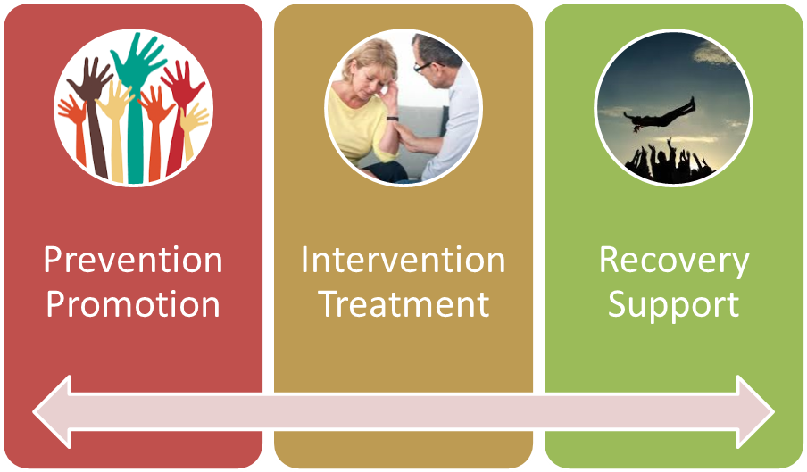
Primary Care
Housing

Slide 9

Notes:
So why am I here?

Slide 10
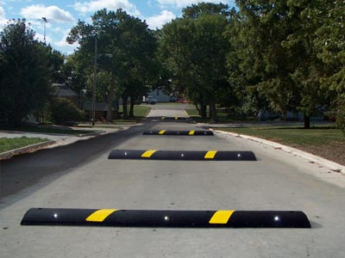
Notes:
Despite knowing all of this

Slide 11
Stigma
Cost of services
Lack of services

Slide 12
Stigma
Cost of services
Lack of services
Workforce shortage

Slide 13


Passion
Practice
Education
Exam
Practice
Notes:
Professional process

Slide 14
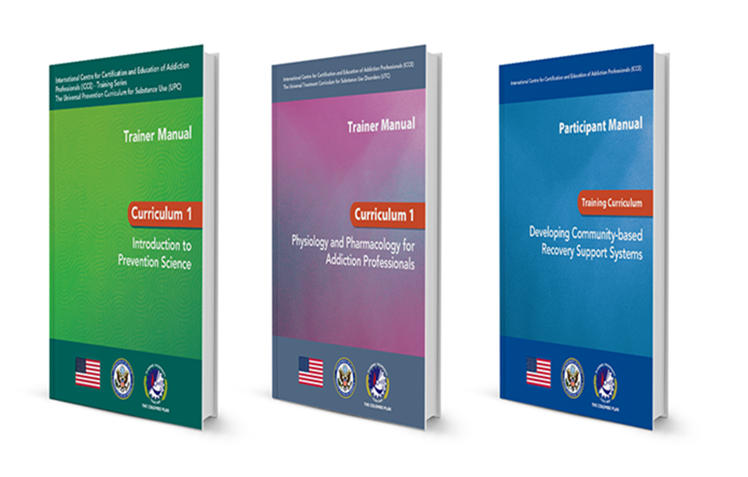
UPC
UTC
URC

Slide 15

Women’s Intervention for Substance Exposure (WISE)

Slide 16

Child Intervention for Living Drug-Free (CHILD)

Slide 17
Passion
Education
Practice
Exam
Practice
Notes:
Professional process

Slide 18
Passion
Education
Practice
Exam
Practice
Notes:
Professional process

Slide 19




Slide 20


Slide 21

Setting the Bar
Notes:
Setting the Bar: Defining and Operationalizing Provider Certification Criteria

Slide 22
Passion
Education
Practice
Exam
Practice
Notes:
Professional process

Slide 23


Slide 24
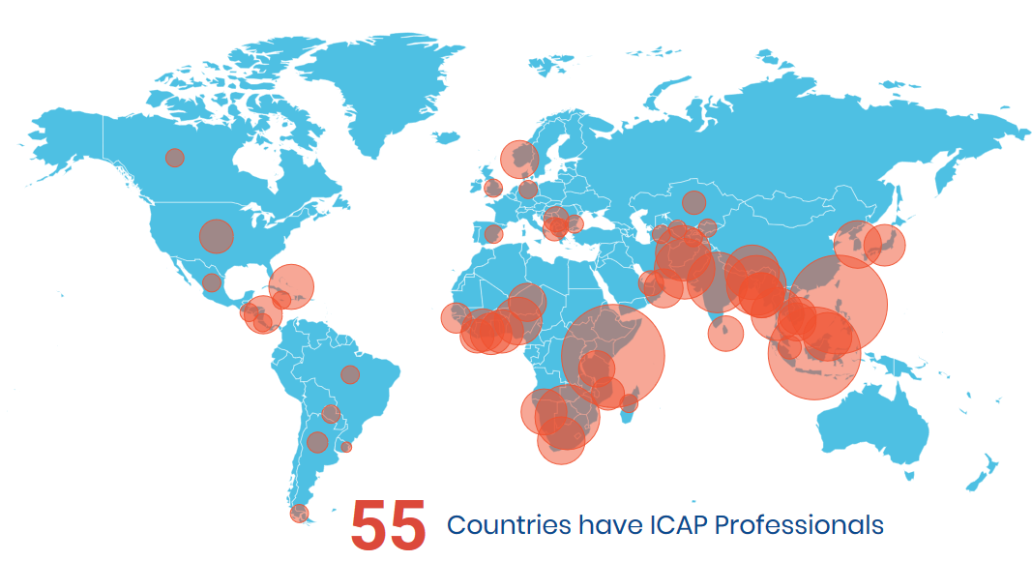

69%
64

Slide 25

Passion
Education
Practice
Exam
Practice
Notes:
Professional process

Slide 26
Passion
Practice
Education
Renew
Practice
Notes:
Professional process

Slide 27

Supervision
Notes:
Oversight: Quality and Data Reporting

Slide 28

Workforce Development

Slide 29




Slide 30


Slide 31
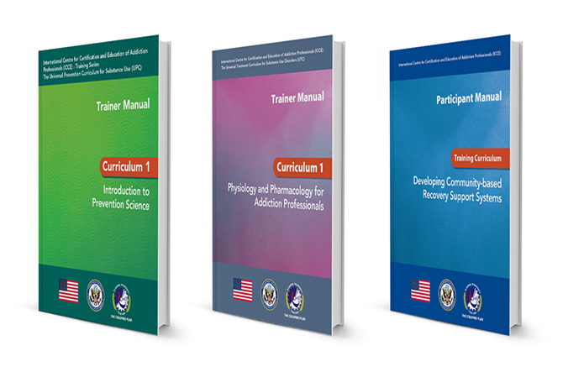


Slide 32
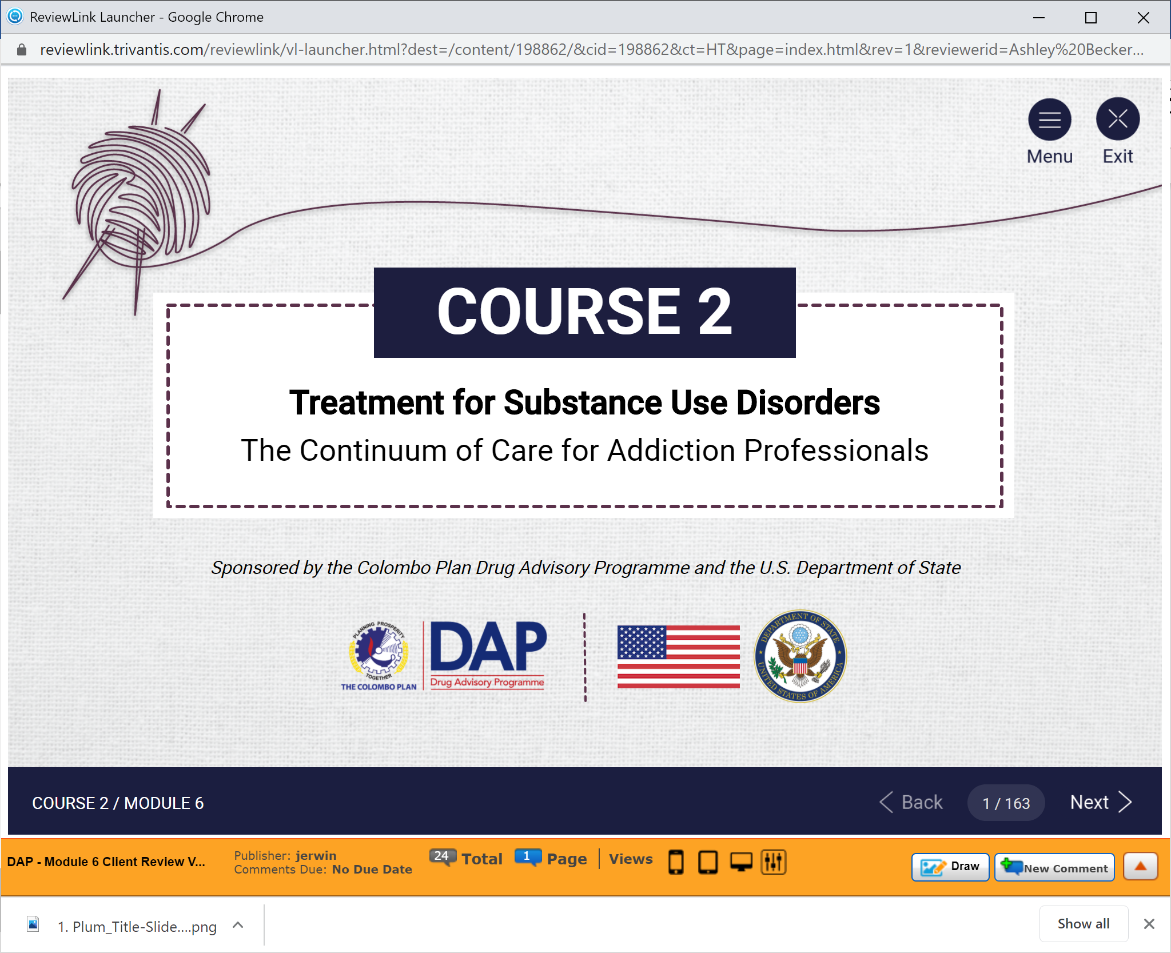

Slide 33
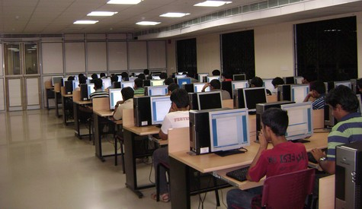


Remote Monitoring

Slide 34
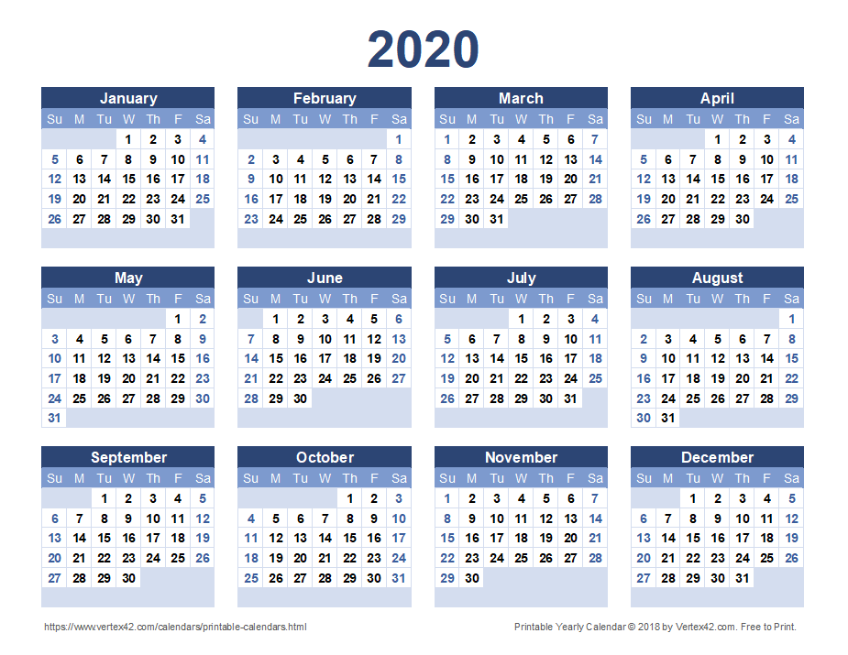

Exams
Notes:
We are working on a draft calendar for 1 date for each active country for 2020. We will have it ready to share by the end of July for your feedback.

Slide 35
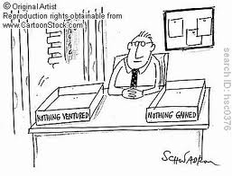


Slide 36
Professional Provider
Professional Provider
Professional Provider
Professional Provider
Professional Provider
Professional Provider
Your Country

Slide 37

TO DO:
1.
2.
3.
Educate/Train
Push for certification
Join ISSUP/ICUDDR

Slide 38


Slide 39
But there’s still plenty to do…

Slide 40


STAY STRONG!
Becky.Vaughn@
Colombo-Plan.org

