Slide 1


Slide 2
Plenary 2
What Constitutes Evidence-Based Prevention?
Jeff Lee, Senior Consultant, ISSUP

Slide 3

ISSUP Focus
Professionalisation of the drug demand reduction workforce
Promote evidence-based, high quality, ethical policy and practice
So:
What constitutes “evidence-based”?

Slide 4
Prevention?
Where does Prevention fit in the Drug Demand Reduction Effort??

Slide 5

The Team Effort: Substance Use Professional F.C.
Forwards:
( Supply Control)
Customs Law and Order Justice System Laws
Midfield
( Demand Reduction)
Prevention Promotion
Education
Defence
( Demand Reduction)
Treatment Recovery Self-Help
Casualties
A suggestion from: Jeff Lee

Slide 6
The Opposition Squad
Includes:
Availability
The Industry (ies)
The Lobbyists
Media
Massive funding
Big Business
Social legitimacy (alcohol)
Taxation
Misinformation
Sponsors
Ignorance
Self interest
Political “intrigues
Money/profit
Jobs
A suggestion from: Jeff Lee

Slide 7
The Task-so many questions!
Evidence or Evidence-based? Definitions?
Prevention – how do we find evidence to something that does not happen?
Evidence-based practice and/or practice-based evidence?
How can we respond to the challenges?

Slide 8
Evidence?
“the available body of facts or information indicating whether a belief or proposition is true or valid.”
“a sign which shows that something exists or is true”
“15 Types of Evidence and How to Use Them”………

Slide 9
15 types of Evidence?
Analogical
Anecdotal
Character
Circumstantial
Demonstrative
Digital
Direct
Documentary
Exculpatory
Forensic
Hearsay
Physical
Prima Facie
Statistical
Testimonial
https://i-sight.com/resources/15-types-of-evidence-and-how-to-use-them-in-investigation/

Slide 10
Evidence-based?
Evidence-based?
“denoting an approach to medicine, education, and other disciplines that emphasizes the practical application of the findings of the best available current research”
For Prevention: Proving that something you do results in something not happening is not easy!

Slide 11
How do we “prove” prevention?
Components towards “prevention: What are the factors that contribute to prevention?
The key is to be clear on our objectives and identifying ways of finding out if they have been achieved
Identify positive and realistic objectives that can be “evaluated” and/or “measured”

Slide 12
Objectives for (Drug)Prevention?
Drugs/Substances = ? – need to define: are we meaning all psychoactive substances; specific drugs; alcohol and tobacco are major health and problem related drugs
Address drugs as a public health and education and not law and order focus
Ultimate Objective?
Stop people using/misusing drugs – avoid and tackle substance use disorders
Stop people from starting to use drugs

Slide 13
Objectives for (Drug)Prevention?
Intermediate objectives towards achieving the ultimate objective
Consider the objectives required to address prevention focused activities in different settings – environment; family; community; school; media; workplace
Address specific objectives with respect to factors that can contribute to achieving the ultimate objective Eg. Availability; personal and social skills and competencies; risk and protective factors; consider behaviour change factors, etc.

Slide 14
Objectives achieved?
How can we find the evidence that an objective has been achieved and that what we are doing “works”?
  Proved by “Research” and producing evidence
  But
  What constitutes acceptable research ?
  What constitutes acceptable “evidence”?
  Is there a place for “Practice-based evidence”? Ie “evidence” based on “experience” more than measurement?
  Are other types of “evidence”( the 15!) acceptable?

Slide 15
Objectives achieved?
Consider:
Should we review the way we address “evidence” in our understanding of prevention – should it accept different types of evidence rather than the more focused definition of “Evidence-based”?
Or can we have ”gold card” evidence ( eg forensic and RCT ) through to “iron card” evidence ( eg. anecdotal )?
Where do we draw the line on what is acceptable as “evidence”? Do we only accept the gold card?

Slide 16
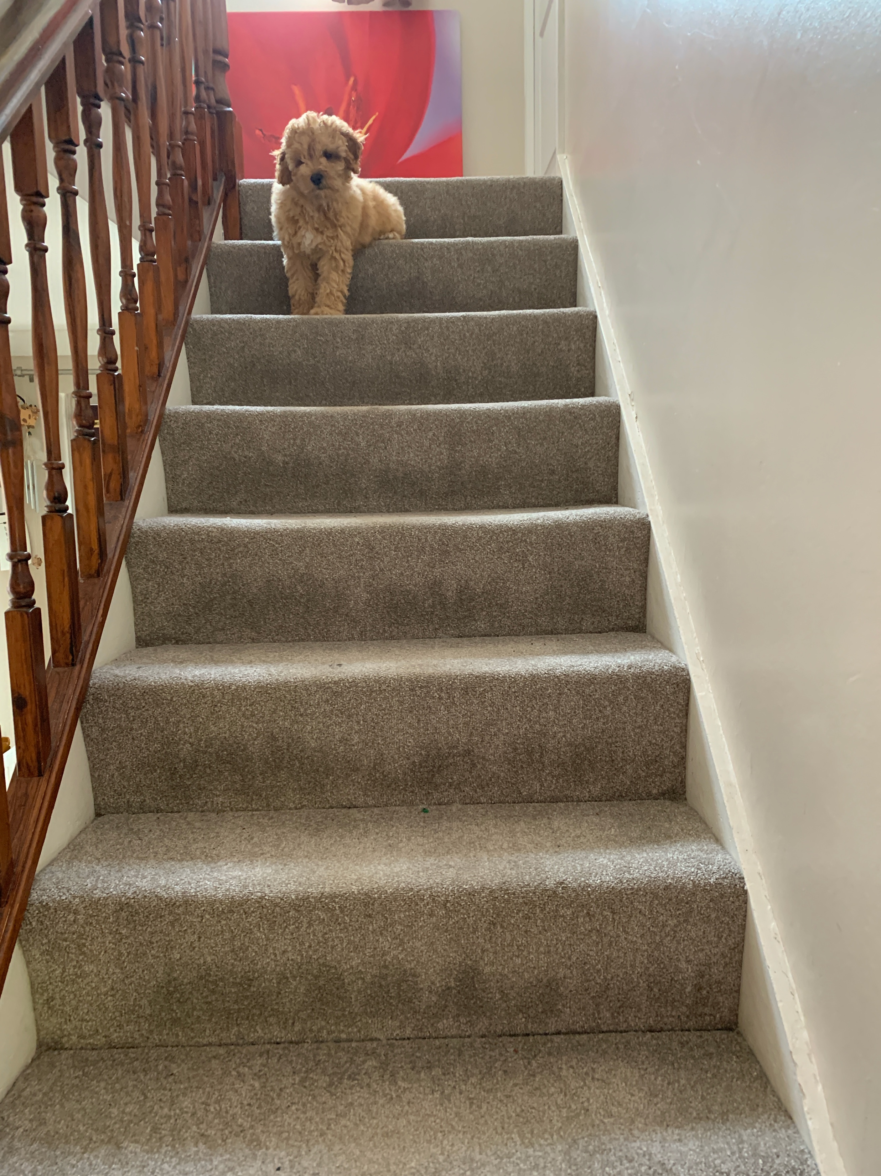
Aspiring to be at the Top
The League Table:
Liverpool
Nottingham Forest
Kaizer Chiefs
Enugu Rangers
Paidha Black Angels
Loughborough Town
There may be a gap in what is possible but all aspiring to “go up”

Slide 17
Undertaking Research
The Gold Card RCT
  Cost – Expertise – Opportunity - Ethics
Other Research methods available: eg Focus Groups; Case Study; Interview and Follow Up; etc. – good enough?
More considerations:
If it “works” in one country, culture, setting, situation does it mean it will apply in others?
Can “greenhouse” research have same effects when applied on a mass scale?
Is “fidelity” a realistic expectation?
What is Research Realistic for developing countries? Asking too much and missing out on objectives being achieved but not ”measured” and therefore rejected?

Slide 18
Practice-based Evidence?
The Reality of what “Joe Public” and “Peter Policy” believe and what results in Investment in prevention is often based on other things than “research” and “evidence”: eg:
Anecdotal feedback
Perceived impact/effect
People like it – good photo opportunity
Looks and sounds good – “singing and dancing”
Responds to instinctive views eg shock horror, Just Say No!
Is there a “middle way”?
When can non gold card research provide enough “evidence” to be acceptable?
Significant and consistent anecdotal feedback?
Perceived impact becoming experience of actual impact?
Activities resulting in regular change or an objective achieved?

Slide 19
And let’s not forget……
So are there other ways of showing that what we “do” in our prevention efforts actually “works”?
And let’s not forget:
Activities not seen as prevention focused can result in prevention eg.
Employment
Education and schooling
Housing
Health Care and Nutrition
Exercise and sporting opportunities
Other opportunities
Human dignity preservation
Do we need more research into this broader concept of what works in prevention and the evidence base for this?

Slide 20
Challenges and more Questions!
There is an evidence base for prevention!
Prevention can and does work! (Standards, UPC etc.)
BUT also consider
How do we focus investment of limited resources into evidence-based activities and evaluation of what is being done?
Should we broaden our understand and acceptance of “evidence”?
Should we be speaking about evidence-based principles or programmes?
How do we ensure we do not prevent new evidence-based activities being developed?

Slide 21
Onwards and Upwards
Consider how we have progressed in identifying an evidence base and evidence-based approach to prevention over past 25 years
The continued need for Research and Evaluation but Remember Realities and to help aspiration
I hope ISSUP can help people find and use that evidence and share what people are doing and achieving
Thank you for listening at this very special event – I hope there will be some evidence that this virtual conference has an impact and helps improve our much needed prevention efforts.

Slide 22
Remember
After all is said and done there is a lot more said than done!
Keep that midfield active – the engine of the team!
Let’s keep trying to climb the table!
Thank you!

