Slide 1
Decreasing heavy drinking among adults in three Latin American countries
Juliana Mejía, Katherine Mora -Team Colombia

Slide 2
Framework
The SCALA Project is aimed at decreasing high risk alcohol consumption among adults in three Latin American countries, through increasing screening and Brief Advice*
Colombia
Peru
Mexico
(*Anderson, et al., 2017)
Notes:
Sponsored by the EU
Control and interventions community
Possibilities to scale up to other cities and countries. Materials will be used when scaling up

Slide 3
SCALA Project
Multi-country intervention
Control (5 PHCC)
and intervention (5 PHCC)
municipalities
Duration: 4 years.
-Preparation period: 2 years
-Implementation: 18 months
-Evaluation: 1 year.
Participants:
-Health professionals
-Patients
-Community advisory board

Slide 4
Duration
Preparation (2 years) | Implementation (18 months) | Evaluation (1 year)
Community advisory board Tailoring materials Recruitment of Primary Health Centers Training of health professionals | Intervention package Screening for alcohol and depression (AUDIT-C / PHQ-2) Brief advice (Motivational Interviewing) Referral Training booster sessions for health professionals Communication campaign | The proportion of consulting adult patients intervened (screened and advice including referral given to screen positives), with the denominator, the number of registered adults. Increase on knowledge about alcohol risks.

Slide 5
Global Status Report on Alcohol and Health 2018
Alcohol per capita consumption
Mexico: 6.5
Peru: 6.3
Colombia: 5.8
Prevalence of alcohol use disorders (AUD)
Highest rates
Peru: 8.9
Colombia: 7.0
Lowest
Mexico: 2.3
Attributable deaths to alcohol:
7,2%-Males
2,6% females
(Global status report on alcohol and health, 2018)

Slide 6
Background COLOMBIA
Alcohol consumption per capita in Colombia is about 5,8 liters of pure alcohol per year, but within active alcohol consumers this increases to 15,2 liters.
Colombia has the second highest rates of alcohol dependence (3,2%).
(Global status report on alcohol and health, 2018)

Slide 7
Target Audience
The total population in Soacha is about 500,000 people
Informal records talk about 1’500.000 people (migrant population – displacement because of violence)
393.009 live in urban areas and the rest in rural areas surrounding the town.
84,37% of the population are adults between 18->60 years old.
Males | Females
49% | 51%
Age Range | 15-44 | 44-59 | 60 or more
Percentage | 48,5% | 13,4% | 5,6%
(Soacha Local Government, 2019)

Slide 8
People who request medical services at Mario Gaitán Yanguas Hospital for any reason.
Mainly, alcohol users divided into four subpopulations:
Young adults (18-26 years)
Adults (27-35 years)
Adults (36 – 59 years)
Elder (60+)
As alcohol is embedded into the culture, people are resistant to messages about how to avoid alcohol consumption
Some of them are illiterate
Target Audience
Evidence-based Communication Campaign

Slide 9
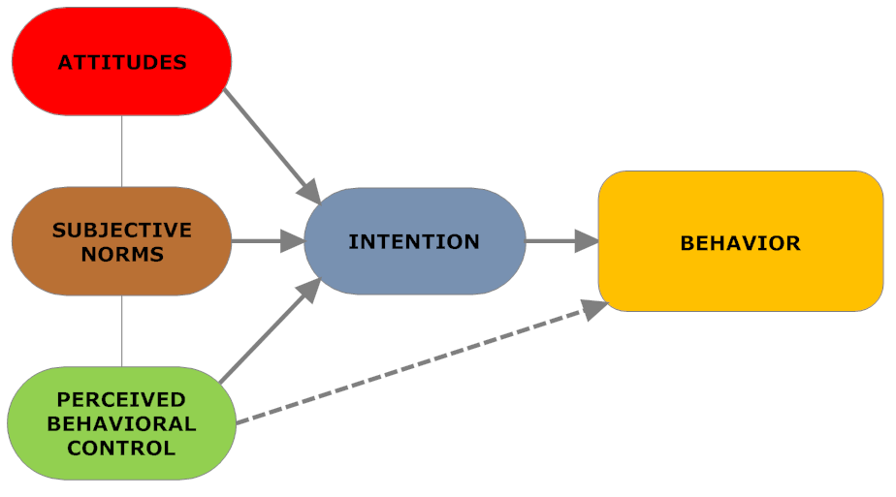
Theory of Planned Behavior (TPB)
Our three principal aims:
Attendance of patients at the Primary health center
Increasing alcohol health literacy
Reducing alcohol consumption
Ajzen (1985); Fishbein & Ajzen (1975)
Evidence-based Communication Campaign

Slide 10
THEORY TO BE USED
PLANNED BEHAVIOR THEORY
Ajzen, 1985

Slide 11
Theory of Planned Behavior (TPB)
We are aiming to change people ́s attitudes toward reducing alcohol consumption through the attendance of patients at the Primary health center and by increasing alcohol health literacy.
Attitude: Positive attitudes to speak with doctors about alcohol use.
Subjective norms: Relatives think that alcohol and health are related. Health professionals could help to understand how it´s affected.
Perceived Behavioral Control: People can talk with a health professional and be screened in the PHCC.
Intention: People will talk with a health professional about their alcohol consumption.
Behavior: If people know speaking with a doctor helps them manage alcohol consumption, they will talk about it.
Evidence-based Communication Campaign

Slide 12
Theory of Planned Behavior (TPB)
We are aiming to change people ́s attitudes toward reducing alcohol consumption through the attendance of patients at the Primary health center and by increasing alcohol health literacy.
Attitude: Positive attitudes toward receiving information about alcohol risks.
Subjective norms: Relatives think that health professionals could help me to understand how heavy drinking affects my health.
Perceived Behavioral Control: People can drink responsibly by limiting the number of drinks per ocassion.
Intention: Drink 4 standard drinks maximum per ocassion.
Behavior: People will not get drunk.
Evidence-based Communication Campaign

Slide 13
Theory of Planned Behavior (TPB)
We are aiming to change people ́s attitudes toward reducing alcohol consumption through the attendance of patients at the Primary health center and by increasing alcohol health literacy.
Attitude: Positive attitudes toward reducing heavy drinking.
Subjective norms: Relatives think that heavy drinking could be harmful.
Perceived Behavioral Control: People can reduce heavy drinking due to screening and brief advice delivered by a health professional.
Intention: Because people were screened and in some cases received brief advice, they will have the intention of reducing heavy drinking.
Behavior: If people know that their talk with the doctor helps them to manage alcohol consumption, they will reduce alcohol consumption.
Evidence-based Communication Campaign

Slide 14
PRESUASION STRATEGY
GAIN AND LOSS –FRAMED

Slide 15
Reducing heavy drinking Gain-framed
Gain-framed
Worried about saving money? Reducing the number of drinks to 2 or a maximum 4 per occasion, can help you save money, be in a better mood, and reduce stress levels.
A routine medical checkup helps detect early signs of cancer due to heavy drinking. Talk with your doctor about alcohol consumption. Get an appoitment at your Primary Health Center.
Evidence-based Communication Campaign

Slide 16
Reducing heavy drinking Gain-framed
Less is more?
- Regarding alcohol, less is more! More awake every day… more probabilities of success! Ask your doctor about your alcohol consumption. Go to your health care unit.
- Being sober helps you to be healthy, conscious and alert every time. A message from…
Evidence-based Communication Campaign

Slide 17
Poster Attendance at PHCC

Slide 18
Increasing alcohol literacy Loss-framed
Loss-framed
How long ago did you visit your doctor?
Talking to your GP about your alcohol consumption, could decrease your problems with memory and sleep.
Ask your doctor about your alcohol consumption. Go to your health care unit.
Evidence-based Communication Campaign

Slide 19
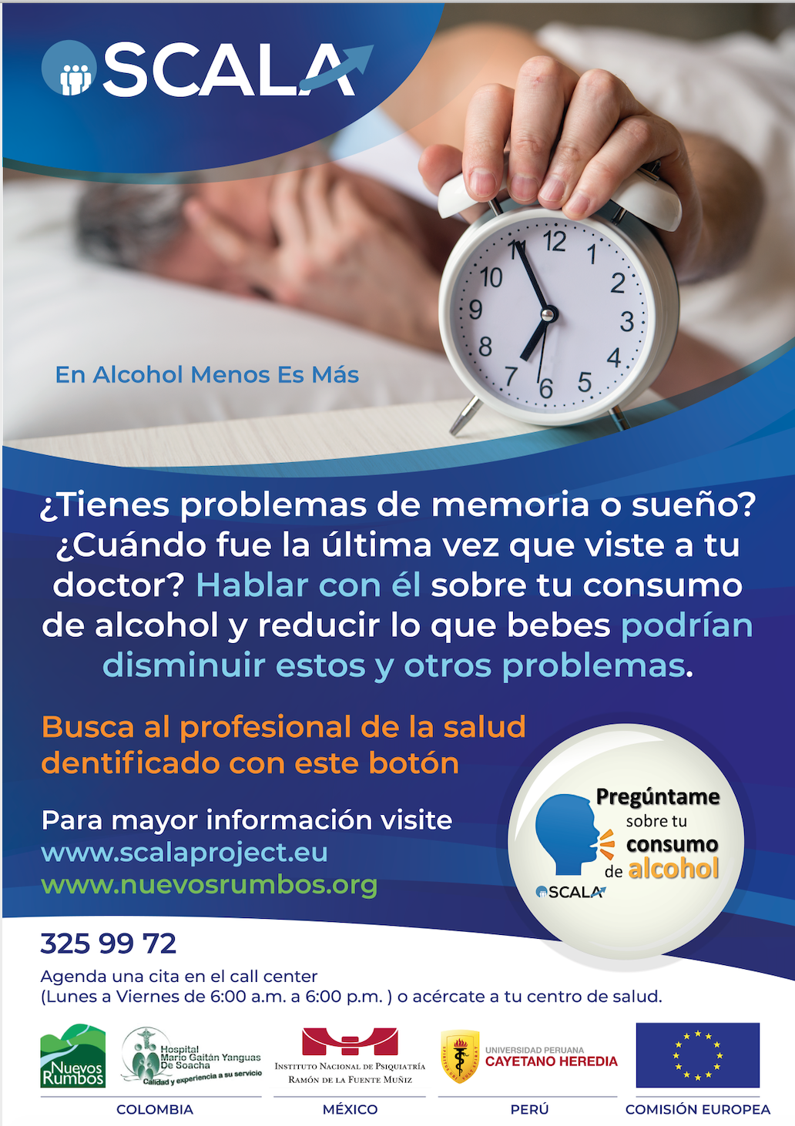
Increasing alcohol literacy Loss-framed
Evidence-based Communication Campaign

Slide 20
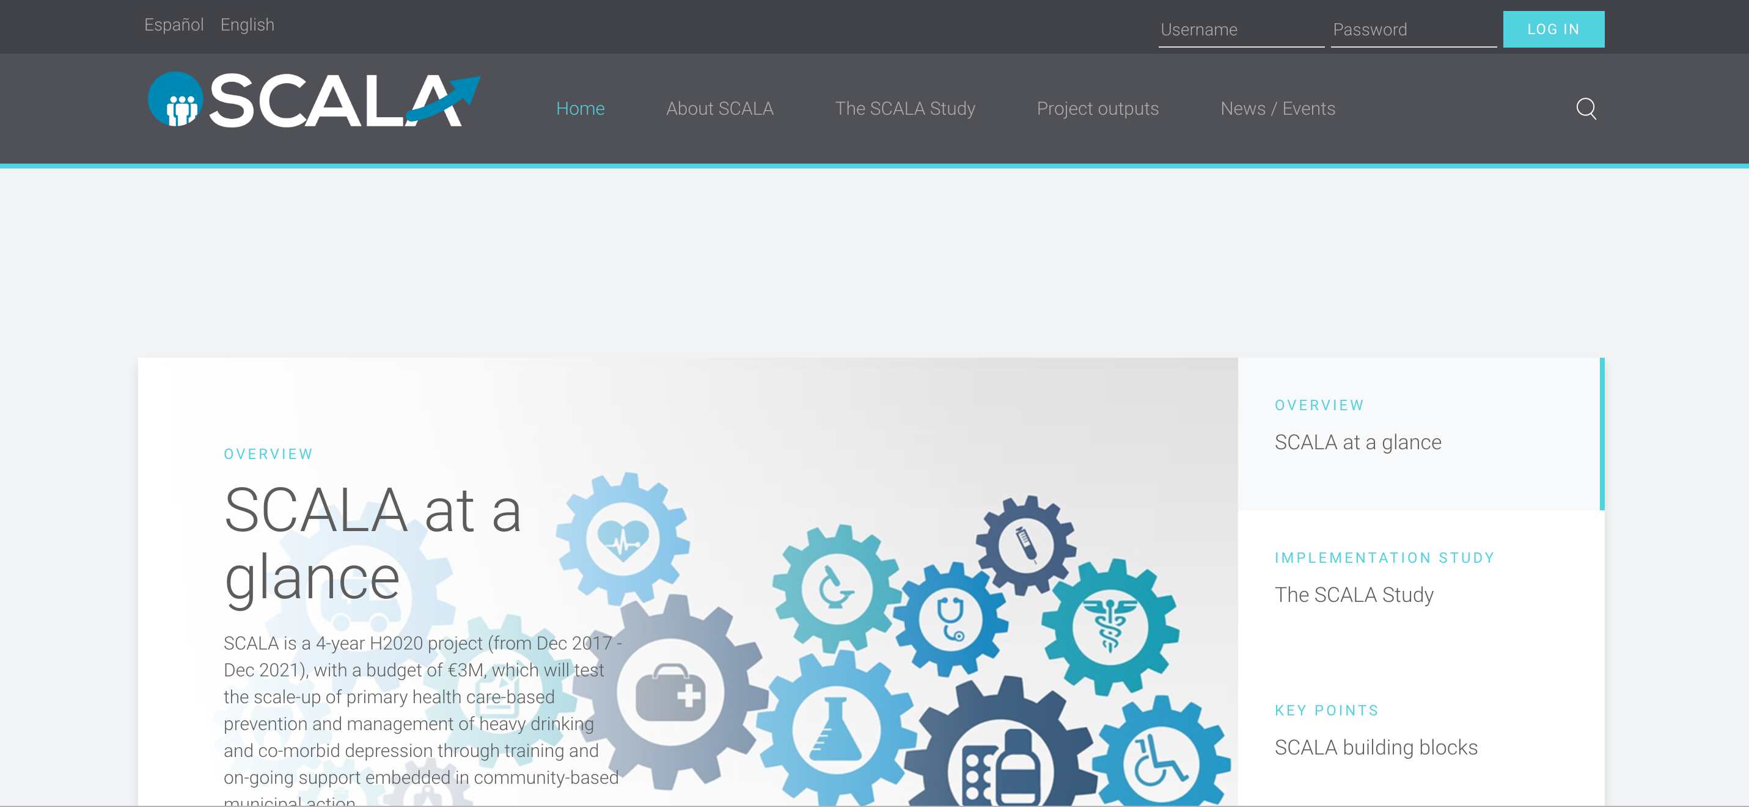
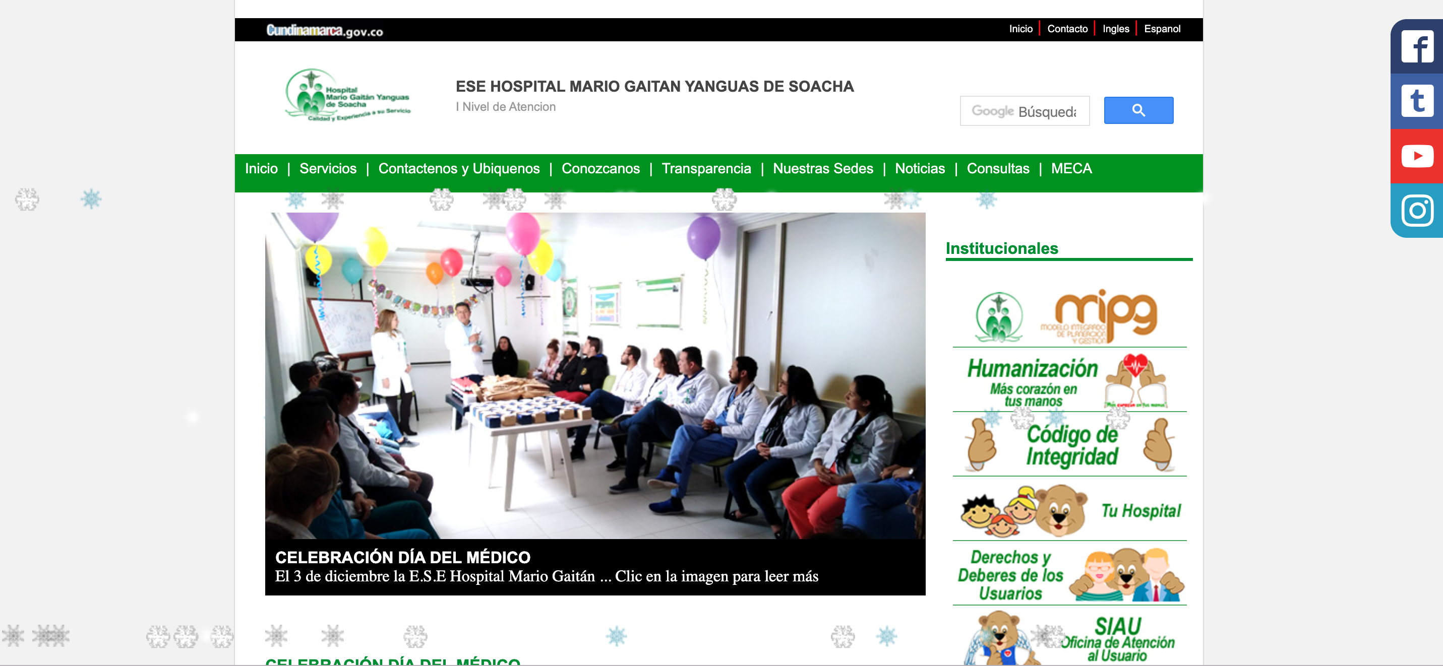
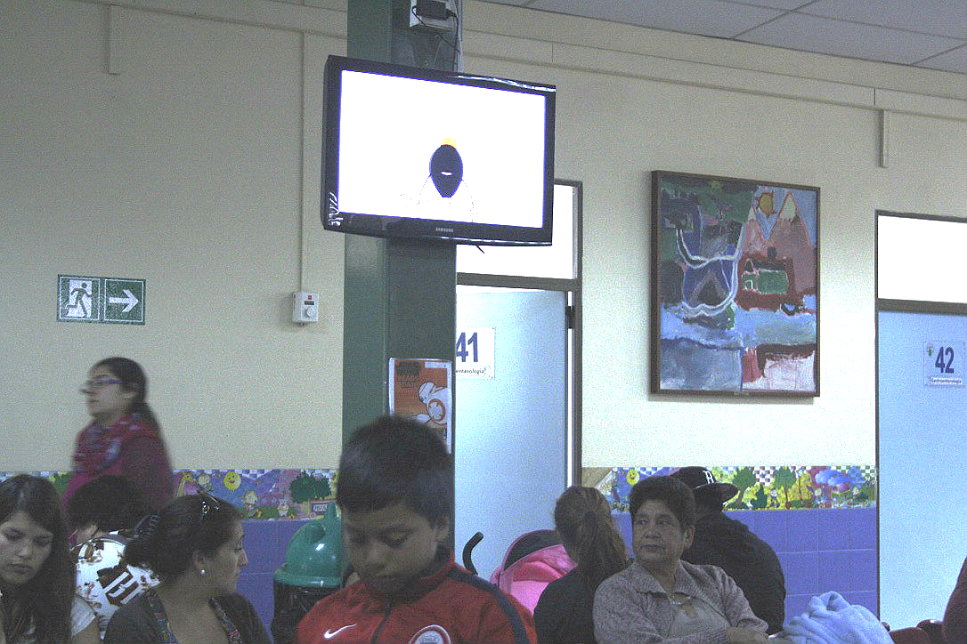
Channels
Young adults (18-26 years) | Adults (27-35 years) | Adults (36 – 59 years) | Elder (60+)
Social media Posters | Social media Posters | Posters Videos in the waitings rooms Radio ads | Videos in the waitings rooms Radio ads
Patients will see prevention messages before appointment in:
Social media (hospital website, SCALA web site)
Posters in each PHCC
Videos in each PHCC
Radio ads
Evidence-based Communication Campaign

Slide 21
Evaluation Plan
Pilot testing: to verify if materials are well received and if are understandable for the target population, through qualitative information.
Focus group
A quasi-experimental design with post-test in each group: experimental (Soacha) and control (Madrid and Funza).
SURVEYS before the patient meet the GP in the PHCC.
The likelihood to go to PHCC if you have been exposed to the campaign.
Knowledge about alcohol use.
X
Evidence-based Communication Campaign

Slide 22
Survey
In-person Intercepts survey
Brief Questionnaire to measure attitudes, subjective norms, perceived behavioral control, intention and behavior regarding attendance, alcohol literacy and reducing alcohol consumption.
Administered in each Primary Health Center before the medical appointment
Evidence-based Communication Campaign

Slide 23
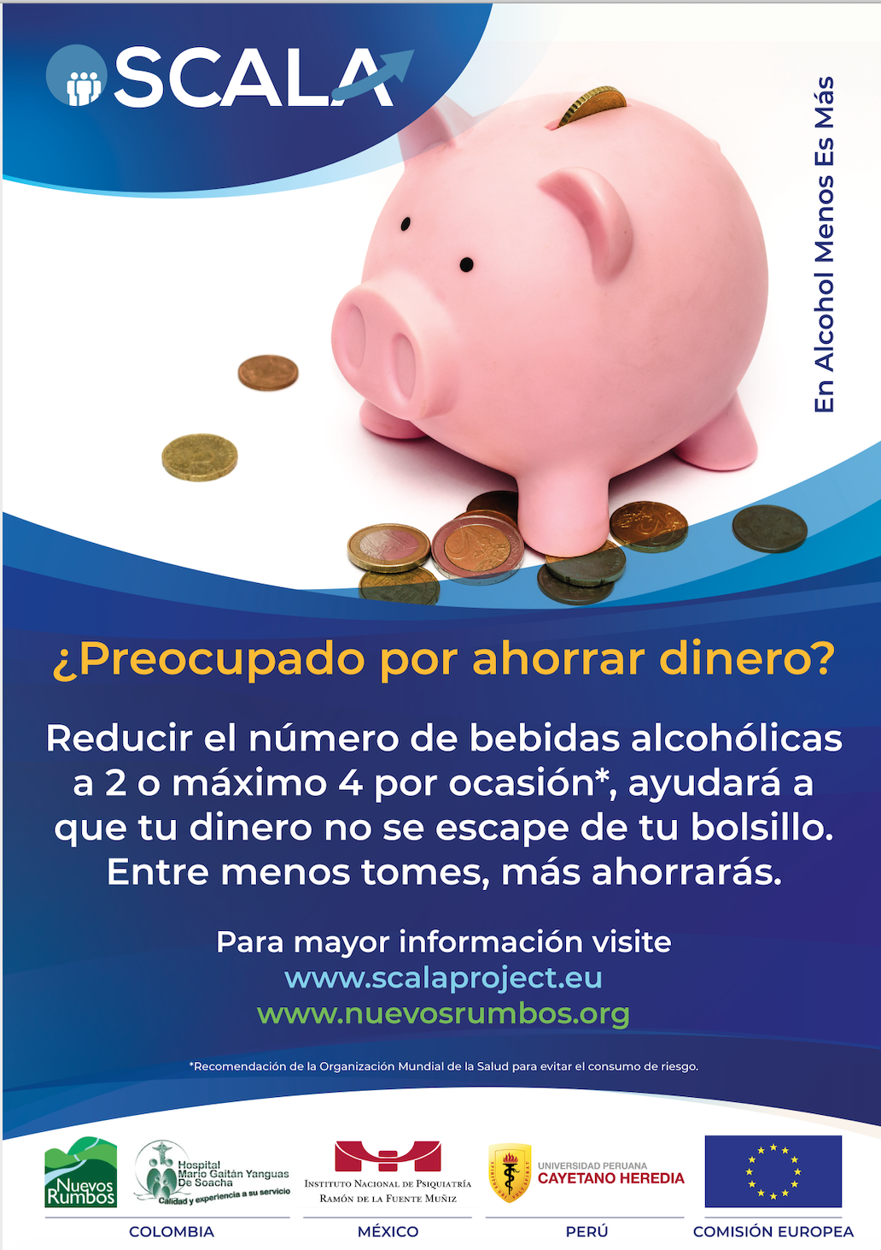
Evaluation* – Survey Image of the campaign
Did you see a campaign (posters, videos, billboards) with prevention information about alcohol use in the Primary health center?
Yes / No
Where did you see the campaign?
Posters / Radio / Video
What do you remember about the campaign?
Inform about alcohol risks
Invite people to talk about alcohol use with the doctor
Inform that there are people who drink and other do not.
Which of these posters did you see?
Please tell me how important you think alcohol use is an issue of public concern.
Not important at all 1 2 3 4 5 6 7 Very important
* Full questionnaire attached
Evidence-based Communication Campaign

Slide 24
Logic Model
Inputs | Activities (2) | Output (3) | Outcomes (4)
Resources Financial resources to cover the campaign Professional design of the campaign (messages and appearance) | Development of posters and social media to encourage health professionals to prevent alcohol consumption (screening and deliver brief advice) Development of posters, billboards, videos and radio ads to encourage adult population to visit primary care centers to be screened and receive brief advice. Videos and posters to increase alcohol health literacy (facts about alcohol) Social media campaign to address young population between 18-25 years old. | To engage people in Primary Care to be screened by a health professional To increase alcohol health literacy among the general population | Shorter Term | Longer Term
 |  |  | Increase of people who are screened regarding alcohol consumption. Increase of people who have received a brief advice regarding alcohol consumption Increase of people who have been referred to specialized services for alcohol use disorders. | Increase of alcohol health literacy among general population
 |  |  | Impact (5)
 |  |  | Reduction of alcohol use disorders and comorbid illness among general population

