Slide 1
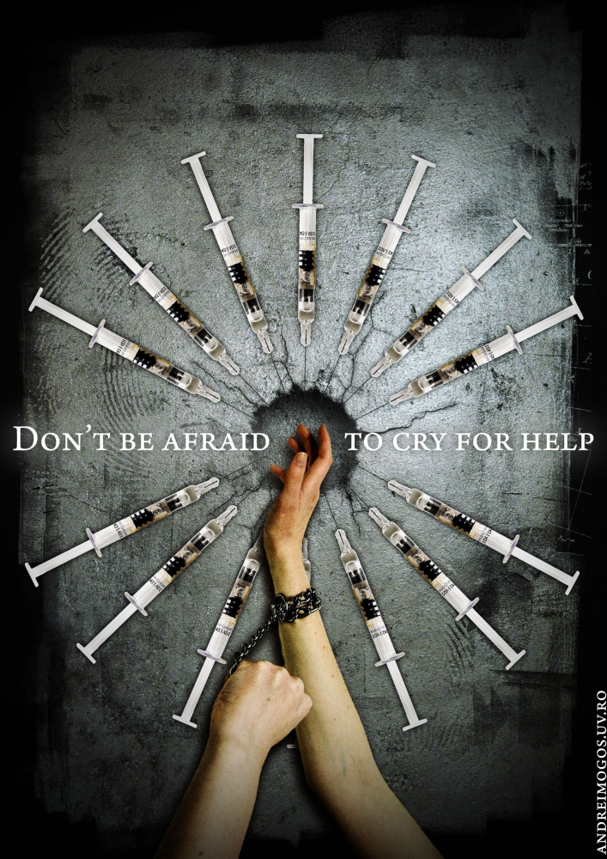
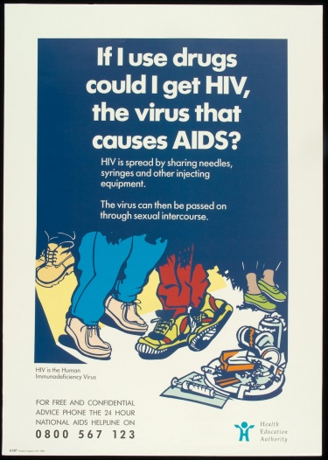
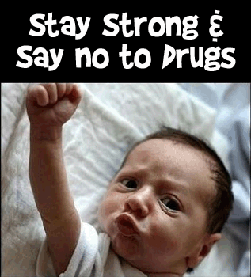
Media-Based Persuasive Prevention: Presentations from the Claremont Graduate University Media-Based Prevention Science Certificate Program Trainees
William D. Crano & Eusebio M. Alvaro
Claremont Graduate University
Hang Pham, VTVI Reporter, Vietnam
Patrick Madayag. PDEA, The Philippines
Juliana Mejia and Katherine Mora, Nuevos Rumbos, Colombia

Slide 2
THe Issues
-Mass Media have been irregularly successful in prevention of psychotropic substance use.
-Successful campaigns are of exceptional value.
-Failed campaigns are intolerably expensive.
-Failed campaigns have almost always ignored evidence & have used misguided, “evidence-free, unpersuasive preventive messages.”

Slide 3
Our Goal: Prevention based on Persuasion Persuasive Prevention
We seek to offset prevention failure by disseminating information our trainees need to build persuasion into their efforts – an approach we call persuasive prevention
In the Claremont program, we are not merely concerned with teaching the basics of persuasion prevention; rather, we seek candidates in positions who can “make things happen” in their communities, states, and ideally, countries
We believe our training will breeds success, so we require a prevention program with a high likelihood of success ready to field immediately upon program completion

Slide 4
Our (usual) Training Process
Rigorous in-class graduate-level training at Claremont Graduate University for 6-7 hours per day, 6 days/week, for three weeks; tests in AM on prior night’s readings, etc.
Three in-class courses:
Introduction to Prevention Science, Theories of Prevention, and Persuasion Applied to Prevention –e.g., we examine a theory of persuasion and develop applications of the theory to a prevention issue relevant to their specific concerns
Three-month UPC Media-based distance training
Weekly meetings of 3 hours, professionally moderated; and trainees develop their projects for implementation at home
Final Capstone week at Claremont, polish projects, review, more review, certification test, graduation and celebration

Slide 5

Some Of the theories we have covered in past trainings to Integrate Persuasion & Prevention courses 2 & 3
Health Belief Model
Theory of Reasoned Action
Social Cognitive Theory
Transtheoretical (stages of change) model
Psychological Reactance Theory
Attribution Theory
IIFF Model
Gain/Loss Frame Approach
Deviance Regulation Theory
Vested Interest Theory
Leniency Contract Theory
Ambivalence
Context/Categorization Theory
Two-step flow of communication model

Slide 6
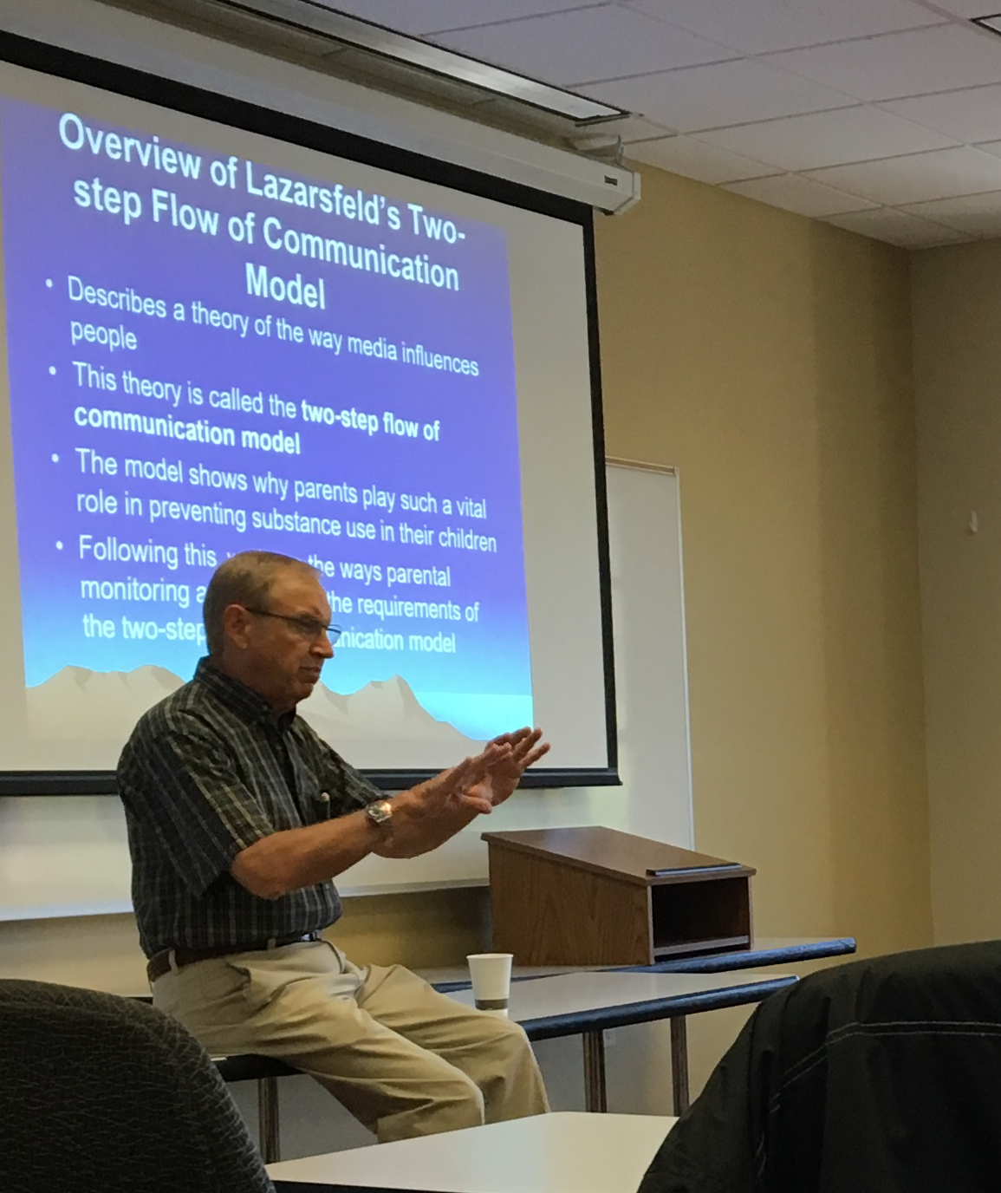
Our Translation of the vast literature of Persuasion to applied application in developing Persuasion messages: The EQUIP Model
The Problem: often, our popular prevention theories operate at too high a level of abstraction
They tell what to do, but not how to do it
We require theories of the “middle range,” as Robert Merton argued many years ago
EQUIP highlights the key message features for successful media-based persuasion
It is flexible enough to be integrated for use in most prevention models
It is based on a strong evidence base established over 60 years of research on persuasion

Slide 7
The Central Action Components of the EQUIP Model
To succeed, your persuasive message must
Engage: Attract and maintain attention of your audience throughout presentation
Question: Raise question in mind of receiver about their pro-drug attitude
Undermine: Destabilize the contrary (held) attitude
Inform: Provide plausible replacement of existing belief
Persuade: Provide incentives for agreement with your message
Most models fail on one or many of these factors, to their detriment – consider most messages: how many incorporate all these evidence-based to induce attitude change?

Slide 8
Building on the EQUIP, when designing our persuasive message, we learn how to:
Make resistance difficult, impossible, or apparently unnecessary
Target or tailor the persuasive message to the susceptibilities of the audience
Engage parents when dealing with adolescent audiences– Parents are credible sources and they want to help

Slide 9
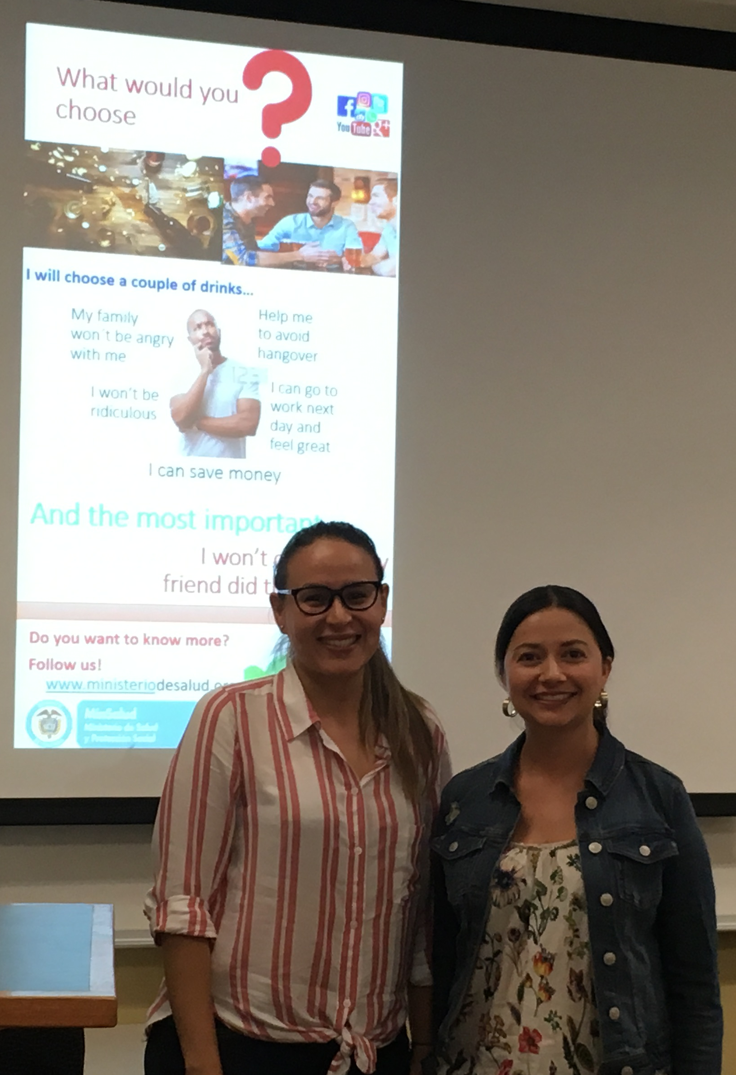
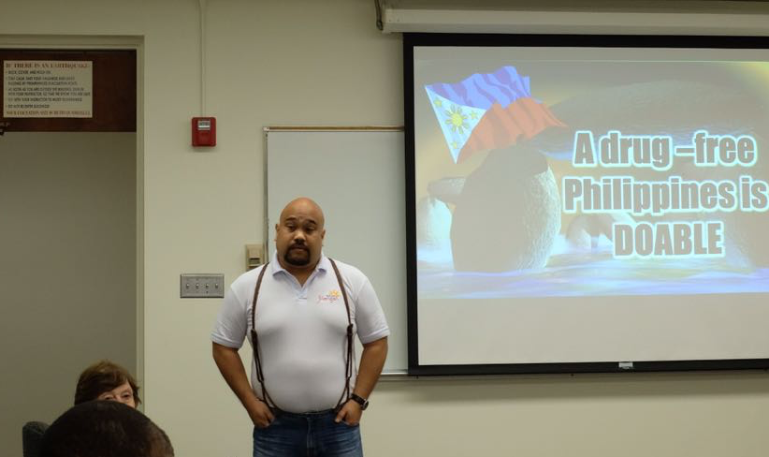
And now you will hear from our 2018 and 2019 Claremont Graduate University Advanced Certificate Graduates from The Philippines, Vietnam, and Colombia

Slide 10


Prevention Activities in the Philippines
Application Scientific Theories and Models acquired during the Media Based Drug Prevention Program in Claremont Graduate University

Slide 11
Implemented:
PDEA Drug Abuse Prevention Education Animated Video for the Generation Z “Tara na Kaibigan (Onward My Friend)”
Comics on Drug Free Workplace
Pending:
Training Security Guards as Partners Anti-Illegal Drugs Advocacy

Slide 12
1) PDEA Anti-Drug Animated Video
Objective:
To persuade Generation Z to stay away from activities involving illegal drugs.
Background:
Generation Z comprise 40% of the all Filipinos that makes them significant just by their sheer number. They were born from 1996 to 2015 (4-23 y.o.).
Utilization of Evidence Based Practice (EBP) as a requirement by the Bureau of International Narcotics and Law Enforcement Affairs (INL) of the U.S. State Department.
Application of the The EQUIP Model and Two-step Flow of Communication Model
Consulted with Dr. William Crano
Subjected to test audience

Slide 13
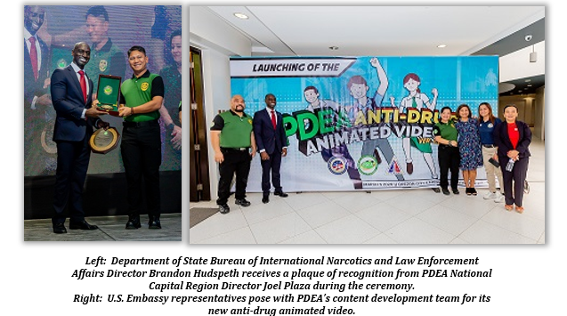
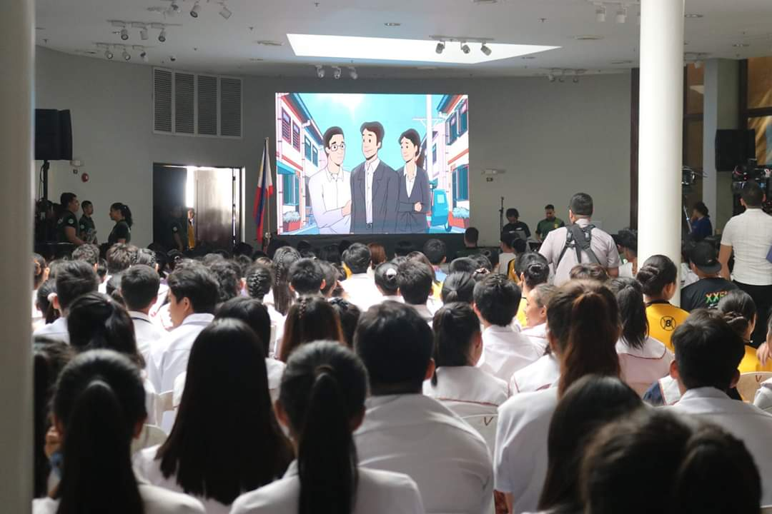
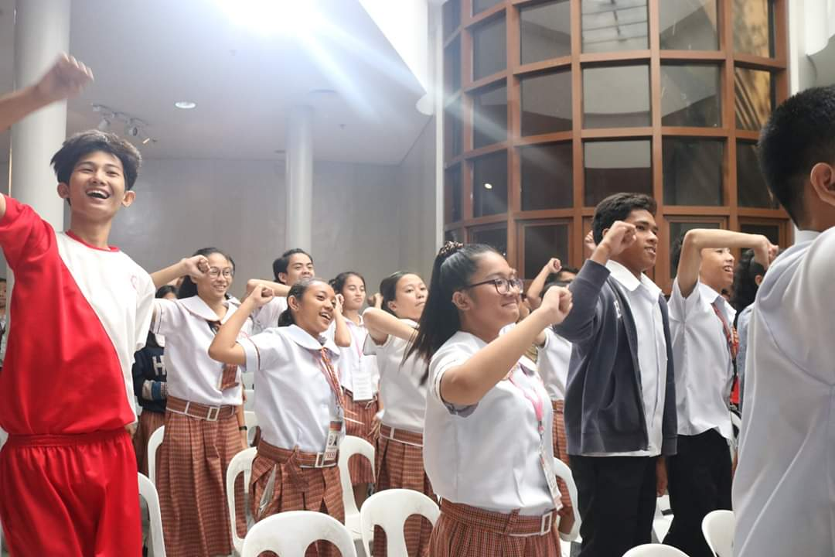
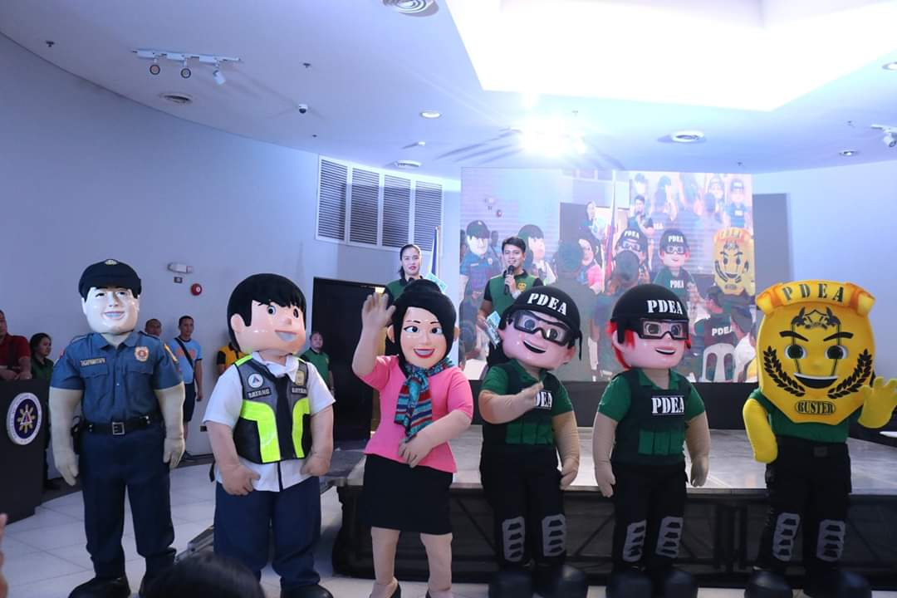
Launching of the Animated Video on March 5, 2020

Slide 14
2) Comics on Drug Free Workplace “Doors of Change”
Objective:
To educate employees and officials of private and government institutions about the importance of drug free workplaces
Background:
The Drug Free Workplace Program in the private and government sectors was institutionalized through the enactment of regulations by the national government.
There is a need to enhance information dissemination on these regulations
Development, publication, and dissemination of comics was chosen as a means to enhance the information drive
Application of the Psychological Reactance Theory and Gain-Framed Messaging

Slide 15

Comics for a Drug Free Workplace published in English and Filipino

Slide 16
Pending Activity:
Training Security Guards as Partners in Anti-Illegal Drugs Advocacy
Objective:
Develop/Reinforce positive attitude of security guards towards their role in the anti-illegal drugs campaign
Instill in them the belief that the institution they serve values their capabilities to be significant contributors to the anti-drug campaign
Ensure that they have the capability to perform their roles in the campaign.
Background:
This concept is anchored on the following constructs of the Theory of Planned Behavior:
Attitude - Develop a positive attitude in Security Guards toward being Drug Free
Subjective Norms - To increase awareness in Security Guards that important individuals in their environment believe in them and expect them to play a significant role in ensuring a Drug Free environment
Perceived Behavioral Control – capacitate and instill the belief in Security Guards that they have the ability to contribute to a Drug Free Philippines.

Slide 17
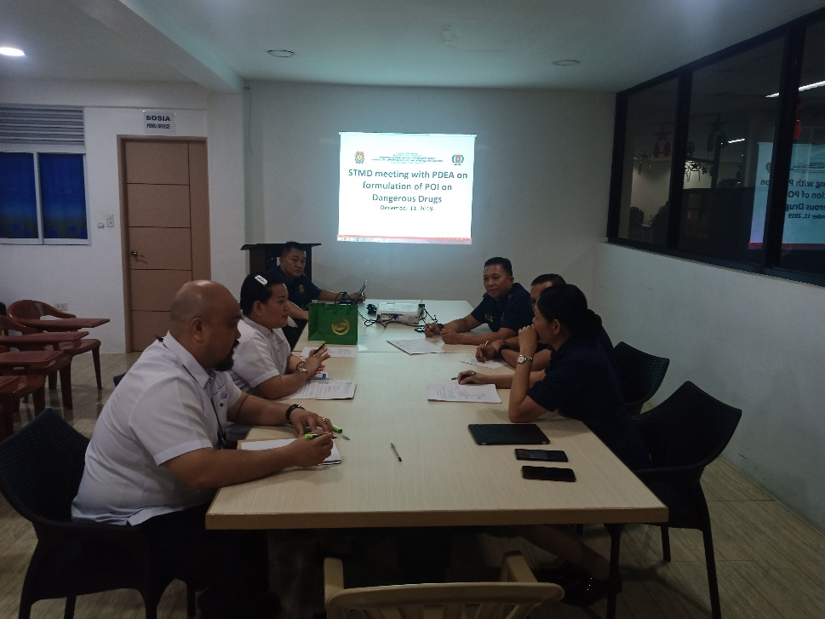
The Supervisory Office for Security and Investigation Agencies of the Philippines passed a Resolution on January 9, 2020 updating their Program of Instruction (POI).
This new POI will include modules that will train Security Guards to be partners in the anti-illegal drugs campaign based on our training.
All applicants for Security Guard license and renewal (every 3 years) will undergo this training.
The COVID-19 Pandemic halted its pilot implementation last April 16, 2020

Slide 18
Prevention 2020-2021
Psychoactive Substance Prevention 2020-2021
A new approach
Hanoi, Vietnam 2021
By Team Vietnam (Hang Pham, Nam Cao and Chung Nguyen) Presented by Hang Pham

Slide 19

Triangle Execution Point
Law and Policy Advocacy
Media training
Create new
Prevention messages

Slide 20
2020
Contributed to the discussion at the National Assembly on the Law on Drugs Prevention and Control
Suggested an additional and clear definition of drug prevention intervention in the law.
Advocated for a chapter of prevention plan including education, family, workplace
Organized Student Dialogue Workshop
300-400 students attended
Officers from the Department of Drugs and Social Vices Prevention and Control gave talks on drugs, prevention, demand reduction

Slide 21

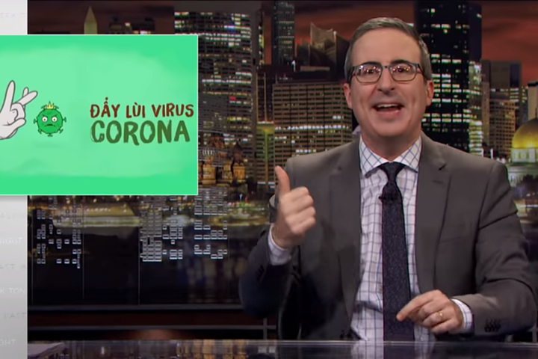

2020 (continued…)
Drafting surveys to gain a better picture of
drugs knowledge among adolescent and how to influence them with prevention message
Drafting project Social-media-based prevention
Target audience: students from 13-20 years old, parents and teachers from 25-50 years old
Main media platforms: facebook, youtube, tiktok
Traditional media: organize seminar on various topics of drugs prevention to increase expose on prints, TV.
Prevention messages: Don’t try even once! Think before you start! High in your own healthy way!
Coordinate with singers to compose catchy songs on drugs prevention

Slide 22
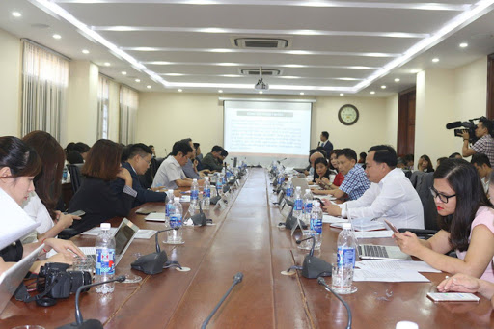
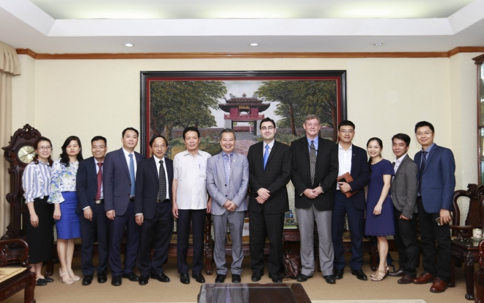
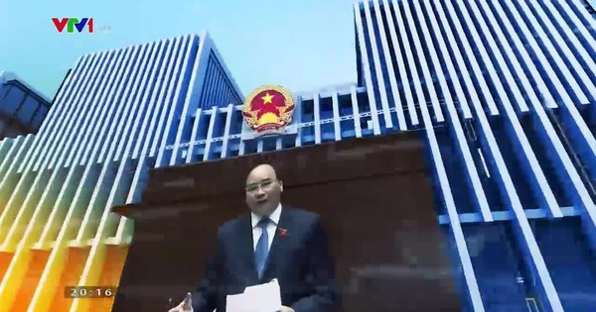
2021
Organize seminars on the Amended Law on Drugs Prevention and Control which is being discussed among National Assembly deputies.
Venue: National University
Organizers: Government Office, National Assembly Office, Ministry of Labour, Invalids and Social Affairs
Tentative Sponsors: Facebook, UNESCO
Participants: CDC, Drugs Prevention Experts, Author of the amended law, mainstream prints and e-newspaper, several TV outlets...
Run a TV-feature of 15 minutes to
Advocate for the chapter of prevention
science on Vietnam Television.

Slide 23

2021 (continued…)
Distributed surveys on drugs prevention knowledge to students
Implement the social-media-based prevent plan
Fund-raise and execute the plan as discussed and agreed in 2020
Monitor effect on social-media-based prevention on various platforms of facebook, youtube, tiktok
Continue Student dialogue workshops (4 more workshops)
Prepare/plan a fun-run race to increase awareness on drugs prevention and control.
Prevention messages:
High in your own healthy way!
Choose your high wisely!

Slide 24
2021 (continued…)
Media training workshop (Train the trainers)
Participants: TV, print, e-newspaper and e-magazine reporters covering current affairs and health and youth issues
Content: Basic knowledge of prevention and how to create persuasive messages
Tentative lecturer: Dr. Crano
Platforms: online (via zoom) and also offline
Co-organizer: Government Office, UNESCO, Authority of Press (Ministry of Information and Communications

Slide 25



Decreasing heavy drinking among adults in Colombia, Peru, and Mexico: The SCALA Project
LESS IS MORE
Juliana Mejía T., Director of Prevention
Katherine Mora, Psychologist

Slide 26
Decreasing heavy drinking among adults in Colombia, Peru, and Mexico: The SCALA Project
LESS IS MORE
Juliana Mejía T., Director of Prevention
Katherine Mora, Psychologist

Slide 27


CORPORACIÓN NUEVOS RUMBOS INVESTIGACIÓN Y PREVENCIÓN
Alcohol per capita consumption
Global Status Report on Alcohol and Health 2018
Mexico: 6.5 Liters
Peru: 6.3 Liters
Colombia: 5.8 Liters
Prevalence of alcohol use disorders (AUD)
Highest rates
Peru: 8.9
Colombia: 7.0
México 2.3
* 12-month prevalence estimates (15+); **including alcohol dependence and harmful use of alcohol.
Attributable deaths to alcohol per year
7,2% Males
2,6% Females

Slide 28
The Media Campaign: Target audience
CORPORACIÓN NUEVOS RUMBOS INVESTIGACIÓN Y PREVENCIÓN
Total population in Soacha, an industrial suburb of Bogota, is about 500,000 people
Informal records suggest 1’500.000 people (migrant population – displaced because of violence)
(Soacha Local Government, 2019)
Males | Females
49% | 51%
Age Range | 15-44 | 44-59 | 60 or more
Percentage | 48,5% | 13,4% | 5,6%

Slide 29
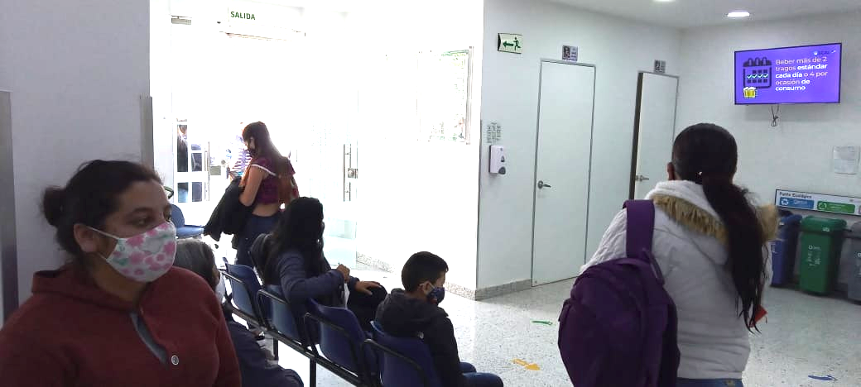
CORPORACIÓN NUEVOS RUMBOS INVESTIGACIÓN Y PREVENCIÓN
People requesting services will see prevention messages before appointment:
Channels
Young adults (18-26 years) | Adults (27-35 years) | Adults (36 – 59 years) | Elder (60+)
Social media Posters | Social media Posters | Posters Videos in the waitings rooms Radio ads | Videos in the waitings rooms Radio ads

Slide 30
Target audience: People requesting services at Mario Gaitán Yanguas Hospital for any reason
Alcohol users divided into four subpopulations:
Young adults (18-26 years)
Adults (27-35 years)
Adults (36 – 59 years)
Elder (60+)
As alcohol is embedded into the culture, people are resistant to messages about how to avoid alcohol consumption
Some patients are illiterate
(Soacha Local Government, 2019)

Slide 31
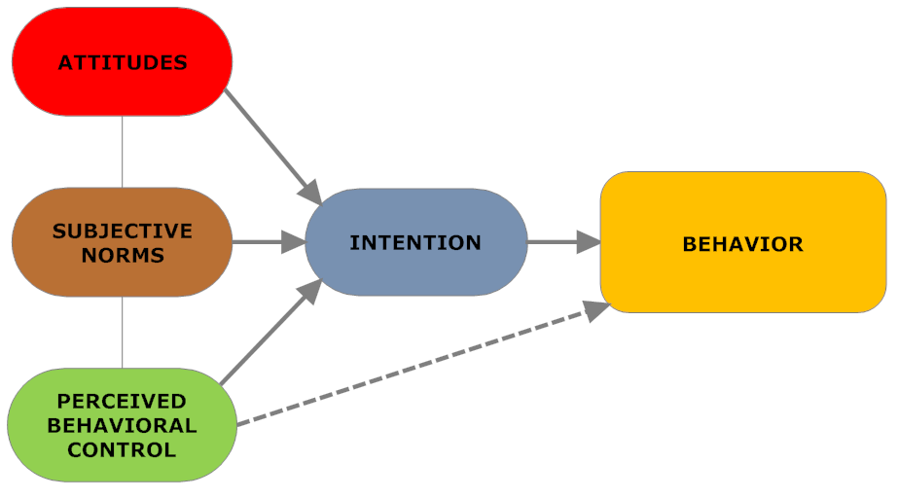
Theoretical Framework: The Theory of Planned Behavior - TBP
CORPORACIÓN NUEVOS RUMBOS INVESTIGACIÓN Y PREVENCIÓN

Slide 32
We seek to reduce alcohol consumption by influencing people’s attitudes, subjective norms, and perceived behavioral control through their attendance at the Primary health center and by increasing alcohol health literacy.
Attitude: Positive attitudes toward receiving information about alcohol risks.
Subjective norms: Relatives think that health professionals could help me to understand how heavy drinking affects my health.
Perceived Behavioral Control: People can drink responsibly by limiting the number of drinks per occassion.
Intention: Drink 4 standard drinks maximum per ocassion.
Behavior: People will reduce drinking – amount & frequency.
Theory of Planned Behavior
(TBP)

Slide 33
CORPORACIÓN NUEVOS RUMBOS INVESTIGACIÓN Y PREVENCIÓN
PERSUASIVE STRATEGY
Theory of planned behavior
coupled with:
Gain & loss-framed messages &
developed using EQUIP principles

Slide 34

CORPORACIÓN NUEVOS RUMBOS INVESTIGACIÓN Y PREVENCIÓN
Health Literacy
Worried about saving money?
Reducing the number of drinks to 2 or 4 per occasion will help you to keep money in your pocket. Drink less, savings up.

Slide 35
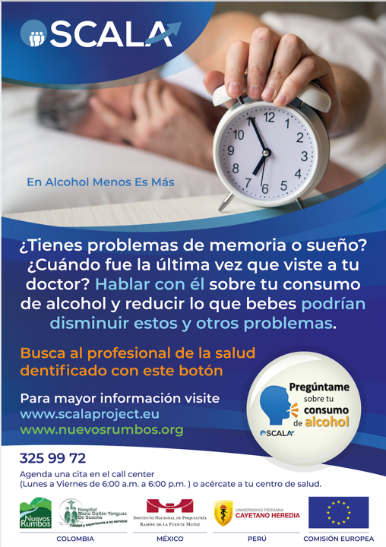
CORPORACIÓN NUEVOS RUMBOS INVESTIGACIÓN Y PREVENCIÓN
Fostering Attendance at the Primary Health Care Center
¿Do you have memory and sleeping troubling?
When was the last time you consulted your doctor? Talk with him about your alcohol consumption will help you to reduce these and other problems.

Slide 36
CORPORACIÓN NUEVOS RUMBOS INVESTIGACIÓN Y PREVENCIÓN
People requesting services will see prevention messages before appointment:
Channels
Young adults (18-26 years) | Adults (27-35 years) | Adults (36 – 59 years) | Elder (60+)
Social media Posters | Social media Posters | Posters Videos in the waitings rooms Radio ads | Videos in the waitings rooms Radio ads

Slide 37
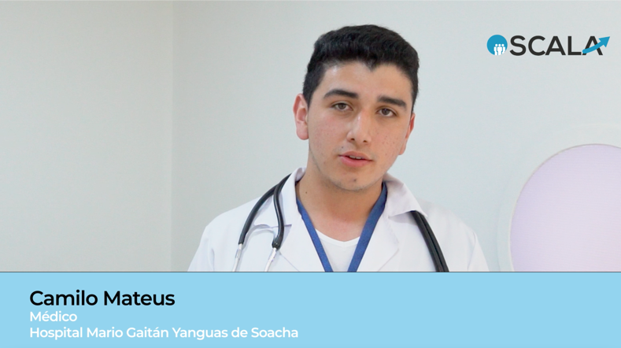
CORPORACIÓN NUEVOS RUMBOS INVESTIGACIÓN Y PREVENCIÓN
Videos in waiting rooms

Slide 38
CORPORACIÓN NUEVOS RUMBOS INVESTIGACIÓN Y PREVENCIÓN
Pilot testing: to verify if materials are well received and are understandable for the target population, through qualitative information (focus groups)
Posttest in each group.
Quasi-Experimental (Soacha) and Control (Madrid and Funza).
SURVEYS before the patients meet the GP in the PHCC.
Number of patients who attend the PHCC and have been exposed to the campaign.
Knowledge of alcohol use.
EVALUATION PLAN
Quasi-experimental design

Slide 39







GRACIAS
Do you have any questions?
Contact us
jmejia@nuevosrumbos.org/ kmora@nuevosrumbos.org / info@nuevosrumbos.org
Follow us
www. nuevosrumbos.org
@cnuevosrumbos
Corporación Nuevos
Rumbos Oficial
cnuevosrumbos
@CNuevosRumbos

Slide 40


And now, some words of wisdom from Dr. Eusebio Alvaro

Slide 41
Contact Information
Dr. William D. Crano - william.crano@cgu.edu
Dr. Eusebio Alvaro - eusebio.alvaro@cgu.edu
Patrick Madayag - patrikmadayag@yahoo.com
Hang Pham - phaminhang@gmail.com
Juliana Mejía T. - julianamejiat@gmail.com
Katherine Mora - kathemorac@gmail.com

