Slide 1
Substance abuse among adolescents – the influence of sexual behavioUr
Presented by
Ikenna Daniel Molobe (M.Sc Public Health)
Director, Unified Initiative for a Drug Free Nigeria

Slide 2
Learning outcomes
Identify reasons for early exposure and risky sexual behaviours in adolescents
Establish the nexus between adolescents, drugs and influence of sexual behaviours
Identify consequences of substance abuse and risky sexual behaviours
Highlight the consequences of teenage abortion
Recommendations for prevention

Slide 3
Introduction
Adolescents need accurate and comprehensive education about sexuality to practice healthy sexual behavior while growing up or becoming adult.
Early exposure to sexual activity may lead to health and social problems.
Most adolescents who engage in sexual activities abuse both prescribed drugs and psychoactive substances to enhance their sexual activity.
-

Slide 4
Introduction
With free access to the internet, teens can surf on the internet to discover substances or drugs to enhance their sexual activity.
Most times these drugs are purchased through street drug vendors who misinform the teens that the drugs help to enlarge the sexual organ in order to convince them to buy the drugs.
In most developing countries, teens have been able to obtain prescription sexual enhancement drugs from the pharmacy shops without doctor’s prescription.

Slide 5
Introduction
Teens have also developed a strong network of sex engagements on social media to connect to others and negotiate for physical visits or arrangement for sexual intercourse. In this process they also discuss or exchange information on various drugs and substances they can use to enhance their sexual craving or activity.
Drugs and substances are abused or misuse without knowledge of the effect, risk and health implications of the use.
Most of these sexual act is unprotected.

Slide 6
Reasons for early exposure and risky sexual behaviours in adolescents
Risky sexual behaviours, defined as having multiple partners or having sex with strangers,
Adolescents most likely to engage in earlier sexual activity include those with;
social, behavioural, or emotional problems;
those from low-income families;
victims of physical and sexual abuse;
adolescents in families with marital discord and low levels of parental supervision;
exposure to magazines, movies and internet pornography;
lack of information and misinformation;
peer pressure;
Homelessness
Loneliness

Slide 7
Adolescents, drugs and influence of sexual behaviours
Adolescents out of ignorance, misinformation and peer pressure abuse various drugs and substances while engaging in sexual activities.
Some have become sexually dependent and also dependent on drugs.
Chemsex or use of drugs to enhance sexual activity is fast becoming a public health concern. This is also becoming more prevalent among the gay community, and teens who engage in chemsex are more likely to engage in high-risk sexual behaviours.

Slide 8
Adolescents, drugs and influence of sexual behaviours
Adolescents who are involved in sexualized drug or chemsex experiment sex under the influence of psychoactive substances such as with;
Methamphetamine
Mephedrone.
Gammahydroxybutyrate/gammabutyrolactone (also known as GHB/GBL)
Cocaine
Ketamine
These drugs are taken on their own, in combinations or together with other drugs (such as ecstasy, marijuana or alcohol, etc) to experiment enhancement.

Slide 9
Adolescents, drugs and influence of sexual behaviours
Each of these drugs has very different mental and physical effects.
Adolescents use these drugs to change the physical sensations they have during sex such as increasing pleasure, and their ability to have sex for longer and often with multiple sexual partners, or to change their psychological experiences such as increasing their confidence or removing inhibitions.
With the exception of ketamine, the above four mentioned drugs are stimulant drugs which means that they increase heart rate and blood pressure and trigger feelings of euphoria.

Slide 10
Adolescents, drugs and influence of sexual behaviours
Crystal methamphetamine, GHB/GBL and mephedrone are also reported to facilitate feelings of sexual arousal
Because these drugs heighten sexual arousal and facilitate longer sex sessions, it has pave way for chemsex parties, clubs or private accommodation whereby fuel a quick turnover of sexual partners.
Other drugs can also be involved such as Viagra and amyl/alkyl nitrates (poppers). These drugs do not provide the high euphoria and instead are considered casual additions to the high that is associated with mephedrone, GHB/GBL and methamphetamine.

Slide 11
Adolescents, drugs and influence of sexual behaviours
Viagra is a sexual stimulant prescription drug which is becoming widespread abuse among the male adolescents and has been found to be abused in combination with psychoactive substances for sexual enhancement.
Research has shown in Nigeria and other parts of West Africa that tramadol is widely abused by teens to delay ejaculation and prolong intercourse for sexual satisfaction.
Pharmacologically, tramadol which is a prescription opioid painkiller for moderate pain has been found to have effect to prolong ejaculation but the Food and Drug Administration has not approved tramadol for use for sexual enhancement because of the risk involved.

Slide 12
Adolescents, drugs and influence of sexual behaviours
As a narcotic drug, tramadol has a potential for abuse and can be dangerous in large doses.
Those who misuse or abuse tramadol are at risk for developing an addiction as well.

Slide 13
Adolescents, drugs and influence of sexual behaviours
Sometimes dependence on some of these drugs can stimulate someone to commit sexual violence or rape.
On the other hand, some of these drugs such as GHB can cause someone to ‘pass out’, leaving the person more vulnerable to sexual assault.
“Date Rape Drugs” most especially Rohypnol has been discovered to be sometimes used by the teen boys when they invite their teen mate through their social media interaction.
The use of sedative is also becoming more common which is slipped into someone’s drink in order to cause drowsiness and sometimes short memory loss, and as a result, he or she may be sexually assaulted or agree to have sex.
.

Slide 14
Adolescents, drugs and influence of sexual behaviours
“Date Rape Drug” can be in form of powder, pill, capsule or liquid form and have little or no taste, color or odor
Sexualized drug use can lead to more forceful sex than usual as well as unprotected sex.

Slide 15
Consequences of substance abuse and risky sexual behaviours
Sexualized drug use is associated with increased sexual risk behaviours and negative health outcomes. There are various reasons for this, such as;
possible link with HIV, hepatitis C and other sexually transmitted infection (STI),
physical and mental health effects of the drugs used (e.g of mental health could be confusion, paranoid, frightened, hallucinations).
fear of disclosure of infections and drug use to parents or guardians thereby result to missed care or reduced access to treatment.
fear of disclosure leading to self medication to treat STI misinformation resulting to misuse of medications to prevent pregnancy to occur

Slide 16
Consequences of substance abuse and risky sexual behaviours
low performance in school
drop out of school
depression as a result of life set back
substance abuse other than for sexual activity
drug addiction

Slide 17
Consequences of substance abuse and risky sexual behaviours
Some sexual activities have resulted to pregnancy among the girl partners who have also committed unsafe abortion.
Due to fear, studies have revealed that teens who are victims use all kinds of harmful substances or drugs including psychotropic drugs to induce abortion in cases of unwanted pregnancy , thereby exposing themselves to health hazards.
A study conducted by Ikenna Daniel Molobe revealed the most abortion substances used by the teens in Nigeria; https://www.drugabuse.gov/international/abstracts/drug-abuse-unsafe-abortion-among-teenage-girls-in-nigeria

Slide 18
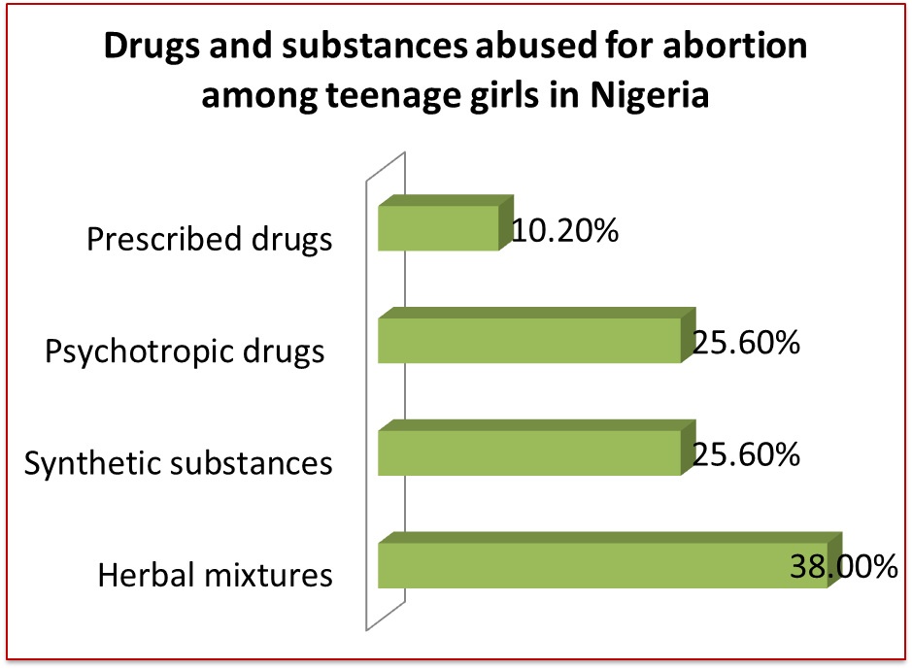
Consequences of substance abuse and risky sexual behaviours

Slide 19
Consequences of teenage abortion
Infertility and damage to vital organs in the body.
Some teens that have committed an unsafe abortion are experiencing post abortion syndrome while passing through physical and emotional trauma thereby resort to drugs and substance abuse.
Some have educational setback or have dropped out from the school.
Emotional and psychological disturbance that follows after the abortion known as Post-abortion traumatic effects and disturbances are depression, isolation, drug abuse and attempt to commit suicide.
These post abortion syndrome can cause mental ill health.

Slide 20
Recommendations for Prevention
Parents and guardians should keep close to their children and provide them with care they need. Such as;
- be mindful on their children’s use of internet, watching of movies/TV/magazines
- know the kind of friends their children keep
- maintain a good parent-child relationship
- monitor their child’s social activities
- observe their child performance in school
Adolescents should be provided with information and skills for taking care of their sexual health, and help them make sound decisions now and in the future.

Slide 21
Providing information and skills to the adolescents could be enhanced through peer educators training, training of teachers, training of parents/guardians and training of community and religious leaders.
Sexuality education should be integrated into the confidential and longitudinal relationship the parents and guardians develop with children through the education children acquire in the school, and the society must be aware of the children’s own attitudes, beliefs, and values so that their effectiveness in discussing sexuality in the community setting is not limited.
Out of school and school-based interventions should provide opportunities for individual risk assessments or targeted preventive counseling.

Slide 22
There is need to access professional help to support adolescents who already have the problem of sexualized drug use. In this case, counsellors and psychotherapist can assist by;
- providing and engaging the adolescent in counselling
- helping the family to discuss and identify issues and address these events
- provide referral for possible rehabilitation and treatment for the adolescent recovery and wellbeing

Slide 23
Conclusion
Drugs and substance abuse is detrimental to health, and should be avoided while education is very important for the adolescents to get the right information, and therefore, drugs and substance abuse prevention should be integrated into sexual reproductive health education for adolescents to reduce the risky behaviours associated.

Slide 24
Thanks

