Slide 1

Webinar | Prevention of Drug Use and other Risky Behaviors in Youth: Data-Based Planning for Effective Prevention
Feb 11, 2021
Lilian Adnan Ghandour (PhD MPH)
Associate Professor
American University of Beirut
Email: lg01@aub.edu.lb
Twitter: @LilianGhandour
Notes:
I should probably start the talk with a disclaimer - while thinking of a title for this talk, I ended up borrowing part of the title of the 2012 SAMHSA report on Data-Based Planning for Effective Prevention: State Epidemiological Outcomes Workgroups and what I liked about the title is the use of “data-based” a modifier of evidence-based which I thought may help catch the eye☺

Slide 2
Learning Outcomes
Talk outline:
Public Health and the Public Health Approach to Substance Use Prevention
Linking epidemiology to effective prevention
A public health approach to the development of a national alcohol policy in an under resourced setting: The Case of Lebanon
Describe the public health approach to addressing public health problems such as youth substance use
Describe the role of epidemiological data in the planning, implementation and evaluation of substance use prevention in youth
Describe the components (standards) of successful youth substance use prevention programs/interventions

Slide 3
Public health CONTROVERSIES
Unique features of Public Health
Focuses primarily on the health of populations & communities
Focused on prevention / Use of prevention as a prime strategy
Basis in social justice philosophy
Inherently political nature
Links with government
Grounding in the science / Evidence
Economics
Individual liberties
Moral opposition
Chapter 1 Public Health: What is it and how does it work? Bernard Turnock
Schneider M. (2000). Public health: Science, politics and prevention. Chapter 1 in Introduction to Public Health, Gaithersburg, Maryland: Aspen Publishers, Inc.

Slide 4
Substance USE Prevention & PUBLIC HEALTH
Population health is affected [DUI-related injuries and deaths; Increased risk of health and social problems, property crimes; direct and indirect costs related to crime, health, and lost productivity]
Totally preventable [modifiable risk factors]
Inherently political in nature [regulatory frameworks]
Grounded in science [data-based]

Slide 5


2016 United Nations General Assembly Special Session on drugs (UNGASS 2016), unanimously approved by the 193 Member States, has recognized “drug addiction as a complex multifactorial health disorder characterized by chronic and relapsing nature” that is preventable and treatable and not the result of moral failure or a criminal behavior.
recognition of the need to shift from a criminal justice to a public health approach represents a major shift in mentality by United Nations Member States
achievement was the result of a continuous dialogue between policy makers and the scientific community during recent sessions of the United Nations Commission on Narcotic Drugs
also highlighted evidence-based approaches to drug policy based on public health principles, emphasizing social protection and health care instead of conviction and punishment

Slide 6
eight recommendations adopted unanimously by UN Member States, UNGASS 2016
Eliminate stigma and discrimination toward individuals with substance use disorders
Address substance use disorders as public health problems instead of criminal justice issues. A comprehensive public health approach should offer accessible evidence-based prevention, treatment, and recovery options to drug users, and engage those who commit criminal offences in evidence-based treatment during and following, or in lieu of, incarceration, to prevent relapse and recidivism.
Implement evidence-based prevention programs.
Implement evidence-based treatments for substance use disorders.
Collect and utilize scientific data and engage scientific experts in policy making. Reliable epidemiological data on the economic and social factors that contribute to drug use and substance use disorders should be gathered and analyzed to drive planning and evaluation of drug policy interventions and decision making. The scientific community should provide knowledge of effective prevention and treatment interventions as well as training in their implementation and ongoing evaluation. Member States should establish national early warning systems to monitor changing drug trends and identify emerging public safety and health threats
Engage diverse stakeholders in coordinated policy making. “…. policy makers should involve diverse stakeholders, including public health, education, law enforcement, science, and health care systems, as well as solicit input from countries with different cultures, resources, and experiences.
Support drug-related research
Ensure access to scheduled medications for therapeutic use.
https://www.ncbi.nlm.nih.gov/pmc/articles/PMC5428163/pdf/WPS-16-213.pdf
Notes:
evidence-based interventions (EBIs) to refer to programs and policies supported by research

Slide 7

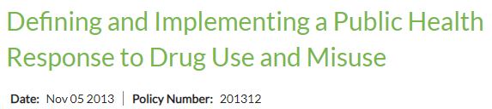
Related APHA Policy Statements
APHA Policy Statement 8817 – A Public Health Response to the War on Drugs: Reducing Alcohol, Tobacco and Other Drug Problems among the Nation’s Youth^{[1]}
APHA Policy Statement 7121 – Substance Abuse as a Public Health Problem^{[2]}
APHA Policy Statement 9123 – Social Practice of Mass Imprisonment^{[3]}
APHA Policy Statement 9415 – Syringe and Needle Exchange and HIV Disease^{[4]}
APHA Policy Statement 2002-12 – Syringe Prescription to Reduce Disease Related to Injection Drug Use^{[5]}
APHA Policy Statement 8931 – Illicit Drug Use and HIV Protection^{[6]}
APHA Policy Statement LB-12-02 – Preventing Overdose Through Education and Naloxone Distribution^{[7]}
APHA Policy Statement 7015 – Narcotic Epidemic^{[8]}
APHA Policy Statement 6907 – Drug Abuse^{[9]}
https://www.apha.org/policies-and-advocacy/public-health-policy-statements/policy-database/
Notes:
This policy statement calls on federal, state, and local elected officials and agency staff, health care professionals, community health workers, and other stakeholders to support a full reorientation toward a health approach to drug use

Slide 8
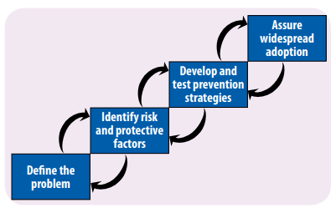
The Public Health Approach?
Step 1: Define and Monitor the Problem
The first step in preventing [substance use] is to understand the "who", "what", "when", "where" and "how" associated with it.
Step 2: Identify Risk and Protective Factors
It is important to understand what factors protect people or put them at risk for [substance use] . Risk and protective factors help identify where prevention efforts need to be focused.
Step 3: Develop and Test Prevention Strategies
Data from needs assessments, community surveys, stakeholder interviews, and focus groups are useful for adopting an evidence-based approach to program planning, implementation and evaluation.
Step 4: Assure Widespread Adoption
Communities are encouraged to implement evidence-based programs and to evaluate the program's success. Dissemination techniques to promote widespread adoption include training, networking, technical assistance, and evaluation.
https://www.cdc.gov/violenceprevention/overview/publichealthapproach.html

Slide 9
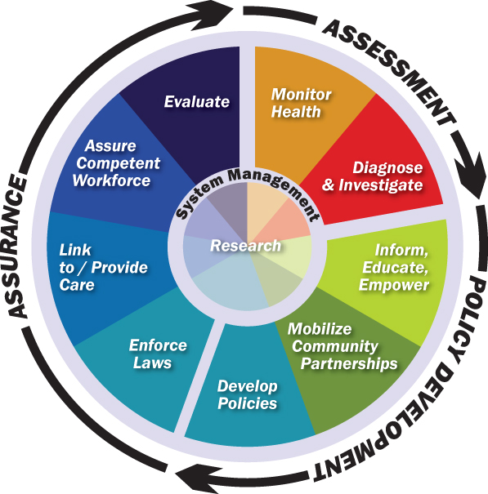
Core functions of public health
Epidemiology is the
BASIC SCIENCE of PUBLIC HEALTH
EVALUATION should be ONGOING
Source of core functions: Institute of Medicine. The Future of Public Health. 1988.
Ten Essential Public Health Services: Core Public Health Functions Steering Committee, 1994
Notes:
Monitor health status to identify and solve community health problems (e.g., community health profile, vital statistics, and health status).
. Diagnose and investigate health problems and health hazards in the community (e.g., epidemiologic surveillance systems, laboratory support).
3. Inform, educate, and empower people about health issues (e.g., health promotion and social marketing).
4. Mobilize community partnerships and action to identify and solve health problems (e.g., convening and facilitating community groups to promote health).
5. Develop policies and plans that support individual and community health efforts (e.g., leadership development and health system planning).
6. Enforce laws and regulations that protect health and ensure safety (e.g., enforcement of sanitary codes to ensure safety of environment).
7. Link people to needed personal health services and ensure the provision of health care when otherwise unavailable (services that increase access to health care).
8. Assure competent public and personal health care workforce (e.g., education and training for all public health care providers).
9. Evaluate effectiveness, accessibility, and quality of personal and population-based health services (e.g., continuous evaluation of public health programs).
10. Research for new insights and innovative solutions to health problems (e.g., links with academic institutions and capacity for epidemiologic and economic analyses).

Slide 10
Epidemiology and effective prevention
Data-based understanding of substance use epidemiology
Data-driven decision-making and evidence-based interventions
Notes:
Epidemiology is the basic science of public health – and the “foundation and logic of interventions” in public health (and medicine). It is data-driven and relies on a systematic and unbiased approach to the collection, analysis, and interpretation of data to inform public health interventions, policy and practice.

Slide 11
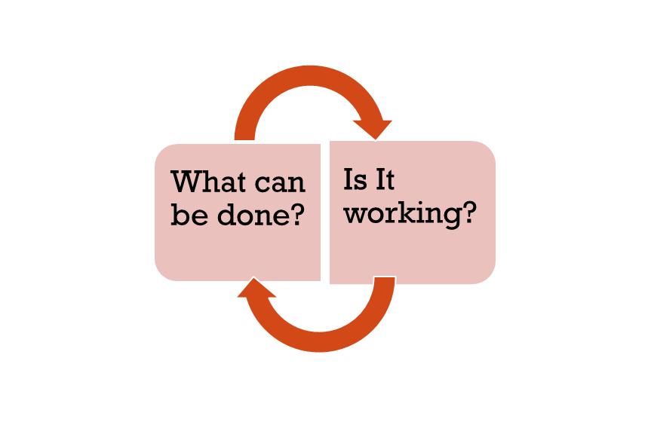
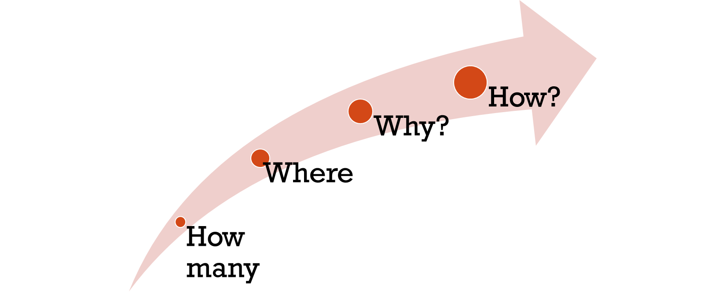
Epidemiology and effective prevention
(James C. Anthony, michelle L. van etten, 1998)
https://www.epi.msu.edu/janthony/documents%20up%20to%202010/Epidemiology%20and%20its%20Rubrics.pdf
Notes:
Descriptive vs analytical EPI

Slide 12
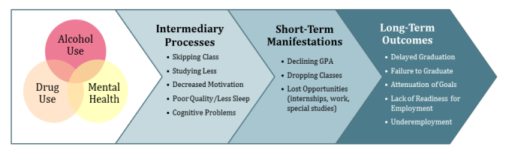
Alcohol use, drug use, and mental health outcomes have a cascade of effects on college students’ academic outcomes
Arria, A. M., Caldeira, K. M., Bugbee, B. A., Vincent, K. B., & O’Grady, K. E. (2013). The academic opportunity costs of substance use during college. College Park, MD: Center on Young Adult Health and Development. Available at www.cls.umd.edu/docs/AcadOppCosts.pdf.
Notes:
Even if they graduate, they may not have maximized on the skills they could have picked up

Slide 13
Epidemiology and effective prevention
Descriptive studies by place and person help identify high risk areas/groups
Analytical studies that test specific hypotheses and investigate causes at the individual including genetic, social-environmental, and policy levels identify targets for intervention
Descriptive and analytical studies guide decisions of program planners, regulators and other decision makers while developing and implementing optimal strategies
Surveillance over time data helps evaluate impact of data-driven specific activities, services, interventions, and policies

Slide 14
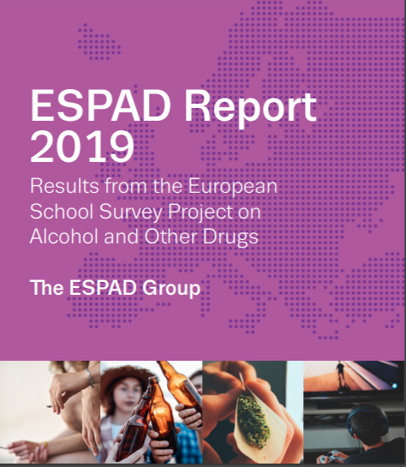
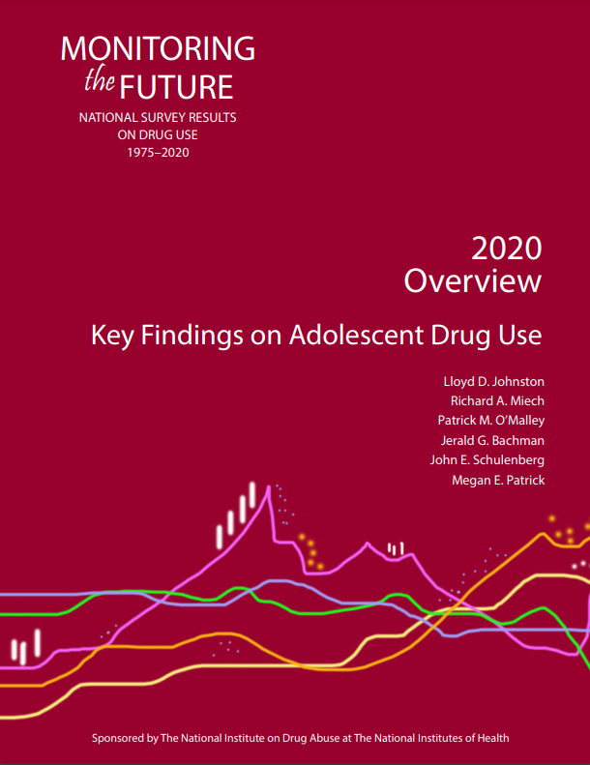
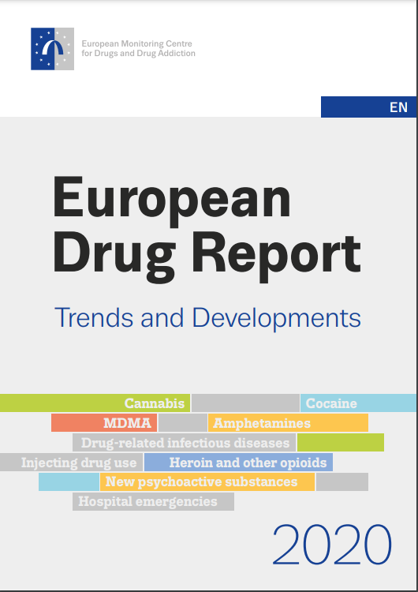
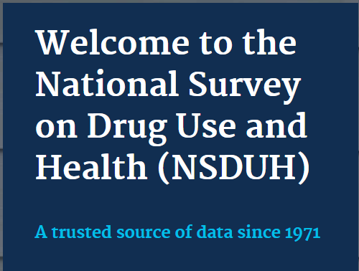

Slide 15
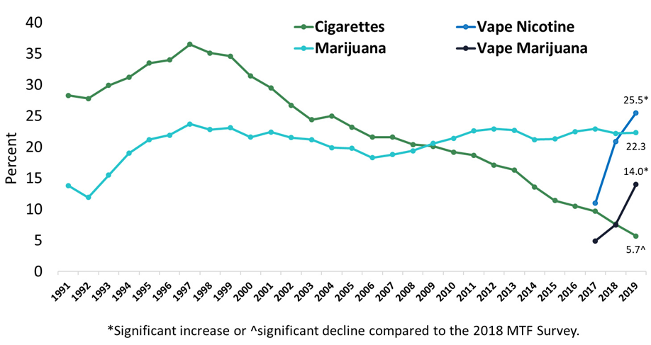
Monitoring the Future (MTF) Survey – past 30-day prevalence of Marijuana, Cigarette, and Vape Use among 12th graders (1991-2019)
Notes:
Allows for understanding current practices
Enables early detection of trends
Provides a basis for the planning and evaluation of interventions
Necessary for estimating potential effectiveness of policy changes (such as policies addressing availability, affordability, and marketing/advertising.. )

Slide 16

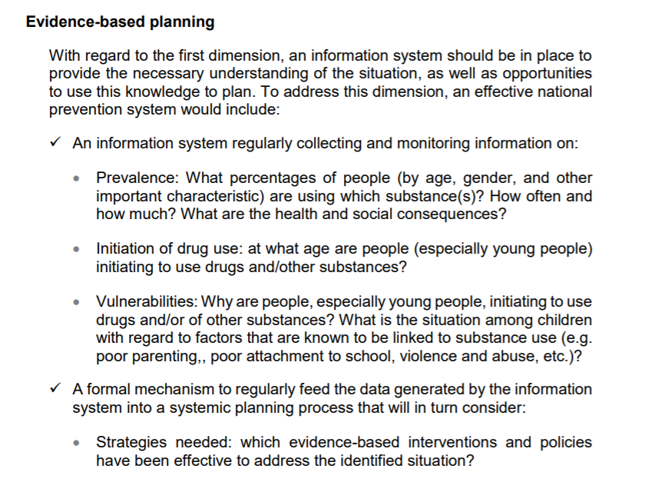
Notes:
One of the members of the Group of Experts on the Prevention Standards, for providing the relevant scientific evidence and technical advice

Slide 17
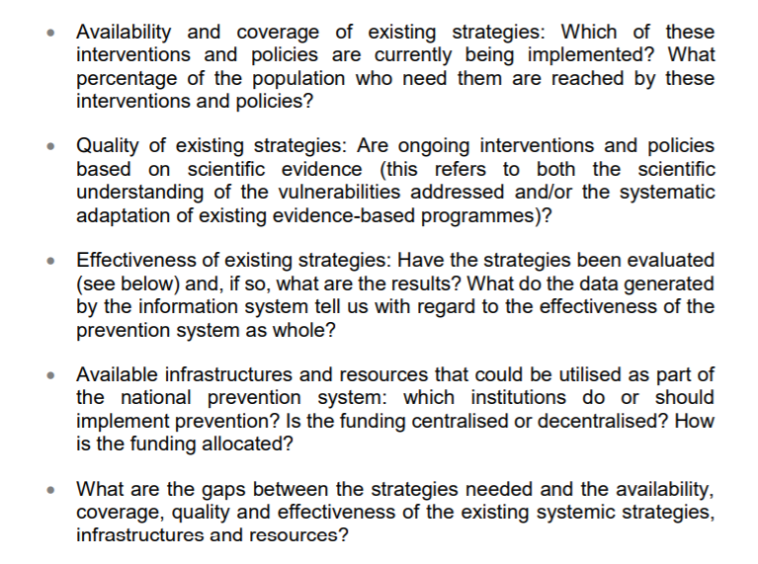

Slide 18
Types of prevention
Universal: aimed at all members of a given population (e.g., all children of a certain age)
Selective: aimed at a subgroup determined to be at high-risk for substance use (e.g., homeless children)
Indicated: (targeted to individuals who are already using substances but have not developed a substance use disorder)

Slide 19
Individual
Peer
Early initiation
Family
Family management problems (monitoring, rewards…)
Community
Low cost of alcohol
School
Academic failure
Rebelliousness
Favorable attitude towards substance use
Peer substance use
Genetic predictors
Family conflict
Favorable parental attitudes towards substance use
Family history of substance use
Lack of commitment to school
High availability
Community laws/norms
Media portrayal
Low SES
Adapted from Table 3.1: Risk Factors for Adolescent and Young Adult Substance Use (https://www.ncbi.nlm.nih.gov/books/NBK424857/pdf/Bookshelf_NBK424857.pdf)

Slide 20
Selected Evidence-based interventions | <10 years | 10-18 years | 18+
Universal | Raising Healthy Children (F&S) Good Behavior Game (S) Classroom Centered Intervention (S) Linking the Interests of Families and Teachers (M) | Life Skills Training (S) School Health and Alcohol Harm Reduction Project (S) Unplugged (S) keepin’ It REAL (S) ATLAS (S) Strengthening Families Program (M) Guiding Good Choices (F) | Parent Handbook (C)
Selective | Nurse-Family Partnership Program (F) Preventive Treatment Program (M) | Preventure/ Adventure (S)
Indicated | Fast Track (M) |  | BASICS (C)
S: school; M: multicomponent; F: family; C: college
For the full list of interventions, The Surgeon General’s Report on Alcohol, Drugs and Health (2016)
Appendix B- https://www.ncbi.nlm.nih.gov/books/NBK424857/pdf/Bookshelf_NBK424857.pdf
Notes:
One well-researched and widely used program is LifeSkills Training, a school-based program delivered over 3 years.117 Research has shown that this training delayed early use of alcohol, tobacco, and other substances and reduced rates of use of all substances up to 5 years after the intervention ended.

Slide 21
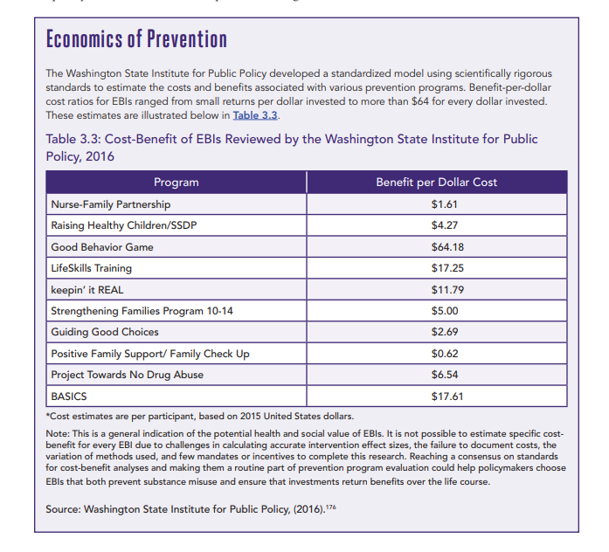
The Surgeon General’s Report on Alcohol, Drugs and Health (2016)
https://www.ncbi.nlm.nih.gov/books/NBK424857/pdf/Bookshelf_NBK424857.pdf

Slide 22
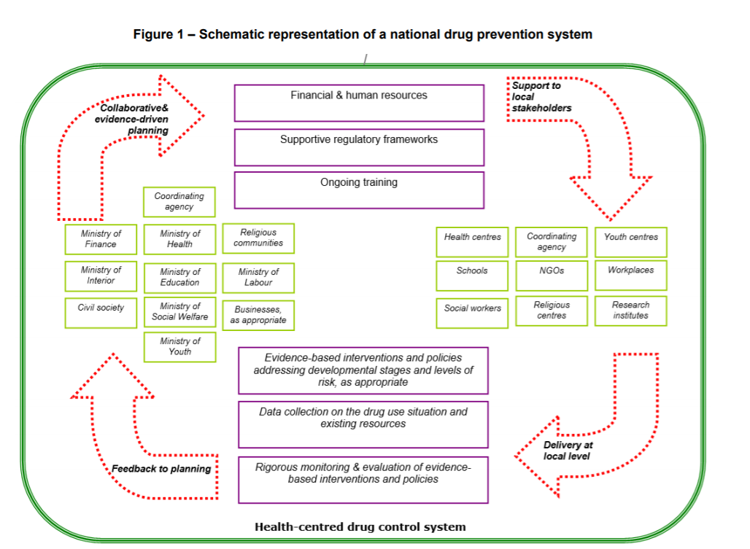
https://www.unodc.org/documents/prevention/standards_180412.pdf

Slide 23
A public health approach to the development of a national alcohol policy in an under-resourced setting: The case of Lebanon

Slide 24
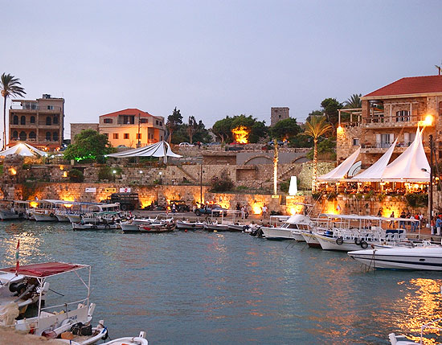
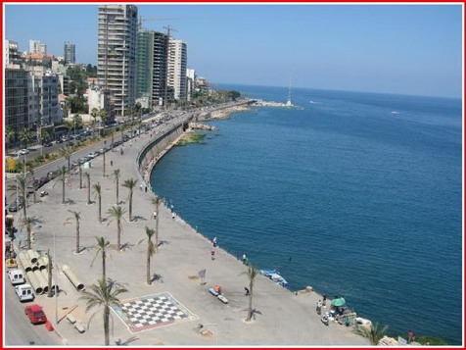



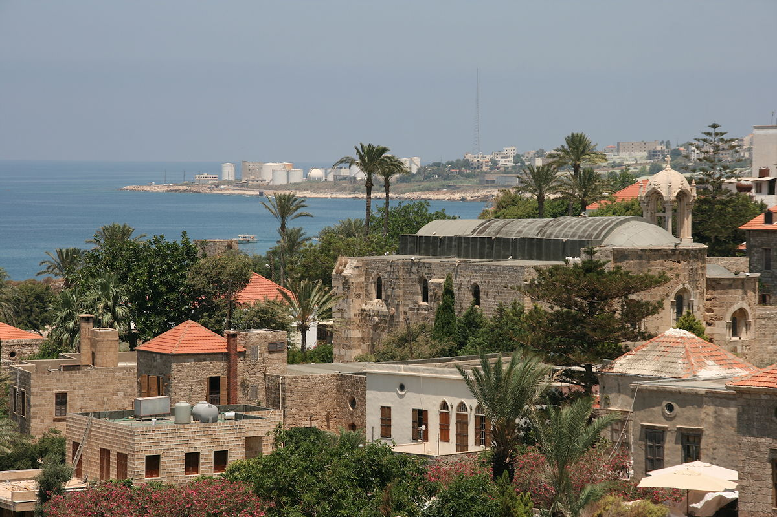

LEBANON
Notes:
I will start on a positive note….

Slide 25
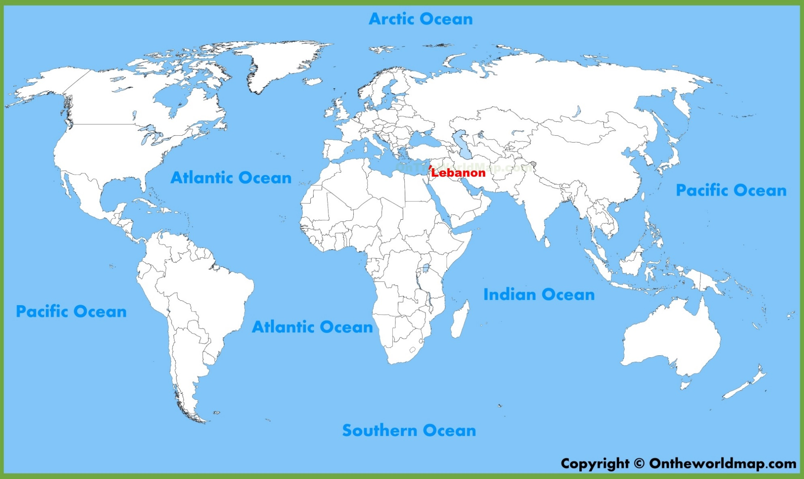
“LEBANON is located on the Eastern shores of the Mediterranean Sea, at the Crossroads of land and sea routes that link Europe, Asia and Africa”

Slide 26
Why alcohol
Foreign currency for exported beverages/tax revenues for government
Important contributor to business/job opportunities in hospitality/retail sectors
Direct and indirect costs related to crime, and other social problems including lost productivity
Associated with acute and chronic medical (intoxication) and social problems (violence)
World’s largest risk factor for disease and disability (particularly in 15-29)
“Alcohol: NO Ordinary Commodity” (The Alcohol and Public Policy Group)
Its harms are preventable
It is a public health and developmental issue [alcohol has been identified as an obstacle to achieving 12 out of 17 SDGs].
“Because alcohol is no ordinary commodity, the public has a right to expect a more enlightened approach to alcohol policy” (The Alcohol and Public Policy Group)

Slide 27

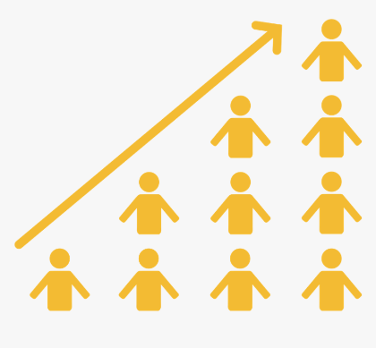


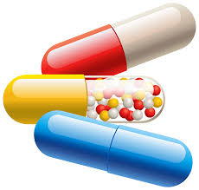
My research has shown:
Drinking starts as early as 13
More young people are drinking, especially females
Drinking is more regular than occasional
Drinking done more harmfully than “responsibly” with significant numbers reporting drunk driving
At higher risk of other mental health problems (prescription drug abuse, gambling, suicide…)

Slide 28
More research (youth perceptions)
“It is very easy [to get a drink]… no one asks us anything: There is no control!”
“We were in a “pub” yesterday, I am under 18 and my brother is also under 18 with my two cousins. We were playing bowling and we ordered some Tequila and Gold and Absinthe no one asked for our IDs or anything”
“Also many stores do sell alcohol… they are everywhere… Next to these stores you find groups of young people there”
The problem is that it is not expensive because many young people with relatively low economic status can drink alcohol and drink it excessively”
“You can buy a (huge) drink for 2000 L.L (1.33 $)”
“Many car accidents are happening due to excessive drinking and we are losing many young people because of that…”
“Ahla Alam” where every once in while an accident happens or a fight near that place… because of drunk people”
Yassin N, Afifi R, Singh N, Saad R, Ghandour L (corresponding author). “There Is Zero Regulation on the Selling of Alcohol”: The Voice of the Youth on the Context and Determinants of Alcohol Drinking in Lebanon. Qualitative Health Research. 2018;28(5):733-744. doi:10.1177/1049732317750563

Slide 29
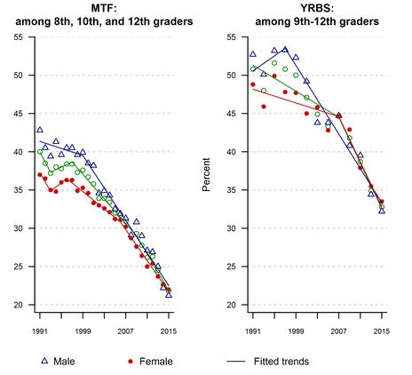
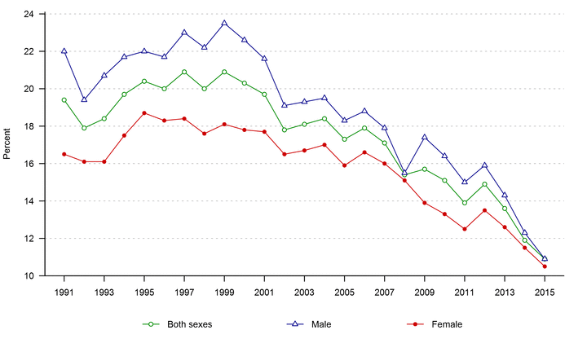

decline in alcohol consumption
Prevalence of drinking in the past 30 days, by sex, 1991–2015.
Prevalence of having been drunk or very high from drinking alcoholic beverages in the past 30 days among 8th-12th graders, by sex, 1991–2015

Slide 30

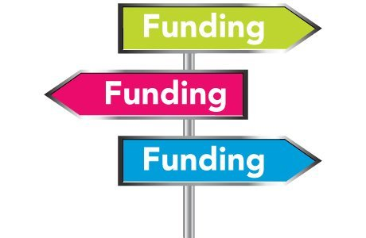
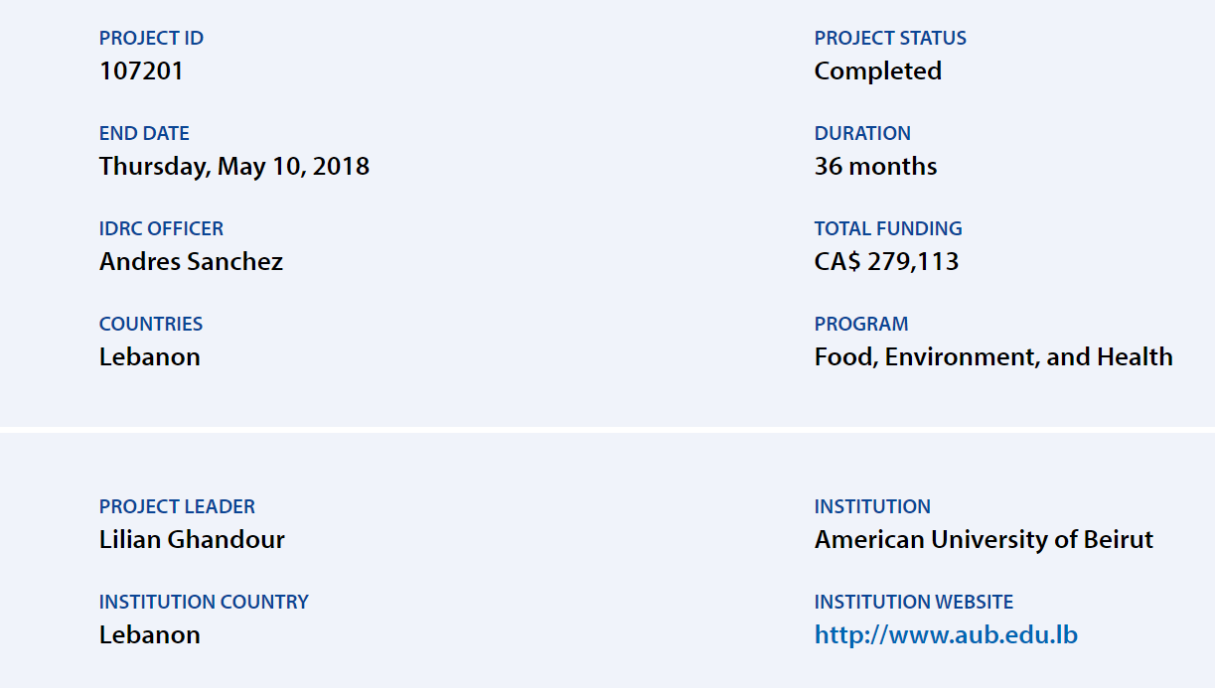

Slide 31
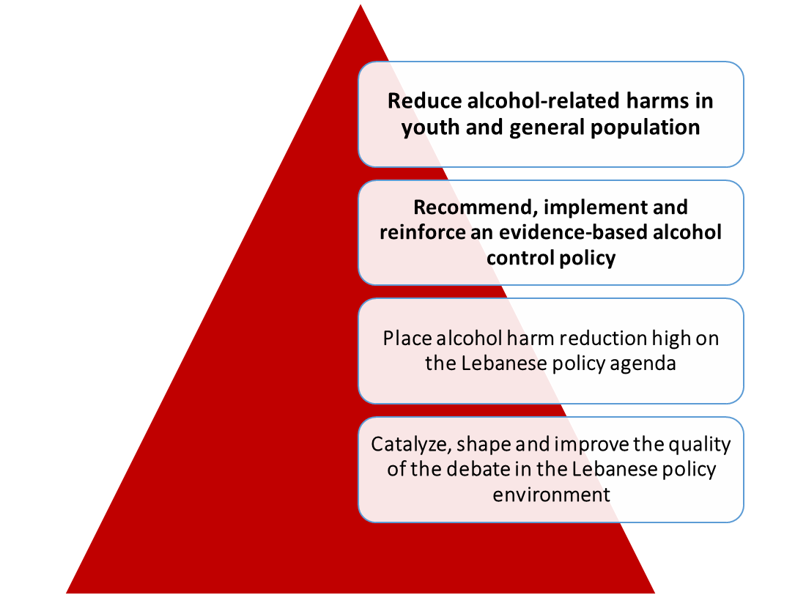
Alcohol harm reduction research program-(AHRRPY)
MULTIDISCIPLINARY RESEARCH TEAM
Lilian Ghandour (PI - Epidemiology/Biostatistics)
Nasser Yassin (Health Policy)
Rima Afifi (Health promotion/M&E-University of Iowa)
Ali Chalak (Applied Economics)
Rima Nakkash (Health policy evaluation, knowledge translation, and advocacy)
Aida El Aily (project coordinator)
Sirine Anouti (project coordinator)
Collaborators/Consultants
Mitra Tauk (Lawyer)
Fadi Al Jardali (K2P Director)
Jessika Nicholas (ArcGIS specialist)
Tamim Moussa (Policy Advisor)
Select local NGO’s/government officials (advisory team)
Initiated in 2013-ongoing

Slide 32
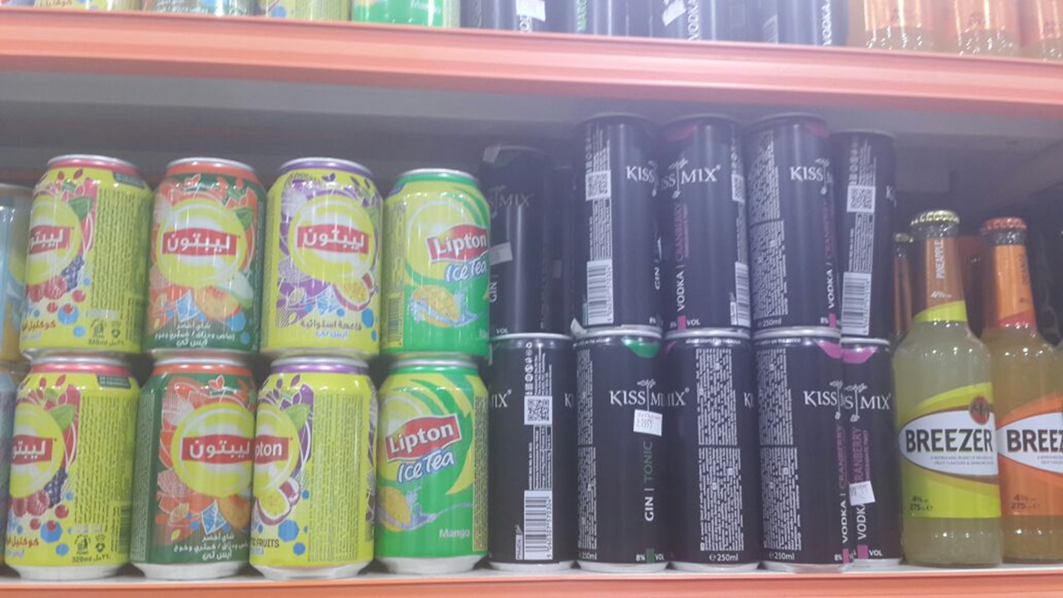
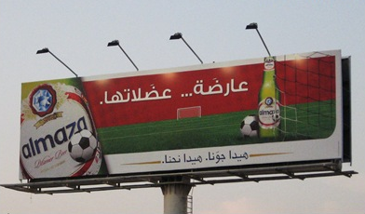
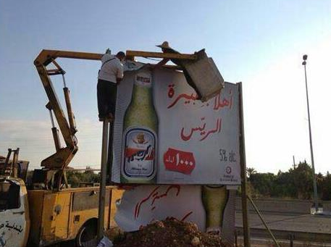
Policy Background
OUTDATED OR LOOSELY ENFORCED POLICIES
  Low alcohol prices & negligible excise taxes
  Unregulated sales to minors- easy access
    banning of the import, manufacture and marketing of energy drinks
    mixed with alcohol (MOPH and Ministry of Commerce)- not for health reasons!
  Lax law enforcement of drinking and driving (drive-thru drinking!!)
    new traffic law (limit of BAC set at 0.05%- not enforced)
  No regulation of alcohol advertising/marketing
Notes:
About 7 different systematic reviews report negative price elasticities reducing among youth/adults, in high/low-middle income countries both: alcohol consumption (results mixed among heavy drinkers) and alcohol-related morbidity and mortality (e.g. alcohol related diseases, suicide, motor vehicle crashes/fatalities, etc.) (Booth et al., 2008; Elder et al., 2010; Wagenaar et al., 2010; Wagenaar, Salois, & Komro, 2009; Wagenaar, Tobler, & Komro, 2010; Komro & Toomey, 2002).
Since 2010, the most important achievements in Lebanon on alcohol policy include: the new traffic law and its stipulations on drunk driving (limit of blood alcohol concentration set at 0.05% and mandatory penalty for exceeding this legal limit); and the banning of the import, manufacture and marketing of energy drinks that are mixed with alcohol (as per inter-ministerial decision by the MOPH and Ministry of Commerce issued on Feb. 3, 2014). Important setbacks remain however, including the low financial and human resources for proper enforcement and monitoring and the alcohol industry lobbying activities.

Slide 33
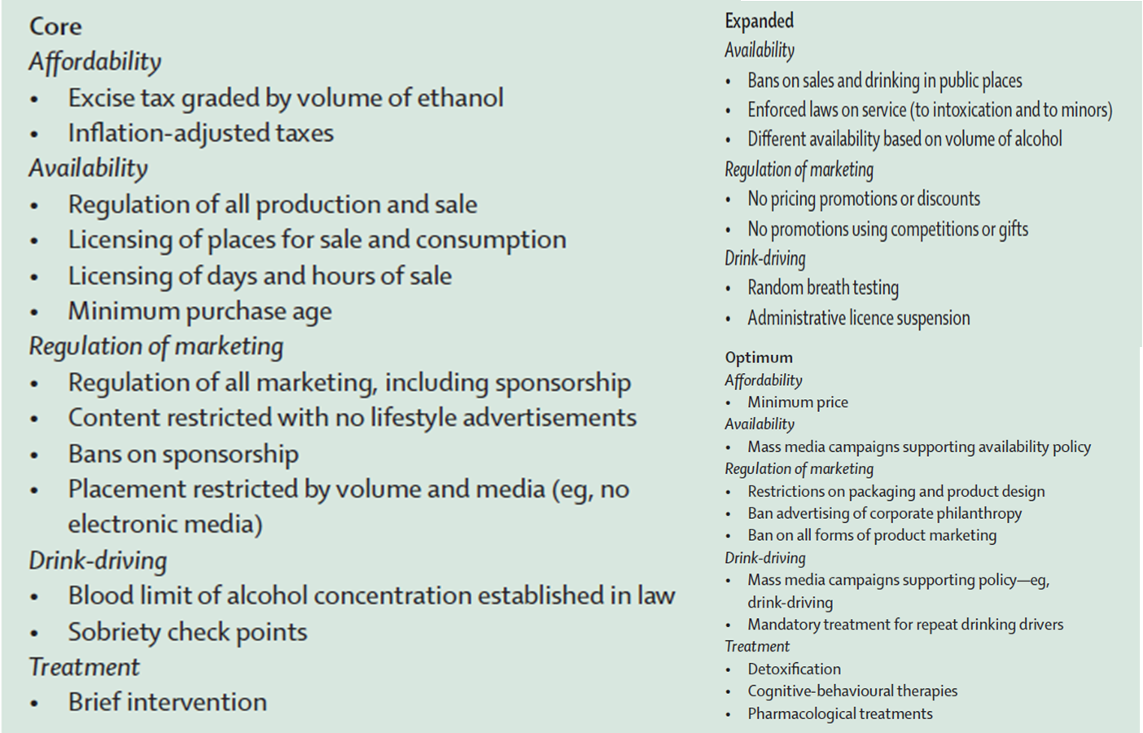
World Health Organization (WHO) Best-BUYS
Casswell S, Thamarangsi T. Reducing harm from alcohol: call to action. Lancet. 2009 Jun 27;373(9682):2247-57. doi: 10.1016/S0140-6736(09)60745-5. PMID: 19560606.
Notes:
Since alcohol consumption is an important public health problem, the World Health Organization (WHO) has called for a global response to mitigate alcohol-related harms by requesting all member states (including Lebanon) to implement effective harm reduction policies (L Ghandour, Chalak, et al., 2015; WHO, 2010).

Slide 34
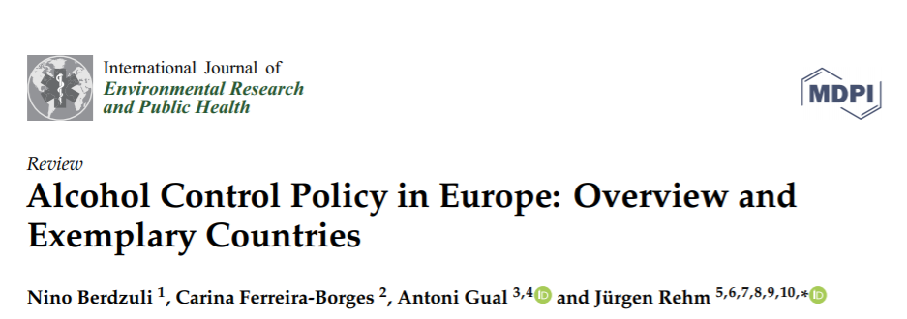
Overall, there is a great deal of variability in the policies implemented between countries, but two countries, the Russian Federation and Lithuania, have both recently implemented significant increases in alcohol taxation, imposed restrictions on alcohol availability, and imposed bans on the marketing and advertising of alcohol within short time spans. Both countries subsequently saw significant decreases in consumption and all-cause mortality. i

Slide 35
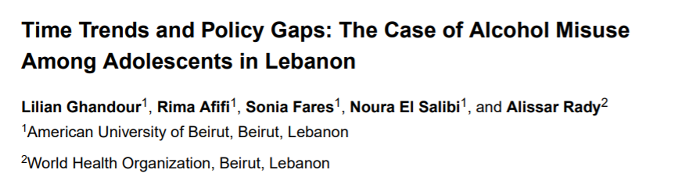
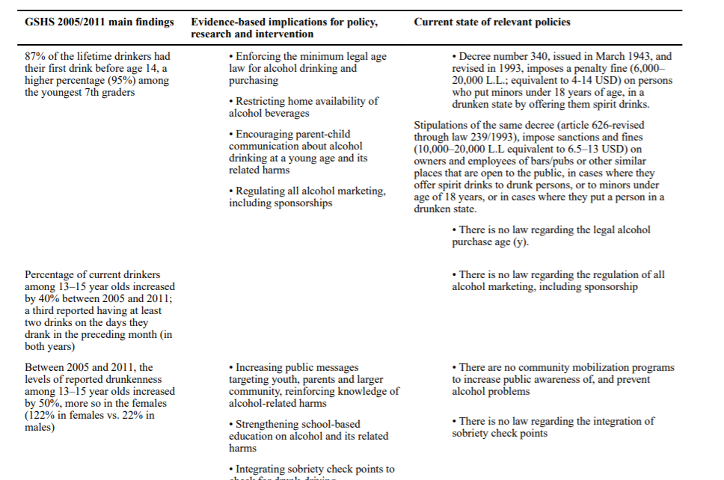
Ghandour, L (corresponding author), Afifi, R., Fares, S., El Salibi, N., & Rady, A. (2015). Time Trends and Policy Gaps: The Case of Alcohol Misuse Among Adolescents in Lebanon. Substance use & misuse, 50(14), 1826–1839. https://doi.org/10.3109/10826084.2015.1073320

Slide 36
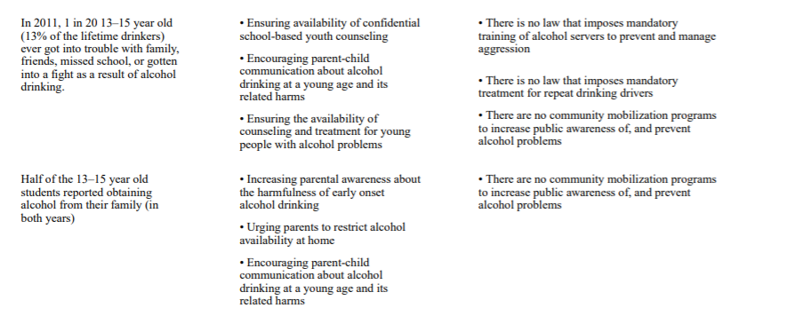
Ghandour, L (corresponding author), Afifi, R., Fares, S., El Salibi, N., & Rady, A. (2015). Time Trends and Policy Gaps: The Case of Alcohol Misuse Among Adolescents in Lebanon. Substance use & misuse, 50(14), 1826–1839. https://doi.org/10.3109/10826084.2015.1073320

Slide 37




Multi-methods multi-source approach
GPS Surveillance
Alcohol outlets
Stakeholder interviews
Stakeholders
Policy Dialogue
Policy Content Analysis
Published
evidence review
DCE among drinking university
Youth
(18+)
FGD Youth
Epi Survey university youth (18+)

Slide 38
ACTIVITY | Published evidence review | Policy content analysis | Stakeholders Interviews | Surveillance of alcohol outlets density in Beirut | Youth Surveys (one epidemiological, one econometrical)
PROBLEM IDENTIFICATION | WHAT? (is the available evidence) | WHAT? (are existing policies; enforced/outdated) | WHAT? (are existing challenges & opportunities/ implementation considerations ) | WHAT? (is the density of alcohol outlets) | HOW? (do young people purchase/consume alcohol, and how would a policy impact their behaviors)
METHOD | Review of alcohol- related published studies in all Arab countries (1993- 2013) (PubMed, Medline, PsychNet Google Scholar, IMEMR) WHO website | WHO/GISAH database Library of the Lawyer/ Tawk’s law firm | Thematic analysis of 18 completed interviews with key stakeholders* | GPS/GIS surveillance of all alcohol-serving outlets in the 8 major areas of Beirut** | Examine impact of alcohol policy packages Examine influence of distal/proximal policy-relevant variables on alcohol consumption/purchasing patterns
CONTRIBUTION | Describing density and distribution of published data Describing the extent of alcohol problem in the region (using published and unpublished data) | Describing existing policies Identifying important gaps identifying key stakeholders/ guiding discussions Comparative analysis of national and regional policies | Complementing the content analysis, gaps, facilitators (opportunities) and barriers (challenges) to implementation Validation of the information gathered in content analysis/ GISAH | Visually displaying location and density of community alcohol outlets in the Beirut area. Creating reference points for alcohol outlets Determining distance and adjacency to other landmarks. | Identifying alcohol consumption and purchasing attributes Assessment of the potential impact of specific alcohol control policy packages on youth alcohol consumption and purchasing behaviors DCE validation of instrument for use in DCE survey

Slide 39
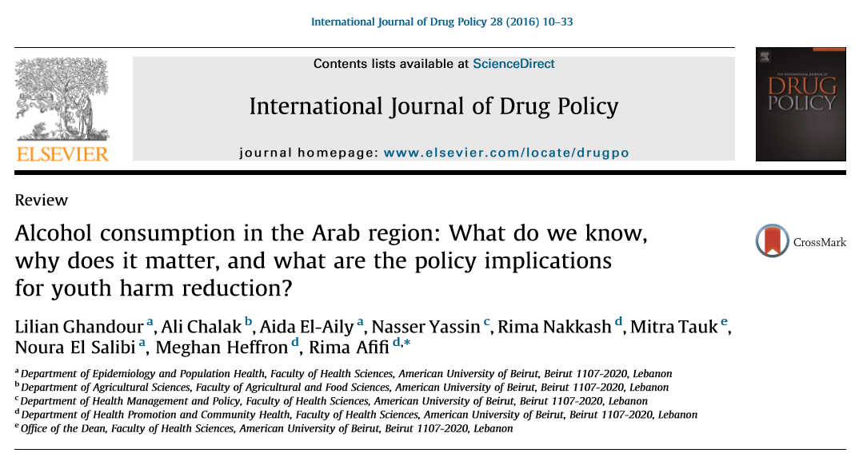
… described the landscape of alcohol research in the Arab region and discussed evidence- informed recommendations and future directions for policy and research tailored to the countries’ current stance on alcohol legislation and consumption.

Slide 40
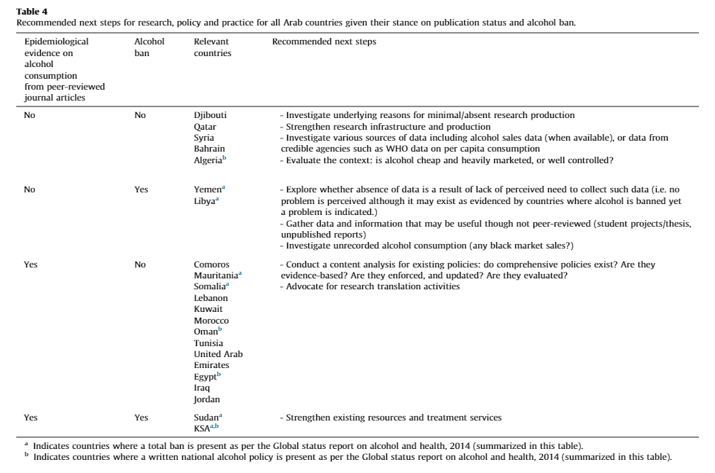

Slide 41
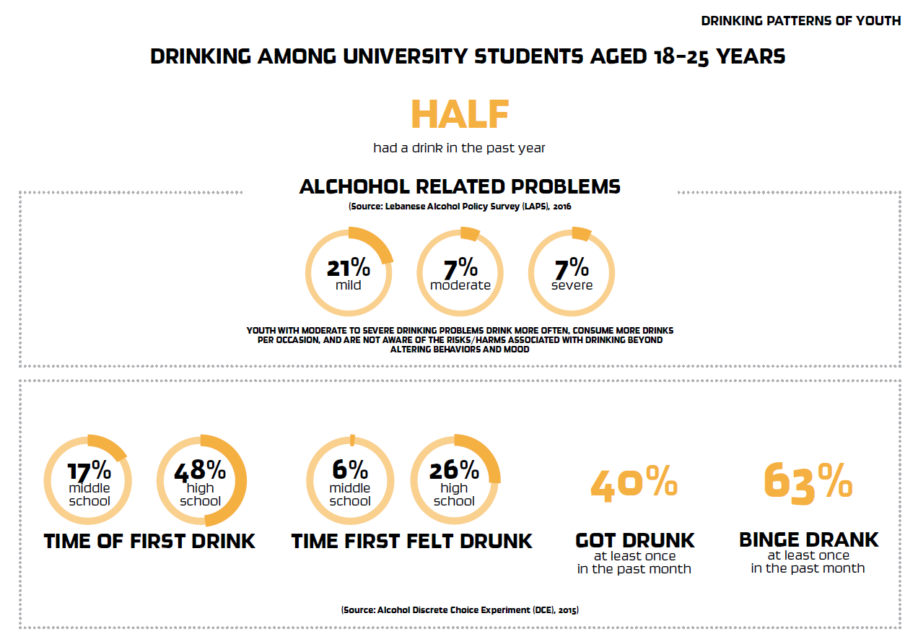

Slide 42
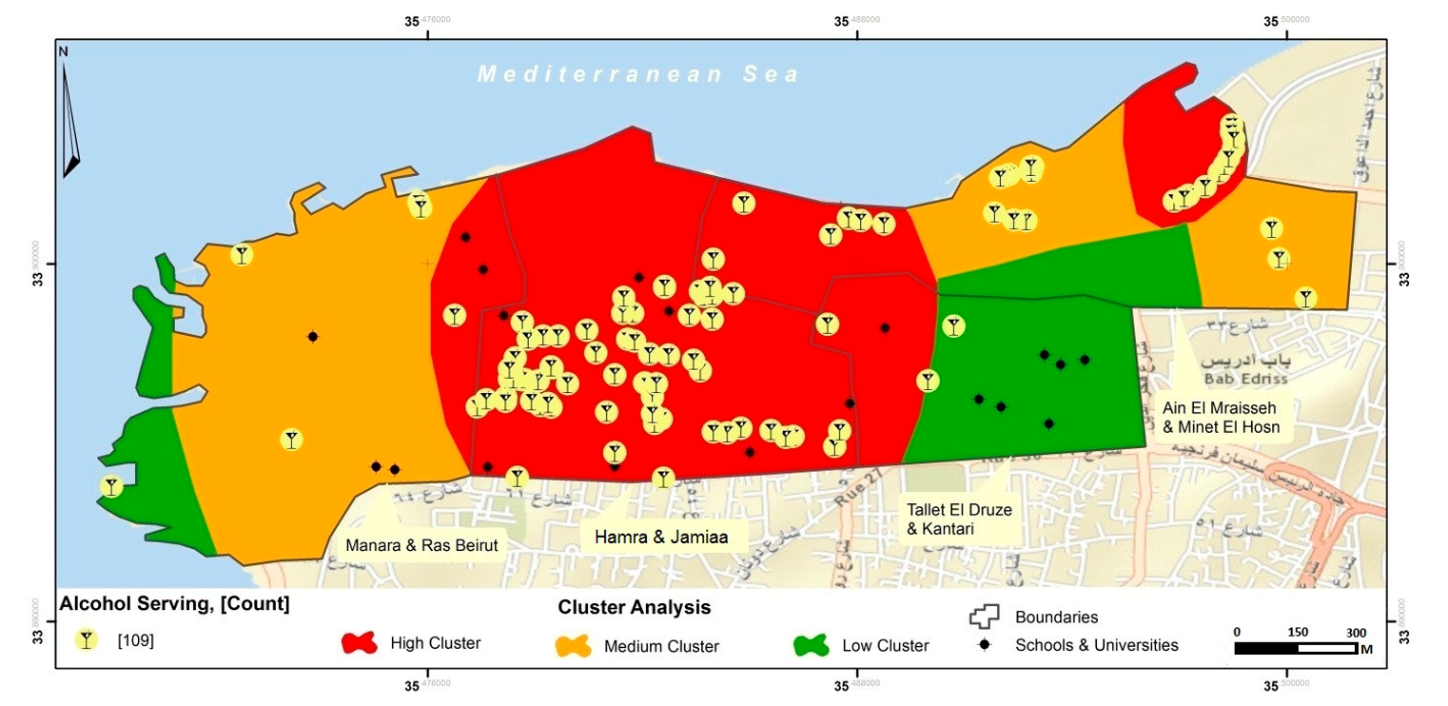
GIS mapping of alcohol outlets in four residential neighborhoods in Beirut revealed a high alcohol-outlet density in areas with close proximity to schools, universities and places of worship, higher density than in many similar contexts.
Nakkash R, Ghandour LA (corresponding author), Anouti S, Nicolas J, Chalak A, Yassin N, Afifi R. Surveying Alcohol Outlet Density in Four Neighborhoods of Beirut Lebanon: Implications for Future Research and National Policy. Int J Environ Res Public Health. 2018 Sep 14;15(9):2006. doi: 10.3390/ijerph15092006. PMID: 30223460; PMCID: PMC6164322.

Slide 43
Key messages
Impact of taxation
 | Overall | Binge drinkers | Low ethanol drinkers
S1 | -5.3% | +3.3% | -2.5%
S2 | -15.7% | -16.3% | -15.6%
High-ethanol drinks (wine, spirits and Arak) exhibit negative price elasticities.
Binge drinkers tend to use low-ethanol drinks when faced with increased price.
Taxes targeting high-ethanol beverages reduce consumption more than broad-based taxes.
Alcohol taxation should be mindful of youth’s behavioral and substitution patterns.
S1—a blanket 20% tax is imposed on all five alcoholic beverage categories; S2—20% tax is levied only on the high alcohol content beverages, namely spirits and arak, exempting beer, wine and vodka mixes and alcopops from it.
Chalak A, Ghandour L (corresponding author), Anouti S, Nakkash R, Yassin N, Afifi R. The impact of broad-based vs targeted taxation on youth alcohol consumption in Lebanon. Health Policy Plan. 2020 Jul 1;35(6):625-634.
doi: 10.1093/heapol/czaa018. PMID: 32330932.

Slide 44
Stakeholders
Policy Implementation considerations
Weak governance
Disregard for rule of law
Diversion of responsibility towards ‘other’ stakeholders;
Clear industry resistance to change
  Advertising bans are not effective
  Promoting responsible drinking
  Self-regulation
  Importance of alcohol business to economy
  Others’ behavior is the problem
  Labeling of alcohol products not effective
  Taxation of alcohol products not effective
  Corporate Social Responsibility programs
Ministry of Industry
Ministry of Social Affairs
Ministry of Tourism
Ministry of Youth & Sports
Mistry of Economy and Trade
Ministry of Information
Ministry of Justice
Ministry of Finance
Ministry of Public Health
Kunhadi
YASA
JAD
Mentor Arabia
Skoun-Lebanese Addictions Center
MENAHRA
Syndicate of Importers of Foodstuff, Consumer Products & Drinks
Syndicate of Lebanese Food Industrialists
Syndicate of Alcohol Importers
Syndicate of Alcoholic Beverages Industries
Syndicate of Owners of Restaurants, Cafes, Night clubs and Pastries
Union Vinicole du Liban (UVL)
Nakkash RT, Ghandour LA, Yassin N, Anouti S, Chalak A, Chehab S, El-Aily A, Afifi RA. "Everyone Has the Right to Drink Beer": A Stakeholder Analysis of Challenges to Youth Alcohol Harm-Reduction Policies in Lebanon. Int J Environ Res Public Health. 2019 Aug 12;16(16):2874. doi: 10.3390/ijerph16162874

Slide 45
A public health approach to the development of a national alcohol policy in an under-resourced setting: The Case of Lebanon
Identify the problem
Describe the scope of the problem
Understand international evidence/standards
Collect/Analyze DATA
Triangulate data sources
Expand the description of the scope of the problem based on needs of country and international framework
Create multidisciplinary team + advisory group (consultative meetings)
Disseminate/Discuss findings with all* stakeholders
Propose evidence-based recommendations/ways forward
Evaluate interventions/strategies
Guiding principles (equity, commercial influence…), Resources (M, P, T), M&E, dissemination, build new partnerships/strengthen existing ones, continuous sensitization of stakeholders, flexibility and openness…
Notes:
When we realized that the government officials do not regard alcohol as a problem
When we realized that the NGOs need to be educated about COI
When we educated various media outlets

Slide 46
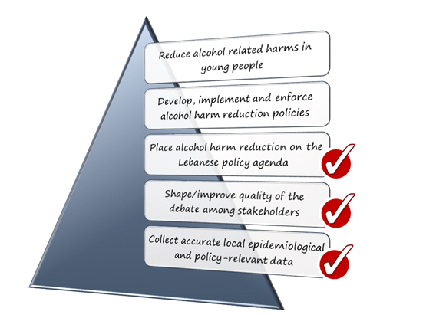
Major Success elements

Slide 47




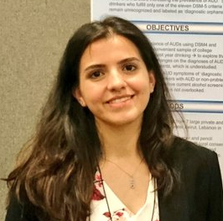




Create a Multidisciplinary team
Lilian Ghandour (PI - Epidemiology/Biostatistics)
Nasser Yassin (Health Policy)
Rima Afifi (Health promotion/M&E-University of Iowa)
Ali Chalak (Applied Economics)
Rima Nakkash (Health policy evaluation, knowledge translation, and advocacy)
Aida El Aily (project coordinator)
Sirine Anouti (project coordinator)
Collaborators/Consultants
Mitra Tauk (Lawyer)
Fadi Al Jardali (K2P Director)
Jessika Nicholas (ArcGIS specialist)
Tamim Moussa (Policy Advisor)
Local NGO’s/state officials (advisory team)

Slide 48
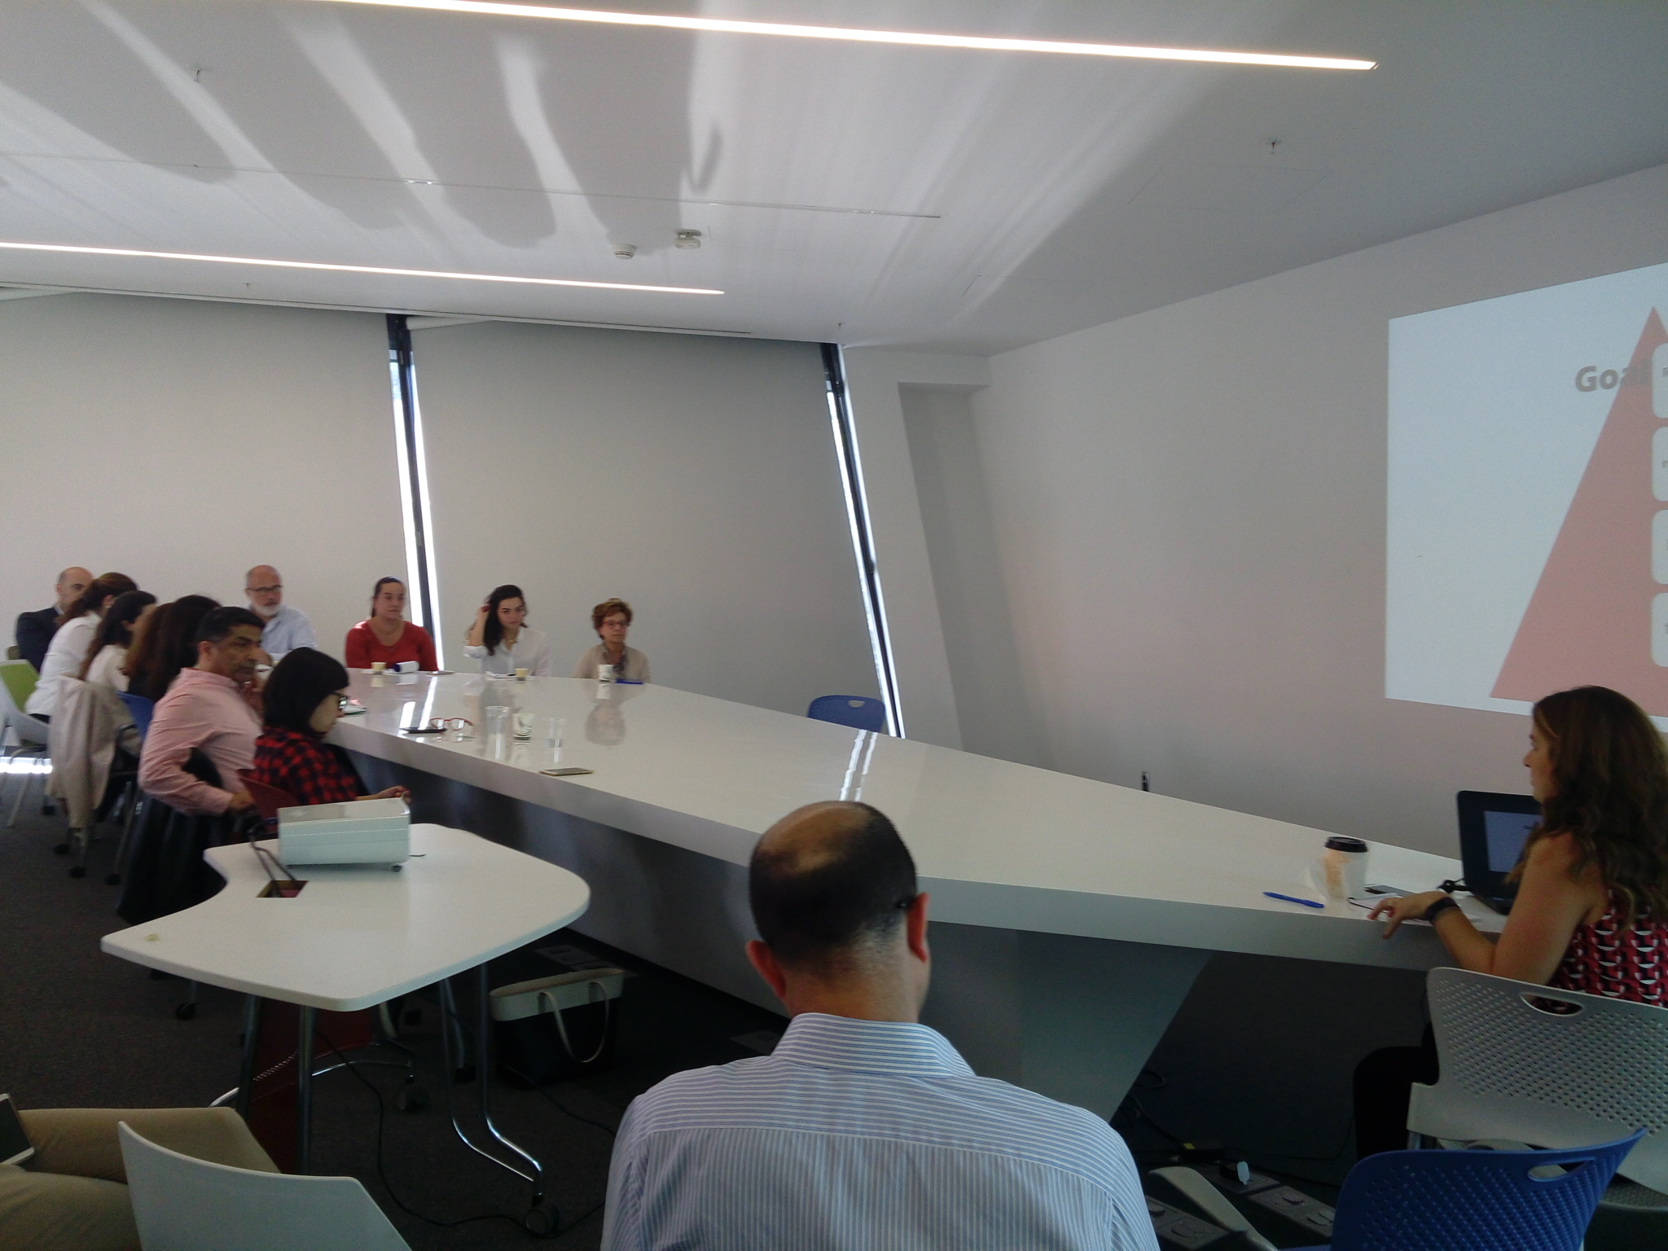
Followed a Participatory-based approach

Slide 49
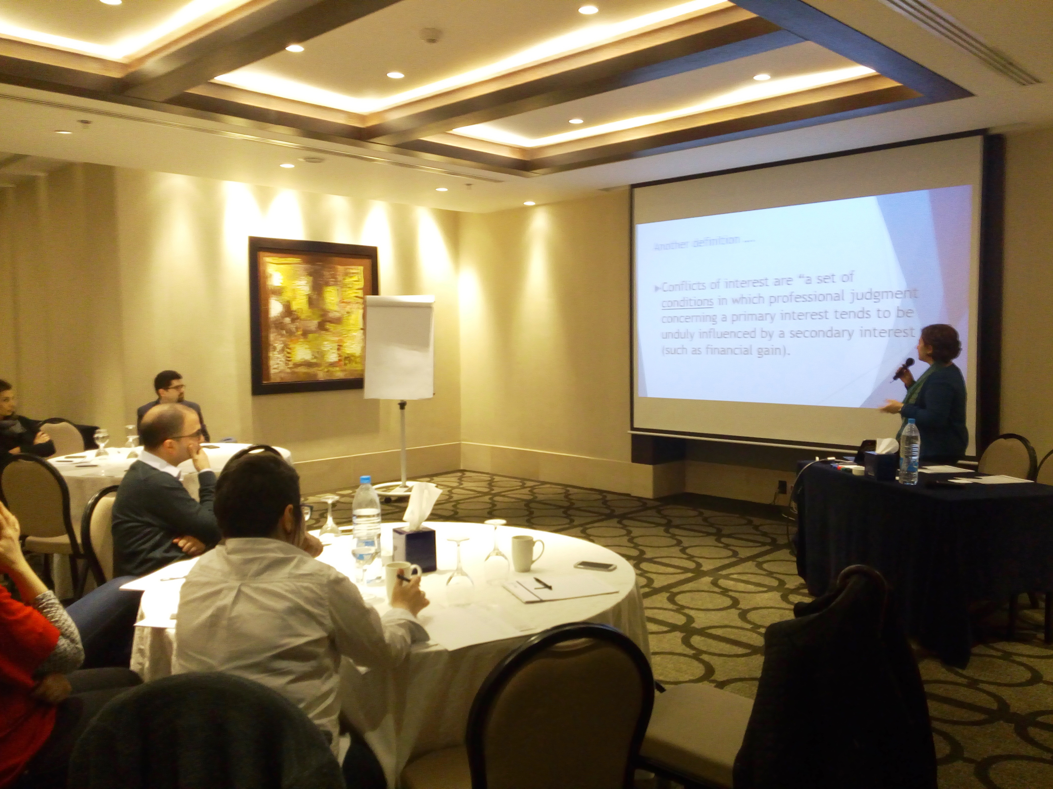
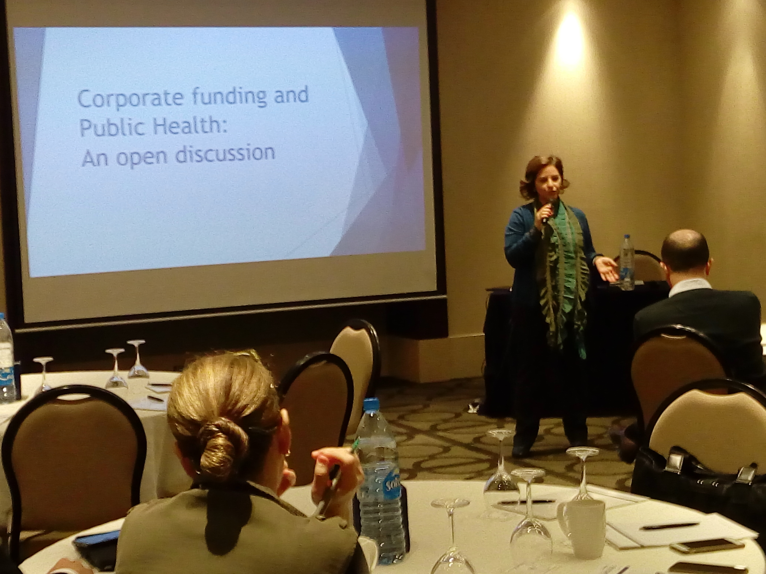
Mobilize allies in the community

Slide 50
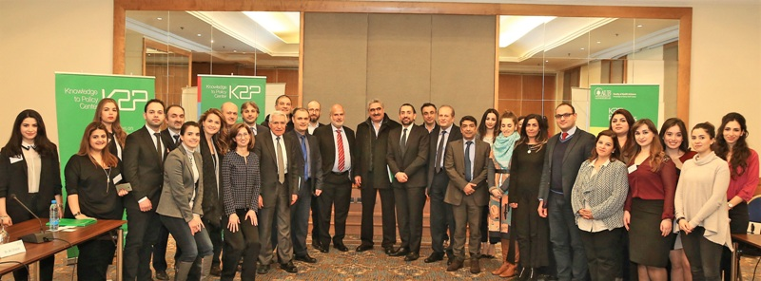
Engage stakeholders
Policy dialogue to sensitize them to the issue of underage drinking and its harms

Slide 51
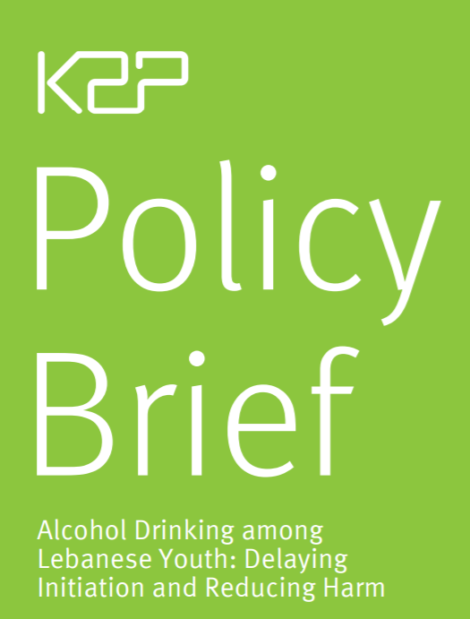
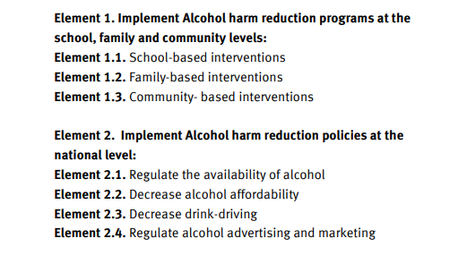
Disseminate as policy briefs
Ghandour L, Nakkash R, Afifi R, Anouti S, Saleh R, Mogharbel S, Jamal D, El-Jardali F, K2P Policy Brief Alcohol Drinking among Lebanese Youth: Delaying Initiation and Reducing Harm, January 2017 https://www.aub.edu.lb/k2p/Documents/K2P_PolicyBrief_Alcohol_English_January_2017.pdf
Notes:
Interventions at the individual and/or family or community levels are among the most common approaches to the prevention and reduction of alcohol-related harms among youth, however they have shown only modest effects (Babor et al., 2010a). Evaluations of these intervention programs conclude that even small positive effects cannot be sustained in the absence of more effective public policy level strategies such as pricing policies, marketing restrictions, law enforcement initiatives, etc. (Cairns et al., 2014). Thus, an effective approach for reducing alcohol-related harms among youth requires a comprehensive alcohol control and harm reduction strategy (Komro & Toomey, 2002; Naimi & Nelson, 2011). We describe below all the approaches demonstrated to be effective as alcohol harm reduction interventions for youth categorized into two elements:

Slide 52
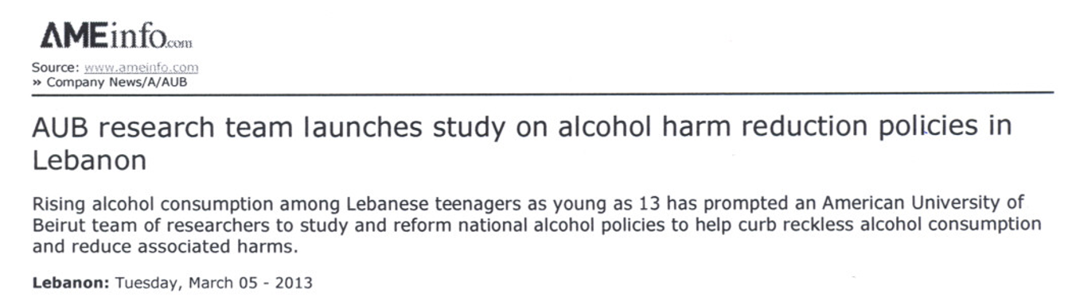

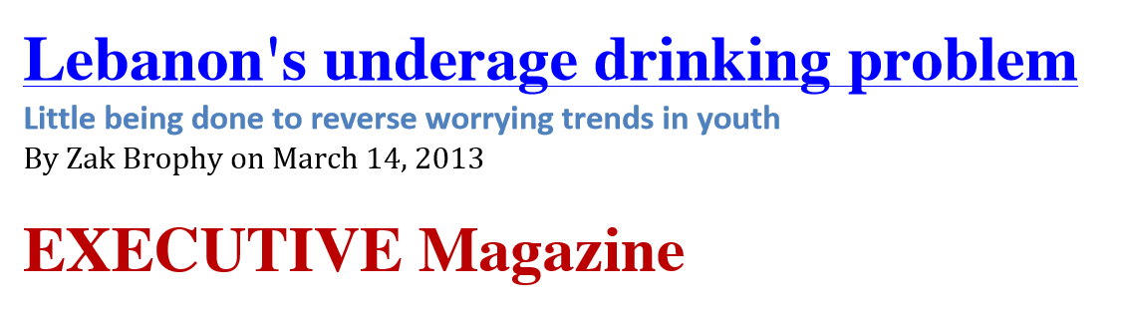
Spark media interest and support
Notes:
Need to disseminate [beyond academic publications]

Slide 53
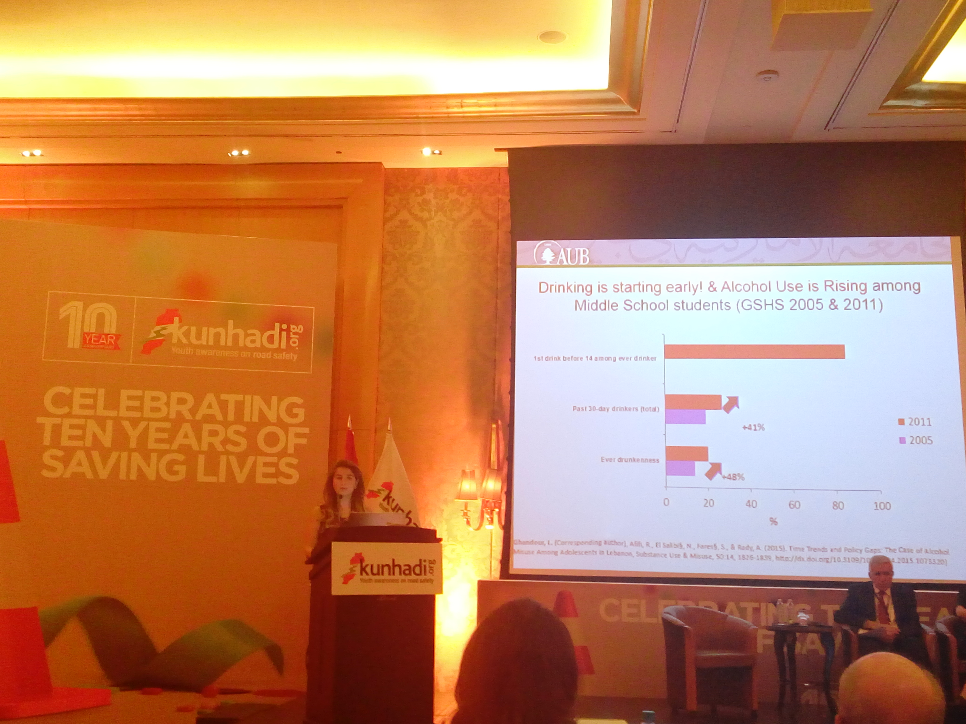
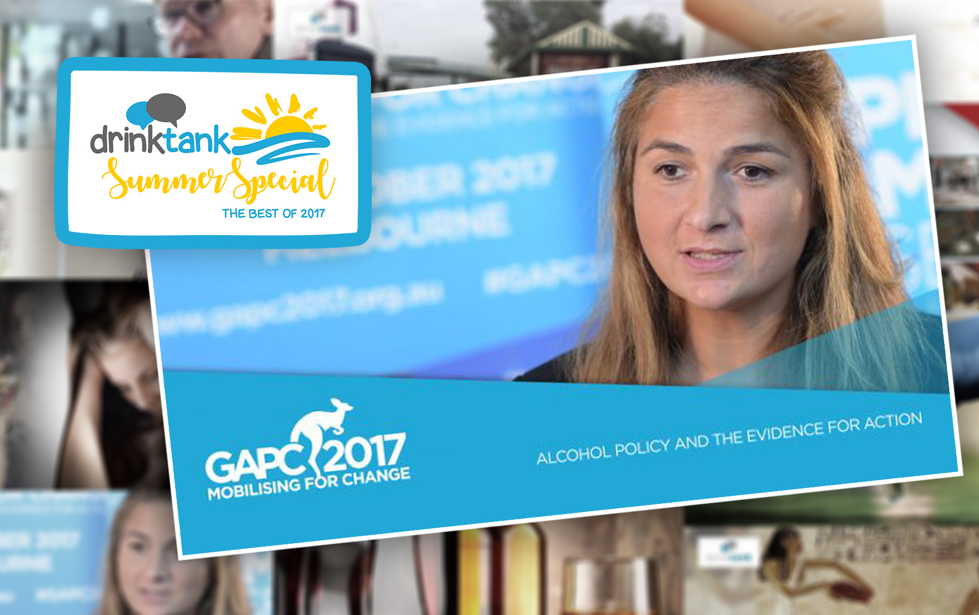
Engage with scholars
Local and international meetings and conferences
Notes:
Need to disseminate [beyond academic publications]

Slide 54

Triangulate data

Slide 55


Slide 56


Slide 57


Slide 58


Slide 59
Opportunities

Slide 60



Slide 61






Slide 62







Slide 63




Global momentum

Slide 64
Major threats/challenges

Slide 65




Notes:
Other competing issues… no government or trust in the government… Covid19 pandemic…

Slide 66
Other challenges
Alcohol industry/distributors lobbying activities, expansion of commercial production and sophisticated marketing campaigns
Alcohol is a sensitive topic BUT socially acceptable substance
Unsustainable research funding [lack of government funding]
Low financial and human resources for proper enforcement and monitoring of regulations and policies

Slide 67
To deliver an integrated range of interventions and policies, a system requires strong structural foundations:
A supportive policy and legal framework;
Scientific evidence and research
Coordination of multiple sectors and levels (national, sub-national and municipal/ local) involved;
Training of policy makers and practitioners; and,
Commitment to provide adequate resources and to sustain the system in the long term
A single prevention intervention that is often isolated and limited in its timeframe and reach does NOT work!
Notes:
One of the members of the Group of Experts on the Prevention Standards, for providing the relevant scientific evidence and technical advice
Prevention research over the past three decades has demonstrated that reductions in problems such as substance use and substance use disorders require comprehensive solutions—a variety of intervention approaches directed to multiple opportunities.
An optimal mix of interventions will fit the particular needs of the community—its population, cultural context, and unique local circumstances, including community readiness
Alcohol-specific school, family and community-level interventions are minimal,
inconsistent and rarely evaluated and are not supported by any policy interventions

Slide 68
More challenges
SDG elements that threaten alcohol policy advances
SDG elements that emphasize “partnerships with the private sector” are being used by leading alcohol producers to push forward their agenda – “project themselves as partners in progress rather than vectors of an industrial epidemic”. (Commentary in the Lancet by Jeff Collin and Sally Casswell, 2016)
Incoherent messages by high level health agencies
At a UN high level meeting on NCDs, NYC Sept 2011—there was no place for tobacco there, but Diageo and Saab Miller were there as part of a Civil Society Delegation -- > possibility of partnerships to reduce burden of NCDs risk factors!!!

Slide 69



Slide 70

Ways forward
Research/DATA:
Set up continuous data monitoring systems
Evaluate adapted programs implemented at the family, school, and individual levels [ensure contextualization]
Improve access to data and data-sharing mechanisms [public/private agencies]
PARTNERSHIPS
Mobilize allies to create a solid sustainable team of advocates
Bring together state agencies, active NGOs, academicians including epidemiologists and basic scientists, activists and others to diversify perspectives to the data-driven planning process
Notes:
Just like the alcohol molecule, a comprehensive effective approach has important “connected” elements

Slide 71


The road is long
Email: lg01@aub.edu.lb
Twitter: @LilianGhandour
Notes:
So it is clear we need to be focused on ALCOHOL given the DATA + lack of POLICY + alcohol industry!! The road is long – but we must not give up…and the fact that there are competing issues makes substance use a more warranted public health problem considering that all these events are stressors highly linked with increased SU and decreased access to care.

