Slide 1
How can employers help employees who have problems with substance use?
Options for proactive approaches
Miriam Komaromy, MD
Medical Director, Grayken Center for Addiction
Boston Medical Center, Boston University
Miriam.Komaromy@bmc.org

Slide 2
Hidden drinking
Ms. D is a patient who I saw recently in our addiction treatment urgent-care clinic. She is married and is the mother of an adolescent son. She works full time as an administrative assistant, and is proud of her work performance. Ms. D reveals that she is having tremendous problems with alcohol use and depression. She drinks alone at night, and hides her drinking from her family. She is consuming increasing quantities of alcohol, and has started to have panic attacks each afternoon. She is afraid to tell her employer about her problem, and does not know where to turn, in order to get help. Another employee was recently “run out of the company” after he developed frequent tardiness and his alcohol use was discovered. She has also considered joining an AA group, but is afraid that someone would recognize her and reveal her secret. I discuss a range of treatment options with Ms. D, but she feels too frightened to take action.
Two weeks later, Ms D is hospitalized in the ICU due to the combined effects of alcohol and benzodiazepine use. After her release, she quits her job in order to avoid being fired.

Slide 3
Receiving support
Ms. D works full time as an administrative assistant, and is proud of her work performance. She is married and is the mother of an adolescent son. For the past year she has been experiencing depression, and drinking heavily when she is alone at night. Frightened by her increasing need to drink, she thinks about where she can get help. Susan, an HR representative at her company, recently provided information to all employees about the availability of treatment for substance use problems. Susan encouraged employees to seek help through their Employee Assistance Program (EAP), and reassured them that the company is committed to working with employees who are struggling with substance use to try to help them return to full functioning. Ms. D decides to call the EAP and ask about services.
One year later, Ms. D is regularly attending peer support groups, and is taking a medication to cut her craving for alcohol and another medication to treat depression. She sees a counselor and an addiction treatment doctor regularly. She receives a promotion for her excellent work performance.

Slide 4

Employer approaches
Crafting policies to address employee substance use disorders (SUDs) is complicated
Consider carefully whether you want to encourage employees to reveal their substance-related problems to their manager or others within the company
  Challenges with maintaining confidentiality
  Potential liability concerns
What are alternatives?

Slide 5

Elements of a proactive employer approach to substance use disorders
Combat stigma
Provide healthcare benefits that include strong coverage for substance use disorders (SUDs)
Create leave policies that encourage employees to get help for SUDs
Educate employees and managers about SUDs
Some industries may need specialized approaches, depending on cultural practices related to substances.

Slide 6
Combat stigma
An essential first step
Shame often prevents people from seeking help with substance use problems
A sustained anti-stigma campaign can help employees to seek help for substance-related problems before they damage their work-performance and health
Important to aim for pervasive change
  Lead from the top of the organization
  Train managers
  Reinforce messages frequently, not just once

Slide 7
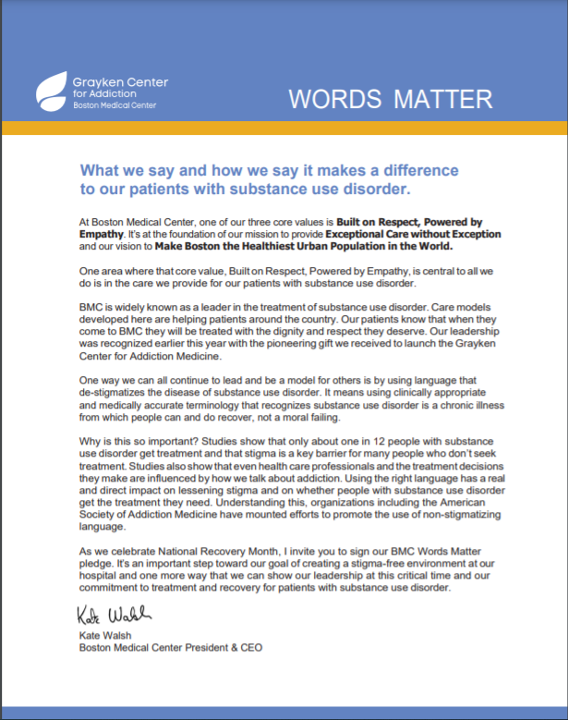
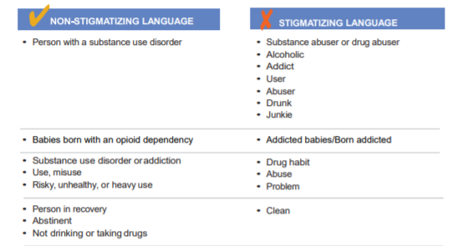
“Words Matter” Pledge

Slide 8

Employer approaches
Provide healthcare benefits that include strong coverage for substance use disorders (SUDs)
  Offered through an Employee Assistance Program (EAP)
  Offered as part of health insurance benefits
Create leave policies that encourage employees to get help for SUDs
Some industries may need specialized approaches, depending on cultural practices related to substances.
  Car dealerships
  Truckers
  Restaurant workers
  “Happy Hour”

Slide 9

Employer approaches
Educate employees and managers about SUDs
  Healthy and unhealthy levels of use
  Prevalence
  Impact on health
  Effectiveness of treatment
  Treatment options
  Availability of treatment through an EAP or insurance benefit (40% of employees are unaware of available benefits) ¹
1. Agovino, HR Magazine, August 2021

Slide 10
Conclusion
Employers can play a big role in encouraging employees to address excessive substance use
An anti-stigma campaign can combat shame and open the door to treatment
Other important steps include
  Ensuring that there is parity in treatment benefits for SUDs
  Making sure employees know about available benefits
  Clarifying that leave time can be used for SUD treatment
  Providing education about SUDs and treatment
  Examine your work environment and address any factors that promote substance use

