Slide 1

Substance use among adolescents: Risk & Protective Factors
Bilal Ahmad, SPYM, Delhi, India

Slide 2
ABOUT SPYM
A registered Civil Society Organisation since 1986, working in the field of health and socio-economic development with countrywide presence for more than three decades.
Serving adults, juveniles, children, and women with substance use disorders (SUD) since its inception in 1986.

Slide 3
Scenario of drug use among children, adolescents

Slide 4
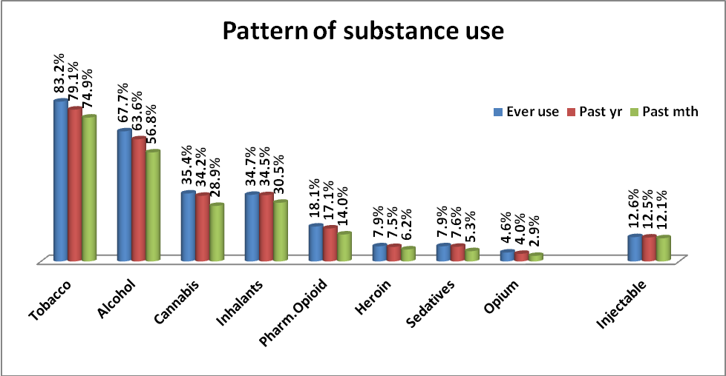
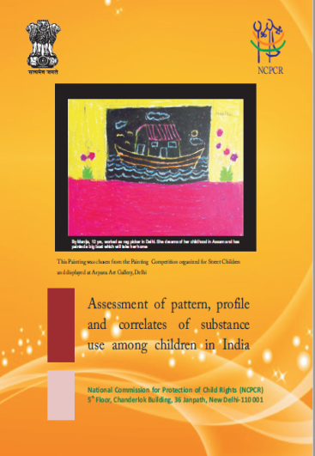
NCPCR Study (2013)

Slide 5
Average age at initiation of substance use
The street children initiated substances 1-1.5 years earlier

Slide 6
Stressful events
 | School going | Out of school | Street child
Anything difficult, stressful, bad happened in life | 54.9% | 58.0% | 62.6%
Ever been sick, injured - needed to go to hospital | 35.0% | 44.0% | 53.1%
Someone close died | 39.2% | 47.6% | 46.7%
Been in a situation where feared losing life / harmed | 27.0% | 32.9% | 40.9%
Ever lived in environment - conflict area | 16.7% | 14.0% | 18.7%
Ever faced violence from police/ community | 19.6% | 36.2% | 55.1%

Slide 7
 | School going | Out of school | Street child
Drug use by family member | 51.6% | 60.1% | 55.2%
Family fights | 36.2% | 50.1% | 51.9%
Beaten and abused by family | 33.9% | 49.7% | 49.5%

Slide 8
Associated Problems
 | School going | Out of school | Street child
Experienced intoxication | 53.7% | 53.0% | 40.3%
Got into fights under effect | 34.5% | 46.7% | 51.5%
Sexual behaviour under effect | 15.4% | 19.6% | 28.7%
Sexual behaviour for drugs/money | 18.6% | 16.1% | 20.0%
Experienced physical problems | 42.6% | 50.2% | 49.7%
Experienced sadness/anxiety | 44.2% | 52.8% | 50.8%
Got into legal problems | 32.0% | 39.9% | 53.8%

Slide 9
National Survey On extent and Pattern of Substance Use in India – 2017-18

Slide 10
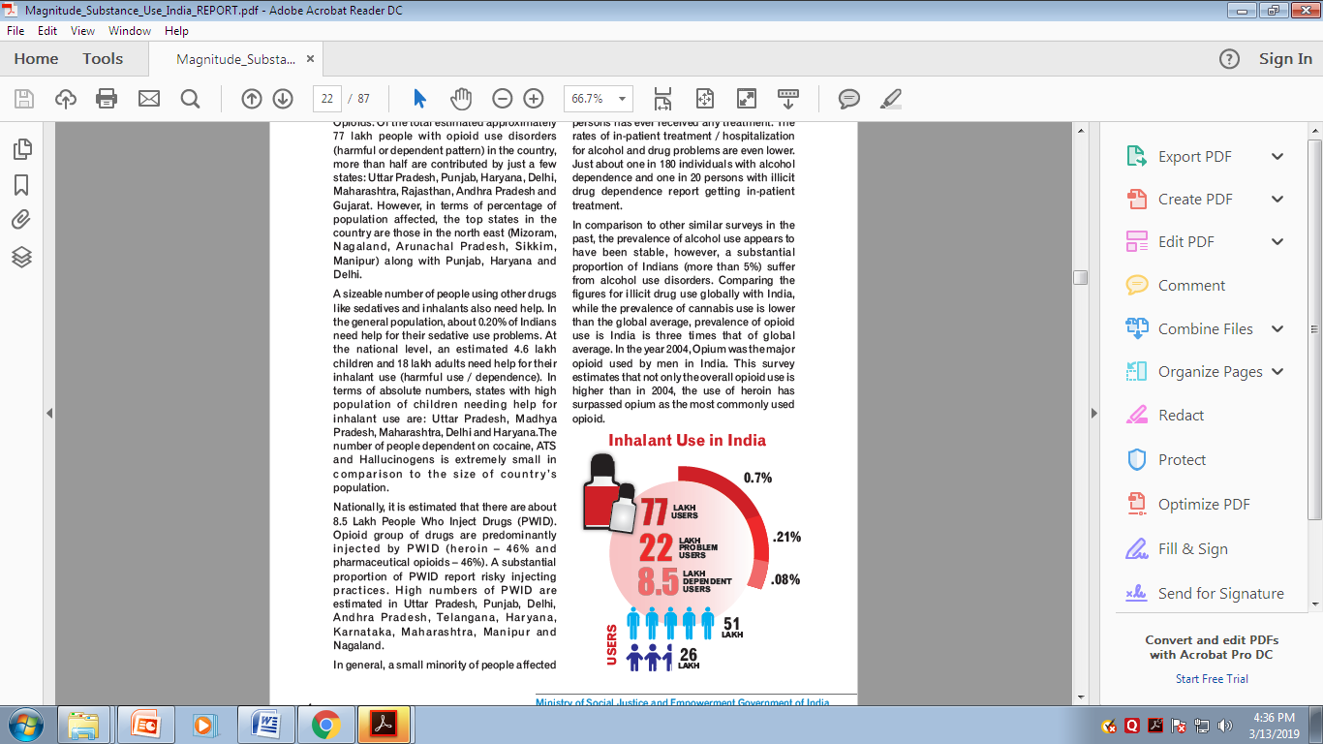

Slide 11
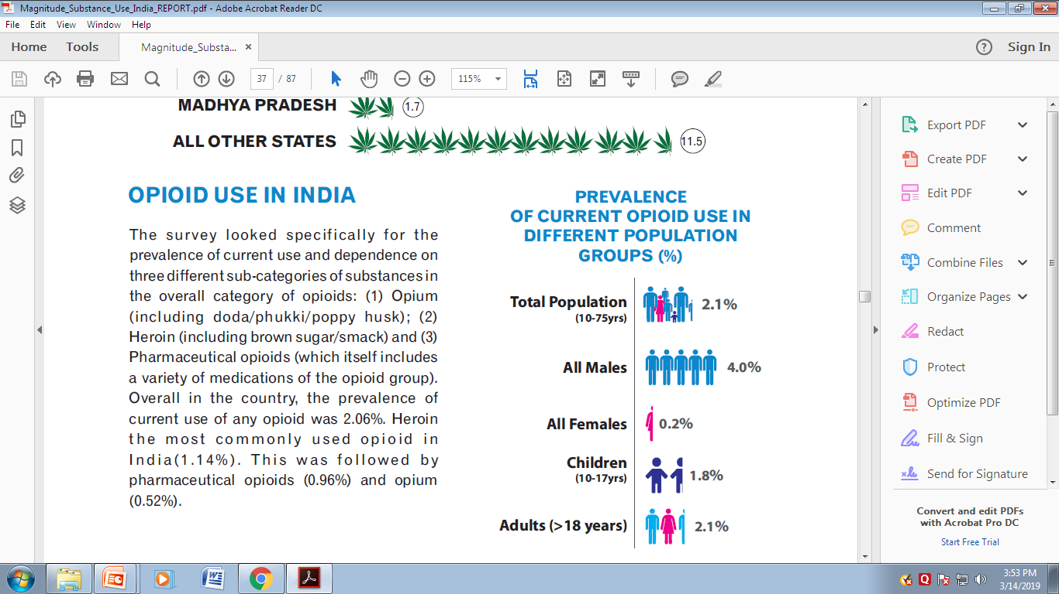

Slide 12
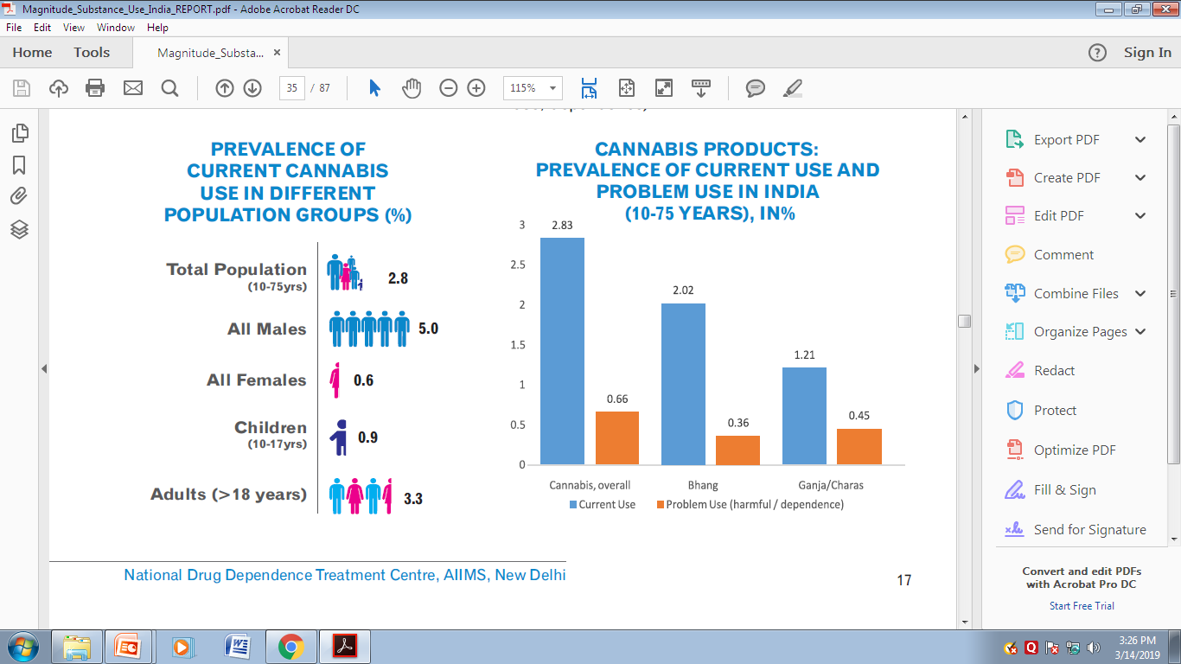

Slide 13
Drug use among adolescents
Differences between adults and adolescents
lower problem recognition
higher rates of binge use
higher rates of co morbid mental health problems often not addressed timely
more likely to be susceptible to peer influence
Lack of Treatment options tailored to their specific psychological, developmental, and social needs
(Winters et al, 2011)

Slide 14
Risk Factors
INDIVIDUAL
Biological factors
Favourable attitudes toward alcohol/ drugs
SCHOOL/ PEERS
Parental history of alcohol/ drug use
Family management problems – poor monitoring, inconsistent discipline
Family conflict
Early aggressive behaviour/ anti-social behaviour
Alienation and rebelliousness
Temperamental traits (sensation seeking, impulsivity)
FAMILY
Peers with anti-social behaviour
Substance using peers
Favourable parental attitude
Academic failure including in elementary school
Low commitment to school/ expectations for achievement
COMMUNITY
Laws and norms favorable
Easy availability
Media portrayals
Economic deprivation
Neighborhoods lacking service organisations

Slide 15
Protective factors
INDIVIDUAL
Higher attachment with family
Involvement in family activities
COMMUNITY
Pro-social involvement and recognition
Better Social skills
Better life skills
FAMILY
Access to information and knowledge
Access to community services / resources
Family supervision

Slide 16
Key Challenges- treatment seeking behavior
Adolescents often do not seek help in drug treatment settings
Alcohol/drug use not perceived as a major problem
Family often unaware of drug use among their children
Lack of drug treatment centres for adolescents
Lack of knowledge about availability of services
Services not adolescent friendly
Perceived lack of privacy or confidentiality

Slide 17
National Adolescent Health Program - launched in 2014 by the Ministry of Health & Family Welfare, Government of India
Objectives:
Improve Nutrition
Improve Sexual and Reproductive Health
Enhance Mental Health
Prevent Injuries and violence
Prevent substance misuse

Slide 18
Substance use intervention in school settings
Ministry of Social Justice & Empowerment, GOI assigned SPYM to develop modules for school children on drug demand reduction. These modules will be implemented in schools across the country
Easy to access children in school settings and possible to provide preventive interventions for early identification
School teachers and counselors being trained in conducting screening and brief intervention under the project .

Slide 19
Other SPYM’s POLICY & ADVOCACY EFFORTS
Advocated and contributed in the development of National Action Plan on Drug Demand Reduction in 2018-19 with new components of setting up special treatment and rehabilitation program for women and children in all the provinces of India.
Based on the model of community peer-led intervention by SPYM the Ministry of Social Justice and Empowerment, Govt. of India has adapted the program and scaled up the same across 180 districts in India.

Slide 20
Thank you

