Slide 1

The Humphrey Fellowship Program
Presentation at ISSUP
26 June 2024
Robert L. Balster, Virginia Commonwealth University
Hala Najm, ISSUP
Olajumoke Koyejo, Federal Neuropsychiatric Hospital Yaba

Slide 2
Conflicts of Interest
Robert Balster receives a salary from VCU for his work with the Humphrey Fellowship Program
Hala Najm and Olajumoke Koyejo have no conflicts to declare

Slide 3
What is the Humphrey Fellowship Program
Non-degree, 10.5-month leadership development program for mid-career professionals
  45th Anniversay
13 US campuses host the programs covering a wide range of development areas
  In 2023-24 there were 148 Fellows in the U.S.
  VCU Program focuses on Substance Abuse Prevention, Treatment and Policy, and Public Health more generally
Funded by the U.S. State Department (one of the Fulbright Programs) and administered by the Institute of International Education (IIE)

Slide 4
VCU Humphrey Program
Began in 2006-2007, taking over from Johns Hopkins University which hosted Substance Abuse Fellows for many years
Typically 8-12 Fellows per year
180 VCU alumni from 72 countries
About 25 attending ISSUP this year

Slide 5
Program Elements
Short-term and long-term Professional Affiliations
Graduate level coursework
Field trips
Networking
Cultural exchange
Meetings with national Humphrey Program
  Global Leadership Forum

Slide 6
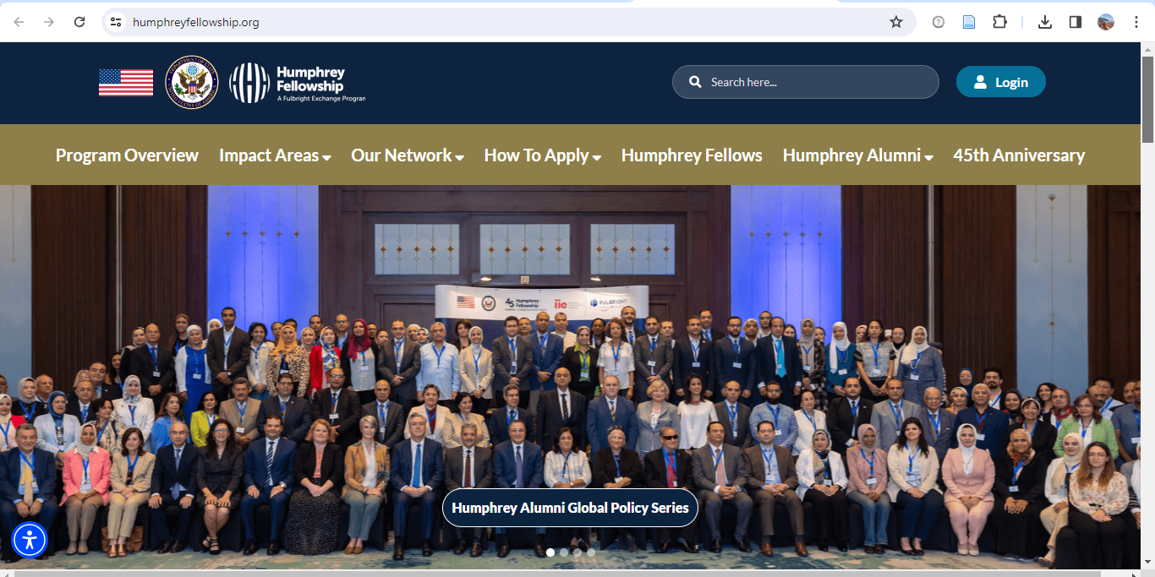
Home screen for the Humphrey Fellowship https://www.humphreyfellowship.org/

Slide 7
Key Eligibility Criteria
Resides in a Lower- or Middle-Income Country
Proven or potential for leadership
Commitment to service in the public or private sector
Limited prior experience in the United States
Bachelor’s degree or higher
5 years of full-time experience in their professional field
Be at a point in their careers to fully benefit from this mid-career, non-degree program

Slide 8
Timelines
Program starts in August each year, end in June
Fellows typically notified of acceptance in April/May
Application deadlines vary by country, but typically are about a year before you would begin
Contact the U.S. Embassy (Public Affairs Section) or Binational Fulbright Commission in your country

Slide 9
What the Fellowship Program Includes
Payment of tuition and fees at the assigned host university
Pre-academic English language training, if required
A maintenance (living) allowance, including a one-time settling in allowance
Accident and sickness coverage
A book allowance
A one-time computer subsidy
Air travel (to and from the home country to the U.S. and within the U.S. to required program events)
A Professional Development allowance for professional activities such as field trips, professional visits, conferences

Slide 10
Alumni Stories
Hala Najm, 2022-2023 Fellow
Olajumoke Koyejo, 2016-2017 Fellow

Slide 11
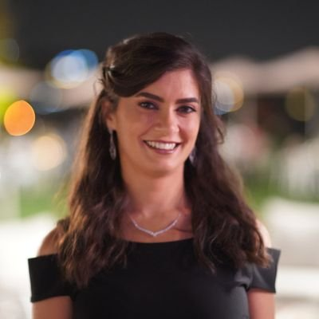
Hala Najm
VCU Humphrey Fellow
2022-2023 from Lebanon
Scientific Support Coordinator, International Society of Substance Use Professionals (ISSUP)
Programs Manger for Research with the International Consortium of Universities for Drug Demand Reduction (ICUDDR)

Slide 12


Topics I’ll cover
The Beginning of the Journey
The Story Unfolds
Lessons Learned and Memories Made

Slide 13

The Beginning of the Journey…

Slide 14
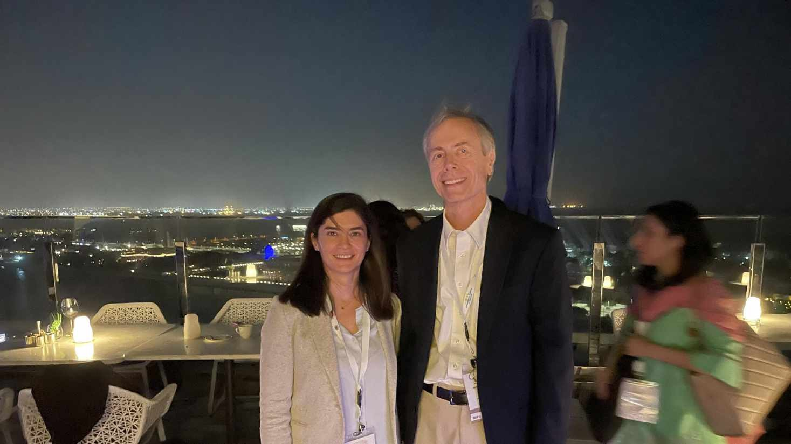

Slide 15
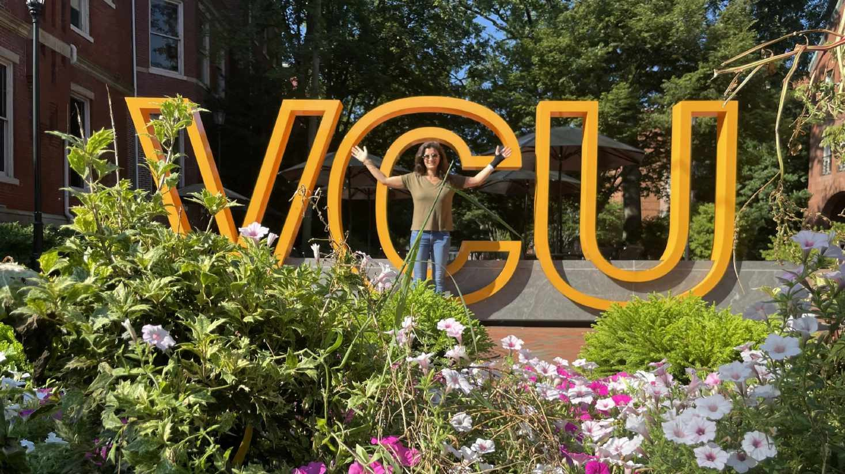

Slide 16
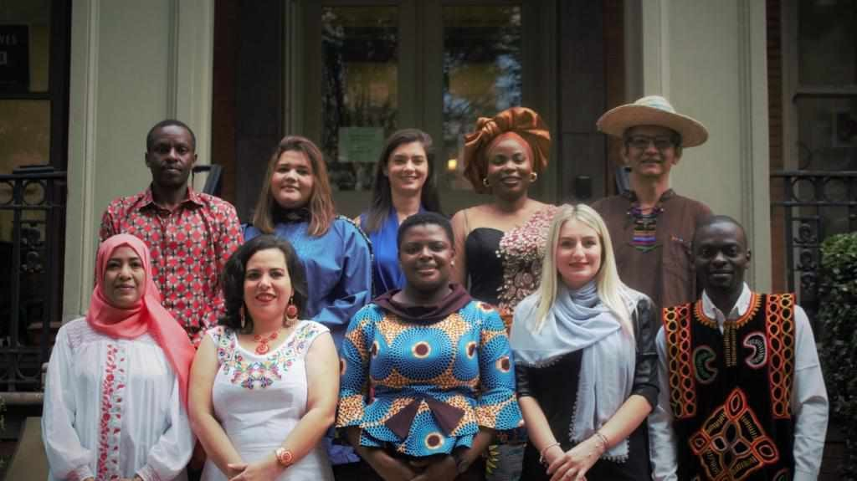

Slide 17

The Journey Unfolds…

Slide 18

Back to the basics…

Slide 19
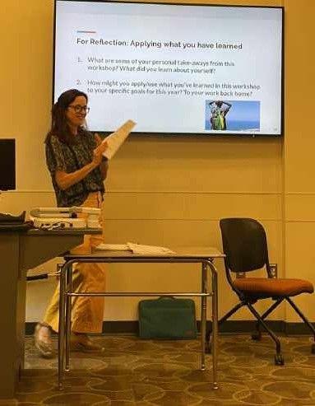
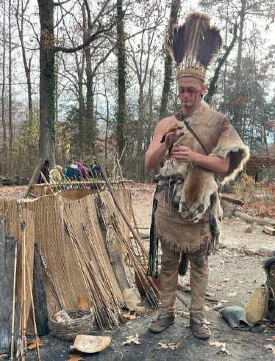
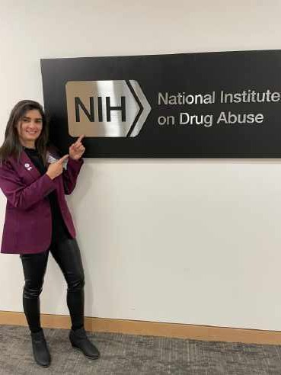
Seminars, Courses, & Fieldtrips
Maryland

Slide 20
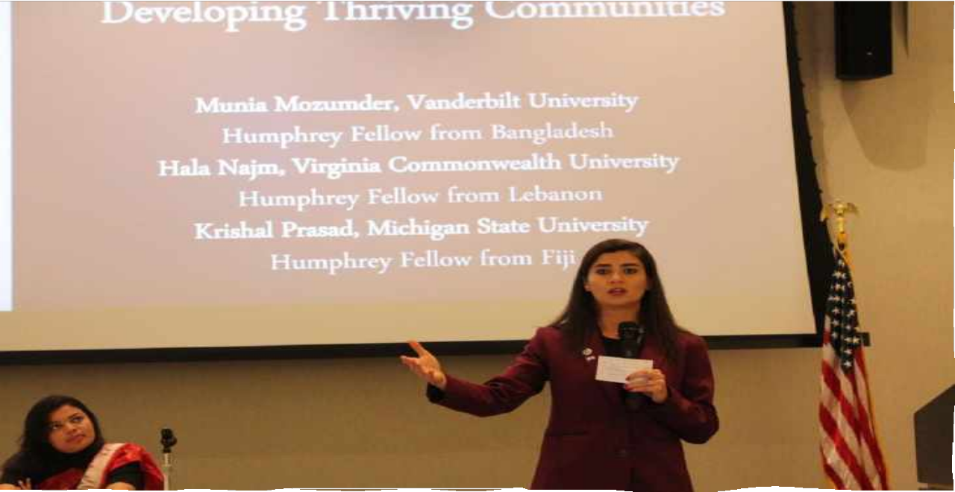
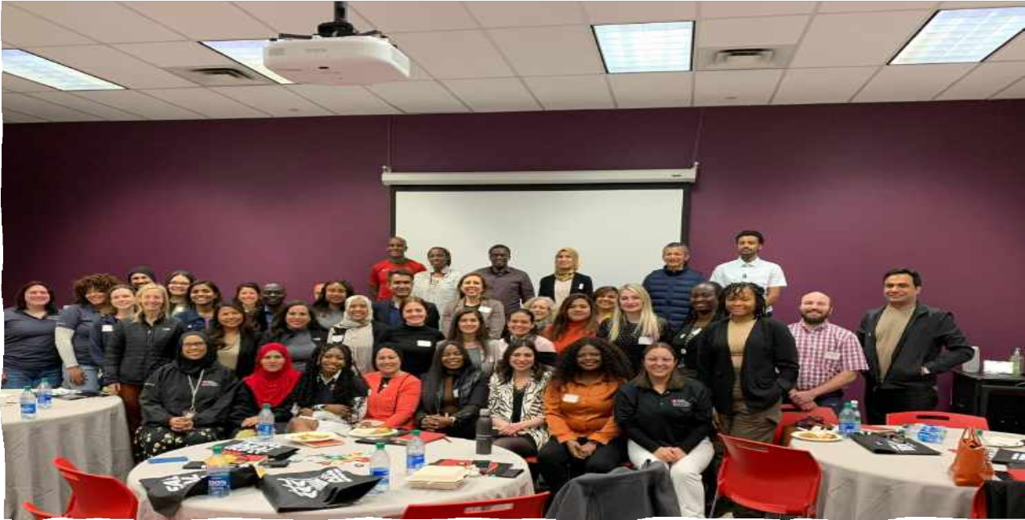
Global leadership Forum & Workshops
Washington D.C.
Philadelphia, Pennsylvania

Slide 21

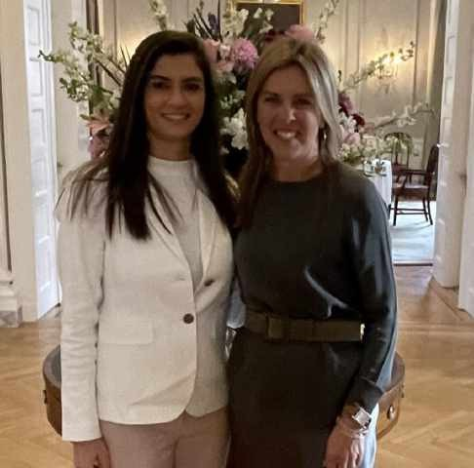

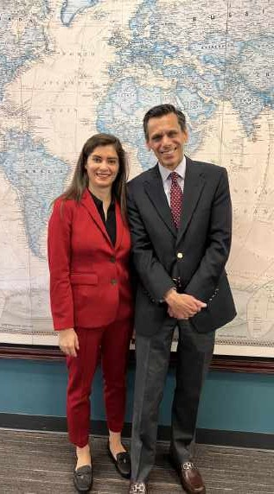

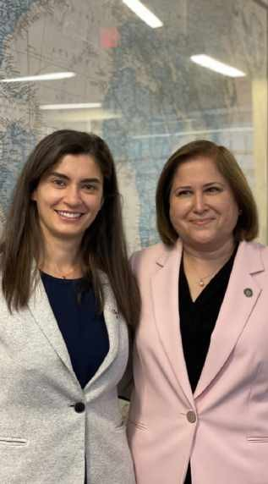
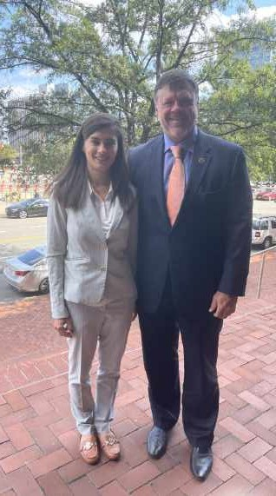
State Senators
First Lady of Virginia
President of VCU
Networking Opportunities

Slide 22
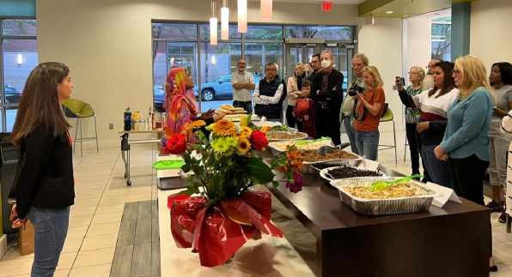


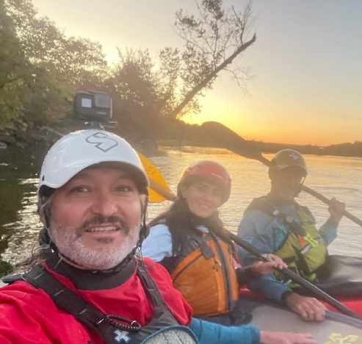

Cultural Exchange Activities

Slide 23

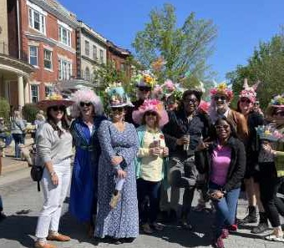

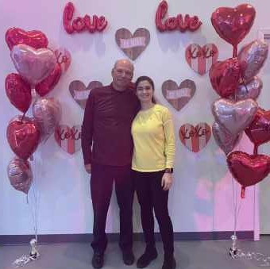
Cultural Exchange Activities

Slide 24
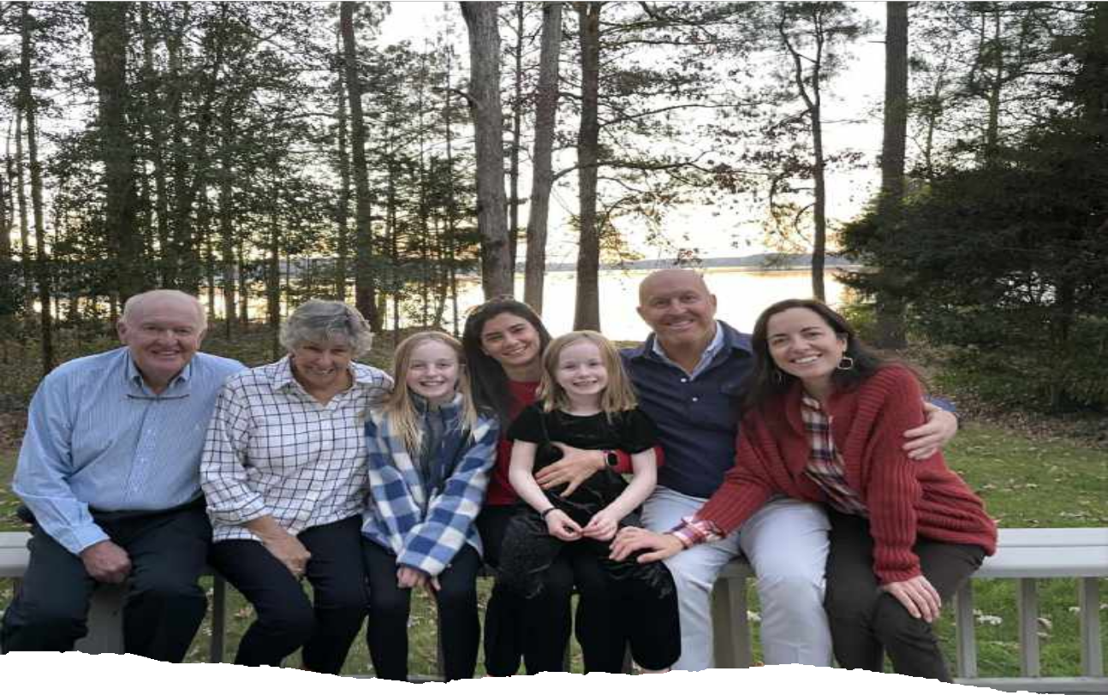
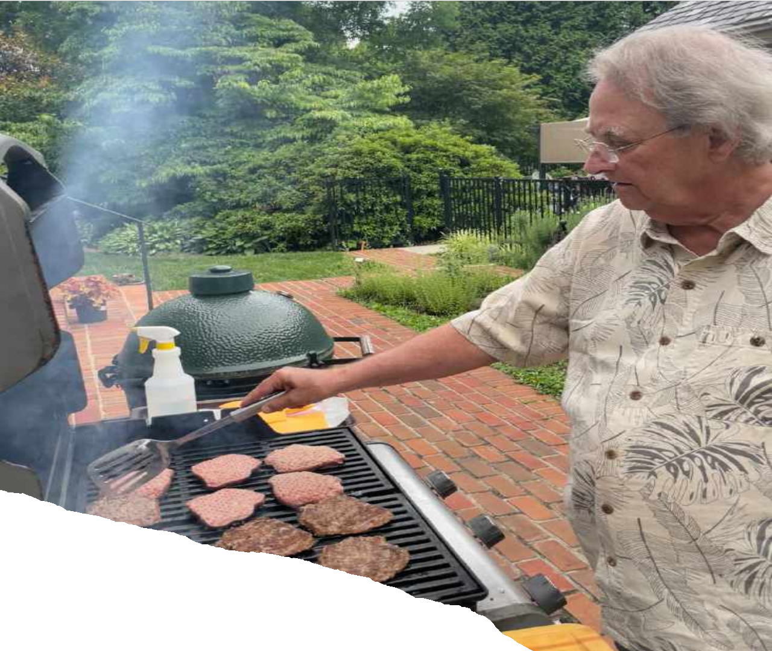
Cultural Exchange Activities

Slide 25
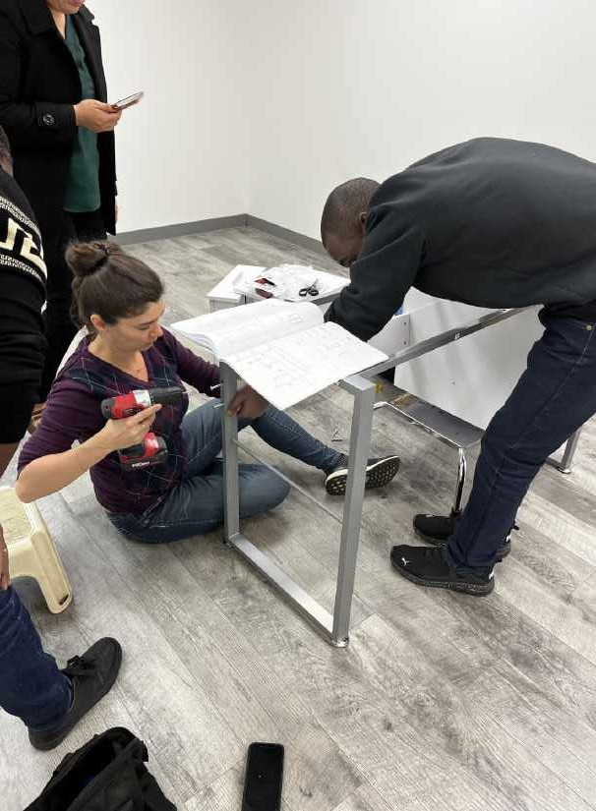

Volunteering

Slide 26
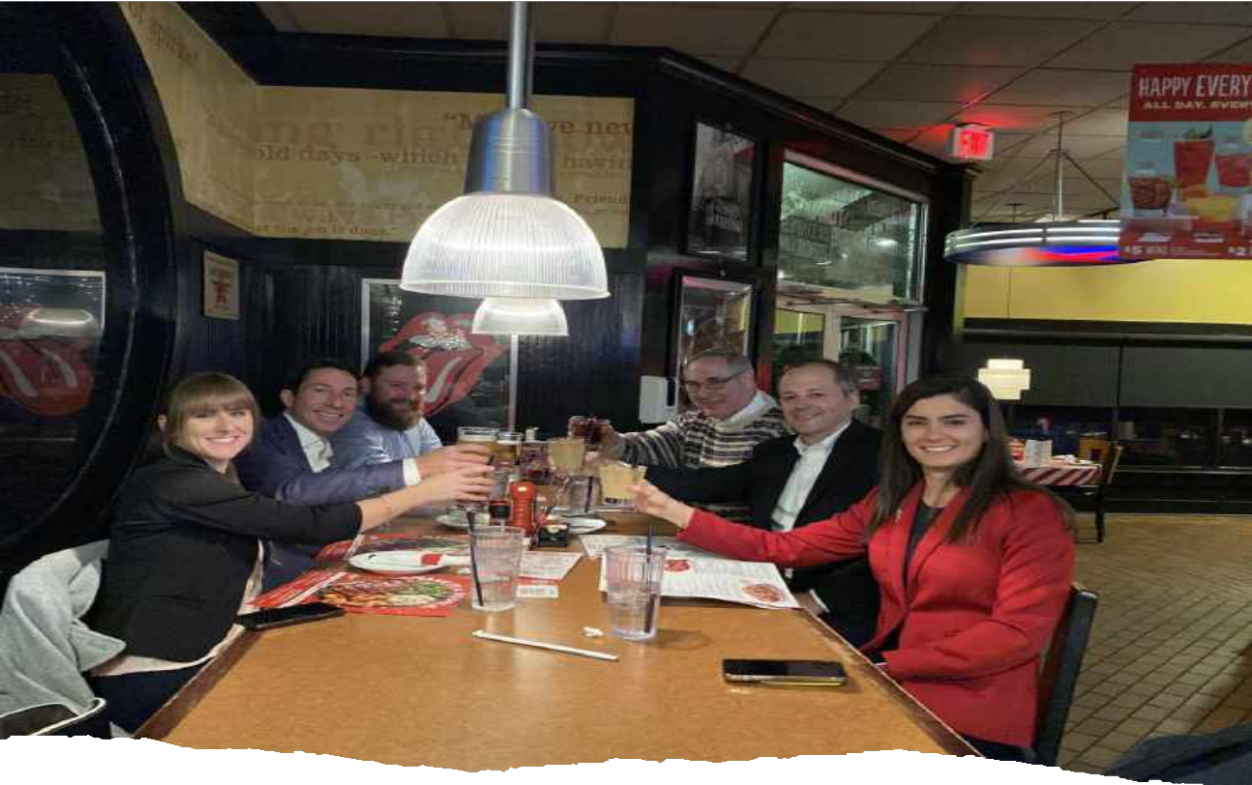
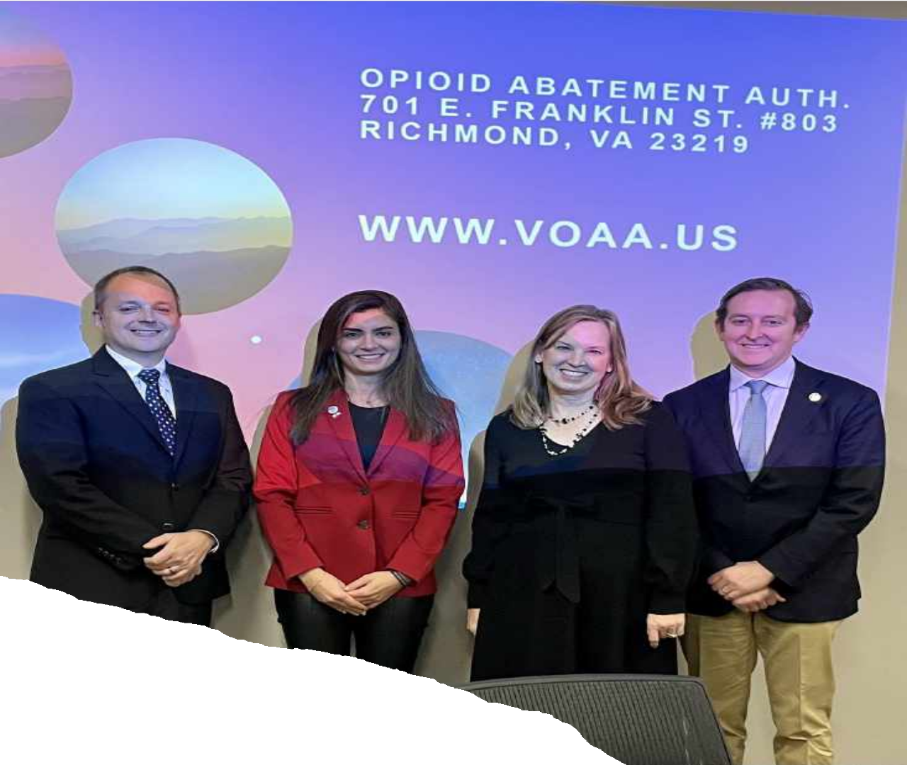
Professional Affiliation

Slide 27

Lessons Learned and Memories Made!

Slide 28


Slide 29
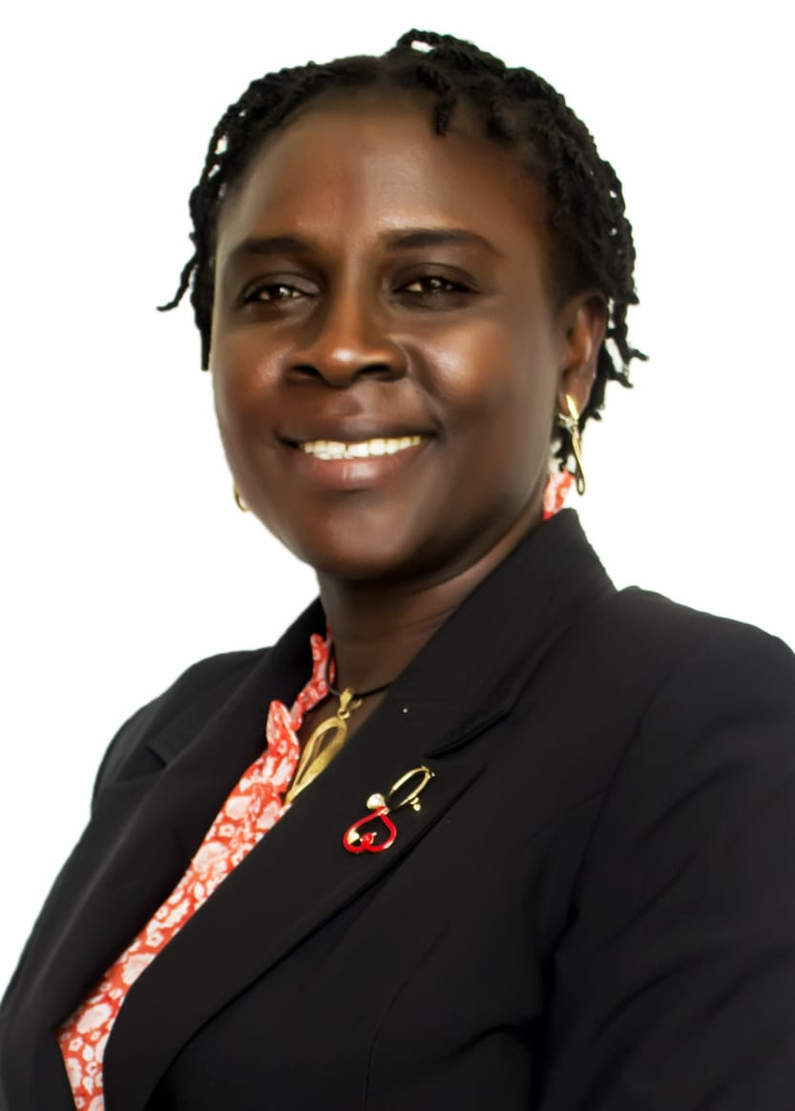
Hubert H. Humphrey
Fellowship:
The Icing on my Cake
Dr. Olajumoke Koyejo,
Consultant Addiction Psychiatrist,
Colombo Plan DAP Coordinator,
Humphrey Alumnus 2016 - 17
Federal Neuropsychiatrist Hospital,
Yaba, Lagos

Slide 30
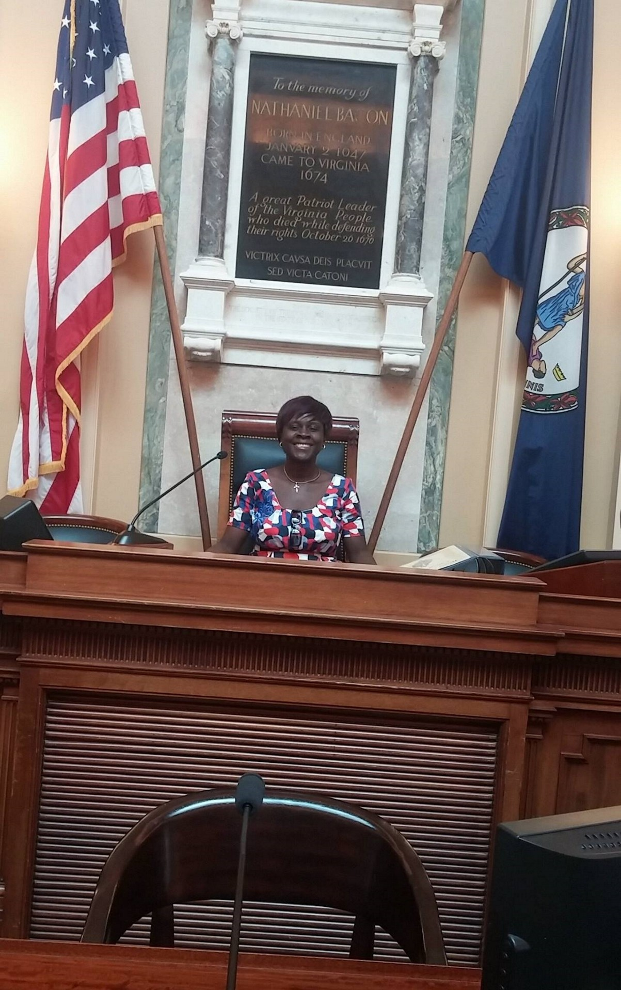
Bringing out the leader in me…..
The Virginia State Capitol

Slide 31
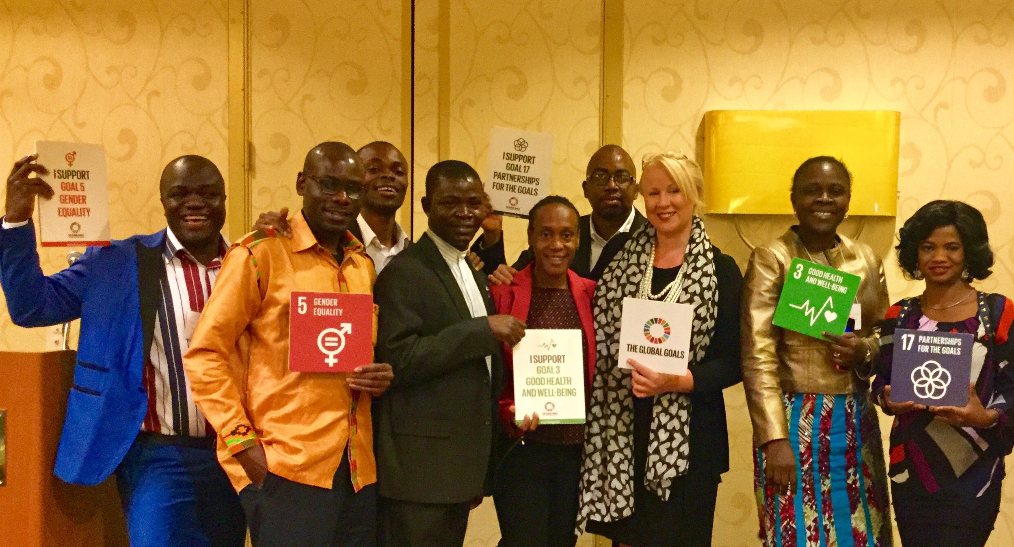
The spirit of collaboration
Global Leadership Forum
Picture with State Department Rep and African Fellows
10/26/2016

Slide 32

Outcome in Nigeria
Colombo Plan Drug Advisory Program was introduced to Nigeria to conduct TOT for all basic level UTC curriculum.
Grant from IIE / HHE to conduct:
TOT on the CHILD. 2020
TOT on the advanced level UTC. 2023
723 professionals have been trained in the basic level UTC
48 CHILD Professionals
71 URC professionals
45 professionals have been trained in the advanced level UTC.
And many more ........................

