Slide 1


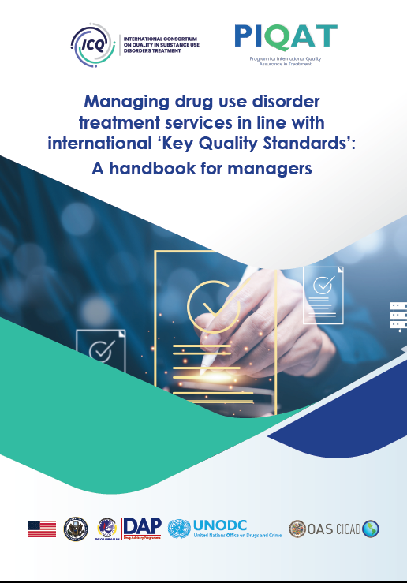
Managing drug use disorder treatment services in line with international ‘Key Quality Standards’: A handbook for managers.
Annette Dale

Slide 2
Overview
Why did we develop the “Management handbook”
Background: International guidelines and the ‘Key Quality Standards’
What – a brief overview of content
With power comes responsibility
Voluntary consortium of people from around the world

Slide 3
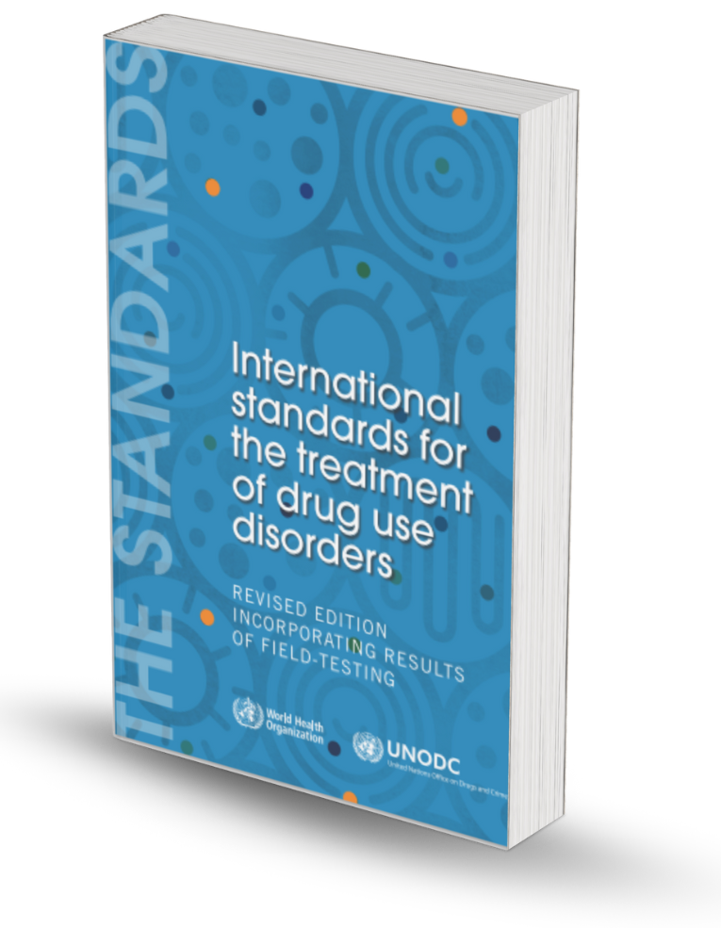
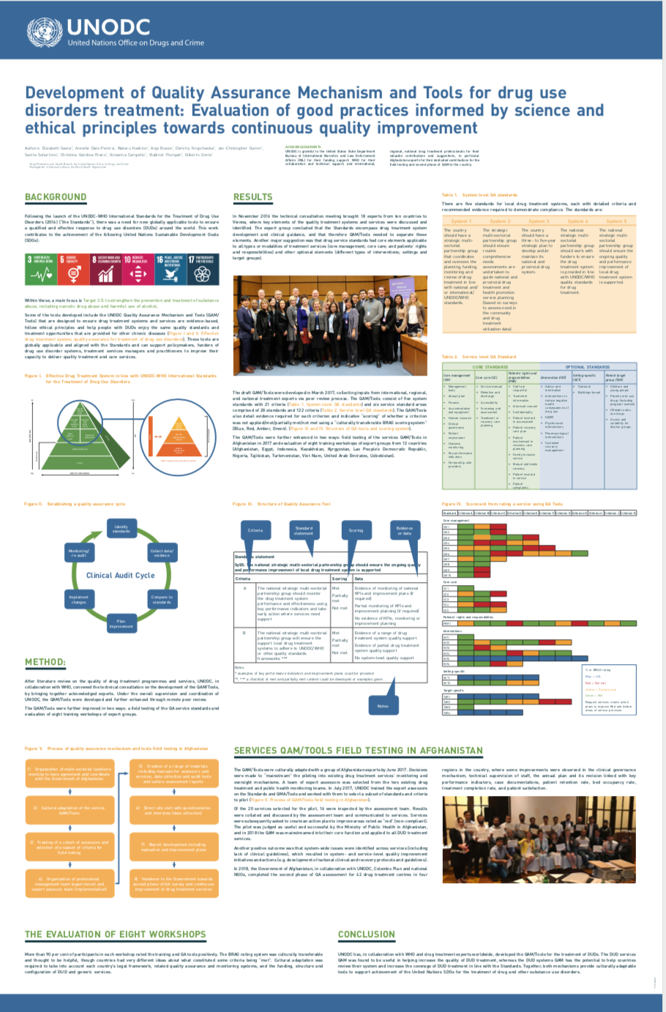
The QA backstory
Decades of international work on QA in substance use disorder treatment by international agencies. Including:
WHO and UNODC “International Standards for the Treatment of Drug Use Disorders” (WHO/UNODC 2020) and the UNODC QA Toolkits for Services and Systems with training and technical assistance countries
European Union “Minimum Quality Standards in Drug Demand Reduction EQUS, Minimum Quality Standards in Drug Demand Reduction in the European Union”, FENIQS-EU project
COPOLAD/CICAD programmes of quality assurance work in Latin America and the Caribbean – in partnership with the European Union
The African Union: African Continental Minimum Quality Standards for Drug Treatment.
Also – significant on standards and quality assurance by
Many countries around the work
Quality Assurance organizations
Voluntary consortium of people from around the world

Slide 4
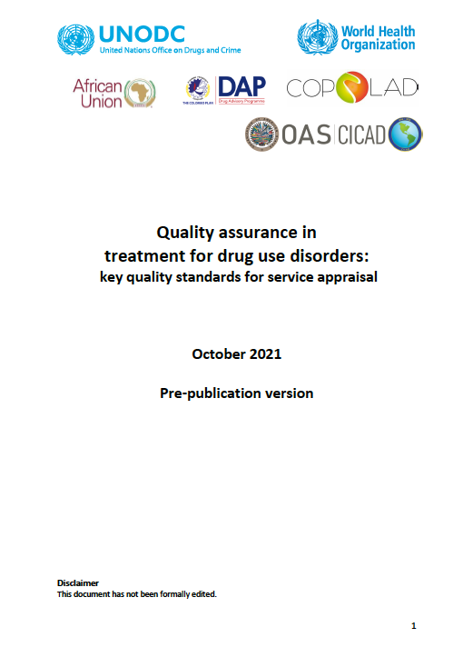
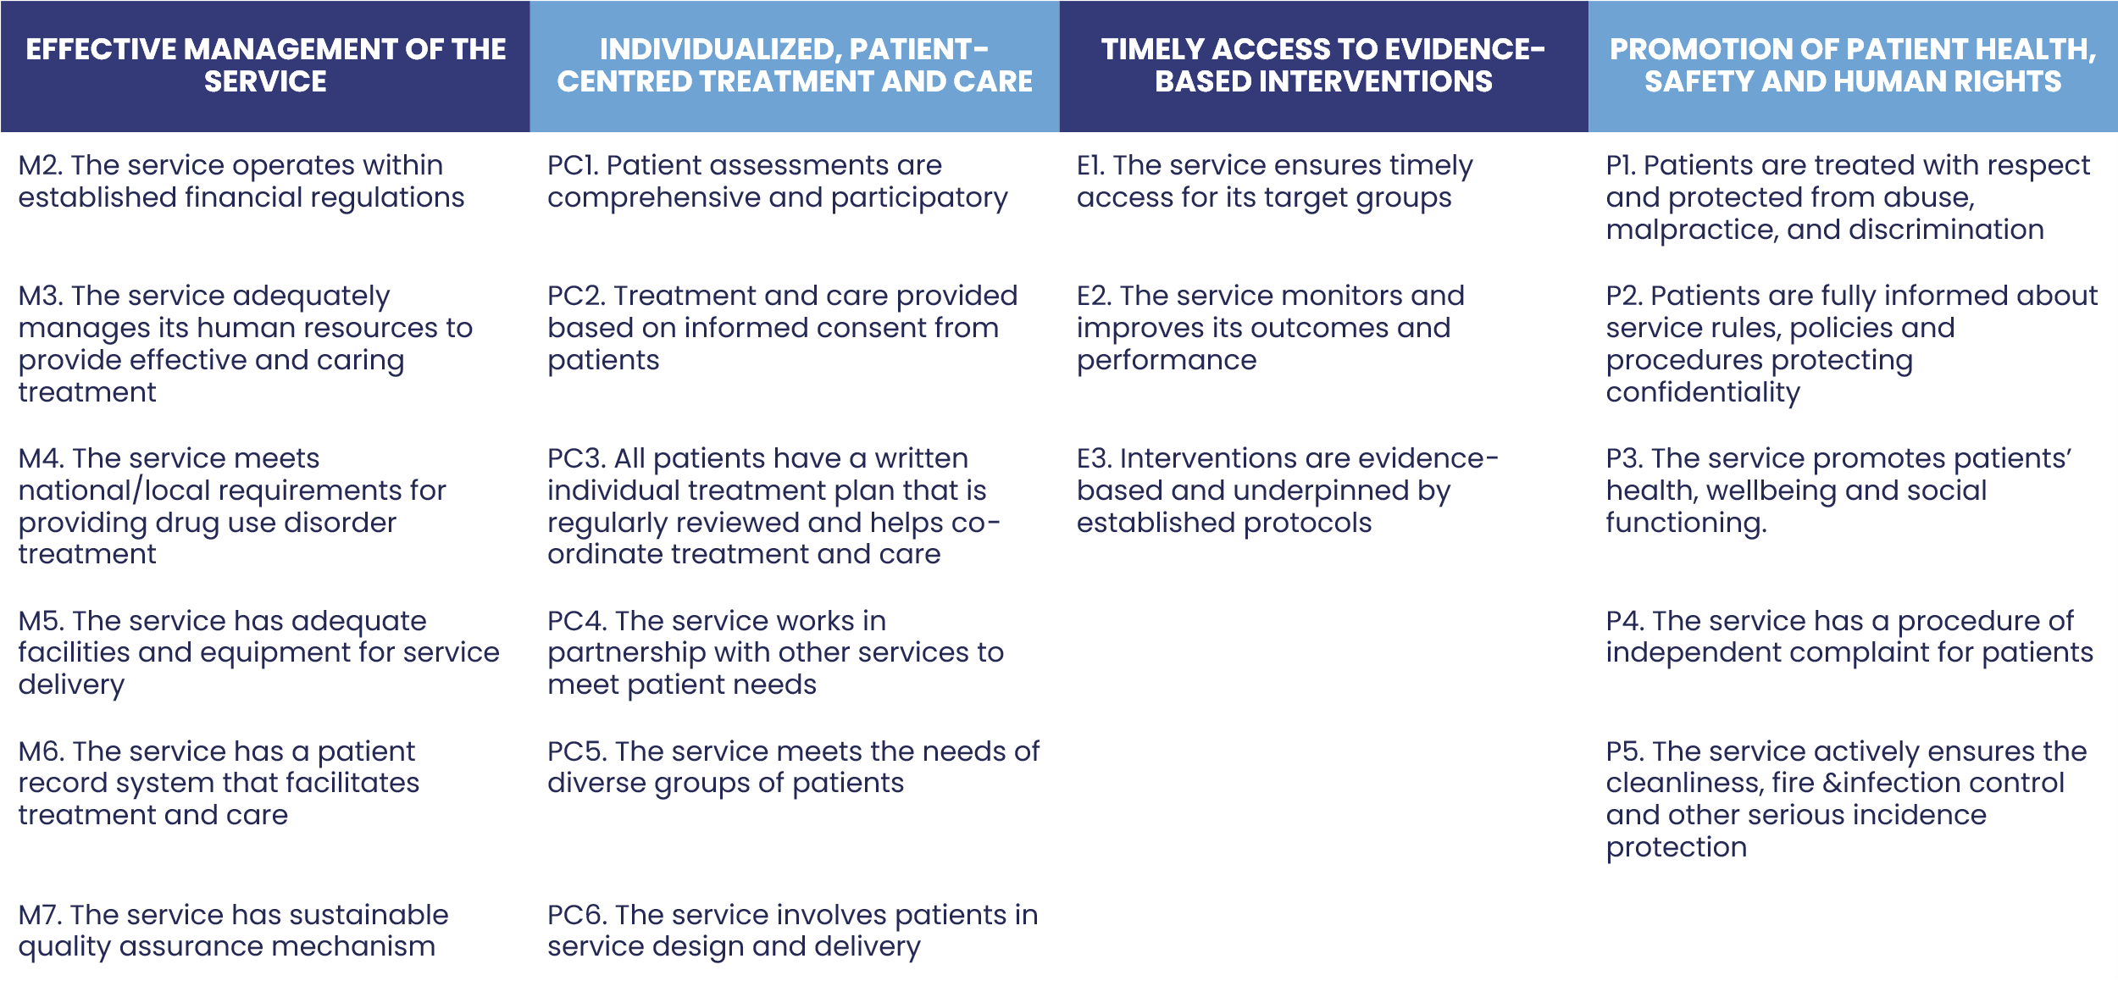
Key Quality Standards 2021
(22 Standards, 59 Criteria)
2020/21 exercise to gain consensus amongst the International Organizations to agree what is the ‘smaller set’ of most important SUD treatment service quality standards. Resulted in the ‘Key Quality Standards’
Voluntary consortium of people from around the world
One of the core documents to ICQ.

Slide 5


Why develop a management handbook?
Variability in requirements for managers and leaders to have ‘qualifications’ or experience in management – especially clinical leaders.
Treatment for drug use disorders is cost effective and has positive impact on individuals and communities IF it is evidence-based and good quality
A range of excellent international standards and guidelines on SUD treatment.
A lack of international guidance/ written specifically for SUD treatment service leaders on how to manage this important type of service
A dedication:
Mr Peter Child – Enhancing drug treatment services: a management handbook for quality and effectiveness: P. Child and A. Dale (1997) SCODA, London
Thank you
    Dr Mariano Montenegro for suggesting this project and my wonderful colleagues at ICQ
    All those involved in the review of the document
Voluntary consortium of people from around the world

Slide 6
Why develop a management handbook?
Substantial evidence that effective leadership and management in healthcare services is associated with improved patient safety, higher quality of care, and better health results. In summary
Patient Safety and Quality of Care: Services with strong leadership, effective organizational processes, and continuous quality improvement have lower rates of medical errors, infections, and adverse events.
Operational Efficiency: Good management leads to optimal resource utilization, reduced waiting times and improving access to care, which can positively influence health outcomes.
Staff management and satisfaction: Effective human resources management fosters staff competence; a supportive work environment, and reduces staff turnover, which correlates with higher quality care delivery.
Evidence from Research: Numerous studies, systematic reviews, and reports (such as those from the WHO and healthcare quality organizations) confirm that healthcare organizations with strong management practices achieve better patient outcomes.
References:
Harper, P., & Andersen, T. (2022). "Leadership and management in healthcare: a systematic review of their effects on health outcomes.” Published in BMJ Open, 12(4), e058835.
Evidence from substance use disorder treatment services research including seminal work of Prof Dwayne Simpson et al: service effectiveness and organisational readiness to implement change
Voluntary consortium of people from around the world

Slide 7
What – a brief overview
Content
  Introduction
  Effective management
  Individualised person-centred treatment
  Providing interventions that are evidence-based
  Monitoring service access, performance, patient outcomes
  Ensuring services promote patients’ health, safety and human rights
  Auditing your services using the ‘Key Quality Standards’
Voluntary consortium of people from around the world

Slide 8
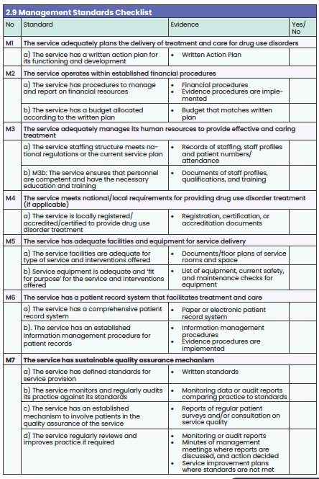
What – content for each section
Each section
Describes requirements for good practice in line with standards
Gives examples
Outlines relevant standards and criteria – both KQS and UNODC Service Standards
Provides a checklist of standards and suggested evidence
Voluntary consortium of people from around the world

Slide 9

What – Introduction
Recovery-oriented systems and services
Target Audience
All those involved in leadership, management and quality assurance of specialised drug use disorder treatment services.
What are specialised drug use disorder treatment services
Services primarily designed to treat patients or clients with drug and alcohol use disorders. They vary.
Long-term support
Empower and build recovery capital
Partnerships to meet multiple needs
Voluntary consortium of people from around the world
Hope
Recovery is
Voluntary control over substance use
Improved health and well-being
Integration into society

Slide 10


What – Effective management
Content
Effective leadership and management
Service planning
Managing financial resources
Managing contracts and funders
Human resource management
Managing facilities and equipment
Patient record systems
Quality assurance systems
Voluntary consortium of people from around the world

Slide 11
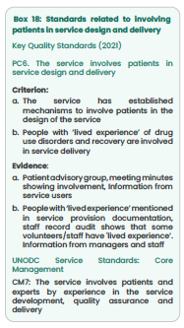
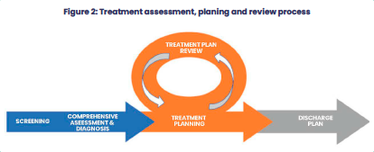
What – Individualised person-centred treatment
Content
Patient screening, assessment, risk assessment (and diagnosis)
Informed consent
Treatment planning and review
Partnership with other providers
Meeting the needs of different patient groups
Involving patients in service design and delivery
Voluntary consortium of people from around the world
Figure 4: Assessment, treatment planning and review process

Slide 12
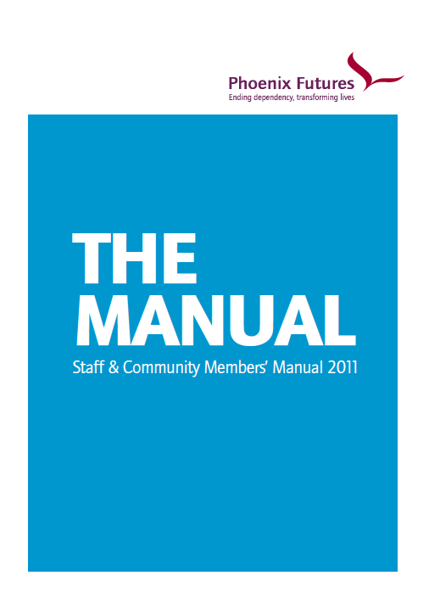
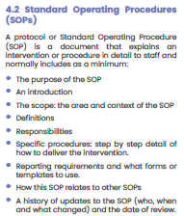
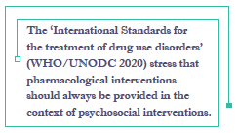
What: Providing interventions that are evidence-based
Content
The importance of a documented approach
Standard Operating Procedures
Ensuring interventions are in line with international guidelines
Interventions to reduce negative health and social consequences of drug use
Psychosocial interventions
Pharmacological interventions
Recovery management interventions
Voluntary consortium of people from around the world

Slide 13
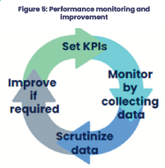

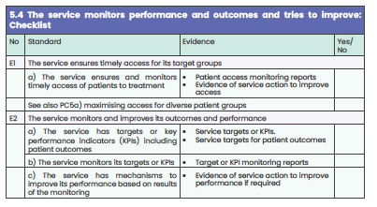
What – The service Monitors performance and outcomes and tries to improve outcomes
Content
  Ensuring timely access
  Performance management and monitoring
  Outcome monitoring and management

Slide 14




What – Ensuring services promote patients’ health, safety and human rights
Content
Treating patients with respect and protecting them from abuse, malpractice and discrimination
Informing patients of service rules, policies and procedures
Promoting patient health, well-being and social functioning
Independent complaints procedures for patients
Ensuring cleanliness, infection control, fire and serious incident prevention
Medicines management
Voluntary consortium of people from around the world

Slide 15


What – Auditing your services using the ‘Key Quality Standards’
Content
  Plan and allocate resources for auditing
  Adapt (Key Quality Standards)
  Assess (against Key Quality Standards)
  Report
  Improve
Voluntary consortium of people from around the world

Slide 16
Conclusion: With great power comes great responsibility
Leadership and management of SUD treatment services is an honor and responsibility
It is not easy but can be a very rewarding and impactful
There are enablers that can help individuals and teams
We want to educate, support and train those who do this job or want to do this job well for the patients and communities they serve
Voluntary consortium of people from around the world

Slide 17
Managing drug use disorder treatment services in line with international ‘Key Quality Standards’: A handbook for managers.
Rita Notarandrea

Slide 18
CALL TO ACTION: Application and implementation is critical
Let’s make a difference together for those we serve; let’s continue to promote and implement Quality in SUDs systems and services.
We know there is a gap between what we know and what we do.
This handbook aims to fill that gap.
Voluntary consortium of people from around the world
The handbook is the knowledge translation tool to help us implement Quality in our services.
It is built upon and promotes international standards and guidance which is based on the current evidence.
It provides guidance to leaders on how best to check adherence to this evidence via the standards, criteria and details on what to look for.
It offers Quality Assurance mechanisms and cycles of continuous improvement to help achieve quality and sustainable ways to ensure fidelity to and alignment with international standards and guidance.

Slide 19


CALL TO ACTION: Increase awareness of and application of the Management Handbook
APPLICATION BASED ON:
Standards based on evidence.
QA mechanisms.
Leaders with the tools and skills.
Ongoing training opportunities.
What is the most effective way of helping countries and services improve quality?
Voluntary consortium of people from around the world
This handbook supported by Quality Assurance mechanisms can help us:
Recognize good practice.
Challenge poor practice.
Encourage continuous improvement.

Slide 20
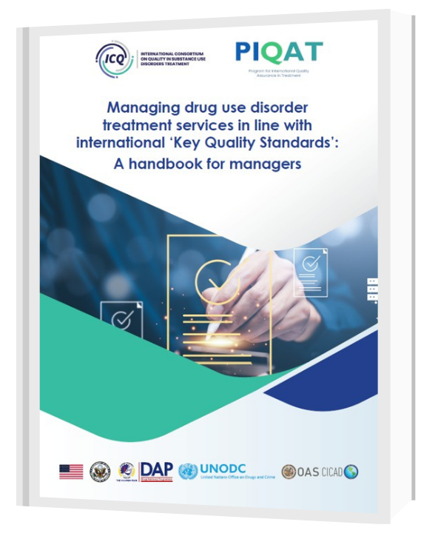

You can access the full document via the link or QR code below
https://www.issup.net/knowledge-share/resources/2025-05/managing-drug-use-disorder-treatment-services

Slide 21
Thank you
For further information, please contact:
Annette Dale
ICQ International Consultant
The Colombo Plan
adpconsultancy@icloud.com
Rita Notarandrea
ICQ International Consultant
The Colombo Plan
ritanotar@gmail.com
Rodrigo Portilla (Spanish)
The Colombo Plan
rodrigo.portilla@colombo-plan.org

