Slide 1
ALCOHOL PACKAGING IN AFRICA
SACHET BAN, ACCESS, AND REFORMS
By Rogers Kasirye (Ph.D.)
Uganda Youth development Link
Email kasiryer@yahoo.com

Slide 2
Outline
Brief background on alcohol packaging in Africa
Why packaging matters (health, environment, access, policy)
Scope of discussion
Sachet Ban,
Impact and challenges
Recommendations

Slide 3
Motivation -Alcohol Packaging in Africa
Focus: Intersection of public health, policy, and socio-economic realities.
Issue: Cheap sachet alcohol drives underage drinking, abuse, and health crises.
Response: Bans aim to protect communities but raise challenges—livelihoods, access, enforcement.
Goal: Advocate reforms that balance health protection with economic opportunities and strong regulation.
Impact: Encourage informed debate, evidence-based policy, and sustainable solutions.
Vision: Healthier societies that respect local economic and cultural contexts.

Slide 4
Alcohol packaging in Africa
Sachet alcohol packaging is a widespread problem in Africa (WHO , 2018).
Alcohol use is increasing in developing countries due to global market expansion, pricing, packaging, and aggressive marketing.
Small sachets contribute significantly to illicit, unregistered alcohol, raising consumption and affecting local revenue.
Price and packaging strongly influence alcohol availability and consumption levels (Room et al., 2000).
Alcohol burden in Africa is accelerating, driven by packaging strategies and intensive marketing (Swahn et al., 2022).
Youth are particularly affected, often engaging in episodic or binge drinking.

Slide 5
Sachets /Tot packs debate
A bigger picture of the Alcohol sachet bans in African countries is unknown.
Generally, in Africa laws regarding alcohol are poorly enforced as alcohol is sold in all places, lack standardisation, no restriction on promotion .
Many don’t have health warning
Mismatch on the what amount is inside the bottle and on plastic
All African countries are trying to ban alcohol sachets from 2010.
Long-term economic costs from alcohol-related illnesses, accidents, and reduced workforce productivity often outweigh short-term profits.

Slide 6
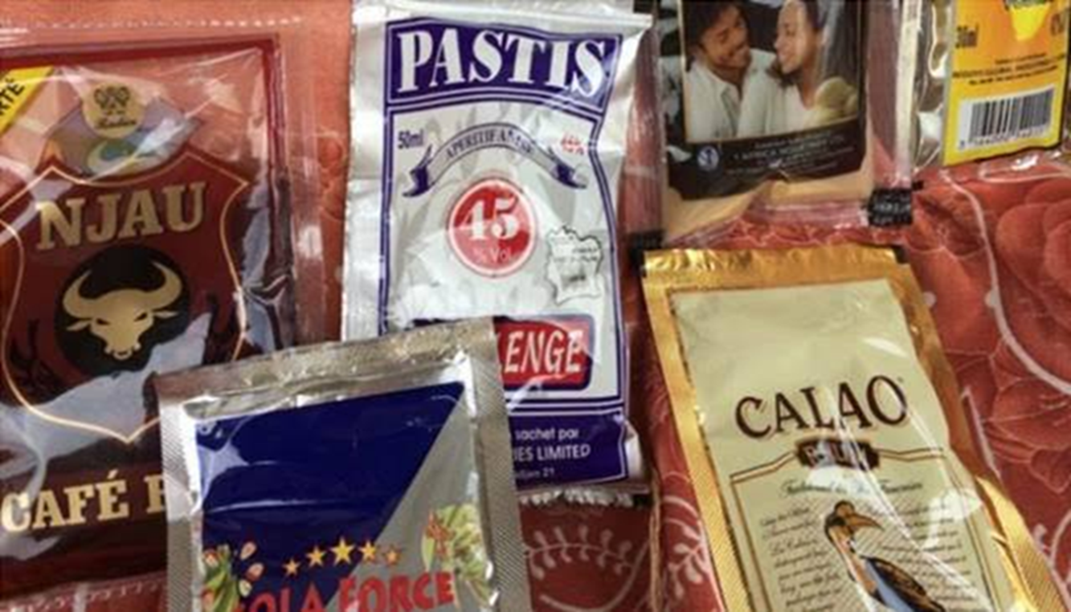
Zambia

Slide 7
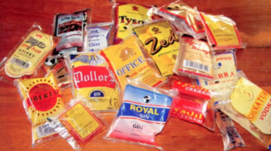

Slide 8
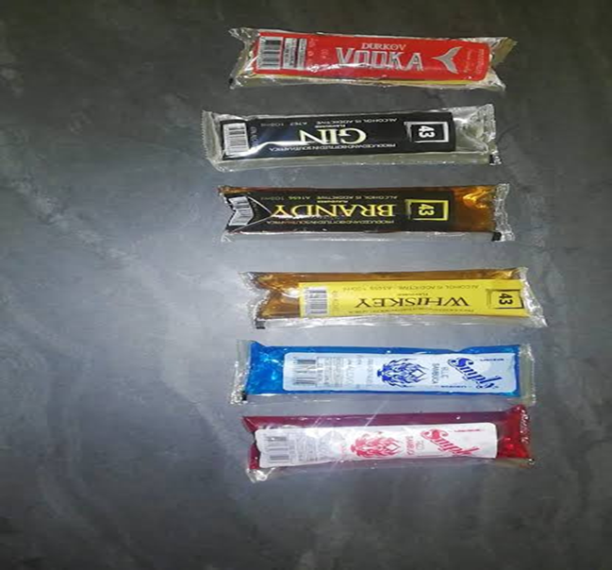
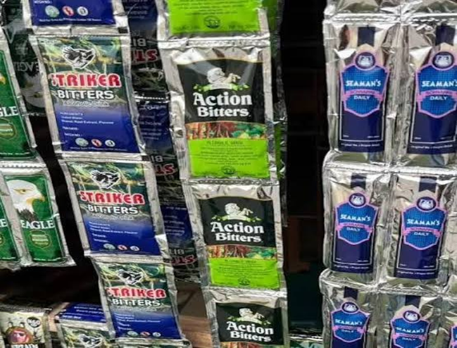
South Africa and Nigeria

Slide 9
Sachet Ban in Africa
The interest of the ban was increased taxation revenue and eliminating the small packages given the revenue authority’s difficulty in tracking them using their digital systems.
Fewer countries acknowledge the public health approach.
Least package (volume of the alcohol sachets varied in most countries and for most of these the volume was around 50 millilitres (mls),
Except in Uganda where a smaller packaging of 25 mls had been reported.
The number of units in a drink can be calculated from the alcohol by volume (ABV) and the size of the drink. The higher the ABV, the stronger the drink.
More brewers used methanol and wood ethanol

Slide 10
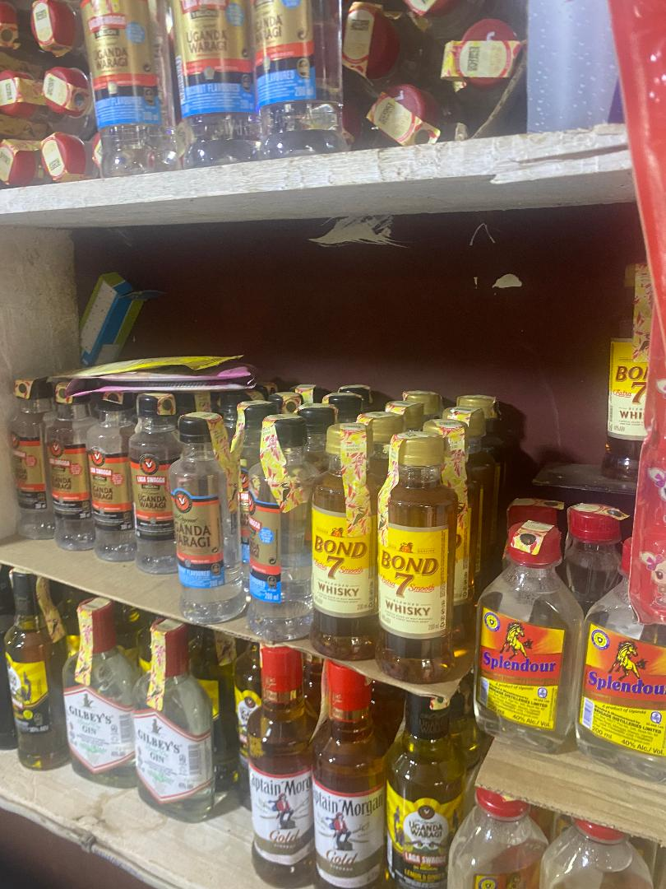
Sachet Alcohol: Economic front
Small sachets make alcohol cheap and easily accessible, especially to children and low-income populations.
This affordability can increase sales volumes for manufacturers in the short term.
Encourages informal and unregulated production, which undermines legitimate businesses and tax revenues.
In countries where sachets are banned, enforcing the ban can be costly, and loss of sachet sales may impact small-scale traders who depend on them for income.

Slide 11
Health effects and Social concerns
Sachets often contain strong, unregulated alcohol, enabling quick, dangerous consumption—especially among youth.
They're cheap price, portability, and concealability encourage underage and on-the-go drinking, raising risks of drunk driving, public intoxication and addiction.
Long-term use can cause liver, heart, and mental health problems.
While profitable for some sellers, sachets worsen public health, reduce productivity, and create plastic waste, adding to social and environmental burdens.
East Africa has experienced alcohol poisoning.

Slide 12
Countries the enforced the ban
Country | Price vs $ | Reason for ban
Cameroon | A sachet costs 100-150 CFA francs or 15-23 US cents. | Harm, illegal production and smuggled across borders, easy access and availability to children.
Ivory Coast | In Ivory Coast, the small plastic bags containing rum, vodka, gin or other spirits are cheap, and cost between $0.35 (£0.28) and $1.65. | Harm, illegal production and smuggled across borders, easy access and availability to children. Sachets are more likely to contain toxic chemicals such as methanol or wood alcohol.
Uganda | Smallest sachet of 50 going for only sh500 ($0.25). | Protect their youths and environment. Serious harm these products have caused to society. To curb alcohol abuse.
Malawi | Malawi liquor sachets sell for less than 100 Malawi kwacha ($0.02) each. | Protect the youth and environment. Severe harm these products have caused to society.
Senegal | * | *

Slide 13
Country | Price vs $ | Reason for ban
Tanzania | Sachet bags were of 50 millilitres and the drinks were largely cheap as some brands go for a quarter of a dollar ($0.25). | Protect their youths and environment. The harm these products have caused to society, health and economy. Easily concealed in the pockets of trousers or school bags, they can be easily smuggled into classrooms.
South Africa | * | *
Zambia | Contain 30 ml of strong liquor sachets, commonly known as tujilijili | Help reduce incidences of gender-based violence, abused by young people contributed to violence against women and children. They are sold at really low prices, often in unlicensed bars and often to minors. underage people were consuming tujilijili in large quantities.
Nigeria | With N50, they could buy one sachet and with N100, you could get three. | Cut availability and consumption and curb abuse of alcohol in the country.

Slide 14
Price and content they're in
Local sachets often named after famous figures, appealing to young drinkers.
Both small and large brewers used sachets; some outsold sodas/water.
Alcohol content (ABV) varies; most use ethanol, some use methanol or wood ethanol.
Drink strength depends on ABV and size.
In Uganda, major brewers supported the ban, anticipating market gains.
About 70% of alcohol consumed is informal or illicit, including unsafe brews and smuggled/counterfeit products, affecting legal vs. illegal markets and urban vs. rural access.

Slide 15
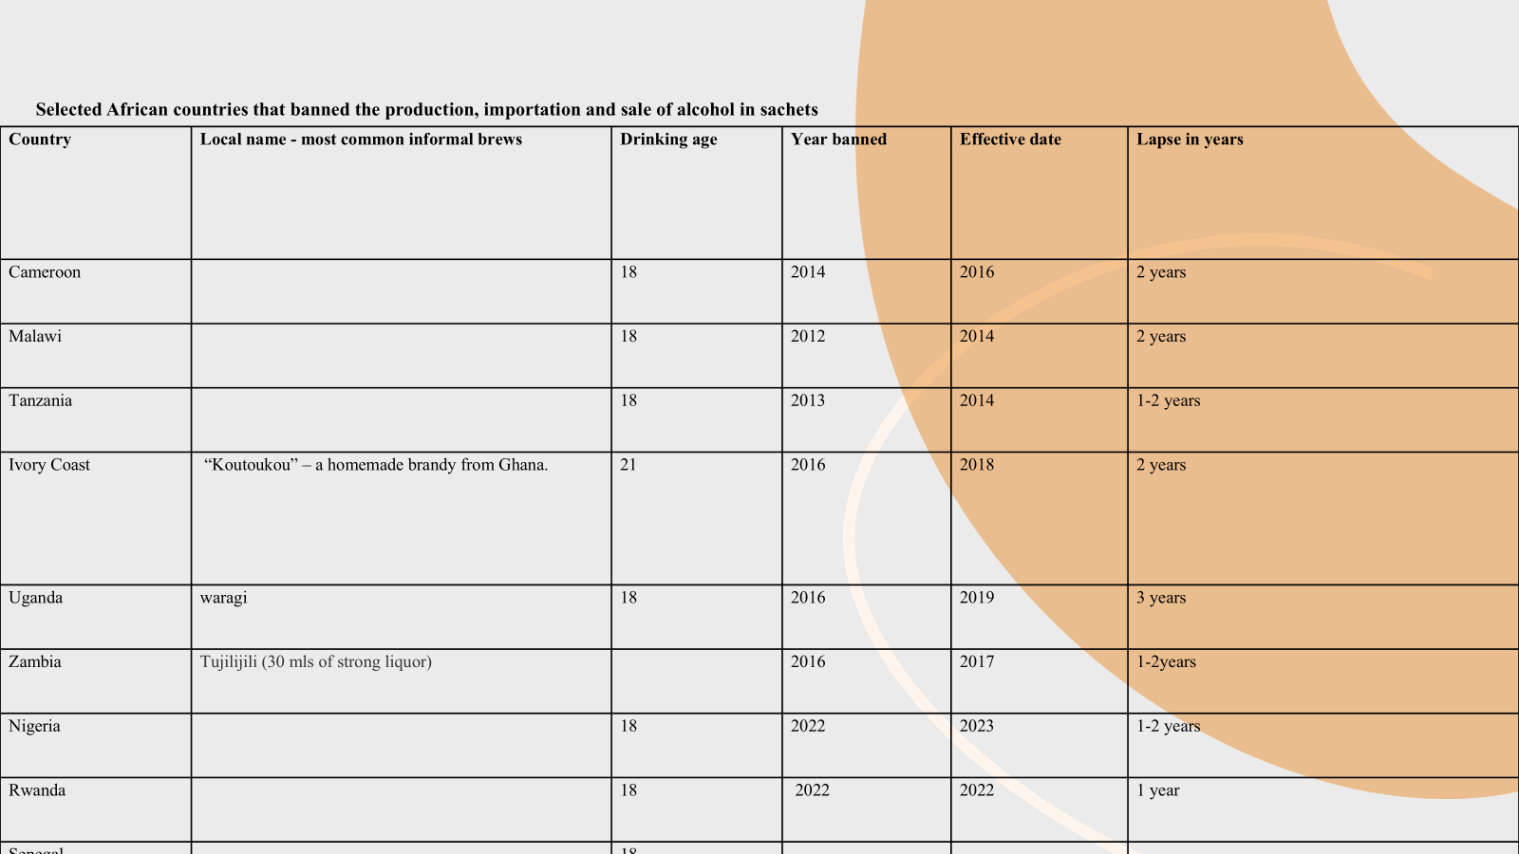

Slide 16
Directives for banning the alcohol sachets
Most African countries banned alcohol sachets via ministerial directives.
Tanzania: had an immediate ban in 2017 by President Magufuli (three-month transition).
Other countries: longer timelines—2 years in Zambia, Malawi, Ivory Coast; >3 years in Uganda.
Bans targeted packaging (≤100 ml) and regulated transport, export, and distribution—not alcohol content.
Enforcement varied: some used single agencies; others involved multiple bodies (food/drug authorities, standards bureaus, trade/health ministries, police).
Rwanda: government led enforcement, supported by tax authorities and local governments.

Slide 17
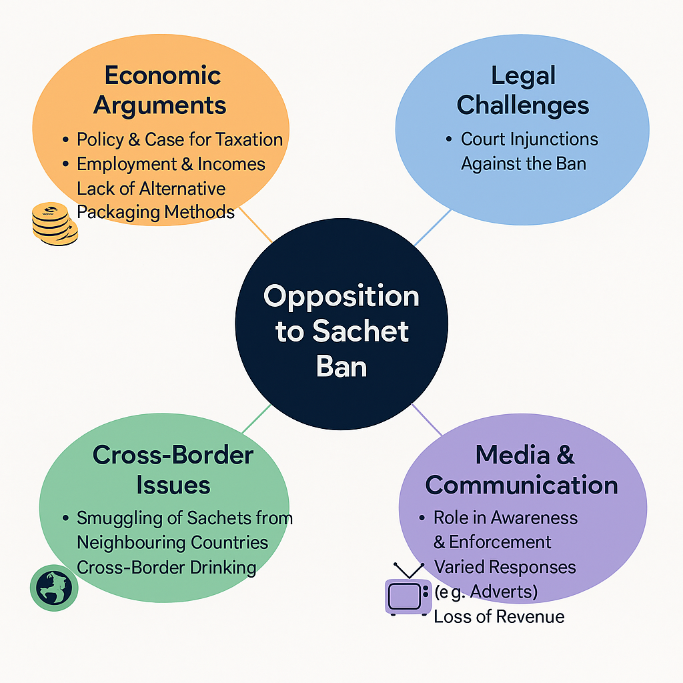

Slide 18
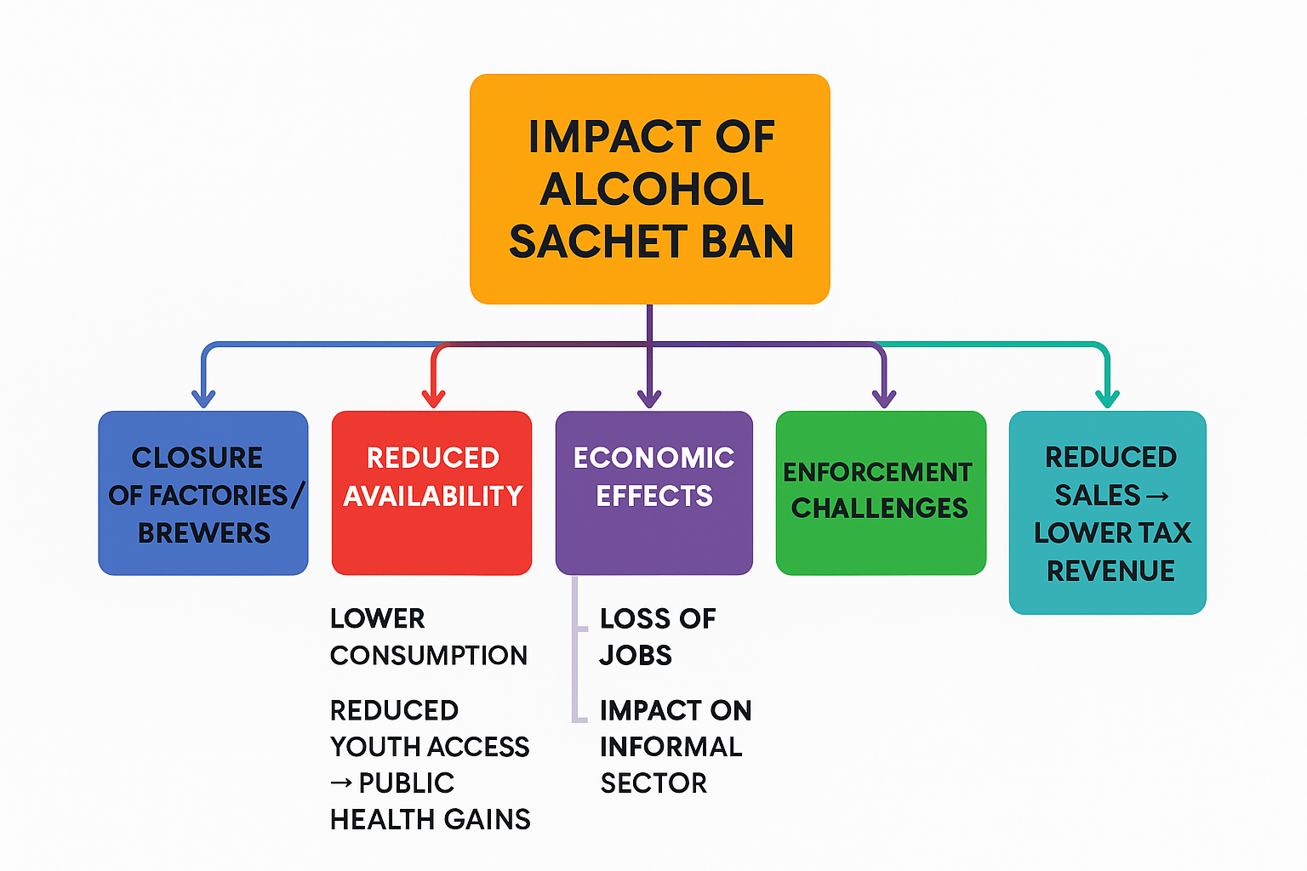

Slide 19
Point-challenges faced in countries | Evidence | Interpretation
Failure to monitor and enforce the ban | Small local producers continued operations despite the ban, smuggling Resurgence of new brewers. | Weak enforcement undermined public health goals
Phased compliance requested by brewers | Producers argued imported raw materials would cause financial losses if the ban was immediate | Transitional arrangements are necessary to avoid harming local businesses
Gradual reduction as a model | Nigeria reduced sachet alcohol production by 50% (Jan 2022) and planned full phase-out by Jan 2024 | Phased approaches balance regulatory goals with economic realities

Slide 20
Policy Reforms and Innovations
Regulatory approaches (packaging size restrictions, labelling laws) --Who issues the directives (Availability/acess)
Multiple enforcement and coordination
Public awareness campaigns (Norms)
Industry engagement in safer packaging

Slide 21
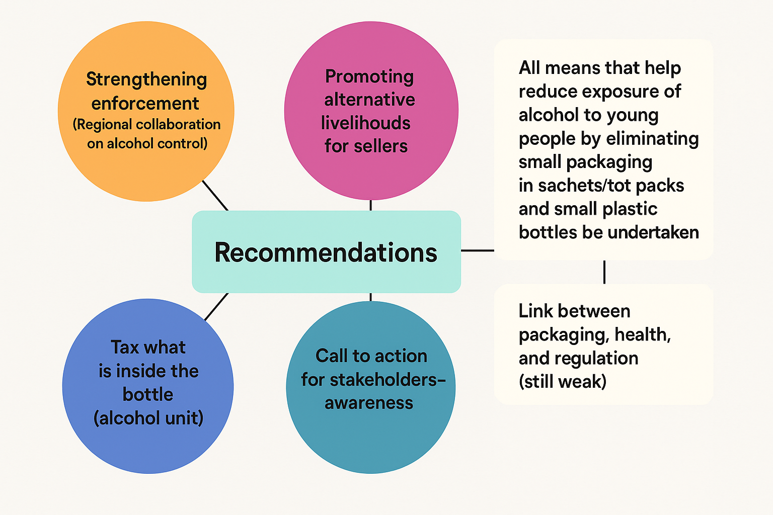

Slide 22
Citation
Kasirye Rogers (Ph.D.)*. Alcohol Sachets an Endemic Problem in Sub-Saharan Africa: Do the Alcohol Sachet Bans in Africa Achieve the Policy Goals on Access and Availability. Sch J Psychol & Behav Sci. 8(3)-2024. SJPBS MS.ID.000286. D
https://lupinepublishers.com/psychology-behavioral-science-journal/pdf/SJPBS.MS.ID.000286.pdf

Slide 23
Thank you for listening!!

