Slide 1

Alcohol Packaging in Africa: Sachet Ban, Access, and Reforms
Insights from the PAENDU Report (2016–2021)
26 August 2025
Abiola Olaleye
Lead, Research and Drug Epidemiology, AUC

Slide 2
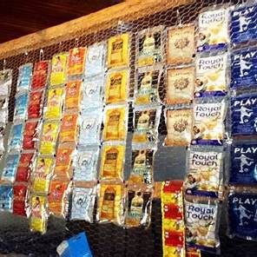
Outline
Problem of substance use in Africa
Why Focus on Alcohol?
Sachet Alcohol and Accessibility
Regional Perspectives (East, Southern, West Africa)
Policy Gaps
Reforms & Sachet Ban
Way Forward
Key Takeaways

Slide 3
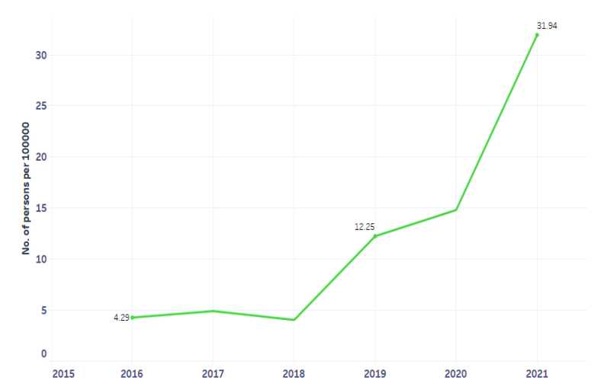
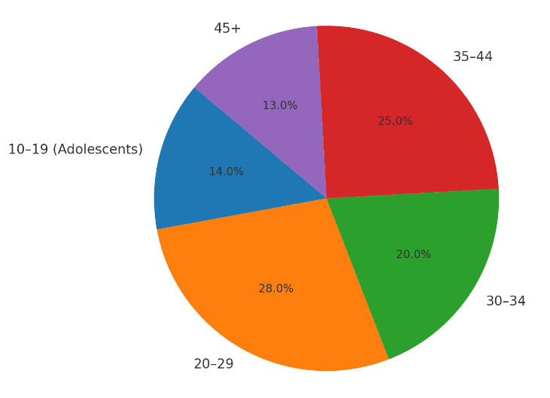
Substance Use in Africa: The Bigger Picture
Key Facts from PAENDU (2016–2021):
Adolescents & Youth heavily affected → 70% of treatment clients are aged 15–34 years.
Women underrepresented in treatment but increasing cases, esp. with alcohol & prescription misuse.
Treatment gap: demand rising but services grossly inadequate; stigma and cost are barriers.
Avg. number of persons per 100,000 population who entered treatment for substance use disorders in Africa, 2016-2021
Source: :PAENDU 2023
Age groups of persons who accessed substance use treatment services
Source: :Data from PAENDU 2023

Slide 4
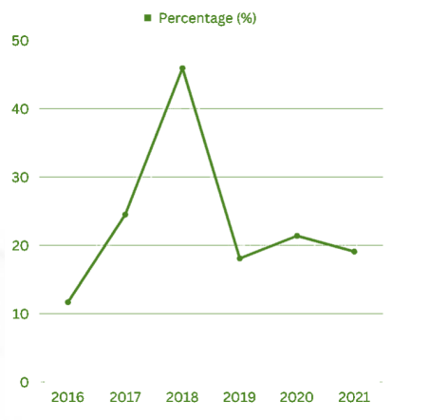
Why Focus on Alcohol ?
Most reported psychoactive substance in Africa
In treatment, alcohol:
  Peaked at 45.8% in 2018
  Accounts for 20% of primary substances (2021)
Particularly high in East Africa (59.5%) and Southern Africa (40.3%)
Strong link to early initiation, harmful use, and treatment demand
Proportion of persons who reported alcohol as primary substance use among treatment entrants, 2016-2021
Source: :PAENDU 2023

Slide 5

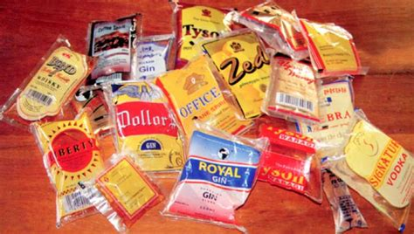
Sachet Alcohol and Accessibility
Standard bottles are larger, regulated, and less accessible to youth and low-income groups.
Sachets/small bottles, in contrast, are cheap, portable, and easily concealed—leading to higher availability and misuse.
May be linked to:
  Early initiation → adolescents (10–19 yrs) = >10% of treatment entrants
  Youth vulnerability → 70% of treatment clients aged 15–34
Women increasingly represented → 16% of alcohol treatment cases in 2021
Standard Packaging vs Sachet Packaging of Alcohol

Slide 6
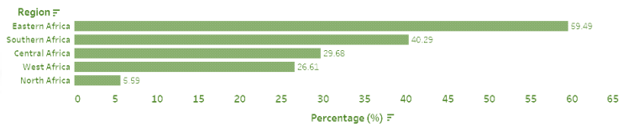
Regional Perspectives
East Africa
Highest burden: 59.5% harmful alcohol use in treatment
Linked to low-cost packaging and cross-border trade
Southern Africa
Alcohol was cited as the primary substance used among persons in drug treatment in the index period (2016-2021).
Adolescents and women significantly represented in drug treatment
West Africa
Alcohol second to cannabis in treatment demand
Sachets and small bottles widespread, may be driving early initiation
Reported harmful use of alcohol among persons who accessed drug treatment (2016-2021), by region
Source: :PAENDU 2023

Slide 7
Policy Gaps
• Only 21 AU Member States (40%) reported having a national drug policy (2021)
• Weak regulation of alcohol packaging and retail
• High accessibility undermines public health efforts
• Lack of monitoring frameworks → no systematic evaluation of sachet bans

Slide 8
Reforms & Sachet Ban
• Sachet ban is a key policy innovation
• Which may align with PAENDU’s recommendations for:
- Restricting harmful packaging → reduce accessibility
- Excise reforms → raise prices, reduce affordability
- Community sensitisation → shift social norms
• Protects youths, women, and low-income groups

Slide 9
Way Forward
Evidence-based alcohol control: integrate into national drug strategies, depending on local conditions
Expand treatment & community-based services
Strengthen data collection & monitoring (PAENDU role)
Promote multi-sectoral action – health, education, law enforcement
Sachet bans = part of broader reforms → sustainable reduction in harmful alcohol use

Slide 10
Key Takeaways
Alcohol = top psychoactive substance in Africa
• Sachets/small bottles = driver of harmful access
• Regional variation – East & Southern Africa highest burden
• Policy gaps remain, but sachet bans and reforms are viable solutions
• Aligns with Agenda 2063 vision for health and development

Slide 11

Thank you! Merci! Obrigado!
Abiola Olaleye
Lead, Research and Drug Epidemiology, AUC
OlaleyeA@africanunion.org

