Slide 1


The Digital Drug: Mental Health Effects of Addictive Screen Use
Exploring the impact of excessive screen time on well-being
Notes:
Every generation has battled its own kind of addiction — from opium to nicotine, alcohol to methamphetamine.
But today, a new kind of addiction is silently spreading across campuses, classrooms, and even hospital wards — one that doesn’t require a dealer or a syringe, only a screen.

Slide 2
, Impact of Addictive Screen Use on Quality of Life, Burnout, and Psychiatric Morbidity among Nigerian University Undergraduates:
: A cross-sectional Analysis from Ahmadu Bello University, Northwest Nigeria
Notes:
My name is Fatima Hassan Labo, a year 5 medical student from Ahmadu Bello University Teaching Hospital (ABUTH), Nigeria. I’m truly excited to be here today to share a research experience that I am not only part of — but also a subject of titled, Impact of Addictive Screen Use on Quality of Life, Burnout, and Psychiatric Morbidity among Nigerian University Undergraduates: A cross-sectional Analysis from Ahmadu Bello University, Northwest Nigeria

Slide 3
Understanding Addictive Screen Use (ASU)

Slide 4

Introduction to Addictive Screen Use
Rising Concern of Screen Addiction
  Addictive screen use is increasingly recognized as a serious issue affecting adolescents and young adults worldwide.
Psychological and Neurological Effects
  Screen addiction mimics substance addiction patterns, impacting brain function and mental health adversely.
Global and Local Research Insights
  The presentation combines international studies and findings from Ahmadu Bello University to explore screen addiction deeply.
Need for Awareness and Intervention
  Emphasizing urgent awareness and strategies to mitigate the growing problem of addictive screen use.
Notes:
After studying methamphetamine use, we noticed something intruging. There seemed to br agroupof people. People who hae never used drugs come down with psychiatric comorbidities such as depresson, anxiety, psychosis with symptoms more severe than those seen in heavy drug users. At first we thought stress, unemployment, financial difficulties could explain it all but it didn’t. rather we realized that almost everyone spent significant amount of time on their phones. Could this be the real culprit?
To answer that question, we decided to go beyond assumptions and look for evidence.

Slide 5
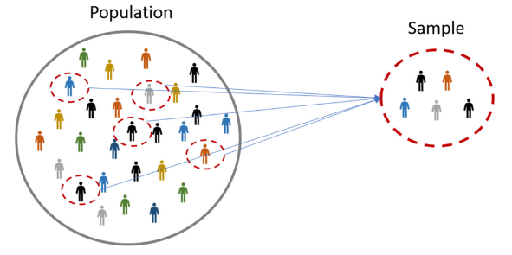
Study Overview and Methodology
Location: Ahmadu Bello University, Zaria, Nigeria
Sample: 450 undergraduates (multistage random sampling)
Tools Used:
  Smartphone Addiction Scale – Short Version (SAS-SV)
  Maslach Burnout Inventory – Student Survey (MBI-SS)
  MINI Neuropsychiatric Interview (v7.0)
  WHOQoL-BREF (Quality of Life)
  Analysis: SPSS v29, Chi-square, and Logistic Regression (95% CI)
Notes:
We designed a cross-sectional study right in the heart of Ahmadu Bello University, Zaria, one of the largest and most diverse universities in Nigeria.
Our team sampled 450 undergraduate students, carefully selected using a multistage random-sampling technique so that every faculty, department, and level was represented.
Our goal was simple yet ambitious:
To understand how addictive screen use affects the mental health, burnout levels, and quality of life of Nigerian university students.

Slide 6
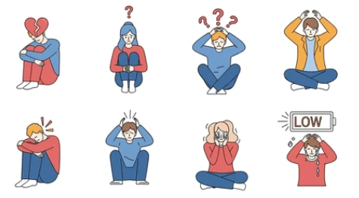
Key Findings and Statistical Evidence
Addictive Screen Use (ASU): 72.2%
Burnout: 61.1%
Depression: 47.8%
Anxiety: 42.2%
Suicidality: 17.8%
Poor HRQoL: 65.6%
Notes:
What we found was both staggering and deeply concerning.
Among these 450 students:
72.2 percent met criteria for addictive screen use — that’s nearly three in every four students.
61.1 percent were already showing signs of burnout.
47.8 percent had depression.
42.2 percent experienced anxiety.
And 17.8 percent reported suicidal thoughts or tendencies.
Even more alarming, 65.6 percent rated their overall quality of life as poor.
When we analyzed the relationships statistically, the associations were undeniable.
Addictive screen use was significantly associated with burnout, depression, anxiety, suicidality, and poor quality of life — all with p-values less than 0.001.
In plain language, students addicted to their phones were:
2.35 times more likely to experience burnout,
2.87 times more likely to develop depression,
2.41 times more likely to have anxiety,
And 1.95 times more likely to experience suicidal tendencies.
So when I looked at these numbers, one realization struck me:
The digital world that connects us might also be quietly breaking us.

Slide 7

Key Findings and Statistical Evidence
Addictive screen users were:
  2.35x more likely to experience burnout
  2.87x more likely to develop depression
  2.41x more likely to have anxiety
  1.95x more likely to have suicidal thoughts
All associations p < 0.001
Notes:
When we analyzed the relationships statistically, the associations were undeniable.
Addictive screen use was significantly associated with burnout, depression, anxiety, suicidality, and poor quality of life — all with p-values less than 0.001.
In plain language, students addicted to their phones were:
2.35 times more likely to experience burnout,
2.87 times more likely to develop depression,
2.41 times more likely to have anxiety,
And 1.95 times more likely to experience suicidal tendencies.
So when I looked at these numbers, one realization struck me:

Slide 8
Insights from Nigerian University Study
Notes:
Now comes the most interesting part of the research. The statistics of Addictive Screen Use (ASU) were competing with those of methamphetamine use, showing even higher prevalence of depression and psychosis among heavy screen users.

Slide 9
Neurobiological Parallels with Substance Addiction

Slide 10
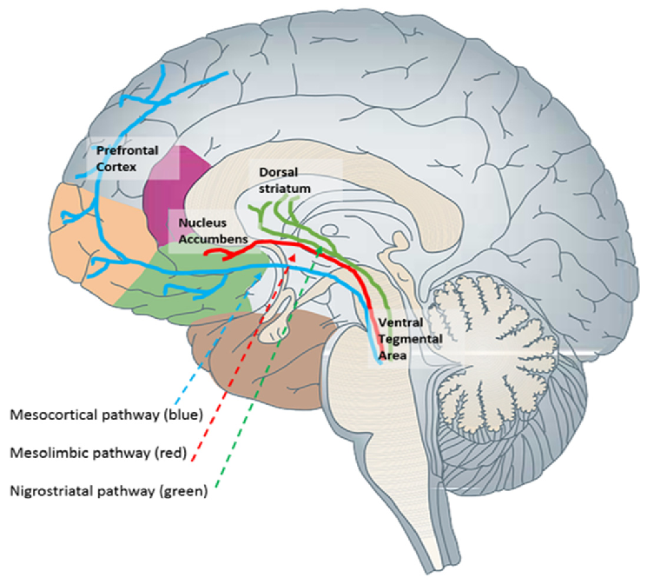
The Neuroscience of Digital Addiction
Drug addiction overstimulates dopamine in the brain’s reward pathway.
Screen addiction activates similar neural circuits through behavioral reinforcement.
Both cause:
  Dopamine dysregulation
  Impaired self-control
  Reduced prefrontal cortex activity
Notes:
As a medical student, I needed this phenomenon to make neurobiological sense — so I explored the neuroscience of both internet addiction and drug addiction.
In drug addiction, substances overstimulate dopamine release in the mesolimbic reward pathway, producing intense pleasure and reinforcing repeated use. Over time, the brain adapts by reducing dopamine sensitivity, leading to tolerance and dependence. The prefrontal cortex, responsible for judgment and self-control, becomes weakened — resulting in compulsive drug-seeking behavior.
In internet or screen addiction, similar neural circuits are activated through behaviors such as social media use, gaming, or constant scrolling.
Brain imaging studies show reduced gray matter volume and lower activity in the orbitofrontal and anterior cingulate cortices — regions critical for self-control and decision-making — changes that closely mirror those seen in substance addiction

Slide 11
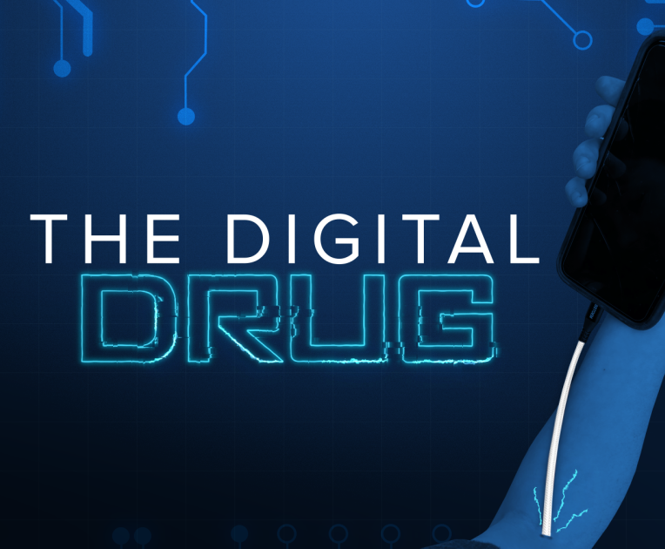
Discussion: The Digital Drug Parallel
Similarities between drug and screen addiction:
  Loss of control
  Compulsive engagement
  Withdrawal effects
  Impaired functioning
Female students showed higher depression rates due to online stressors.
Screen addiction mirrors chemical addiction in neurobiology and behavior.
Notes:
Though substance addiction is chemical and screen addiction is behavioural, both activate the same dopamine pathways.
So if the brain cannot tell the difference between a chemical high and a digital one — can we not then call it ‘the digital drug’?”

Slide 12
Global Perspectives on Digital Addiction
Notes:
WHO and International Findings

Slide 13

Global Context: WHO Findings
WHO reports rising digital addiction among teens in 44 countries.
Strong links between excessive screen use and depression, anxiety, and reduced well-being. (WHO, 2024)
Notes:
The World Health Organization (WHO) has identified a troubling rise in digital addiction among adolescents across 44 countries. This increase is closely linked to adverse mental health outcomes, including heightened levels of depression, anxiety, and diminished overall well-being.

Slide 14

Youth Mental Health Study
JAMA study (Xiao et al., 2025) tracked 4,000+ adolescents.
Addictive screen use doubled the risk of suicidal thoughts.
Elevated anxiety and depression in high-ASU users.
Notes:
A notable study published in JAMA by Xiao et al. (2025) tracked over 4,000 adolescents and found that those with high levels of addictive screen use were twice as likely to experience suicidal thoughts compared to their low-use peers. These findings reinforce the notion that the mental health consequences of screen addiction are not confined to specific regions but represent a global public health challenge. The convergence of data from diverse populations highlights the universal nature of this issue and the need for coordinated international efforts to address it.

Slide 15
Psychological Vulnerabilities of Screen Dependence
Individuals with high screen dependence often show:
      Poor self-regulation
      Impulsivity
      Reduced ability to delay gratification
These traits are strongly linked to vulnerability to substance use.
In adolescents and young adults, whose brain control systems are still developing, these traits can increase the risk of experimenting with drugs and risky behaviors.
Notes:
The Big Question: Put on Your Thinking Cap

Slide 16

Emotional & Behavioral Triggers
Prolonged screen use leads to:
      Emotional dysregulation
      Social isolation
      Sleep disturbances
      Elevated stress
These are all known triggers for substance use.
Many individuals may turn to drugs to cope with restlessness or negative emotions caused by digital deprivation.
Notes:
The Big Question: Put on Your Thinking Cap

Slide 17
Recommendations and Future Directions
Notes:
Dr. rogers said, drug use is a symptom of what has not been done properly and so could be said about screen addiction. The problem here is that we have not even identified it as a problem talk more of finding solutions. Its sth legal that we can consume anytime anywhere. So the fist step is identifying it as a problem.

Slide 18
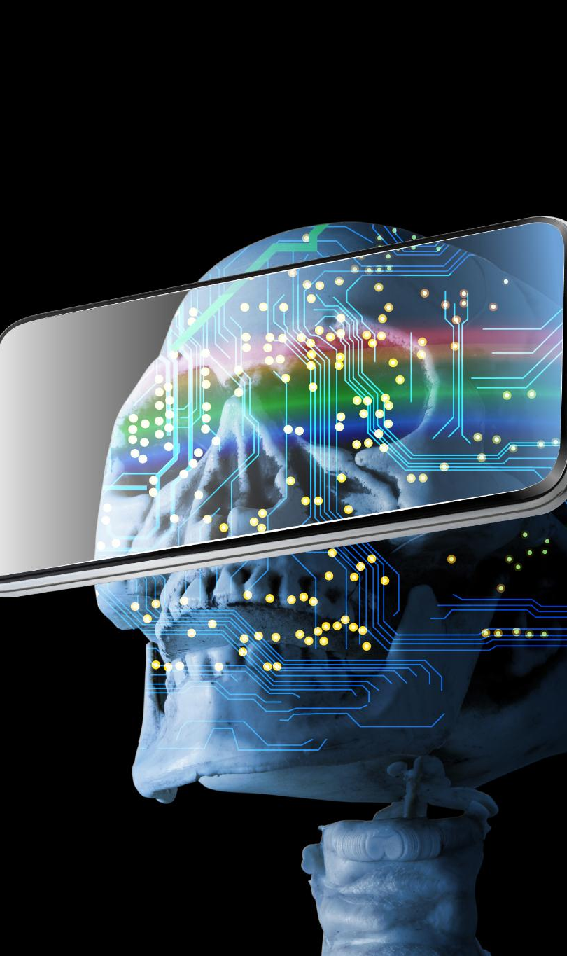
Strategies for Mitigating Screen Addiction
Screening and Identification
  Implement screening protocols in universities and healthcare to detect individuals at risk of digital overuse early.
Promoting Digital Hygiene
  Encourage offline breaks, monitor screen time, and improve sleep habits to balance connectivity and mental health.
Research and Longitudinal Studies
  Conduct long-term studies to establish causality and understand screen addiction's effects over time.
Addressing Emotional Triggers
  Reduce reliance on digital devices by tackling stress, isolation, and lack of recreational alternatives.
Notes:
1️⃣ Treatment and Recovery
“Unlike substance abuse where we often apply an abstinence model, recovery from addictive screen use isn’t about going cold turkey.
It’s more similar to food addiction — the goal is moderated, intentional use.
This is where we apply the concept of a Digital Diet and Digital Nutrition — controlling not just how long we spend online, but what kind of content we consume.”
“Digital Diet involves restricting daily screen hours.
Digital Nutrition means choosing content that adds value — for example, online classes or airline reservations — over endless scrolling.”
Then include your vivid examples:
“We often hear: check your checking, check your timing, disconnect to reconnect.
But it begins much earlier — children as young as two or three are already exposed to screens. How young is too young?”
3️⃣ Public Health Perspective
“Evidence now links excessive early screen use to reading deficits and childhood obesity.
South Korea is leading prevention through screen-smart schools, where teachers are trained to identify early signs of digital overuse and apply the 3-6-9-12 rule — structured, age-appropriate screen exposure.”
4️⃣ Policy and Prevention
“We recommend implementing screening and identification protocols in universities and healthcare centers to detect individuals at risk early.
Encourage digital hygiene — offline breaks, sleep improvement, and recreational alternatives.
Invest in research and longitudinal studies to better understand digital addiction’s neurobiological impact.”
Explore Neurotechnology – The Promise of rTMS
Emerging neurotechnologies may hold promise for rehabilitation.
Our prior research on repetitive Transcranial Magnetic Stimulation (rTMS) in substance addiction demonstrated reductions in craving and improved executive control via modulation of the prefrontal cortex and reward circuitry.
Given the shared pathways between substance and screen addiction, rTMS could offer a novel, non-invasive intervention for severe digital dependency — blending neuroscience, technology, and behavioral therapy to enhance recovery outcomes.

Slide 19
References
Abdullahi A.Y. et al. (2025). West J Med & Biomed Sci, 6(3):53–57.
Griffiths M.D. (2011). Psychology and the Internet.
Kuss D.J. & Griffiths M.D. (2011). Int J Environ Res Public Health, 8(9):3528–52.
Wambua G.N. et al. (2020). BMC Psychiatry, 20:409.
Twenge J.M. et al. (2019). Emotion, 19(1):45–56.
Andreassen C.S. (2015). Curr Addict Rep, 2(2):175–84.

Slide 20
Thank You

Slide 21

FATIMA HASSAN LABO
5th Year Medical Student (ABUTH)
Contact Information: Fatima_labo92@yahoo.com
linkedln: Fatima Hassan Labo
AMADU BELLO UNIVERSITY TEACHING HOSPITAL, ZARIA, NIGERIA

