Slide 1

“Reimagining Prevention: What Actually Works for Youth and Families Today”
Presented by: Hari,
Preventive Drug Education Specialist

Slide 2

About SANA
Vision:
As a leader in drug addiction prevention and recovery, SANA aspires to mobilise the community towards a drug-free Singapore.
Mission:
We educate the community on the harms of drug abuse, provide support for persons-in-recovery towards desistance, and advocate for a drug-free society.

Slide 3



The Challenge Facing This Generation
Across ASEAN, young people navigate a rapidly shifting landscape of risk — often without the tools to resist it.
Identity Crisis
Adolescents face intense pressure to conform, belong, and perform — making them vulnerable to risky choices.
Online Misinformation
Digital platforms amplify misleading narratives about drugs, addiction, and mental health at unprecedented scale.
Mental Health Pressures
Anxiety, isolation, and academic stress create conditions where substance use becomes a coping mechanism.

Slide 4
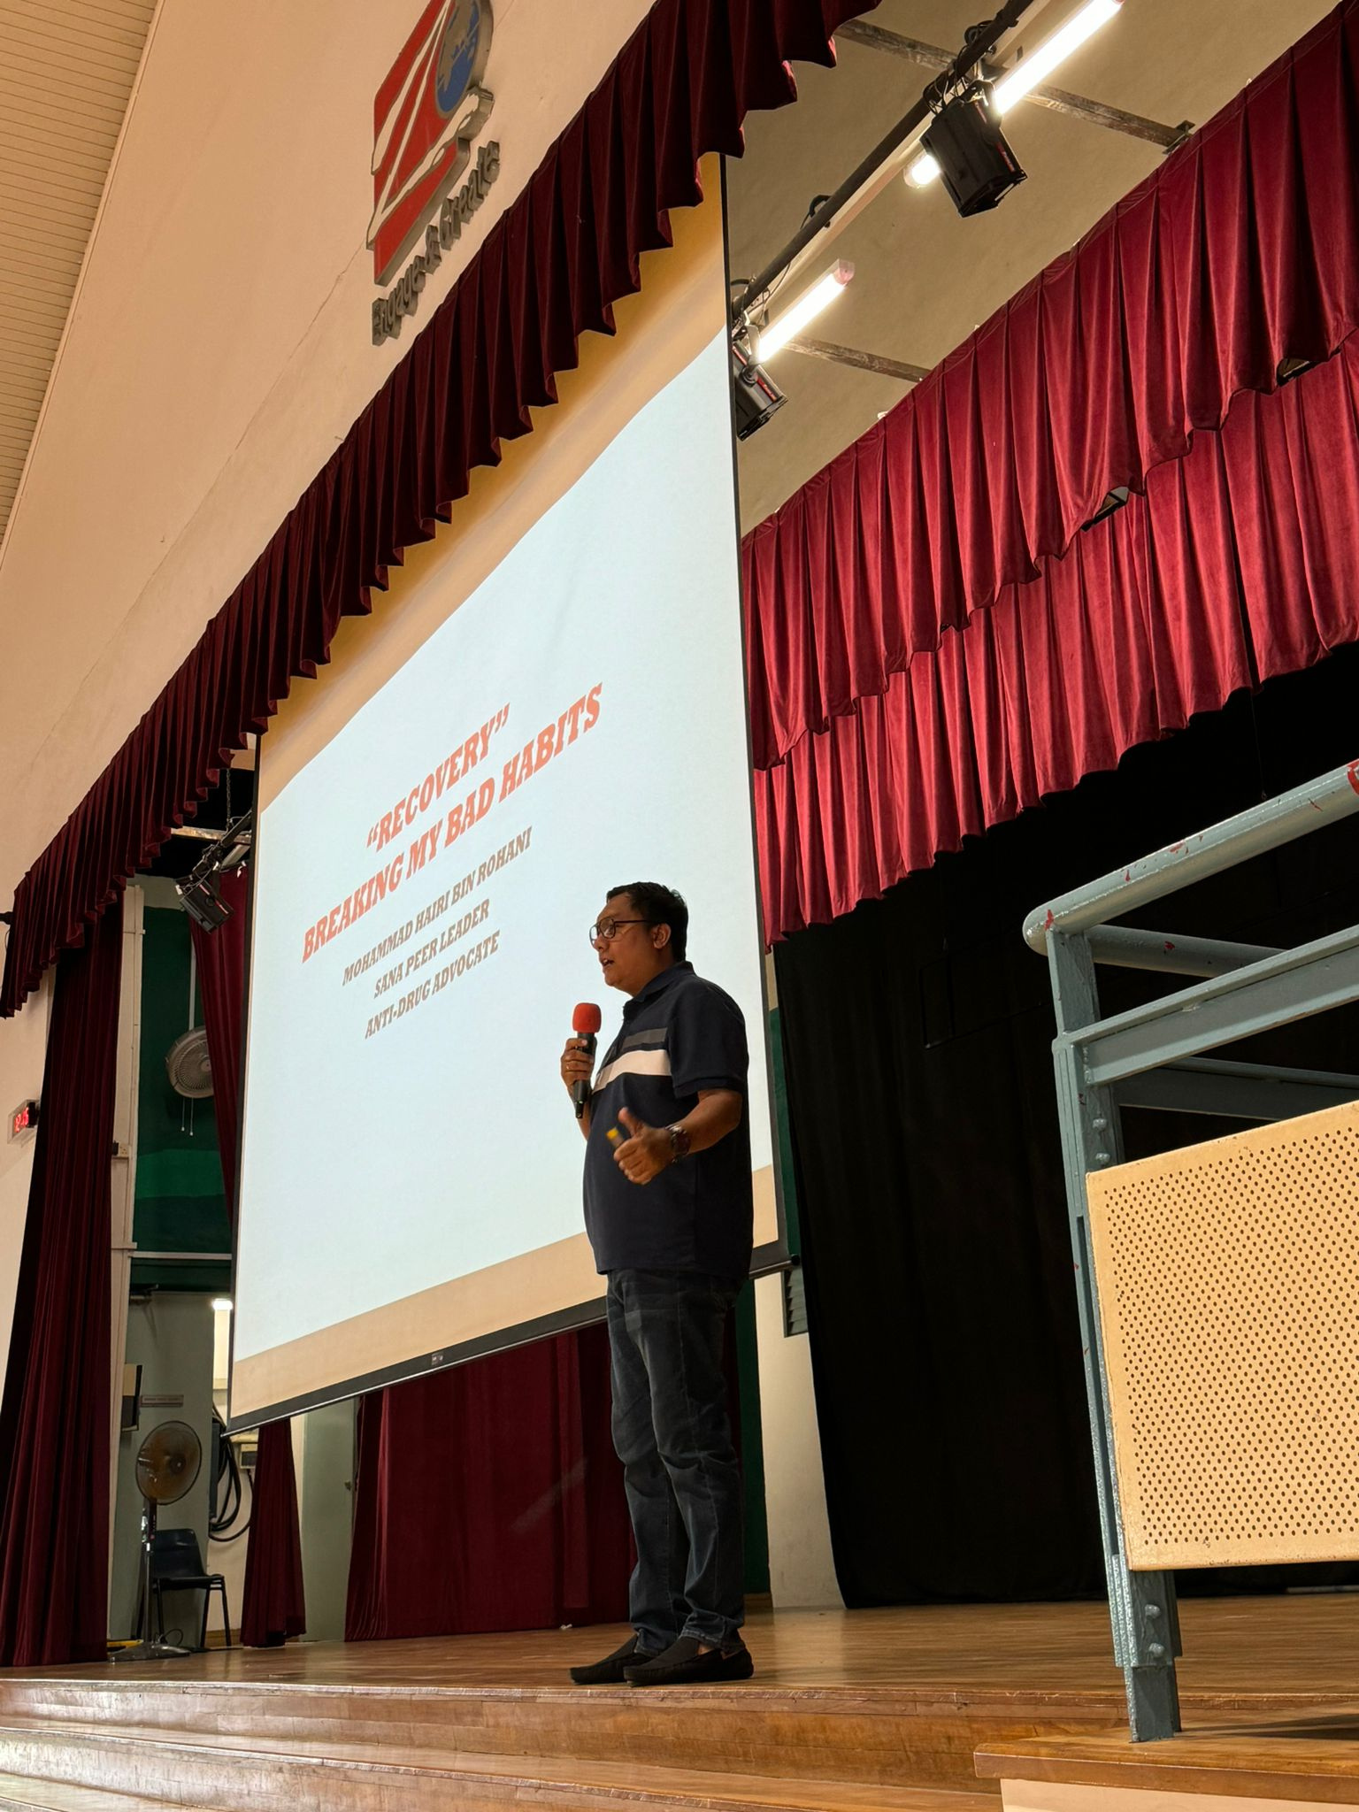
Youth Prevention Must Evolve
Today’s Youth Are Different
They are digital natives - highly shaped by peer culture, social meida, and rapidly evolving drug trends. One-way information delivery no longer works.
Research shows that experiential learning and peer engagement significantly improve prevention outcomes – shifting behaviour where lectures alone cannot. (Alqahrani et al., 2025)
Information Delivery → Youth Empowerment

Slide 5

Why We Need Youth Leaders
When young people take the lead in prevention efforts, communities undergo significant transformation.
Build Safe Space/Positive Role Modelling
OUR YOUTH INTERN
Young people can create safe environments for open discussions, and they can be guided by positive role models.
Relatable Communication
Current young people possess their own unique way of communicating, and when youth lead their peers, information can be effectively conveyed.
Improved Engagement in Programmes
Young people can design activities that resonate with their peers, leading to more effective program delivery.

Slide 6
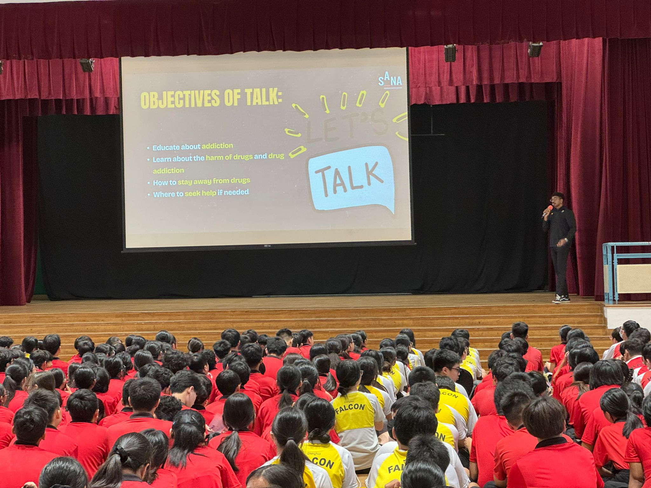
SANA’ ACT FRAMEWORK
Advocating Change Together
ACT is a structured, evidence-based framework that transforms youth from passive recipients into active prevention leaders — through three progressive pillars.
Awareness
Deep insight into drugs, addiction, mental health, and risk factors — building informed, resilient young minds
Action
Youth create content, run campaigns, and lead school-based initiatives — turning knowledge into real prevention impact.
Advocacy
Empowered young advocates champion drug-free lifestyles among peers — sustaining prevention beyond the programme.

Slide 7

Built on Prevention Science
Every element of the ACT framework is grounded in research and continuously refined through programme evaluation.
What Guides Our Design
How We Measure Impact
Current drug abuse patterns among youth in Singapore and the region
Pre & Post Assessments
Measuring shifts in knowledge, attitudes, and intention before and after each programme.
Peer-reviewed prevention research and behavioural science
Student Feedback
Direct input from youth participants shapes continuous improvement of content and delivery.
Prevention science principles — social influence, self-efficacy, and life skills
Feedback with Youth Workers/Teachers
Engage in regular discussions following each session to gain insights into effectiveness and make adjustments as needed.

Slide 8



The ACT Badge: A progressive Learning Journey
The ACT Badge is a tiered recognition system that guides uniform group students through meaningful, escalating levels of prevention engagement.
Bronze — Raise Awareness
Offer insights on addiction, substances, vaping, and the factors that may lead individuals to drug abuse or criminal behavior.
Silver — Take Action
Students will create anti-drug videos or posters to raise awareness about the dangers of drugs in society.
Gold — Drive Advocacy
Participate at in-person program designed to educate participants on becoming effective advocates for an anti-drug community.

Slide 9
Badge Tier: Bronze — Raise Awareness
Addiction
Substance Abuse Awareness
Mental Health
Assist youths in grasping the fundamentals of addiction to enhance their understanding of how it functions.
Deepens understanding of harmful substances, the factors that contribute to abuse, and Singapore's legal framework around drug offenses.
Helps young people identify underlying vulnerabilities — stress, peer pressure, mental health struggles — that may increase their risk of drug use.

Slide 10
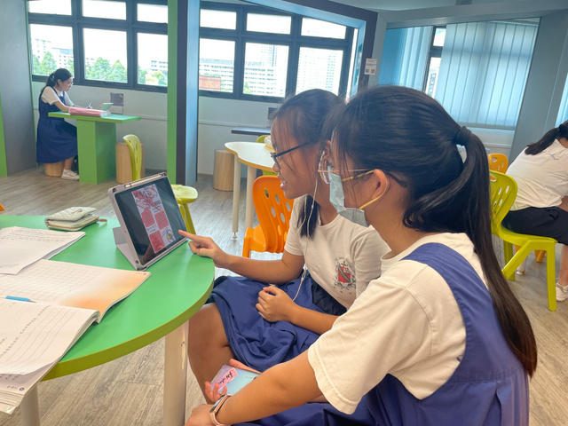

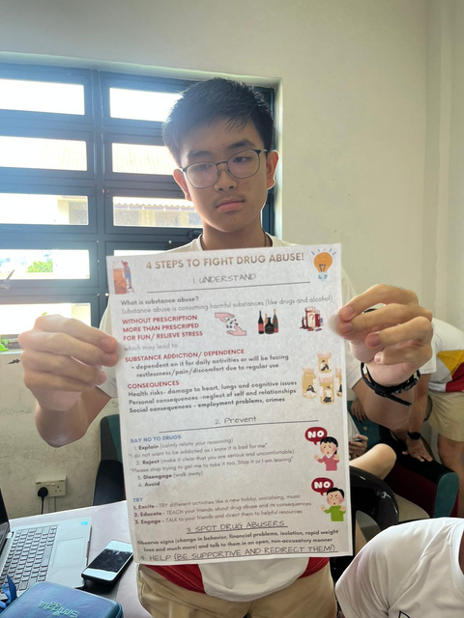
Badge Tier: Silver — Take Action
What Students Engage In
At the Silver tier, students move from learning to doing. They create anti-drug videos or posters that speak directly to their peers and highlight the dangers of drugs in a clear, memorable way.
Through this creative, project-based challenge, students build communication skills, strengthen conviction, and turn awareness into active prevention.

Slide 11

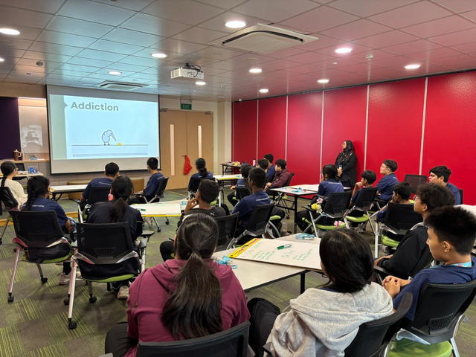

Badge Tier: Gold — Drive Advocacy
The Pinnacle of the ACT Badge
Gold tier participants step into an in-person advocacy program designed to shape them into confident community champions.
They learn to communicate anti-drug messages with clarity and conviction, engage peers in meaningful dialogue, and lead conversations that inspire positive change across schools and communities in Singapore.
Gold Badge holders are equipped to represent SANA’s mission in their schools and communities.

Slide 12
Youth Ownership in Prevention
When young people are empowered to take the lead,
prevention evolves into a true movement.

Slide 13
THANK YOU

Slide 14
REFERENCES
Alqahtani, N. S., Alanazi, S., Almuhayd, R., Alanazi, E., & Alanazi, J. (2025). Generational Differences in Dietary Behaviours: A Cross-Sectional Study of Generations X, Y, and Z. F1000Research, 14, 858. https://doi.org/10.12688/f1000research.167810.1

